Slide 1
Distributed Stock Data Platform
Group 12: Ahsan Ali Laghari, Leen Al-Jallad, Balaaj Arbab,
Anusha Sheikh, Vincent Li, River Wang
CS4471A
Nazim Madhavji
Department of Computer Science, University of Western Ontario

Slide 2
Demo breakdown
Assigned | Demo
Vincent Li | Security and JWT, Demo
Ahsan Ali Laghari | Demo
Leen Al-Jallad | IBM Cloud, Caching Mechanisms
Balaaj Arbab | Azure, Caching Mechanisms
Anusha Sheikh | Cloud deployment, IBM SQL Database
River Wang | Modifiability, and Allocation Structures, GCP

Slide 3
Modifiability
Notes:
River - I will go over one key quality attribute that our system was designed around, modifiability.

Slide 4
Modifiability
Traits:
Cloud agnostic
Language agnostic
Tactics:
Reduced coupling (through intermediaries and encapsulation)
Deferred Binding (through service discovery and resource files)
Benefits:
Organizational flexibility
Low cost to modify
High portability
Notes:
River – We leverage some key tactics to increase our system's modifiability, and flexibiliy. Microservice architecture utilizing a service registry and service discovery allows us to work agnostic of cloud platform, and programming language.
We are able to fully leverage the technical skills of each of our group members, through the reduced coupling and deferred binding tactics which we implemented. This allows for organizational flexibility, and can easily integrate external services or teams.

Slide 5

Allocation View
Service Registry
Ahsan
Javascript, IBM Code Engine
Service Registry UI
Vince
Typescript, React
Trend Service
River
Golang, Google Cloud
Stock Price Lookup Service
Balaaj
C# .NET, Azure, MongoDB
Market News Sentiment Service
Leen
Python, IBM Code Engine
Notes:
River – In our project, we each utilized a different cloud platform and programming language tool chain in order to develop each independent service. This demonstrates the high modifiability and portability that we were able to achieve thanks to the architectural tactics we implemented.

Slide 6

Cloud Service Providers
Notes:
River – trannsition into this section

Slide 7
Deployment on IBM Cloud
Platform: IBM Cloud
Deployment Tool: IBM Cloud Engine
Why IBM Cloud Engine ?
Simplified Deployment!
Serverless Infrastructure:
Automatically scales resources based on incoming request
IBM Cloud Engine Key Features:
Deploys containerized applications with minimal configs
Ensures availability and reliability with automated service monitoring

Slide 8
IBM Deployment Tactics
Serverless Model
Automatically adjusts to incoming traffic
Heartbeat Mechanism:
Ensures availability in SR
Containerization:
Docker ensures consistent across environments

Slide 9
Deployment on Google Cloud
The Trend Service was developed using Golang
Many integrations and toolchains available for golang projects
Dynamic Load Balancer
  Reconfiguration
Dynamic Scaling (1-50 instances)
  Redundant Spares, dynamically increasing resources
CI/CD toolchains
  Hitless in-service upgrade
Notes:
River

Slide 10
Deployment on Azure Cloud
Purpose built tools and integrations for .NET/C# applications (Microsoft)
Microservice 1, StockPriceLookup was developed in C# and ASP.NET.
Azure offers seamless deployment for .NET/C# via Visual Studio publishing
Azure Web Apps:
  Multiple instances of deployment (Autoscaling or Manual)
  Dynamic load balancing between instances
  Logging

Slide 11
Performance

Slide 12
Performance -
Caching Mechanisms: Redis & MongoDB
Microservice 2: Market News and Sentiment --> Redis
  Used in real-time cache to store frequently queried news and sentiment data
  Ensures low latency responses by storing the data temporarily in the memory which reduces external API calls
  Enables scalability for high throughput operations handling spikes in user traffic efficiently
  Minimizes the load on external APIs, and thus improving the overall performance and reducing the cost
  Supports time-based expirations which ensures that stale data is automatically cleared to maintain data relevance
Microservice 1: Stock Price Lookup --> MongoDB
  Document(JSON)based DB used as a medium-grade cache for repeat JSON data from AV API.
  Deployed using MongoDB Atlas on Azure in the same region(East-NA) as the service to reduce latency.
  Contains backing replica sets of the database in case the primary fails, improving reliability and availability
  Allows for sharding of the database, to split read/writes between partitions, improving performance via horizontal scaling of the database.
  Caching also reduces calls to the AlphaVantage API saving on costs.

Slide 13
Dynamic Service Registry Integration:
Features:
Dynamic Registration:
The microservice registers itself with the SR upon the startup
Heartbeat Mechanism:
It sends heartbeats to inform the registry that the service is live and operational
Deregistration:
Upon shutdown, the service automatically deregisters itself to avoid stale entries in the registry
Benefits:
Service Discovery:
Other services can easily discover this service when needed
Health Monitoring:
Ensures that only active services are listed for clients
Reliability:
Improved the overall integrity by removing failed or inactive services

Slide 14
Front-end Demo https://cs4471-frontend.1p3tqozhqyrn.us-east.codeengine.appdomain.cloud/dashboard
Ahsan Ali Laghari & Vincent Li

Slide 15
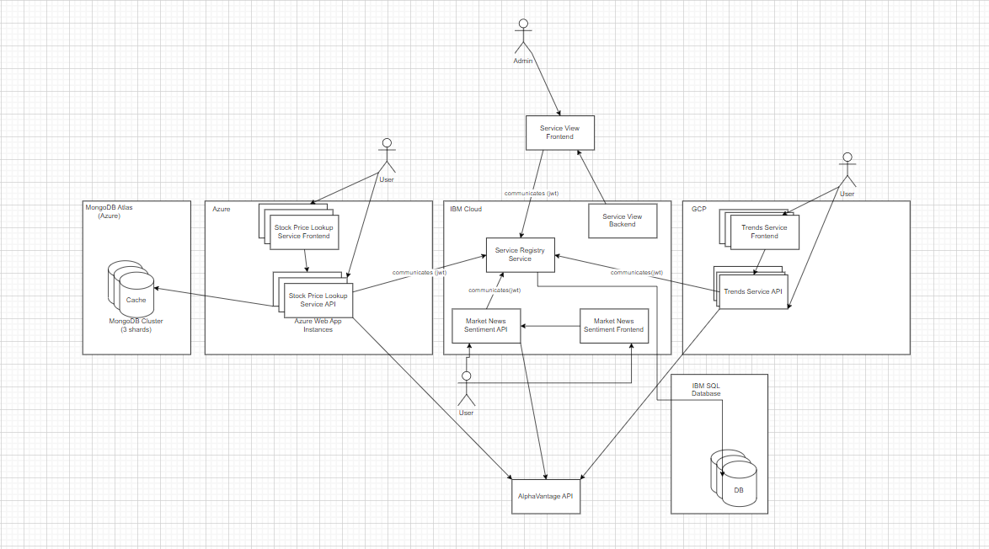

Slide 16
Security and JWT
Using JWT (JSON Web Tokens) for authorization and requiring tokens on every API call when communicating with the service registry enhances security in our system.
Stateless Authentication: JWTs are self-contained and include all the necessary information to verify the user’s identity and authorization. This allows the server to avoid maintaining session state, reducing vulnerabilities
Granular Access Control: JWT payloads can include claims that define the user’s roles, permissions, or scopes. APIs can validate these claims to enforce fine-grained access control, ensuring users only access what they're authorized to.
This approach not only strengthens security but also improves the flexibility and scalability of the application.

Slide 17
Availability
Cloud database utilized to sync data
Automated CI/CD
Tactics:
State resync (through cloud database)
Redundant spares
State rollbacks (in case of build/environmental failures)
Hitless in-service upgrades (through CI/CD and request routing)
Benefits:
If services fail, the integrity and continuity of data is maintained
Other spares and instances can resync state with cloud database

Slide 18
Scalability, Availability and Resilience
Hosting platforms used on each of the cloud platforms offer scalability via increasing instance count of each webapp deployment(auto-scaling or manual)
Each cloud platform offers a load balancer to divide traffic between instances.
Improved Resilience and Availability within the system, for each service.
Improved ability to handle surges in incoming traffic.

