Slide 1
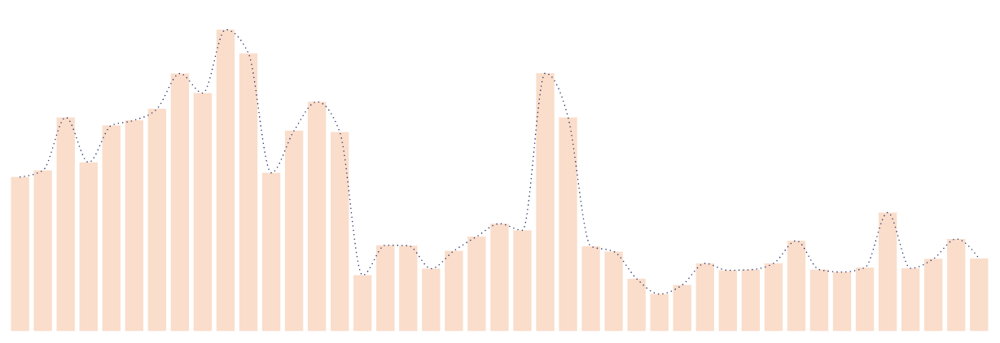
What happens to your complaint?
An Analysis of Bangalore City’s Complaint Data, 2019 to 2022
16K complaints | 198 wards | 11 agencies | 42 categories
Mohamed Ahsan | Data Analyst

Slide 2
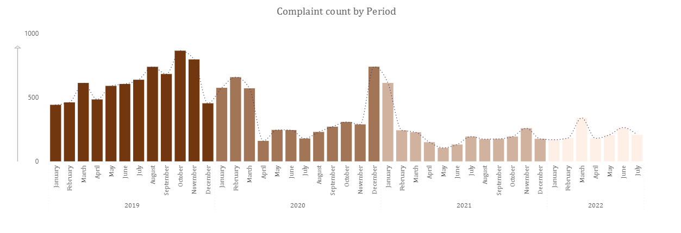
The Temporal Insight
Covid-19 has played a major role in city complaint volume over the period, being potentially responsible for the dip in complaints from Apr 2020 (first national lockdown) and also could be responsible for the dip in complaints from May 2021. Moreover, alongside this the expiry of BBMP council’s term after which the administration was taken by the municipal corporation could also plausibly explain the spike in complaints in Dec 2020
The 2019 Lok Sabha elections (Mar – May 2019) together with the cancellation of the state sponsored Tipu Jayanthi Celebrations (Jul 2019) and government transition post election could be possible causes for elevated complaint levels from Mar 2019
Note : External context sourced via online research, not verified against primary news archives.

Slide 3
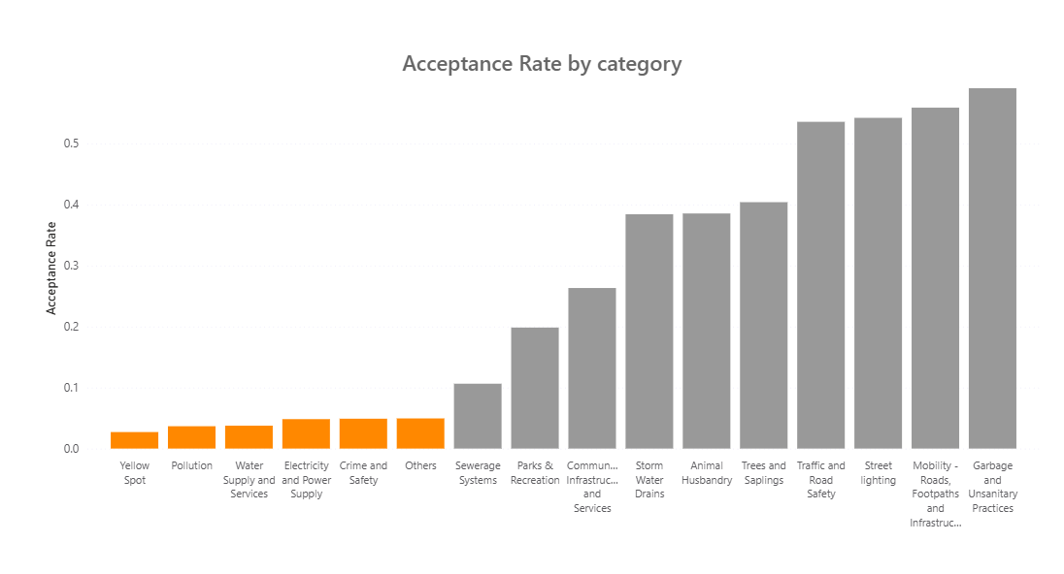
6 of 16 Categories, Under 5% acceptance
Acceptance refers to complaints that were acknowledged as of the cut off date. Simply means complaints with any status title other than “open”
complaints with open status are ambiguous, since the dataset has a fixed cutoff, it could mean complaints are in process or being deliberately left unresolved to avoid a worse-looking status like Closed or Ignored.
Note: Only categories with more than 100 complaints registered are considered to avoid small sample bias.

Slide 4
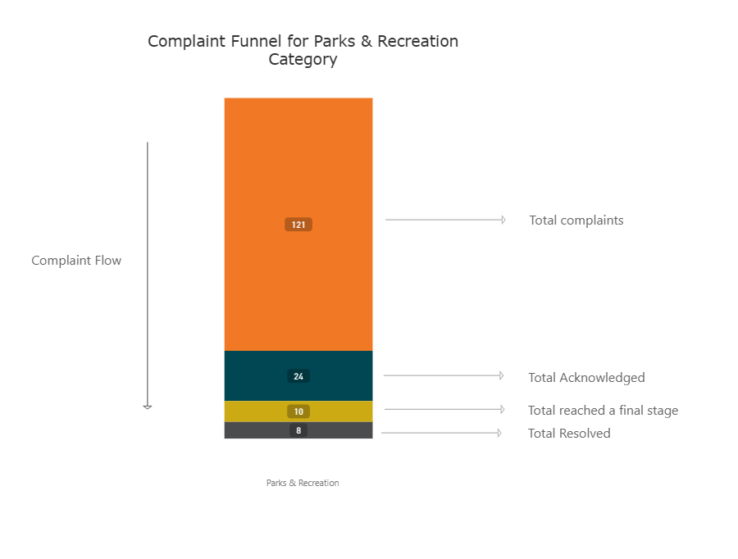
Why It matters?
Aggregate resolution rate does not distinguish between complaints not acknowledged as of the cutoff date, complaints still in process, and complaints that reached a terminal status without resolution (e.g., closed unresolved or ignored).For categories with low acceptance, resolution rate understates how much of the process is upstream acceptance lag rather than actual resolution failure.
Before proposing any intervention the dataset requires a complaint age at cutoff to differentiate genuine processing delays.
33% Effective Resolution Rate as opposed to
6.6% Resolution Rate
[8/24 = 0.33]
[8/121 = 0.066]

Slide 5
Seasonal Behaviours
Street lighting shows a clear monsoon season pattern, peaking in September and falling to its lowest point in the post monsoon month of April, while maintaining an 82% effective resolution rate and a 0% ignorance rate year-round, suggesting consistent handling regardless of seasonal demand
Water Supply and Services shows a separate seasonal pattern, peaking in March and February, consistent with Bangalore's pre monsoon period when groundwater levels decline and demand rises with rising temperatures.
Electricity (November) and Sewerage Systems (March) also show spikes with no identifiable seasonal or external cause, flagged for further investigation.
Note : Additional non-seasonal categories (e.g., Storm Water Drains) checked and detailed in the full report.

Slide 6
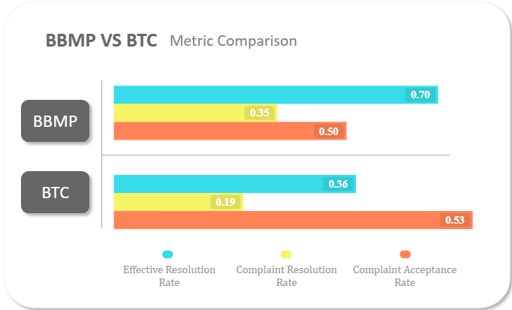
Agency Accountability
Scale vs Competence
BBMP recorded an acceptance rate of 50%, a resolution rate of 35% and an effective resolution rate of 70%, while BTC recorded a resolution rate of 19%, an effective resolution rate of 36% and a higher ignorance rate of 34%.
BBMP covers over 13000 complaints and its dominance is expected. As the primary municipal body, it handles the widest range of complaint categories and the highest complaint volume, yet maintains a 70% effective resolution rate. In contrast, BTC has a 36% effective resolution. But it is primarily driven by parking-related sub categories whose evidence-verification requirements and time-sensitive nature may plausibly contribute to the observed contrast
Other than the agencies above, every other agency left over 90% of assigned complaints unacknowledged.
Note: Only Agencies with more than 100 complaints registered are considered to avoid small sample bias.

Slide 7
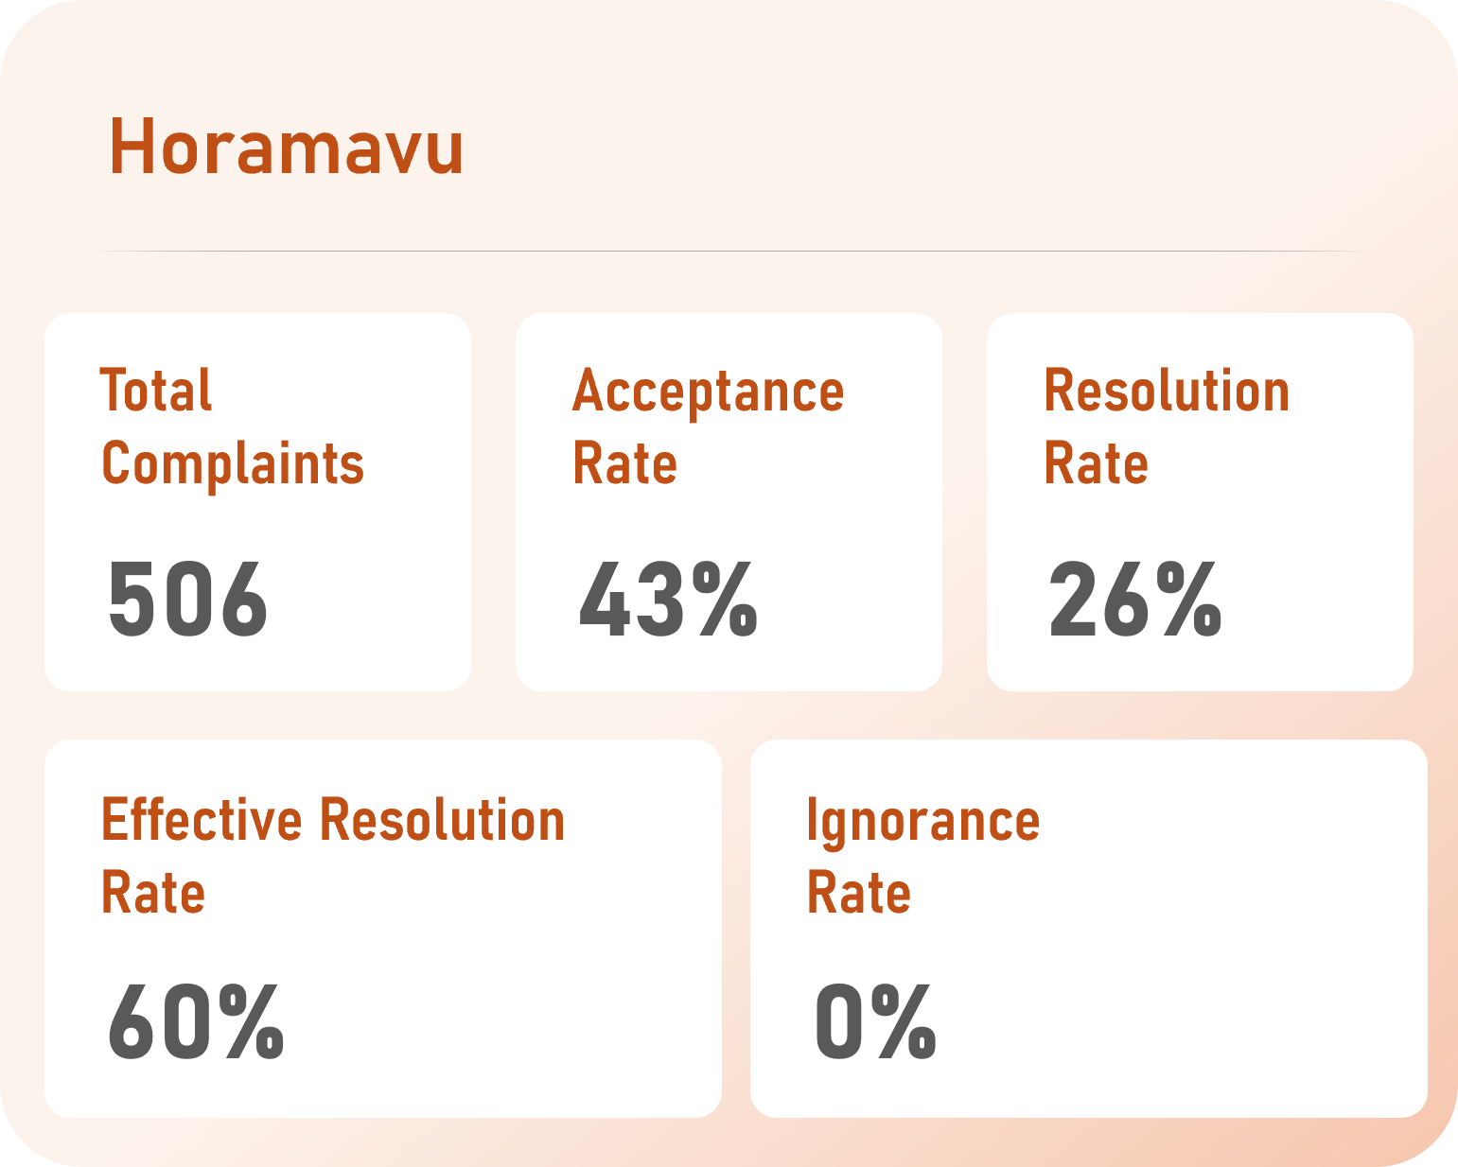
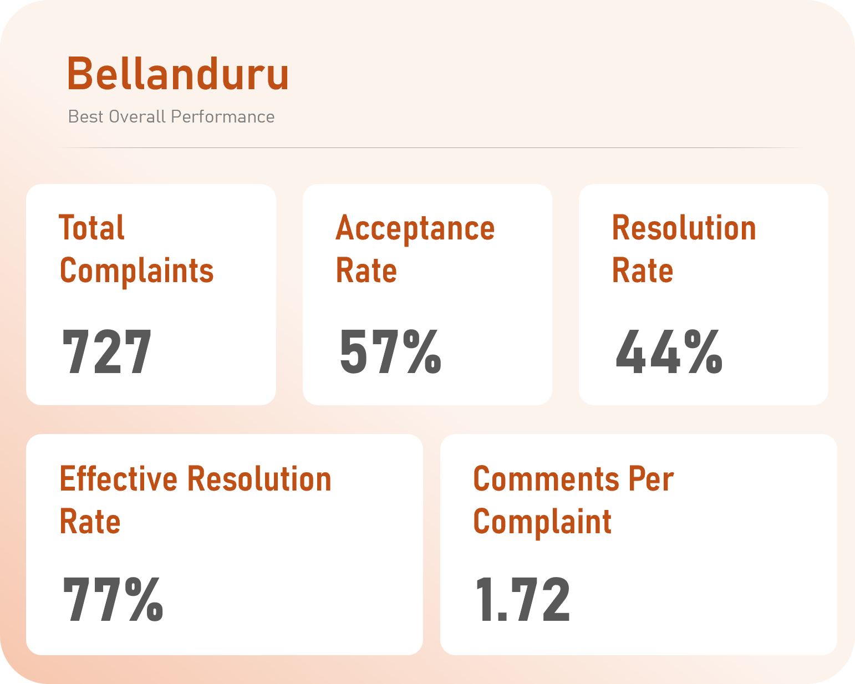
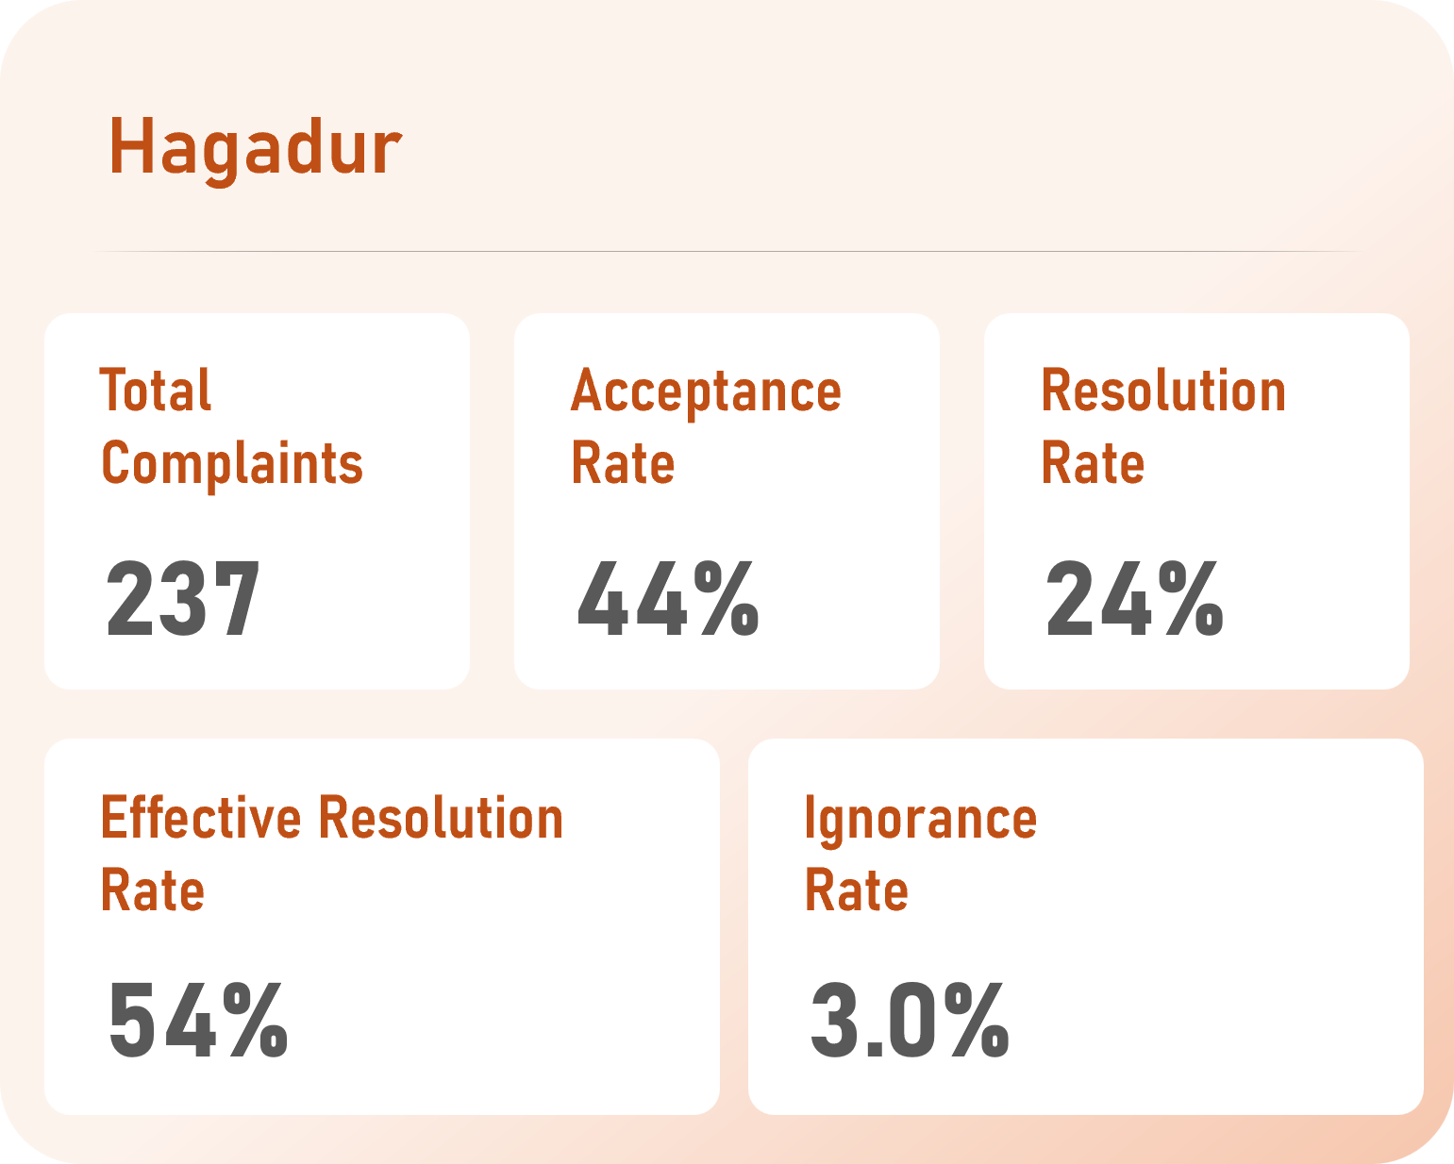
Does your ward matter?
Yes! more than your category
Horamavu has a 0% ignorance rate despite having above average acceptance rate, however its other metrics are slightly below average. A resident complaint can get delayed but not ignored.
Bellanduru with most complaints and impressive effective resolution proves scale isn’t the enemy, but process is. However, it has a relatively higher comments per complaint. As a resident you might have to follow up the complaint to get it solved and the administrators can improve solving complaints at the first instance.
Hagadur has a subpar performance across all the metrics with a below average resolution and effective resolution rates and 2x the median ignorance rate, warranting an assessment of the existing grievance redressal system.
Note: Only Wards with more than 100 complaints registered are considered to avoid small sample bias.

Slide 8
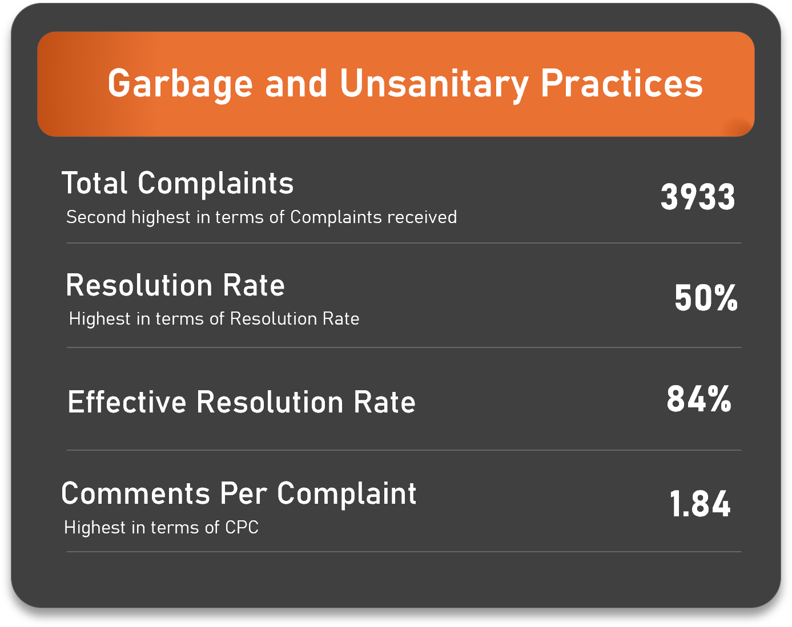
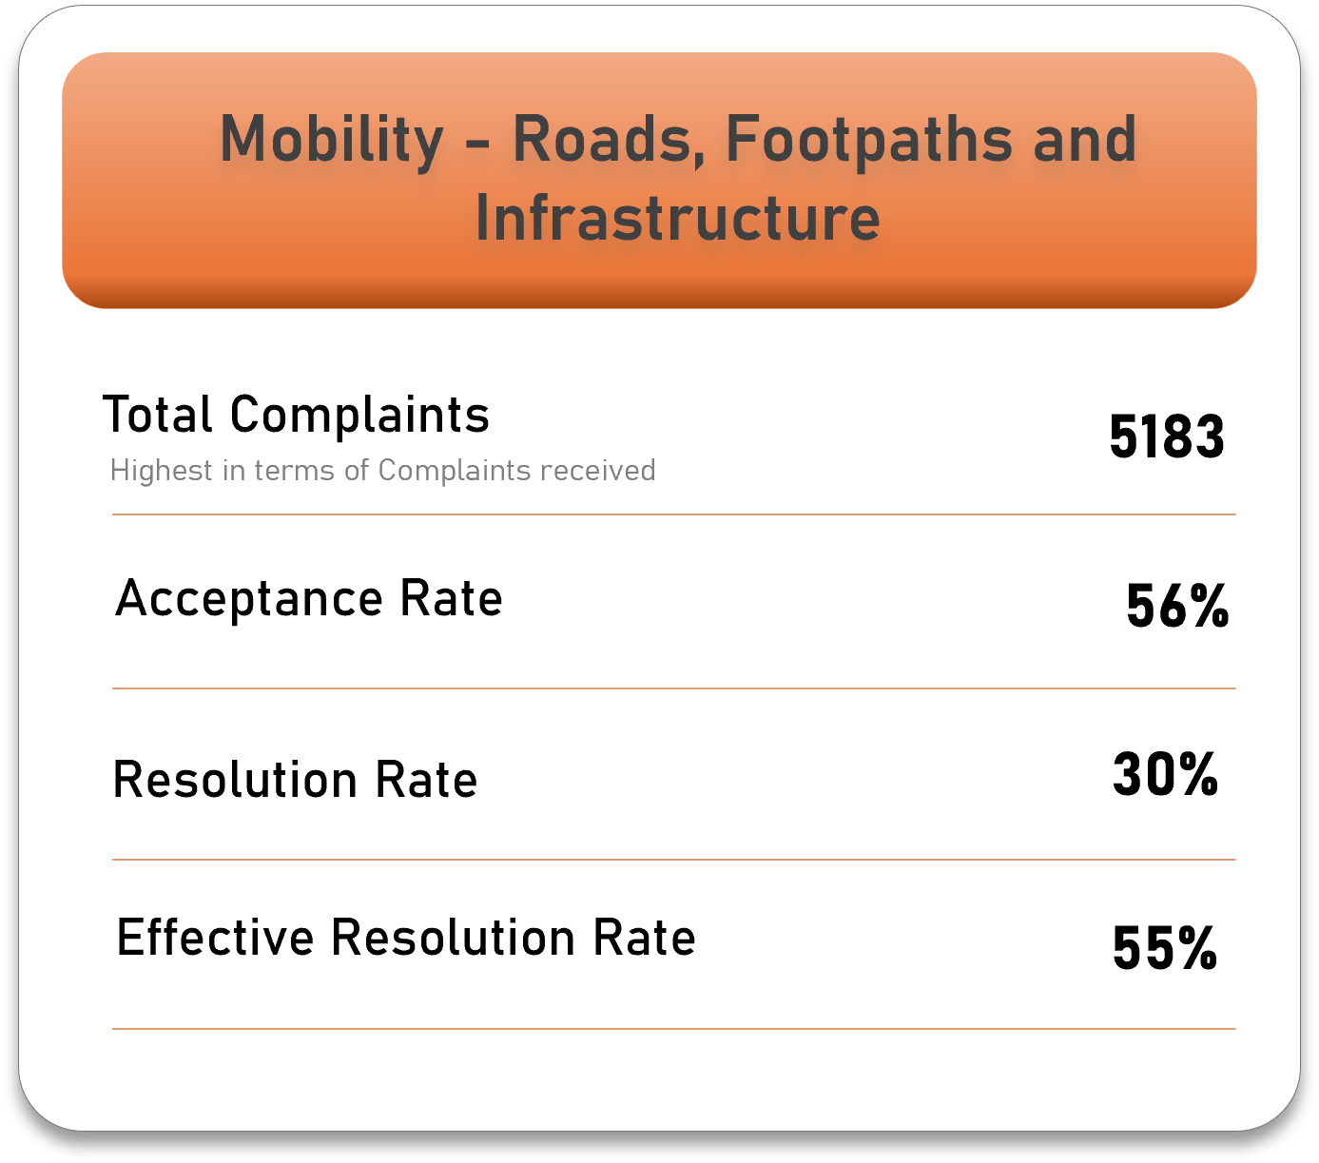
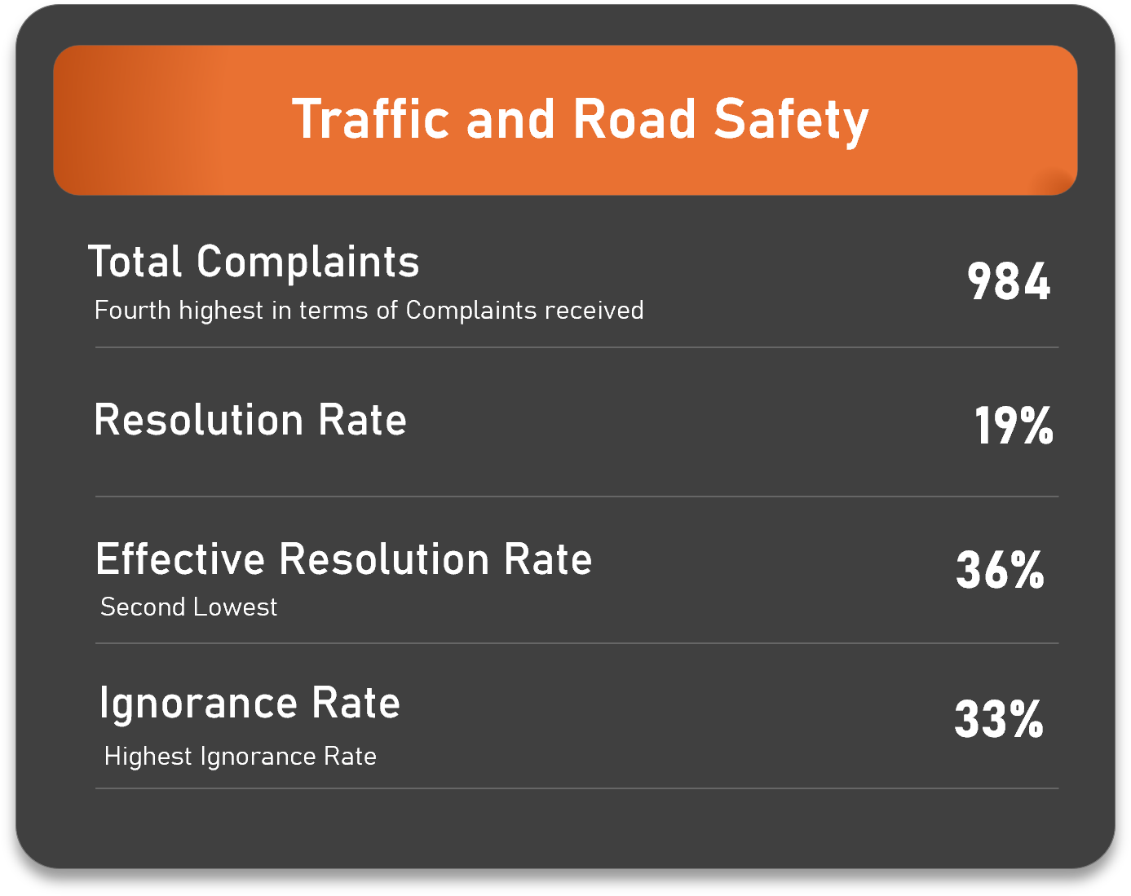
Where the work actually is
Operational Burden
It is dominated by one sub category “Clearance Of Garbage Dump Or Black Spot“ with 3100 complaints registered to it.
It by far bears the highest operational burden, but with a subpar performance across all metrics.
Two of its sub categories having ignorance rates of 50% and 60% are parking related
Parking-related complaints require appropriate verifiable evidence and are inherently time-sensitive. This may partly explain the comparatively higher ignorance rate.
Composed of 11 relevant sub categories, covering a huge range of complaints.
Could improve resolving complaints regarding this at the first instance thereby improving resolution lag.
A thorough review of complaint process could cause a city wide impact.
And the only category under BTC, hence the exact metrics.

Slide 9


Your complaint matters! But where you filed it from and what category it falls under might matter more.
That’s it! I appreciate your attention.
Full analysis, notebook, and report:
ahsankassim/Bangalore_Citizen_Complaint_Analysis
LinkedIn |
ahsankassim@gmail.com
Mohamed Ahsan | Data Analyst |

