Slide 1
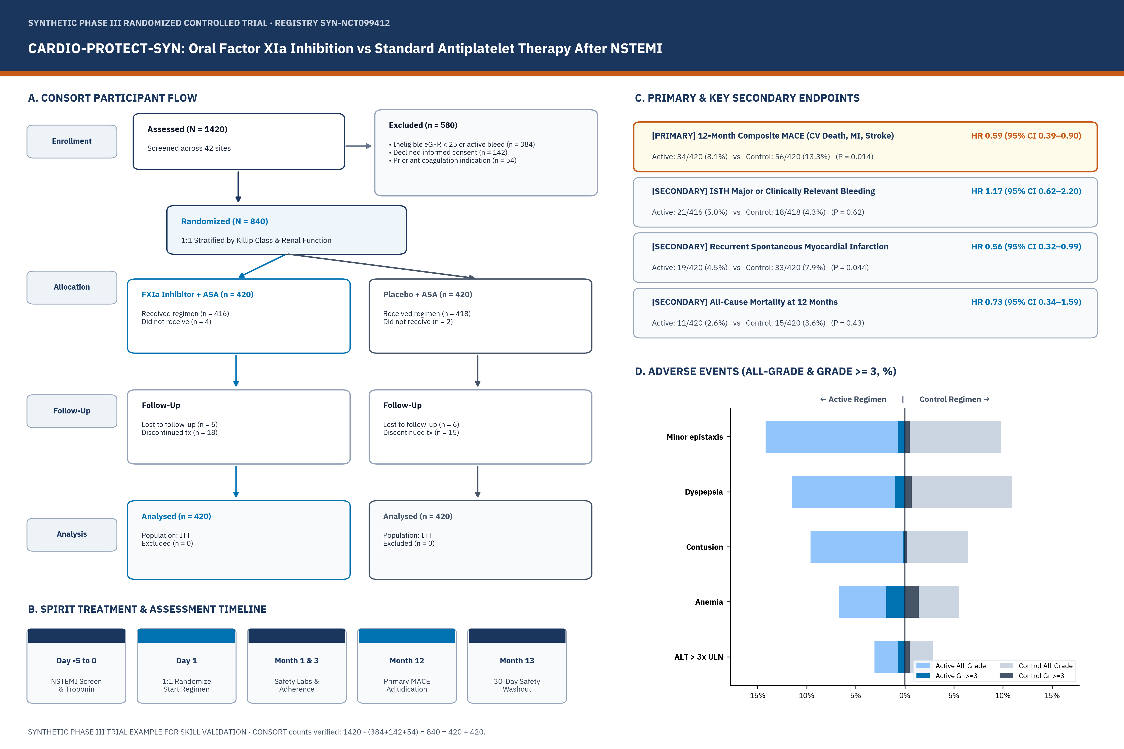
CARDIO-PROTECT-SYN: Oral Factor XIa Inhibition vs Standard Antiplatelet Therapy After NSTEMI

