Slide 1


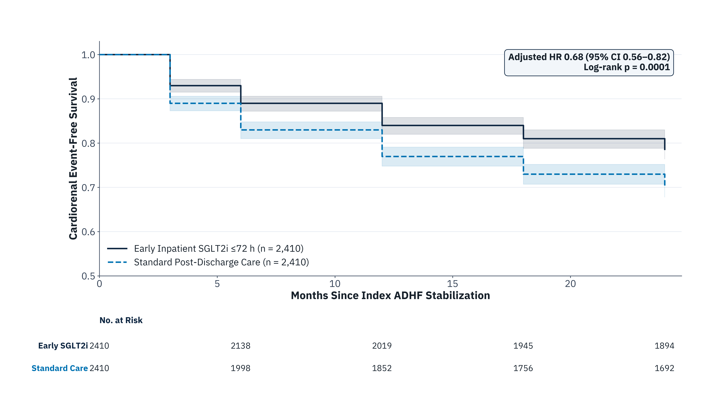
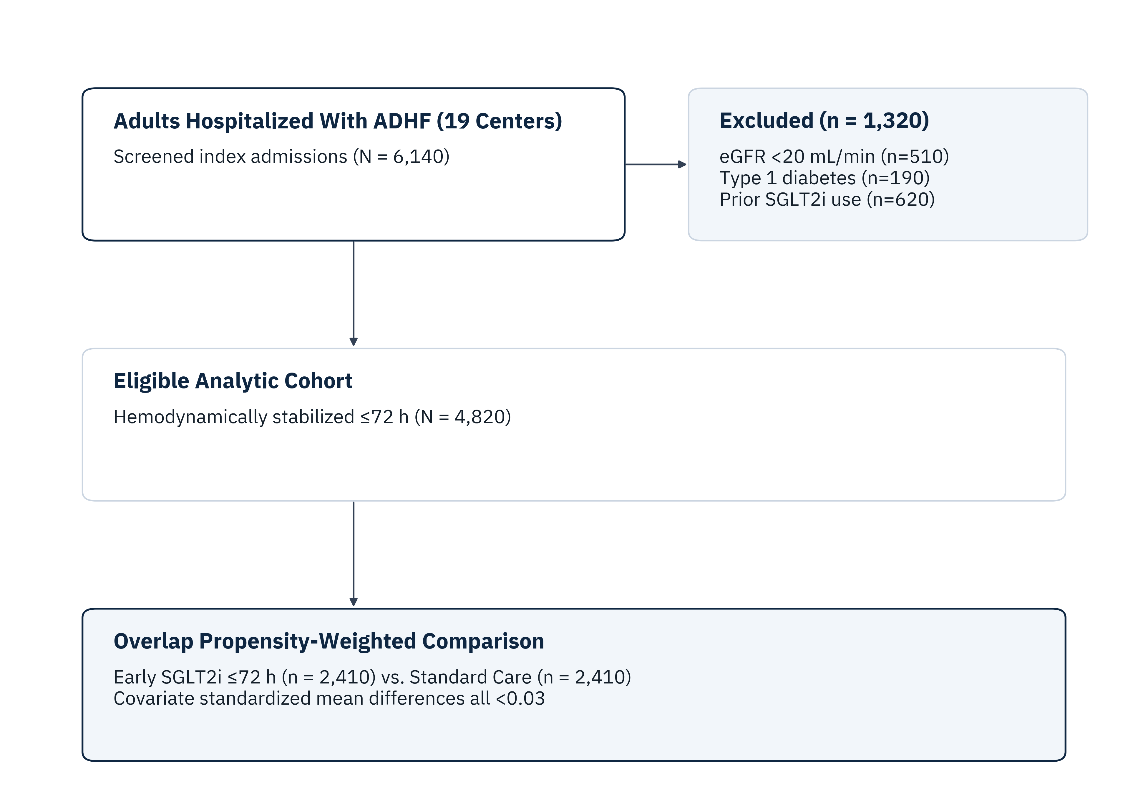
MULTICENTER OBSERVATIONAL COHORT · STROBE · SYNTHETIC DEMO DATA
Early SGLT2 Inhibitor Initiation Within 72 Hours of Acute Heart Failure Admission and 24-Month Cardiorenal Outcomes
Elena Rostova, MD, PhD¹; Marcus Vance, MD¹; Tariq Al-Mansoor, MPH²; Hannah Lindqvist, PhD²
¹Dept. of Cardiovascular Medicine, Synthetic Academic Health Network; ²Center for Clinical Biostatistics (Synthetic Demonstration Study)
01 Clinical Background & Objective
Acute decompensated heart failure (ADHF) hospitalization marks high vulnerability for recurrent congestion and progressive kidney decline [1]. Whether initiating SGLT2 inhibitors within 72 hours of inpatient stabilization improves 24-month cardiorenal survival across ejection fraction strata remains uncertain.
• Primary Objective: Compare 24-month composite cardiovascular death, HF rehospitalization, or ≥40% sustained eGFR decline between early inpatient SGLT2i (≤72 h) vs. standard post-discharge care.
Primary 24-Month Cardiorenal Composite
aHR 0.68 (95% CI 0.56–0.82; p = 0.0001)
Early SGLT2i initiation reduced cumulative 24-month event incidence from 29.8% (718/2,410) to 21.4% (516/2,410), corresponding to an absolute risk reduction of 8.4% (NNT = 12).
05 Component & Safety Endpoints
Outcome (24 Months) | Early SGLT2i | Standard | aHR (95% CI) | p-value
Primary composite | 21.4% | 29.8% | 0.68 (0.56–0.82) | 0.0001
HF rehospitalization | 14.8% | 21.9% | 0.65 (0.53–0.80) | 0.0002
CV mortality | 6.9% | 8.8% | 0.78 (0.61–0.99) | 0.041
≥40% eGFR decline | 5.2% | 7.3% | 0.71 (0.55–0.92) | 0.009
HFrEF (<40%) stratum | 22.1% | 31.0% | 0.67 (0.54–0.83) | 0.0003
HFpEF (≥50%) stratum | 20.3% | 28.1% | 0.70 (0.55–0.89) | 0.004
Euglycemic DKA (safety) | 0.4% | 0.3% | 1.31 (0.52–3.30) | 0.56
04 24-Month Event-Free Survival
Subgroup p-interaction by LVEF phenotype = 0.64. Euglycemic DKA was exploratory safety outcome.
02 Cohort Derivation & Propensity Weighting
06 Strengths & Limitations
• Strengths: Active-comparator new-user design across 19 centers with adjudicated renal laboratory trajectories.
• Limitations: Residual confounding by unmeasured inpatient diuretic responsiveness cannot be excluded; post-12-month adherence relied on dispensation claims.
Clinical Conclusions
Initiating SGLT2 therapy within 72 hours of inpatient ADHF stabilization was associated with a 32% relative hazard reduction in 24-month cardiorenal events across HFrEF and HFpEF phenotypes, without excess ketoacidosis or acute renal injury.
Figure 1. STROBE cohort selection across 19 hospitals (N = 4,820; synthetic cohort).
Figure 2. Overlap-weighted Kaplan-Meier cardiorenal event-free survival with shaded 95% CIs and aligned number at risk (N = 4,820).
03 Statistical Architecture
• Exposure: Empagliflozin or dapagliflozin started ≤72 h of IV loop diuretic stabilization.
• Models: Overlap propensity-weighted Cox models & Fine-Gray competing-risk regression adjusted for age, LVEF, NT-proBNP, baseline eGFR, and background GDMT [2].
References: [1] Voors AA et al. Nat Med 2022;28:568–574. [2] Li F, Morgan KL, Zaslavsky AM. JASA 2018;113:390–400.
Funding: Synthetic Translational Grant SYN-2026-014 | Correspondence: e.rostova@synthetic-ahn.org | SYNTHETIC DATASET DISCLOSURE: Simulated cohort created strictly for poster skill testing.

