Slide 1

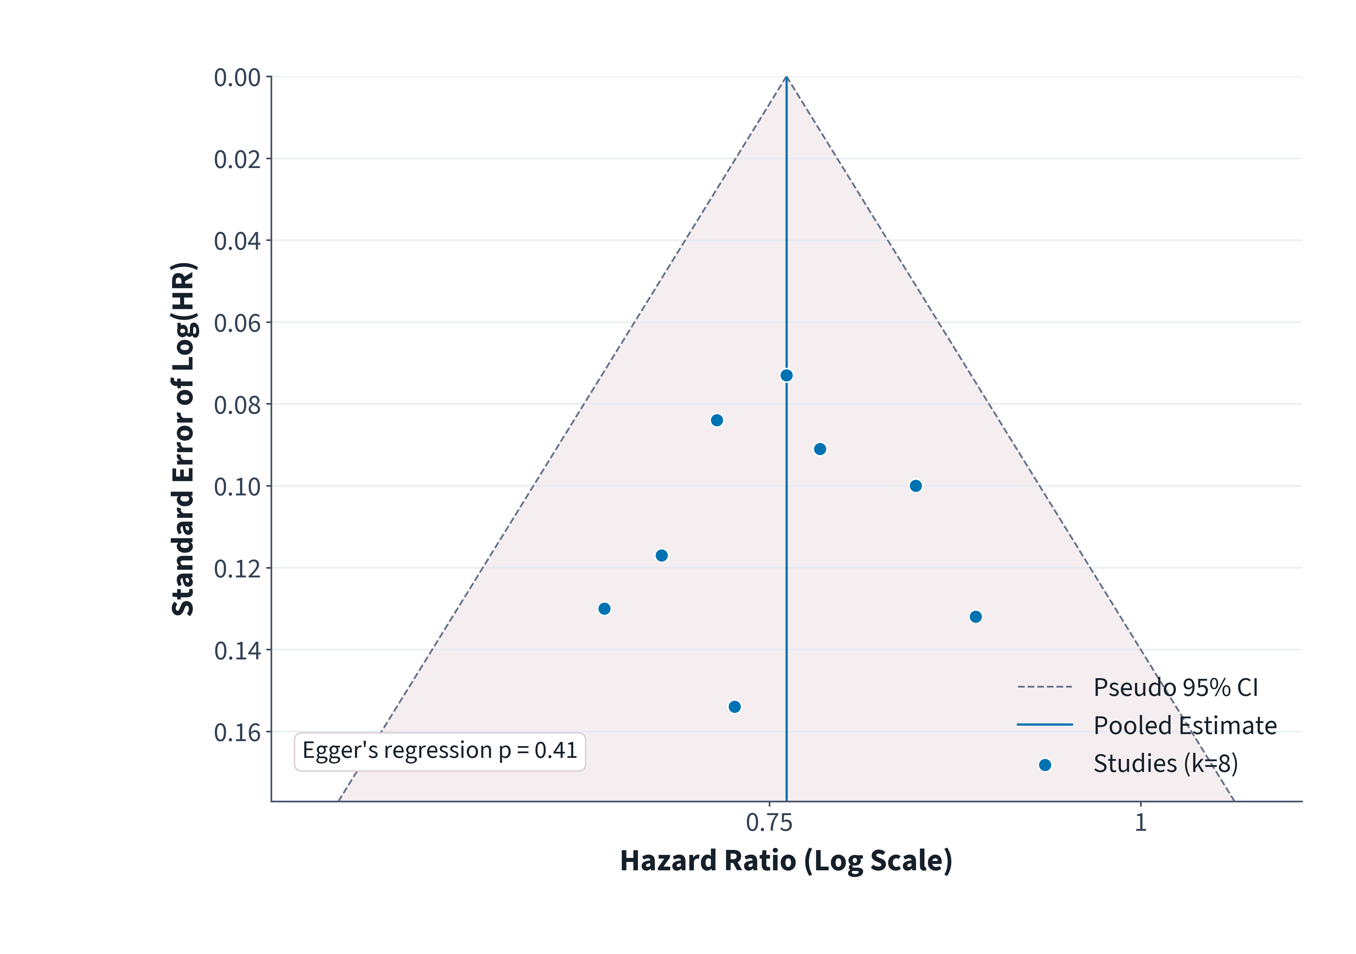
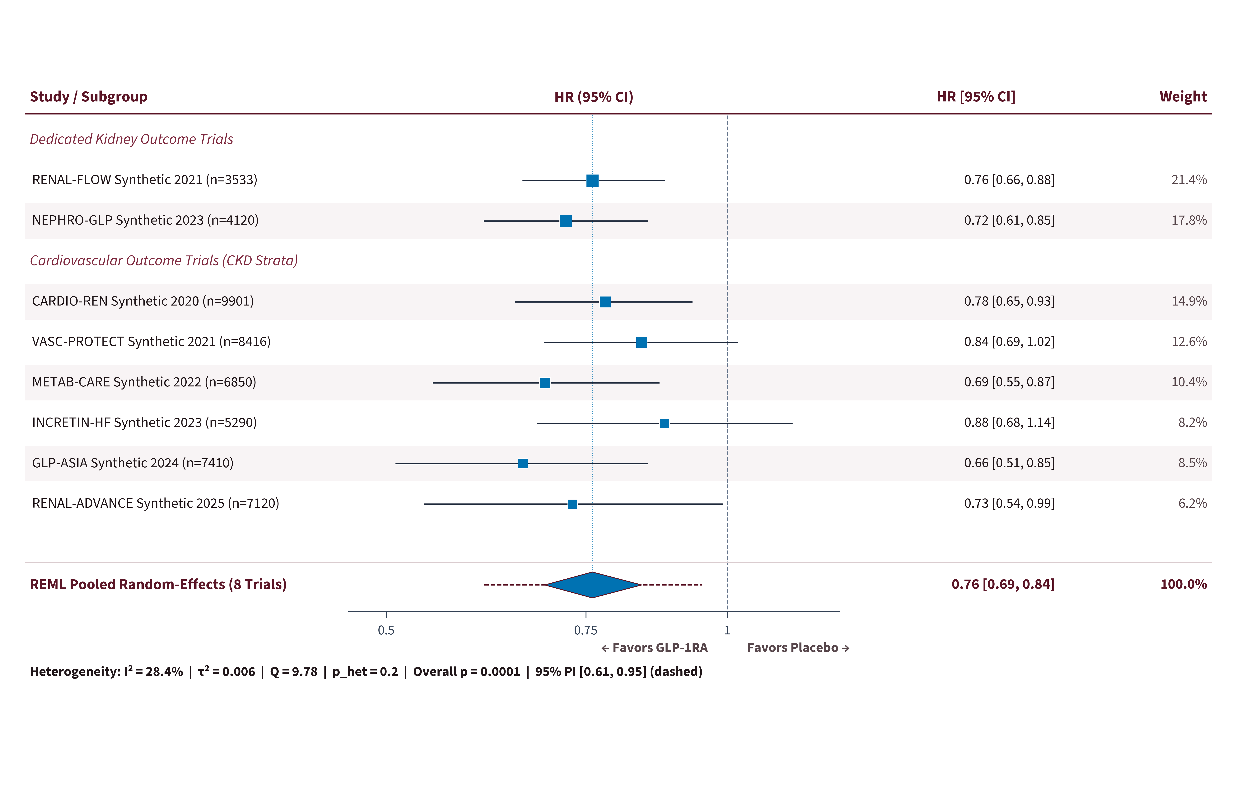
RANDOM-EFFECTS META-ANALYSIS OF 8 RCTS · PRISMA 2020 · SYNTHETIC DATA
GLP-1 Receptor Agonists and Major Adverse Kidney Events in Type 2 Diabetes: A Random-Effects Meta-Analysis of 8 Trials (N = 52,640)
Sophia Chen, MD, PhD¹; David Okafor, PhD²; Claire Moreau, MD¹
¹Renal Trials Synthesis Group, Synthetic Institute of Medical Research; ²Dept. of Evidence Synthesis (Synthetic Demonstration Data)
01 Clinical Rationale & Objective
Diabetic kidney disease remains the leading cause of kidney failure worldwide. While albuminuria reductions with GLP-1 receptor agonists (GLP-1RA) are established, individual trials varied in power for hard renal endpoints [1].
• Objective: Estimate the pooled effect of GLP-1RA vs. placebo on Major Adverse Kidney Events (MAKE: ≥50% sustained eGFR decline, ESKD, or renal death) across randomized trials.
Pooled Random-Effects Synthesis (8 RCTs, N = 52,640)
HR 0.76 (95% CI 0.69–0.84; p = 0.0001)
GLP-1RA therapy conferred a consistent 24% relative hazard reduction in Major Adverse Kidney Events with low heterogeneity (I² = 28.4%, τ² = 0.006, 95% prediction interval 0.61–0.95).
05 Small-Study Effects Funnel Plot
04 Trial-Level & Pooled Random-Effects Forest Plot
02 Data Sources & Quantitative Synthesis
• Eligibility: Double-blind placebo-controlled RCTs ≥1,000 adults with T2D reporting adjudicated MAKE outcomes (searched through Aug 2026).
• Synthesis: REML random-effects inverse-variance pooling of log-HRs with 95% CI and 95% prediction interval [2].
• Heterogeneity & Bias: Assessed via I², τ², Cochran's Q, pre-specified subgroup interactions, and Egger funnel regression.
03 Pre-Specified Subgroup Analyses
Subgroup Stratum | Trials | Pooled HR (95% CI) | I² | p-int
Dedicated renal trials | 2 | 0.74 (0.67–0.83) | 0.0% | 0.52
CV outcome trials | 6 | 0.77 (0.69–0.87) | 34.1% | —
Baseline eGFR <60 | 8 | 0.75 (0.68–0.83) | 19.5% | 0.68
Baseline eGFR ≥60 | 6 | 0.78 (0.69–0.88) | 22.0% | —
With background SGLT2i | 4 | 0.77 (0.66–0.90) | 11.2% | 0.81
Without SGLT2i | 8 | 0.75 (0.68–0.83) | 26.8% | —
Figure 2. Funnel plot of log(HR) against standard error across k = 8 trials; symmetric distribution (Egger p = 0.41).
06 Methodological Limitations
• Aggregate trial-level synthesis precluded patient-level continuous eGFR slope spline modeling.
• Composite kidney definitions varied modestly between ≥40% and ≥50% sustained eGFR thresholds in two earlier CVOTs.
No statistically significant heterogeneity across baseline eGFR or background SGLT2i strata.
07 Conclusions
Across 52,640 randomized participants, GLP-1 receptor agonists significantly reduced major adverse kidney events by 24%, with a 95% prediction interval wholly below unity and additive protection independent of baseline SGLT2i therapy.
Figure 1. REML random-effects forest plot for Major Adverse Kidney Events (N = 52,640). Dashed whiskers on diamond denote 95% prediction interval [0.61, 0.95].
References: [1] Perkovic V et al. N Engl J Med 2024;391:109–121. [2] IntHout J, Ioannidis JPA, Borm GF. BMJ Open 2016;6:e010247.
Registration: PROSPERO CRD42026001122-SYN (Synthetic) | Correspondence: s.chen@synthetic-imr.org | SYNTHETIC DATASET DISCLOSURE: Simulated trial estimates generated strictly for poster engine validation.

