Slide 1

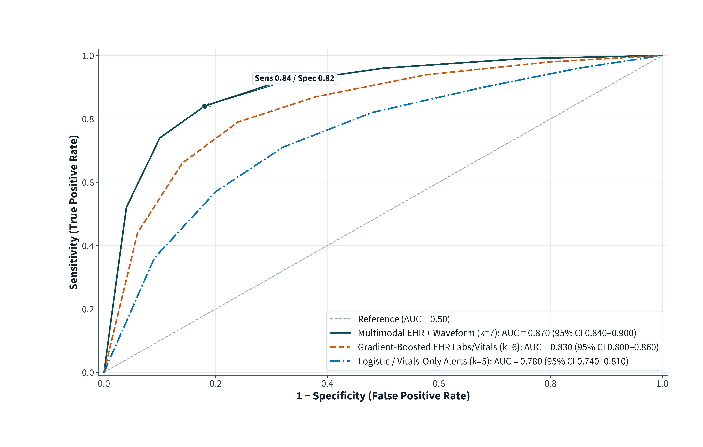
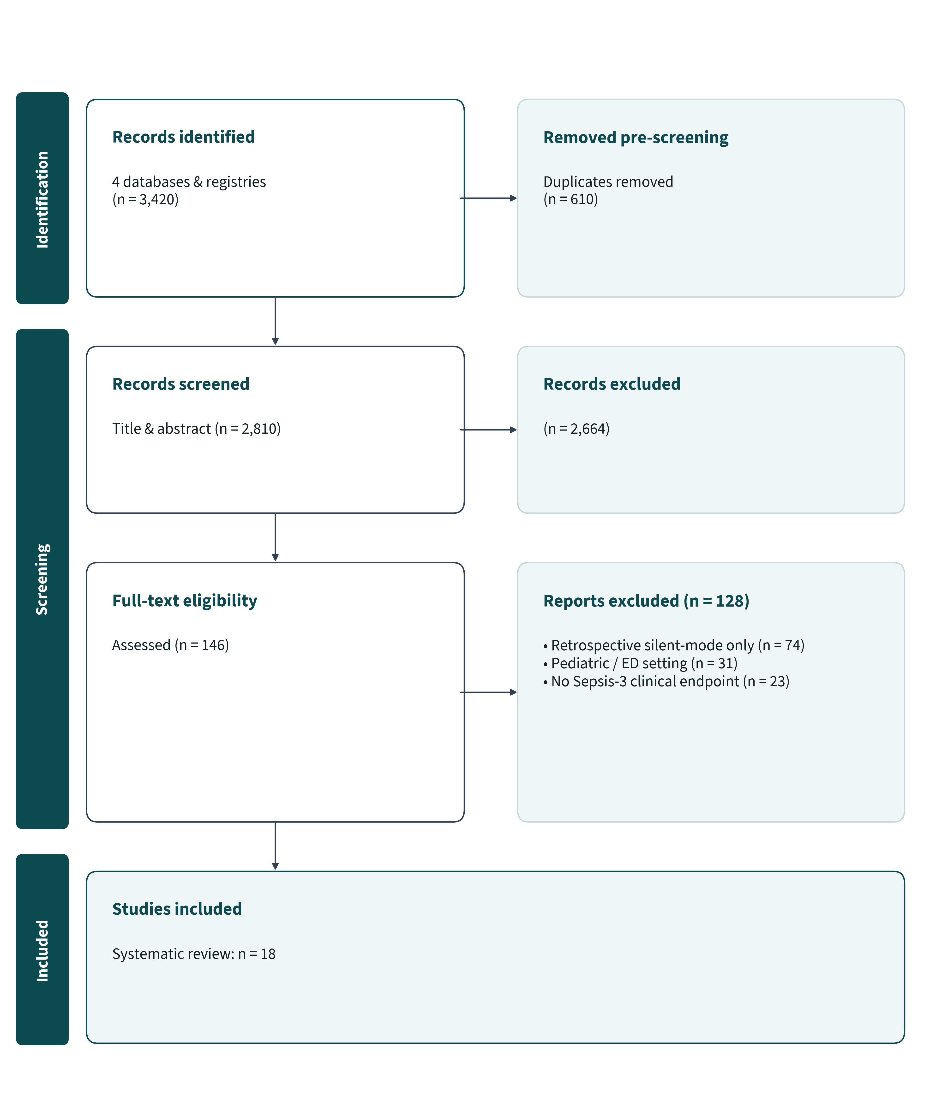
PRISMA 2020 SYSTEMATIC REVIEW · SYNTHETIC DEMONSTRATION DATA
Machine-Learning Sepsis Early Warning Systems in Adult Intensive Care Units: A PRISMA 2020 Systematic Review
Priya Nair, MD¹; Lukas Meyer, PhD²; Mei-Ling Zhou, MSc¹
¹Institute of Critical Care Informatics; ²Dept. of Health Data Science, Synthetic University Hospital
01 Clinical Question & PICOS
• Population: Adult medical/surgical ICU admissions (Sepsis-3 criteria).
• Intervention: Real-time prospective ML sepsis early warning systems.
• Comparator: Standard clinical surveillance or MEWS/SOFA rules.
• Outcomes: Diagnostic discrimination (AUROC), time-to-antimicrobials, and 28-day ICU mortality.
Synthesis Across 18 Prospective Studies (N = 94,300)
−1.8 h Time-to-Antibiotics | AUROC 0.87
Across 6 RCTs and 12 prospective interventional cohorts, multimodal EHR + waveform models achieved median AUROC 0.87 (IQR 0.84–0.90) and shortened antimicrobial initiation by 1.8 hours overall (−2.1 h in huddles-integrated ICUs).
02 Search & Appraisal Methods
• Databases: MEDLINE, Embase, CENTRAL, IEEE Xplore (Jan 2018 – Jun 2026).
• Dual independent screening (κ = 0.86); bias appraised via RoB 2 (RCTs) and ROBINS-I (non-randomized studies); certainty graded with GRADE [1].
04 Prospective Model Discrimination by Architecture
03 PRISMA 2020 Study Selection
Figure 2. Summary prospective ROC profiles across model architecture tiers (18 ICU studies, N = 94,300).
05 Evidence Summary by Implementation Tier
Architecture Tier | Studies | Admissions | Median AUROC | Abx Δ (h) | Low/Mod RoB
Multimodal EHR + Waveform | 7 (3 RCT) | 41,200 | 0.87 (0.84–0.90) | −2.1 h | 6 / 7 (86%)
Boosted EHR Labs + Vitals | 6 (2 RCT) | 34,600 | 0.83 (0.80–0.86) | −1.7 h | 4 / 6 (67%)
Vitals-Only Rule / Logistic | 5 (1 RCT) | 18,500 | 0.78 (0.74–0.81) | −0.9 h | 2 / 5 (40%)
Overall Synthesis | 18 (6 RCT) | 94,300 | 0.84 (0.78–0.89) | −1.8 h | 12 / 18 (67%)
RoB 2 applied to randomized trials; ROBINS-I applied to prospective interventional cohorts.
07 Conclusions & Implementation Guidance
Prospective ML sepsis alerts reliably accelerate antibiotic administration only when paired with structured nurse-physician escalation workflows and precision-calibrated alert thresholds (PPV ≥0.30) to prevent alarm fatigue [2].
Figure 1. PRISMA 2020 flow diagram verifying arithmetic count closure across 3,420 records to 18 prospective ICU studies.
06 GRADE Certainty & Limitations
• Moderate GRADE certainty for faster antibiotic administration; low-to-moderate certainty for mortality due to workflow co-interventions.
• Unstandardized positive-predictive-value reporting limited quantitative pooling across alert thresholds.
References: [1] Page MJ et al. PRISMA 2020 statement. BMJ 2021;372:n71. [2] Adams R et al. Nat Med 2022;28:1455–1460.
Protocol: PROSPERO CRD42026000999-SYN (Synthetic) | Correspondence: p.nair@synthetic-icu.org | SYNTHETIC DATASET DISCLOSURE: Simulated review data for skill validation.

