Slide 1
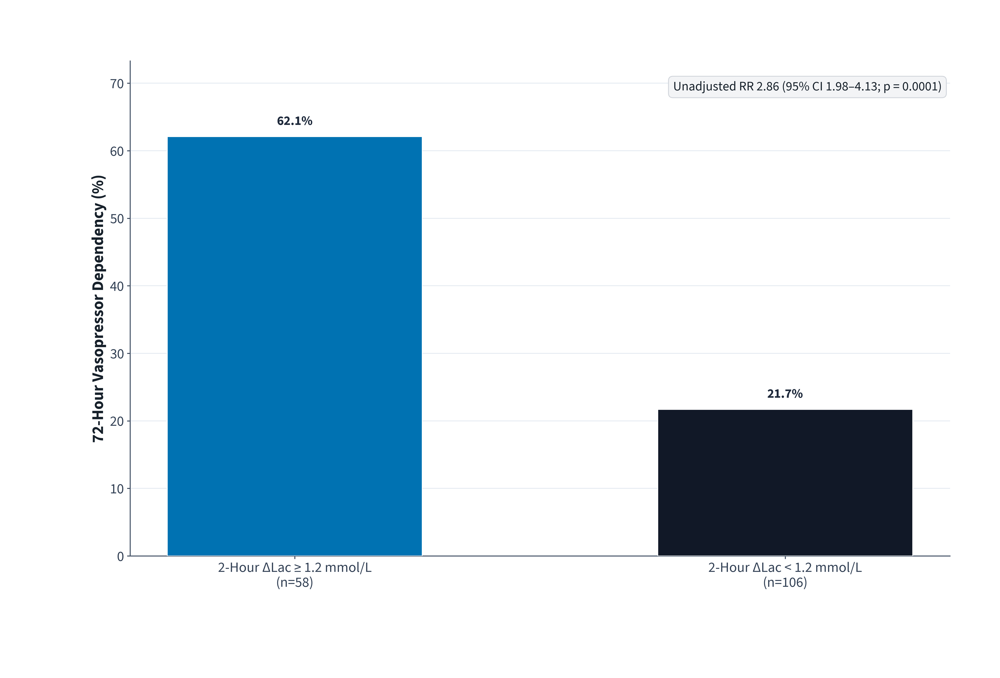
PROSPECTIVE ED PILOT COHORT · ABSTRACT SUBMISSION · SYNTHETIC DATA
Point-of-Care Capillary Toe-to-Finger Lactate Gradient During Early Emergency Department Sepsis Resuscitation
Nadia Karim, MD; Owen Brooks, RN, MSN
Institutional affiliation not specified in source abstract (Synthetic Pilot Submission)
Clinical Context
Macrohemodynamic stabilization during early septic shock resuscitation can mask persistent peripheral microcirculatory hypoperfusion.
• Objective: Test whether bedside capillary toe-to-finger lactate gradient (ΔLac) at 2 hours predicts 72-hour vasopressor dependency.
Principal Pilot Finding
RR 2.86 (95% CI 1.98–4.13; p = 0.0001)
Patients with persistent 2-hour capillary ΔLac ≥ 1.2 mmol/L experienced nearly threefold higher 72-hour vasopressor dependency (62.1% vs. 21.7%).
Pilot Study Design (N = 164)
• Setting & Cohort: Prospective single-ED observational pilot study of N = 164 adults with suspected septic shock.
• Measurement: Paired fingertip and hallux point-of-care capillary lactate sampled at baseline (0 h) and 2 hours post-crystalloid resuscitation.
• Pre-specified Exposure Threshold: 2-hour ΔLac ≥ 1.2 mmol/L (n = 58, 35.4%) vs. ΔLac < 1.2 mmol/L (n = 106, 64.6%).
72-Hour Vasopressor Dependency by 2-Hour ΔLac
Source Scope & Transparency Note
Designed strictly from the accepted pilot abstract. Multivariable adjusted models, secondary organ-dysfunction endpoints, and formal limitation statements were not reported in the abstract and were intentionally omitted without fabrication.
Figure 1. Observed 72-hour vasopressor dependency across 2-hour capillary lactate gradient strata (N = 164; exact binomial proportions).
Conclusions & Next Steps
Bedside 2-hour capillary toe-to-finger lactate gradient rapidly identifies occult microcirculatory failure during initial ED sepsis resuscitation and warrants prospective multicenter validation.
SYNTHETIC PILOT ABSTRACT DISCLOSURE: Created strictly to validate missing-data handling without hallucination.

