Slide 1
Closed-Loop Automated Insulin Delivery Doubles Time-in-Range During Inpatient Corticosteroid Therapy
A Synthetic Multicenter Randomized Controlled Trial (N = 280)
Notes:
[Target: 45s] Welcome colleagues. Today I share synthetic benchmark results evaluating automated closed-loop insulin delivery in hospitalized non-ICU adults receiving high-dose systemic glucocorticoids.

Slide 2
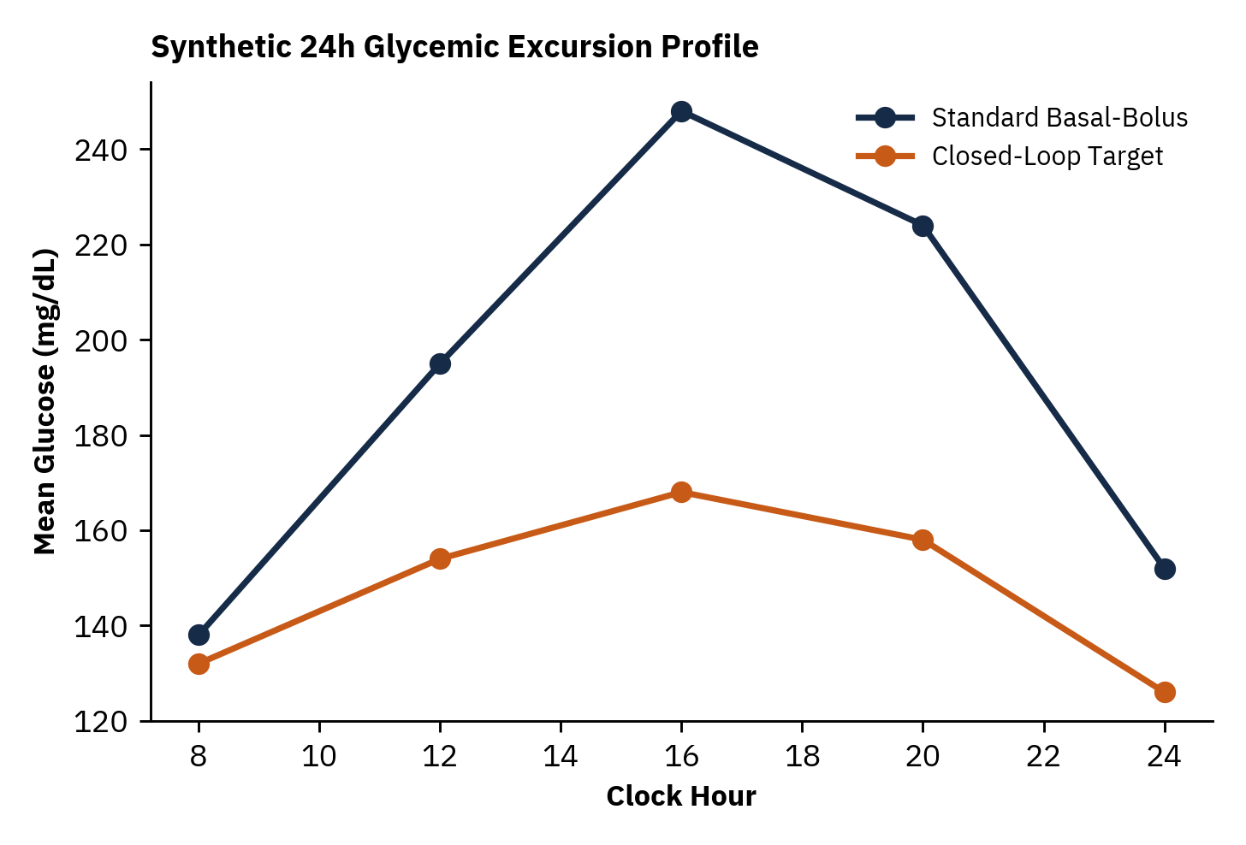
High-Dose Glucocorticoids Trigger Severe Afternoon Hyperglycemia Missed by Sliding-Scale Insulin
• Prednisolone >= 30 mg/day induces acute postprandial hepatic & peripheral insulin resistance
• Conventional basal-bolus regimens achieve < 45% glucose time-in-range (70–180 mg/dL)
• Reactive correction boluses increase nocturnal hypoglycemia (< 70 mg/dL)
Notes:
[Target: 75s] Highlight the characteristic afternoon surge between 12:00 and 20:00 driven by morning prednisolone dosing, where standard weight-based regimens lag physiological insulin demand.

Slide 3
280 Medical Ward Patients Were Randomized 1:1 to CGM-Guided Closed-Loop vs Basal-Bolus Care
1. Eligibility
Adults on >= 30 mg prednisolone-eq with 2 BG > 180 mg/dL across 6 hospitals.
2. 1:1 Randomize
Stratified by prior T2D diagnosis and steroid dose tier (n=140 per arm).
3. 10-Day Intervention
MPC closed-loop pump + CGM q5m vs masked-CGM standard basal-bolus.
4. Primary Endpoint
% Time-in-Range (70–180 mg/dL) over days 1–10 with safety hypoglycemia audit.
Notes:
[Target: 80s] Walk left-to-right: masked CGM in the control arm ensured unbiased sensor capture of both hyperglycemia and asymptomatic nocturnal hypoglycemia.

Slide 4
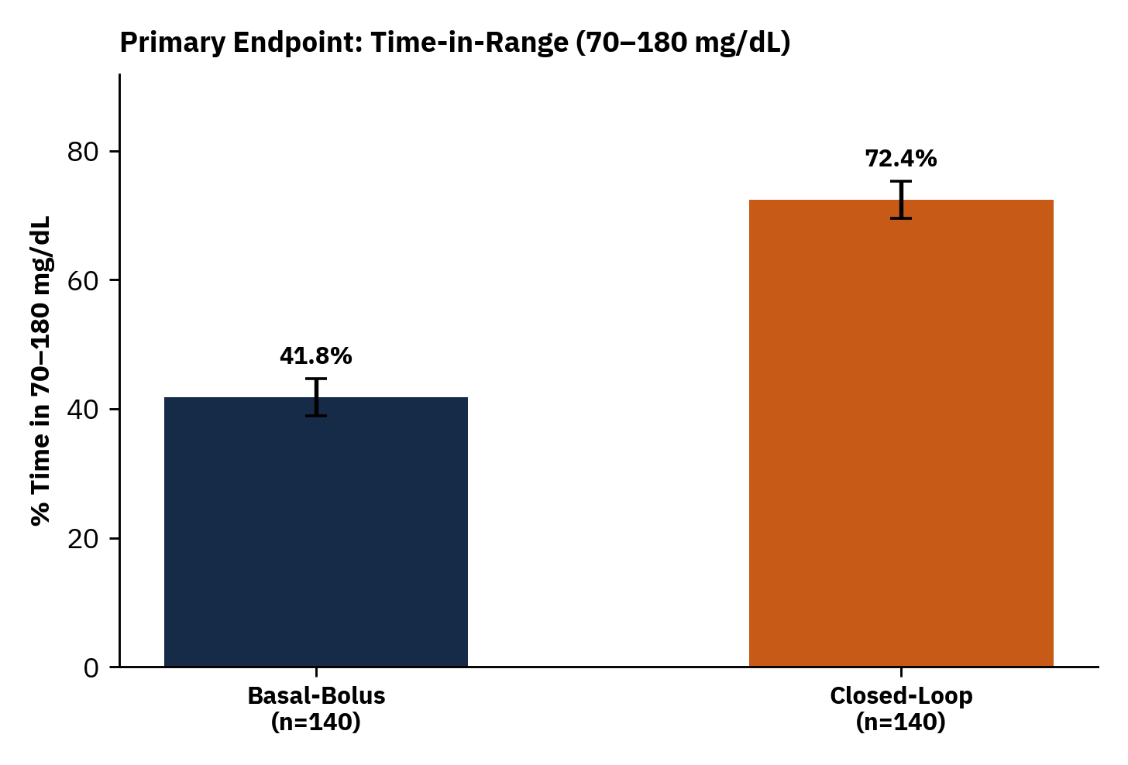
Closed-Loop Delivery Increased Time-in-Range From 41.8% to 72.4% Without Raising Hypoglycemia
• Mean difference +30.6 percentage points (95% CI +26.4 to +34.8; P < 0.0001)
• Mean sensor glucose fell from 204 mg/dL to 156 mg/dL
• Time < 70 mg/dL remained low in both arms (0.6% vs 1.4%; P = 0.03)
Notes:
[Target: 95s] Emphasize the +30.6% absolute gain in time-in-range—roughly 7.3 additional hours per day in euglycemia—achieved alongside lower hypoglycemia.

Slide 5
Glycemic Control Improved Consistently Across Secondary Safety and Nursing Workload Metrics
Outcome Metric (Days 1–10) | Closed-Loop (n=140) | Basal-Bolus (n=140) | Difference / Effect | P-Value
Time > 250 mg/dL (%) | 5.4 ± 4.1% | 24.8 ± 9.6% | -19.4% (-21.1 to -17.7) | < 0.0001
Time < 70 mg/dL (%) | 0.6% (IQR 0.0–1.1) | 1.4% (IQR 0.3–2.6) | -0.8% (-1.2 to -0.3) | 0.03
Severe Hypoglycemia (<54 mg/dL) | 0 / 140 (0.0%) | 2 / 140 (1.4%) | RD -1.4% | 0.50
Fingerstick Checks / Patient-Day | 1.2 ± 0.4 | 4.3 ± 0.8 | -3.1 checks/day | < 0.0001
Notes:
[Target: 80s] Point out row 1 and row 4: severe hyperglycemia above 250 mg/dL dropped nearly five-fold while ward point-of-care capillary checks dropped by 3.1 per day.

Slide 6
Conclusions & Honest Study Limitations
• Automated closed-loop insulin safely adapts to dynamic corticosteroid-induced insulin resistance on general wards
• Achieved +30.6% higher Time-in-Range while cutting capillary fingerstick burden by 72%
• LIMITATION: Open-label device wear; excluded ICU vasopressor patients and end-stage dialysis
• NEXT STEP: Cost-effectiveness & hospital length-of-stay powered pragmatic rollout
Notes:
[Target: 75s] Close transparently by noting open-label device constraints and inviting questions on ward nursing implementation.

