Slide 1
Coffee Shop Sales and Profit Analysis
By Ahsan Mubarak

Slide 2
Business Context and Objective
Context:
In the food and beverage industry, coffee shops face strong competition. Sales and profit are the main indicators that show how well the business is running. By looking at sales trends and profit distribution, we can understand which products and markets contribute the most. This helps the business know where they are strong and where they need to improve.
Objective:
The aim of this analysis is to explore sales and profit performance of a coffee shop. The goal is to find top products, markets, and customer segments that drive revenue and profit. With these insights, the coffee shop can make better decisions for pricing, promotion, and product strategy to increase overall profitability.

Slide 3
Dataset Overview
Dataset: USA Coffeeshop
Source: Kaggle - USA Coffeeshop
This dataset contains information about Sales Values in Dollars on American Coffee shops between 2010 and 2011.
This dataset includes:
Profit
Sales
State
Product
Market size

Slide 4
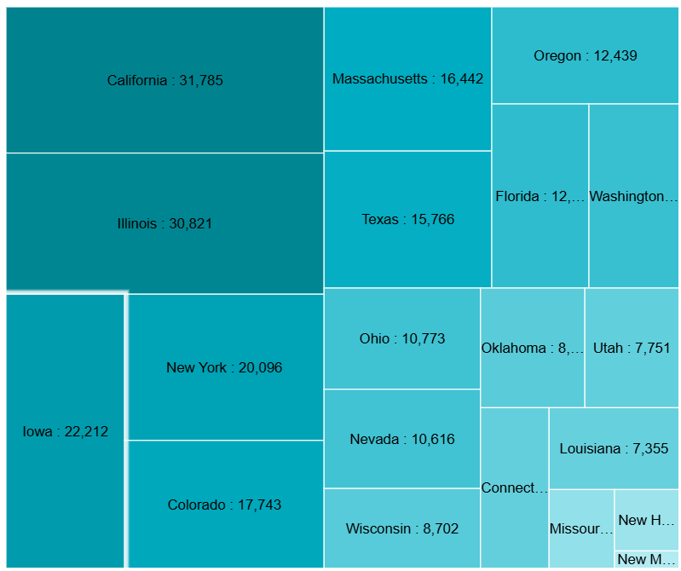
Most Profitable State
Insight
California $ 31,785k
Illinois $ 30,821k
New Mexico $ 799
California leads with the highest profit, followed by Illinois and New York, showing that these states are the key contributors to overall profitability
New Mexico has the lowest profit among the state, indicating either a smaller market size.

Slide 5
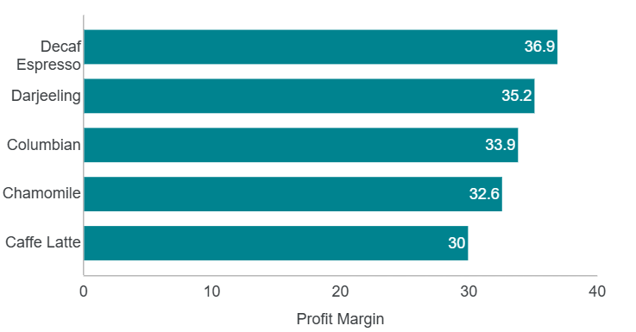
Top 5 Product with Highest Profit Margin
Insight
Decaf espresso: 36.9%
Decaf espresso: 35.2%
Columbian 33.9%
Decaf Espresso has the highest profit margin, followed closely by Darjeeling and Columbian. These products are the most efficient at converting sales into profit.

Slide 6
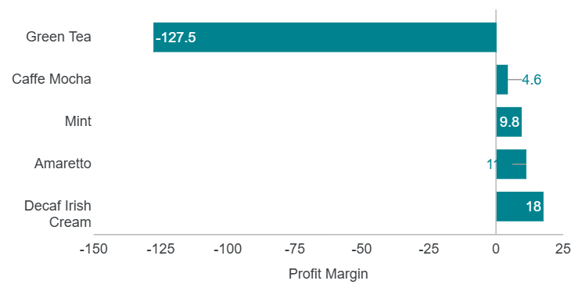
Top 5 Product with The Lowest Profit Margin
Insight
Green Tea: -127.5%
Caffe Mocha: 4.65%
Mint: 9.80%
Green Tea has an unusually negative profit margin, which suggests it might be underpriced or overproduced. Immediate action should be taken to either increase its price or reduce associated costs.

Slide 7
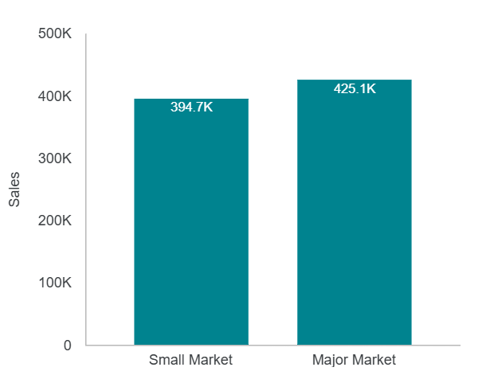
Sales by Market Size
Insight
Major Market: $425,1k
Small Market: $394,7k
Major Market leads by a significant margin, showing that larger markets are more lucrative. This should be a focal point for expanding campaigns.

Slide 8
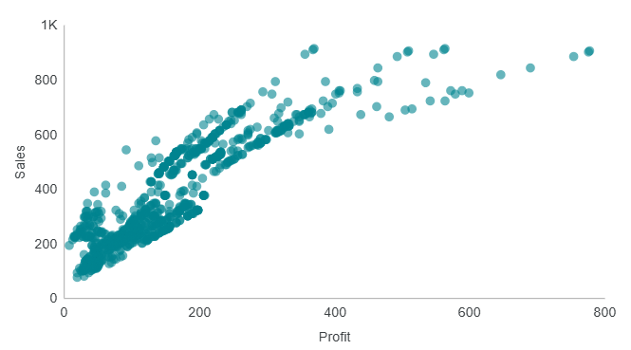
Profit VS Sales
Insight
Profit vs Sales Correlation: 0.80 (strong positive correlation)
The strong positive correlation between Profit and Sales suggests that as sales increase, profits generally increase as well. This reinforces the importance of driving sales to boost profitability.

Slide 9
Final Insight and Recommendation
Final Insight
Based on the insights above:
Decaf Espresso, Darjeeling, and Columbian are the top products with the highest margins they’re good at turning sales into profit.
Green Tea has a negative profit margin and needs a pricing or cost review ASAP.
California, Illinois, and New York are the big contributors to profit.
Smaller markets aren't doing great, but there’s room for growth with targeted marketing.

Slide 10
Final Insight and Recommendation
Final Insight
Based on the insights above:
There's a strong link between sales and profit. The more sales, the more profit. But low-margin products like Green Tea could be pulling down the numbers.
Major markets lead in sales, but small markets can still grow with the right strategies.

Slide 11
Final Insight and Recommendation
Recommendations:
Focus on High-Profit Products Promote products like Decaf Espresso and Darjeeling to boost profit without adding extra costs.
Fix Low-Profit Products Green Tea needs a price hike or cost cut. If it doesn’t improve, think about discontinuing it.
Market More in Major Areas Keep focusing on Major Markets since they drive most of the sales. But also consider segmenting those markets for more targeted campaigns.
Grow Small Market Sales Invest in smaller markets by running ads and promos specific to those regions, or partner with local retailers and influencers.

