Slide 1
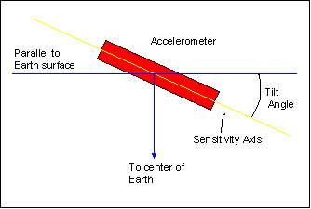
Measuring the tilt of two points of a movable object

Slide 2
Objectives and Motivation
Objectives
To measure the tilt of a movable object
To find the height difference of two different points on object
Motivations
The tilt measurement device can find many applications where we have to maintain stability.
Coupling the application with our device will provide the application user with the tilt information on the display.
User can manually work towards achieving stability, or design a separate control systems.

Slide 3
Apparatus & Tools
Atmega8 Microcontroller
MPU 6050 Accelerometer
Connecting wire
4 * 3 Keypad
LCD Display 2* 16
Proper Case

Slide 4
Structure and Working Principle
Structure
The device will consist mainly of a Microcontroller ( ATmega8)
An Accelerometer ( MPU 6050 ) will be connected with it.
A 4*3 Keypad and a 2*16 LCD will be used to input and output respectively.
Working Principle
The accelerometer will give the tilt as analogue signal.
The microcontroller will convert it into digital signal.
Processing the digital signal, actual tilting angle will be extracted.
The value of the angle and height is shown on the LCD.

Slide 5
Structure and Working Principle
We input the object length through the 4*3 number pad.
Using trigonometric function equations, the microcontroller will calculate the height difference of the two points.
The output will be shown on the LCD.

Slide 6
Equations of Working Principal
A
x
ϴ
h
C
B
Suppose AB is a flat object with length x. It is tilted as A is on a higher point than B. We have to calculate how much higher A is positioned than B, that is h.

Slide 7
Equations of Working Principal
A
x
ϴ
h
C
B
AB creates an angle ϴ with the vertical line AC. The accelerometer is located at point A and it can give this angle. Now we know that cosϴ = AC/AB So AC = ABcosϴ. So h = x*cosϴ

Slide 8
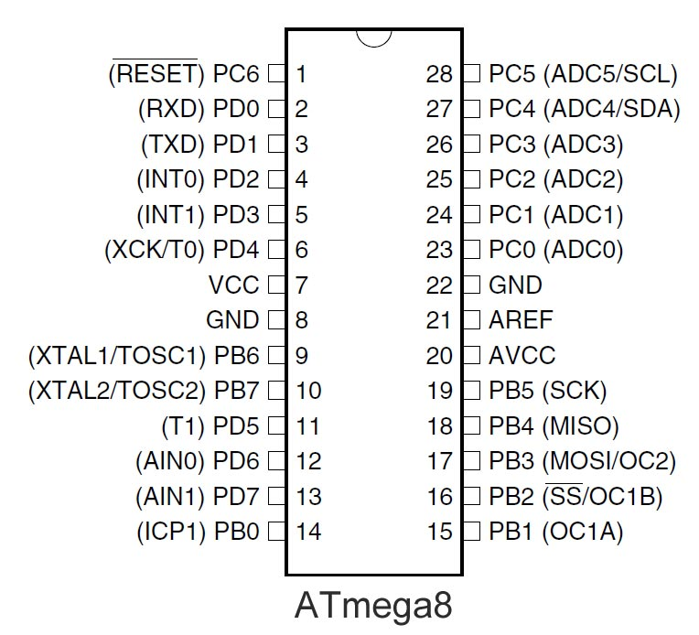
ATmega8 Pins

Slide 9
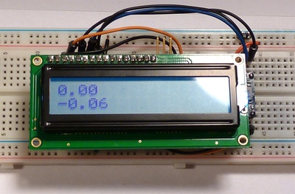
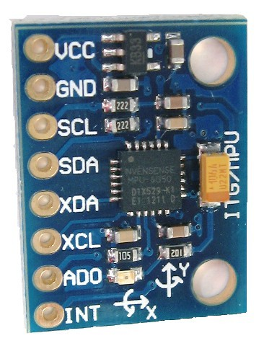
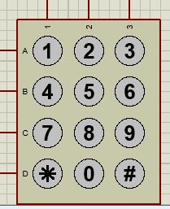
MPU 6050 Accelerometer
LCD
4 * 3 Keypad

Slide 10
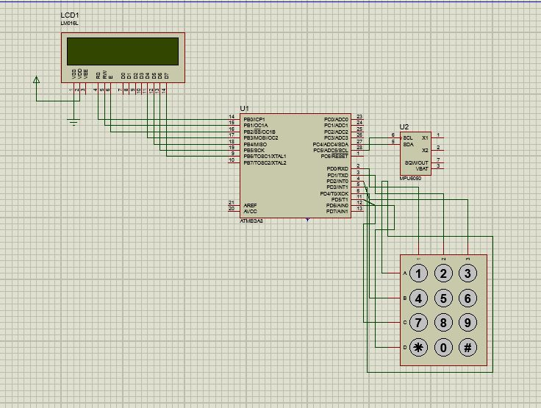
Circuit Diagram

Slide 11
Thank You

Slide 12
Submission
Submitted To:
Submitted By:
Md. Zahidul Islam
Assistant Professor
Mr. Sarfaraz Newaz
Lecturer
Computer Science & Engineering Discipline
Khulna University,
Khulna – 9208, Bangladesh.
S. M. Shakir Ahsan (130203)
Ekhlashur Rahman (130212)
Binayak Ray (130220)
3rd Year, Term I
Computer Science & Engineering Discipline
Khulna University, Khulna.

