Slide 1
A Presentation on Microprocessors and Microcontrollers Project
https://www.facebook.com/MicroArena
COURSE TEACHER:
Sarfaraz Newaz
Group Member’s ID:
130201,130203,130212,130220

Slide 2
Project Name
Measuring the tilt of two points of one movable object

Slide 3
What is it about
This Project helps measuring the tilt of two points
of a movable object.
This project can be handy to measure the height distance of two points of a movable object.

Slide 4
Objective Of The Project
The tilt measurement device can find many applications where we have to maintain stability. Coupling the application with our device will provide the application user with the tilt information on the display. Hence, he can manually work towards achieving stability, or design a separate control system with the same purpose. The user can confirm that the control system is functioning correctly by monitoring the visual readout provided by our device.

Slide 5
Description of the Project
It is a microcontroller project where a microcontroller measures the tilt of a movable object by using accelerometer.
Using the digital signal from the accelerometer, the microcontroller will calculate the amount of tilt and will show it on the display.

Slide 6
Circuit Components:
Microcontroller.
Programming board.
Accelerometer.
LCD ((Liquid crystal Display).
Connecting wires.

Slide 7
Working Process
A
x
ϴ
h
C
B
Suppose AB is a flat object with length x. It is tilted as A is on a higher point than B. We have to calculate how much higher A is positioned than B, that is h.

Slide 8
Working Process
A
x
ϴ
h
C
B
AB creates an angle ϴ with the vertical line AC. The accelerometer is located at point A and it can give this angle. Now we know that cosϴ = AC/AB So AC = ABcosϴ. So h = x*cosϴ

Slide 9
Working Process
The accelerometer sends the angle via digital signal to the microcontroller, then the calculations are performed in the microcontroller program. Then the value of the height is shown on the display.

Slide 10
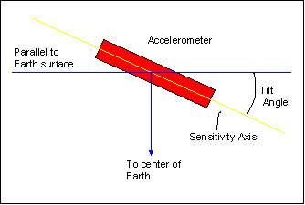
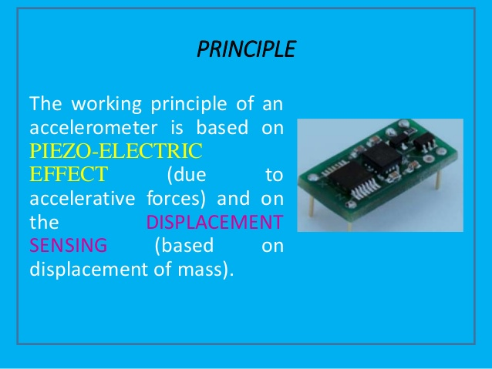
Working Principal of accelerometer
An accelerometer takes the earths surface as reference frame by detecting the gravitational acceleration of earth. Then it calculates the tilt according to the reference.

Slide 11
Applications
This tilting measurement project can be used in tilting applications used in PDAs for screen navigations is a new method to view, scroll, select and move with a minimum number of buttons required.
Interactive video games are becoming increasingly popular. Accelerometers are used to detect the tilting motions of the joystick for the game. This has created games where the user can feel more immersed in the game.
The measurement tilting of water vehicle is very important to take necessary steps to prevent accidents.
Some sports need absolutely flat surface that is totally parallel with the horizontal line. A tilting measurement device can be very handy to make proper environment for that kind of sports.
Various kind of flying objects need it to be controlled properly such as helicopters, aero planes etc.

