Slide 1

" Enhancing ML-DL based IDS with Robust Adversarial Defense Techniques”
Presented By:-
Farhana Mim
Ahsan Md. Sajid Khan
Team-10
Submitted to,
Professor Sk Md Mizanur Rahman
Bharti School of Engineering and Computation
Science, Engineering and Architecture
Date 28 July, 2024

Slide 2
Content
Introduction
Background / Literature Review
Project objective
ML/DL Based IDS
Adversarial Attacks-IDS
Defense Mechanisms
Evaluation Results
Recommendations
References

Slide 3
Introduction
Machine Learning and Deep Learning-based Intrusion Detection Systems (IDS) are vital for network security, detecting malicious activities in network traffic. However, they can be tricked by adversarial attacks that subtly change input data, leading to incorrect classifications. In our project, we studied and examined an open-source framework that strengthens IDS against these attacks using two main techniques: adversarial training and feature squeezing. Adversarial training helps IDS recognize deceptive patterns by using adversarial examples during training. Feature squeezing simplifies input data, making it easier to detect manipulations. While working on this project, we found that this framework significantly improves IDS robustness, providing a stronger defense against advanced threats.

Slide 4
Background and Literature Review
Our findings from literature review
Role of IDS in Network Security
IDS are crucial for detecting and mitigating malicious activities in network traffic.
Traditional methods include signature-based and anomaly-based detection.
Limitations of Traditional IDS
Often fail to identify new and sophisticated attacks.
Limited by predefined signatures and patterns.
Deep Learning-Based IDS
Utilize neural networks to identify complex patterns in network traffic.
More effective in detecting novel attacks compared to traditional methods.

Slide 5
Background and Literature Review
Our findings from literature review… Cont.
Vulnerability to Adversarial Attacks
Small, deliberate changes in input data can mislead IDS, causing incorrect classifications.
First noted in image recognition systems by Goodfellow et al. (2014) [5].
Adversarial Training
Involves using adversarial examples during training to strengthen model resistance.
Effective but resource-intensive, requiring significant computational resources.
Feature Squeezing
Proposed by Xu et al. (2017) [6] to simplify input data, helping detect adversarial manipulations.
Reduces the complexity of data, making it easier to spot anomalies.

Slide 6
Background and Literature Review
Our findings from literature review… Cont.
Studies on Defense Techniques
Wang et al. (2018) and Sadeghzadeh et al. (2019) explored adversarial training and feature squeezing in IDS.
Provided insights into the strengths and limitations of these methods.
Explored Framework for IDS-Adversarial case
Combines adversarial training and feature squeezing.
Extensive experiments show improved IDS robustness against adversarial attacks.

Slide 7
Background and Literature Review
Our findings from literature review… Cont.
IDS-Anta is an open source code which is designed to enhance the robustness of Intrusion Detection Systems (IDS) against adversarial attacks. IDS-Anta integrates multiple defense mechanisms to improve IDS resilience:
Adversarial Training: IDS-Anta incorporates adversarial examples during the training phase to help the model better recognize and resist malicious inputs.
Feature Squeezing: It simplifies input data to reduce the impact of adversarial perturbations, making it easier to detect and mitigate adversarial manipulations.
Hybrid Approach: IDS-Anta combines these techniques to provide a more robust defense against sophisticated attacks.

Slide 8
Project Objectives
The primary objective of our project is to explore, study, and experiment with a robust defense mechanism for machine learning (ML) and deep learning (DL)-based intrusion detection systems (IDS) to counter adversarial attacks. In this project, we used the open-source IDS-Anta, and the approach involves using Multi-Armed Bandits with Thompson Sampling and Ant Colony Optimization to optimize classifier selection and enhance resilience. Additionally, adversarial samples generated through methods like Zeroth Order Optimization (ZOO) and Fast Gradient Sign Method (FGSM) are used for rigorous testing.
Key Objectives:
Enhance cybersecurity defenses against adversarial attacks.
Create an adaptable solution to combat evolving cyber threats.
Strengthen intrusion detection systems for robust protection.

Slide 9
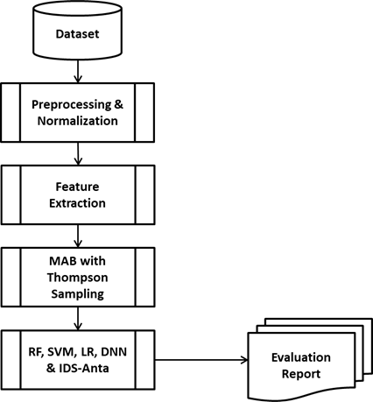
ML/DL Based IDS
We utilized open-source Python code to demonstrate a general Intrusion Detection System (IDS) [1]
Datasets: The process begins with gathering the datasets.
Preprocessing & Normalization: This step involves cleaning the data and normalizing it to ensure consistency.
Feature Extraction: Relevant features are extracted from the processed data, which are crucial for training models.
MAB with Thomson Sampling: This step seems to implement a Multi-Armed Bandit (MAB) approach using Thomson Sampling, likely for model selection or optimization.
Model Training: Various machine learning models, such as Random Forest (RF), Support Vector Machine (SVM), Logistic Regression (LR), Deep Neural Networks (DNN), and the IDS-Anta model, are trained using the features.
Performance Analysis: The trained models are evaluated to analyze their performance.
Figure 1 Machine Learning Based IDS

Slide 10
ML/DL Based IDS
Random Forest
Accuracy: 0.9956714030300179
F1 Score: 0.9968099861303745
Detection Rate : 0.9963953971995009
Precision: 0.9972249202164563
Recall: 0.9963953971995009
AUC Score: 0.9997303776272598
Support Vector Machine
Accuracy: 0.9383645431448198
F1 Score: 0.9550723643596954
Detection Rate : 0.9652017191182587
Precision: 0.9451534075481944
Recall: 0.9652017191182587
AUC Score: 0.9679244401117523
Logistic Regression
Accuracy: 0.6947398136821304
F1 Score: 0.7945274892323284
Detection Rate : 0.8695411063357826
Precision: 0.7314285714285714
Recall: 0.8695411063357826
AUC Score: 0.7890340059212557
Metrics of DNN
Accuracy: 0.985696810012233
IDS-Anta
Accuracy: 0.9962360026347982
Classification Report:
precision recall f1-score support
0 0.99 1.00 0.99 3414
1 1.00 1.00 1.00 7213
accuracy 1.00 10627
macro avg 1.00 1.00 1.00 10627
weighted avg 1.00 1.00 1.00 10627

Slide 11
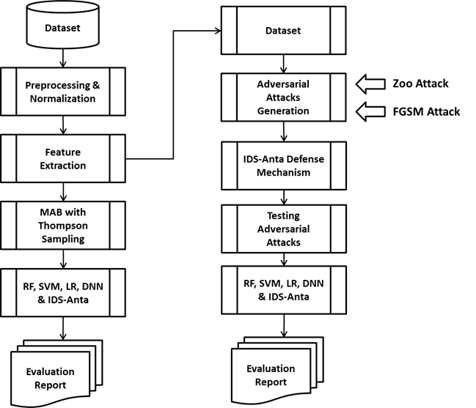
Adversarial Attacks-IDS
Adversarial Attack Generations: This step involves generating adversarial attacks based on the 2017 dataset using methods like ZOO attack and FGSM attack.
IDS-Anta: Defense Mechanism: The IDS-Anta's defense mechanisms are tested against these adversarial attacks.
Testing Adversarial Attacks: This step involves testing the IDS-Anta against the generated adversarial attacks to evaluate its robustness.
Performance Analysis: Similar to the ML based IDS, the performance of this, including its resilience to adversarial attacks, is analyzed.
Figure 2: Adversarial Attack Generation and Detection

Slide 12
Adversarial Attacks-IDS
After generating the zoo adversarial attacks and following the Figure-2 process, we have the following outputs. Due to resource constraints, we minimized the number of iterations in a few cases.
Test Accuracy: 0.9945422038204573
Classification Report:
precision recall f1-score support
0 0.99 0.99 0.99 3414
1 1.00 1.00 1.00 7213
accuracy 0.99 10627
macro avg 0.99 0.99 0.99 10627
weighted avg 0.99 0.99 0.99 10627
Test Accuracy (Adversarial): 0.48414416109908726
Classification Report (Adversarial):
precision recall f1-score support
0 0.38 0.97 0.55 3414
1 0.95 0.25 0.40 7213
accuracy 0.48 10627
macro avg 0.66 0.61 0.47 10627
weighted avg 0.77 0.48 0.45 10627
Non-Adversarial Metrics:
Precision: 0.9945468513565168
Recall: 0.9945422038204573
F1-score: 0.9945438832199173
Detection Rate: [0.99267721 0.99542493]
AUC Score: 0.9940510693484418
Adversarial Metrics:
Precision: 0.7660224400351157
Recall: 0.48414416109908726
F1-score: 0.44765301212047637
Detection Rate: [0.97070885 0.25384722]
AUC Score: 0.6122780331126081

Slide 13
Defense Mechanism
Proposed Framework: A combined approach has been proposed of adversarial training and feature squeezing to enhance the robustness of DL-based IDS against adversarial attacks.
Adversarial Training: This technique involves incorporating adversarial examples into the training dataset, allowing the model to learn and recognize these deceptive patterns. By exposing the model to various adversarial examples during training, it becomes better equipped to resist manipulative inputs during real-world deployment.
Feature Squeezing: Feature squeezing reduces the complexity of input data by compressing its features, aiding in detecting adversarial manipulations. Simplifying the input data limits the adversary's ability to introduce effective perturbations, making it easier for the IDS to identify and mitigate adversarial attacks.

Slide 14
Evaluations and Results
For the studied paper [1] the proposed framework (IDS-Anta) effectiveness is validated through extensive experiments, showing significant improvements in IDS robustness. Tests using various adversarial attack methods demonstrate that the proposed framework can effectively mitigate the impact of adversarial attacks, thereby enhancing the security and reliability of DL-based IDS.
In summary, the research underscores the critical threat posed by adversarial attacks to DL-based IDS and presents a robust defense framework combining adversarial training and feature squeezing. This approach enhances the IDS's ability to detect and resist adversarial manipulations, ensuring more reliable network security.

Slide 15
Recommendations
After exploring several papers on adversarial attacks and IDS, we found the following recommendations to defeat adversarial attacks on IDS:
Incorporate Adversarial Examples: Integrate adversarial examples into the training dataset and continuously update the training process.
Feature Squeezing: Simplify input data through feature squeezing and combine it with other defensive strategies for a multi-layered defense.
Hybrid Defense Strategies: Adopt dynamic hybrid defenses that adapt to emerging threats.
Training and Best Practices: Educate users and stakeholders on adversarial attacks and establish best practices for secure IDS deployment.

Slide 16
References
[1] Barik, K., & Misra, S. (2024). IDS-Anta: An open-source code with a defence mechanism to detect adversarial attacks for intrusion detection system. Software Impacts, 100664. https://doi.org/10.1016/j.simpa.2024.100664
[2] A simple framework to enhance the adversarial robustness of deep learning-based intrusion detection system. (n.d.). https://arxiv.org/html/2312.03245v1
[3] Yang, L., & Shami, A. (2022). IDS-ML: An open source code for Intrusion Detection System development using Machine Learning. Software Impacts, 14, 100446. https://doi.org/10.1016/j.simpa.2022.100446
[4] IDS 2017 | Datasets | Research | Canadian Institute for Cybersecurity | UNB. (n.d.). https://www.unb.ca/cic/datasets/ids-2017.html
[5] Goodfellow, I. J., Pouget-Abadie, J., Mirza, M., Xu, B., Warde-Farley, D., Ozair, S., Courville, A., & Bengio, Y. (2014, June 10). Generative adversarial networks. arXiv.org. https://arxiv.org/abs/1406.2661
[6] Xu, W., Evans, D., Qi, Y., University of Virginia, & evadeML.org. (n.d.-b). Feature Squeezing: Detecting adversarial examples in deep neural networks. In Network and Distributed Systems Security Symposium (NDSS) 2018 [Conference-proceeding]. https://www.ndss-symposium.org/wp-content/uploads/2018/02/ndss2018_03A-4_Xu_paper.pdf

Slide 17
Thank You

