Slide 1
Cosc 1P03
Week 1 Lecture slides
“For myself, I am an optimist--it does not seem to be much use being anything else.”
Winston Churchill

Slide 2
COSC 1P03
Audience
  planning to major in COSC (prereq. 1P02 60%)
Lectures, labs, tutorials, Help Desk are through MS Teams
Web
  COSC 1P03 Sakai site
  COSC: http://www.cosc.brocku.ca/
Course Outline
  Textbook
  Software
  Marking scheme
  Assignment submission/return
Plagiarism
Succeeding in COSC 1P03
  labs/assignments
Notes:
COSC 1P03
2002/03
2.<number>

Slide 3
Arrays
(review)
collections of values (objects)
  elements
use
  declare
  create
  process
memory model
length attribute
right-sized vs variable-sized arrays
arrays as parameters
Strings as array of char
  toCharArray & String(char[])
  palindrome revisited

Slide 4
Multidimensional Arrays
e.g. tables
  2 or more dimensions
  enrollment data by university and department
declaration
  type ident[]… or type []… ident
creation
  new type[expr]…
subscripting
  ident[expr]…
length
  regular vs irregular arrays
variable-sized
  fill upper left corner
  one counter for each dimension
This form is more consistent with other type declarations. Hence type ident.

Slide 5
Processing 2-Dimensional Arrays
random access
  look-up table
sequential access
  row-major order
    lexicographic order
    pattern
  column-major order
    pattern
    regular arrays

Slide 6
E.g. Tabulating Enrolments
data
right-sized array
totals
readStats
  row-major processing
sumRows
  row processing
sumCols
  column processing
sumAll
  row-major processing
writeStats
  row-major & report generation

Slide 7
Array Representation
contiguous allocation
  value/object/array is sequence of consecutive cells
  row-major vs column-major
single dimensional
  contiguous allocation
  address(a[i]) = address(a) + i × s
    where
      s = size of element type
  if not zero-based subscripting
    address(a[i]) = address(a) + (i-l) × s
    where
      l = lower bound

Slide 8
multi-dimensional
  lexicographic (row-major) ordering
  consider as array of rows
  address(a[i]) = address(a) + i × S
    where
      S = size of row (S=a[0].length × s)
    start of i^{th} row
  address(a[i][j]) = address(a[i]) + j × s
  substitution gives
    address(a[i][j]) = address(a) + i × S + j × s
  for non-zero based
    address(a[i][j]) = address(a) + (i-l_{r}) × S + (j-l_{c}) × s

Slide 9
Arrays of Arrays
non-contiguous allocation
  each row contiguous
memory model
addressing
  address(a[i][j]) = content(address(a)+i×4) + j × s
access
  row-major order
ragged array
  creation

Slide 10
Array Slices
int [][] x;
int [] y,z;
x = new int [3][4];
for (int i=0;i<x.length;i++)
for (int j=0; j<x[0].length;j++) x[i][j]=(i*(x.length+1)) + j;
y=x[0];
z=x[1];
x[0]=z;
x[1]=y;
X contrains the Following,
4 5 6 7
0 1 2 3
8 9 10 11

Slide 11
Special Array Forms
large arrays with many zero entries
  1000 × 1000 double = 8,000,000 bytes
  time-space tradeoff
    reduce space consumption at cost of time to access

Slide 12
Diagonal Matrix
elements on diagonal, zeros elsewhere
e.g. 1000 ×1000 has 1000 or 0.1% non-zero
represent as vector of main diagonal
mapping function
  address(a[i][i]) = address(d) + i × s
class specification
  usage

Slide 13
Triangular Matrix
elements above or below diagonal
  lower-triangular
50% elements (n(n+1)/2) filled
n partial rows side-by-side
mapping function
  address(a[i][j]) = address(d) + i×(i+1)/2 × s + j × s
also ragged array

Slide 14
TriDiagonal Matrix
one element on either side of diagonal
e.g. 1000 ×1000 is about 0.3% (3n-2)
place n-partial rows (without zeros) end to end
  each offset from last by 2 positions
mapping function
  address(a[i][j]) = address(d) + i × 2 × s + j × s

Slide 15
Sparse Matrices
few randomly-distributed non-zero elements
represent only non-zero
cannot use mapping function
Use
  Link List Structure
  Matrix Compression Algorithms
  Covered in Cosc 2P03

Slide 16
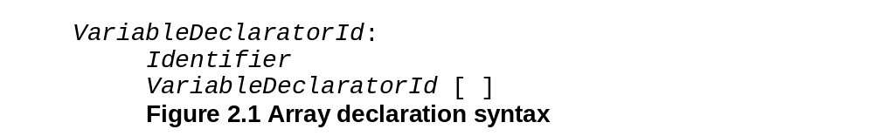

Slide 17
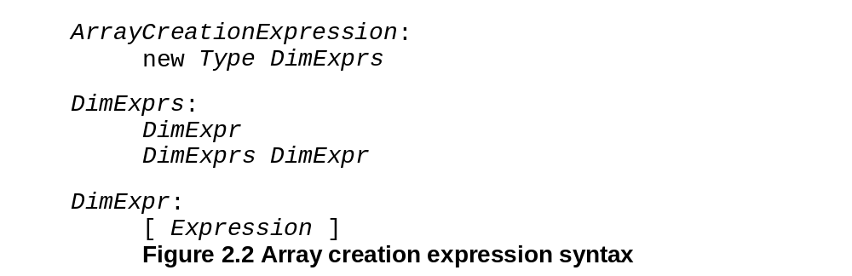

Slide 18
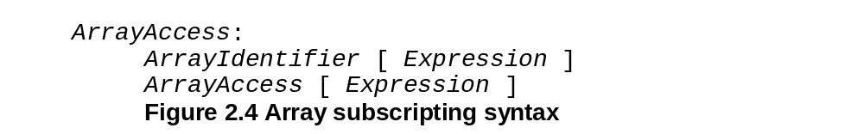

Slide 19
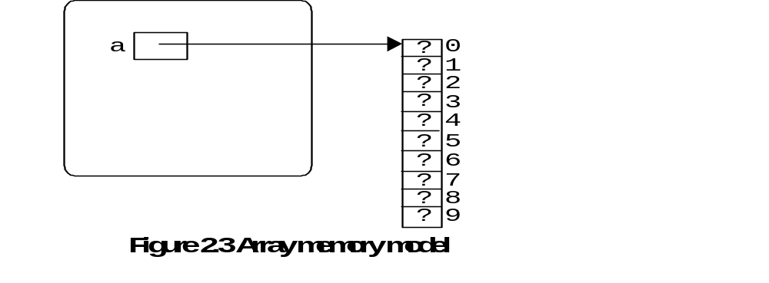

Slide 20
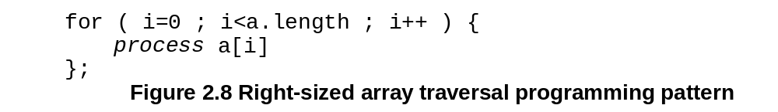

Slide 21
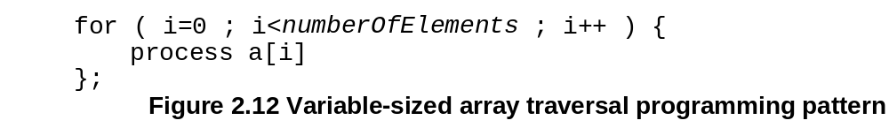

Slide 22
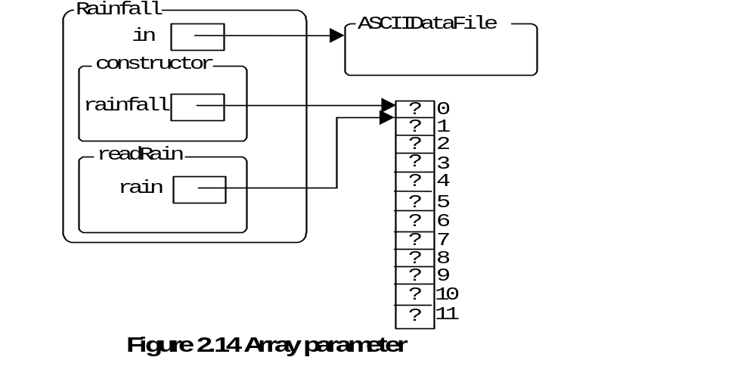

Slide 23
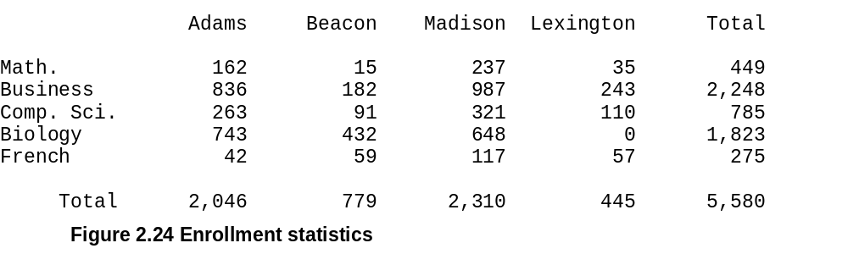
Calculated as the Row totals
Sum of all students in the table
Calculated as Column totals

Slide 24
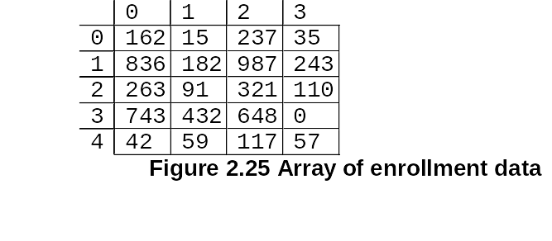
Universities
Departments

Slide 25
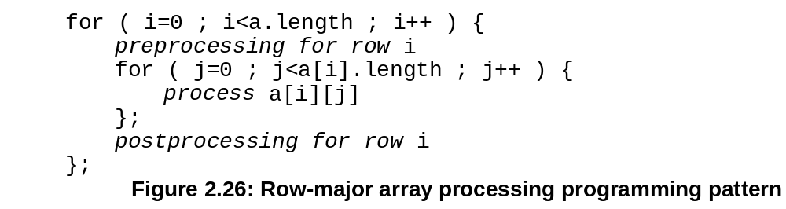

Slide 26
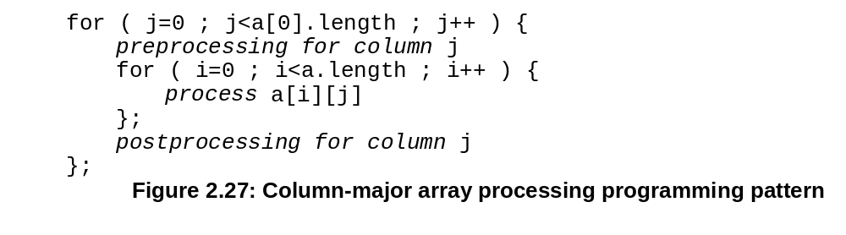

Slide 27
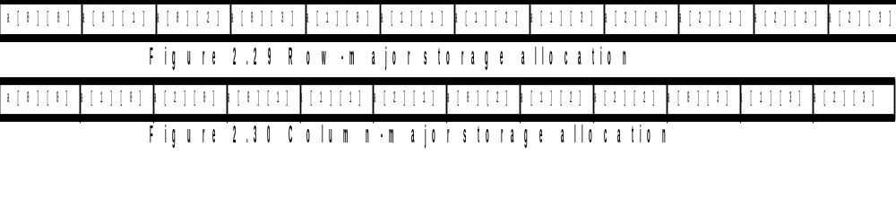

Slide 28
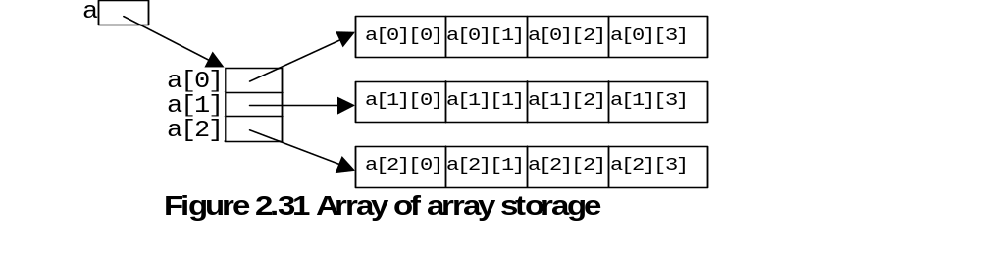

Slide 29
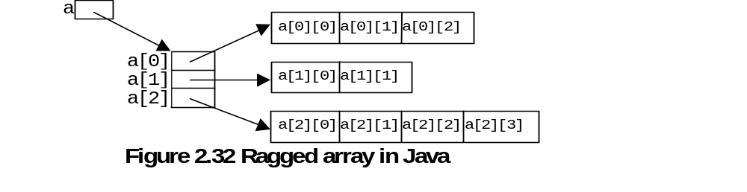

Slide 30
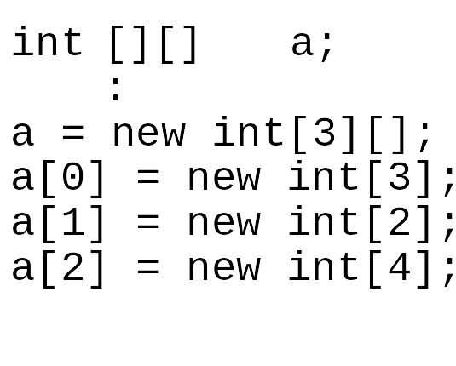

Slide 31
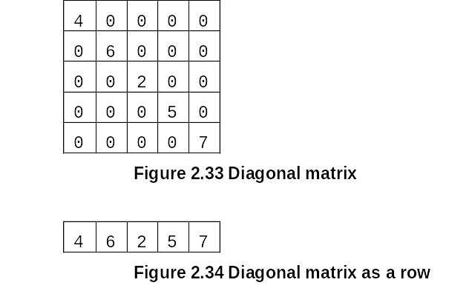

Slide 32
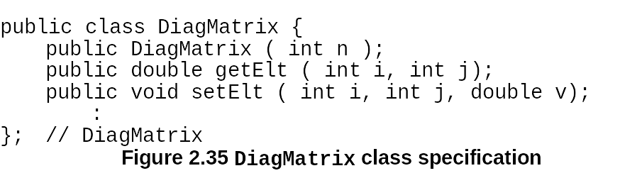

Slide 33
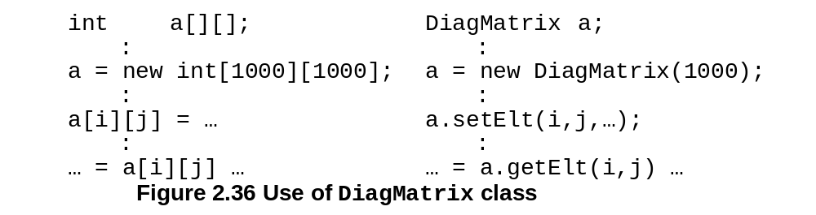

Slide 34
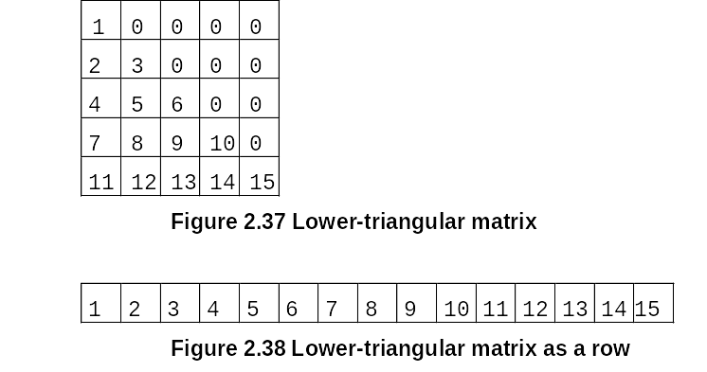

Slide 35
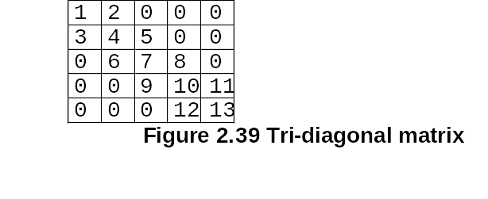

Slide 36
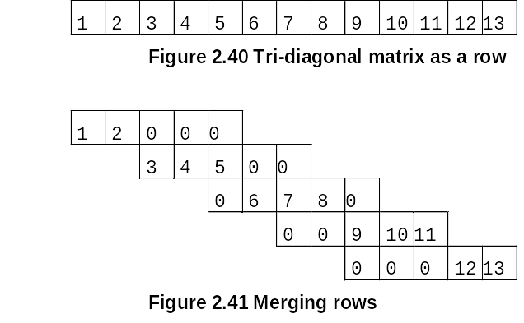

Slide 37
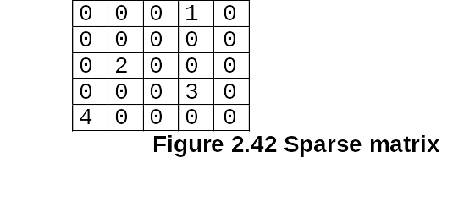

Slide 38
Reversing a char array
O L I V E R
R L I V E O
R E I V L O
R E V I L O

Slide 39
Palindrome Revisited
Read in the string to check
private void checkPalindromes ( ) {
String str; // string to be checked as palindrome
String reversed; // reversed version of str
while ( true ) {
in.setLabel("Enter string");
str = in.readString();
if ( ! in.successful() ) break;
out.writeLabel("\"");
out.writeString(str);
reversed = reverse(str);
if ( str.equalsIgnoreCase(reversed) ) {
out.writeLabel("\" is a palindrome");
}
else {
out.writeLabel("\" is not a palindrome");
};
out.writeEOL();
};
}; // checkPalindromes
Call the reverse method which reverses the order of the characters
Check the original with the reversed, if they are the same then they are Palindromes

Slide 40
Palindrome Revisited.
private String reverse ( String str ) {
char [] theString; // string as array of characters
char c;
int i;
theString = str.toCharArray();
for ( i=0 ; i<theString.length/2 ; i++ ) {
c = theString[i];
theString[i] = theString[theString.length-1-i];
theString[theString.length-1-i] = c;
};
return new String(theString);
}; // reverse
Define a character array
Loop runs 1/2 the length of the char array
Method converts the string to a right sized character array
Last is defined by length -1. As i is increased the upper index is decremented proportionately.
Swap the first and last char
Constructor converts the character array back to a string. Which is returned by the method.

Slide 41
Enrollments
public class UStats {
private final String [] UNIVS = {" Adams"," Beacon"," Madison"," Lexington"};
private final String [] DEPTS = {"Math.","Business","Comp. Sci.","Biology","French"};
private ASCIIDataFile dataFile; // file for input
private ASCIIReportFile report; // file for report
private ASCIIDisplayer msg; // displayer for messages
public UStats ( ) {
dataFile = new ASCIIDataFile();
report = new ASCIIReportFile();
msg = new ASCIIDisplayer();
display();
dataFile.close();
report.close();
msg.close();
}; // constructor
private void display ( ) {
int [][] enrol; // enrolment stats
int [] uTotals; // University totals
int [] dTotals; // Department totals
int total; // grand total
msg.writeLabel("Processing.....");
enrol = new int[DEPTS.length][UNIVS.length];
readStats(enrol);
uTotals = sumRows(enrol);
dTotals = sumCols(enrol);
total = sumAll(enrol);
writeStats(enrol,uTotals,dTotals,total);
msg.writeLabel(".....complete");
msg.writeEOL();
}; // display
Arrays of strings used for the row and column headings
Array declarations for enrolment table, row & column stats
Rows are represented by the departments, Columns by the universities.
Length of each dimension is based on the heading lengths.

Slide 42
Enrollments.
Stats is passed via reference
Attribute for number of rows
private void readStats ( int [][]stats ) {
int i, j;
for ( i=0 ; i<stats.length ; i++ ) {
for ( j=0 ; j<stats[i].length ; j++ ) {
stats[i][j] = dataFile.readInt();
};
};
}; // readStats
/** This method sums the enrollments by row.*/
private int [] sumRows ( int [][] stats ) {
int []sums;
int i, j;
sums = new int[stats.length];
for ( i=0 ; i<stats.length ; i++ ) {
sums[i] = 0;
for ( j=0 ; j<stats[i].length ; j++ ) {
sums[i] = sums[i] + stats[i][j];
};
};
return sums;
}; // sumRows
Attribute for number of columns
Loading the stats table, iXj integer reads
Creation of array to hold row statistics
For each row i we add the columns indexed by j.
The row tabulation array sum is returned add the reference assigned to uTotals.
Initialize sum[i] to 0 prior to tabulation.
Traverse each row

Slide 43
Enrollments..
Stats is passed via reference.
//This method sums the enrollments by column.
private int [] sumCols ( int [][] stats ) {
int []sums;
int i, j;
sums = new int[stats[0].length];
for ( j=0 ; j<stats[0].length ; j++ ) {
sums[j] = 0;
for ( i=0 ; i<stats.length ; i++ ) {
sums[j] = sums[j] + stats[i][j];
};
};
return sums;
}; // sumCols
//This method computes the grand sum of the enrollment statistics.
private int sumAll ( int [][] stats ) {
int sum;
int i, j;
sum = 0;
for ( i=0 ; i<stats.length ; i++ ) {
for ( j=0 ; j<stats[i].length ; j++ ) {
sum = sum + stats[i][j];
};
};
return sum;
}; // sumAll
The attribute reflects the # of elements in a columns
Sums is a tmp array and is processed the same as in sumRows
The i and j indexes are reversed. Causes a traversal down the columns
To add all values we do a running total for each element of the table.

Slide 44
Enrollments...
//This method computes the grand sum of the enrollment statistics.
private int sumAll ( int [][] stats ) {
int sum;
int i, j;
sum = 0;
for ( i=0 ; i<stats.length ; i++ ) {
for ( j=0 ; j<stats[i].length ; j++ ) {
sum = sum + stats[i][j];
};
};
return sum;
}; // sumAll
Alternate Form of sumAll
private int sumAll ( int [][]stats ) {
int sum;
int i, j;
sum = 0;
for ( int [] u : stats ) {
for ( int d : u ) {
sum = sum + d;
};
};
return sum;
}; // sumAll
To add all values we do a running total for each element of the table.
Stats defines a matrix
u defines an array slice of stats.
d defines a single element of the array slice u.
Can be read as: For each array slice u in stats, and For each element d in u.
Important to realise that each time the loop starts u and d represent the next value.
There are no indices, thus they do not need to be updated. No i++ or j++
This definition is called an iterator which can extend data structures such as arrays.
Since d is an element, we use it directly in the running total expression.

Slide 45
Enrollments….
Each element in the University Name array is printed as part of the title
/** This method initializes the enrolment report. */
private void initReport ( ) {
report.setTitle("Enrolment Report",getDateInstance().format(new Date()));
report.addField("dept","",10);
for ( int i=0 ; i<UNIVS.length ; i++ ) {
report.addField("u"+i,UNIVS[i],getIntegerInstance(),10);
};
report.addField("total"," Total",getIntegerInstance(),10);
}; // initReport
Add field is in the loop to allow flexibility

Slide 46
Enrollments…..
/**This method displays the enrollment stats in a tabular format with labels and
totals for each row and column and a grand total. */
private void writeStats( int [][]stats, int []rSums, int []cSums, int sum ) {
int i, j;
for ( i=0 ; i<stats.length ; i++ ) {
report.writeString(DEPTS[i]);
for ( j=0 ; j<stats[i].length ; j++ ) {
report.writeInt(stats[i][j]);
};
report.writeInt(rSums[i]);
};
report.writeString("Total");
for ( j=0 ; j<cSums.length ; j++ ) {
report.writeInt(cSums[j]);
};
report.writeInt(sum,10);
}; // writeStats
Prints the data for row i.
Prints Row i header
Column totals are printed at the bottom along with the total number of students enrolled
Followed by the sum of that data

Slide 47
0
12 10
0
0 1
0
0 2
0
0 4
0
0 6
0
0 9
0
2 0
5
2 2
2
2 9
0
5 0
4
5 1
9
5 4
0
6 0
6
6 6
0
8 0
1
8 1
3
8 9
0
11 0
8
11 2

Slide 48
The End

