Slide 1
Recursion
Data Structures and Algorithms

Slide 2
Recursion
We have seen that repetition can be achieved by writing loops:
  such as for loops and while loops.
Another way to achieve repetition is through recursion,
  Which occurs when a function refers to itself in its own definition.

Slide 3
Introduction to Recursion
A recursive function is a function that calls itself.
Recursive functions can be useful in solving problems that can be broken down into smaller or simpler sub-problems of the same type.
A base case should eventually be reached, at which time the breaking down (recursion) will stop.

Slide 4
Recursive Functions
Consider a function for solving the count-down problem from some number num down to 0:
  The base case is when num is already 0: the problem is solved and we “blast off!”
  If num is greater than 0, we count off num and then recursively count down from num-1

Slide 5
Recursive Functions
A recursive function for counting down to 0:
void countDown(int num)
{
if (num == 0)
cout << "Blastoff!";
else
{
cout << num << ". . .";
countDown(num-1); // recursive call
}
}

Slide 6
first call to
countDown
num is 2
OUTPUT:
2...
countDown(1);
second call to
countDown
num is 1
1...
countDown(0);
third call to
countDown
num is 0
Blastoff!
// no
// recursive
// call

Slide 7
Stopping the Recursion
A recursive function should include a test for the base cases
In the sample program, the test is:
if (num == 0)

Slide 8
Stopping the Recursion
  void countDown(int num)
  {
  if (num == 0) // test
  cout << "Blastoff!";
  else
  {
  cout << num << "...\n";
  countDown(num-1); // recursive
  } // call
  }

Slide 9
Stopping the Recursion
With each recursive call, the parameter controlling the recursion should move closer to the base case
Eventually, the parameter reaches the base case and the chain of recursive calls terminates

Slide 10
Stopping the Recursion
void countDown(int num)
{
if (num == 0) // base case
cout << "Blastoff!";
else
{ cout << num << "...\n";
countDown(num-1);
}
}
Value passed to recursive call is closer to base case of num = 0.

Slide 11
What Happens When Called?
Each time a recursive function is called, a new copy of the function runs, with new instances of parameters and local variables being created
As each copy finishes executing, it returns to the copy of the function that called it
When the initial copy finishes executing, it returns to the part of the program that made the initial call to the function

Slide 12
Types of Recursion
Direct recursion
  a function calls itself
Indirect recursion
  function A calls function B, and function B calls function A. Or,
  function A calls function B, which calls …, which calls function A

Slide 13

The Recursive Factorial Function
The factorial of a nonnegative integer n is the
product of all positive integers less or equal to n
Factorial of n is denoted by n!

Slide 14
Cont . . .
For example, 5! = 5 · 4 · 3 · 2 · 1 = 120.
To make the connection with functions clearer, we use the notation factorial(n) to denote n!
factorial(5) = 5 ·(4 ·3 ·2 ·1) = 5 ·factorial(4).

Slide 15

Recursive definition
First, it contains one or more base cases, which are defined non-recursively in terms of fixed quantities.
In this case, n = 0 is the base case.

Slide 16
Recursive Factorial Function
Recursive function
int factorial(int n) // recursive factorial function
{ if (n == 0) return 1; // basis case
else
return n *factorial(n-1); // recursive case
}

Slide 17
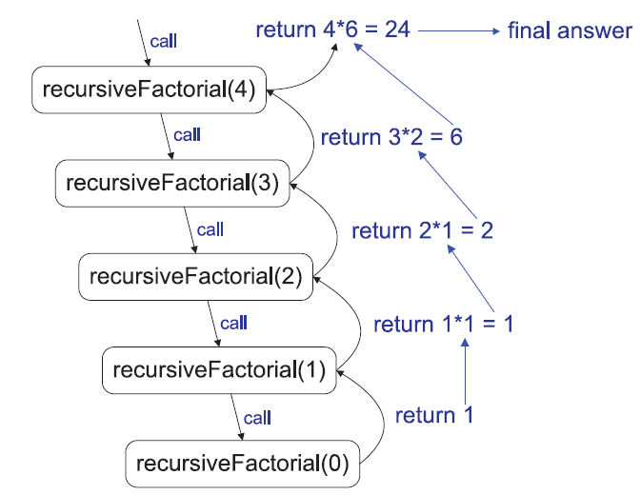
A recursion trace for the call recursiveFactorial(4)

Slide 18
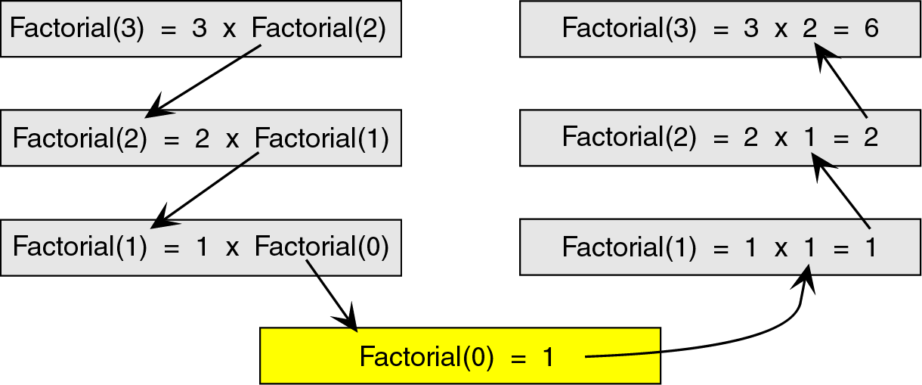
Another example
A recursion trace for the call Factorial(3)

Slide 19
Iterative Factorial Algorithm
The iterative solution is very straightforward. We simply loop through all the integers between 1 and n and multiply them together.
factorial(n) {
i = 1
factN = 1
loop (i <= n)
factN = factN * i
i = i + 1
end loop
return factN
}

Slide 20
How Recursion Works
To truly understand how recursion works we need to first explore how any function call works.
When a program calls a subroutine (function) the current function must suspend its processing.
The called function then takes over control of the program.

Slide 21
How Recursion Works
When the function is finished, it needs to return to the function that called it.
The calling function then ‘wakes up’ and continues processing.
One important point in this interaction is that, unless changed through call-by- reference, all local data in the calling module must remain unchanged.

Slide 22
How Recursion Works
Therefore, when a function is called, some information needs to be saved in order to return the calling module back to its original state (i.e., the state it was in before the call).
We need to save information such as the local variables and the spot in the code to return to after the called function is finished.

Slide 23
How Recursion Works
To do this we use a stack.
Before a function is called, all relevant data is stored in a stackframe.
This stackframe is then pushed onto the system stack.
After the called function is finished, it simply pops the system stack to return to the original state.

Slide 24
Recursion
Recursion of course is an elegant programming technique, but not the best way to solve a problem, even if it is recursive in nature.
This is due to the following reasons:
  1. It requires stack implementation.
  2. It makes inefficient utilization of memory, as every time a new recursive call is made a new set of local variables is allocated to function.
  3. Moreover it also slows down execution speed, as function calls require jumps, and saving the current state of program onto stack before jump.
  4. If proper precautions are not taken, recursion may result in non-terminating iterations.

Slide 25
NON-tail Recursion
class GFG {
static int fact(int n)
{
if (n == 0) return 1;
return n*fact(n-1);
}
// Driver program
public static void main(String[] args)
{ System.out.println(fact(5));
}
}
we can see that the value returned by fact(n-1) is used in fact(n), so the call to fact(n-1) is not the last thing done by fact(n)

Slide 26
Tail Recursion
A recursive function is tail recursive when a recursive call is the last thing executed by the function.
// An example of tail recursive function
static void print(int n)
{
if (n < 0)
return;
System.out.print(" " + n);
// The last executed statement
// is recursive call
print(n - 1);
}

Slide 27
Indirect Recursion
public class IndirecRecursion {
static int n=0;
static void functionOne()
{
if (n <= 20)
{
System.out.println(n +" ");
n++;
functionTwo();
}
}
static void functionTwo()
{
if (n <= 20)
{
System.out.println(n+" ");
n++;
functionOne();
}
}
public static void main(String args[])
{
functionOne();
}
}

Slide 28
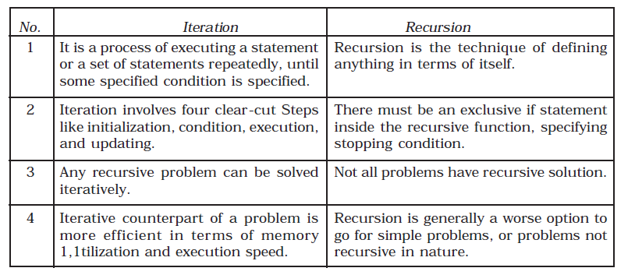
Recursion vs iteration

Slide 29
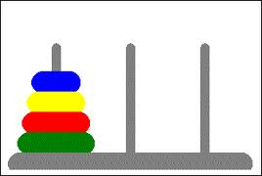
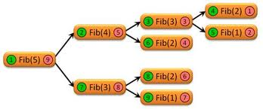


Some examples

Slide 30
Example Task
Write code for printing even numbers from 1 to 50 using recursion.
Modify the code in above example to print the numbers in reversed order.

Slide 31
Computing Fibonacci Numbers via Recursion
Fibonacci numbers are recursively defined as follows:
Task: write the recursive as well iterative algorithm for Fibonacci numbers
F₀ = 0
F₁ = 1
F_{i} = F _{i−1}+F _{i−2} for i > 1
Notes:
//////// recursive algorithm of Fibonacci series/////////////////
int Fibonacci(int n)
{
if (n==0)
return 0;
else if(n==1)
return 1;
else
return (Fibonacci(n-1) +Fibonacci(n-2));
}

Slide 32
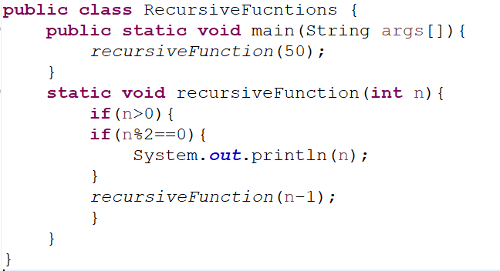
Example Task Solution

Slide 33
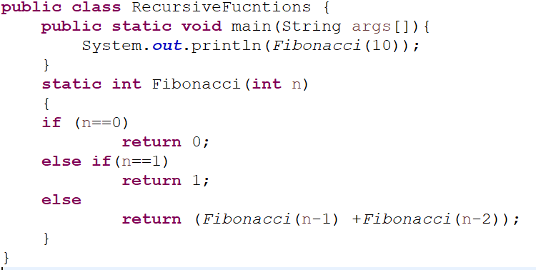
Example Task Solution

