Slide 1
How to solve a Problem?

Slide 2
Analysis of algorithms
When we design an algorithm there are two main aspects which should be analyzed:
correctness:
analyze if the algorithm produces the desired output after a finite number of operations
efficiency:
estimate the amount of resources needed to execute the algorithm on a machine

Slide 3
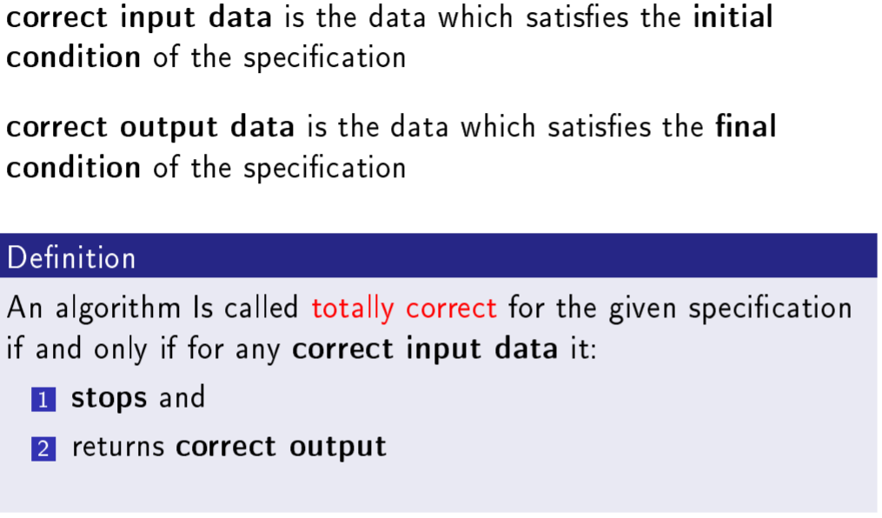
Total Correctness

Slide 4
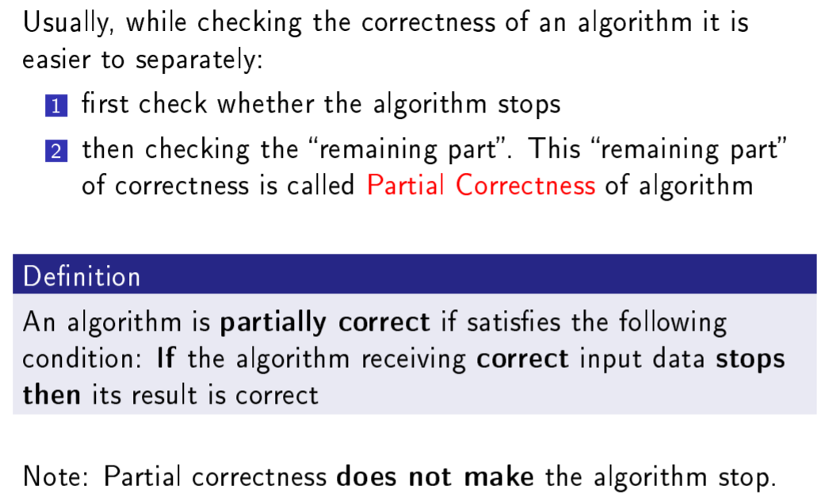
Partial Correctness

Slide 5
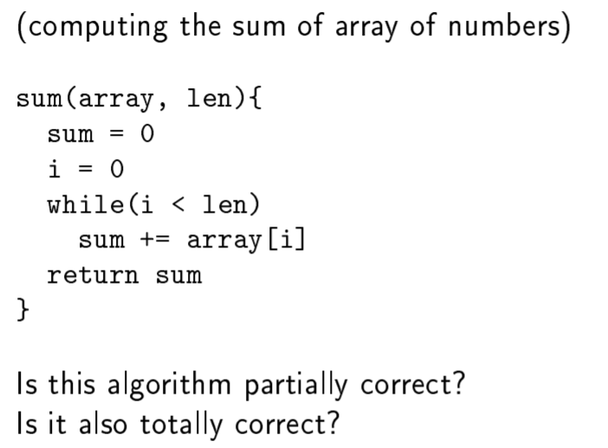

Slide 6
Correctness
There are two main ways to verify if an algorithm solves a given problem:
Experimental (by testing): the algorithm is executed for a several instances of the input data
Formal (by proving): it is proved that the algorithm produces the right answer for any input data

Slide 7
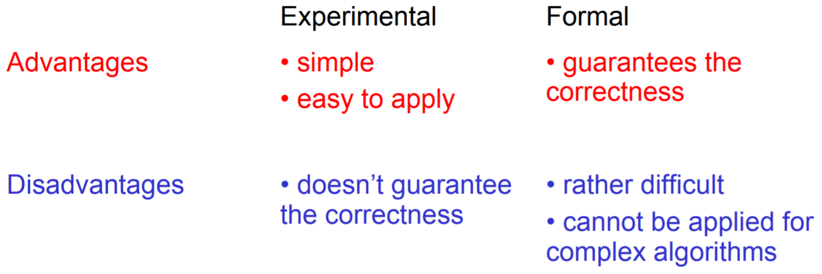
Advantages and Disadvantages

Slide 8
Algorithm Efficiency
The efficiency of an algorithm is simply the amount of work the algorithm performs to complete its task.

Slide 9
Types of Analysis
Worst case
Provides an upper bound on running time
An absolute guarantee that the algorithm would not run longer, no matter what the inputs are
Best case
Provides a lower bound on running time
Input is the one for which the algorithm runs the fastest
Average case
Provides a prediction about the running time
Assumes that the input is random

Slide 10
How do we compare algorithms?
We need to define a number of objective measures.
(1) Compare execution times?
Not good: times are specific to a particular computer !!
(2) Count the number of statements executed?
Not good: number of statements vary with the programming language as well as the style of the individual programmer.

Slide 11
Ideal Solution
Express running time as a function of the input size n (i.e., f(n)).
Compare different functions corresponding to running times.
Such an analysis is independent of machine time, programming style, etc.
What do we mean by running time analysis?
Determine how running time increases as the size of the problem increases.

Slide 12
Theoretical analysis of time efficiency
Time efficiency is analyzed by determining the number of repetitions of the basic operation as a function of input size
Basic operation: the operation that contributes most towards the running time of the algorithm
T(n) ≈ c_{op}C(n)
input size
running time
execution time
for basic operation
Number of times basic operation is executed

Slide 13
Input size and basic operation examples
Problem | Input size measure | Basic operation
Searching for key in a list of n items | Number of list’s items, i.e., n | Key comparison
Multiplication of two matrices | Matrix dimensions or total number of elements | Multiplication of two numbers
Typical graph problem | #vertices and/or edges | Visiting a vertex or traversing an edge

Slide 14
Model Machine
has one processor
executes one instruction at a time
each instruction takes "unit time“
has fixed-size operands, and
has fixed size storage (RAM and disk).

Slide 15
Example
Associate a "cost" with each statement.
Find the "total cost“ by finding the total number of times each statement is executed.
Algorithm 1 Algorithm 2
Cost Cost
arr[0] = 0; c₁ for(i=0; i<N; i++) c₂
arr[1] = 0; c₁ arr[i] = 0; c₁
arr[2] = 0; c₁
... ...
arr[N-1] = 0; c₁
----------- -------------
c₁+c₁+...+c₁ = c₁ x N (N+1) x c₂ + N x c₁ =
(c₂ + c₁) x N + c₂

Slide 16
Another Example
Algorithm 3 Cost
sum = 0; c₁
for(i=0; i<N; i++) c₂
for(j=0; j<N; j++) c₂
sum += arr[i][j]; c₃
------------
c₁ + c₂ x (N+1) + c₂ x N x (N+1) + c₃ x N²

Slide 17
Asymptotic Analysis
To compare two algorithms with running times f(n) and g(n), we need a rough measure that characterizes how fast each function grows.
Hint: use rate of growth
Compare functions in the limit, that is, asymptotically!
(i.e., for large values of n)

Slide 18
Rate of Growth
Consider the example of buying elephants and goldfish:
Cost: cost_of_elephants + cost_of_goldfish
Cost ~ cost_of_elephants (approximation)
The low order terms in a function are relatively insignificant for large n
n⁴ + 100n² + 10n + 50 ~ n⁴
i.e., we say that n⁴ + 100n² + 10n + 50 and n⁴ have the same rate of growth

Slide 19
Asymptotic Notation
O notation: asymptotic “less than”:
f(n)=O(g(n)) implies: f(n) “≤” g(n)
Ω notation: asymptotic “greater than”:
f(n)= Ω (g(n)) implies: f(n) “≥” g(n)
Θ notation: asymptotic “equality”:
f(n)= Θ (g(n)) implies: f(n) “=” g(n)

Slide 20
Big-O Notation
We say f_{A}(n)=30n+8 is order n, or O (n) It is, at most, roughly proportional to n.
f_{B}(n)=n²+1 is order n², or O(n²). It is, at most, roughly proportional to n².
In general, any O(n²) function is faster- growing than any O(n) function.

Slide 21
Visualizing Orders of Growth
On a graph, as you go to the right, a faster growing function eventually becomes larger...
f_{A}(n)=30n+8
Value of function →
f_{B}(n)=n²+1
Increasing n →

Slide 22
More Examples …
n⁴ + 100n² + 10n + 50 is O(n⁴)
10n³ + 2n² is O(n³)
n³ - n² is O(n³)
constants
10 is O(1)
1273 is O(1)

Slide 23
Back to Our Example
Algorithm 1 Algorithm 2
Cost Cost
arr[0] = 0; c₁ for(i=0; i<N; i++) c₂
arr[1] = 0; c₁ arr[i] = 0; c₁
arr[2] = 0; c₁
...
arr[N-1] = 0; c₁
----------- -------------
c₁+c₁+...+c₁ = c₁ x N (N+1) x c₂ + N x c₁ =
(c₂ + c₁) x N + c₂
Both algorithms are of the same order: O(N)

Slide 24
Example (cont’d)
Algorithm 3 Cost
sum = 0; c₁
for(i=0; i<N; i++) c₂
for(j=0; j<N; j++) c₂
sum += arr[i][j]; c₃
------------
c₁ + c₂ x (N+1) + c₂ x N x (N+1) + c₃ x N² = O(N²)

Slide 25
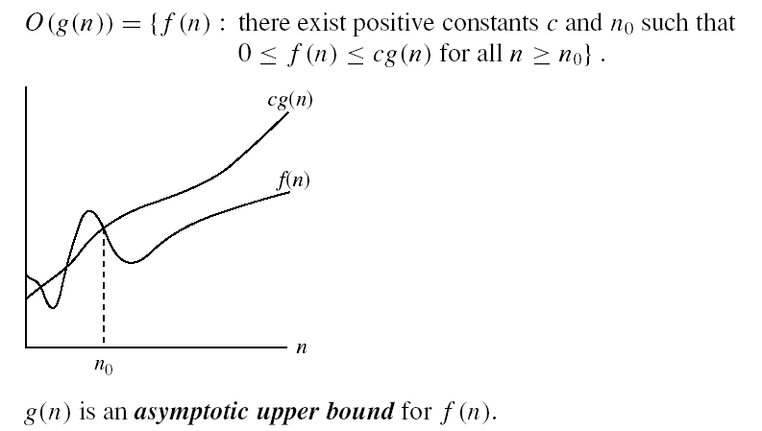
Asymptotic notations
O-notation
f(n)=2n+3<=5n
2n+3<=5n^2

Slide 26
More Examples
Show that 30n+8 is O(n)

Slide 27
Big-O example, graphically
Note 30n+8 isn’t less than n anywhere (n>0).
It isn’t even less than 31n everywhere.
But it is less than 31n everywhere to the right of n=8.
cn = 31n
30n+8
30n+8 ∈O(n)
Value of function →
n
n>n₀=8 →
Increasing n →

Slide 28
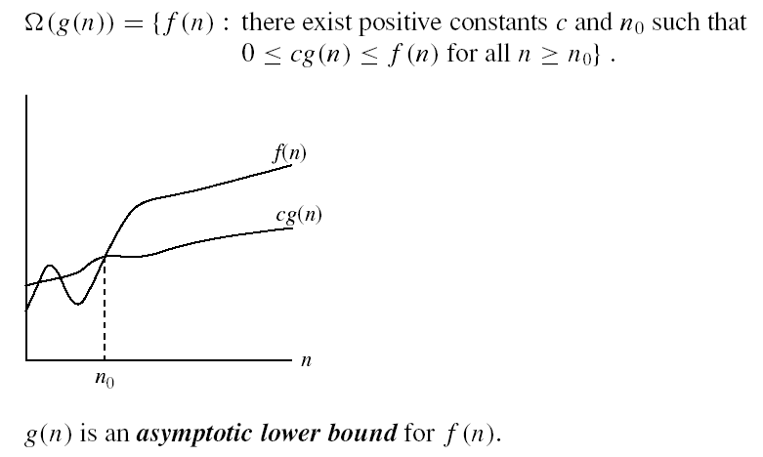
Asymptotic notations (cont.)
Ω - notation
Ω(g(n)) is the set of functions with larger or same order of growth as g(n)
f(n)=2n+3>=1n for all n>=1
f(n)=2n+3>=1logn for all n>=1

Slide 29

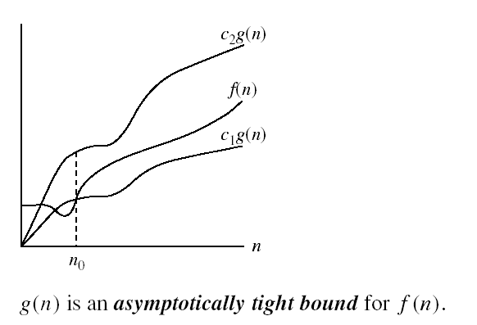
Asymptotic notations (cont.)
Θ-notation
Θ(g(n)) is the set of functions with the same order of growth as g(n)
1n<=2n+3<=5n

Slide 30
Searching

Slide 31
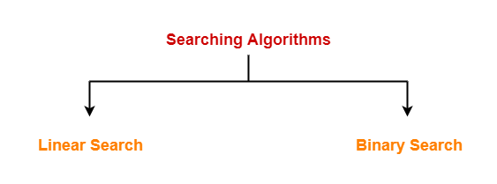
Searching
Searching Algorithms are a family of algorithms used for the purpose of searching.
The searching of an element in the given array may be carried out in the following two ways-

Slide 32
Linear Searching
The sequential or linear search is a simple and straightforward technique to search a specified item in an unordered list.
The specified value is searched in the list sequentially, i.e., starting from the first element to the last clement in the list in a sequence.
When the required value is found, search operation stops.
The sequential search is a slow process.
It is used for small amounts of data. This method is not recommended for large amount of data.

Slide 33
Linear Search
SET LOC -1 //to control location
[Enter value that is to be searched] INPUT ITEM
REPEAT STEP-4 FOR I =0 TO N -1
IF ITEM =ARRAY[I] THEN LOC = I
PRINT "Data found at location ", LOC
EXIT
END IF [End of step-3 loop]
5. IF LOC -1 THEN
RINT "Item not Found“
EXIT
END IF
For n elements the algorithm takes order of n time
Worst case O(n)
Best Case O(1)
Average case O(n/2)

Slide 34
Binary Search
It is a more efficient technique to search a specific item from sorted list of items.
It is mostly used for relatively large lists or table of records that are sorted in ascending or descending order.
A binary search begins by searching the required value from the middle of the list.
If the required value is in the middle of the list, then search process terminates at that point.
If the list is sorted in ascending order and the required value is greaten than the value at the middle, the control goes to the higher value to search the required value.
Similarly, if the list is sorted in ascending order and the required value is less than the value at the middle, the control goes to the lesser values to search the required value. In both cases, half of the list is searched to find the required value.

Slide 35
Binary Search
Requires a sorted array or a binary search tree.
Cuts the “search space” in half each time.
Keeps cutting the search space in half until the target is found or has exhausted the all possible locations.
Inappropriate for linked lists because linked lists lack random access.

Slide 36
The Algorithm
look at “middle” element
if no match then
look left or right
1 7 9 12 33 42 59 76 81 84 91 92 93 99

Slide 37
The Algorithm
look at “middle” element
if no match then
look left or right
1 7 9 12 33 42 59 76 81 84 91 92 93 99

Slide 38
The Algorithm
look at “middle” element
if no match then
look left or right
1 7 9 12 33 42 59 76 81 84 91 92 93 99

Slide 39
The Algorithm
look at “middle” element
if no match then
look left or right
1 7 9 12 33 42 59 76 81 84 91 92 93 99

Slide 40
SET LOC =1
Enter value to be ,earthed) INPUT ITEM
MID (0+ N)/2
IF ITEM=ARRAY[MID] THEN
PRINT "Value found at middle"
EXIT
END IF
5. IF ITEM > ARRAY[MID] THEN
REPEAT FOR I=MID+1 TO N
IF ITEM= ARRAY[I]THEN
PRINT "Value at position °, I
EXIT
END IF
ELSE REPEAT POR I=MID-1 TO 0
IF ITEM = ARRAY[I] THEN
PRINT "Value at position ", I
EXIT
END IF
IF LOC =1 THEN
PRINT "Data not found" EXIT END IF

Slide 41
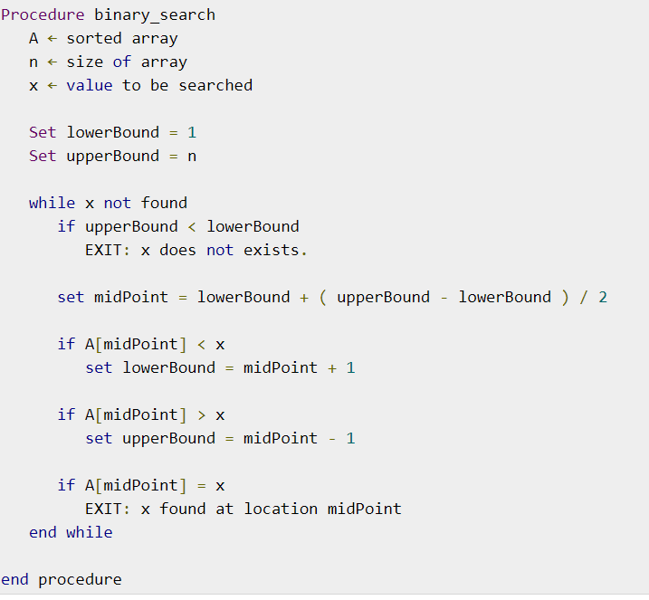

Slide 42
Summary
Binary search reduces the work by half at each comparison
With the array, we need to keep track of which “part” is currently “visible”
We know the element isn’t in the array when our first and last indices “cross”

