Slide 1
Assignment 1: Gradual Implementation of Symbol Table
CSE310: Compiler Sessional Lab
Dr. S. M. Farhad
Associate Professor
CSE, BUET

Slide 2
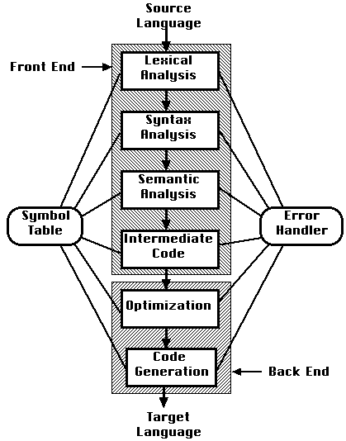
Symbol table
Stores information about the entire source program
It is used by all phases of a compiler

Slide 3
Symbol table
Symbol table will be used to answer two questions:
Given a use of a name, to which declaration does it correspond or is it undeclared?
Given a declaration of a name, is it multiply declared?

Slide 4
What operations do we need?
Look up a name in the symbol table
Insert a new name into the symbol table with its attributes
Dump or display all the information of the table

Slide 5
Implementation
Class SymbolInfo
Storing information (name, type) about the symbol or token
Class SymbolTable
Since our symbol table will be a hash-table based on chaining, we will have to start with an array of pointers where each pointer points to a list of nodes of type class SymbolInfo

Slide 6
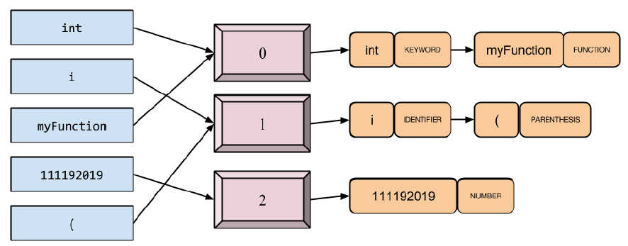
Symbol table data structure

Slide 7
Methods of SymbolTable
insert(): to insert a new symbol along with its type into the symbol table
lookup(): to lookup whether a given symbol already exists in the symbol table or not
dump(): to dump the contents of the symbol table to the console

Slide 8
Sample input
int, KEYWORD
myFunction, FUNCTION
x, IDENTIFIER
111192019, NUMBER
(, PARENTHESIS

Slide 9
Submission policy
Use dynamic memory allocation
Install a Linux environment
Write explanatory comments and design extensive test cases
Copy detection software will be used

Slide 10
Submission method
Input
Lookup
Insert
Dump

Slide 11
Evaluation
Online requirement will be added to the assignment and a time will be given
Offline: 40% marks are allocated for offline assignment
Online: 60% marks are allocated for online assignment

Slide 12
Deadline
Next sessional class only
Submissions after the deadline will not be accepted

Slide 13
Questions?

