Slide 1
PL/SQL

Slide 2
What is PL/SQL
Procedural Language – SQL
An extension to SQL with design features of programming languages (procedural and object oriented)
PL/SQL and Java are both supported as internal host languages within Oracle products.
Process query results in a tuple-oriented way

Slide 3
Why PL/SQL
Acts as host language for stored procedures and triggers.
Provides the ability to add middle tier business logic to client/server applications.
Provides Portability of code from one environment to another
Improves performance of multi-query transactions.
Provides error handling
Reduce the cost for maintaining and changing applications.

Slide 4
When is PL/SQL handy?
When something is too complicated for SQL
When conditional branching and looping are needed
Example
Write a PL/SQL program that assigns email address to each employee or student in a table. Following these rules:
- email address should be all lower case
- email address should default to first initial plus the first seven letters of the last name
- email can be no longer than eight characters
- if email is already used than use first initial plus middle initial plus first
six letters of last name
- if the previous address is taken use the first two letters of the first name
and the first six letters of the last name.
- if the previous address is taken use first six letters of last name + 01 or 02 …etc

Slide 5
PL/SQL BLOCK STRUCTURE
DECLARE (optional)
- variable declarations
BEGIN (required)
- SQL statements
- PL/SQL statements or sub-blocks
EXCEPTION (optional)
- actions to perform when errors occur
END; (required)
/ (required)

Slide 6
PL/SQL Block Types
Anonymous
DECLARE
BEGIN
-statements
EXCEPTION
END;
Procedure
PROCEDURE <name>
IS
BEGIN
-statements
EXCEPTION
END;
Function
FUNCTION <name>
RETURN <datatype>
IS
BEGIN
-statements
EXCEPTION
END;
Not stored since it cannot be referenced by a name
These are stored since these can be referenced by a name

Slide 7
PL/SQL Variable Types
Scalar (char, varchar2, number, date, etc)
Composite (%rowtype)
Reference (pointers)
LOB (large objects)

Slide 8
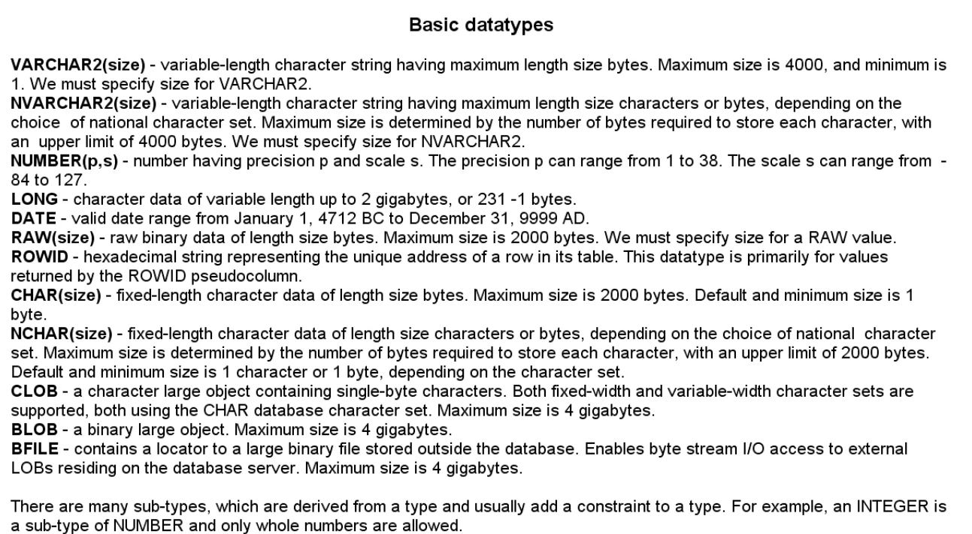

Slide 9
Variable Naming Conventions
Two variables can have the same name if they are in different blocks (bad idea)
The variable name should not be the same as any table column names used in the block.

Slide 10
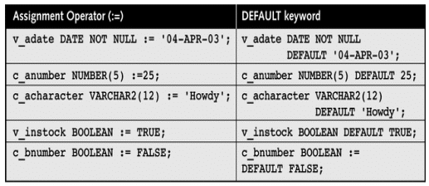
Variable Initialization Examples

Slide 11
PL/SQL is strongly typed
All variables must be declared before their use.
The assignment statement
: =
is not the same as the equality operator
=
All statements end with a ;

Slide 12
PL/SQL Sample Program
DECLARE
g_inv_value number(10,2)
v_price number(8,2) := 10.25;
v_quantity number(8,0) := 400;
BEGIN
g_inv_value := v_price * v_quantity;
END;
/

Slide 13
PL/SQL Sample Program
Set serveroutput on
DECLARE
v_inv_value number(10,2);
v_price number(8,2) := 10.25;
v_quantity number(8,0) := 400;
BEGIN
v_inv_value := v_price * v_quantity;
dbms_output.put('The value is: ');
dbms_output.put_line(v_inv_value);
END;
/

Slide 14
PL/SQL Sample Program
(with user input)
Set serveroutput on
Accept p_price Prompt 'Enter the Price: '
DECLARE
v_inv_value number(8,2);
v_price number(8,2);
v_quantity number(8,0) := 400;
BEGIN
v_price := &p_price;
v_inv_value := v_price * v_quantity;
dbms_output.put_line('******');
dbms_output.put_line('price * quantity=');
dbms_output.put_line(v_inv_value);
END;
/
Note: PL/SQL not designed for user interface programming

Slide 15
PL/SQL Comments
DECLARE
v_salary number(9,2) := 40000;
BEGIN
/* this is a multi-line comment that
will be ignored by the pl/sql
interpreter */
v_salary := v_salary * 2; -- nice raise
END; -- end of program

Slide 16
COMMON PL/SQL STRING FUNCTIONS
CHR(asciivalue)
ASCII(string)
LOWER(string)
SUBSTR(string,start,substrlength)
LTRIM(string)
RTRIM(string)
LPAD(string_to_be_padded, spaces_to_pad, |string_to_pad_with|)
RPAD(string_to_be_padded, spaces_to_pad, |string_to_pad_with|)
REPLACE(string, searchstring, replacestring)
UPPER(string)
INITCAP(string)
LENGTH(string)

Slide 17
COMMON PL/SQL NUMERIC FUNCTIONS
ABS(value)
ROUND(value, precision)
MOD(value,divisor)
SQRT(value)
TRUNC(value,|precision|)
LEAST(exp1, exp2…)
GREATEST(exp1, exp2…)

Slide 18
%ROWTYPE
Set serveroutput on
DECLARE
v_student students%rowtype;
BEGIN
select * into v_student
from students
where sid='123456';
DBMS_OUTPUT.PUT_LINE (v_student.lname);
DBMS_OUTPUT.PUT_LINE (v_student.major);
DBMS_OUTPUT.PUT_LINE (v_student.gpa);
END;
/

Slide 19
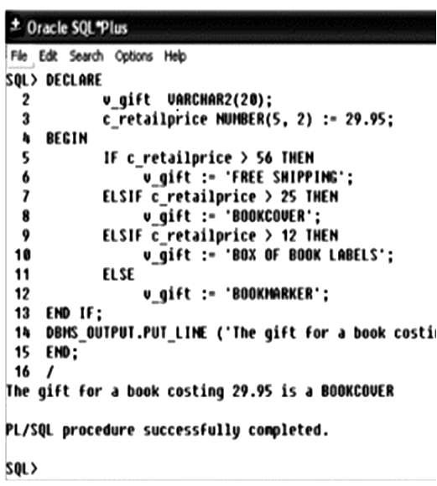
CONDITIONAL STATEMENT
(IF-THEN ELSE)
  IF <condition 1> THEN
  <command 1>
  ELSIF <condition 2> THEN
  <command 2>
  ELSE
  <command 3>
  END IF;

Slide 20
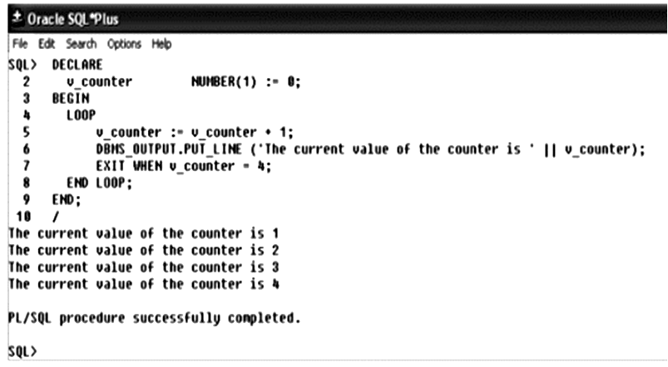
Basic Loop
  LOOP
  Statements;
  EXIT[WHEN condition];
  END LOOP;

Slide 21
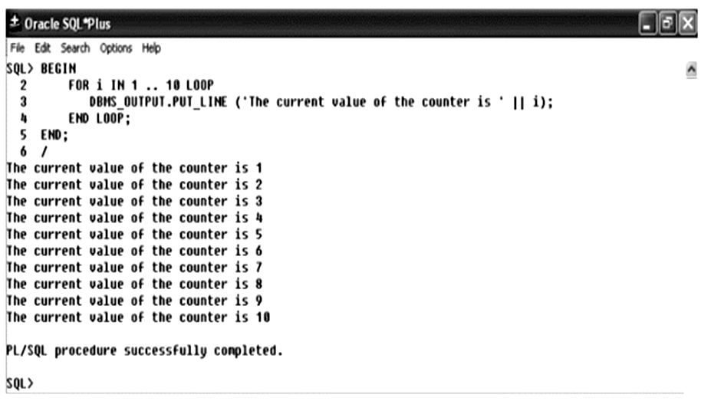
FOR Loop

Slide 22
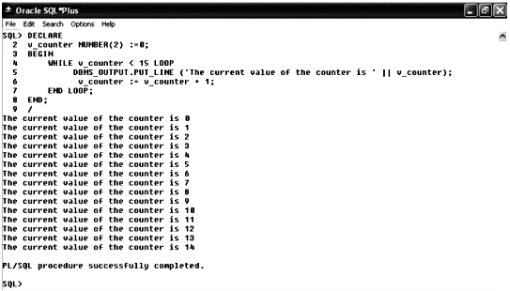
WHILE Loop

Slide 23
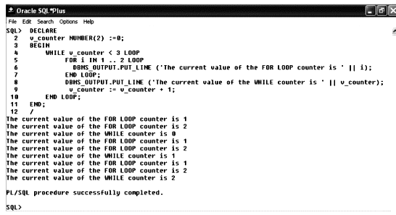
Nested Loops

Slide 24
Continue
You can use the continue statement within loops to exit the current iteration of the loop and transfer control to the next iteration.
For example, if you iterate through a set of counter values, you can skip specific values without exiting the loop entirely.
The two forms of the continue statement are continue and continue when.
The when portion provides the condition to be evaluated.
If the condition is true, the current iteration of the loop will complete and control will pass to the next iteration.

Slide 25
Continue when
declare
pi constant NUMBER(9,7) := 3.1415927;
radius INTEGER(5);
area NUMBER(14,2);
begin
radius := 1;
loop
continue when radius < 5;
area := pi*power(radius,2);
insert into AREAS values (radius, area);
radius := radius+1;
exit when area >100;
end loop;
end;
/

Slide 26
SELECT INTO
SET SERVEROUTPUT ON
DECLARE
v_max_gpa number(3,2);
v_numstudents number(4);
v_lname students.lname%type;
v_major students.major%type;
BEGIN
select max(gpa) into v_max_gpa
from students;
DBMS_OUTPUT.PUT_LINE ('The highest GPA is '||v_max_gpa);
select count(sid) into v_numstudents
from students
where gpa = v_max_gpa;
IF v_numstudents > 1 THEN
DBMS_OUTPUT.PUT_LINE ('There are '||v_numstudents||' with that GPA');
ELSE
select lname, major into v_lname, v_major
from students
where gpa=v_max_gpa;
DBMS_OUTPUT.PUT_LINE ('The student name is '||v_lname);
DBMS_OUTPUT.PUT_LINE ('The student major is '||v_major);
END IF;
END;
/
students
sid | lname | major | gpa

Slide 27
Problem of previous SELECT
It is important to ensure that the select statement retrieves at most one tuple!
Otherwise it is not possible to assign the attribute values to the specified list of variables and a runtime error occurs.
If the select statement retrieves more than one tuple, a cursor must be used instead.
Furthermore, the data types of the specified variables must match those of the retrieved attribute values.
For most data types, PL/SQL performs an automatic type conversion (e.g., from integer to real).

Slide 28
CURSORS
A cursor is a private set of records
An Oracle Cursor = VB recordset = JDBC ResultSet
Implicit cursors are created for every query made in Oracle
Explicit cursors can be declared by a programmer within PL/SQL.
When a query returns multiple rows, defining a cursor allows us to
process beyond the first row returned
keep track of which row is currently being processed

Slide 29
Cursor Attributes
cursorname%ROWCOUNT Rows returned so far
cursorname%FOUND One or more rows retrieved
cursorname%NOTFOUND No rows found
Cursorname%ISOPEN Is the cursor open

Slide 30
Explicit Cursor Control
Declare the cursor
Open the cursor
Fetch a row
Test for end of cursor
Close the cursor
Note: there is a FOR LOOP available with an implicit fetch

Slide 31
Sample Cursor Program
DECLARE
CURSOR students_cursor IS
SELECT * from students;
v_student students_cursor%rowtype;
/* instead we could do v_student students%rowtype */
BEGIN
DBMS_OUTPUT.PUT_LINE ('******************');
OPEN students_cursor;
FETCH students_cursor into v_student;
WHILE students_cursor%found LOOP
DBMS_OUTPUT.PUT_LINE (v_student.last);
DBMS_OUTPUT.PUT_LINE (v_student.major);
DBMS_OUTPUT.PUT_LINE ('******************');
FETCH students_cursor into v_student;
END LOOP;
CLOSE students_cursor;
END;
/

Slide 32
Sample Cursor Program
(same program without composite variable)
DECLARE
CURSOR students_cursor IS
SELECT last, major from students;
v_Last students.last%type;
v_major students.major%type;
BEGIN
DBMS_OUTPUT.PUT_LINE ('******************');
OPEN students_cursor;
FETCH students_cursor into v_last, v_major;
WHILE students_cursor%found LOOP
DBMS_OUTPUT.PUT_LINE (v_last);
DBMS_OUTPUT.PUT_LINE (v_major);
DBMS_OUTPUT.PUT_LINE ('******************');
FETCH students_cursor into v_last, v_major;
END LOOP;
CLOSE students_cursor;
END;
/

Slide 33
Cursor FOR Loops
  DECLARE
    CURSOR emp_cursor IS
    SELECT employee_id, employee_name, sal
    FROM employee
    WHERE employee_name LIKE 'E%';
    BEGIN
    for emp_val in emp_cursor
    LOOP
    emp_sal := emp_val.sal;
    DBMS_OUTPUT.PUT_LINE(emp_val.employee_id);
    END LOOP;
    END;
    /

Slide 34
Cursor FOR Loops
    In a Cursor FOR Loop, there is no open or fetch command.
    A record suitable to store a tuple fetched by the cursor is implicitly declared.
    Note that emp_val is not explicitly declared in the block.
    Furthermore, this loop implicitly performs a fetch at each iteration as well as an open before the loop is entered and a close after the loop is left.
    If at an iteration no tuple has been fetched, the loop is automatically terminated without an exit.

Slide 35
Closing the Cursor
  Closes the cursor (which must be open)
  There is no longer an active set
  Reopening the same cursor will reset it to point to the beginning of the returned table
  CLOSE <cursor name>;
  CLOSE students_cursor;

Slide 36
Procedure
Sophisticated business rules and application logic can be stored as procedures within Oracle
You may experience performance gains when using procedures for two reasons:
The processing of complex business rules may be performed within the database—and therefore by the server.
Because the procedural code is stored within the database and is fairly static, you may also benefit from the reuse of the same queries within the database

Slide 37
Procedure Basic Syntax
  CREATE [OR REPLACE] PROCEDURE name
  [( argument [IN|OUT|IN OUT] datatype
  [{, argument [IN|OUT|IN OUT] datatype }] )]
  AS
  /* declaration section */
  BEGIN
  /* executable section - required*/
  EXCEPTION
  /* error handling statements */
  END;
  /

Slide 38
Parameter direction
  The optional clauses IN, OUT, and IN OUT specify the way in which the parameter is used. The default mode is IN.
  IN (default) : means that the parameter can be referenced inside the procedure body, but it cannot be changed.
  OUT: means that a value can be assigned to the parameter in the body, but the parameter’s value cannot be referenced. The OUT qualifier signifies that the procedure passes a value back to the caller through this argument.
  IN OUT: allows both assigning values to the parameter and referencing the parameter. A value must be specified for this argument when the procedure is called, and the procedure will return a value to the caller via this argument

Slide 39
Stored Procedures
PL/SQL code stored in the database and executed when called by the user.
Called by procedure name from another PL/SQL block or using EXECUTE from SQL+. For example EXEC SQR(50)
Example:
Create procedure SQR (v_num_to_square IN number)
AS
v_answer number(10);
BEGIN
v_answer := v_num_to_square * v_num_to_square;
dbms_output.put_line(v_answer);
END;
/

Slide 40
Function
PL/SQL user defined function stored in the database and executed when a function call is made in code: example x := SQUARED(50)
A procedure can be deleted using the command
drop procedure <procedure name>
  drop function <function name>
Example:
Create or Replace Function SQUARED
(p_number_to_square IN number)
RETURN number
IS
v_answer number(10);
BEGIN
v_answer := p_number_to_square * p_number_to_square;
RETURN(v_answer);
END;
/

Slide 41
Another Stored Procedure Example
Create or replace procedure mytabs
AS
CURSOR table_cursor IS
Select table_name from user_tables;
v_tablename varchar2(30);
BEGIN
open table_cursor;
fetch table_cursor into v_tablename;
while table_cursor%found loop
dbms_output.put_line(v_tablename);
fetch table_cursor into v_tablename;
end loop;
close table_cursor;
END;

Slide 42
Triggers
Triggers are similar to procedures and functions but will execute automatically based on an event
Events are either DML statements or database system actions
Triggers will fire regardless of the source of the event
DML triggers are specifically associated with a table or view

Slide 43
Triggers
Triggers do not issue transaction control statements (such as commit). Triggers are part of the SQL transaction that invoked them.
Often used to:
    enforce complex constraints, especially multi-table constraints. Financial posting is an example of this.
    Trigger related actions
    implement auditing “logs”
    pop a sequence when creating token keys

Slide 44
Triggers
CREATE OR REPLACE TRIGGER <trigger_name>
[BEFORE/AFTER][DELETE/INSERT/UPDATE of <column_name |, column_name… |>
ON <table_name>
|FOR EACH ROW|
|WHEN <triggering condition>|
|DECLARE|
BEGIN
trigger statements
…………
END;
To delete a trigger use:
DROP TRIGGER <trigger_name>;

Slide 45
Trigger Event
INSERT, UPDATE, DELETE
  Use the OR operator to include more than one event in a trigger
OF column_name option
ON table_name

Slide 46
Correlation Identifiers
Special bind variables associated with DML activity
OLD and NEW by default
DML Event
OLD Identifier
NEW Identifier
INSERT
Not available
Contains insert values
UPDATE
Contains values of the original row
Contains new value for any columns updated and original values for any columns not updated
DELETE
Contains values of the original row
Not Available (Note: "Not Available" indicates any references would retrieve a NULL value)

Slide 47
Log Trigger Example
CREATE OR REPLACE TRIGGER LOGSTUDENTCHANGES
BEFORE INSERT OR DELETE OR UPDATE of Major ON STUDENTS
FOR EACH ROW
DECLARE
v_ChangeType CHAR(1);
v_sid varchar2(10);
BEGIN
IF INSERTING THEN
V_ChangeType := 'I';
v_sid := :new.sid;
ELSIF UPDATING THEN
V_ChangeType := 'U';
v_sid := :new.sid;
ELSE
V_ChangeType := 'D';
v_sid := :old.sid;
END IF;
INSERT INTO MAJ_AUDIT (change_type, changed_by, timestamp,
SID, old_major, new_major)
VALUES (v_ChangeType, USER, SYSDATE, v_sid, :old.major, :new.major);
END LOGSTUDENTCHANGES;

Slide 48
UpperCase Trigger Example
CREATE OR REPLACE TRIGGER UPPERCASE
BEFORE INSERT OR UPDATE ON STUDENTS
FOR EACH ROW
DECLARE
BEGIN
:new.lastname:=UPPER(:new.lastname);
:new.firstname:=UPPER(:new.firstname);
END UPPERCASE;
/

Slide 49
Ben & Jerry Trigger Example
(no employee can make more than 10 times as much as the lowest paid employee)
CREATE OR REPLACE TRIGGER SalaryTrig
BEFORE INSERT ON Employees
FOR EACH ROW
DECLARE
v_upper_sal_limit NUMBER(10,2);
v_lower_sal_limit NUMBER(10,2);
BEGIN
SELECT MIN(salary)*10 INTO v_upper_sal_limit
FROM employees;
SELECT MAX(salary)/10 INTO v_lower_sal_limit
FROM employees;
IF :new.salary NOT BETWEEN v_lower_sal_limit AND v_upper_sal_limit THEN
RAISE_APPLICATION_ERROR(-20001,'salary out of allowed range');
END IF;
END SalaryTrig;
/
Notes: Application error number is a parameter between –20,000 and –20,999.
You could also stop the insert by "poisoning" it, changing a :new
buffer value to one that you know will not pass constraint evaluation.

Slide 50
Mutating Table/Trigger Error
Mutating error normally occurs when we are performing some DML operations and we are trying to select the affected record from the same trigger.
So basically we are trying to select records in the trigger from the table that owns the trigger.
This creates inconsistency and Oracle throws a mutating error.

Slide 51
Mutating Table/Trigger Error
CREATE TABLE TEST AS SELECT * FROM USER_OBJECTS;
CREATE OR REPLACE TRIGGER TUA_TEST
AFTER UPDATE OF STATUS ON TEST
FOR EACH ROW
DECLARE
v_Count NUMBER;
BEGIN
SELECT count(*) INTO v_count FROM TEST
WHERE status = ‘INVALID’;
dbms_output.put_line(‘Total Invalid Objects are‘ || v_count);
END;
/
Now if we try to change the status of any object to ‘INVALID’, we will run into mutating error as we are trying to update the record and trigger is trying to select total number of records in ‘INVALID’ status from the same table.

Slide 52
Mutating Table/Trigger Error
SQL> update test
2 set status = 'INVALID'
3 where object_name = 'TEST1';
update test
ERROR at line 1:
ORA-04091: table SCOTT.TEST is mutating, trigger/function may not see it

Slide 53
Solution
Create statement level trigger instead of row level.
If we omit the ‘for each row’ clause from above trigger, it will
become statement level trigger.
CREATE OR REPLACE TRIGGER TUA_TEST
AFTER UPDATE OF STATUS ON TEST
DECLARE
v_Count NUMBER;
BEGIN
SELECT count(*)
INTO v_count
FROM TEST
WHERE status = ‘INVALID’;
dbms_output.put_line(‘Total Invalid Objects are ‘ || v_count);
END;

Slide 54
Other Solutions
Compound Triggers
Autonomous Transactions
Careful use of Before/After
While playing with triggers you will surely face this problem.
Don’t be shy to ask Google for more information about this problem!!!

Slide 55
System Triggers
DDL and database system events
CREATE
RENAME
COMMENT
ALTER
TRUNCATE
ASSOCIATE STATISTICS
DROP
ANALYZE
DISASSOCIATE STATISTICS
GRANT
AUDIT
REVOKE
NOAUDIT

Slide 56
System Trigger Syntax
CREATE [OR REPLACE] TRIGGER trigger_name
[BEFORE, AFTER]
[List of DDL or Database System Events]
[ON DATABASE | SCHEMA]
Trigger body;
ON DATABASE – will cause trigger to fire regardless of schema in which the trigger event originated
ON SCHEMA – only fires when event occurs in the same schema in which the trigger was created

Slide 57
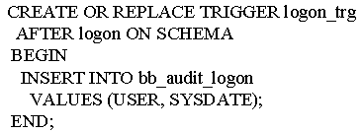
System Trigger Example

Slide 58
Exception Handling
  A PL/SQL block may contain statements that specify Exception handling routines.
  Each error or warning during the execution of a PL/SQL block raises an exception.
  One can distinguish between two types of exceptions:
  system defined exceptions
  user defined exceptions

Slide 59
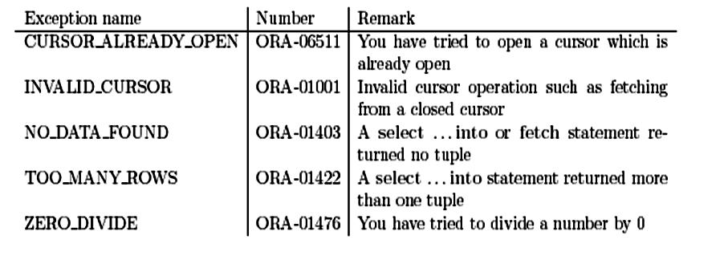
System Defined Exceptions
  System defined exceptions are always automatically raised whenever corresponding errors or warnings occur.

Slide 60
User Defined Exceptions
  User defined exceptions, in contrast, must be raised explicitly in a sequence of statements using raise <exception name>.
  After the keyword exception at the end of a block, user defined exception handling routines are implemented.
  An implementation has the pattern
  when <exception name> then <sequence of statements>;

Slide 61
Exception Handling
  declare
  pi constant NUMBER(9,7) := 3.1415927;
  radius INTEGER(5);
  area NUMBER(14,2);
  some_variable NUMBER(14,2);
  begin
  radius := 3;
  loop
  some_variable := 1/(radius-4);
  area := pi*power(radius,2);
  insert into AREAS values (radius, area);
  radius := radius+1;
  exit when area >100;
  end loop;
  end;
  /

Slide 62
User Defined Exceptions
  Because the calculation for some_variable involves division, you may encounter a situation in which the calculation attempts to divide by zero—an error condition .
        ERROR at line 1:
        ORA-01476: divisor is equal to zero
        ORA-06512: at line 9
  Because an error was encountered, the first row inserted into AREAS is rolled back, and the PL/SQL block terminates.
  You can modify the processing of the error condition by adding an Exception Handling section to the PL/SQL block, as shown next.

Slide 63
Exception Handling
  declare
  pi constant NUMBER(9,7) := 3.1415927;
  radius INTEGER(5);
  area NUMBER(14,2);
  some_variable NUMBER(14,2);
  begin
  radius := 3;
  loop
  some_variable := 1/(radius-4);
  area := pi*power(radius,2);
  insert into AREAS values (radius, area);
  radius := radius+1;
  exit when area >100;
  end loop;
  exception
  when ZERO_DIVIDE
  then insert into AREAS values (0,0);
  end;
  /

Slide 64
Exception Handling
  declare
  emp_sal NUMBER(10,3);
  Emp_no VARCHAR2(12);
  too_high_sal exception;
  begin
  select EMPLOYEE_ID, SALARY into emp_no, emp_sal
  from EMPLOYEE where EMPLOYEE_NAME = ’E_Y’;
  if emp_sal * 1.05 > 2000 then raise too_high_sal;
  end if;
  exception
  when NO_DATA_FOUND
  then DBMS_OUTPUT.PUT_LINE(‘No data found’);
  when too_high_sal
  then DBMS_OUTPUT.PUT_LINE(‘High Salary’);
  end;
  /

Slide 65
Exception Handling
When the PL/SQL block encounters an error, it scans the Exception Handling section for the defined exceptions.
After the keyword when a list of exception names, connected with or can be specified.
In addition to the system-defined exceptions and user defined exceptions, you can use the when others clause to address all exceptions not defined within your Exception Handling section.
This introduces the default exception handling routine, for example, a rollback.

Slide 66
Exception Handling
  declare
  emp_sal NUMBER(10,3);
  Emp_no VARCHAR2(12);
  begin
  select EMPLOYEE_ID, SALARY into emp_no, emp_sal
  from EMPLOYEE where EMPLOYEE_NAME = ’E_Y’;
  if emp_sal * 1.05 > 2000
  then raise_application_error(-20010, ’Salary is too high for ’ || to_char(Emp no) );
  end if;
  end;
  /

Slide 67
Viewing Source Code of Procedure
  The source code for existing procedures, functions, packages, and package bodies can be queried from the following data dictionary views:
    USER_SOURCE For procedural objects owned by the user
    ALL_SOURCE For procedural objects owned by the user or to which the user has been granted access
    DBA_SOURCE For all procedural objects in the database
  Select information from the USER_SOURCE view via a query
      select Text
      from USER_SOURCE
      where Name = 'NEW_BOOK'
      and Type = 'PROCEDURE'
      order by Line;

Slide 68
  Output of above query is:
    TEXT
    -----------------------------------------------------------------
    procedure NEW_BOOK (aTitle IN VARCHAR2, aPublisher IN VARCHAR2, aCategoryName IN VARCHAR2)
    as
    begin
    insert into BOOKSHELF (Title, Publisher, CategoryName, Rating) values (aTitle, aPublisher, aCategoryName, NULL);
    delete from BOOK_ORDER
    where Title = aTitle;
    end;
    the USER_SOURCE view contains one record for each line of the NEW_BOOK procedure so should be ordered by with Line.

