Slide 1

Training Management System
Mohammad Ahsanul Islam
Trainee Software Engineer (J2EE) , Bjit
Id: 30073

Slide 2

Our Training Management System (TMS) aims to streamline training coordination, automate batch management, and foster collaboration between trainers and trainees, resulting in efficient and effective training management.

Slide 3

Project Overview
Feature List
Technologies/Tools
Screenshots of the UI
My Learnings from this Project
Challenges and how to solve those

Slide 4
Feature List
User Authentication
Live Group Chat
Trainers and Trainee Registration
Batch and Course Creation
Batch Scheduling and Management
Trainer/Trainee Assignment

Slide 5

Technology / Tools
Back End
Font End
Spring Boot
Spring Security
Jwt Token
Rest Architechture
JPA, Lombok
Hibernate ORM
Multipart Rest
React Js
MUI
React Bootstrap
React Router.
Local Stroage.

Slide 6
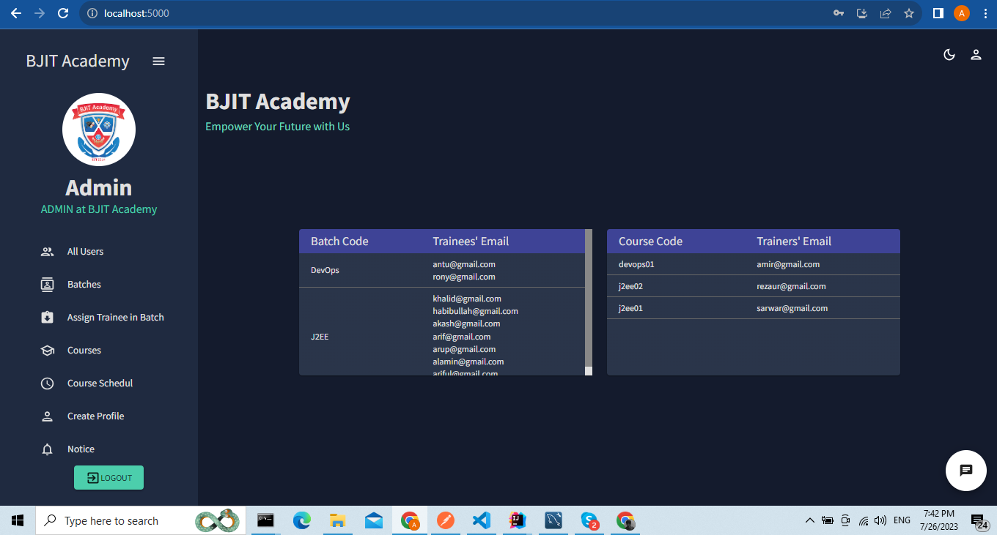
UI

Slide 7
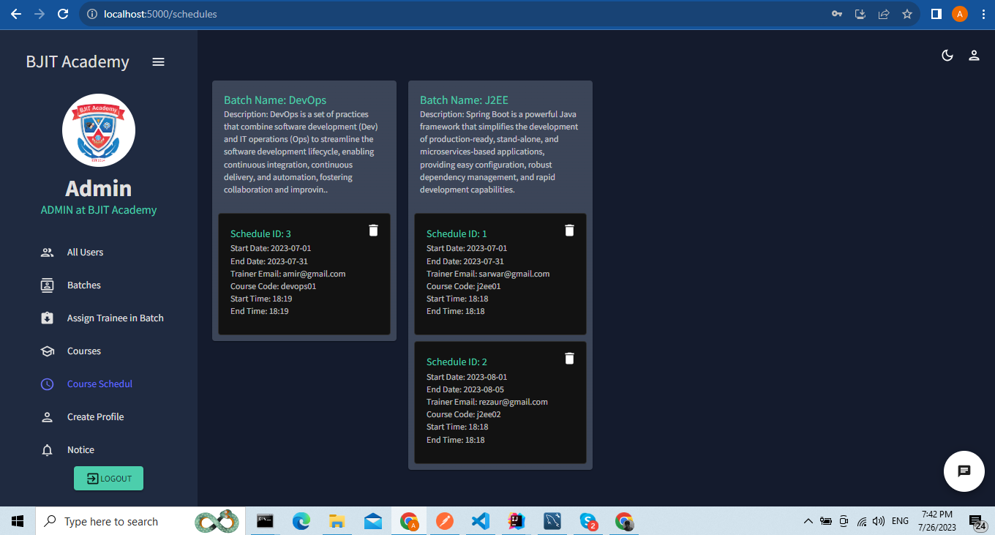

Slide 8
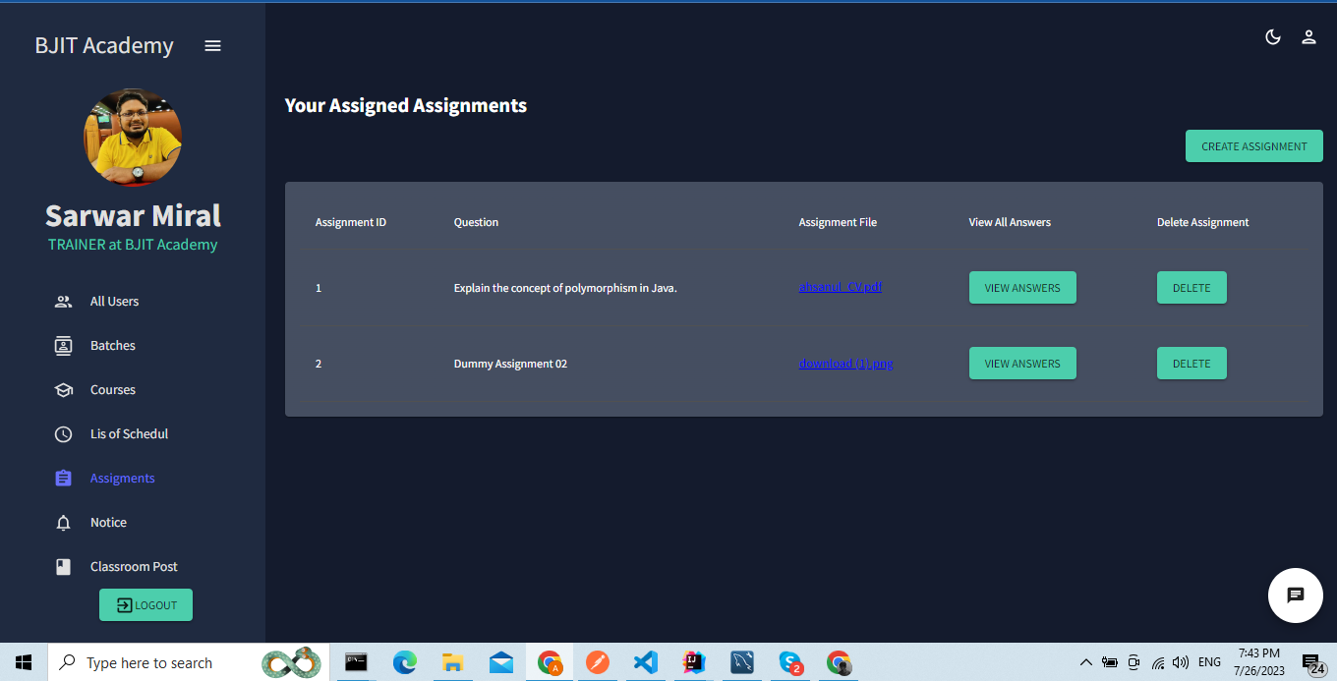

Slide 9
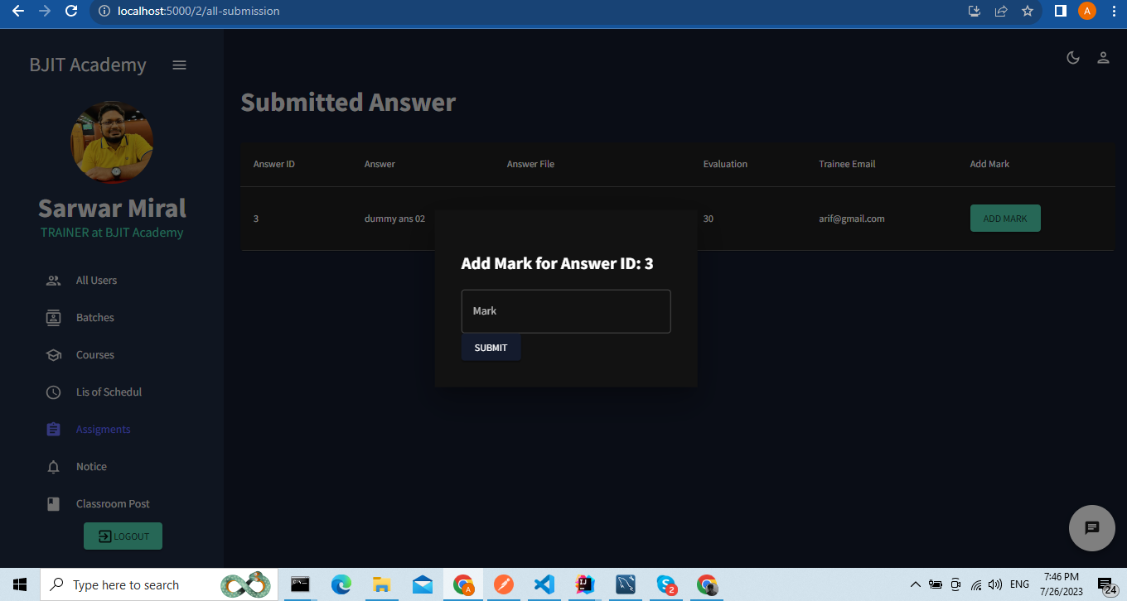

Slide 10
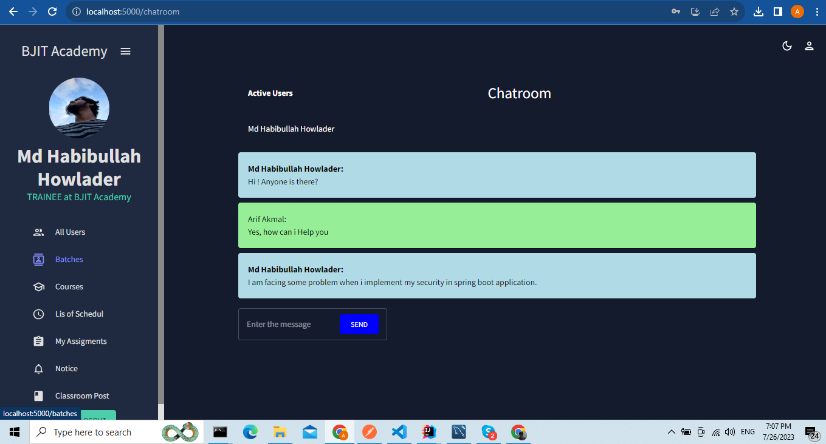

Slide 11
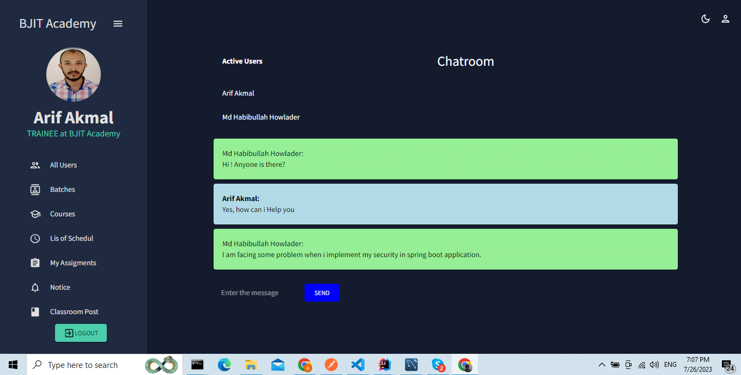

Slide 12
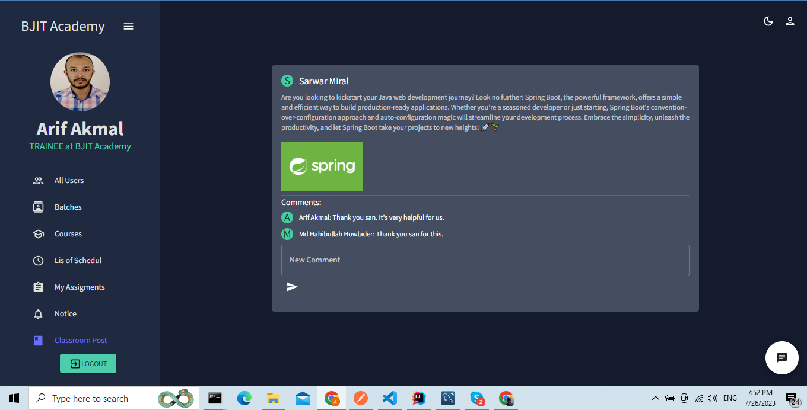

Slide 13

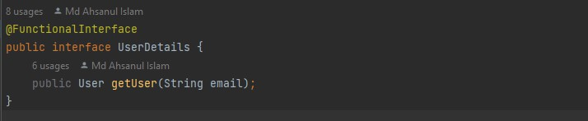
Covered Topic
Lambdra Exception
Functional Interface

Slide 14
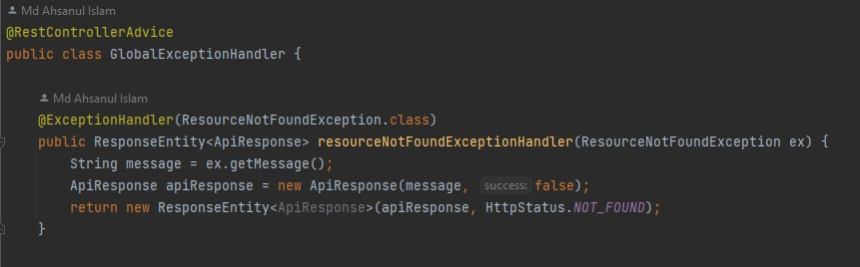
Exception Handling with Annotations

Slide 15
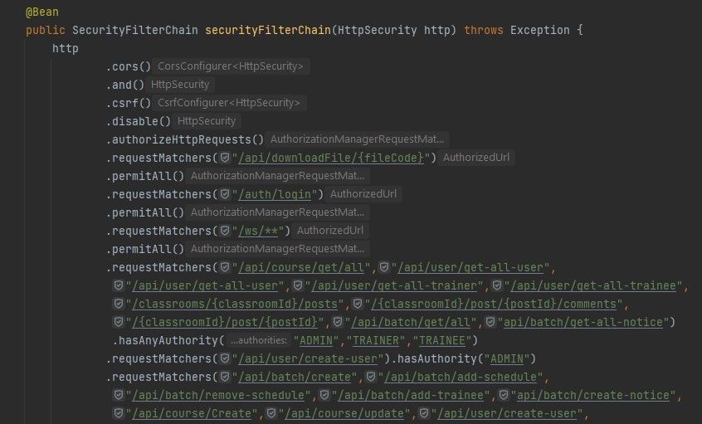
Configure Spring Security

Slide 16
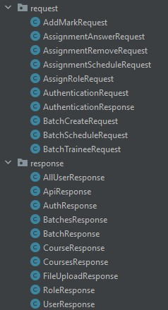
All Request and response model

Slide 17

My Learning
Data Mapping.
Basic Web Socket.
File Upload / Download.
Spring Security.
Able to find solutions by reading errors.

Slide 18
Challenges
Delete any Recourse
Emplementing FontEnd Design

Slide 19
Thank You

