Slide 1
Narrative extraction

Slide 2
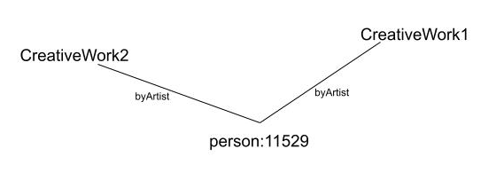
Course of action
Knowledge graph as input
Currently taking .ttl file
Extract all the object properties that are being used
Computationally choose the properties which are of interest to us between two object classes
Currently using frequency and schema.org documentation
Once the properties have been selected, extract all the triples that are using it
Make (sub)graph for each type of property being used. For example:
For each node in the (sub)graphs, assign a weightage to these nodes using some computation
Combine all the (sub)graphs based on the common nodes. The weightage of the common nodes that are being combined on will be added up as well.
Once we have the final graph with nodes having weightages, then traverse through this using relevant algorithm
Currently using node weightages only

Slide 3
Visualization

Slide 4
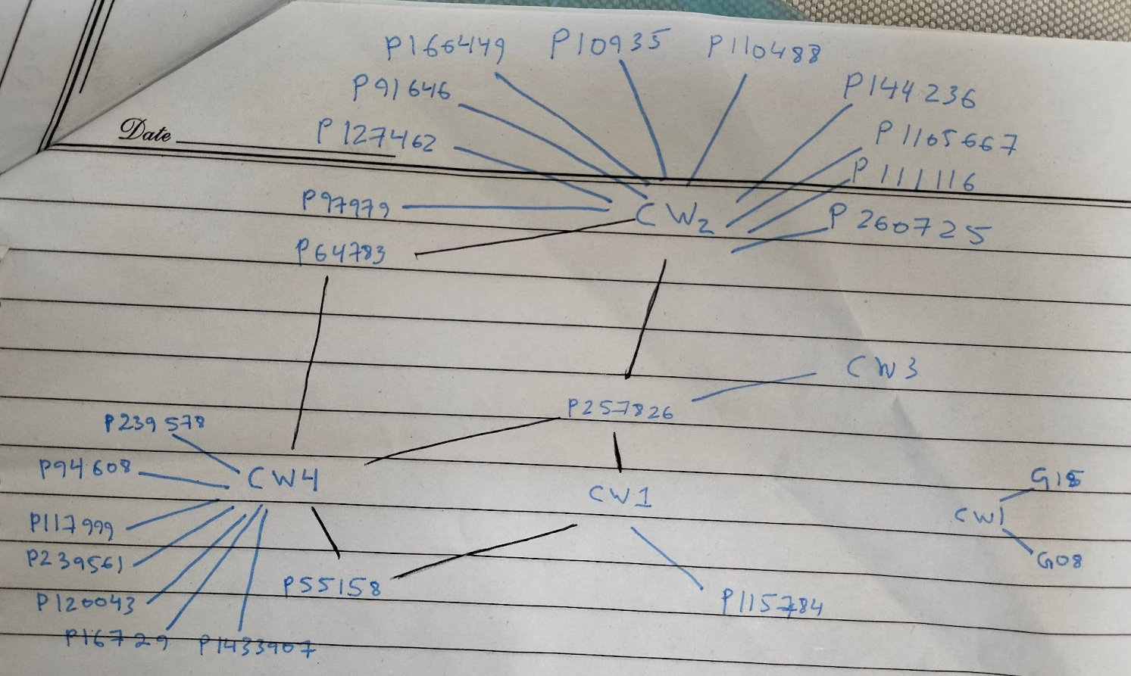
Case study example

Slide 5
Computation
3. Computations based on degree and clustering coefficient
Clustering coefficient is basically looking at how connected your neighbours are to each other (friends of friend's concept). However, that would not be beneficial here so we could look at level-2 clustering coefficients. Basically, looking at all the neighbours that are connected to each other through a shared node.
It is important to also take degrees into account here as well. Because some nodes might have high clustering coefficients but low degree.
Weight = node level-2 clustering coefficient (count)
cw1=2, cw2=2, cw3=0, cw4=3
When new (sub) graph comes then cw1 = 2+0= 2
4. Computations based on eigen-vector centrality (most influential) Feedback loops
Eigen-vector centrality of a node looks at the degrees of its neighbours to see how influential it is.
Weight = feedback score (links give you power)
cw1=7, cw2=16, cw3=4, cw4=15
When new (sub) graph comes then cw1 = 7+2 = 9
Computations based on degree
Assign the degree of each node as the weightage of that node
Weight = node degree
cw1=3, cw2=12, cw3=1, cw4=10
2. When new (sub) graph comes then cw1 = 3+2 = 5
Computations based on degree and cycles
The idea behind this approach is to first get all the cycles in the sub graph
Then using both degree and cycles we construct a formula:
Weight = Number of cyclesx70% + node degreex30%
cw1=3, cw2=5.7, cw3=2.3, cw4=5.1
When new (sub)graph comes then cw1 = 3+0.6 = 3.6

Slide 6
Psuedocode for algorithm
Choose the length of chain
Pick a random node as current
Check if it is creative work
If yes then add this node to visited list
Print all its neighbors
Pick the neighbor which has the highest weightage
Select the creative work of this neighbor with the highest weightage and set it as current
Repeat step 3 till we reach the desired length of chain
Else select the creative work neighbor of this node with the highest weightage
Move to step 3a
Notes:
We don’t want 2 artworks related to the same genre. The idea is to creative narratives between things which are not the same. Focus on the differences between the classes. Should the looping.

Slide 7
Potential
Possible to extract chains of data which have connections between them
Possibility to see how two people are connected to each other
Possibility to see how two creative work are connected to each other
Allows layman users to have an idea of what story is the dataset presenting
Further work
Taking different forms of input
Choosing properties on the basis of some other evaluation
Incorporating the use of edge weightages
Taking dates into account
Make sure all the processes are computationally efficient
Taking into consideration the input of the end user

