Slide 1
RETROFIER Verifier for retrosynthetic pathways
Team:
Aneesha Devulapally
Prakruthi S. Reddy
Sukanya Baichwal

Slide 2
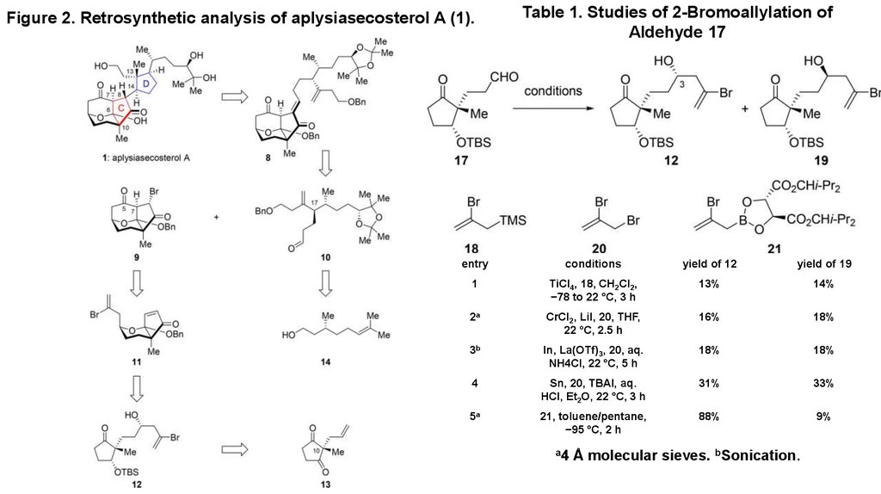
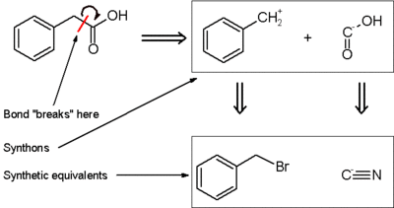
BACKGROUND – Retrosynthetic analysis
https://en.wikipedia.org/wiki/Retrosynthetic_analysis
Retrosynthesis of Aplysiasecosterol A - https://en.ppt-online.org/507062

Slide 3
BACKGROUND – Retrosynthetic analysis
Traditional approach
Chemists identify best paths with the help of their prior knowledge and expertise
Laboratory experiments
Computer-Aided Synthesis Planning
Using Machine Learning techniques to accelerate the planning process
One of the fascinating approaches: Modelling Retrosynthesis as a game and using Reinforcement Learning to play the game

Slide 4
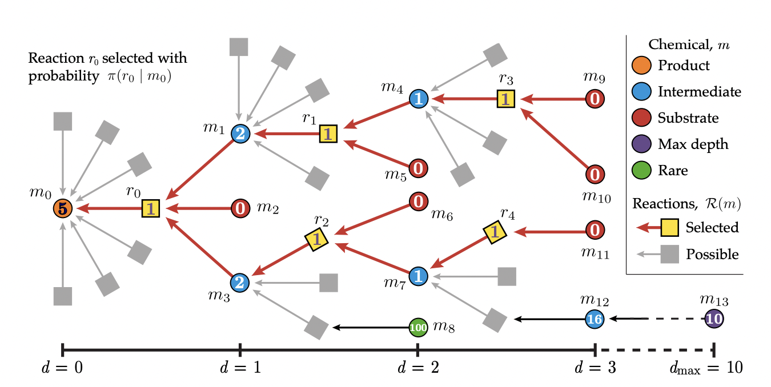

Slide 5
Validating synthesis plans
More often than not, plans produced manually, even with prior knowledge require verification
It then becomes important to verify the plan generated using computer-aided approaches by validating the correctness of the reaction at each step
Computer-aided planning relies a lot on reference templates for each reaction. This is where CSR can be used by designing the atom mapping principles as rules that correspond to those reaction templates
We defined a few predicates and rules that best fit the rules of chemical reactions

Slide 6
Grounds for common-sense reasoning
Is the compound organic?
Does the stoichiometry change?
Is any compound toxic?
Is the target compound a drug?
All molecules should be organic compounds
All the target compounds are assumed to be drugs
Are the starting materials identified commercially available?
Industrial-level toxicity
Relationship between the quantities of reactants and products before, during, after reaction
Checked against a subset of list of commercially available drugs

Slide 7
Assumptions and challenges faced
Assumptions
Single step reaction verification
Toxicity check is done against a list of known toxic compounds
Two-reactant reactions considered
Basic rules of chemical reactions were used
No structure matching
Exact matches only
Representing molecules and reactions
Chemical formulae were used
Eg: C₁₄H₁₈N₆O = C₁₁H₁₂ClN₅O + C₃H₇N
Other standard representations - SMILES
Implementation challenges
To represent composition of molecules, we used prolog dictionary data structure which was not supported yet by s(CASP)

Slide 8
FUTURE SCOPE
The scope of this prototype is basic level of verification. However, in future this can be integrated with softwares like openbabel to incorporate that properties of reactants, along with expert human assistance
Chemical reactions involve more complex conditions for which simple template rules may not be sufficient, owing to the necessity of new templates

Slide 9
Appendix – Data Sources
1. Targets: guidetopharmacology, CHEBI
2. Commercially available molecules: Sigma Aldrich, eMolecules, MolPort
3. Intermediate molecules: ChemSpider and PubChem
4. Toxic compounds: https://webhost.bridgew.edu/c2king/CH489/Lec%203B_Toxicol%20Chem2.pdf

