Slide 1



ATLIQ
ATLIQ
TECHNOLOGIES

Slide 2




AGENDA
Atliq Hardwares (imaginary company) is one of the leading computer hardware producers in India and well expanded in other countries too.
However, the management noticed that they do not get enough insights to make quick and smart data-informed decisions

Slide 3
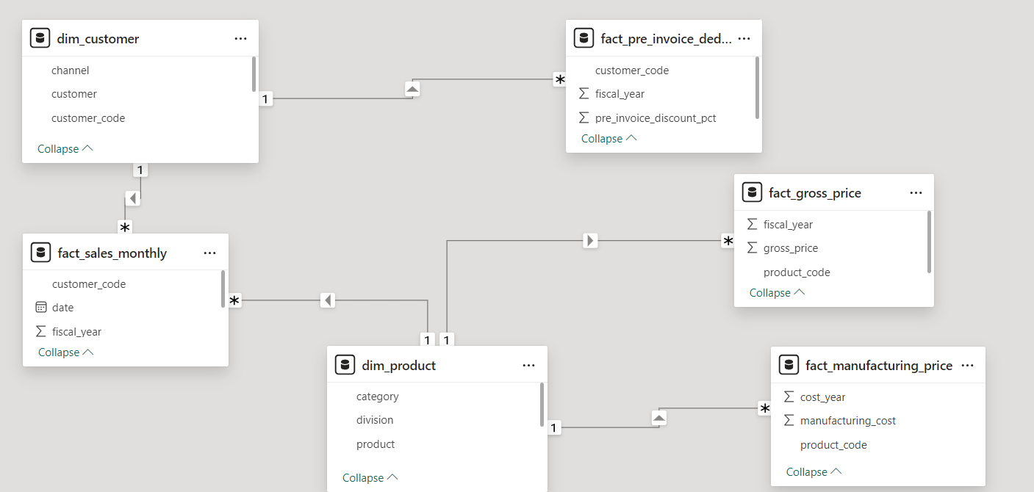
DATA MODEL

Slide 4
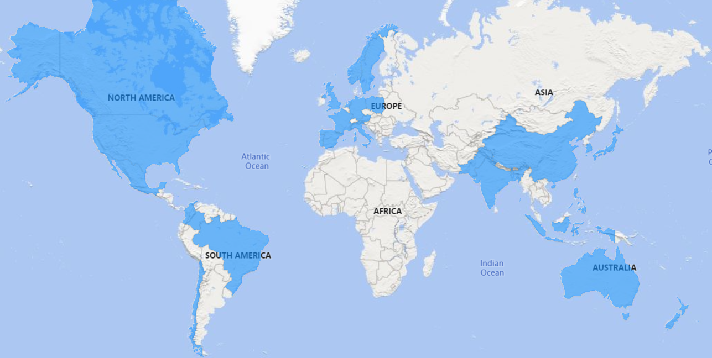
01
PROVIDE THE LIST OF MARKETS IN WHICH CUSTOMER "ATLIQ EXCLUSIVE" OPERATES ITS business in the APAC region
REGIONS WHERE ATLIQ HARDWARES OPERATES

Slide 5
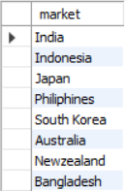
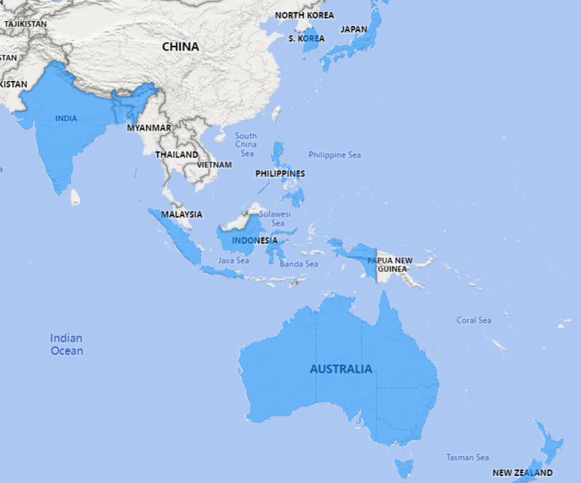
01
PROVIDE THE LIST OF MARKETS IN WHICH CUSTOMER "ATLIQ EXCLUSIVE" OPERATES ITS business in the APAC region
APAC MARKETS

Slide 6
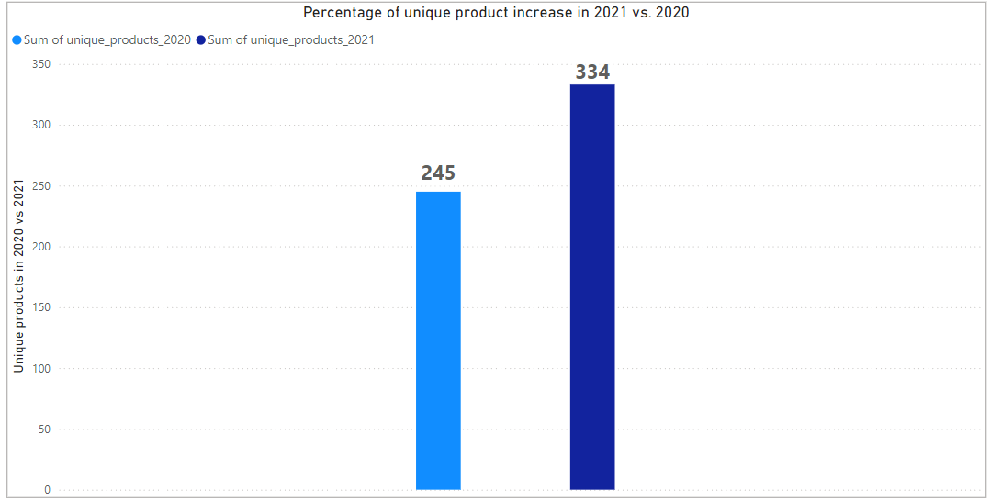

02
WHAT IS THE PERCENTAGE OF UNIQUE PRODUCT INCREASE IN 2021 VS. 2020?
PERCENTAGE OF UNIQUE PRODUCT INCREASE IN 2021 VS. 2020

Slide 7
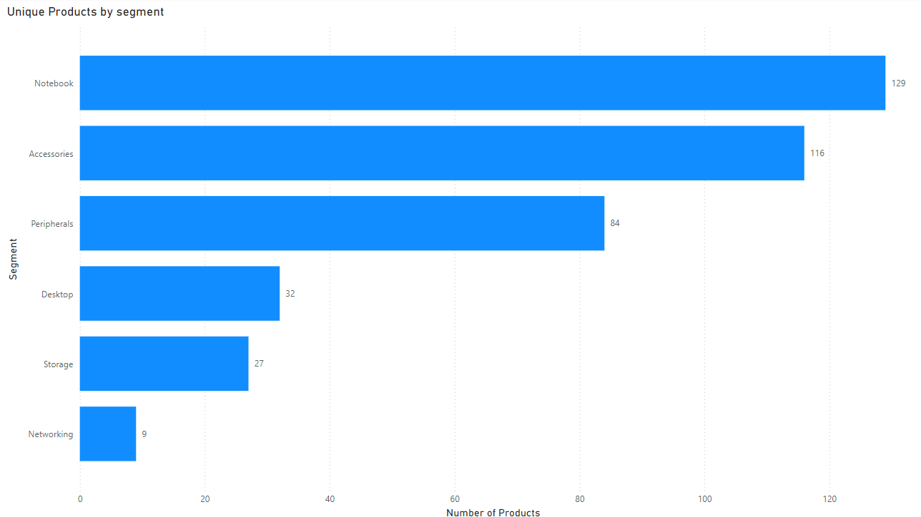
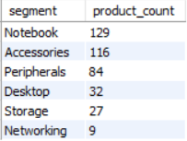
03
PROVIDE A REPORT WITH ALL THE UNIQUE PRODUCT COUNTS FOR EACH SEGMENT AND
sort them in descending order of product counts
UNIQUE PRODUCTS IN EACH SEGMENT

Slide 8
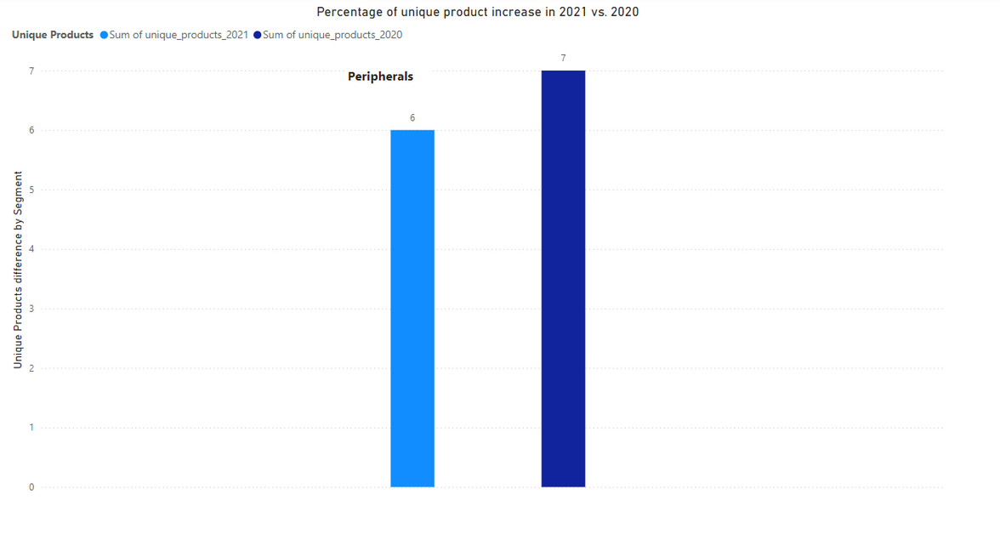
04
WHICH SEGMENT HAD THE MOST INCREASE IN UNIQUE PRODUCTS IN
2021 vs 2020
INCREASE IN UNIQUE PRODUCTS YOY

Slide 9


05
GET THE PRODUCTS THAT HAVE THE HIGHEST AND LOWEST MANUFACTURING COSTS
PRODUCTS WITH HIGHEST AND LOWEST MANUFACTURING COST
HIGHEST
AQ HOME ALLIN1 GEN 2
240.5364
LOWEST
AQ MASTER WIRED X1 MS
0.8920

Slide 10
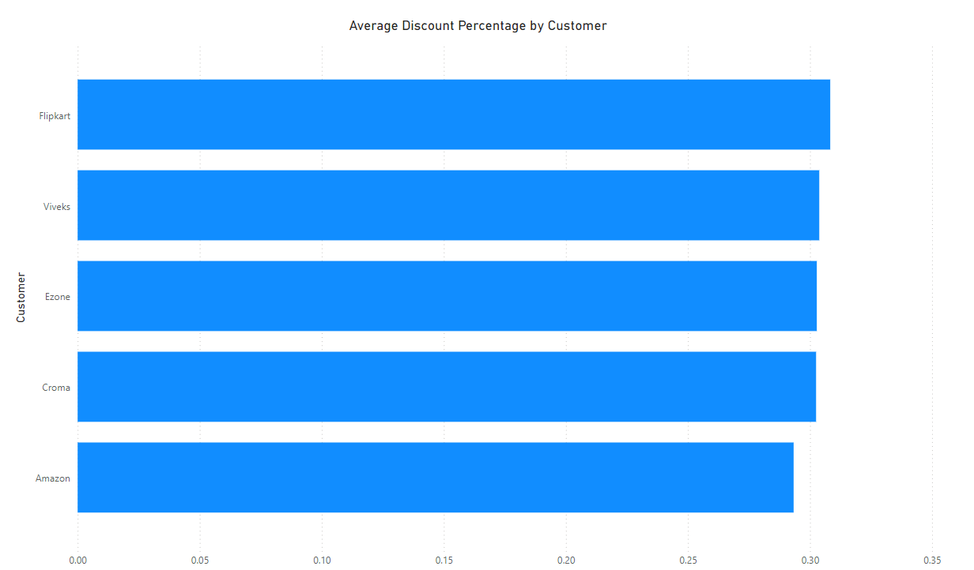
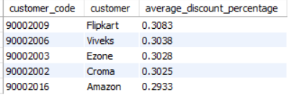
06
GENERATE A REPORT WHICH CONTAINS THE TOP 5 CUSTOMERS WHO RECEIVED AN
average high pre_invoice_discount_pct for the fiscal year 2021 and in the
Indian market
CUSTOMERS WHO RECIEVED HIGH DISCOUNT IN 2021

Slide 11
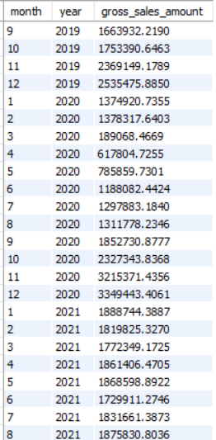
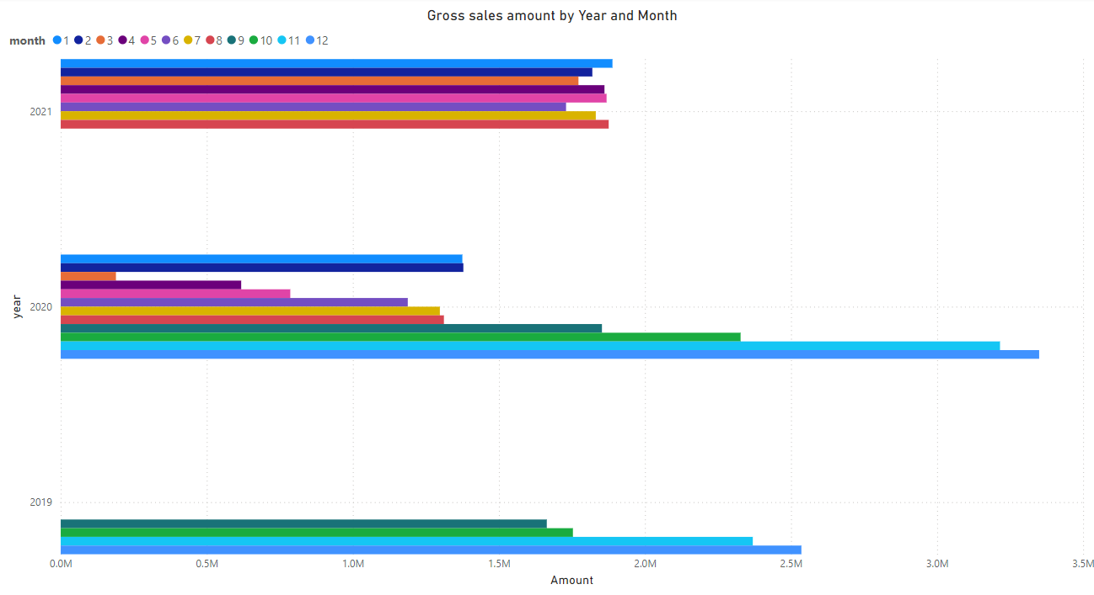
07
GET THE COMPLETE REPORT OF THE GROSS SALES AMOUNT FOR THE CUSTOMER “ATLIQ
Exclusive” for each month
GROSS SALES AMOUNT FROM ATLIQ EXCLUSIVE BY MONTH

Slide 12


08
IN WHICH QUARTER OF 2020, GOT THE MAXIMUM TOTAL_SOLD_QUANTITY
MAXIMUM SALES BY QUARTER

Slide 13
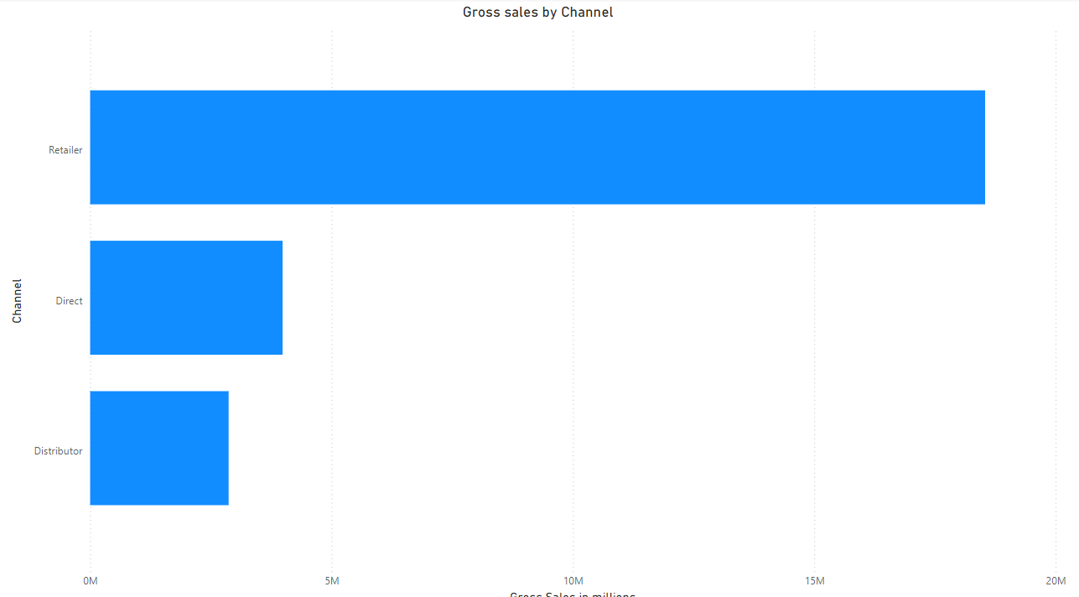

09
WHICH CHANNEL HELPED TO BRING MORE GROSS SALES IN THE FISCAL YEAR 2021
and the percentage of contribution
MAXIMUM SALES BY QUARTER

Slide 14
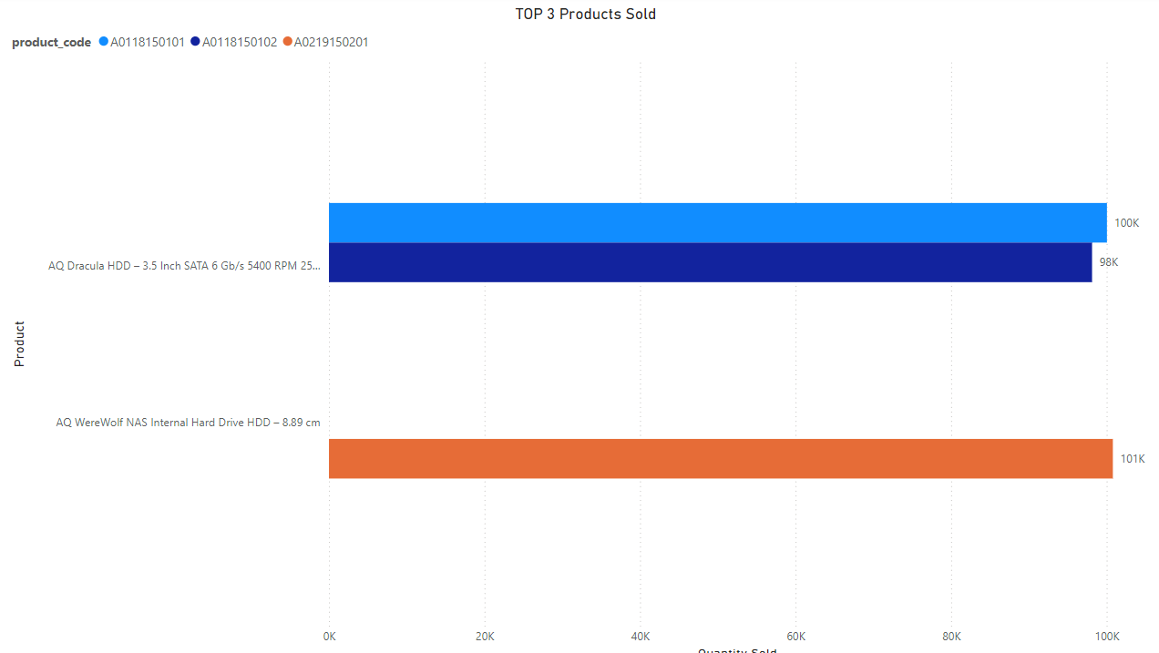

10
GET THE TOP 3 PRODUCTS IN EACH DIVISION THAT HAVE A HIGH
total_sold_quantity in the fiscal_year 2021
HIGHEST SELLING PRODUCTS IN 2021

