Slide 1

Linear Systems
COS 323

Slide 2
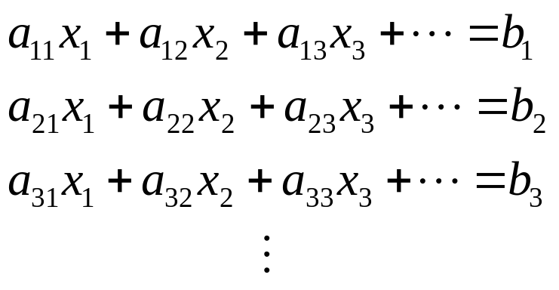
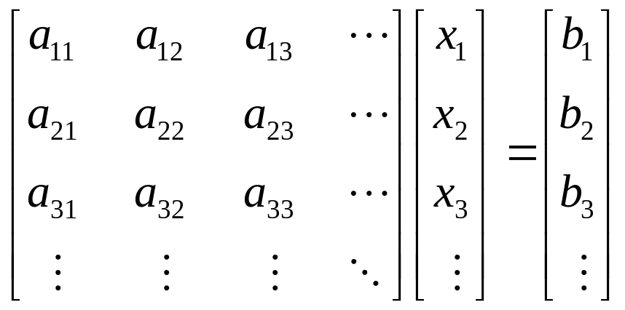
Linear Systems

Slide 3
Linear Systems
Solve Ax=b, where A is an n×n matrix and
b is an n×1 column vector
Can also talk about non-square systems where
A is m×n, b is m×1, and x is n×1
  Overdetermined if m>n:
  “more equations than unknowns”
  Underdetermined if n>m:
  “more unknowns than equations”
  Can look for best solution using least squares

Slide 4
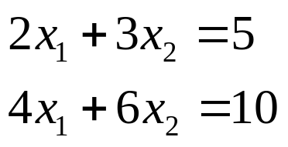
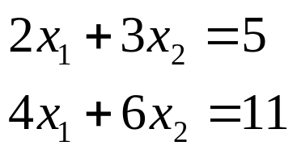
Singular Systems
A is singular if some row is
linear combination of other rows
Singular systems can be underdetermined:
or inconsistent:

Slide 5
Inverting a Matrix
Usually not a good idea to compute x=A⁻¹b
  Inefficient
  Prone to roundoff error
In fact, compute inverse using linear solver
  Solve Ax_{i}=b_{i} where b_{i} are columns of identity,
  x_{i} are columns of inverse
  Many solvers can solve several R.H.S. at once

Slide 6
Gauss-Jordan Elimination
Fundamental operations:
  Replace one equation with linear combination
  of other equations
  Interchange two equations
  Re-label two variables
Combine to reduce to trivial system
Simplest variant only uses #1 operations,
but get better stability by adding
#2 (partial pivoting) or #2 and #3 (full pivoting)

Slide 7
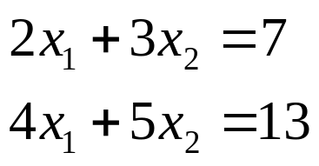
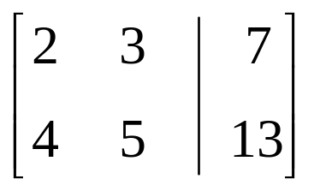
Gauss-Jordan Elimination
Solve:
Only care about numbers – form “tableau” or “augmented matrix”:

Slide 8
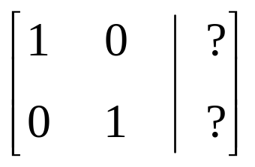
Gauss-Jordan Elimination
Given:
Goal: reduce this to trivial system
and read off answer from right column

Slide 9
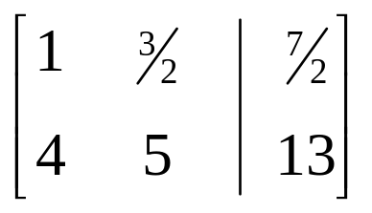
Gauss-Jordan Elimination
Basic operation 1: replace any row by
linear combination with any other row
Here, replace row1 with ¹/₂ * row1 + 0 * row2

Slide 10
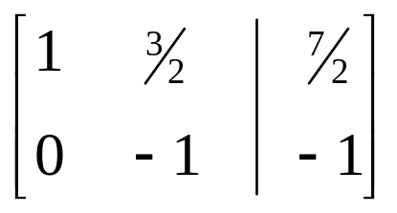
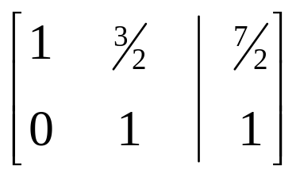
Gauss-Jordan Elimination
Replace row2 with row2 – 4 * row1
Negate row2

Slide 11
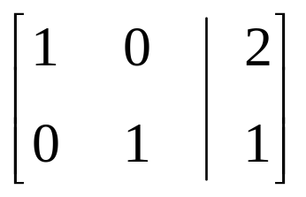
Gauss-Jordan Elimination
Replace row1 with row1 – ³/₂ * row2
Read off solution: x₁ = 2, x₂ = 1

Slide 12
Gauss-Jordan Elimination
For each row i:
  Multiply row i by 1/a_{ii}
  For each other row j:
    Add –a_{ji} times row i to row j
At the end, left part of matrix is identity,
answer in right part
Can solve any number of R.H.S. simultaneously

Slide 13
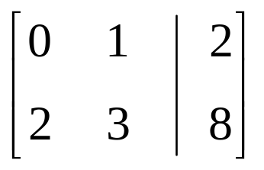
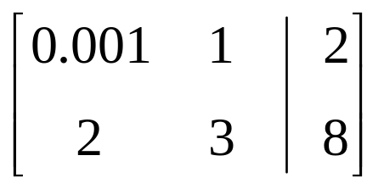
Pivoting
Consider this system:
Immediately run into problem:
algorithm wants us to divide by zero!
More subtle version:

Slide 14
Pivoting
Conclusion: small diagonal elements bad
Remedy: swap in larger element from somewhere else

Slide 15
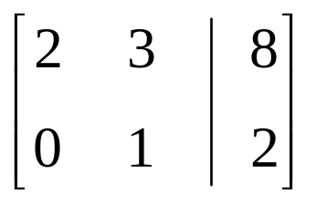
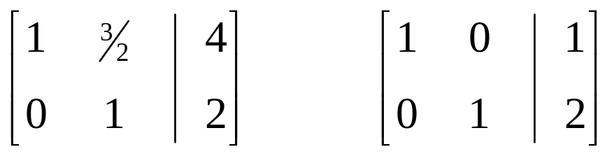
Partial Pivoting
Swap rows 1 and 2:
Now continue:

Slide 16
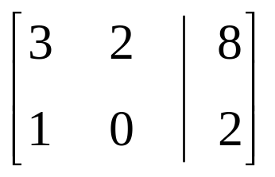
Full Pivoting
Swap largest element onto diagonal by swapping rows 1 and 2 and columns 1 and 2:
Critical: when swapping columns, must remember to swap results!

Slide 17
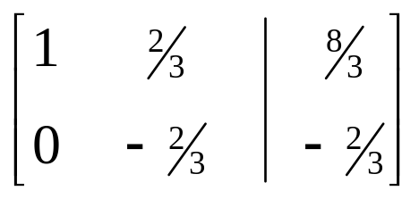
Full Pivoting
Full pivoting more stable, but only slightly
* Swap results
1 and 2

Slide 18
Operation Count
For one R.H.S., how many operations?
For each of n rows:
  Do n times:
    For each of n+1 columns:
      One add, one multiply
Total = n³+n² multiplies, same # of adds
Asymptotic behavior: when n is large, dominated by n³

Slide 19
Faster Algorithms
Our goal is an algorithm that does this in
¹/₃ n³ operations, and does not require
all R.H.S. to be known at beginning
Before we see that, let’s look at a few
special cases that are even faster

Slide 20
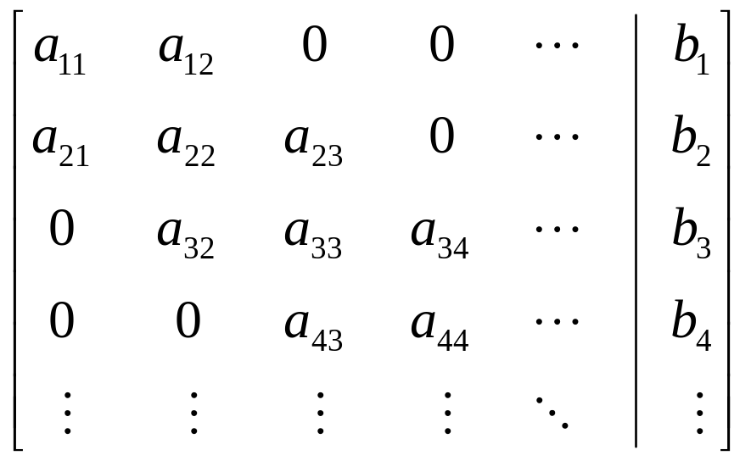
Tridiagonal Systems
Common special case:
Only main diagonal + 1 above and 1 below

Slide 21
Solving Tridiagonal Systems
When solving using Gauss-Jordan:
  Constant # of multiplies/adds in each row
  Each row only affects 2 others

Slide 22
Running Time
2n loops, 4 multiply/adds per loop
(assuming correct bookkeeping)
This running time has a fundamentally different dependence on n: linear instead of cubic
  Can say that tridiagonal algorithm is O(n) while
  Gauss-Jordan is O(n³)

Slide 23
Big-O Notation
Informally, O(n³) means that the dominant term for large n is cubic
More precisely, there exist a c and n₀ such that running time ≤ c n³
if
n > n₀
This type of asymptotic analysis is often used
to characterize different algorithms

Slide 24
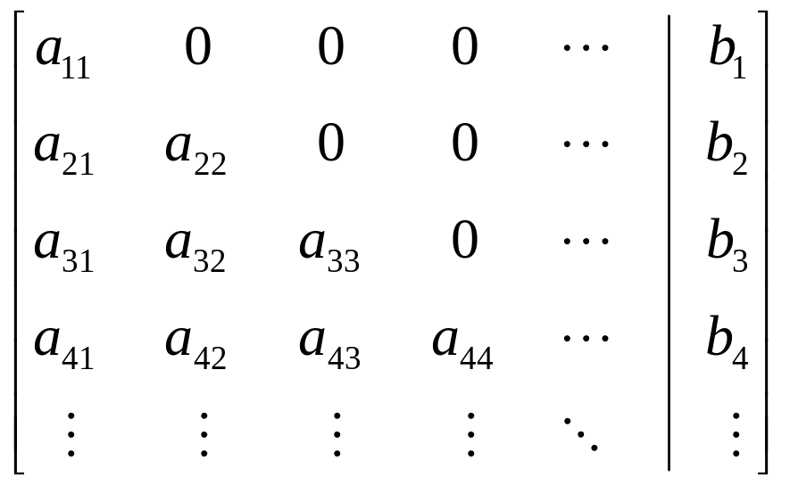
Triangular Systems
Another special case: A is lower-triangular

Slide 25
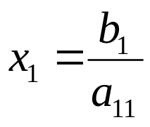
Triangular Systems
Solve by forward substitution

Slide 26
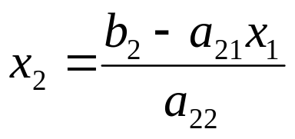
Triangular Systems
Solve by forward substitution

Slide 27
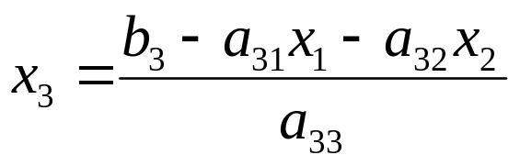
Triangular Systems
Solve by forward substitution

Slide 28
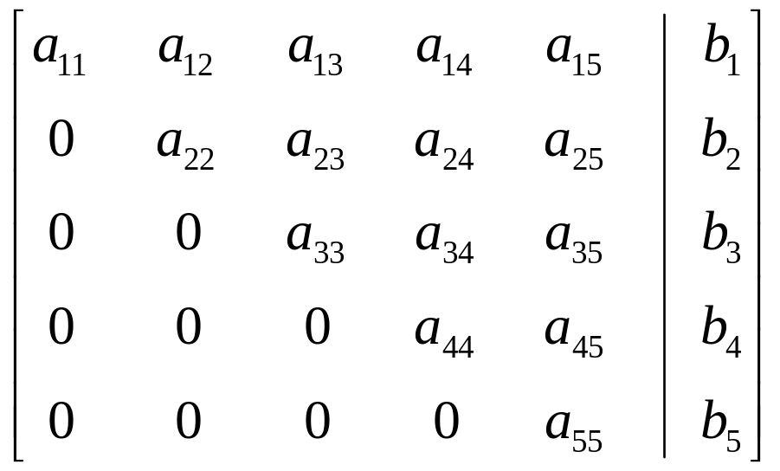

Triangular Systems
If A is upper triangular, solve by backsubstitution

Slide 29

Triangular Systems
If A is upper triangular, solve by backsubstitution

Slide 30
Triangular Systems
Both of these special cases can be solved in
O(n²) time
This motivates a factorization approach to solving arbitrary systems:
  Find a way of writing A as LU, where L and U are both triangular
  Ax=b ⇒ LUx=b ⇒ Ly=b ⇒ Ux=y
  Time for factoring matrix dominates computation

Slide 31
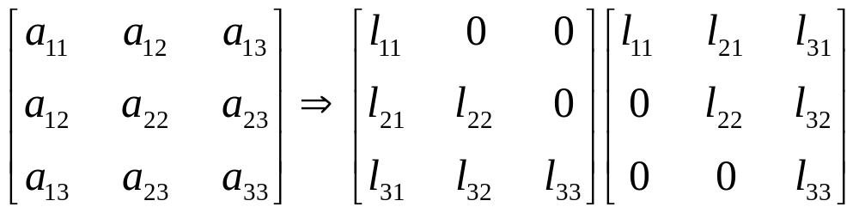
Cholesky Decomposition
For symmetric matrices, choose U=L^{T}
Perform decomposition
Ax=b ⇒ LL^{T}x=b ⇒ Ly=b ⇒ L^{T}x=y

Slide 32
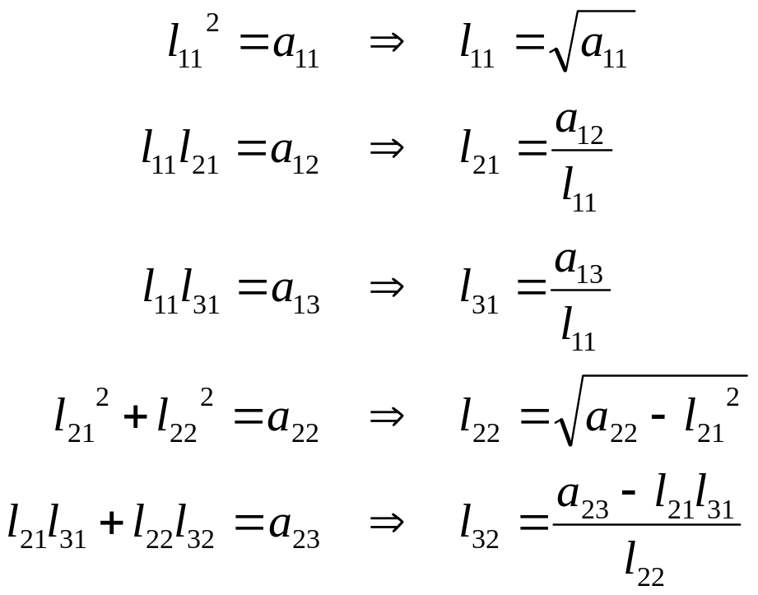
Cholesky Decomposition

Slide 33
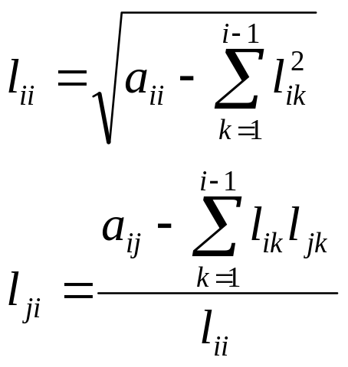
Cholesky Decomposition

Slide 34
Cholesky Decomposition
This fails if it requires taking square root of a negative number
Need another condition on A: positive definite
For any v, v^{T} A v > 0
(Equivalently, all positive eigenvalues)

Slide 35
Cholesky Decomposition
Running time turns out to be ¹/₆n³
  Still cubic, but much lower constant
Result: this is preferred method for solving
symmetric positive definite systems

Slide 36
LU Decomposition
Again, factor A into LU, where
L is lower triangular and U is upper triangular
Last 2 steps in O(n²) time, so total time dominated by decomposition
Ax=b
LUx=b
Ly=b
Ux=y

Slide 37
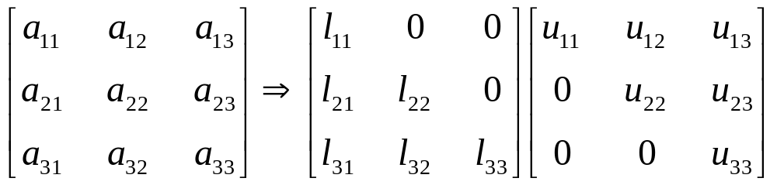
Crout’s Method
More unknowns than equations!
Let all l_{ii}=1

Slide 38
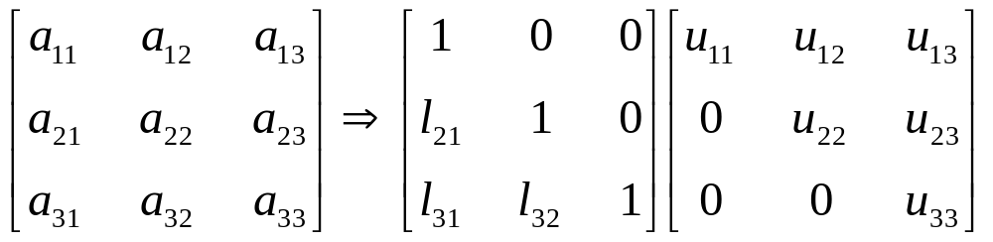
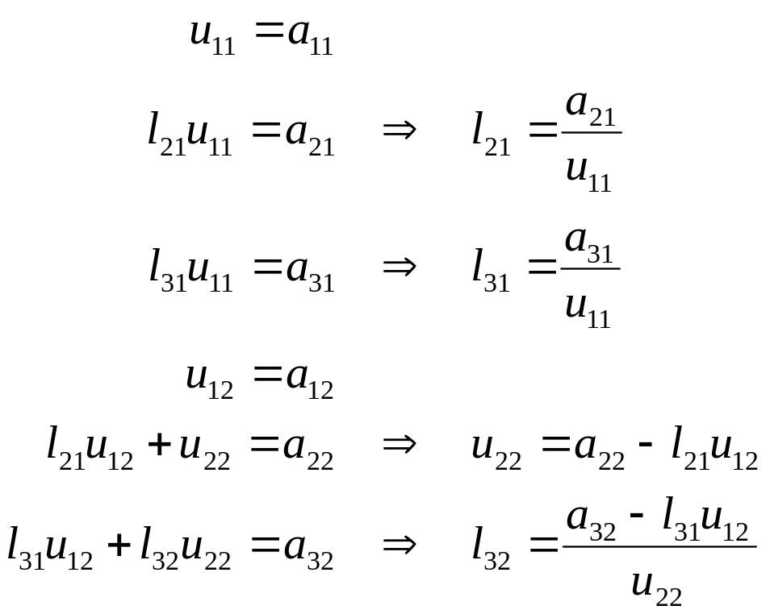
Crout’s Method

Slide 39
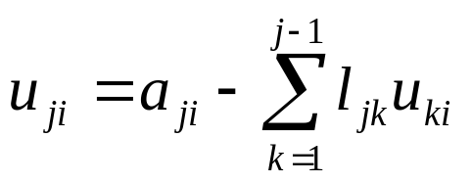
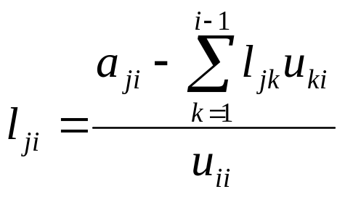
Crout’s Method
For i = 1..n
  For j = 1..i
  For j = i+1..n

Slide 40
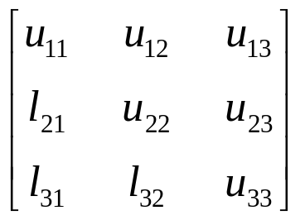
Crout’s Method
Interesting note: # of outputs = # of inputs,
algorithm only refers to elements not output yet
  Can do this in-place!
  Algorithm replaces A with matrix
  of l and u values, 1s are implied
  Resulting matrix must be interpreted in a special way: not a regular matrix
  Can rewrite forward/backsubstitution routines to use this “packed” l-u matrix

Slide 41
LU Decomposition
Running time is ¹/₃n³
  Only a factor of 2 slower than symmetric case
  This is the preferred general method for
  solving linear equations
Pivoting very important
  Partial pivoting is sufficient, and widely implemented

