Slide 1
Iterative Methods and
QR Factorization
Lecture 5
Alessandra Nardi
Thanks to Prof. Jacob White, Suvranu De, Deepak Ramaswamy, Michal Rewienski, and Karen Veroy

Slide 2
Last lecture review
Solution of system of linear equations Mx=b
Gaussian Elimination basics
  LU factorization (M=LU)
  Pivoting for accuracy enhancement
  Error Mechanisms (Round-off)
    Ill-conditioning
    Numerical Stability
  Complexity: O(N³)
Gaussian Elimination for Sparse Matrices
  Improved computational cost: factor in O(N^{1.5})
  Data structure
  Pivoting for sparsity (Markowitz Reordering)
  Graph Based Approach

Slide 3
Solving Linear Systems
Direct methods: find the exact solution in a finite number of steps
  Gaussian Elimination
Iterative methods: produce a sequence of approximate solutions hopefully converging to the exact solution
  Stationary
    Jacobi
    Gauss-Seidel
    SOR (Successive Overrelaxation Method)
  Non Stationary
    GCR, CG, GMRES…..

Slide 4
Iterative Methods
Iterative methods can be expressed in the general form: x^{(k)} =F(x^{(k-1)})
where s s.t. F(s)=s is called a Fixed Point
Hopefully: x^{(k)} → s (solution of my problem)
Will it converge? How rapidly?

Slide 5
Iterative Methods
Stationary:
x^{(k+1)} =Gx^{(k)}+c
where G and c do not depend on iteration count (k)
Non Stationary:
x^{(k+1)} =x^{(k)}+a_{k}p^{(k)}
where computation involves information that change at each iteration

Slide 6
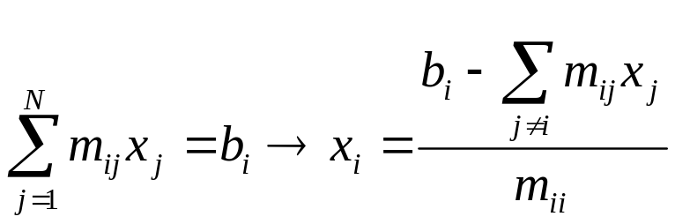
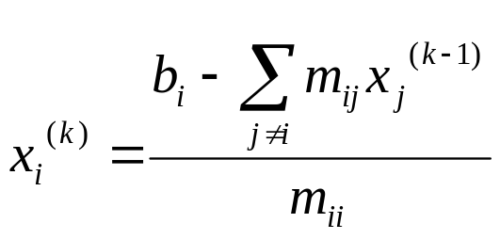

Iterative – Stationary
Jacobi
In the i-th equation solve for the value of x_{i} while assuming the other entries of x remain fixed:
In matrix terms the method becomes:
where D, -L and -U represent the diagonal, the strictly lower-trg and strictly upper-trg parts of M

Slide 7
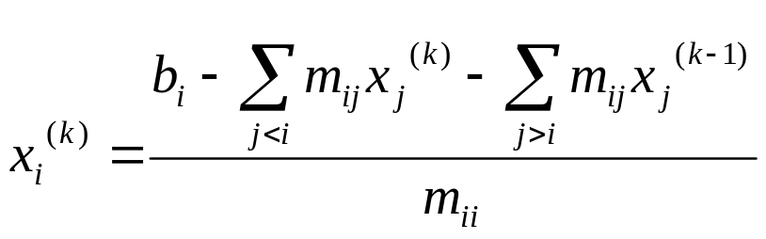
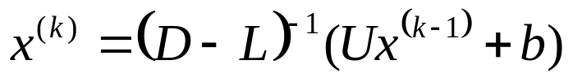
Iterative – Stationary
Gauss-Seidel
Like Jacobi, but now assume that previously computed results are used as soon as they are available:
In matrix terms the method becomes:
where D, -L and -U represent the diagonal, the strictly lower-trg and strictly upper-trg parts of M

Slide 8

Iterative – Stationary
Successive Overrelaxation (SOR)
Devised by extrapolation applied to Gauss-Seidel in the form of weighted average:
In matrix terms the method becomes:
where D, -L and -U represent the diagonal, the strictly lower-trg and strictly upper-trg parts of M
w is chosen to increase convergence

Slide 9
Iterative – Non Stationary
The iterates x^{(k)} are updated in each iteration by a multiple a_{k} of the search direction vector p^{(k)}
x^{(k+1)} =x^{(k)}+a_{k}p^{(k)}
Convergence depends on matrix M spectral properties
Where does all this come from? What are the search directions? How do I choose a_{k} ?
Will explore in detail
in the next lectures

Slide 10
Outline
QR Factorization
  Direct Method to solve linear systems
    Problems that generate Singular matrices
  Modified Gram-Schmidt Algorithm
  QR Pivoting
    Matrix must be singular, move zero column to end.
  Minimization view point → Link to Iterative Non stationary Methods (Krylov Subspace)

Slide 11
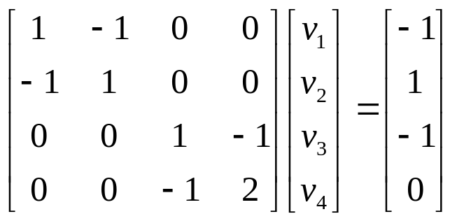
LU Factorization fails – Singular Example
v1
v2
1
v3
v4
1
The resulting nodal matrix is SINGULAR, but a solution exists!

Slide 12
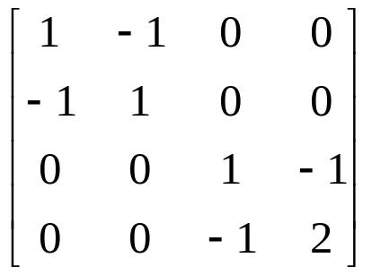
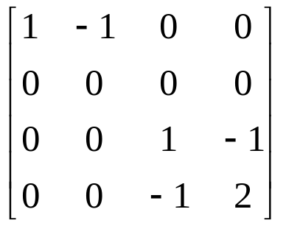
LU Factorization fails – Singular Example
One step GE
The resulting nodal matrix is SINGULAR, but a solution exists!
Solution (from picture):
v₄ = -1
v₃ = -2
v₂ = anything you want ∞ solutions
v₁ = v₂ - 1

Slide 13
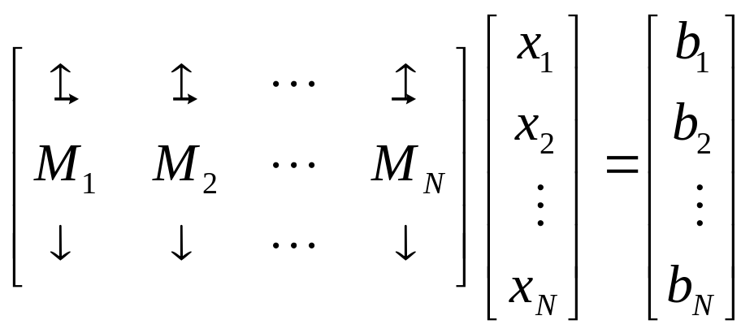
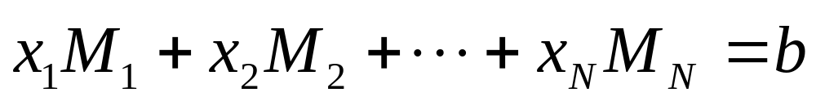
QR Factorization – Singular Example
Recall weighted sum of columns view of systems of equations
M is singular but b is in the span of the columns of M

Slide 14
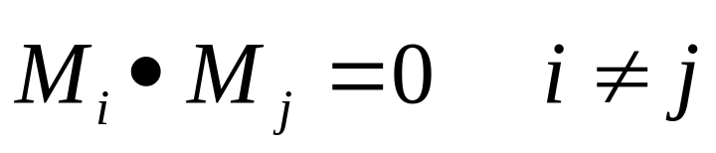
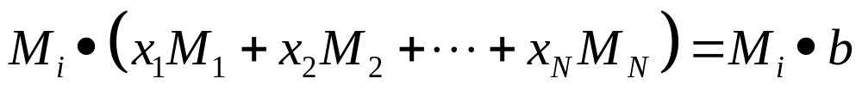
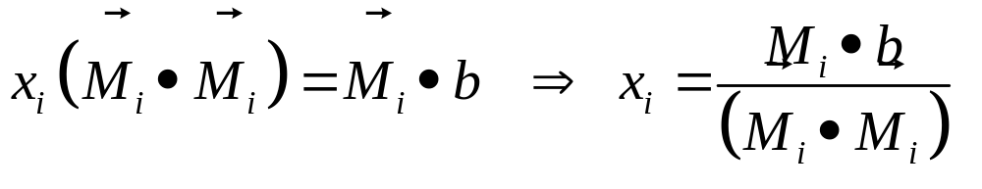
QR Factorization – Key idea
If M has orthogonal columns
Orthogonal columns implies:
Multiplying the weighted columns equation by i-th column:
Simplifying using orthogonality:

Slide 15
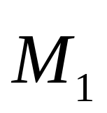

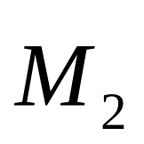


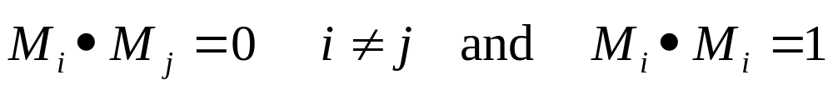
QR Factorization - M orthonormal
Picture for the two-dimensional case
Non-orthogonal Case
Orthogonal Case
M is orthonormal if:

Slide 16
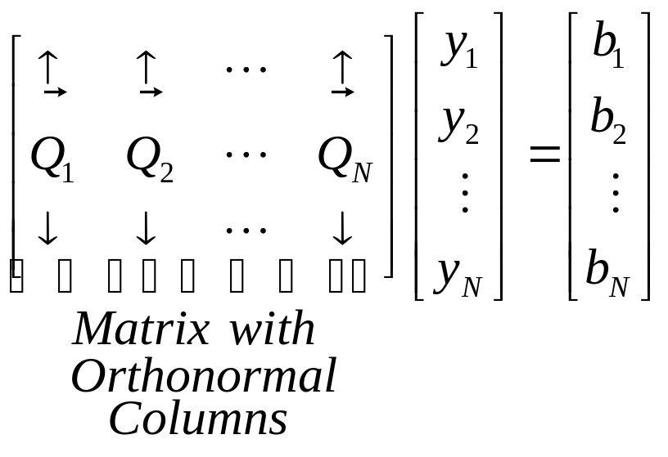
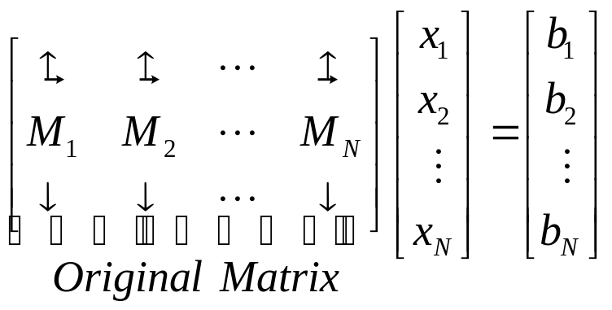
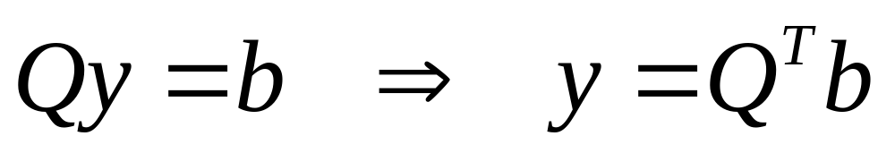
QR Factorization – Key idea
How to perform the conversion?

Slide 17
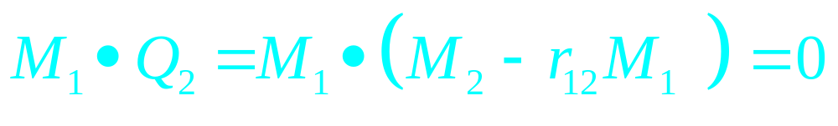
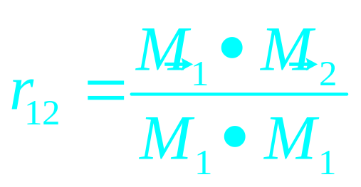
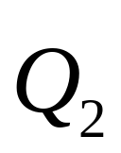
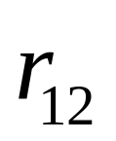
QR Factorization – Projection formula

Slide 18
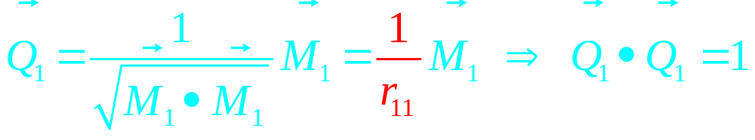
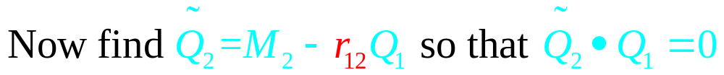
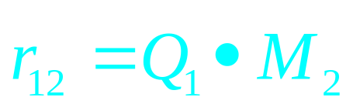
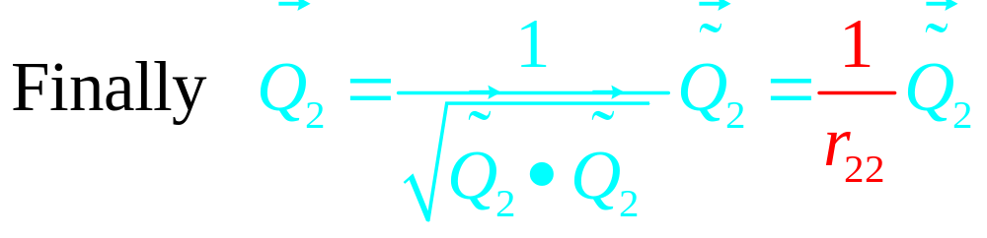
QR Factorization – Normalization
Formulas simplify if we normalize

Slide 19
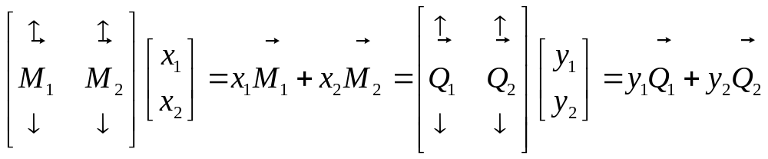
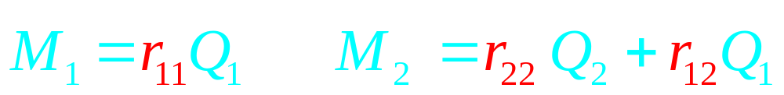
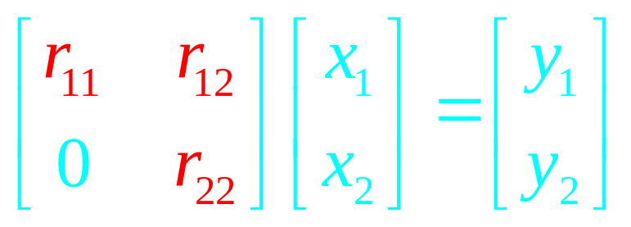
QR Factorization – 2x2 case
Mx=b → Qy=b ⇒ Mx=Qy

Slide 20
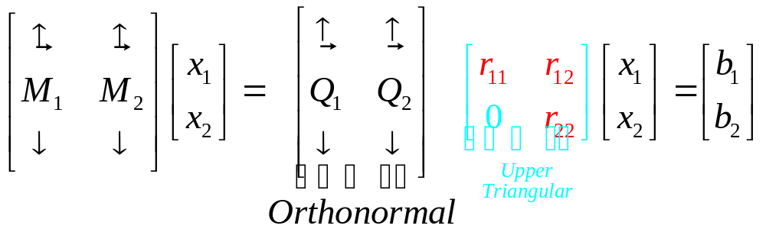
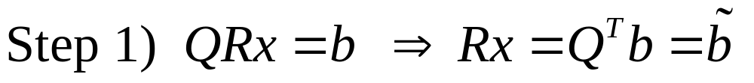
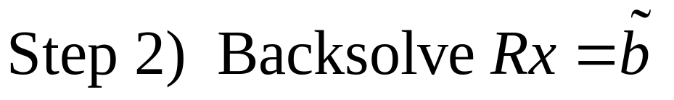
QR Factorization – 2x2 case
Two Step Solve Given QR

Slide 21
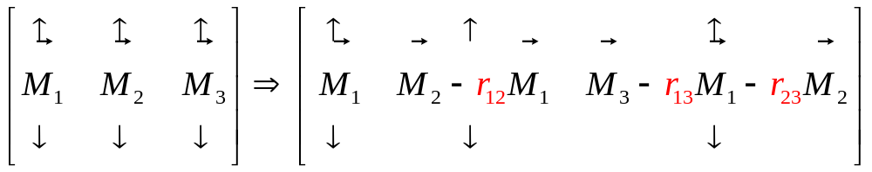
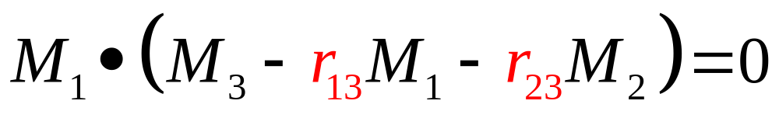
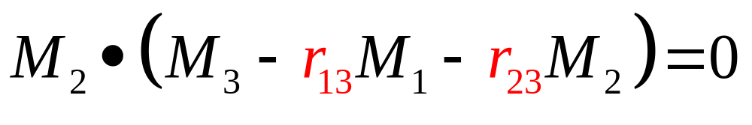
QR Factorization – General case
To Insure the third column is orthogonal

Slide 22
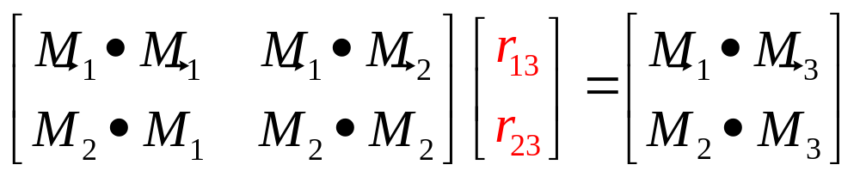
QR Factorization – General case
In general, must solve NxN dense linear system for coefficients

Slide 23
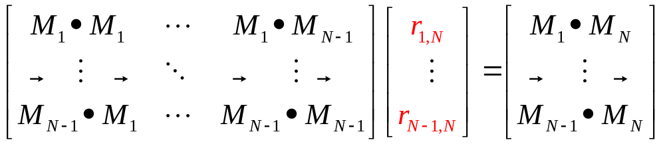
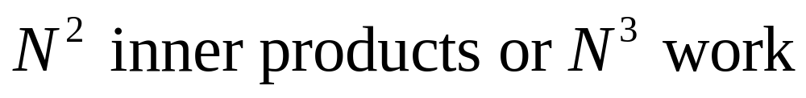
QR Factorization – General case
To Orthogonalize the Nth Vector

Slide 24
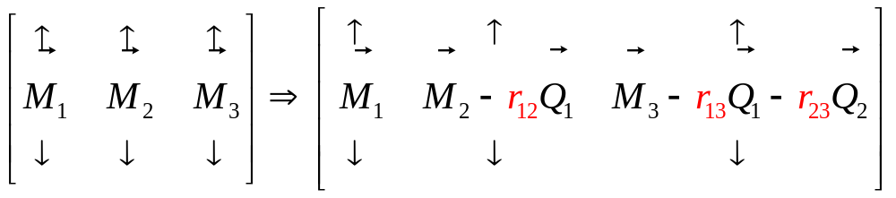
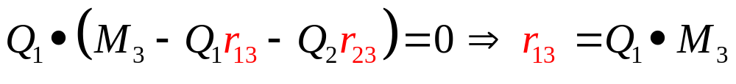
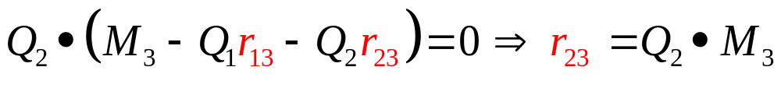
QR Factorization – General case
Modified Gram-Schmidt Algorithm
To Insure the third column is orthogonal

Slide 25
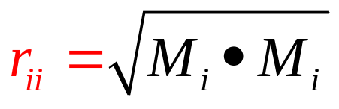
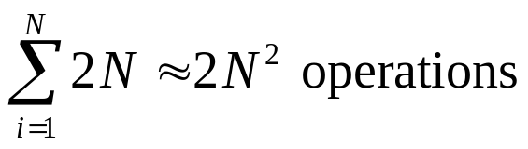
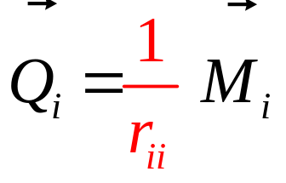
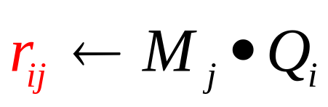
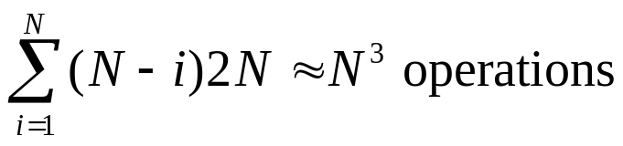
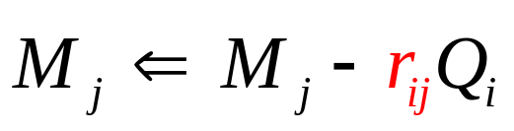
QR Factorization
Modified Gram-Schmidt Algorithm
(Source-column oriented approach)
For i = 1 to N “For each Source Column”
For j = i+1 to N { “For each target Column right of source”
end
end
Normalize

Slide 26

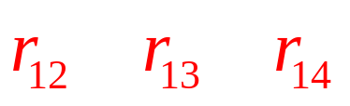

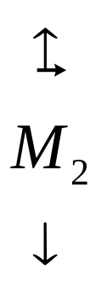
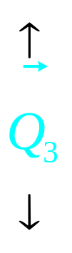










QR Factorization – By picture

Slide 27

QR Factorization – Matrix-Vector Product View
Suppose only matrix-vector products were available?
More convenient to use another approach

Slide 28


QR Factorization
Modified Gram-Schmidt Algorithm
(Target-column oriented approach)
For i = 1 to N “For each Target Column”
For j = 1 to i-1 “For each Source Column left of target”
end
end
Normalize

Slide 29
QR Factorization
r₁₁
r₁₂
r₁₃
r₁₄
r₂₂
r₂₃
r₂₄
r₃₃
r₃₄
r₄₄
r₁₁
r₁₂
r₁₃
r₁₄
r₂₂
r₂₃
r₂₄
r₃₃
r₃₄
r₄₄

Slide 30

QR Factorization – Zero Column
What if a Column becomes Zero?
Matrix MUST BE Singular!
Do not try to normalize the column.
Do not use the column as a source for orthogonalization.
3) Perform backward substitution as well as possible

Slide 31


QR Factorization – Zero Column
Resulting QR Factorization

Slide 32
QR Factorization – Zero Column
Recall weighted sum of columns view of systems of equations
M is singular but b is in the span of the columns of M

Slide 33
Reasons for QR Factorization
QR factorization to solve Mx=b
  Mx=b → QRx=b → Rx=Q^{T}b
  where Q is orthogonal, R is upper trg
O(N³) as GE
Nice for singular matrices
  Least-Squares problem
  Mx=b where M: mxn and m>n
Pointer to Krylov-Subspace Methods
  through minimization point of view

Slide 34




QR Factorization – Minimization View
Minimization More General!

Slide 35




QR Factorization – Minimization View
One-Dimensional Minimization
One dimensional Minimization
Normalization

Slide 36


QR Factorization – Minimization View
One-Dimensional Minimization: Picture
One dimensional minimization yields same result as projection on the column!

Slide 37



QR Factorization – Minimization View
Two-Dimensional Minimization
Residual Minimization
Coupling
Term

Slide 38


QR Factorization – Minimization View
Two-Dimensional Minimization: Residual Minimization
Coupling
Term
To eliminate coupling term: we change search directions !!!

Slide 39




QR Factorization – Minimization View
Two-Dimensional Minimization
More General Search Directions
Coupling
Term

Slide 40

QR Factorization – Minimization View
Two-Dimensional Minimization
More General Search Directions
Goal: find a set of search directions such that
In this case minimization decouples !!!
p_{i} and p_{j} are called M^{T}M orthogonal

Slide 41


QR Factorization – Minimization View
Forming M^{T}M orthogonal Minimization Directions
i-th search direction equals Μ^{Τ}Μ orthogonalized unit vector
Use previous orthogonalized
Search directions

Slide 42


QR Factorization – Minimization View
Minimizing in the Search Direction
When search directions p_{j} are M^{T}M orthogonal, residual minimization becomes:

Slide 43






QR Factorization – Minimization View
Minimization Algorithm
For i = 1 to N “For each Target Column”
For j = 1 to i-1 “For each Source Column left of target”
end
end
Orthogonalize Search Direction
Normalize

Slide 44
Intuitive summary
QR factorization → Minimization view
(Direct) (Iterative)
Compose vector x along search directions:
  Direct: composition along Q_{i} (orthonormalized columns of M) → need to factorize M
  Iterative: composition along certain search directions → you can stop half way
About the search directions:
  Chosen so that it is easy to do the minimization (decoupling) → p_{j} are M^{T}M orthogonal
  Each step: try to minimize the residual

Slide 45





Compare Minimization and QR
Orthonormal
M
M
M
M^{T}M
Orthonormal

Slide 46
Summary
Iterative Methods Overview
  Stationary
  Non Stationary
QR factorization to solve Mx=b
  Modified Gram-Schmidt Algorithm
  QR Pivoting
  Minimization View of QR
    Basic Minimization approach
    Orthogonalized Search Directions
    Pointer to Krylov Subspace Methods

