Slide 1
CSE 245: Computer Aided Circuit Simulation and Verification
Matrix Computations: Iterative Methods I
Chung-Kuan Cheng

Slide 2
Outline
Introduction
Direct Methods
Iterative Methods
  Formulations
  Projection Methods
  Krylov Space Methods
  Preconditioned Iterations
  Multigrid Methods
  Domain Decomposition Methods

Slide 3
Introduction
Iterative Methods
Direct Method
LU Decomposition
Domain Decomposition
General and Robust but can be complicated if
N>= 1M
Preconditioning
Conjugate Gradient
GMRES
Jacobi
Gauss-Seidel
Multigrid
Excellent choice for SPD matrices
Remain an art for arbitrary matrices

Slide 4
Introduction: Matrix Condition
Ax=b
With errors, we have
(A+eE)x(e)=b+ed
Thus, the deviation is
x(e)-x=e(A+eE)⁻¹(d-Ex)
|x(e)-x|/|x| <= e|A⁻¹|(|d|/|x|+|E|)+O(e)
<= e|A||A⁻¹|(|d|/|b|+|E|/|A|)+O(e)
We define the matrix condition as
K(A)=|A||A⁻¹|,
i.e.
|x(e)-x|/|x|<=K(A)(|ed|/|b|+|eE|/|A|)

Slide 5
Introduction: Gershgorin Circle Theorem
For all eigenvalues r of matrix A, there exists an i such that |r-a_{ii}|<= sum_{i=!j} |a_{ij}|
Proof: Given r and eigenvector V s.t. AV=rV
Let |v_{i}|>= |v_{j}| for all j=!i, we have
sum_{j} a_{ij}v_{j} = rv_{i}
Thus
(r-a_{ii})v_{i}= sum_{j=!i} a_{ij}v_{j}
r-a_{ii}=(sum_{j=!i} a_{ij} v_{j})/v_{i}
Therefore
|r-a_{ii}|<= sum_{j=!i} |a_{ij}|
Note if equality holds then for all i, |v_{i}| are equal.

Slide 6
Iterative Methods
Stationary:
x^{(k+1)} =Gx^{(k)}+c
where G and c do not depend on iteration count (k)
Non Stationary:
x^{(k+1)} =x^{(k)}+a_{k}p^{(k)}
where computation involves information that change at each iteration

Slide 7
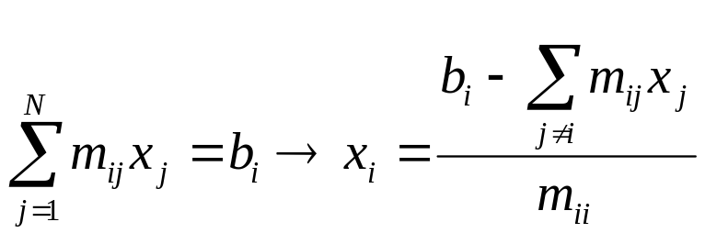
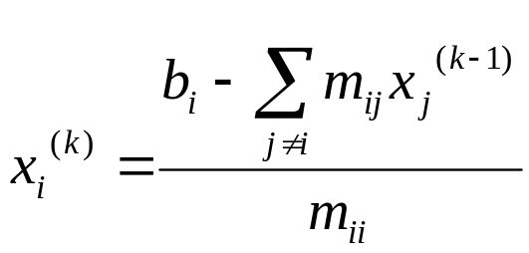

Stationary: Jacobi Method
In the i-th equation solve for the value of x_{i} while assuming the other entries of x remain fixed:
In matrix terms the method becomes:
where D, -L and -U represent the diagonal, the strictly lower-trg and strictly upper-trg parts of M
M=D-L-U

Slide 8

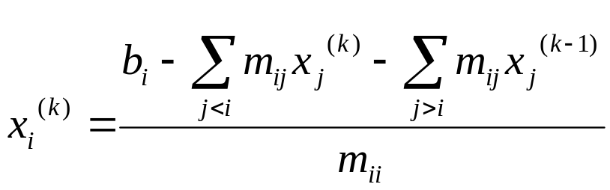
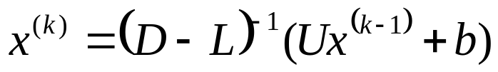
Stationary-Gause-Seidel
Like Jacobi, but now assume that previously computed results are used as soon as they are available:
In matrix terms the method becomes:
where D, -L and -U represent the diagonal, the strictly lower-trg and strictly upper-trg parts of M
M=D-L-U

Slide 9
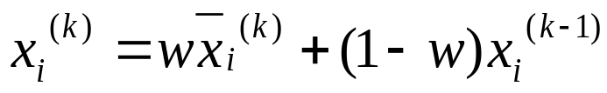
Stationary: Successive Overrelaxation (SOR)
Devised by extrapolation applied to Gauss-Seidel in the form of weighted average:
In matrix terms the method becomes:
where D, -L and -U represent the diagonal, the strictly lower-trg and strictly upper-trg parts of M
M=D-L-U

Slide 10
SOR
Choose w to accelerate the convergence
  W =1 : Jacobi / Gauss-Seidel
  2>W>1: Over-Relaxation
  W < 1: Under-Relaxation

Slide 11
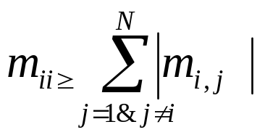



Convergence of Stationary Method
Linear Equation: MX=b
A sufficient condition for convergence of the solution(GS,Jacob) is that the matrix M is diagonally dominant.
If M is symmetric positive definite, SOR converges for any w (0<w<2)
A necessary and sufficient condition for the convergence is the magnitude of the largest eigenvalue of the matrix G is smaller than 1
  Jacobi:
  Gauss-Seidel
  SOR:

Slide 12
Convergence of Gauss-Seidel
Eigenvalues of G=(D-L)⁻¹L^{T} is inside a unit circle
Proof:
G₁=D^{1/2}GD^{-1/2}=(I-L₁)⁻¹L₁^{T}, L₁=D^{-1/2}LD^{-1/2}
Let G₁x=rx we have
L₁^{T}x=r(I-L₁)x
xL₁^{T}x=r(1-x^{T}L₁x)
y=r(1-y)
r= y/(1-y), |r|<= 1 iff Re(y) <= ½.
Since A=D-L-L^{T} is PD, D^{-1/2}AD^{-1/2} is PD,
1-2x^{T}L₁x >= 0 or 1-2y>= 0, i.e. y<= ½.

Slide 13
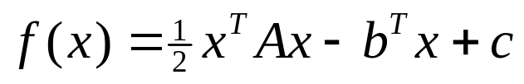


Linear Equation: an optimization problem
Quadratic function of vector x
Matrix A is positive-definite, if for any nonzero vector x
If A is symmetric, positive-definite, f(x) is minimized by the solution

Slide 14
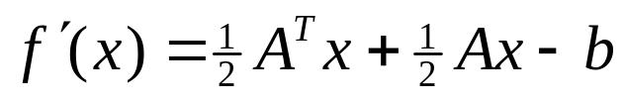



Linear Equation: an optimization problem
Quadratic function
Derivative
If A is symmetric
If A is positive-definite
is minimized by setting to 0

Slide 15
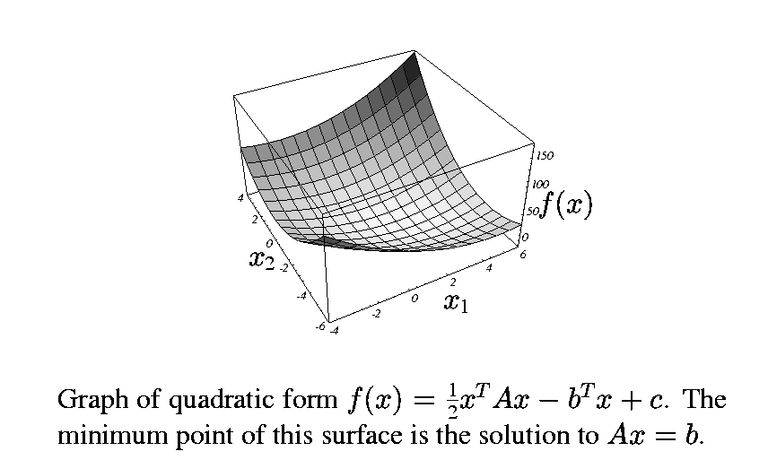
For symmetric positive definite matrix A

Slide 16
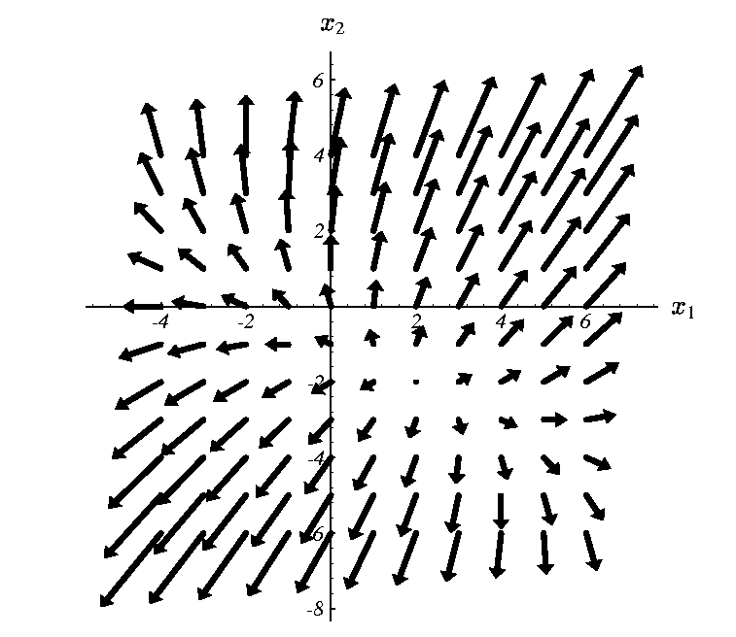
Gradient of quadratic form
The points in the direction of steepest increase of f(x)

Slide 17

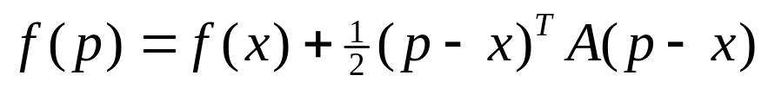
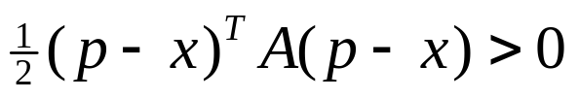

Symmetric Positive-Definite Matrix A
If A is symmetric positive definite
  P is the arbitrary point
  X is the solution point
since
We have,
If p != x

Slide 18
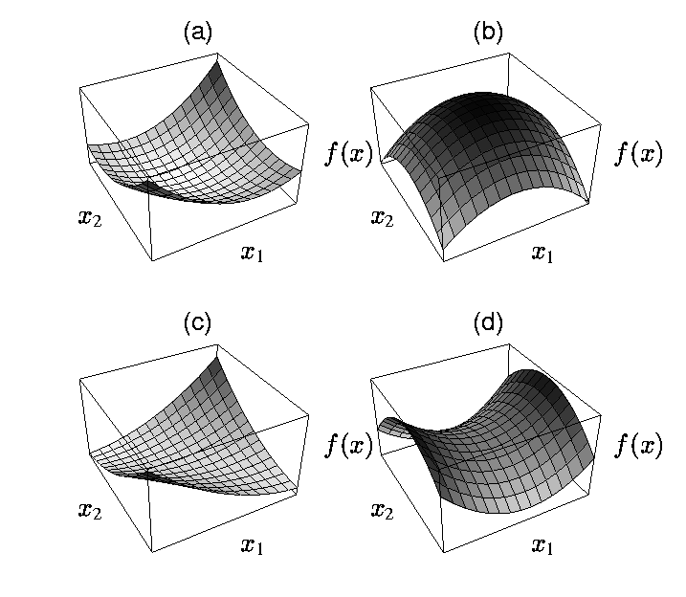
If A is not positive definite
Positive definite matrix b) negative-definite matrix
c) Singular matrix d) positive indefinite matrix

Slide 19
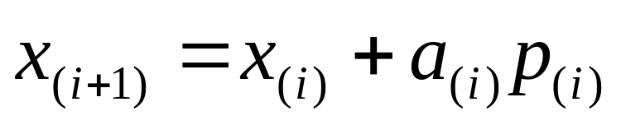
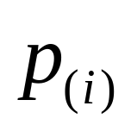
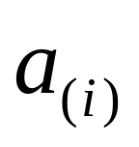
Non-stationary Iterative Method
State from initial guess x0, adjust it until close enough to the exact solution
How to choose direction and step size?
i=0,1,2,3,……
Adjustment Direction
Step Size

Slide 20
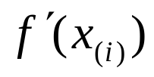
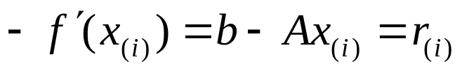
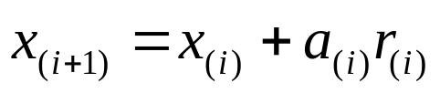
Steepest Descent Method (1)
Choose the direction in which f decrease most quickly: the direction opposite of
Which is also the direction of residue

Slide 21

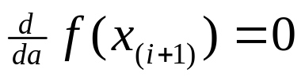
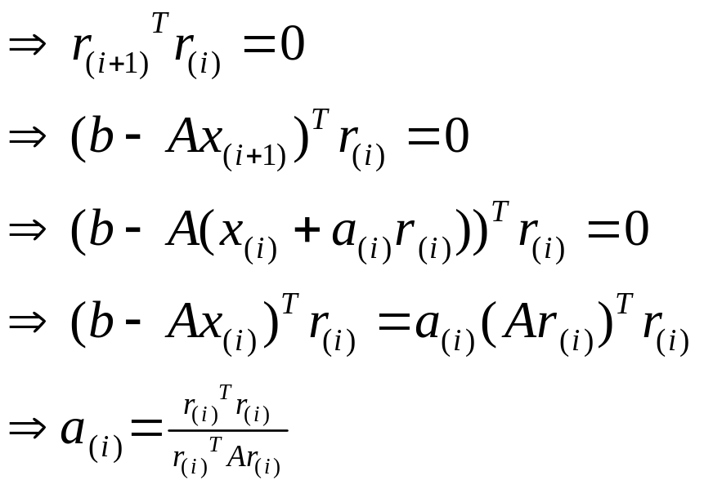
Steepest Descent Method (2)
How to choose step size ?
  Line Search
  should minimize f, along the direction of , which means
Orthogonal

Slide 22
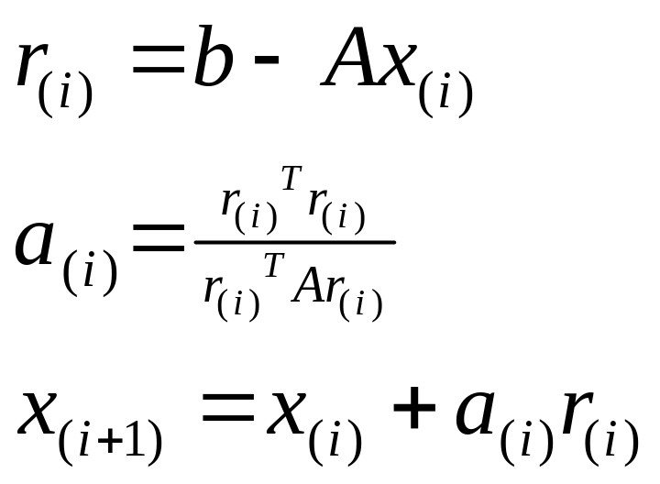
Steepest Descent Algorithm
Given x0, iterate until residue is smaller than error tolerance

Slide 23
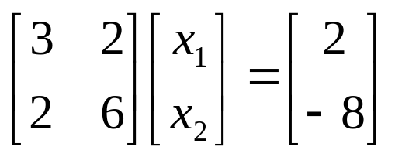
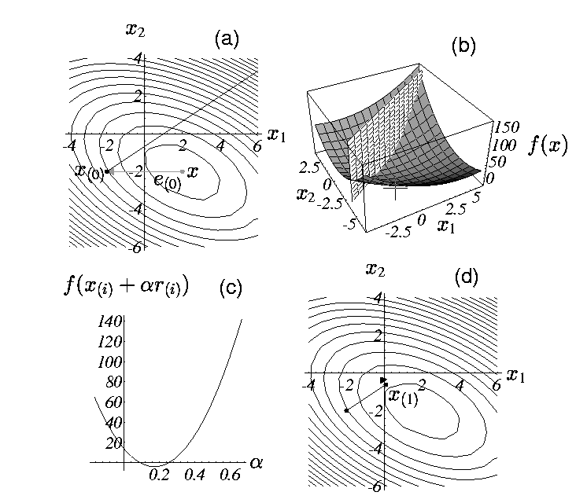
Steepest Descent Method: example
Starting at (-2,-2) take the
direction of steepest descent of f
b) Find the point on the intersec-
tion of these two surfaces that
minimize f
c) Intersection of surfaces.
d) The gradient at the bottommost
point is orthogonal to the gradient
of the previous step

Slide 24
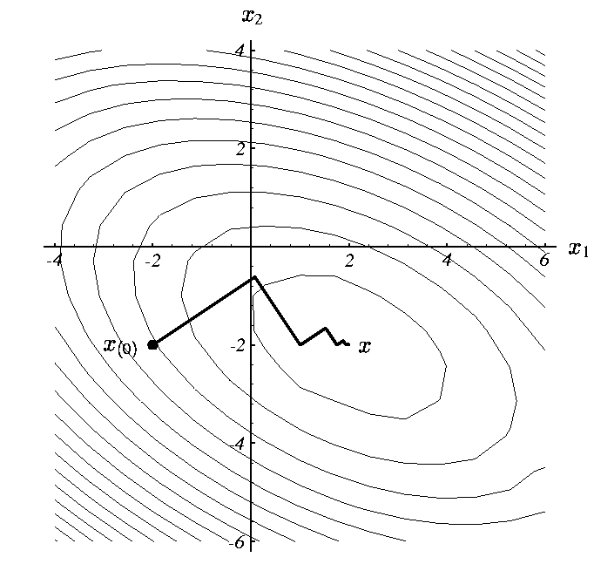
Iterations of Steepest Descent Method

Slide 25
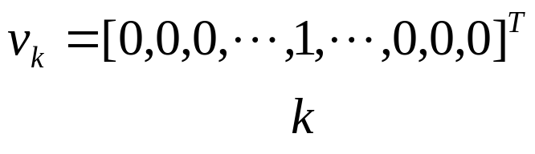
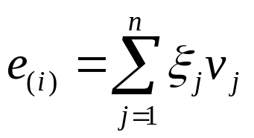

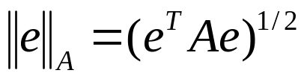
Convergence of Steepest Descent-1
let
Eigenvector:
EigenValue:
j=1,2,…,n
Energy norm:

Slide 26
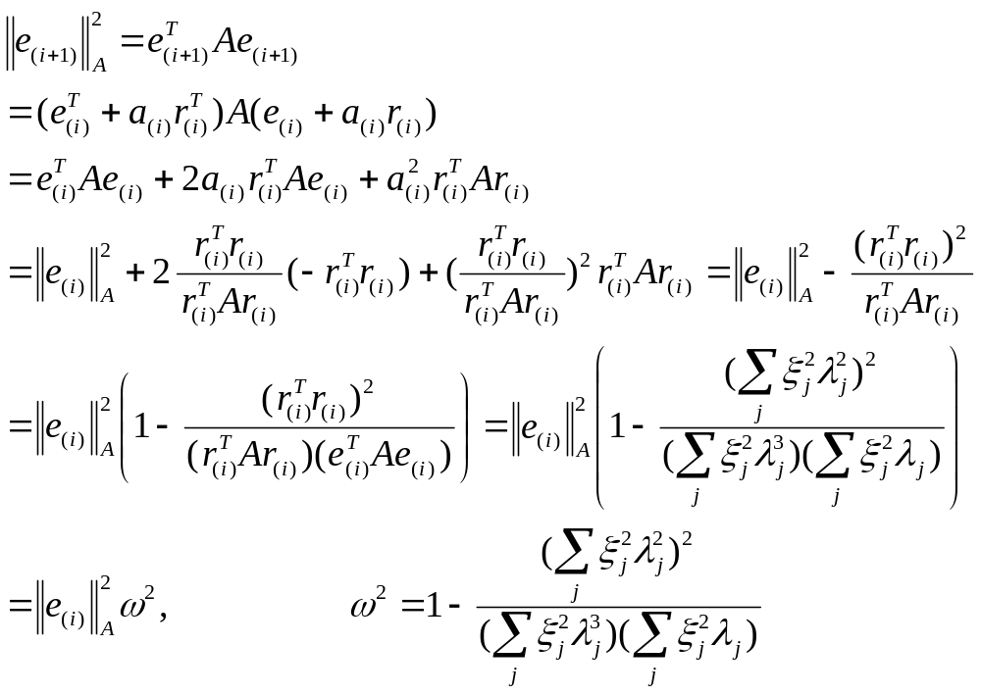
Convergence of Steepest Descent-2

Slide 27


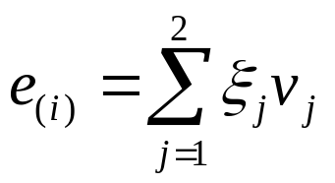

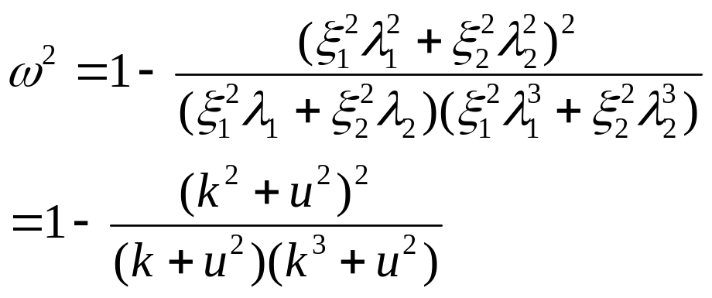
Convergence Study (n=2)
assume
let
Spectral condition number
let

Slide 28
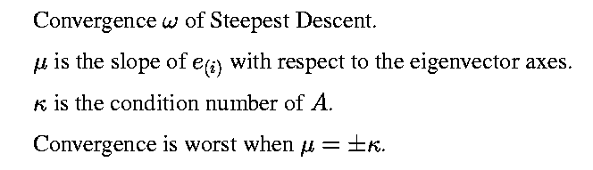
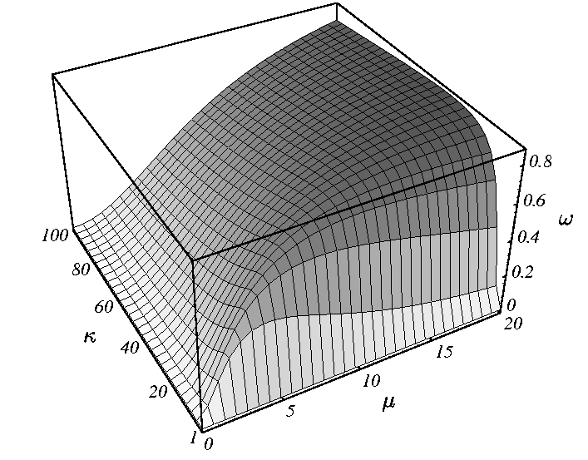
Plot of w

Slide 29
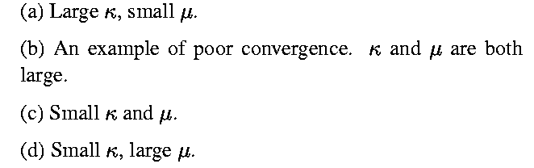
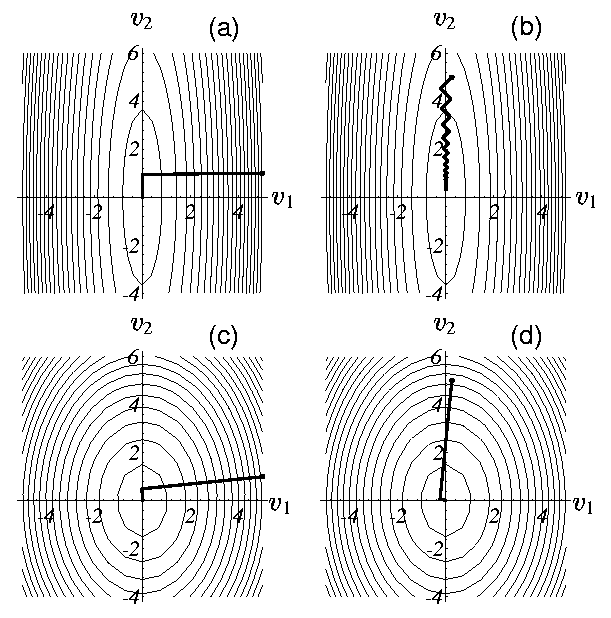
Case Study

Slide 30
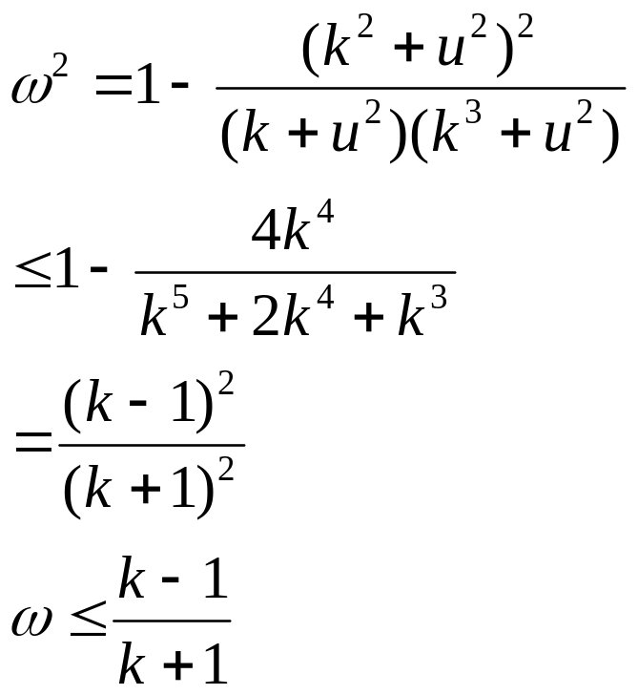
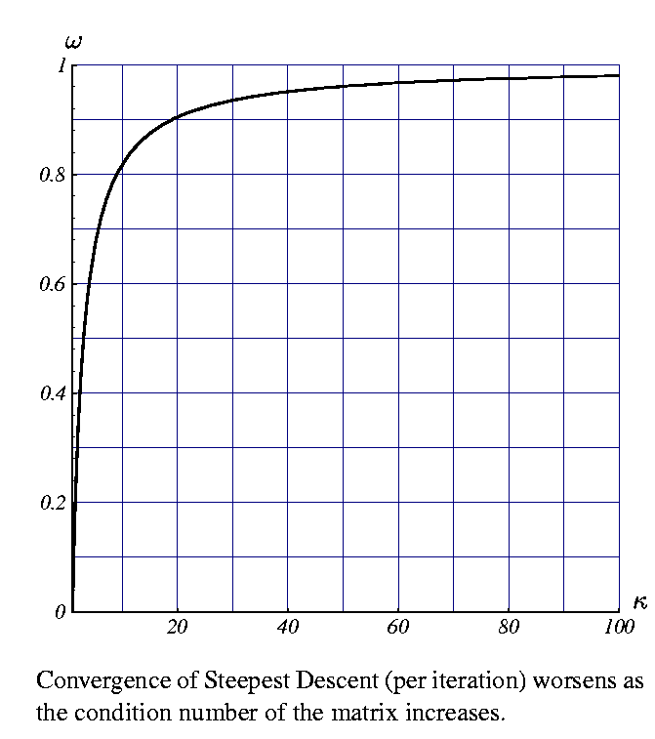

Bound of Convergence
It can be proved that it is
also valid for n>2, where

