Slide 1
Discrete Structures
(Discrete Mathematics)
Lecture -1 (of)
Graphs

Slide 2


Slide 3
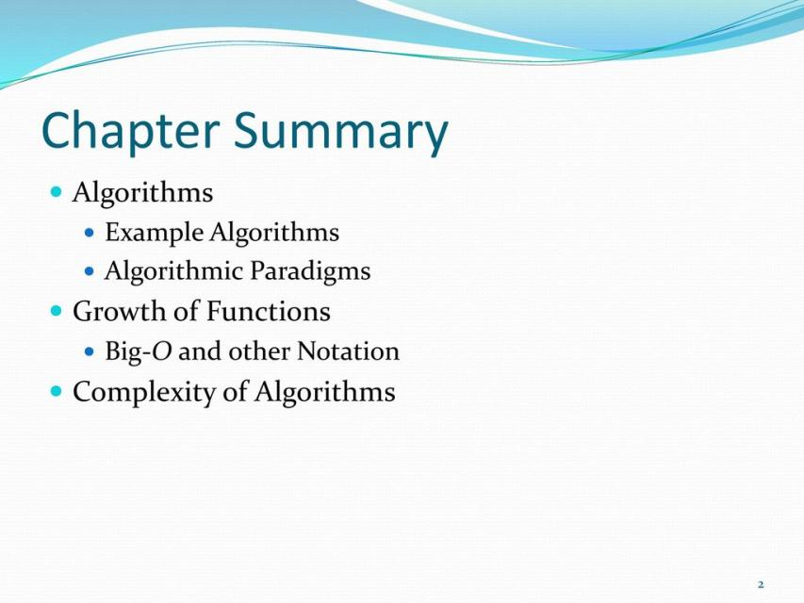

Slide 4


Slide 5
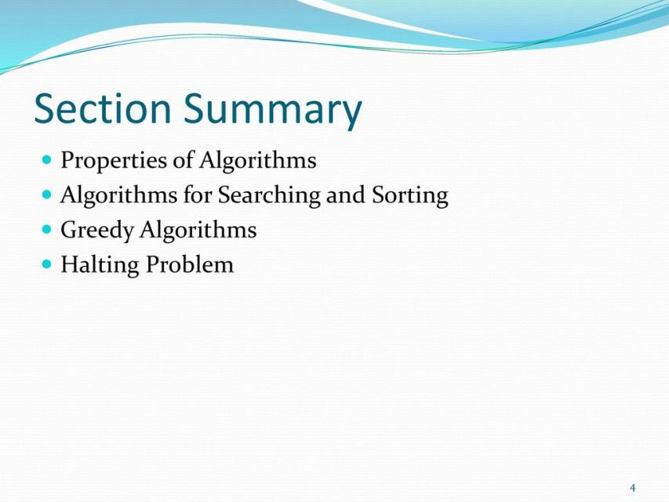

Slide 6
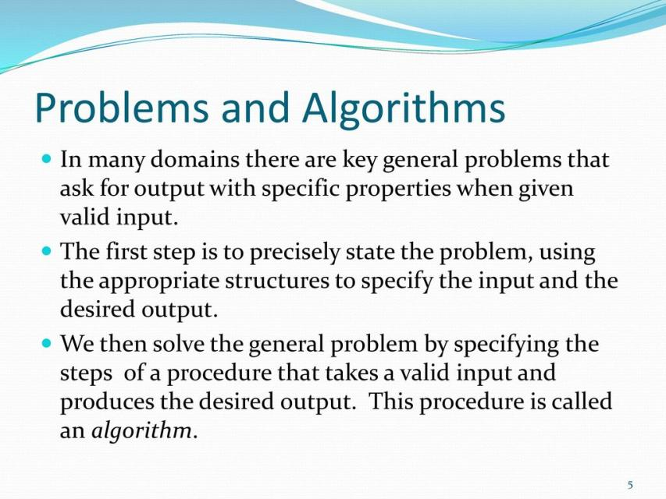

Slide 7
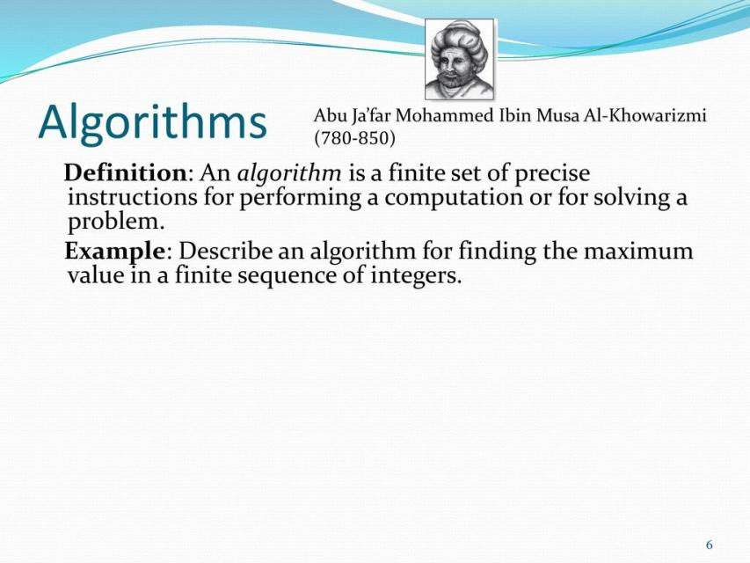

Slide 8
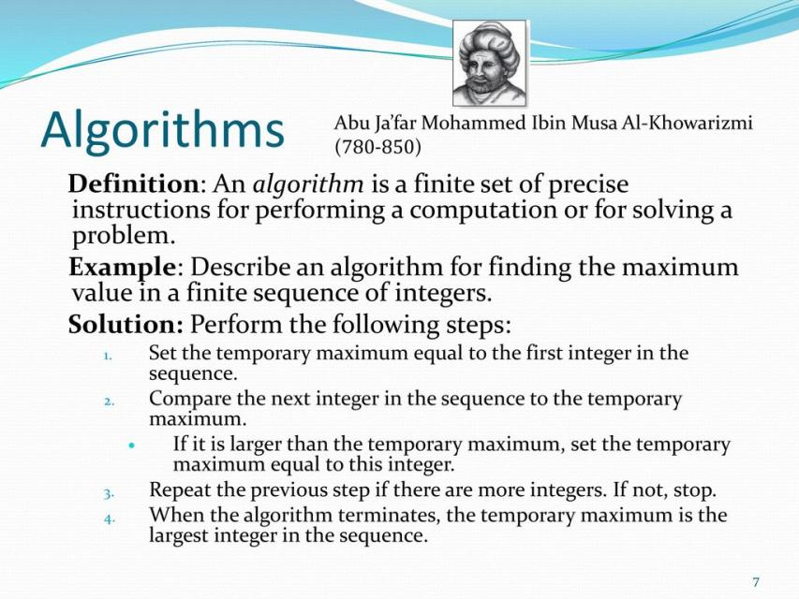

Slide 9
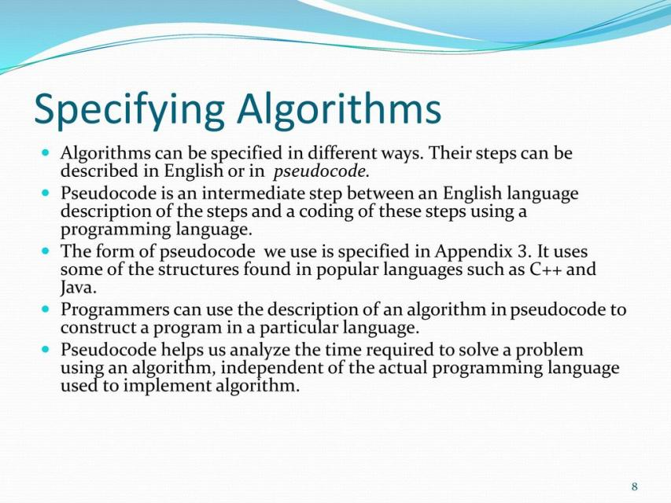

Slide 10
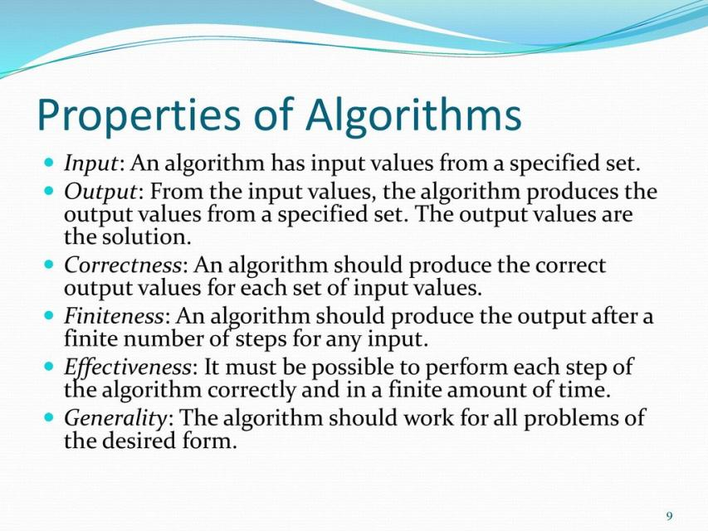

Slide 11
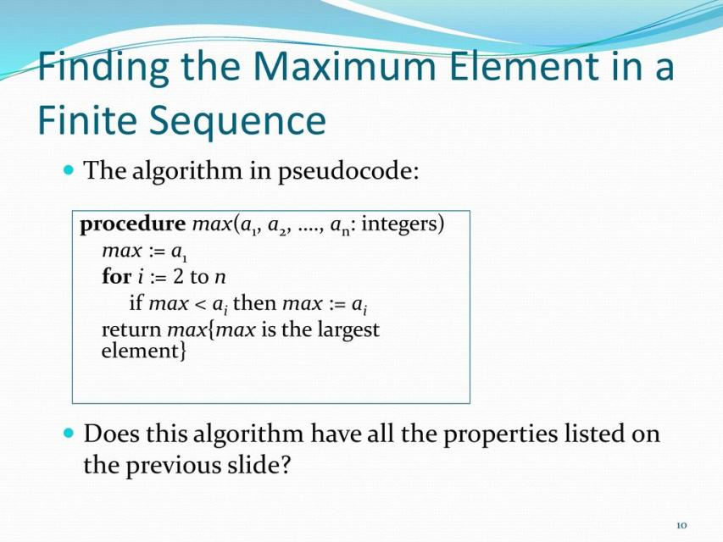

Slide 12
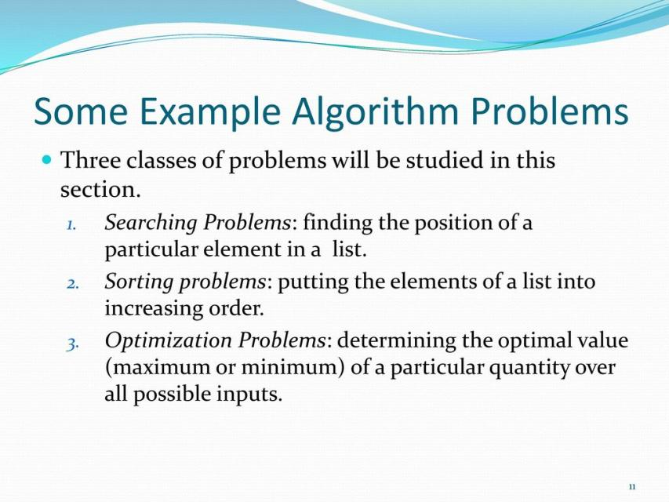

Slide 13
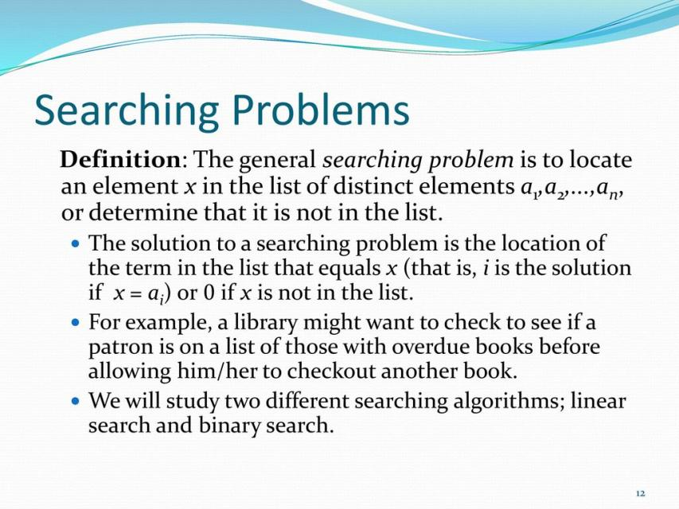

Slide 14
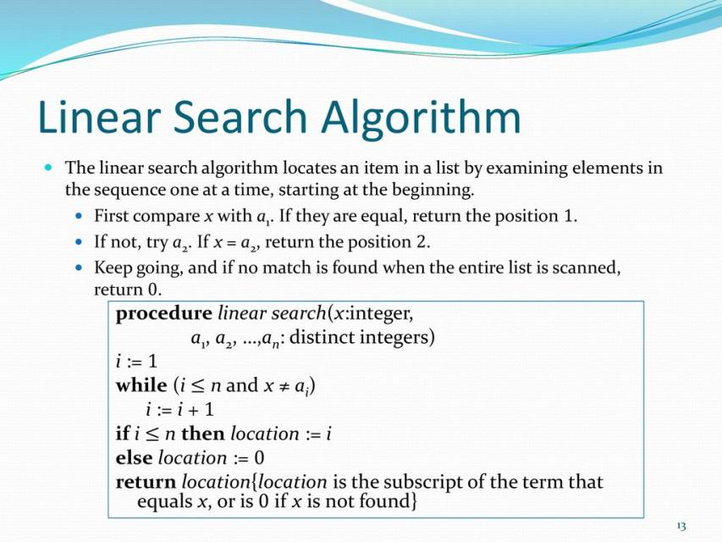

Slide 15
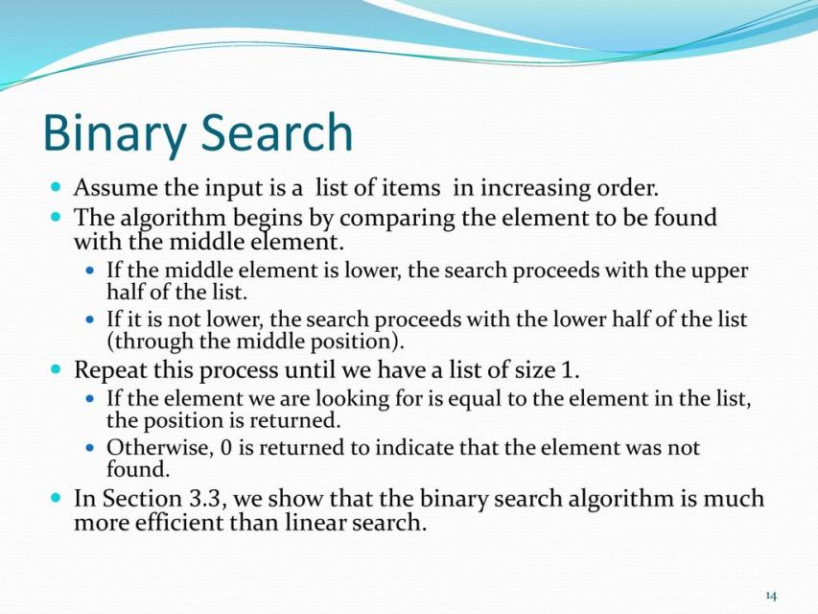

Slide 16
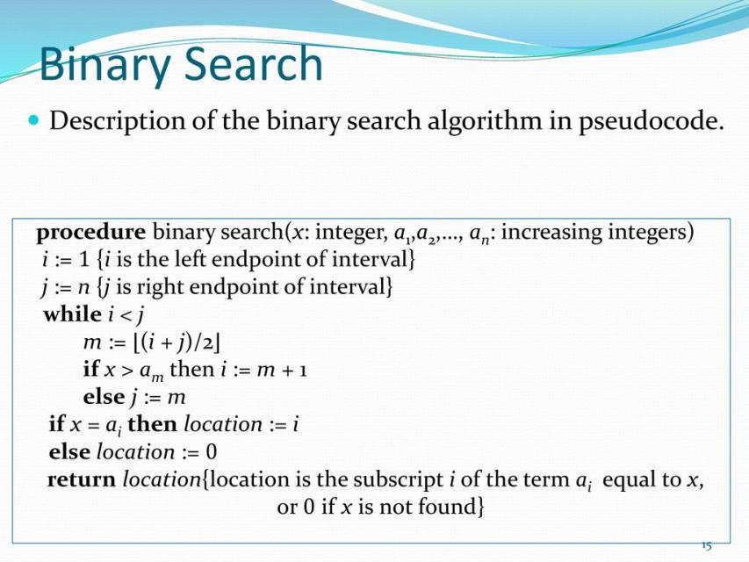

Slide 17
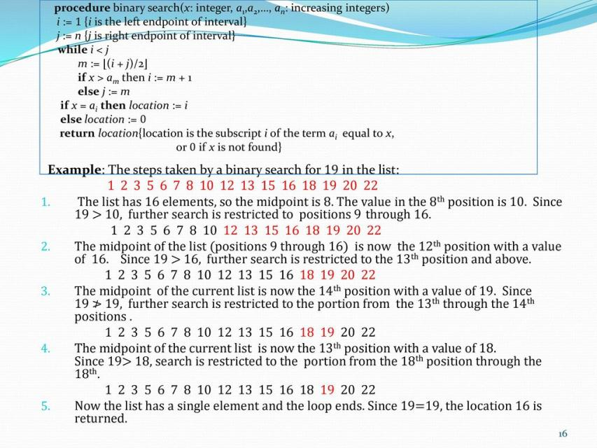

Slide 18


Slide 19
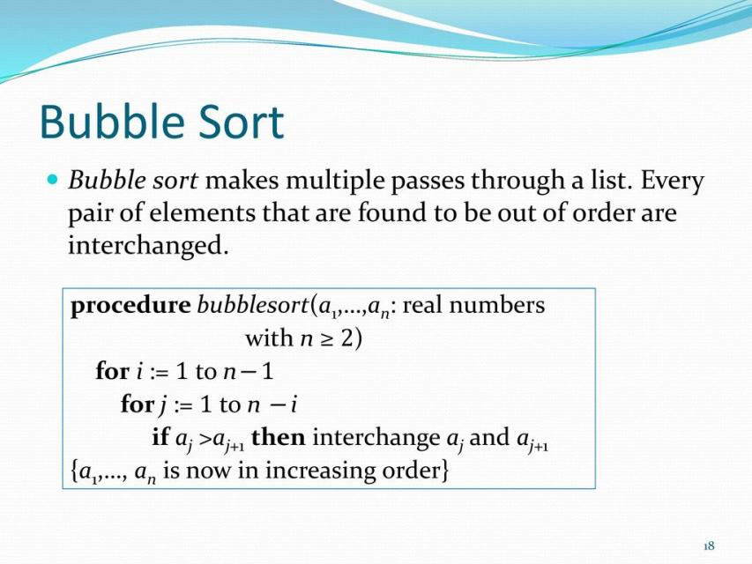

Slide 20
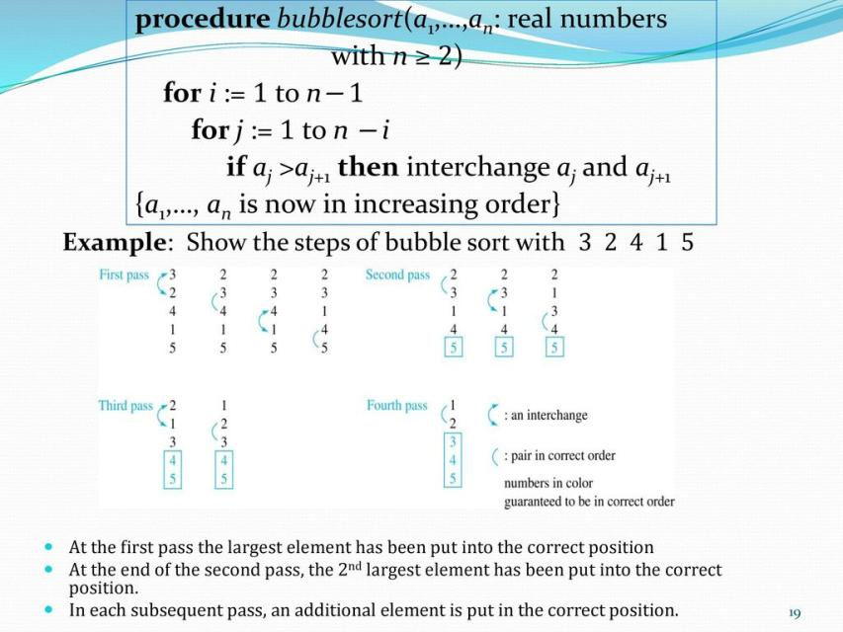

Slide 21
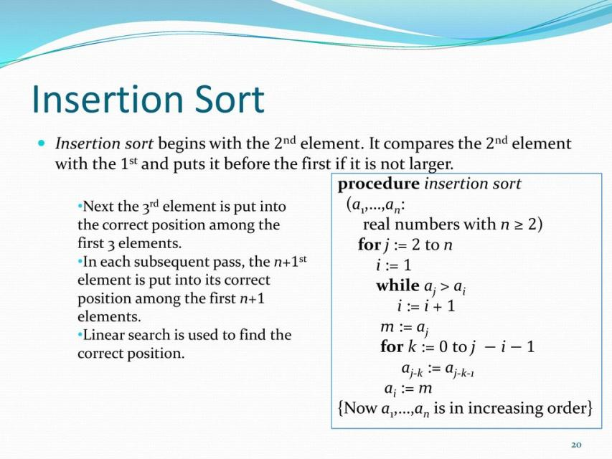

Slide 22
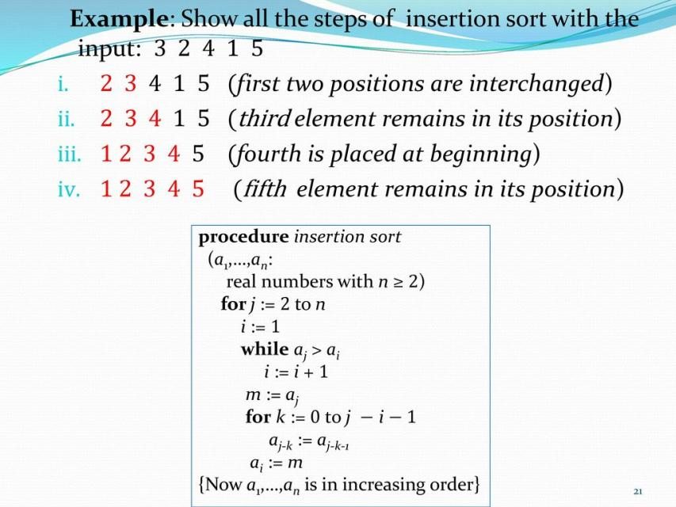

Slide 23
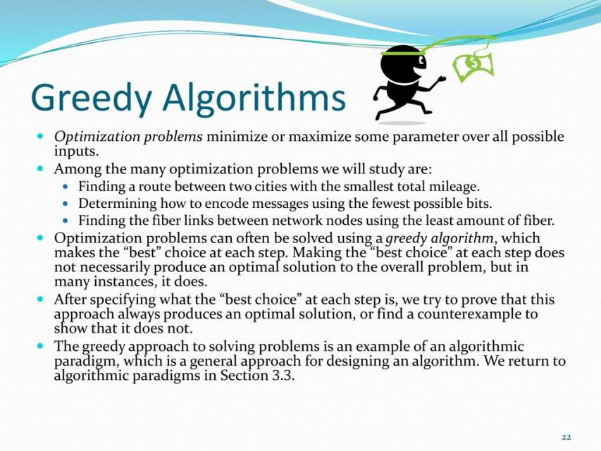

Slide 24
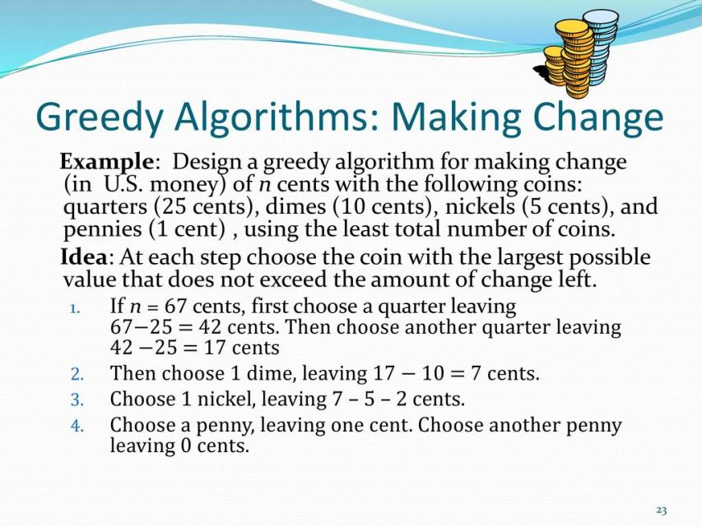

Slide 25
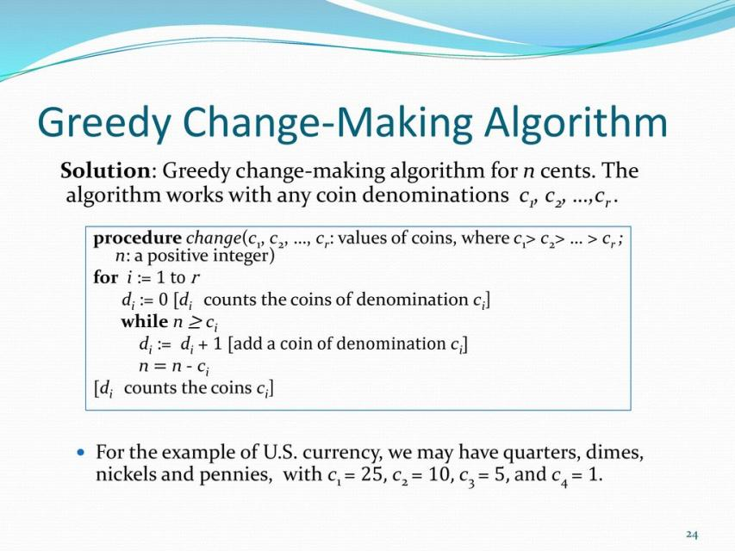

Slide 26
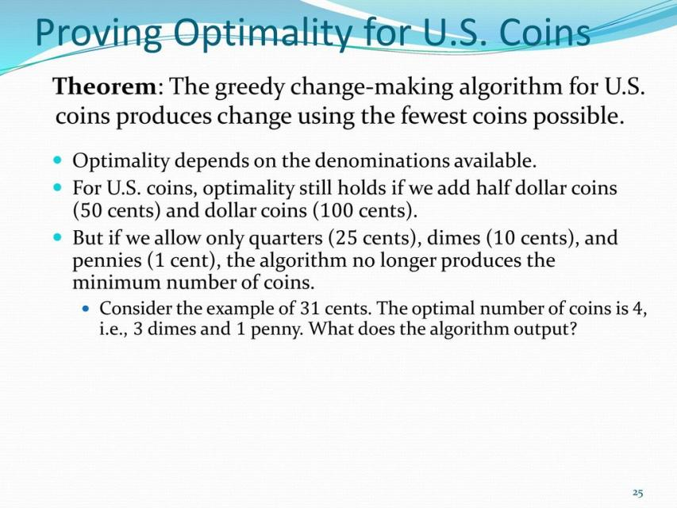

Slide 27
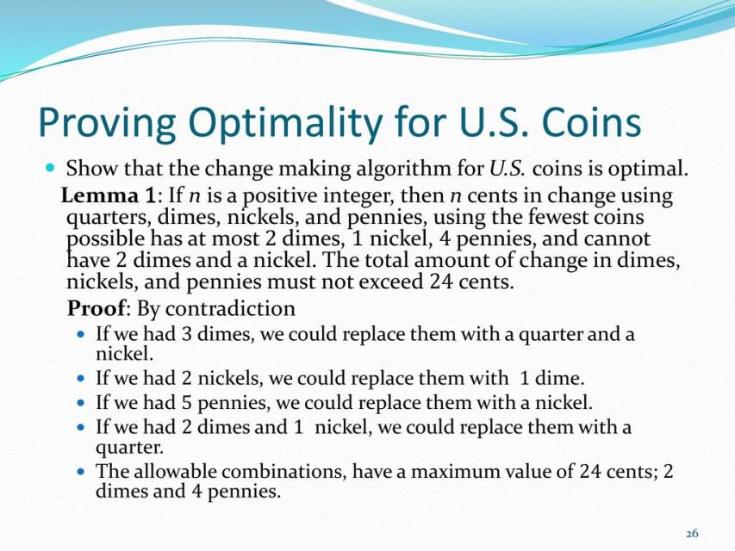

Slide 28
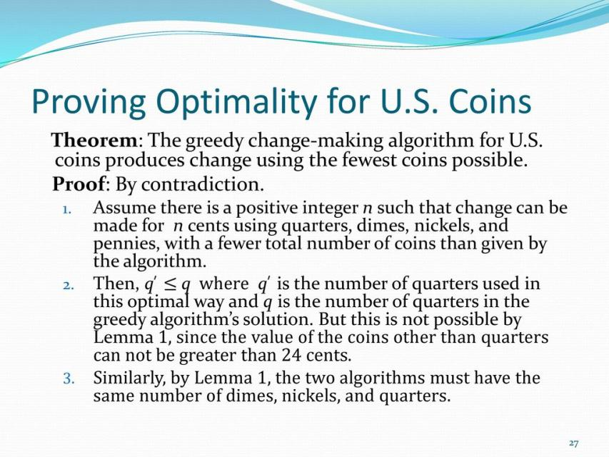

Slide 29
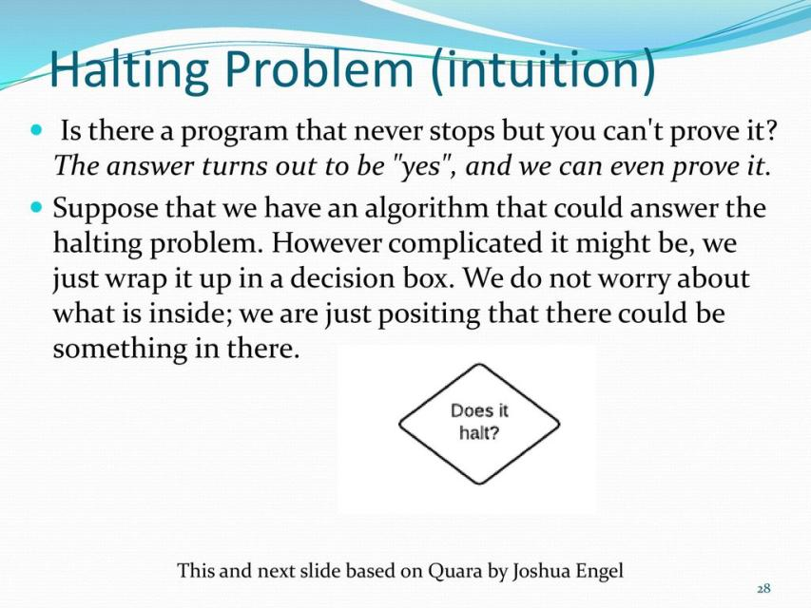

Slide 30
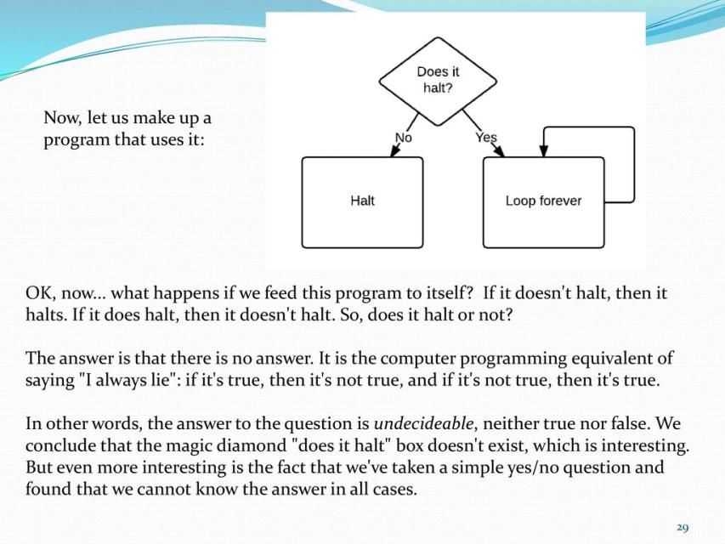

Slide 31
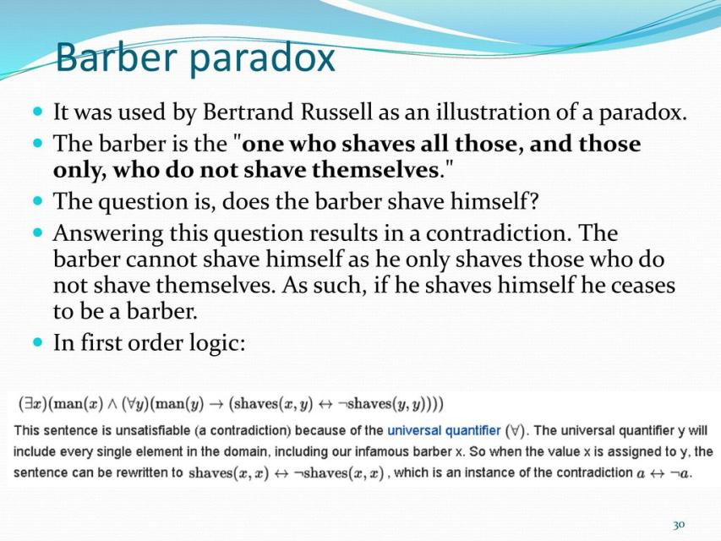

Slide 32
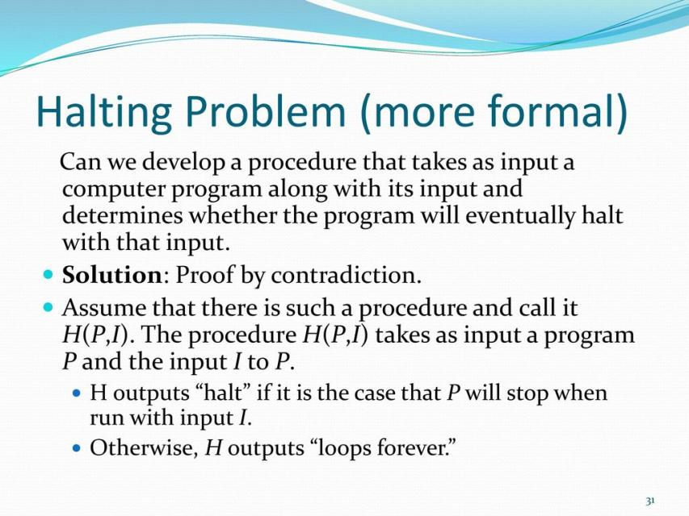

Slide 33
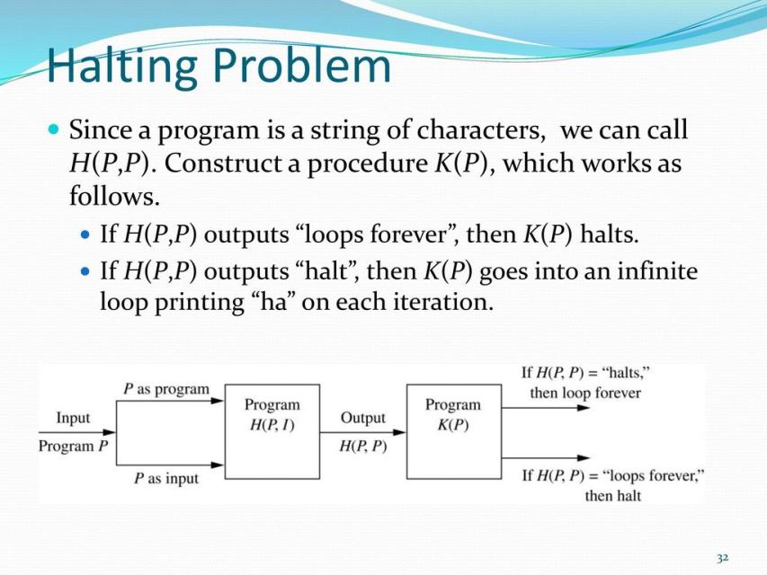

Slide 34
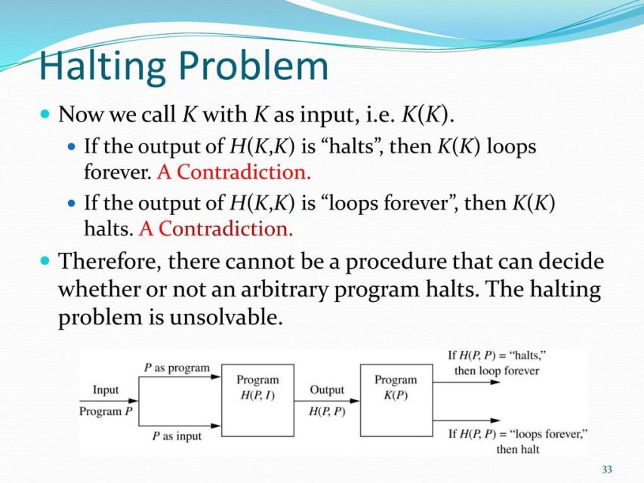

Slide 35


Slide 36
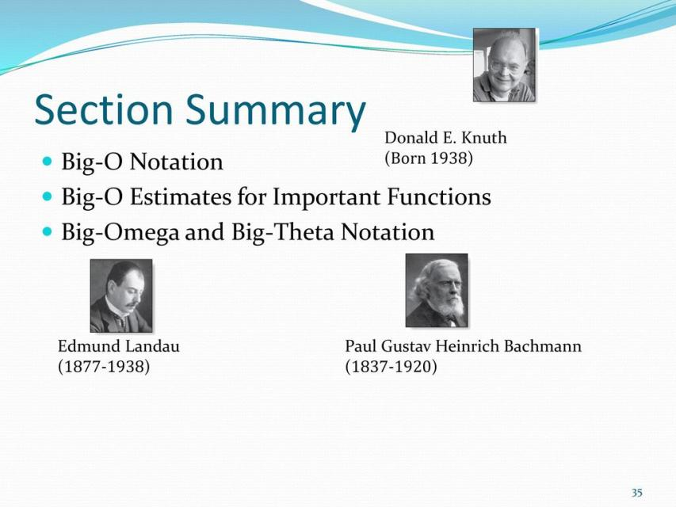

Slide 37
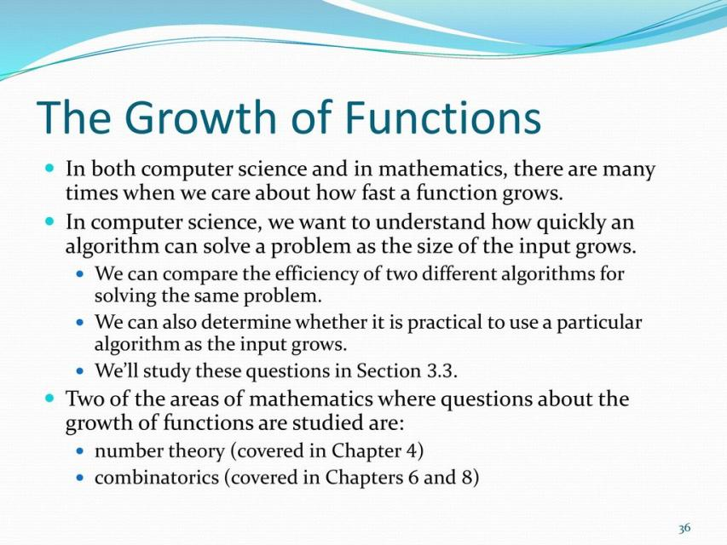

Slide 38
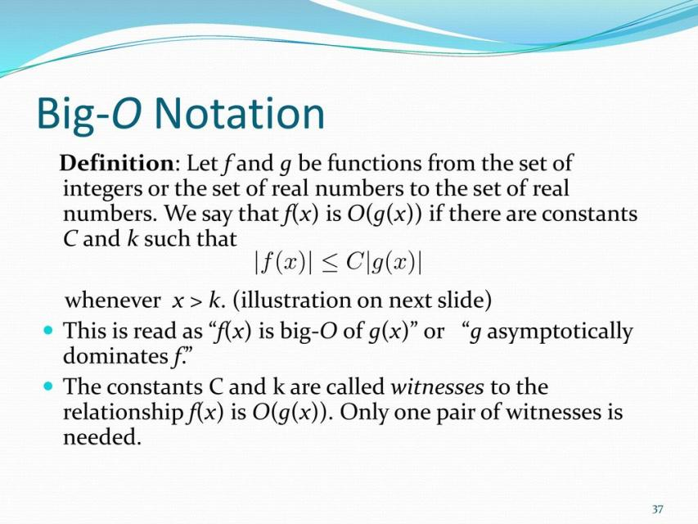

Slide 39
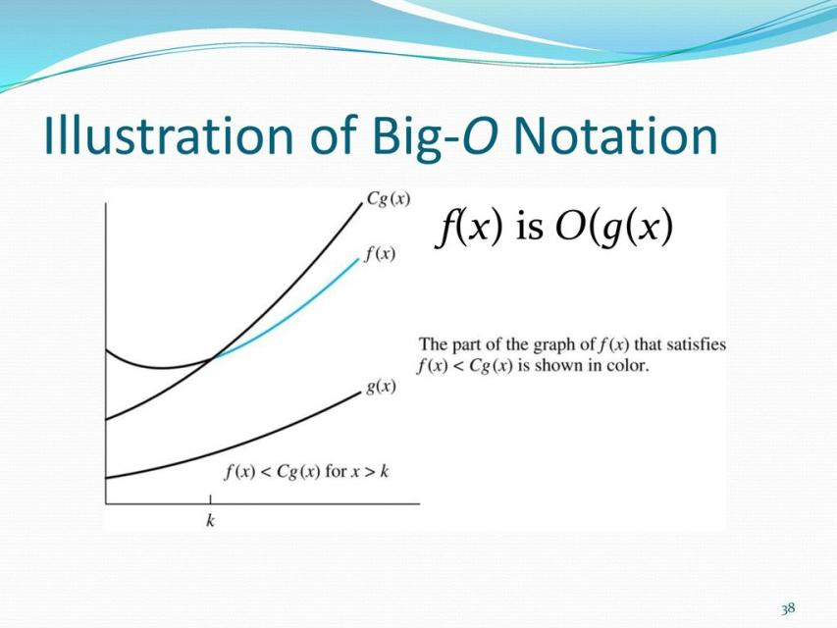

Slide 40
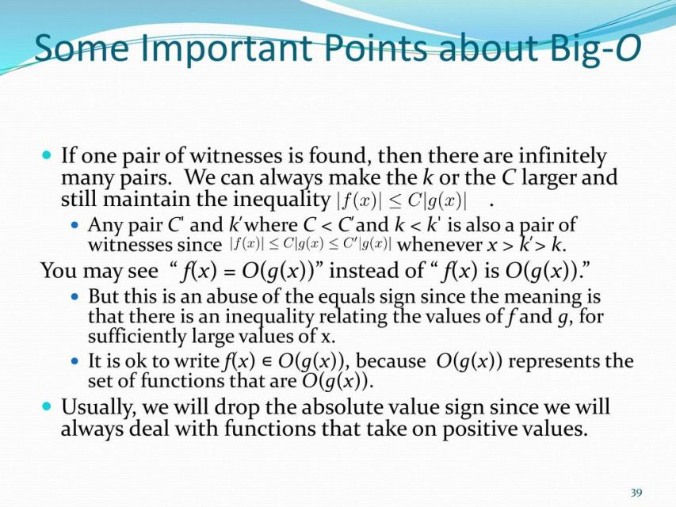

Slide 41
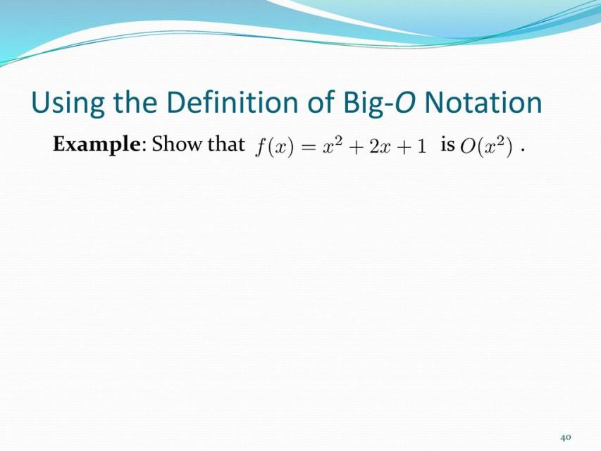

Slide 42
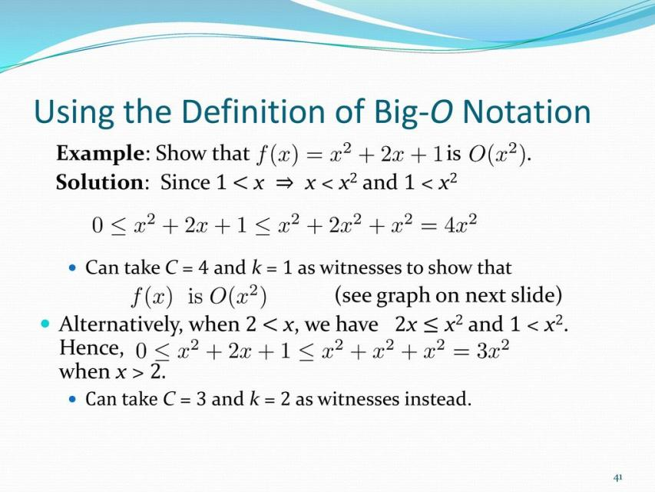

Slide 43
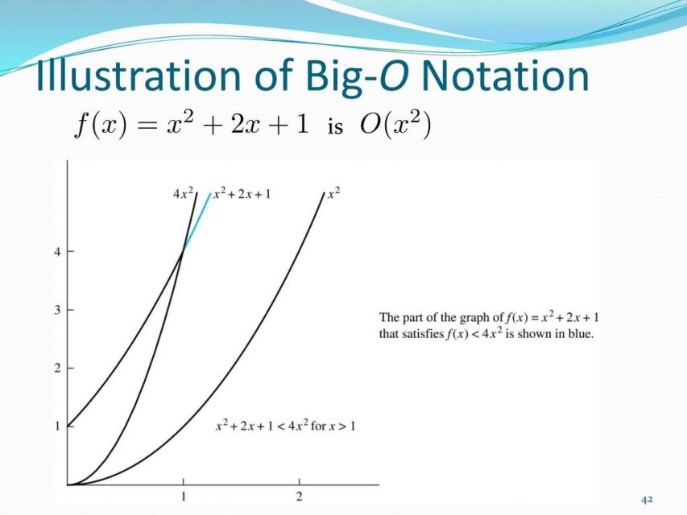

Slide 44
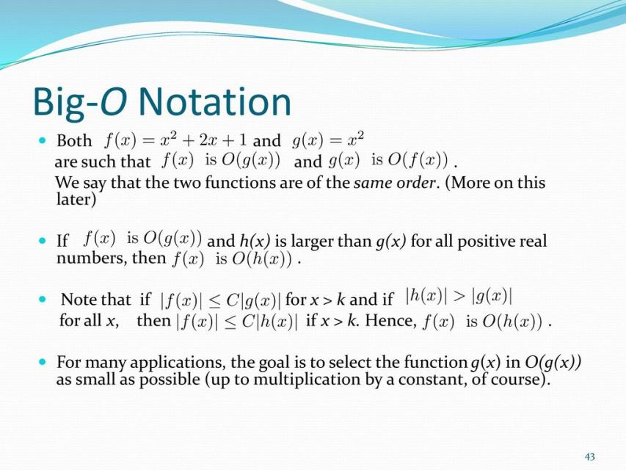

Slide 45
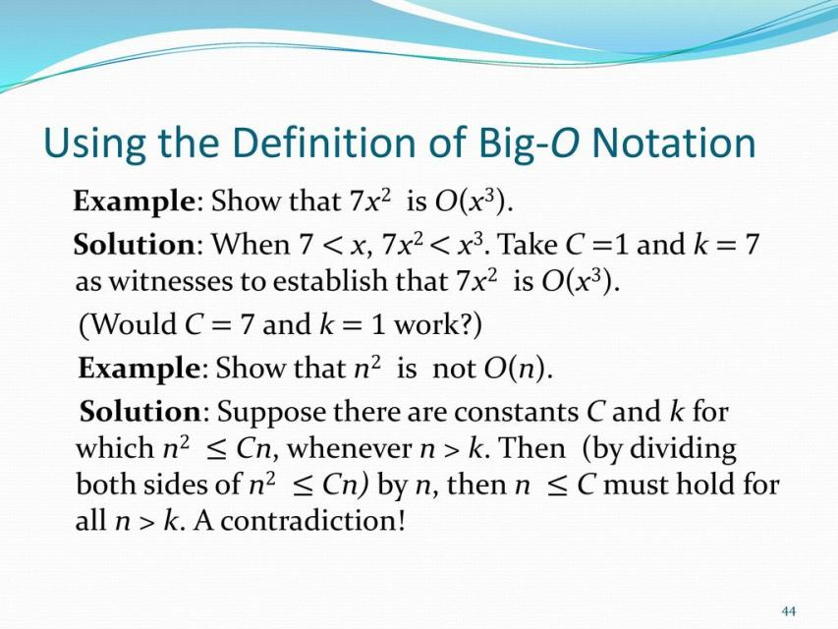

Slide 46
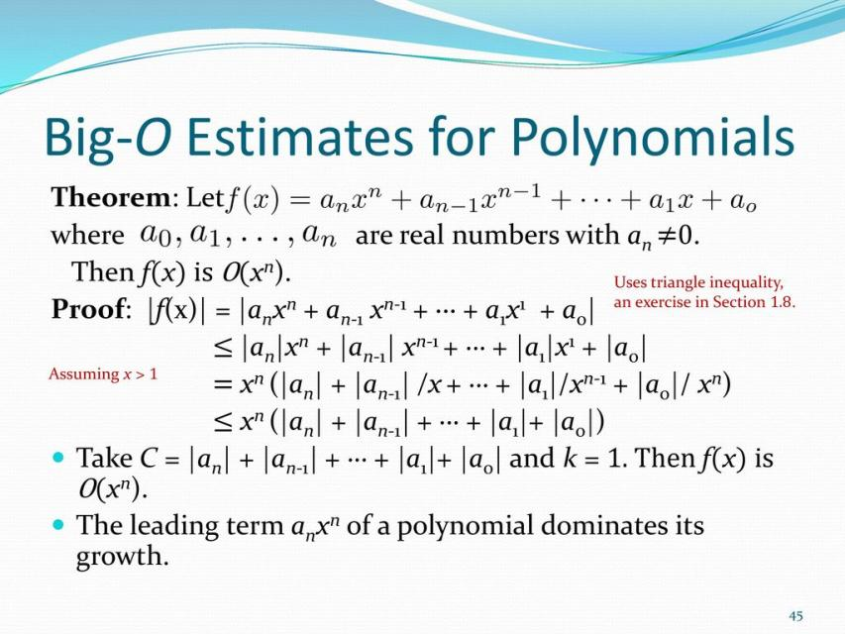

Slide 47
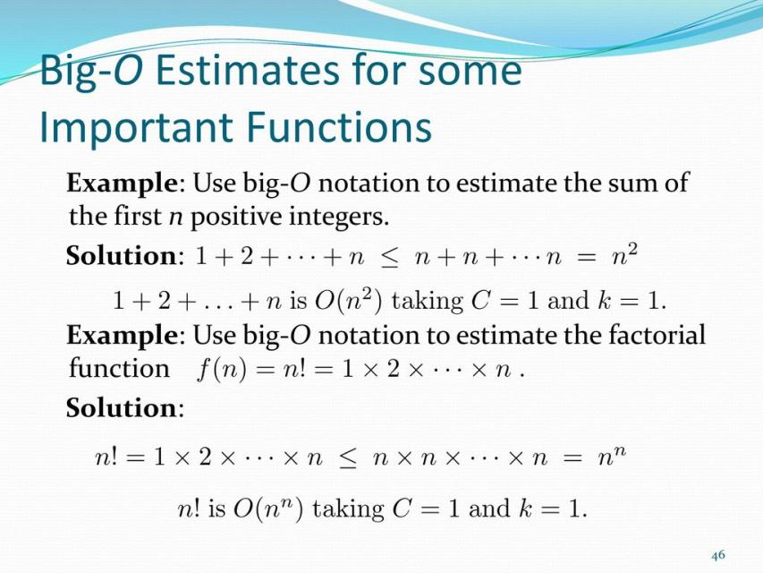

Slide 48
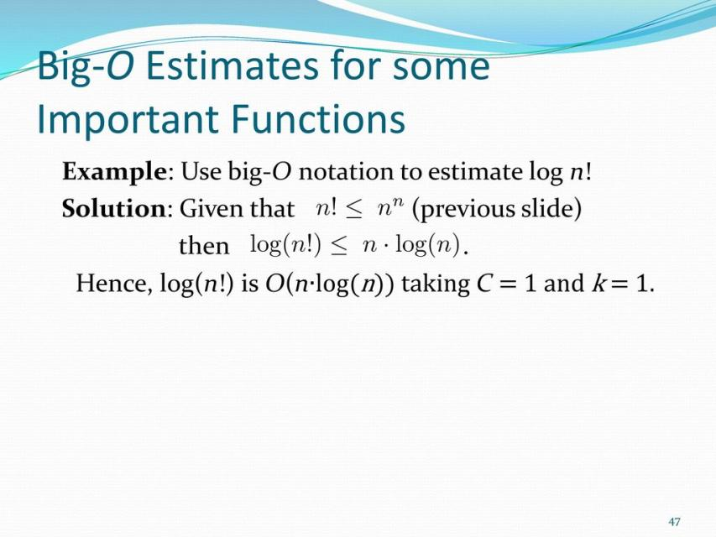

Slide 49
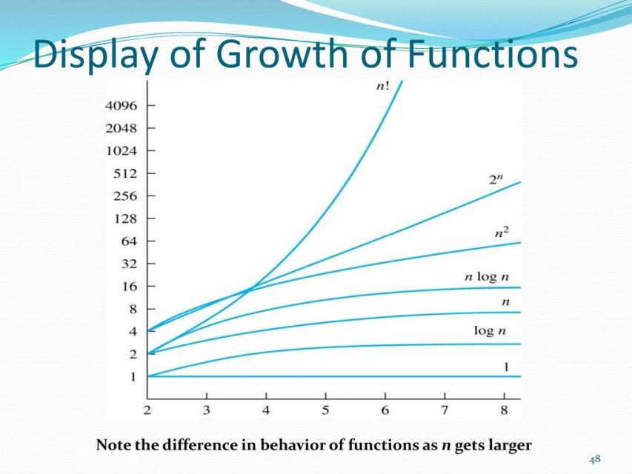

Slide 50
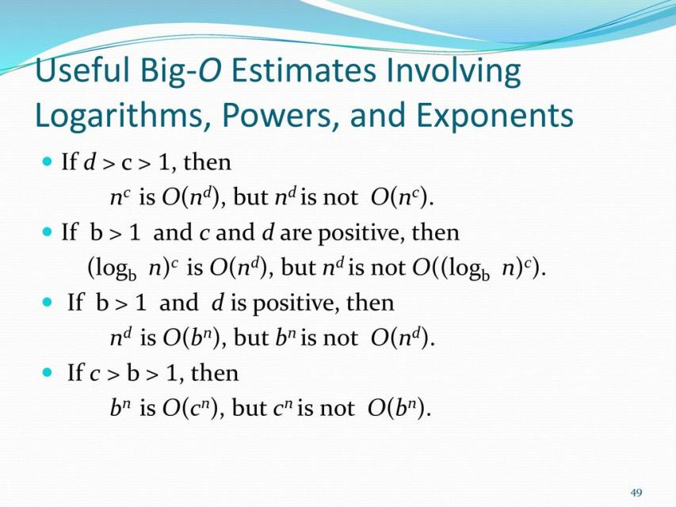

Slide 51
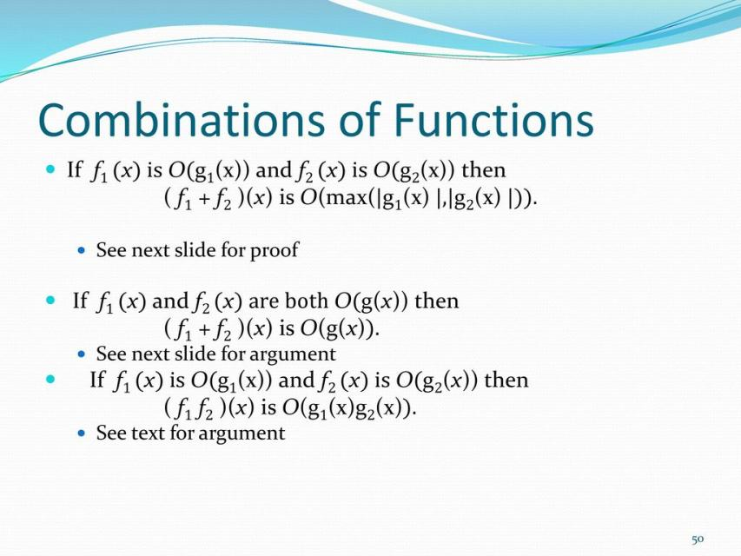

Slide 52
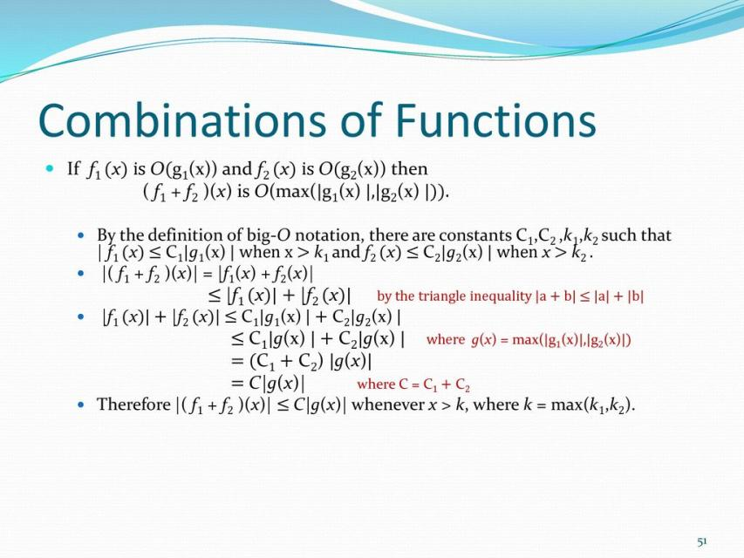

Slide 53
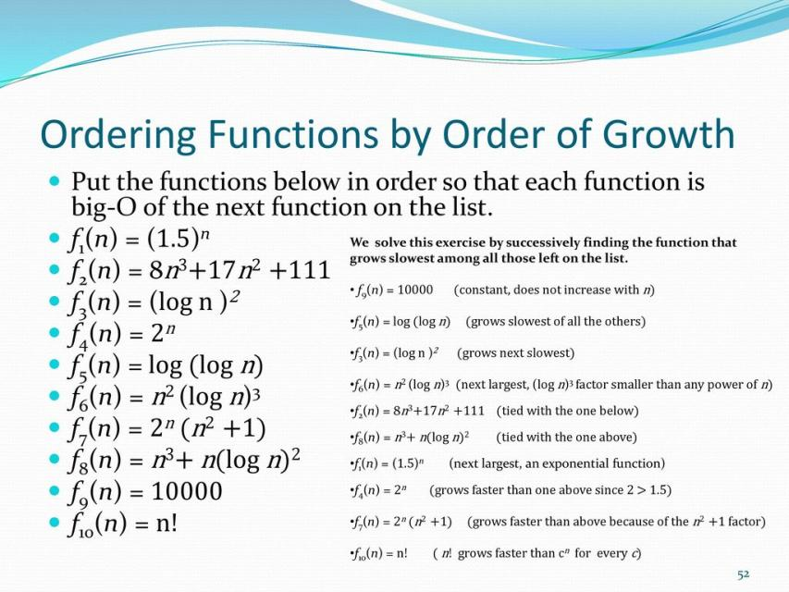

Slide 54
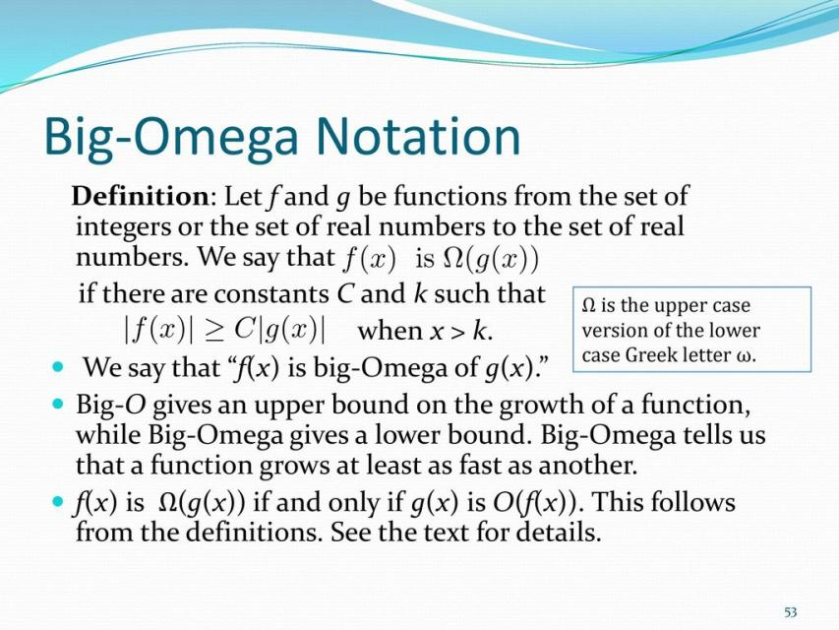

Slide 55
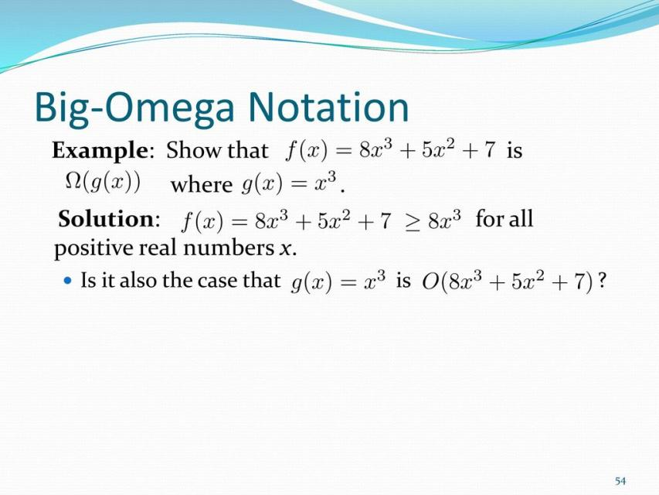

Slide 56


Slide 57


Slide 58


Slide 59


Slide 60


Slide 61


Slide 62


Slide 63


Slide 64


Slide 65


Slide 66


Slide 67


Slide 68


Slide 69


Slide 70


Slide 71


Slide 72


Slide 73


Slide 74


Slide 75


Slide 76


Slide 77


Slide 78


Slide 79


Slide 80


Slide 81


Slide 82


Slide 83


Slide 84


Slide 85


Slide 86


Slide 87

Graphs
What are graphs?
      A class of discrete structures useful for representing relations among objects.
      Vertices (nodes) connected by edges.
      Theory about graphs can be used to solve a lot of important problems

Slide 88

The First Graph Theory
  The first graph theory paper by Leonhard
  Euler in 1736: Seven bridges of Königsberg,
  A town with 7 bridges and 4 pieces of land…

Slide 89

The Origin of Graph Theory
Can we travel each bridge exactly once and return to the starting point?

Slide 90

Definition - Graphs
  A graph G = (V, E) is defined by a set of vertices V , and a set of edges E consisting of ordered or unordered pairs of vertices from V.
  Thus a graph G = (V, E)
    V = set of vertices
    E = set of edges = subset of V × V
Each edge has either one or two vertices
associated with it, called its endpoints.
An edge is said to connect its endpoints.

Slide 91

Simple Graphs
  A graph in which each edge connects two different vertices and where no two edges connect the same pair of vertices.

Slide 92
Example

Slide 93


Multigraph
A multigraph: multiple edges
connecting the same nodes
E.g., nodes are cities, edges are
segments of major highways.

Slide 94

Pseudographs
  Pseudograph: Like a multigraph, but edges connecting a node to itself are allowed.

Slide 95

Example

Slide 96

Directed Graphs
  A directed graph (or digraph) (V,E) consists of a set of vertices V and a set of directed edges E on V. Each directed edge is associated with an ordered pair of vertices. The directed edge associated with the ordered pair (u,v) is said to start at u and end at v.

Slide 97

Example

Slide 98

Directed Multigraphs
  A directed multigraph has directed parallel edges.

Slide 99

Example

Slide 100

Types of Graphs: Summary
  Summary of the book’s definitions.
  Keep in mind this terminology is not fully standardized across different authors...

Slide 101
Graph Models: Acquaintanceship Graph
  Represent whether two people know each other, that is, whether they are acquainted.
  Each person in a particular group of people is represented by a vertex.
  Undirected edge is used to connect two people when these people know each other.
  No multiple edges are used.
  Usually no loops are used. (If we want to include the notion of self-knowledge, we would include loops.)

Slide 102

Example

Slide 103

An Influence Graph
  A directed edge (a, b) means a can influence b.
  E.g. (Fred, Brian) means Fred can influence Brian.

Slide 104
Example
Construct an influence graph for the board members of a company if the President can influence the Director of Research and Development, the Director of Marketing and the Director of Operations; the Director of Research and Development can influence the Director of Operations; the Director of Marketing can influence the Director of Operations; and no one can influence, or be influenced by, the Chief Financial Officer.

Slide 105
Round Robin Tournaments
  A tournament where each team plays each other team exactly once.
  Such tournaments can be modeled using directed graphs where each team is represented by a vertex. Note that (a, b) is an edge if team ‘a’ beats team ‘b’. This graph is a simple directed graph, containing no loops or multiple directed edges.

Slide 106

Example
  Team 1 is undefeated in this tournament, and Team 3 is winless.

Slide 107

Intersection Graph
  The intersection graph of a collections of sets $A_{1},A_{2},A_{3},…,A_{n}$ is the graph that has a vertex for each of these sets and has an edge connecting the vertices representing two sets if these sets have a non empty intersection.
  $A_{1}=\{0, 2, 4, 6, 8\}$
  $A_{2}=\{0, 1, 2, 3, 4\}$
  $A_{3}=\{1, 3, 5, 7, 9\}$

Slide 108
Graph Terminologies
  Adjacent:
    Let G be an undirected graph with edge set E. Let e ∈ E be (or map to) the pair {u,v}. Then we say:
    u, v are adjacent / neighbors / connected.
  Edge e is incident with vertices u and v.
  Edge e connects u and v.
  Vertices u and v are endpoints of edge e.

Slide 109

Degree of a Vertex
  Let G be an undirected graph, v ∈ V a vertex.
  The degree of v, deg(v), is its number of incident edges. (Except that any self-loops are counted twice.)
deg(a) = 3
deg(b) = 5
deg(c) = 5
deg(d) = 5
deg(e) = 0 (isolated vertex)
Pendant vertex = with deg . 1

Slide 110

Example
What are the degrees of vertices of following graph?
How many edges are there in a graph with 10 vertices each of degree six?

Slide 111
Handshaking Theorem
  Let G be an undirected (simple, multi-, or pseudo-) graph with vertex set V and edge set E. Then
deg(a)=3, deg(b)=5, deg(c)=5, deg(d)=5, deg(e)=0

Slide 112

Handshaking Theorem
  Any undirected graph has an even number of vertices of odd degree.
  Let $V_{1}$ and $V_{2}$ be the set of vertices of even and odd degrees respectively, in an undirected graph, then
  |$V_{2}$| has to be even.

Slide 113

Directed Degree
  When $(u,v)$ is an edge of the graph G with directed edges, $u$ is said to be adjacent to $v$. The vertex $u$ is called the initial vertex of $\left(u,v\right)$, and $v$ is called the terminal or end vertex of $\left(u,v\right).$
  The initial vertex and terminal vertex of a loop are the same.

Slide 114

Directed Degree
  Let G be a directed graph, v a vertex of G.
  The in-degree of v, $\deg^{−}(v)$, is the number of edges with $v$ as their terminal vertex.
  The out-degree of v, $\deg^{+}(v)$, is the number of edges with $v$ as their initial vertex.
  The degree of v, $deg⁡(v):≡ \deg^{−}\left(v\right)+\deg^{+}(v)$is the sum of v’s in-degree and out-degree.
  Loop at a vertex contributes 1 to both the in-degree and the out-degree of this vertex.

Slide 115


Example
  Determine in/out-degree of each node
  $\deg^{+}\left(a\right)=4$ $\deg^{−}\left(a\right)=2$
  $\deg^{+}\left(b\right)=1 \deg^{−}\left(b\right)=2$
  $\deg^{+}\left(c\right)=2$ $\deg^{−}\left(c\right)=3$
  $\deg^{+}\left(d\right)=2 \deg^{−}\left(d\right)=2$
  $\deg^{+}\left(e\right)=3$ $\deg^{−}\left(e\right)=3$
  $\deg^{+}\left(f\right)=0 \deg^{−}\left(f\right)=0$

Slide 116

Theorem
Let $G=(V,E)$ be a graph with directed edges then

Slide 117
Chapter Exercise
Chapter # 10
Topic # 10.1
Q – 1,3,4,5,6,7,8,9,13,16,19,21,22
Topic # 10.2
Q -1,2,3,4,7,8,9,10,21,22,23,24,27
Topic # 10.3
Q – 1,2,3,4,5,6,7,8,10,11,12,13,14,15,16,17,18,19,20,21,
22,23,24,26,27

