Slide 1
Discrete Structures (Discrete Mathematics)
Lecture -1 (of) Graphs

Slide 2
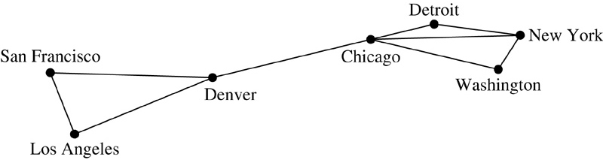
Graphs
What are graphs?
A class of discrete structures useful for representing relations among objects.
Vertices (nodes) connected by edges.
Theory about graphs can be used to solve a lot of important problems

Slide 3
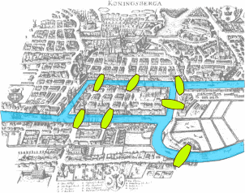
The First Graph Theory
The first graph theory paper by Leonhard
Euler in 1736: Seven bridges of Königsberg,
A town with 7 bridges and 4 pieces of land…

Slide 4
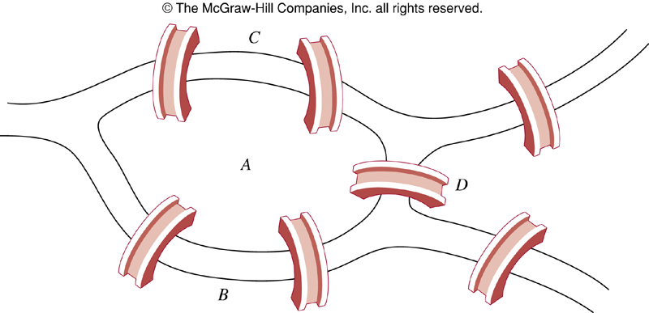
The Origin of Graph Theory
Can we travel each bridge exactly once and return to the starting point?

Slide 5
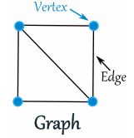
Definition - Graphs
A graph G = (V, E) is defined by a set of vertices V , and a set of edges E consisting of ordered or unordered pairs of vertices from V.
Thus a graph G = (V, E)
V = set of vertices
E = set of edges = subset of V × V
Each edge has either one or two vertices
associated with it, called its endpoints.
An edge is said to connect its endpoints.

Slide 6
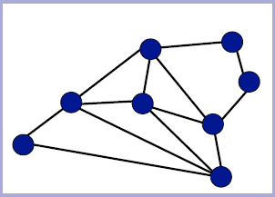
Simple Graphs
A graph in which each edge connects two different vertices and where no two edges connect the same pair of vertices.

Slide 7
Example

Slide 8
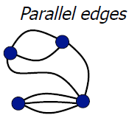
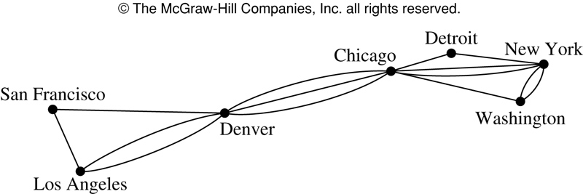
Multigraph
A multigraph: multiple edges
connecting the same nodes
E.g., nodes are cities, edges are
segments of major highways.

Slide 9
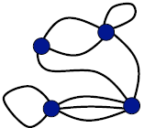
Pseudographs
Pseudograph: Like a multigraph, but edges connecting a node to itself are allowed.

Slide 10
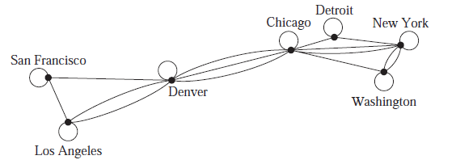
Example

Slide 11
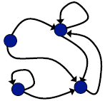
Directed Graphs
A directed graph (or digraph) (V,E) consists of a set of vertices V and a set of directed edges E on V. Each directed edge is associated with an ordered pair of vertices. The directed edge associated with the ordered pair (u,v) is said to start at u and end at v.

Slide 12
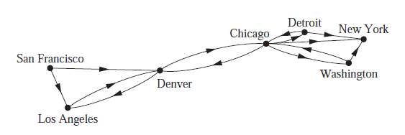
Example

Slide 13
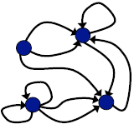
Directed Multigraphs
A directed multigraph has directed parallel edges.

Slide 14
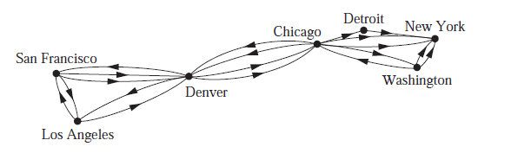
Example

Slide 15
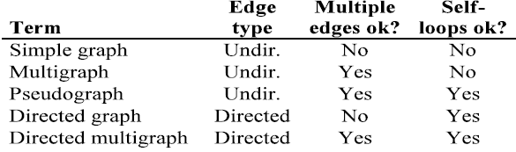
Types of Graphs: Summary
Summary of the book’s definitions.
Keep in mind this terminology is not fully standardized across different authors...

Slide 16
Graph Models: Acquaintanceship Graph
Represent whether two people know each other, that is, whether they are acquainted.
Each person in a particular group of people is represented by a vertex.
Undirected edge is used to connect two people when these people know each other.
No multiple edges are used.
Usually no loops are used. (If we want to include the notion of self-knowledge, we would include loops.)

Slide 17
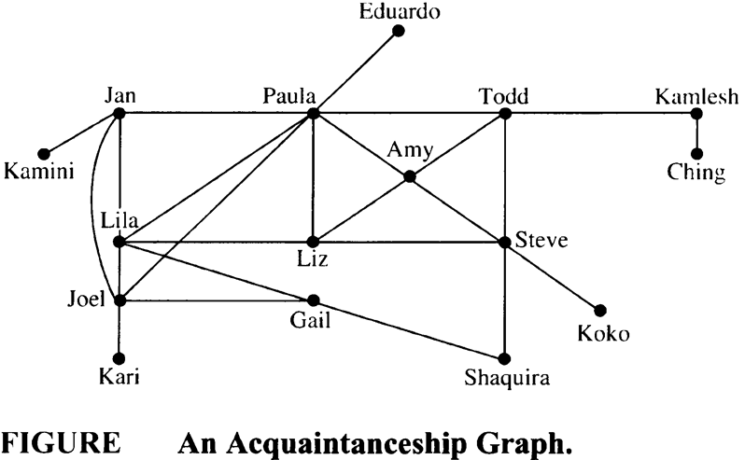
Example

Slide 18
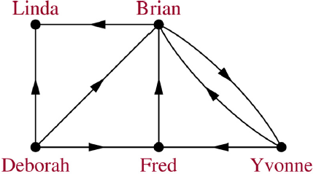
An Influence Graph
A directed edge (a, b) means a can influence b.
E.g. (Fred, Brian) means Fred can influence Brian.

Slide 19
Example
Construct an influence graph for the board members of a company if the President can influence the Director of Research and Development, the Director of Marketing and the Director of Operations; the Director of Research and Development can influence the Director of Operations; the Director of Marketing can influence the Director of Operations; and no one can influence, or be influenced by, the Chief Financial Officer.

Slide 20
Round Robin Tournaments
A tournament where each team plays each other team exactly once.
Such tournaments can be modeled using directed graphs where each team is represented by a vertex. Note that (a, b) is an edge if team ‘a’ beats team ‘b’. This graph is a simple directed graph, containing no loops or multiple directed edges.

Slide 21
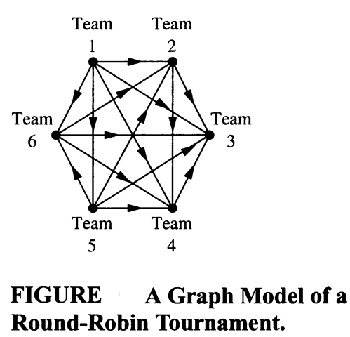
Example
Team 1 is undefeated in this tournament, and Team 3 is winless.

Slide 22
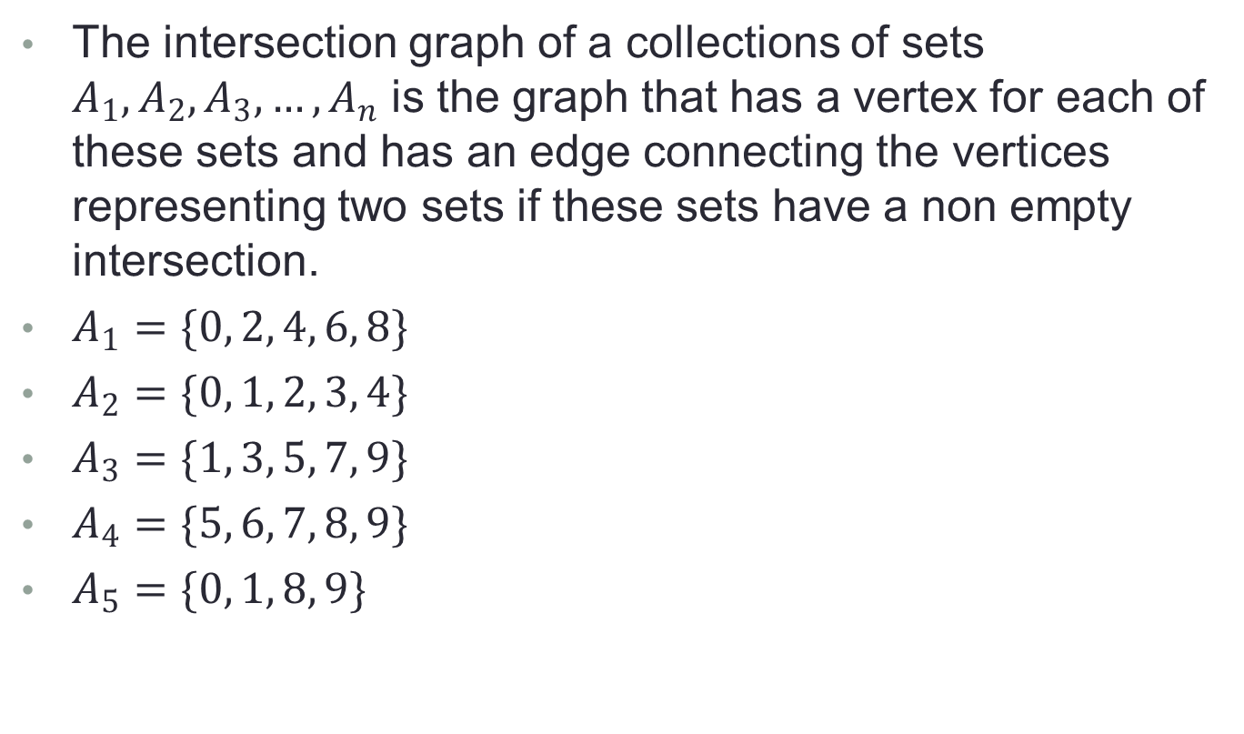
Intersection Graph
The intersection graph of a collections of sets $A_{1},A_{2},A_{3},…,A_{n}$ is the graph that has a vertex for each of these sets and has an edge connecting the vertices representing two sets if these sets have a non empty intersection.
$A_{1}=\{0, 2, 4, 6, 8\}$
$A_{2}=\{0, 1, 2, 3, 4\}$
$A_{3}=\{1, 3, 5, 7, 9\}$

Slide 23
Graph Terminologies
Adjacent:
Let G be an undirected graph with edge set E. Let e ∈ E be (or map to) the pair {u,v}. Then we say:
u, v are adjacent / neighbors / connected.
Edge e is incident with vertices u and v.
Edge e connects u and v.
Vertices u and v are endpoints of edge e.

Slide 24
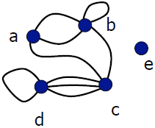
Degree of a Vertex
Let G be an undirected graph, v ∈ V a vertex.
The degree of v, deg(v), is its number of incident edges. (Except that any self-loops are counted twice.)
deg(a) = 3
deg(b) = 5
deg(c) = 5
deg(d) = 5
deg(e) = 0 (isolated vertex)
Pendant vertex = with deg . 1

Slide 25
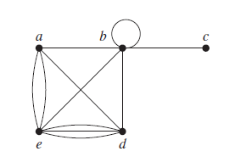
Example
What are the degrees of vertices of following graph?
How many edges are there in a graph with 10 vertices each of degree six?

Slide 26
Handshaking Theorem
Let G be an undirected (simple, multi-, or pseudo-) graph with vertex set V and edge set E. Then
deg(a)=3, deg(b)=5, deg(c)=5, deg(d)=5, deg(e)=0

Slide 27
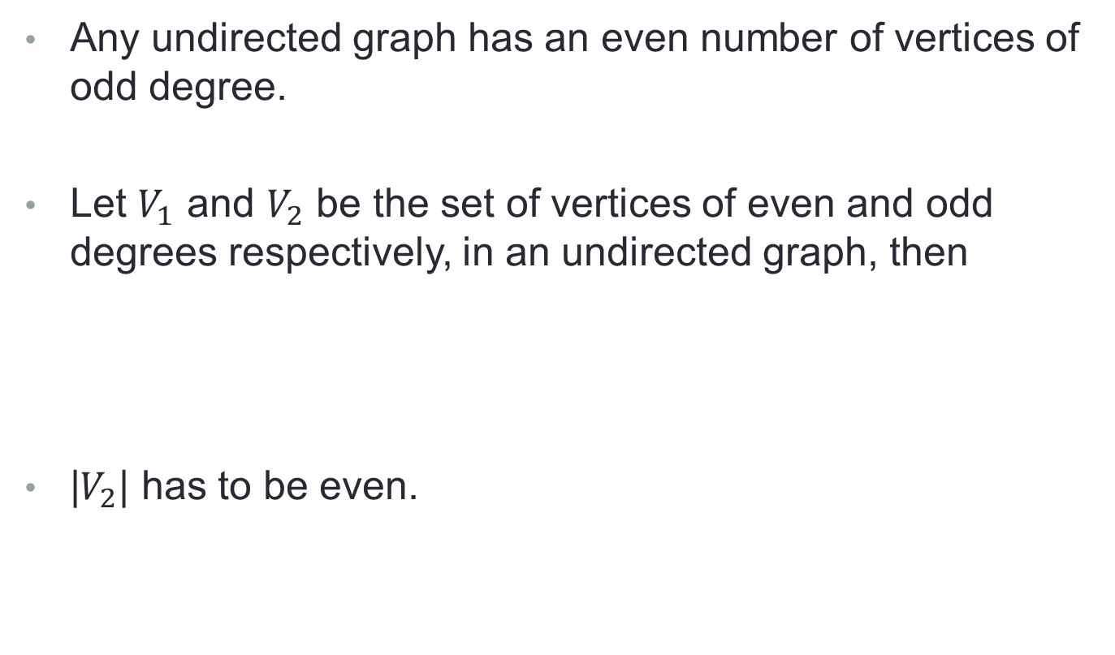
Handshaking Theorem
Any undirected graph has an even number of vertices of odd degree.
Let $V_{1}$ and $V_{2}$ be the set of vertices of even and odd degrees respectively, in an undirected graph, then
|$V_{2}$| has to be even.

Slide 28

Directed Degree
When $(u,v)$ is an edge of the graph G with directed edges, $u$ is said to be adjacent to $v$. The vertex $u$ is called the initial vertex of $\left(u,v\right)$, and $v$ is called the terminal or end vertex of $\left(u,v\right).$
The initial vertex and terminal vertex of a loop are the same.

Slide 29
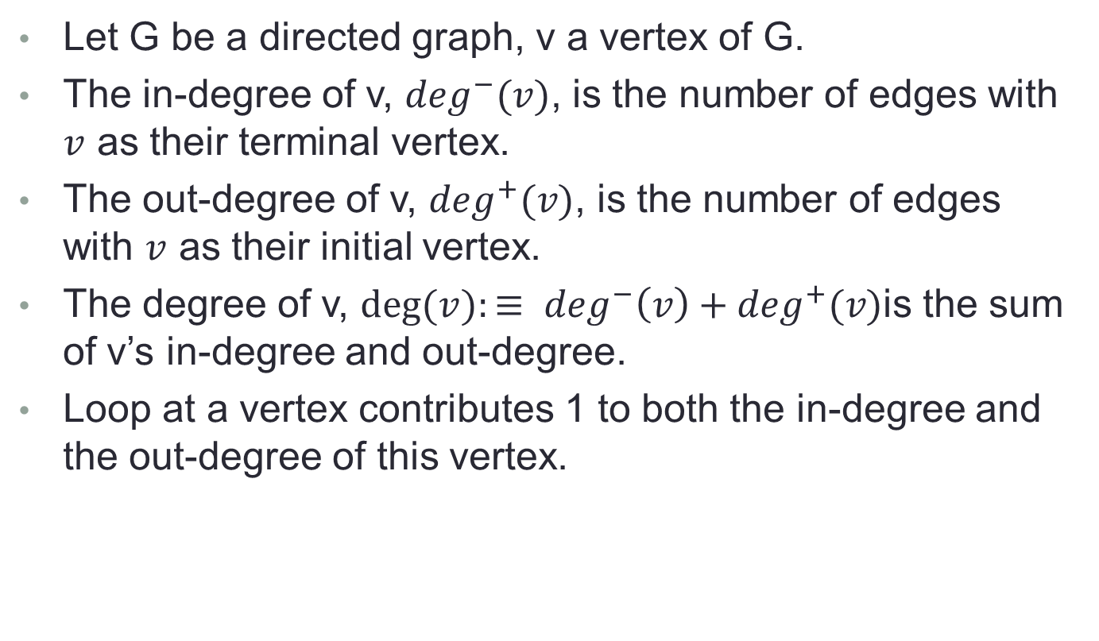
Directed Degree
Let G be a directed graph, v a vertex of G.
The in-degree of v, $\deg^{−}(v)$, is the number of edges with $v$ as their terminal vertex.
The out-degree of v, $\deg^{+}(v)$, is the number of edges with $v$ as their initial vertex.
The degree of v, $deg⁡(v):≡ \deg^{−}\left(v\right)+\deg^{+}(v)$is the sum of v’s in-degree and out-degree.
Loop at a vertex contributes 1 to both the in-degree and the out-degree of this vertex.

Slide 30
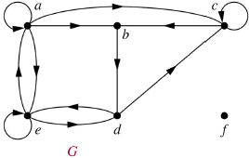
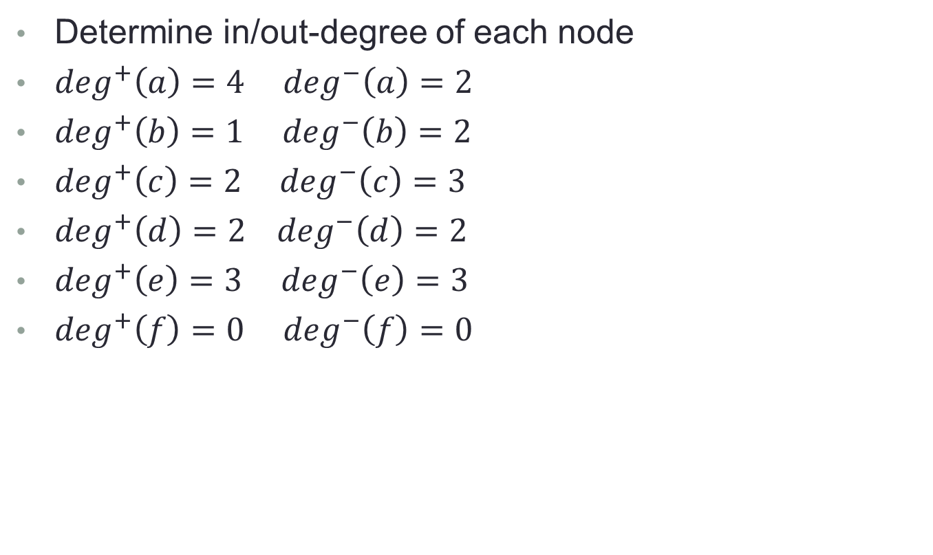
Example
Determine in/out-degree of each node
$\deg^{+}\left(a\right)=4$ $\deg^{−}\left(a\right)=2$
$\deg^{+}\left(b\right)=1 \deg^{−}\left(b\right)=2$
$\deg^{+}\left(c\right)=2$ $\deg^{−}\left(c\right)=3$
$\deg^{+}\left(d\right)=2 \deg^{−}\left(d\right)=2$
$\deg^{+}\left(e\right)=3$ $\deg^{−}\left(e\right)=3$
$\deg^{+}\left(f\right)=0 \deg^{−}\left(f\right)=0$

Slide 31

Theorem
Let $G=(V,E)$ be a graph with directed edges then

Slide 32
Chapter Exercise
Chapter # 10
Topic # 10.1
Q – 1,3,4,5,6,7,8,9,13,16,19,21,22
Topic # 10.2
Q -1,2,3,4,7,8,9,10,21,22,23,24,27
Topic # 10.3
Q – 1,2,3,4,5,6,7,8,10,11,12,13,14,15,16,17,18,19,20,21,
22,23,24,26,27

