Slide 1
CSD101 - Discrete Structures (Discrete Mathematics) Fall 2016
Lecture – 3 (of) graphs
Topic: Trees

Slide 2
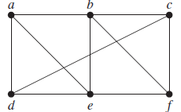
Path
A path is a sequence of edges that begins at a vertex of a graph and travels from vertex to vertex along edges of the graph.

Slide 3
Circuit
The path is a circuit if it begins and ends at the same vertex.
Path a, b, c, d, a is a circuit.

Slide 4
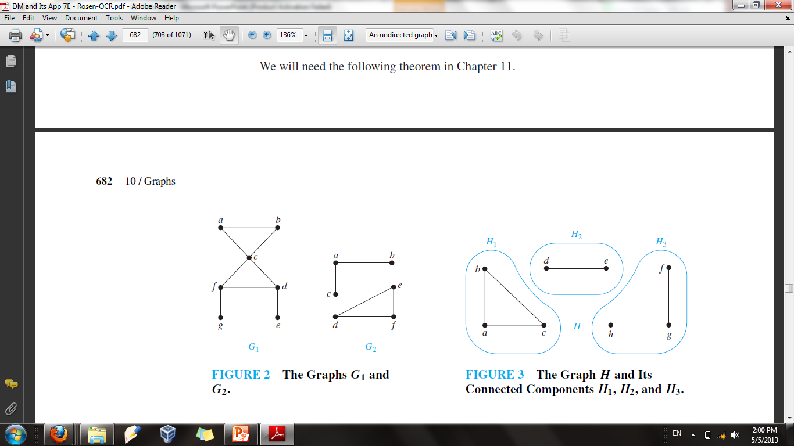
Connected Graph
An undirected graph is called connected if there is a path between every pair of distinct vertices of the graph.

Slide 5
Connected Graph
The graph G1 is connected.
The graph G2 is not connected. (For instance, there is no path in G2 between vertices a and d.)

Slide 6
Tree
Trees are particularly useful in computer science, where they are employed in a wide range of algorithms.
A tree is an undirected graph T such that
T is connected
T has no cycles (circuits)
A tree cannot contain multiple edges or loops. Therefore any tree must be a simple graph.
Tree

Slide 7
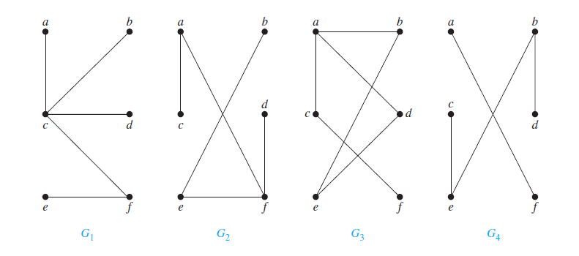
Example
Which of the graphs are trees?

Slide 8
Example
G1 and G2 are trees, because both are connected graphs with no simple circuits.
G3 is not a tree because e, b, a, d, e is a simple circuit in this graph.
G4 is not a tree because it is not connected.

Slide 9
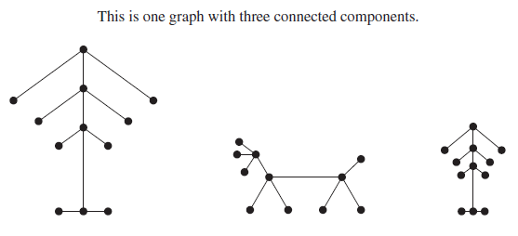
Forest
A forest is an undirected graph such that
It has no simple circuits
It is not necessarily connected
The connected components of a forest are trees

Slide 10
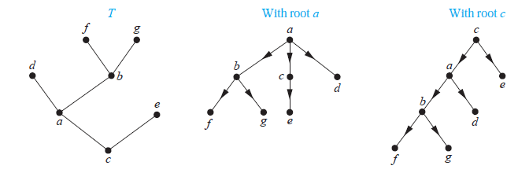
Rooted Tree
A rooted tree is a tree in which one vertex has been designated as the root and every edge is directed away from the root.
Root, parent, child, siblings relations between vertices

Slide 11
Terminologies
Suppose that T is a rooted tree.
If v is a vertex in T other than the root, the parent of v is the unique vertex u such that there is a directed edge from u to v. When u is the parent of v, v is called a child of u.
Vertices with the same parent are called siblings.
The ancestors of a vertex other than the root are the vertices in the path from the root to this vertex, excluding the vertex itself and including the root (that is, its parent, its parent’s parent, and so on, until the root is reached).
The descendants of a vertex v are those vertices that have v as an ancestor.

Slide 12
Terminologies
A vertex of a rooted tree is called a leaf if it has no children.
Vertices that have children are called internal vertices. The root is an internal vertex unless it is the only vertex in the graph, in which case it is a leaf.
If a is a vertex in a tree, the subtree with a as its root is the subgraph of the tree consisting of a and its descendants and all edges incident to these descendants.

Slide 13
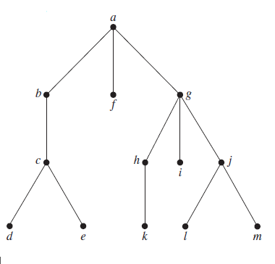
Example
In the rooted tree T (with root a), find the parent of c, the children of g, the siblings of h, all ancestors of e, all descendants of b, all internal vertices, and all leaves. What is the subtree rooted at g?

Slide 14
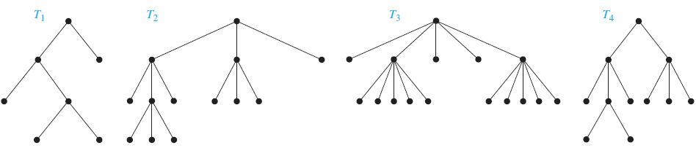
Rooted Tree
A rooted tree is called an m-ary tree if every internal vertex has no more than m children. The tree is called a full m-ary tree if every internal vertex has exactly m children. An m-ary tree with m = 2 is called a binary tree.

Slide 15
Definitions
The level of a vertex v in a rooted tree is the length of the unique path from the root to this vertex.
The level of the root is defined to be zero.
The height of a rooted tree is the maximum of the levels of vertices. In other words, the height of a rooted tree is the length of the longest path from the root to any vertex.

Slide 16
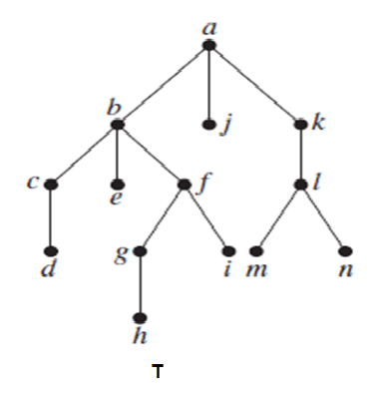
Example
Find the level of each vertex in the rooted tree T. What is the height of this tree?

Slide 17
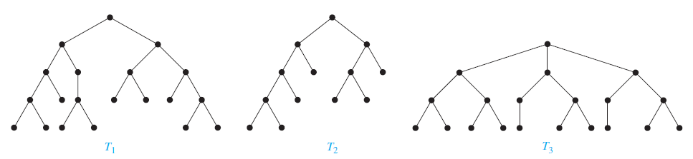
Balanced Trees
A rooted m-ary tree of height h is balanced if all leaves are at levels h or h − 1.

Slide 18
Ordered rooted Tree
An ordered rooted tree is a rooted tree where the children of each internal vertex are ordered.
In a drawing of an ordered rooted tree, with the root shown at the top, the children of a vertex are shown from left to right.

Slide 19
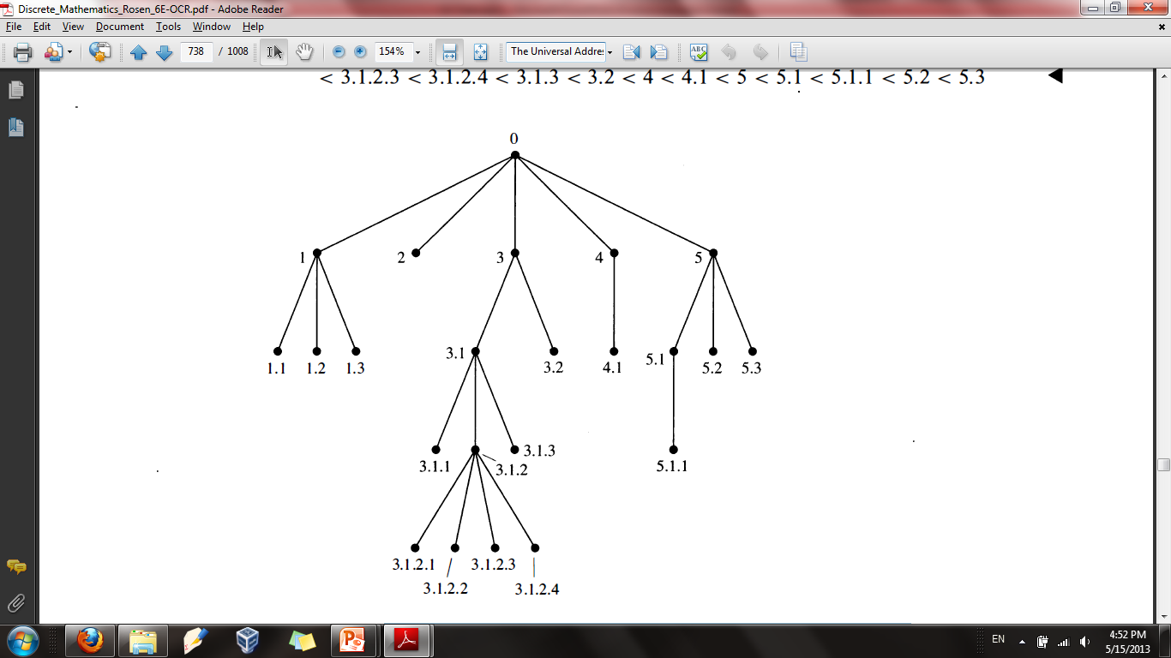
Ordered rooted Tree
An ordered rooted tree is a rooted tree where the children of each internal vertex are ordered.

Slide 20
Tree Traversal and Traversal Algorithms
Ordered rooted trees are often used to store information. Tree traversal is the procedure of visiting different vertices of the tree to read information stored in that vertex. There are three different orders of the tree traversal.
Most commonly used algorithms:
Preorder traversal
Inorder traversal
Postorder traversal
All recursively defined.

Slide 21
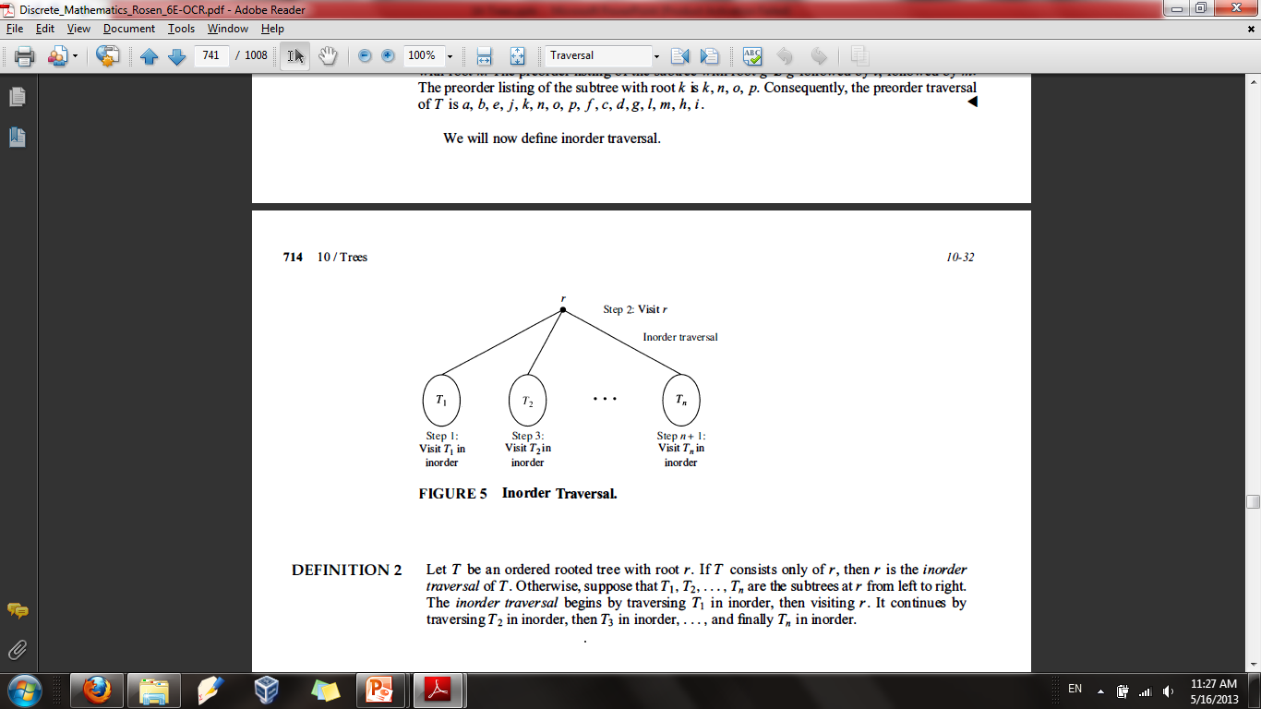

Inorder Traversal
Let $T$ be an ordered rooted tree with root r and $T1, T2, …Tn$are the subtrees at r from left to right. The in order traversal begins by traversing $T1$in inorder, then visiting r. It continues by traversing $T2$ in inorder, then $T3$ in inorder, . .. , and finally $Tn$in inorder.

Slide 22
In-order Tree Walk
Left, root, right
Example:
A, B, D, F, H, K
F
B
H
A
D
K

Slide 23
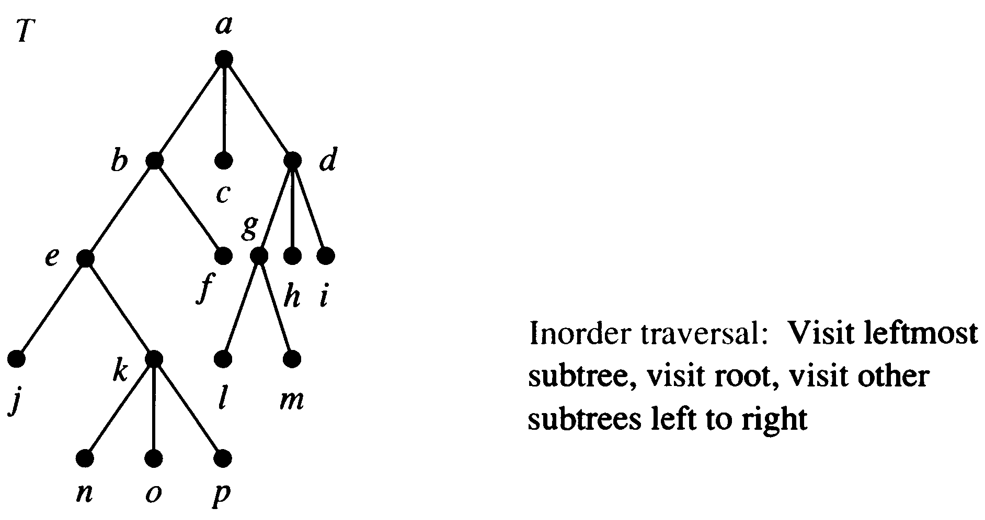
Example

Slide 24
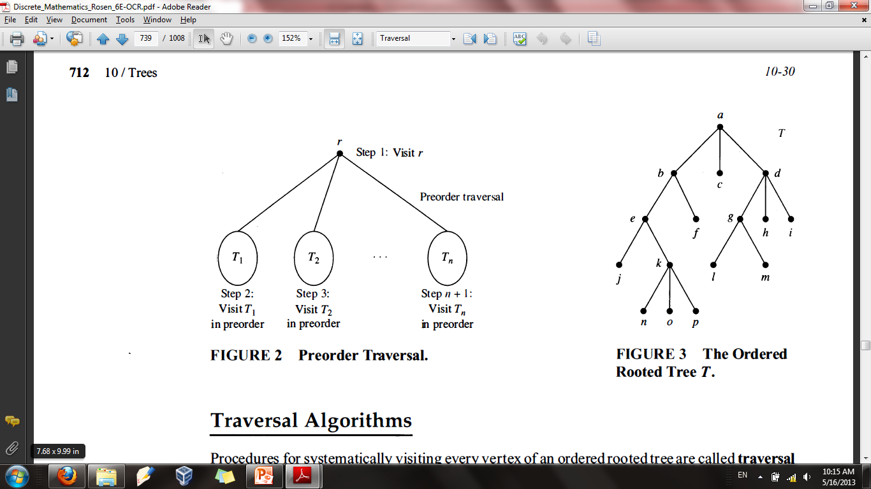

Preorder Traversal
Let T be an ordered rooted tree with root r and $T1, T2, …Tn$are the subtrees at r from left to right. The preorder traversal begins by visiting r . It continues by traversing $T1$ in preorder, then $T2$ in preorder, then $T3$in preorder, . . . , and finally $Tn$ in preorder.

Slide 25
Preorder Traversal
Root, left, right
Example:
F, B, A, D, H, K
F
B
H
A
D
K

Slide 26
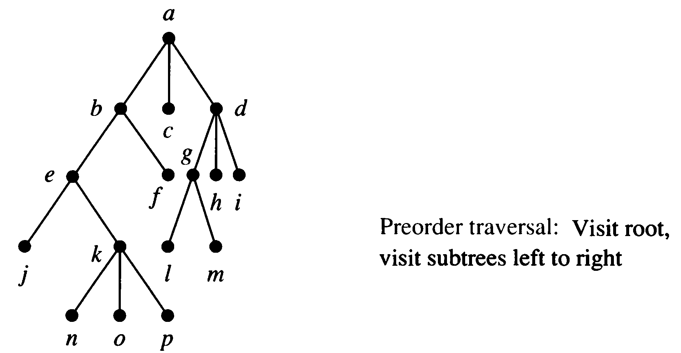
Preorder Traversal

Slide 27
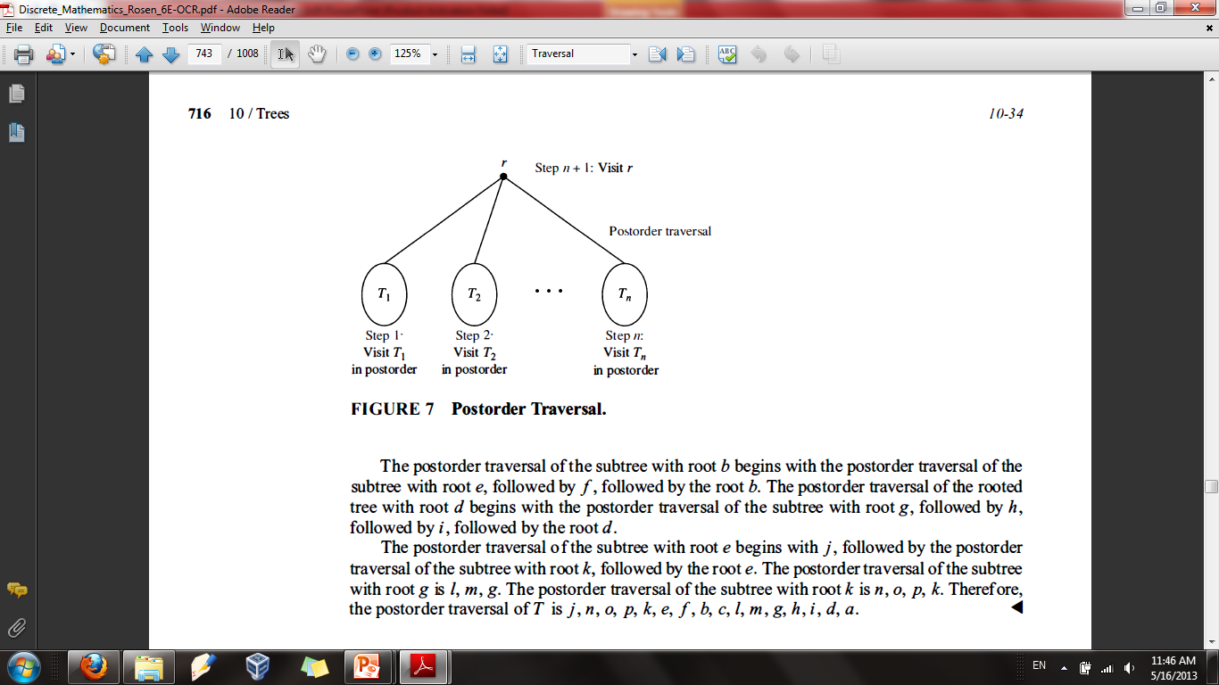

Postorder Traversal
Let T be an ordered rooted tree with root r and $T1, T2, …Tn$ are the subtrees at r from left to right. The postorder traversal begins by traversing $T1$in postorder, then $T2$ in postorder, then $T3$in postorder, . . . , and finally $Tn$ in postorder and ends by visiting r.

Slide 28
Postorder Traversal
Left, right, root
Example:
A, D, B, K, H, F
F
B
H
A
D
K

Slide 29
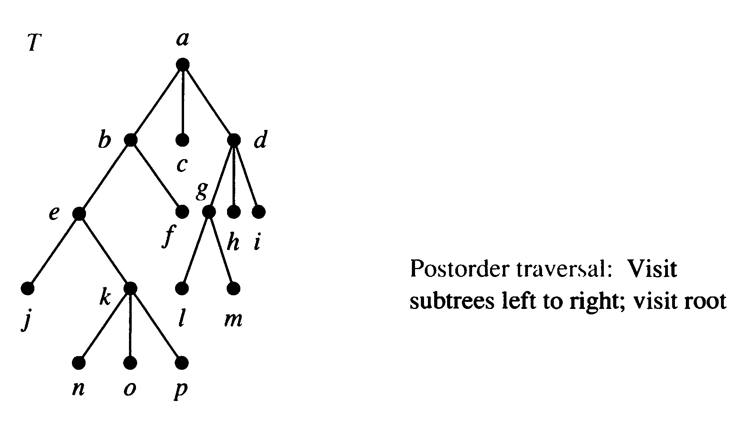
Postorder Traversal

Slide 30
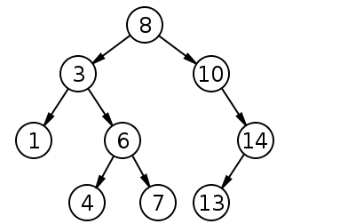
Binary Search Trees
A Binary search tree is a binary tree in symmetric order.
Symmetric order means that:
every node has a key
every node’s key is
larger than all keys in its left subtree
smaller than all keys in its right subtree

Slide 31
Infix, Prefix and Postfix Notation
We can represent complicated expressions using ordered rooted tree.
The representation of an arithmetic expression involving operators + (addition), − (subtraction), ∗ (multiplication),
/ (division), and ↑ (exponentiation).
An ordered rooted tree can be used to represent such expressions, where the internal vertices represent operations, and the leaves represent the variables or numbers.
Use parentheses to indicate the order of the operations.
Each operation operates on its left and right sub trees (in that order).

Slide 32
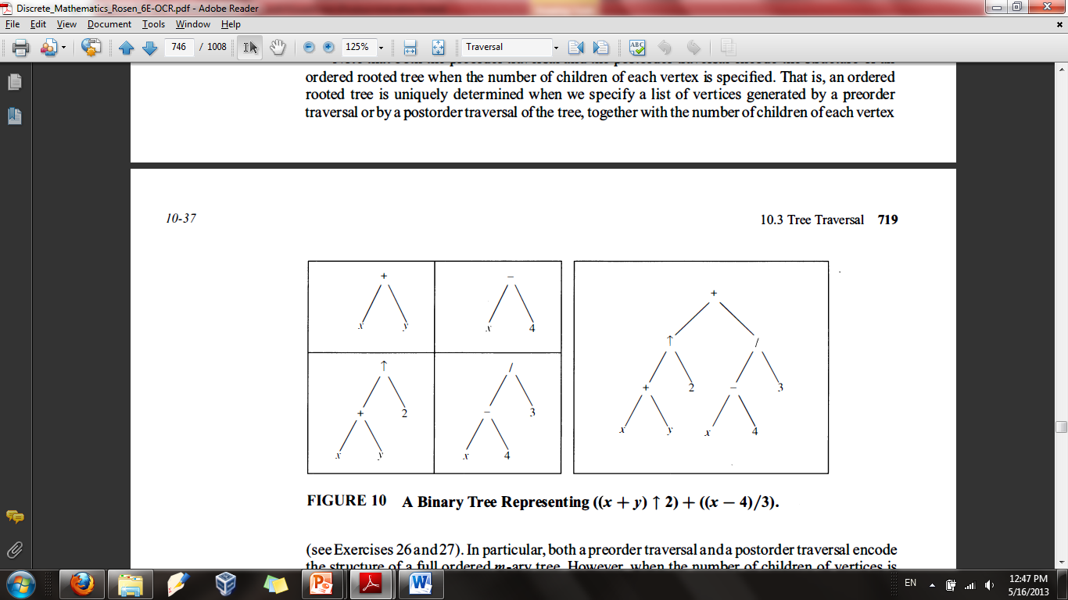

Example
What is the ordered rooted tree that represents the expression $((x + y)↑2) + ((x − 4)/3)$.

Slide 33
Infix, Prefix and Postfix form
Infix Form
It is the common arithmetic and logical formula notation, in which operators are written between the operands
Prefix Form
Also known as Polish notation.
A form of notation for logic, arithmetic, and algebra.
It places operators to the left of their operands.
Postfix Form
Also known as Reverse Polish Notation.
We obtain the postfix form of an expression by traversing its tree in postorder.

Slide 34
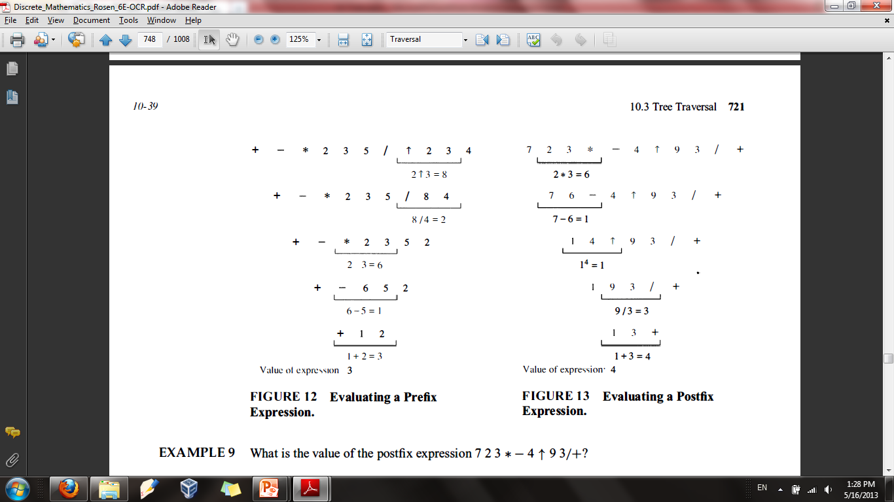

Example
What is the value of prefix expression $+−∗235/↑234.$

Slide 35
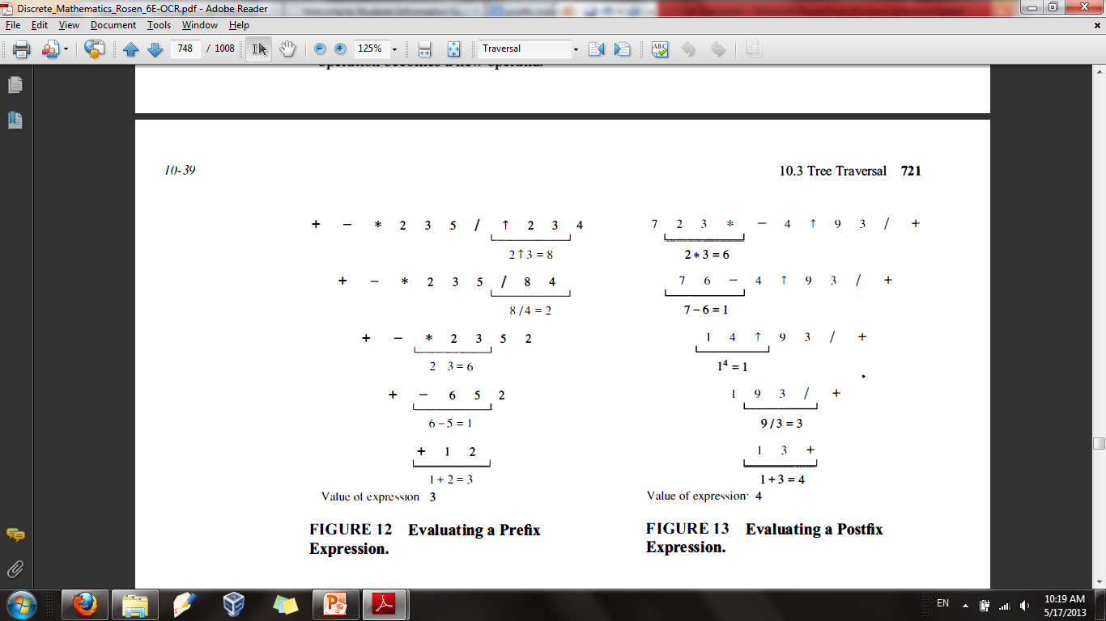

Example
What is the value of postfix expression $723∗−4↑93/+.$

Slide 36
Chapter Exercise
Chapter # 11
Topic # 11.1
Question # 1, 2, 3, 4, 5, 6, 7, 8, 9,10
Topic # 11.3
Question # 7 – 18, 23 ,24

