Slide 1
ITERATIVE TECHNIQUES FOR SOLVING
NON-LINEAR SYSTEMS (AND LINEAR SYSTEMS)

Slide 2
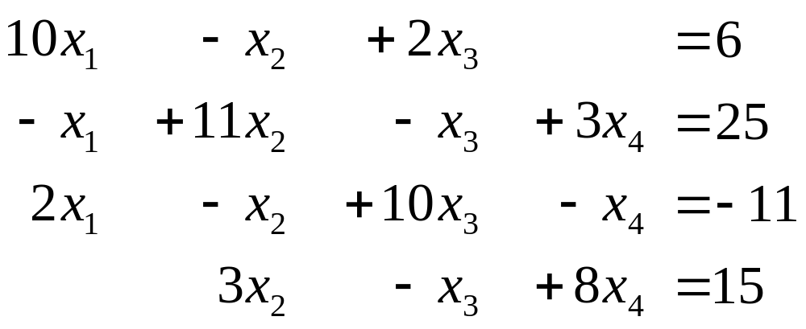
Jacobi Iterative Technique
Consider the following set of equations.

Slide 3
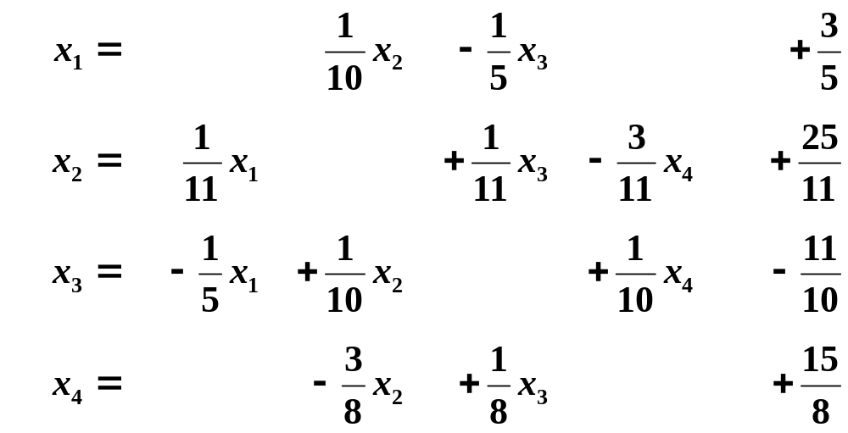
Convert the set Ax = b in the form of x = Tx + c.

Slide 4
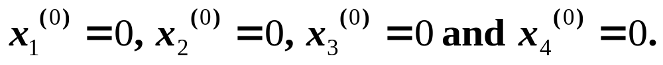
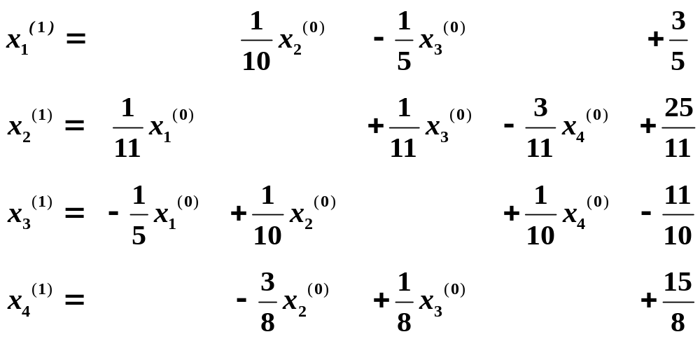
Start with an initial approximation of:

Slide 5
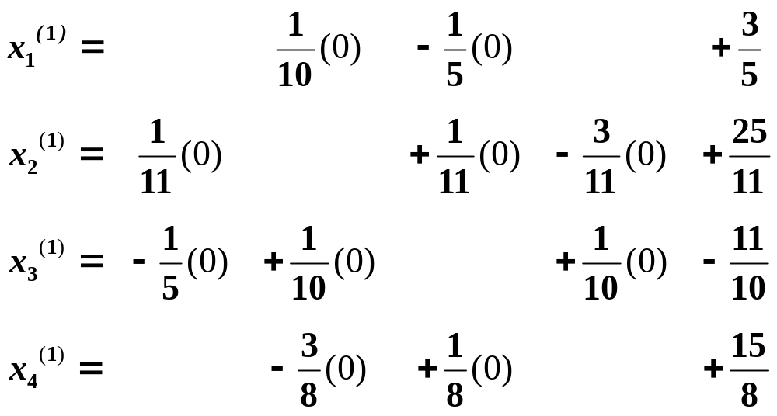
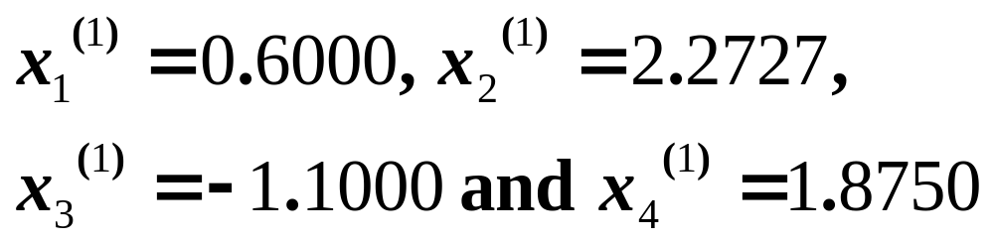

Slide 6


Slide 7
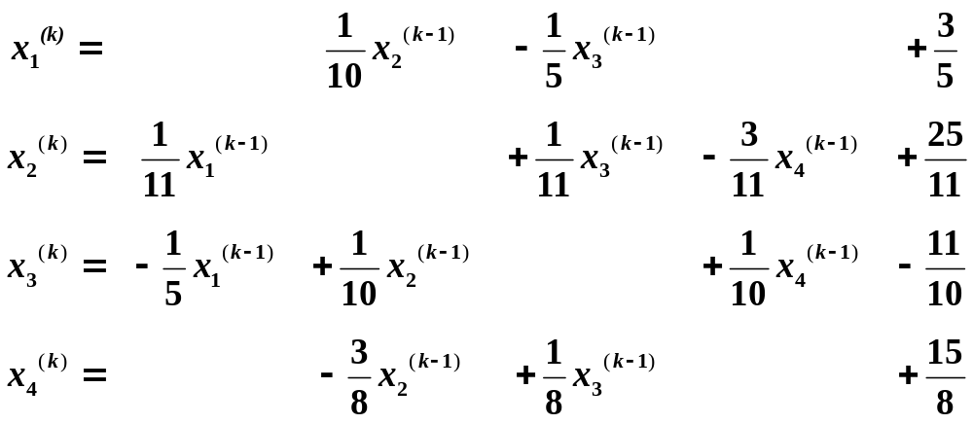

Slide 8
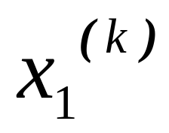
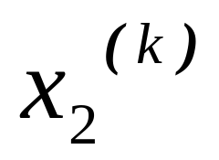
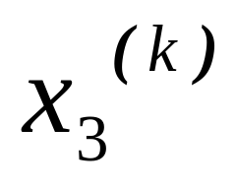
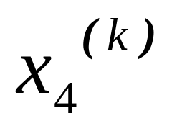
Results of Jacobi Iteration:
k | 0 | 1 | 2 | 3
 | 0.0000 | 0.6000 | 1.0473 | 0.9326
 | 0.0000 | 2.2727 | 1.7159 | 2.0530
 | 0.0000 | -1.1000 | -0.8052 | -1.0493
 | 0.0000 | 1.8750 | 0.8852 | 1.1309

Slide 9
Gauss-Seidel Iterative Technique
Consider the following set of equations.

Slide 10
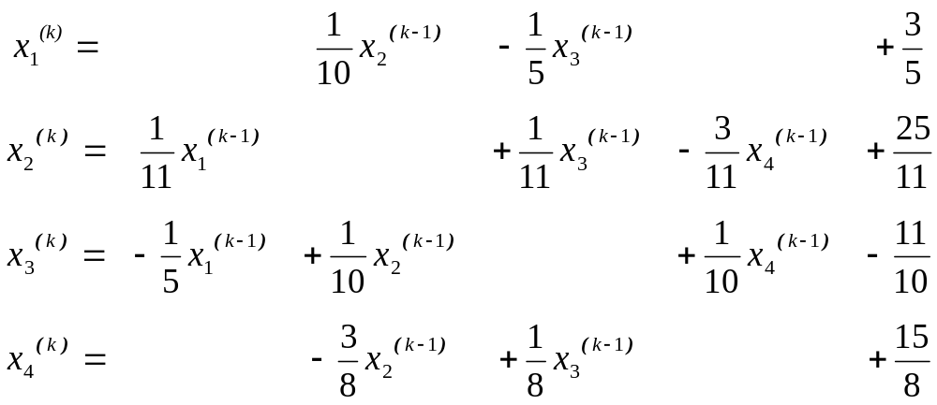

Slide 11
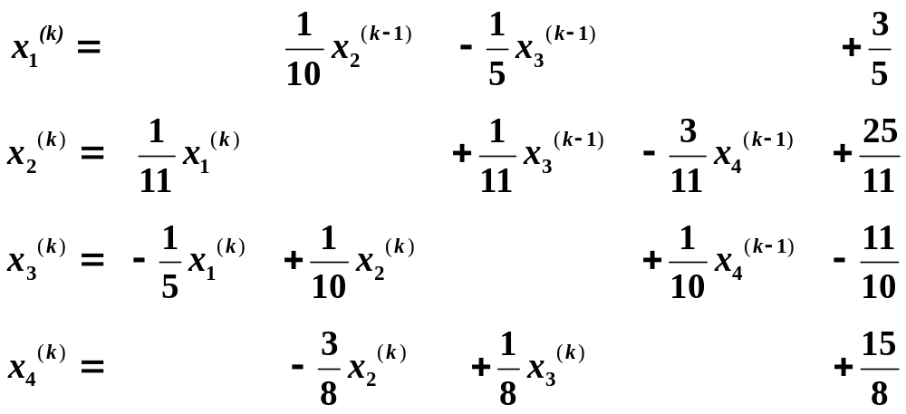

Slide 12
Results of Gauss-Seidel Iteration:
(Blue numbers are for Jacobi iterations.)
k | 0 | 1 | 2 | 3
 | 0.0000 | 0.6000 0.6000 | 1.0300 1.0473 | 1.0065 0.9326
 | 0.0000 | 2.3272 2.2727 | 2.0370 1.7159 | 2.0036 2.0530
 | 0.0000 | -0.9873 -1.1000 | -1.0140 -0.8052 | -1.0025 -1.0493
 | 0.0000 | 0.8789 1.8750 | 0.9844 0.8852 | 0.9983 1.1309

Slide 13
The solution is: x₁= 1, x₂ = 2, x₃ = -1, x₄ = 1
It required 15 iterations for Jacobi method and 7 iterations for Gauss-Seidel method to arrive at the solution with a tolerance of 0.00001.

Slide 14
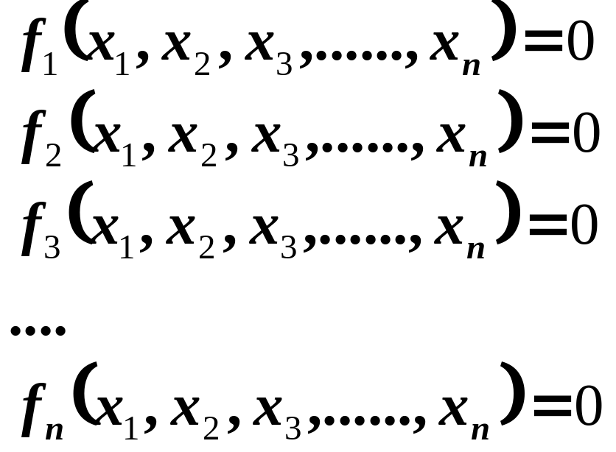
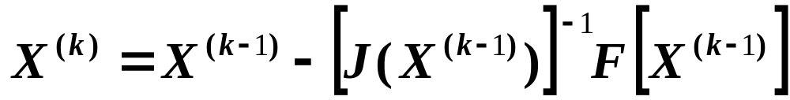
Newton’s Iterative Technique
Given:

Slide 15
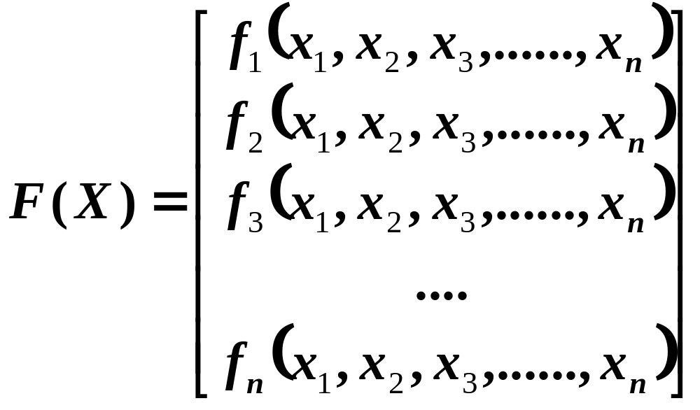

Slide 16
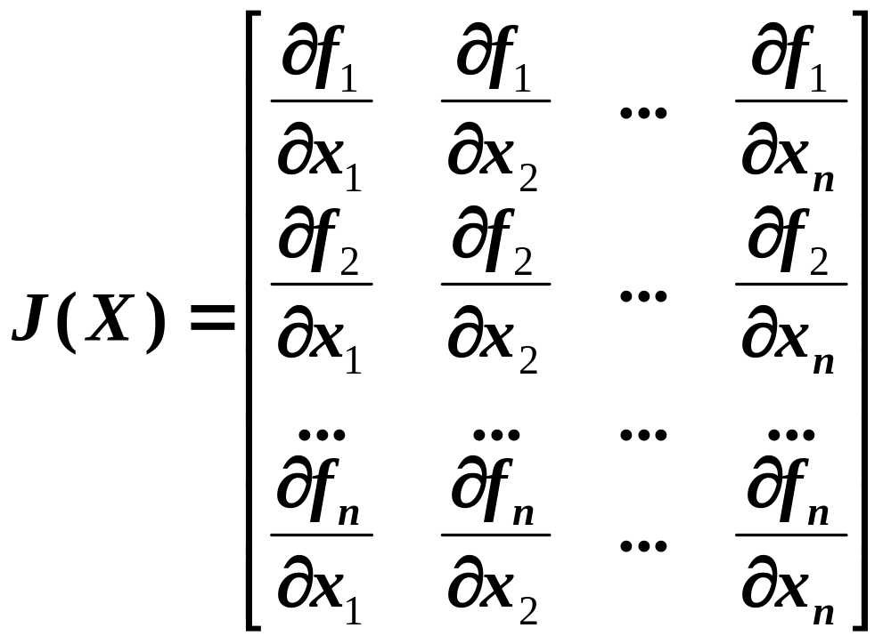
Jacobian Matrix:

Slide 17
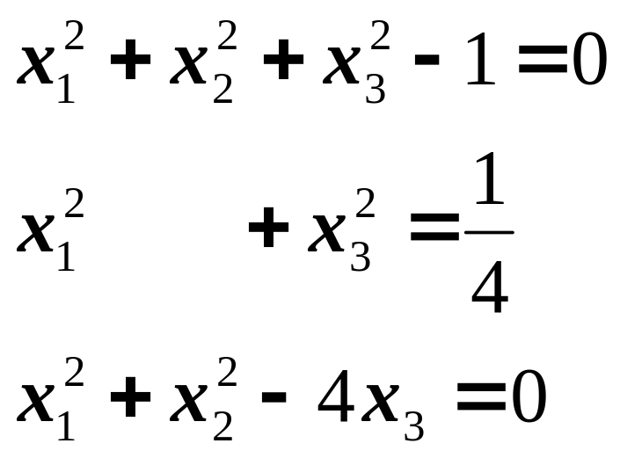
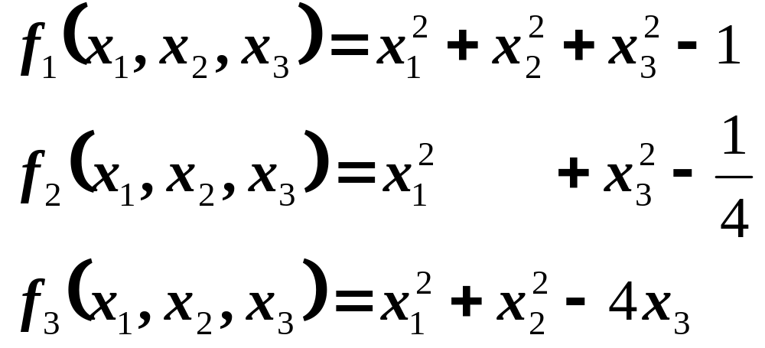
Consider the following set of non-linear equation:

Slide 18
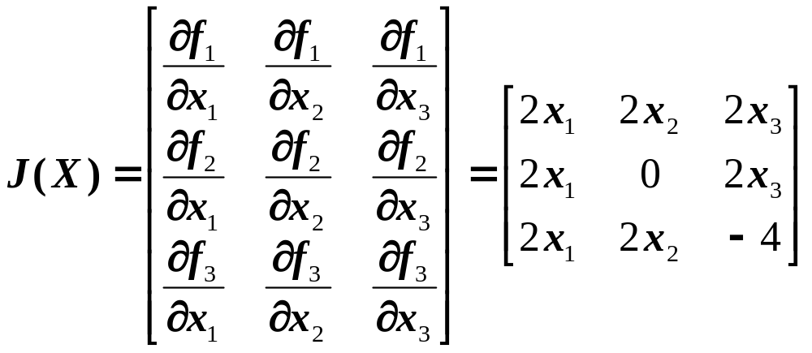
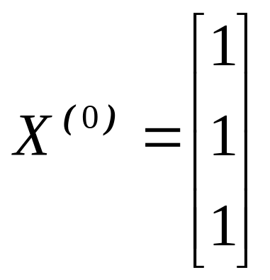
Make an initial guess:

Slide 19
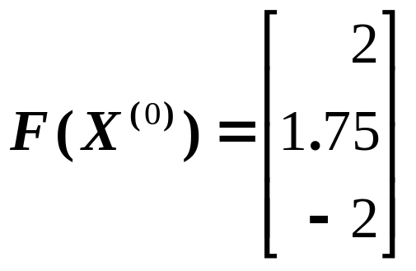
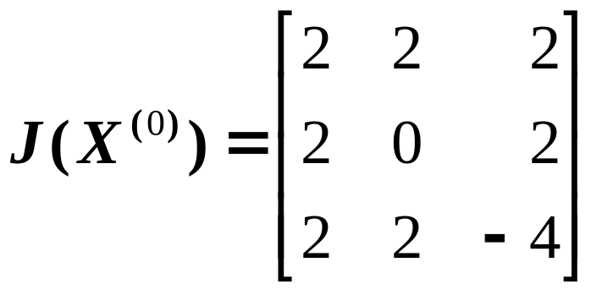
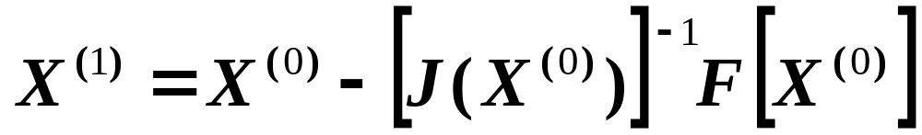
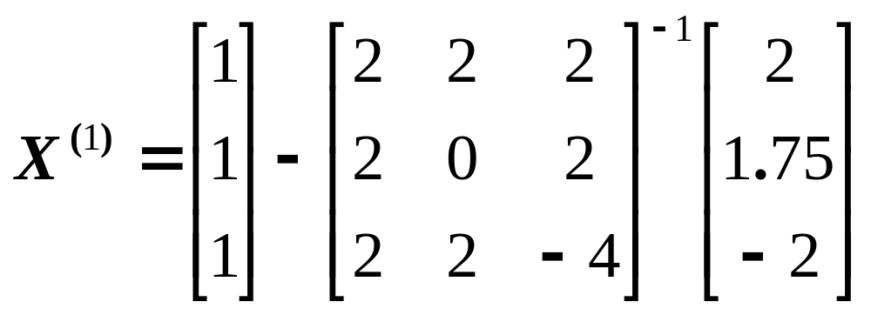

Slide 20
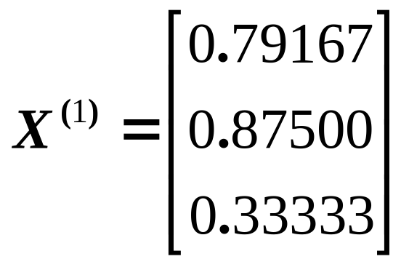
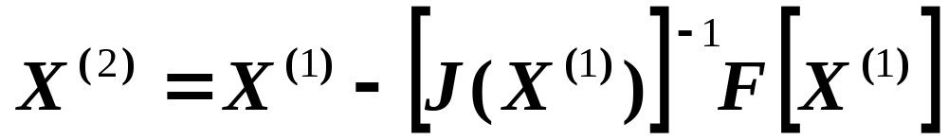
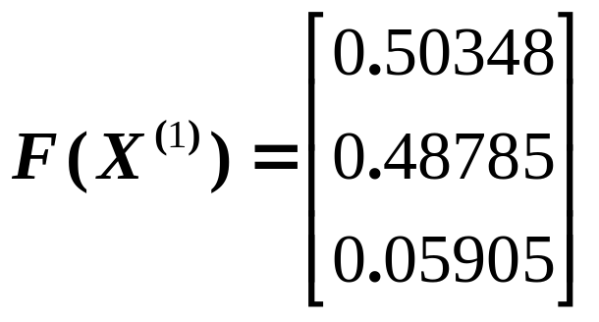

Slide 21
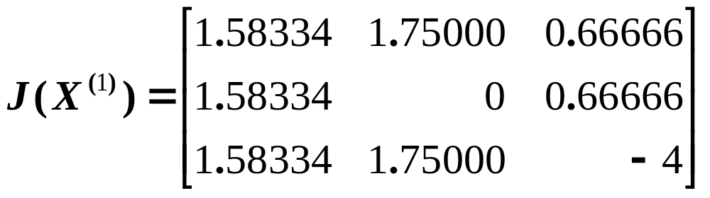
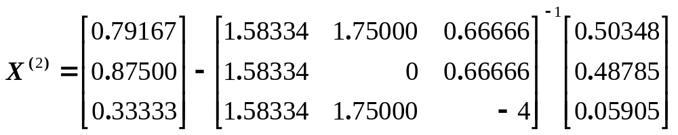

Slide 22
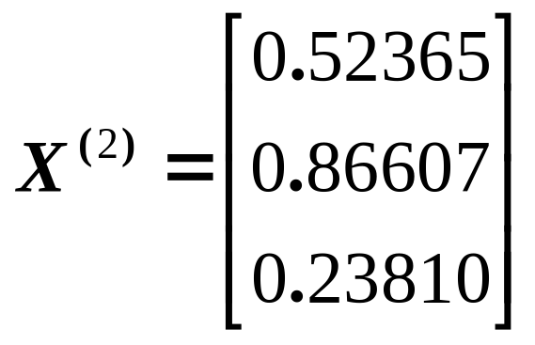
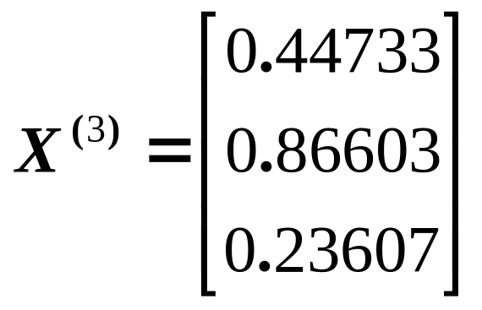
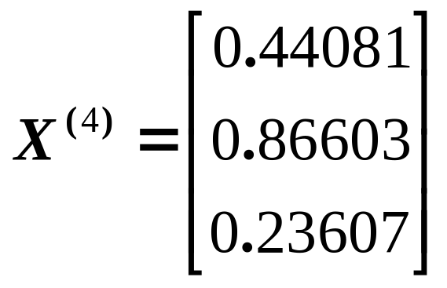

Slide 23
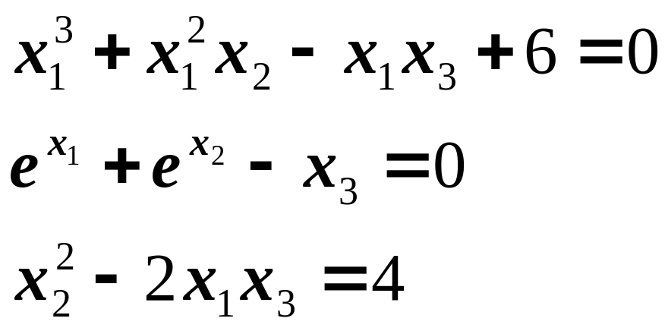
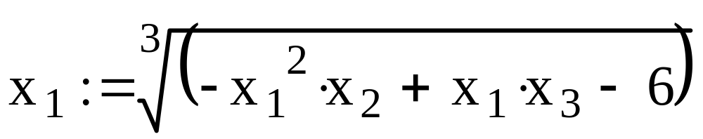
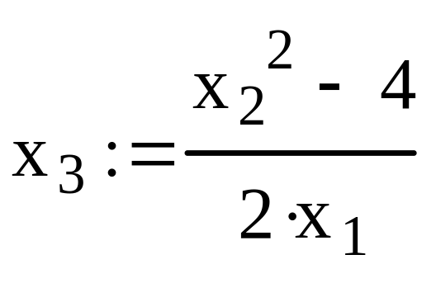
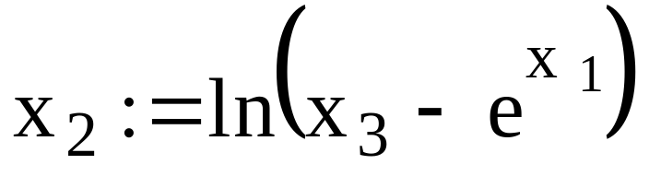
Example of Gauss-Seidel Iteration

Slide 24
