Slide 1
Iterative Methods for Solving Linear Systems of Equations
Numerical Analysis-I
BS (MS) - QUEST

Slide 2

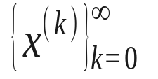

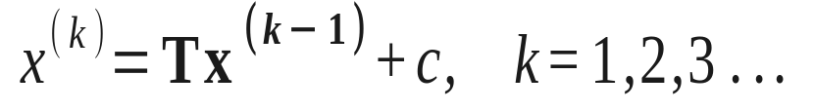
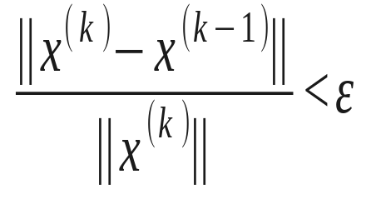
Iterative Methods
An iterative technique to solve Ax=b starts with an initial approximation and generates a sequence
First we convert the system Ax=b into an equivalent form
And generate the sequence of approximation by
This procedure is similar to the fixed point method.
The stopping criterion:

Slide 3
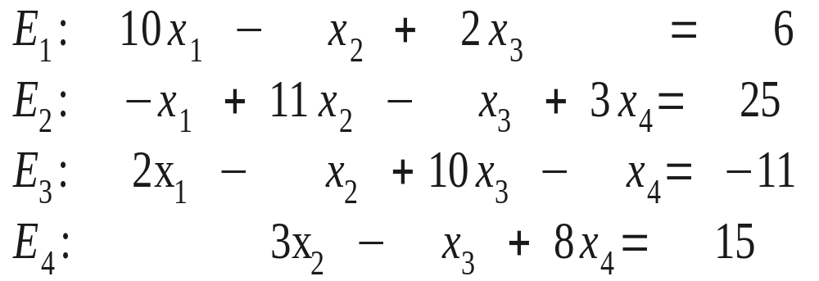
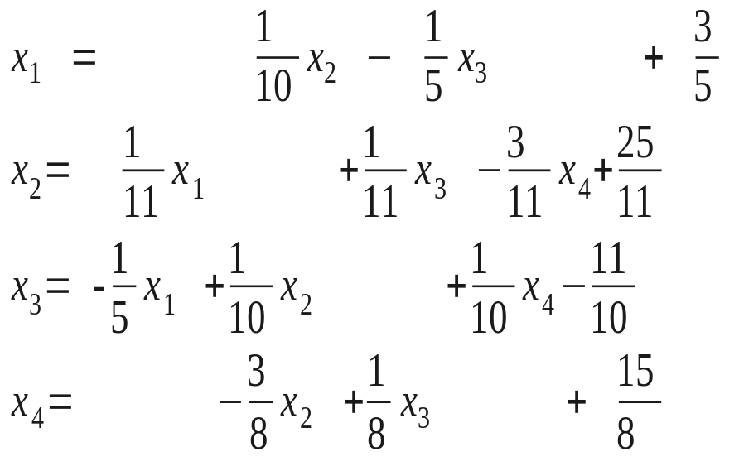
Iterative Methods (Example)
We rewrite the system in the x=Tx+c form

Slide 4

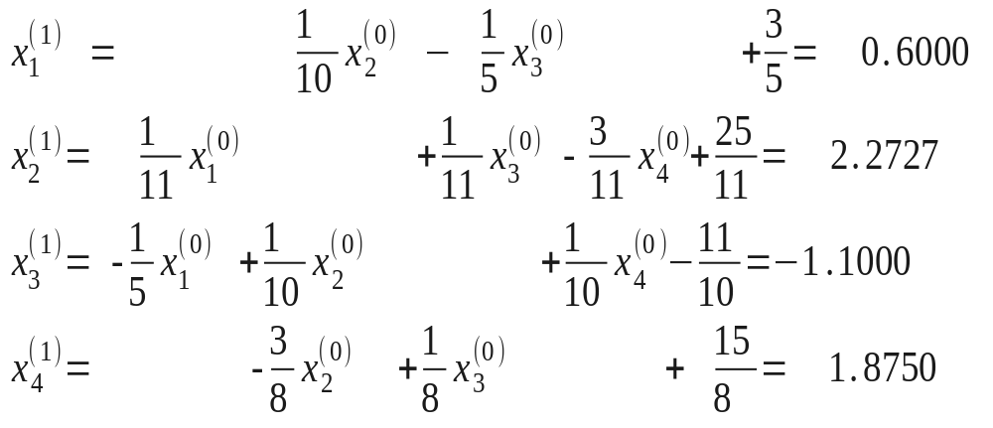
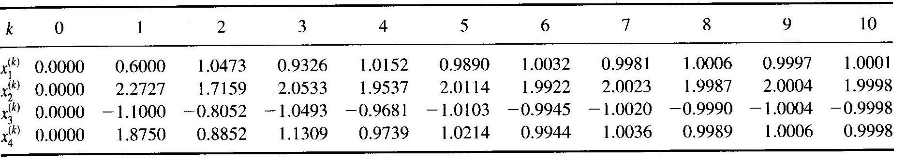
Iterative Methods (Example) – cont.
and start iterations with
Continuing the iterations, the results are in the Table:

Slide 5
Iterative Methods (Example) – cont.
and start iterations with
Continuing the iterations, the results are in the Table:

Slide 6
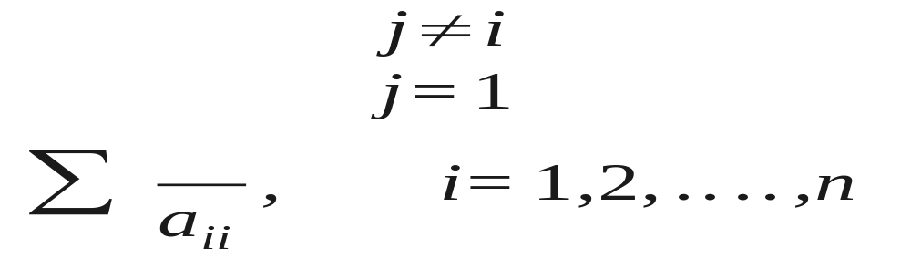
The Jacobi Iterative Method
The method of the Example is called the Jacobi iterative method

Slide 7
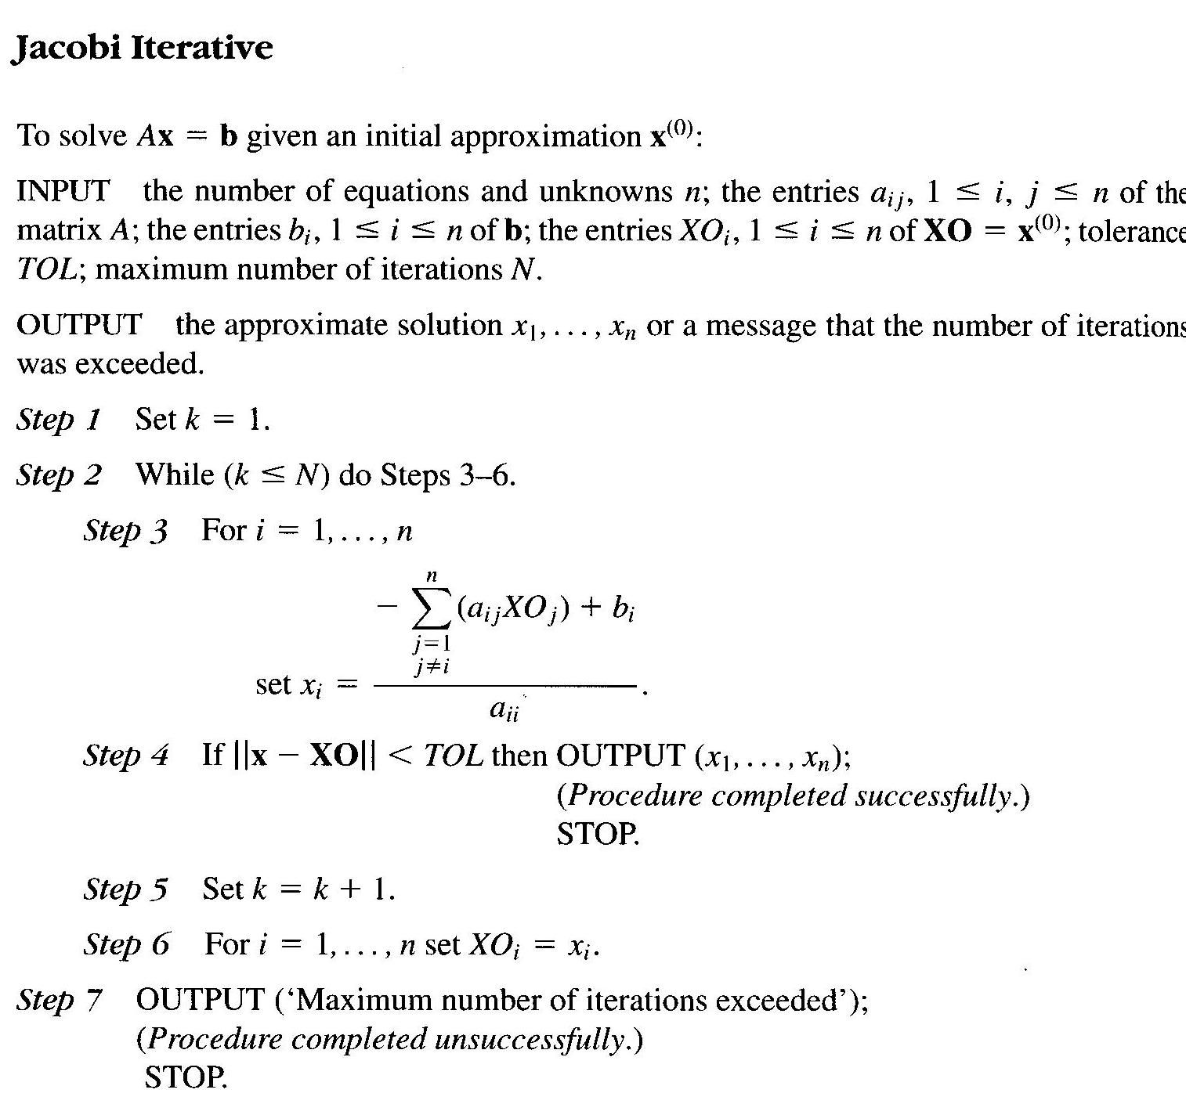
Algorithm: Jacobi Iterative Method

Slide 8
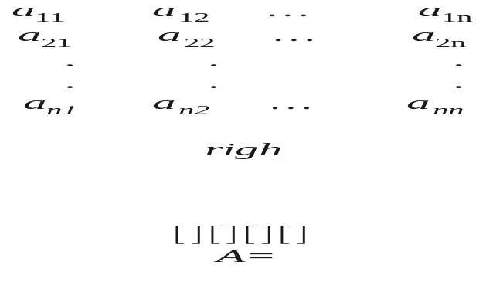
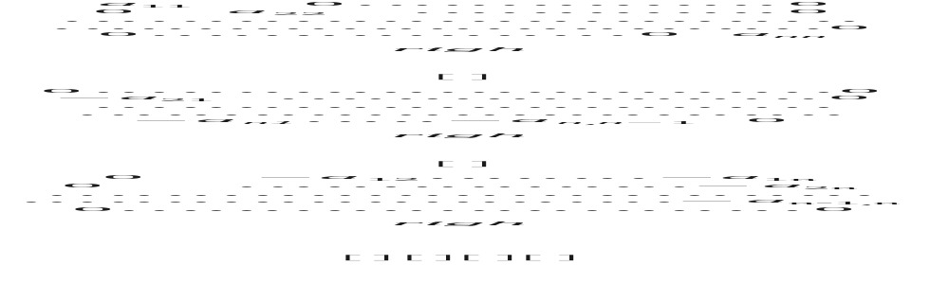
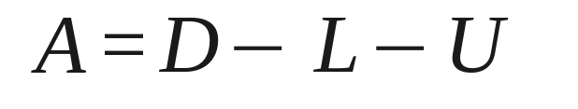
The Jacobi Method: x=Tx+c Form

Slide 9


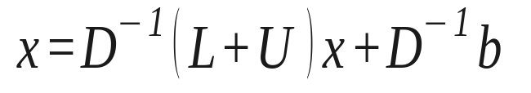
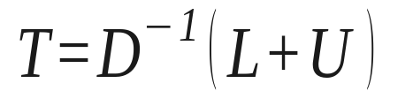
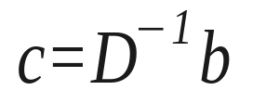
The Jacobi Method: x=Tx+c Form (cont)
and the equation Ax=b can be transformed into
Finally

Slide 10

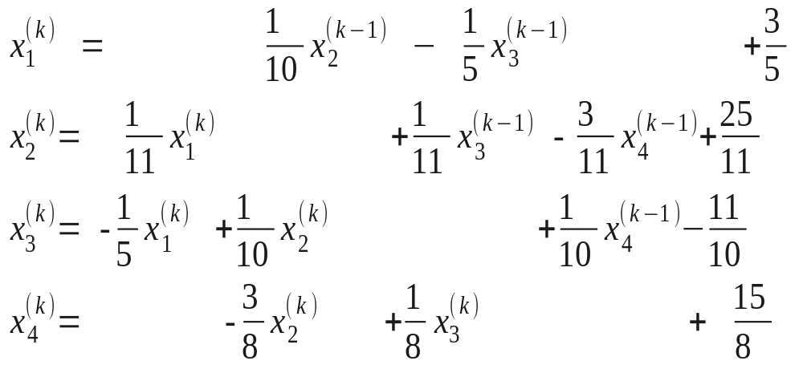
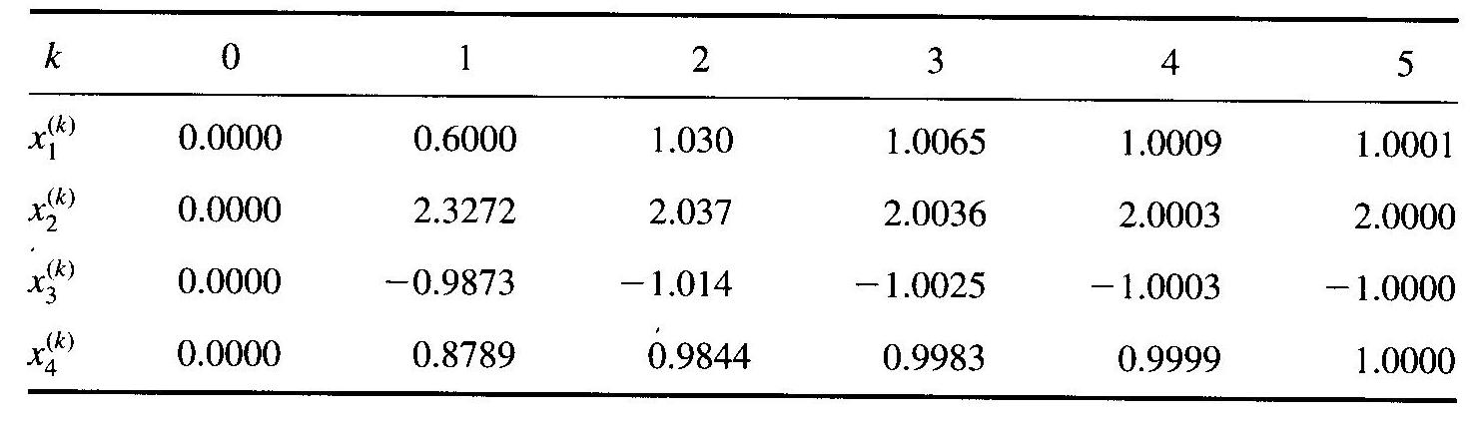
The Gauss-Seidel Iterative Method
The idea of GS is to compute using most recently calculated values. In our example:
Starting iterations with , we obtain

Slide 11
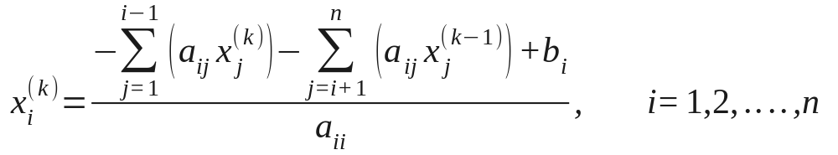


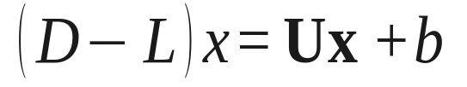
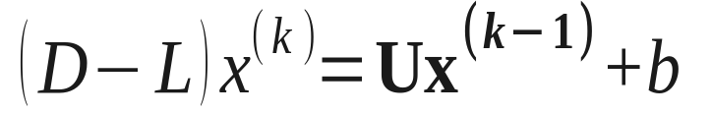
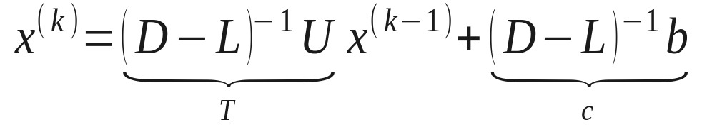
The Gauss-Seidel Iterative Method
Gauss-Seidel in form
Finally

Slide 12
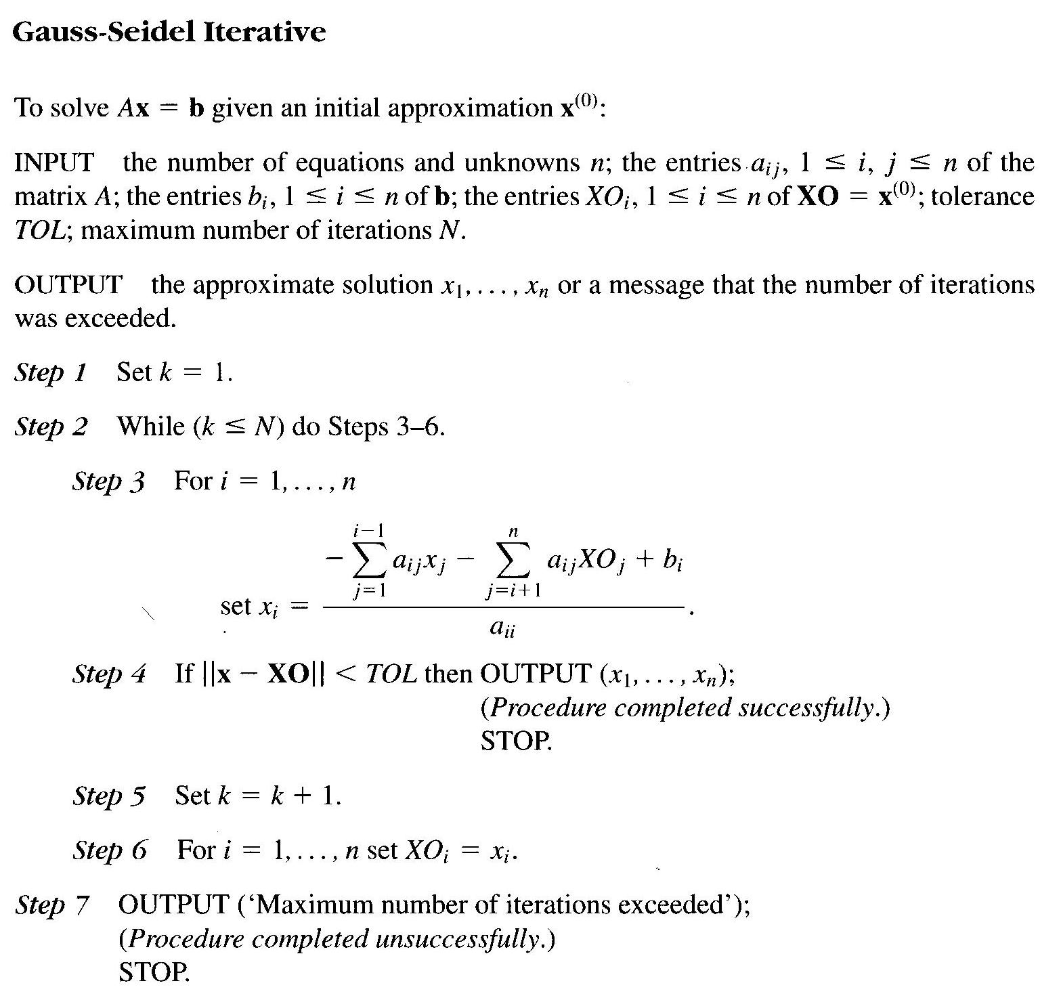
Algorithm: Gauss-Seidel Iterative Method

Slide 13
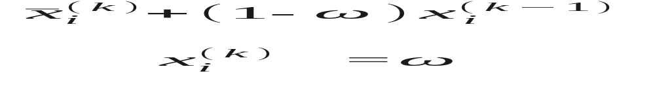
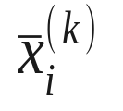


The Successive Over-Relaxation Method (SOR)
The SOR is devised by applying extrapolation to the GS metod. The extrapolation tales the form of a weighted average between the previous iterate and the computed GS iterate successively for each component
where denotes a GS iterate and ω is the extrapolation factor. The idea is to choose a value of ω that will accelerate the rate of convergence.
under-relaxation
over-relaxation

Slide 14
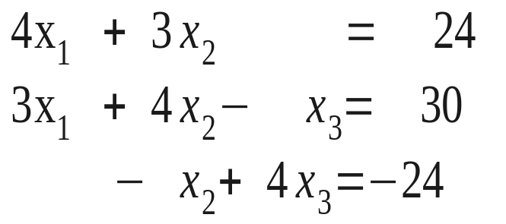
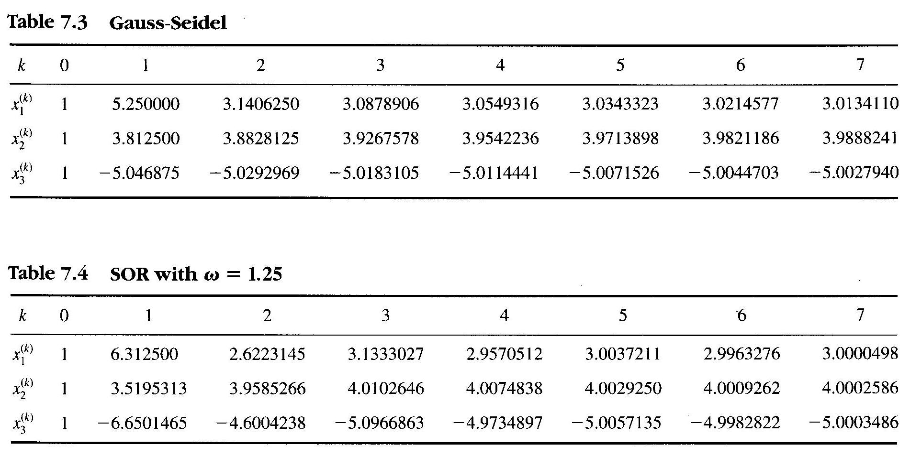
SOR: Example
Solution: x=(3, 4, -5)

