Slide 1
Gauss-Siedel Method

Slide 2
Gauss-Seidel Method
An iterative method.
Basic Procedure:
Algebraically solve each linear equation for x_{i}
Assume an initial guess solution array
Solve for each x_{i} and repeat
Use absolute relative approximate error after each iteration to check if error is within a pre-specified tolerance.
http://numericalmethods.eng.usf.edu

Slide 3
Gauss-Seidel Method
Why?
The Gauss-Seidel Method allows the user to control round-off error.
Elimination methods such as Gaussian Elimination and LU Decomposition are prone to prone to round-off error.
Also: If the physics of the problem are understood, a close initial guess can be made, decreasing the number of iterations needed.
http://numericalmethods.eng.usf.edu

Slide 4



Gauss-Seidel Method
Algorithm
A set of n equations and n unknowns:
If: the diagonal elements are non-zero
Rewrite each equation solving for the corresponding unknown
ex:
First equation, solve for x₁
Second equation, solve for x₂
. .
. .
. .
http://numericalmethods.eng.usf.edu

Slide 5
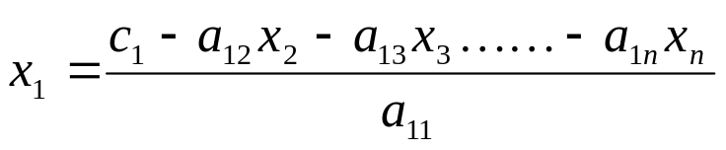
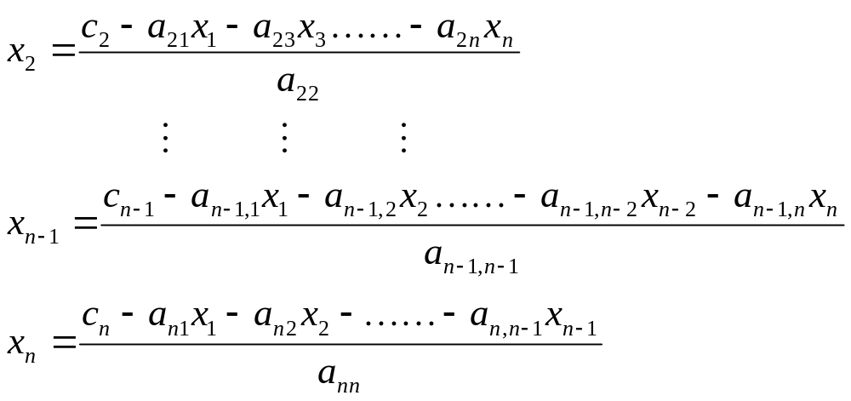
Gauss-Seidel Method
Algorithm
Rewriting each equation
From Equation 1
From equation 2
From equation n-1
From equation n
http://numericalmethods.eng.usf.edu

Slide 6
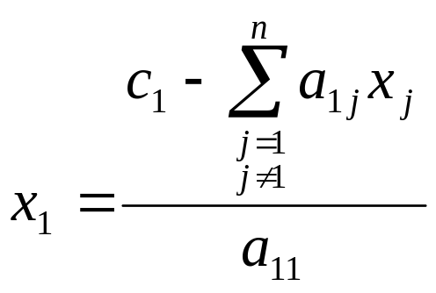
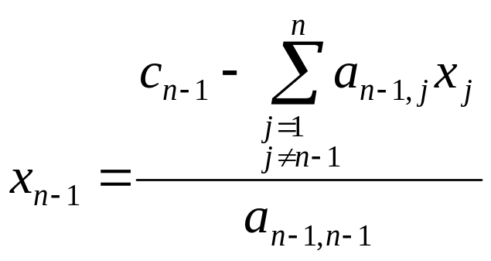
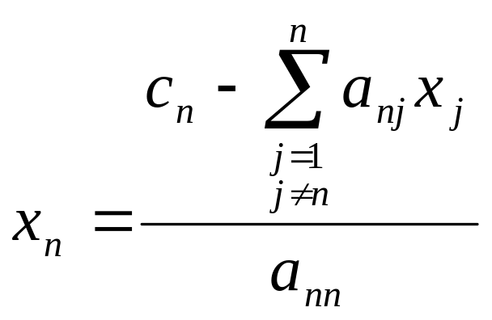
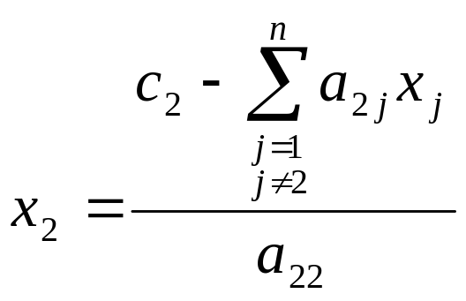
Gauss-Seidel Method
Algorithm
General Form of each equation
http://numericalmethods.eng.usf.edu

Slide 7
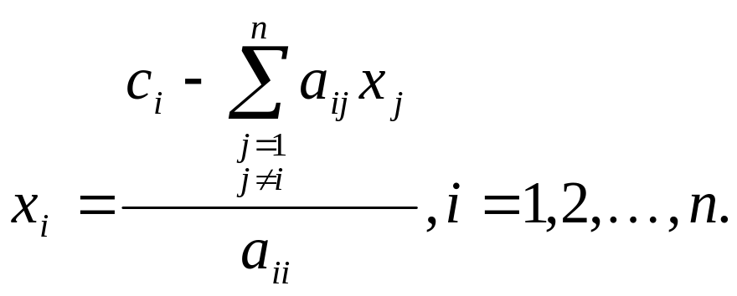
Gauss-Seidel Method
Algorithm
General Form for any row ‘i’
How or where can this equation be used?
http://numericalmethods.eng.usf.edu

Slide 8
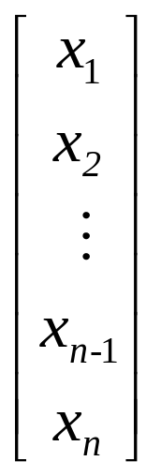
Gauss-Seidel Method
Solve for the unknowns
Assume an initial guess for [X]
Use rewritten equations to solve for each value of x_{i}.
Important: Remember to use the most recent value of x_{i}. Which means to apply values calculated to the calculations remaining in the current iteration.
http://numericalmethods.eng.usf.edu

Slide 9
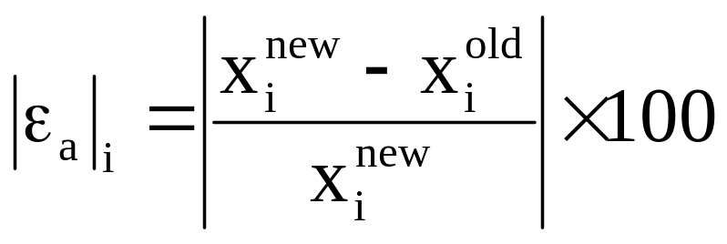
Gauss-Seidel Method
Calculate the Absolute Relative Approximate Error
So when has the answer been found?
The iterations are stopped when the absolute relative approximate error is less than a prespecified tolerance for all unknowns.
http://numericalmethods.eng.usf.edu

Slide 10

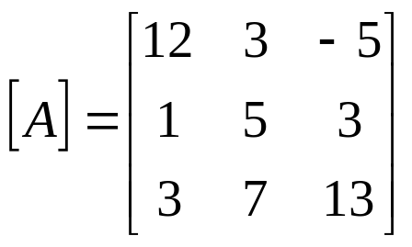


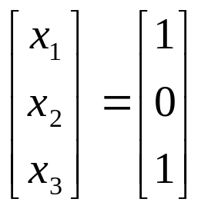
Gauss-Seidel Method: Example 2
Given the system of equations
The coefficient matrix is:
With an initial guess of
Will the solution converge using the Gauss-Siedel method?
http://numericalmethods.eng.usf.edu

Slide 11
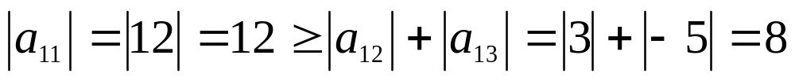
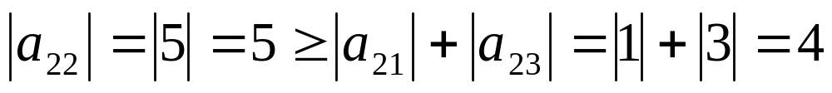
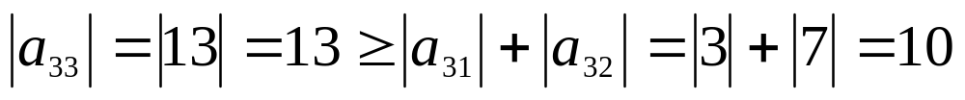
Gauss-Seidel Method: Example 2
Checking if the coefficient matrix is diagonally dominant
The inequalities are all true and at least one row is strictly greater than:
Therefore: The solution should converge using the Gauss-Siedel Method
http://numericalmethods.eng.usf.edu

Slide 12
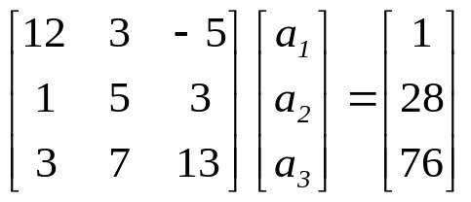
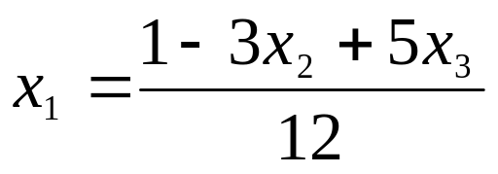
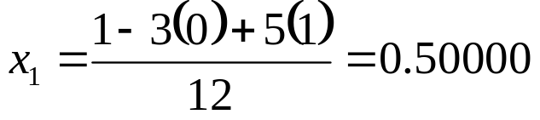
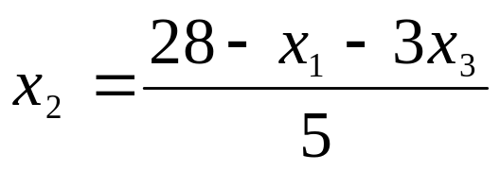
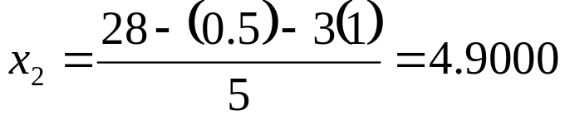
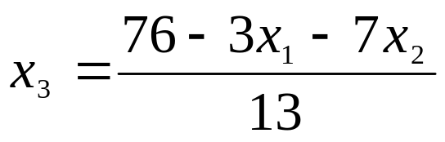
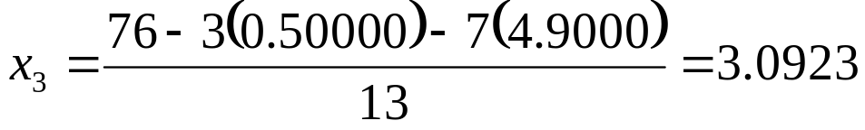
Gauss-Seidel Method: Example 2
With an initial guess of
Rewriting each equation
http://numericalmethods.eng.usf.edu

Slide 13
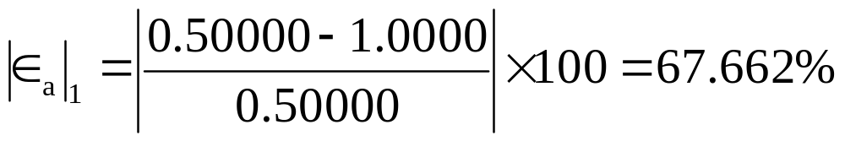
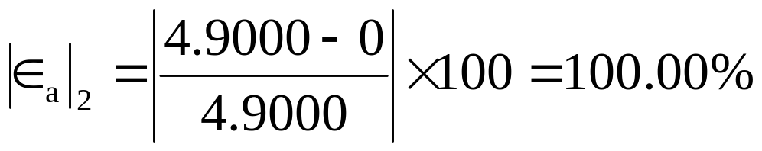
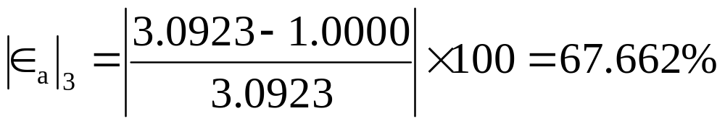
Gauss-Seidel Method: Example 2
The absolute relative approximate error
The maximum absolute relative error after the first iteration is 100%
http://numericalmethods.eng.usf.edu

Slide 14
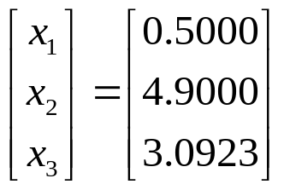
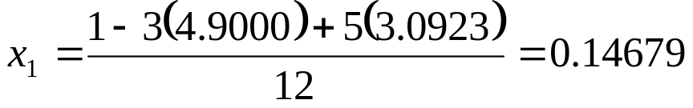
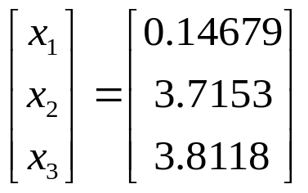
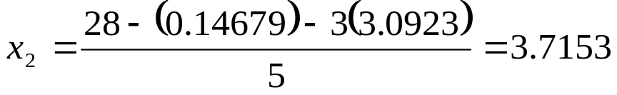

Gauss-Seidel Method: Example 2
After Iteration #1
Substituting the x values into the equations
After Iteration #2
http://numericalmethods.eng.usf.edu

Slide 15
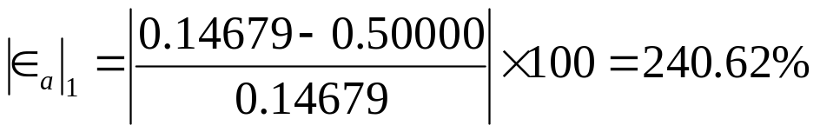
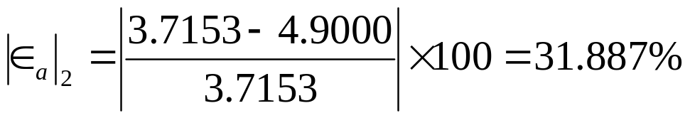
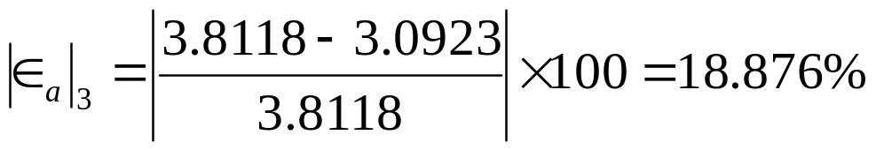
Gauss-Seidel Method: Example 2
Iteration #2 absolute relative approximate error
The maximum absolute relative error after the first iteration is 240.62%
This is much larger than the maximum absolute relative error obtained in iteration #1. Is this a problem?
http://numericalmethods.eng.usf.edu

Slide 16



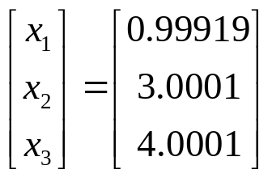
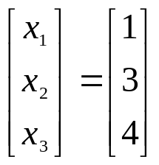
Gauss-Seidel Method: Example 2
Repeating more iterations, the following values are obtained
Iteration | a₁ |  | a₂ |  | a₃
1 2 3 4 5 6 | 0.50000 0.14679 0.74275 0.94675 0.99177 0.99919 | 67.662 240.62 80.23 21.547 4.5394 0.74260 | 4.900 3.7153 3.1644 3.0281 3.0034 3.0001 | 100.00 31.887 17.409 4.5012 0.82240 0.11000 | 3.0923 3.8118 3.9708 3.9971 4.0001 4.0001 | 67.662 18.876 4.0042 0.65798 0.07499 0.00000
The solution obtained
is close to the exact solution of
http://numericalmethods.eng.usf.edu

