Slide 1
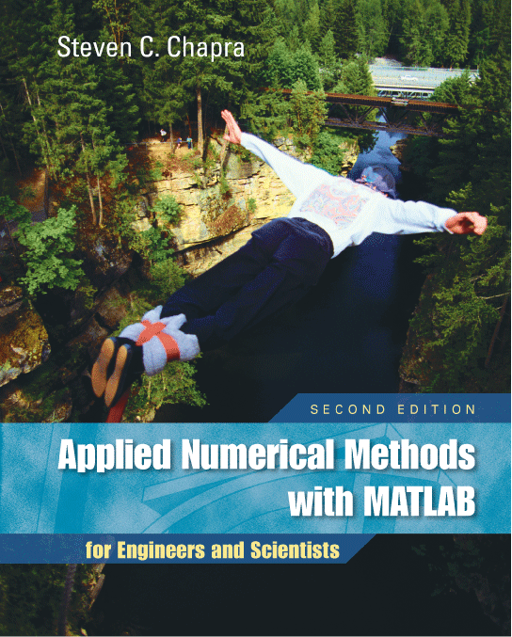
Part 3
Chapter 12
Iterative Methods
PowerPoints organized by Dr. Michael R. Gustafson II, Duke University
All images copyright © The McGraw-Hill Companies, Inc. Permission required for reproduction or display.

Slide 2
Chapter Objectives
Understanding the difference between the Gauss-Seidel and Jacobi methods.
Knowing how to assess diagonal dominance and knowing what it means.
Recognizing how relaxation can be used to improve convergence of iterative methods.
Understanding how to solve systems of nonlinear equations with successive substitution and Newton-Raphson.

Slide 3
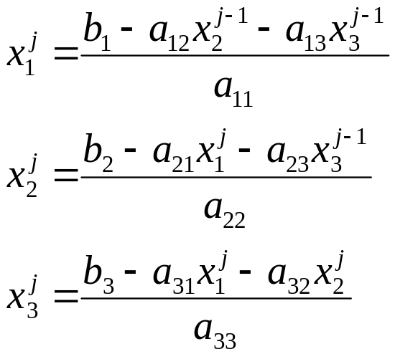
Gauss-Seidel Method
The Gauss-Seidel method is the most commonly used iterative method for solving linear algebraic equations [A]{x}={b}.
The method solves each equation in a system for a particular variable, and then uses that value in later equations to solve later variables. For a 3x3 system with nonzero elements along the diagonal, for example, the j^{th} iteration values are found from the j-1th iteration using:

Slide 4
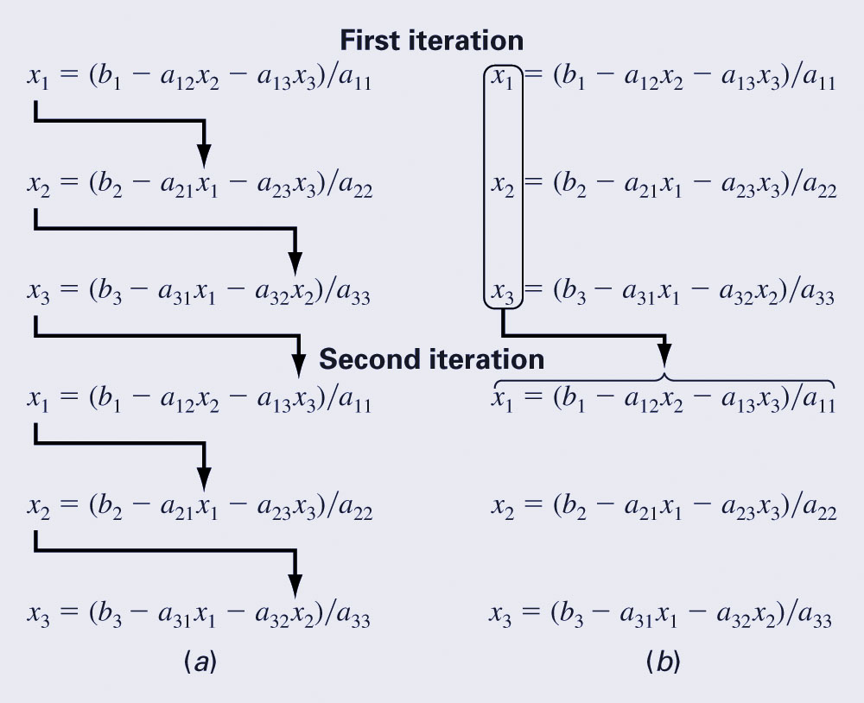
Jacobi Iteration
The Jacobi iteration is similar to the Gauss-Seidel method, except the j-1th information is used to update all variables in the jth iteration:
  Gauss-Seidel
  Jacobi

Slide 5
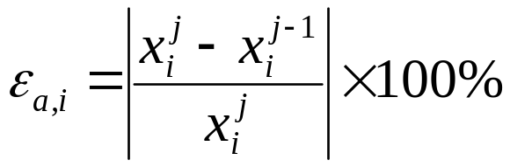
Convergence
The convergence of an iterative method can be calculated by determining the relative percent change of each element in {x}. For example, for the i^{th} element in the j^{th} iteration,
The method is ended when all elements have converged to a set tolerance.

Slide 6
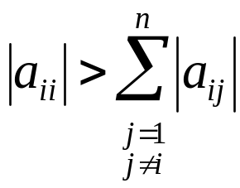
Diagonal Dominance
The Gauss-Seidel method may diverge, but if the system is diagonally dominant, it will definitely converge.
Diagonal dominance means:

Slide 7
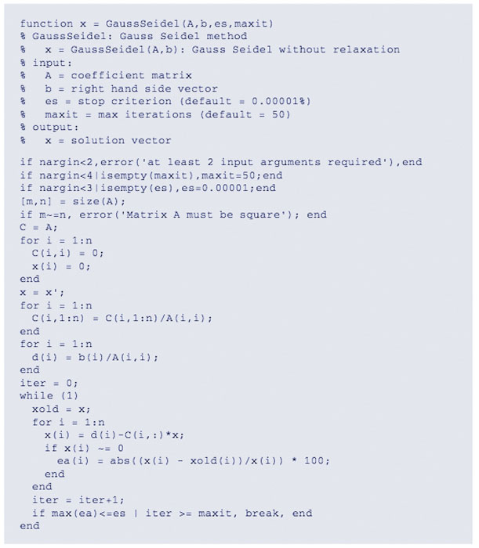
MATLAB Program

Slide 8

Relaxation
To enhance convergence, an iterative program can introduce relaxation where the value at a particular iteration is made up of a combination of the old value and the newly calculated value:
where λ is a weighting factor that is assigned a value between 0 and 2.
  0<λ<1: underrelaxation
  λ=1: no relaxation
  1<λ≤2: overrelaxation

Slide 9
Nonlinear Systems
Nonlinear systems can also be solved using the same strategy as the Gauss-Seidel method - solve each system for one of the unknowns and update each unknown using information from the previous iteration.
This is called successive substitution.

Slide 10
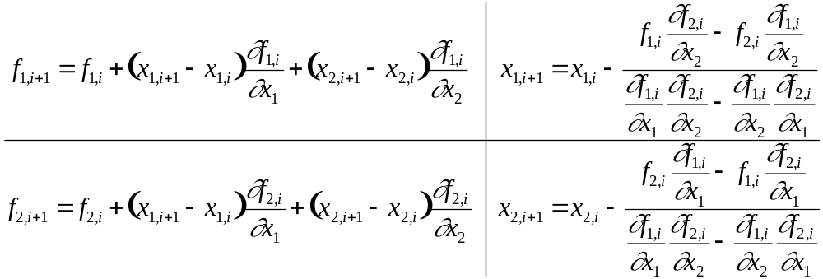
Newton-Raphson
Nonlinear systems may also be solved using the Newton-Raphson method for multiple variables.
For a two-variable system, the Taylor series approximation and resulting Newton-Raphson equations are:

Slide 11
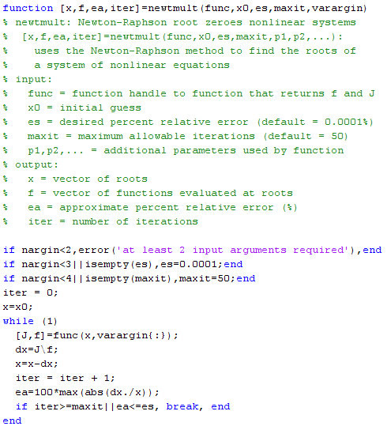
MATLAB Program

