Slide 1
Numerical Analysis
Simultaneous Linear Equations
Topic: Jacobi Method

Slide 2
Introduction
If systems of linear equations are very large, the computational effort of direct methods is prohibitively expensive
Three common classical iterative techniques for linear systems
  The Jacobi method
  Gauss-Seidel method
  Successive Over Relaxation (SOR) method
Matlab’s built-in functions

Slide 3
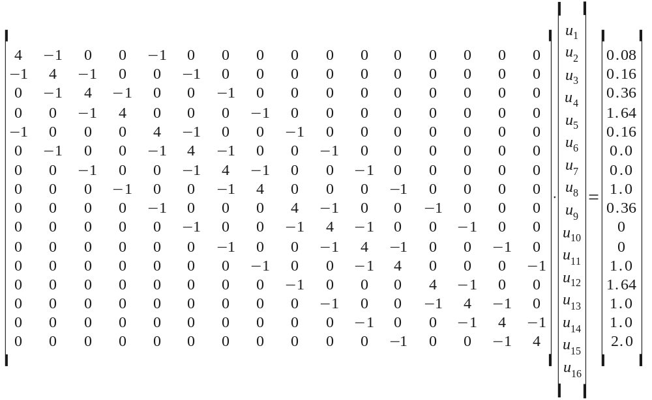
Introduction
For systems that have coefficient matrices with the appropriate structure – especially large, sparse systems (many coefficients whose value is zero) – iterative techniques may be preferable

Slide 4
Iterative solution procedure
Write the system Ax=b in an equivalent form
x=Ex+f (like x=g(x) for fixed-point iteration)
Starting with x⁰, generate a sequence of approximations {x^{k}} iteratively by
x^{k+1}=Ex^{k}+f
Representation of E and f depends on the type of the method used
But for every method E and f are obtained from A and b, but in a different way

Slide 5
Convergence
As k→∞, the sequence {x^{k}} converges to the solution vector under some conditions on E matrix
This imposes different conditions on A matrix for different methods
For the same A matrix, one method may converge while the other may diverge
Therefore for each method the relation between A and E should be found to decide on the convergence

Slide 6


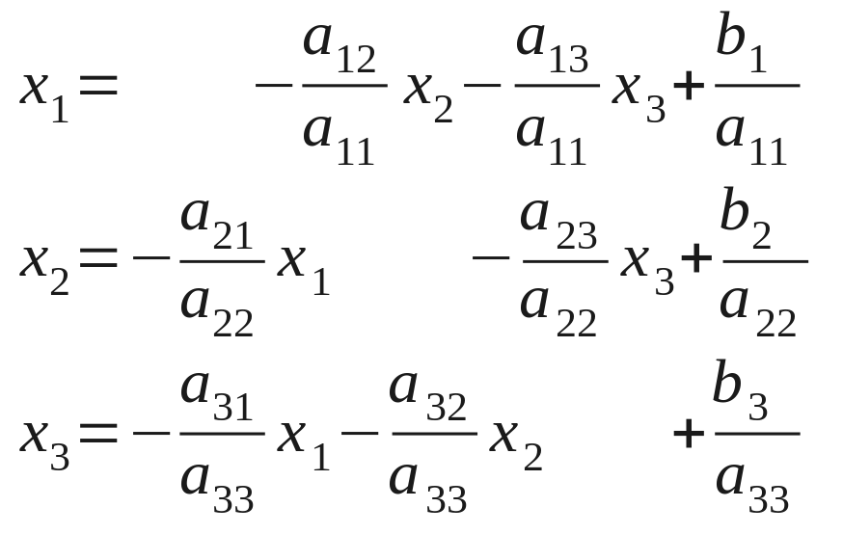
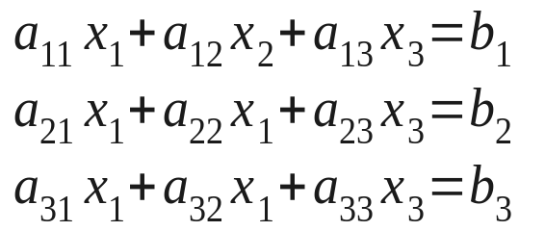


Basic Idea on Jacobi method
Convert the system:
into the equivalent system:
Generate a sequence of approximation

Slide 7
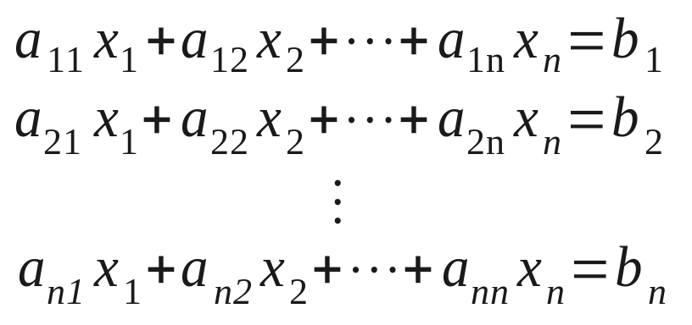
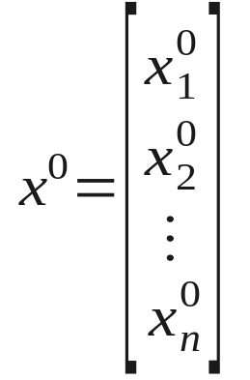
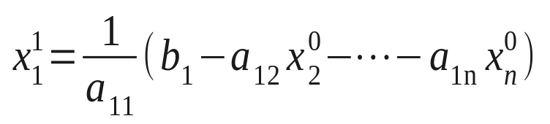
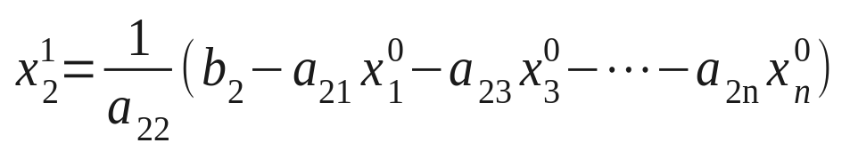
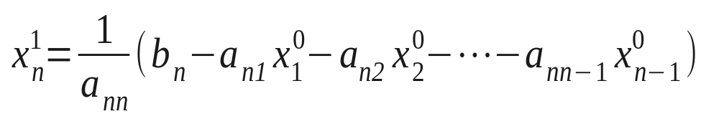
Jacobi iteration method
1
⎡
i
−
1
n
⎤
x
k
+
1
=
b
−
∑
a
x
k
−
∑
a
x
k
⎢
⎥
i
a
⎣
i
ij
j
ij
j
⎦
ii
j
=
1
j
=
i
+
1

Slide 8
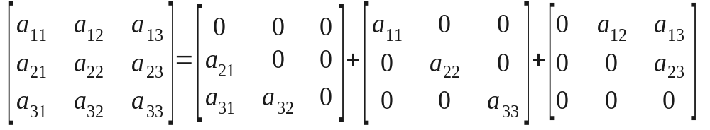
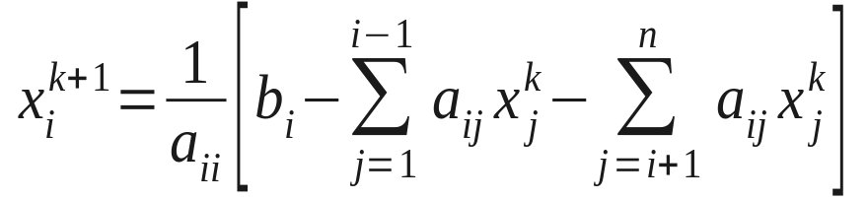
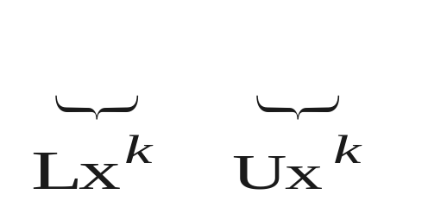
x^{k+1}=Ex^{k}+f iteration for Jacobi method
A can be written as A=L+D+U (not decomposition)
Ax=b ⇒ (L+D+U)x=b
Dx^{k+1} =-(L+U)x^{k}+b
x^{k+1}=-D⁻¹(L+U)x^{k}+D⁻¹b
E=-D⁻¹(L+U)
f=D⁻¹b
Dx^{k+1}

Slide 9
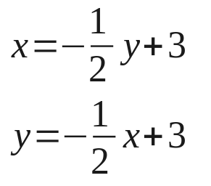
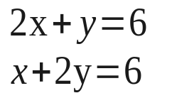

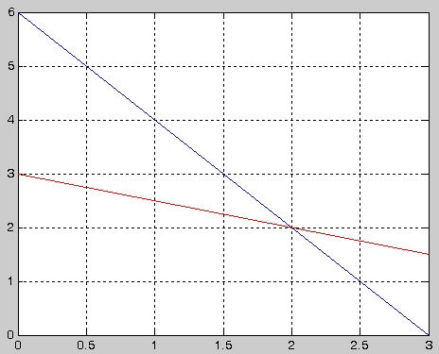

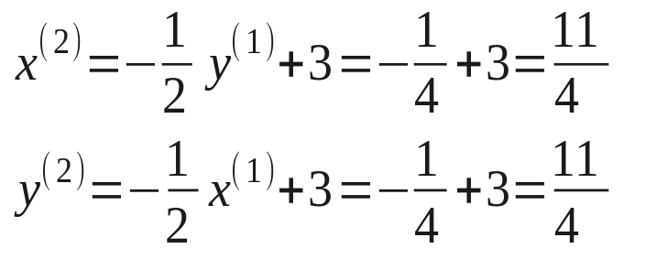



Jacobi Method with examples
Consider the two-by-two system
Start with
Simultaneous updating
  New values of the variables are not used until a new iteration step is begun

Slide 10
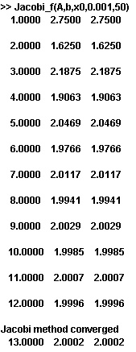
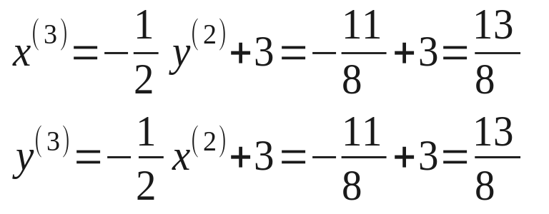
Jacobi Method
Con’t

Slide 11
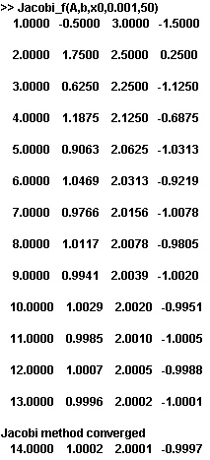
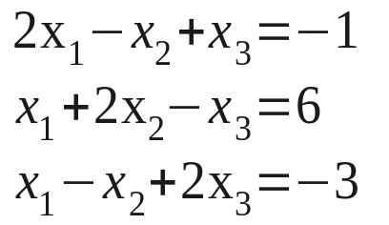
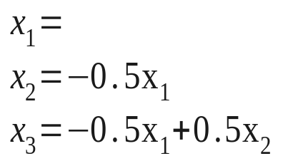
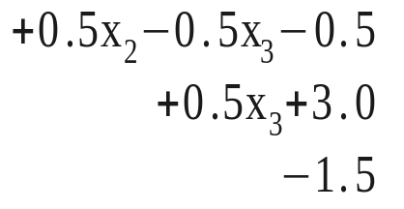
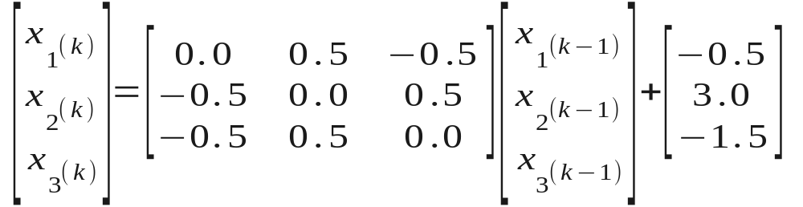

Jacobi Method
Consider the three-by-three system
Start with

Slide 12
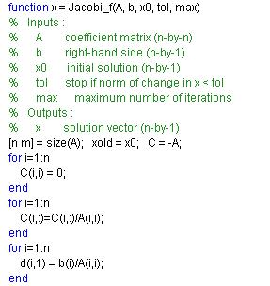
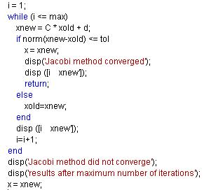
Jacobi Method
Matlab function for jacobi method

Slide 13
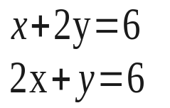
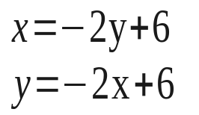
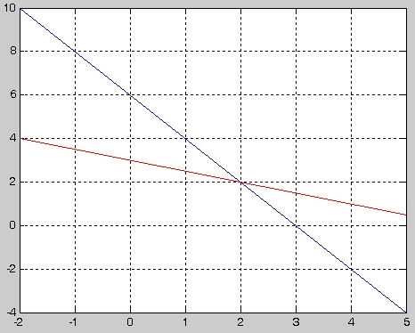
Jacobi Method
y
Discussion
A necessary and sufficient condition for the convergence of the Jacobi method
  The magnitude of the largest eigenvalue of the iteration matrix C be less than 1
x

Slide 14
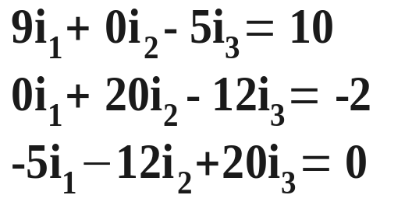
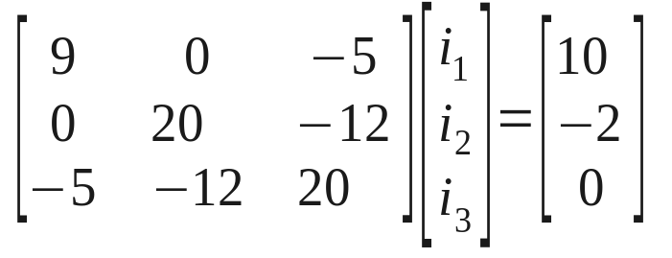
Jacobi method : Example 1
Consider a circuit shown in figure here; currents i₁, i₂, and i₃ are given by
4Ω
8Ω
i₂
2 V
i₁
10 V
12Ω
The matrix form is:
5Ω
i₃
3Ω
Notice that magnitude of any diagonal element is greater than the sum of the magnitudes of other elements in that row
A matrix with this property is said to be Diagonally dominant.

Slide 15
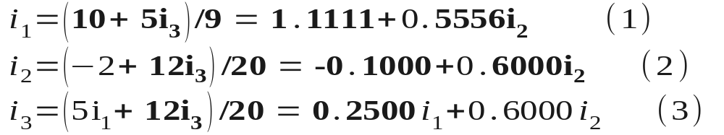
Jacobi method : Example 1
The set of equations:
Let us write for i₁, i₂ and i₃ as
Let us make an initial guess as
i₁ = 0.0; i₂ =0.0 and i₃ = 0.0
First iteration results:
i₁ = 1.1111; i₂ =-0.1000 and i₃ = 0.0

Slide 16
Jacobi method : Example 1
First iteration results:
i₁ = 1.1111; i₂ =-0.1000 and i₃ = 0.0
2nd iteration results:
i₁ = 1.1111; i₂ =-0.1000 and i₃ = 0.22
3rd iteration results:
i₁ = 1.23; i₂ = 0.03 and i₃ = 0.22
4th iteration results:
i₁ = 1.23 ; i₂ = 0.03 and i₃ = 0.33
5th iteration results:
i₁ = 1.29; i₂ = 0.1 and i₃ = 0.33
6th iteration results:
i₁ = 1.29; i₂ = 0.1 and i₃ = 0.38

Slide 17
Jacobi method : Example 2
4X₁ + 2X₂ = 2
2X₁ + 10X₂ + 4X₃ = 6
4X₂ + 5X₃ = 5
Solution: (X₁ , X₂ , X₃ ) = (0.41379, 0.17241, 0.86206)

Slide 18
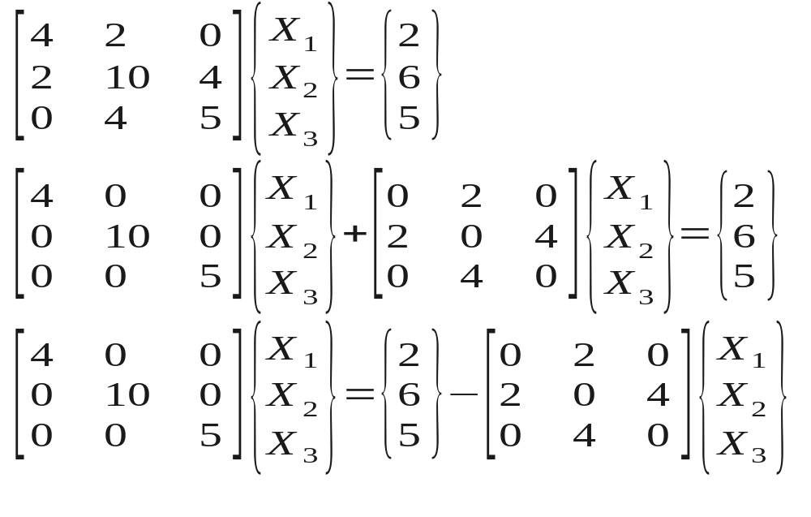
Jacobi method : Example 2

Slide 19
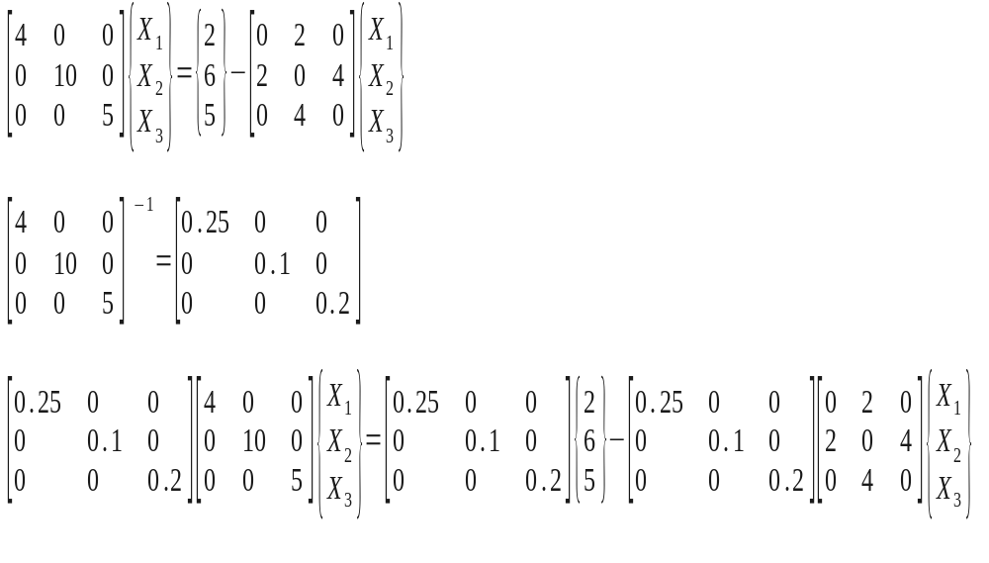
Jacobi method : Example 2

Slide 20
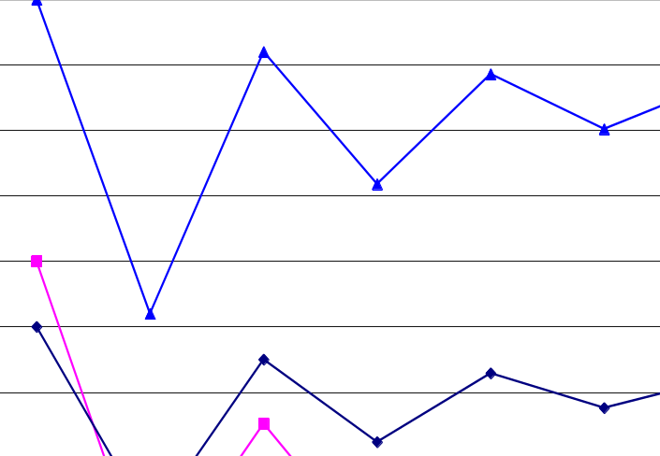
Jacobi method : Example 2
The actual Solution:
(X1 , X2 , X3 ) =
(0.41379, 0.17241, 0.86206)
Iteration 1 2 3 4 5 6 7
X ₁ 0.5 0.2 0.45 0.324 0.429 0.376 0.42
X ₂ 0.6 0.1 0.352 0.142 0.248 0.16 0.204
X ₃ 1 0.52 0.92 0.718 0.886 0.802 0.872

Slide 21
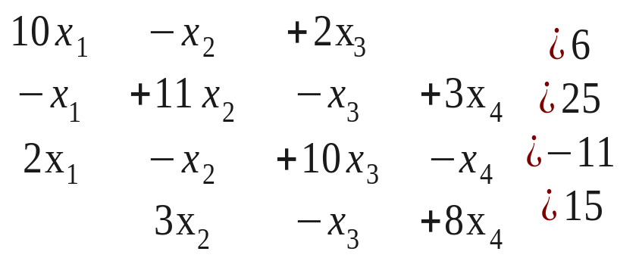
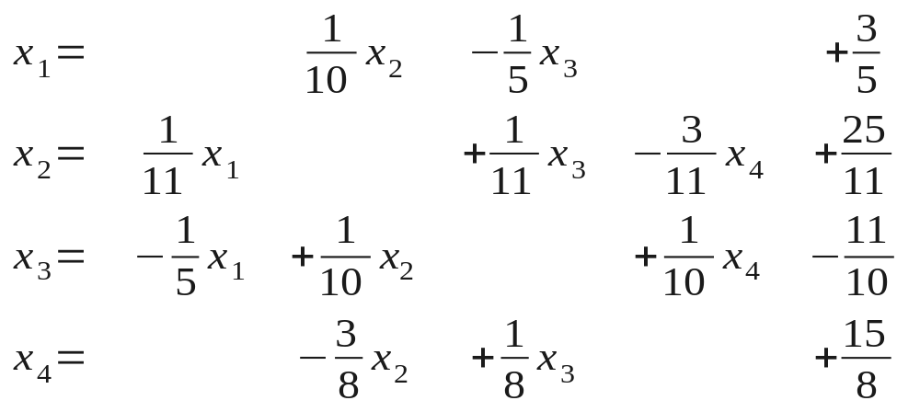
Jacobi method : Example 3
Consider the following set of equations.
Convert the set Ax = b in the form of x = Tx + c.

Slide 22
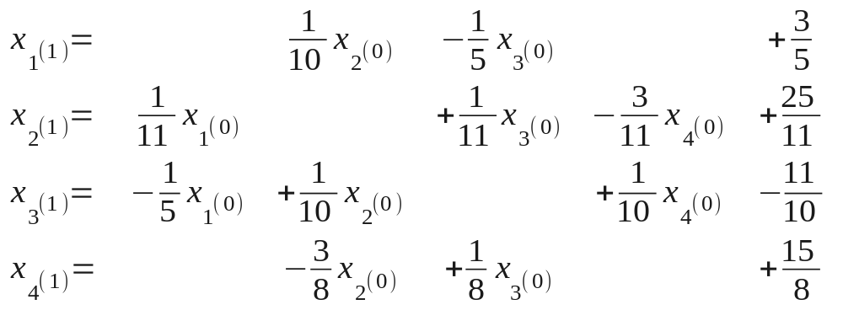

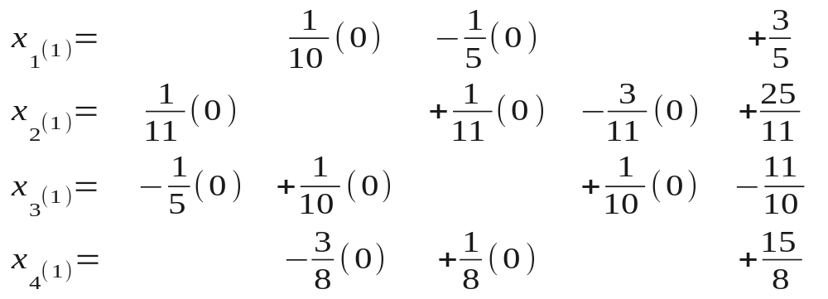
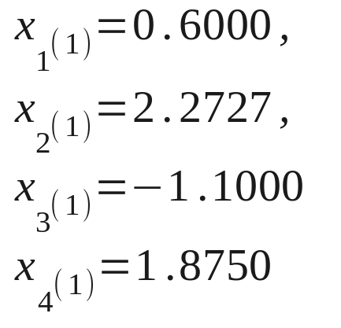
Jacobi method : Example 3

Slide 23
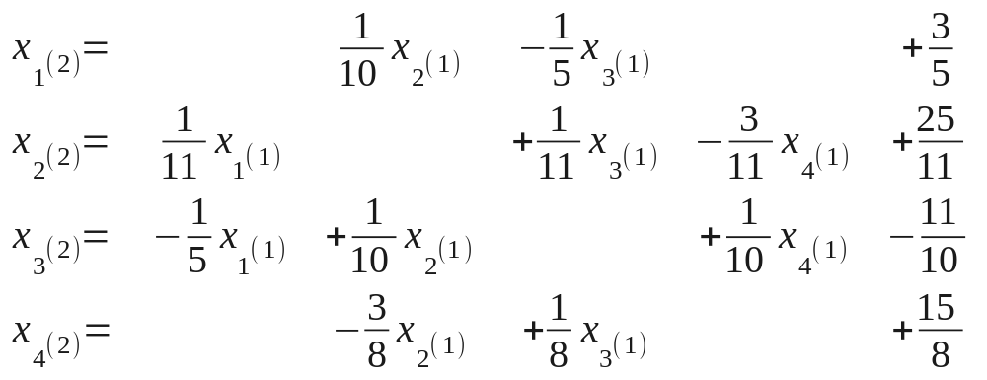
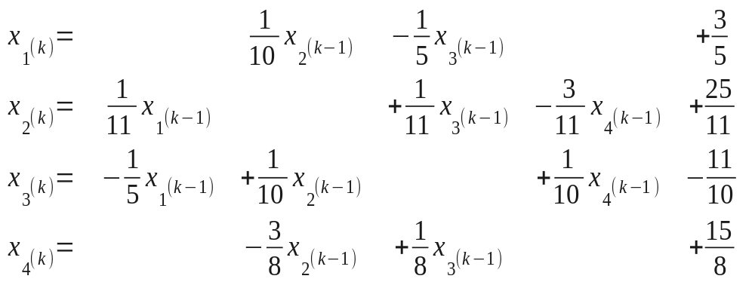
Jacobi method : Example 3

Slide 24
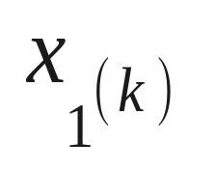
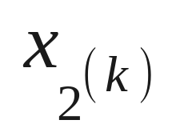
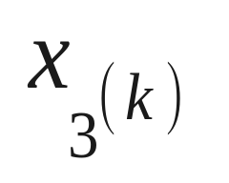
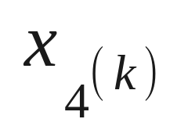
Jacobi method : Example 3
Results:
iteration | 0 | 1 | 2 | 3
 | 0.0000 | 0.6000 | 1.0473 | 0.9326
 | 0.0000 | 2.2727 | 1.7159 | 2.0530
 | 0.0000 | -1.1000 | -0.8052 | -1.0493
 | 0.0000 | 1.8750 | 0.8852 | 1.1309

Slide 25
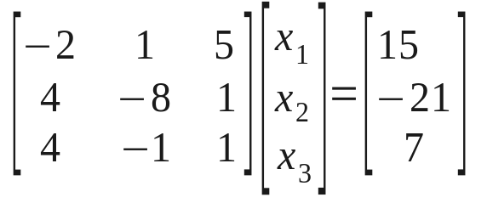
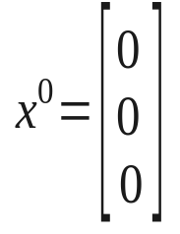

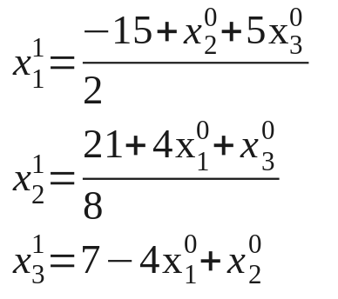
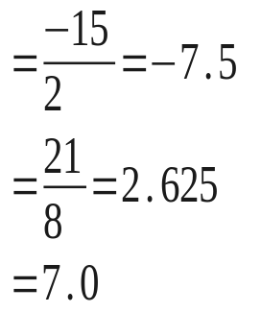

Jacobi method : Example 4
A diverging case study:
The matrix is not diagonally dominant

Slide 26
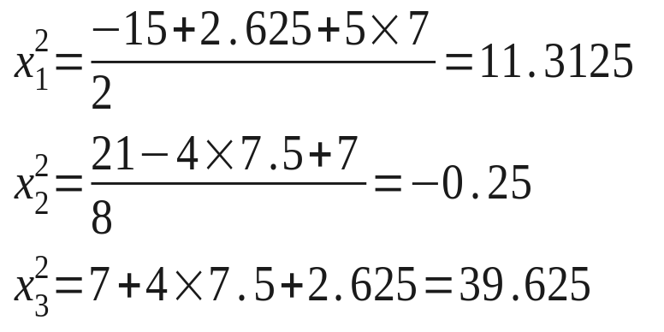

Jacobi method : Example 4
The residual term is increasing at each iteration, so the iterations are diverging.
Note that the matrix is not diagonally dominant

Slide 27
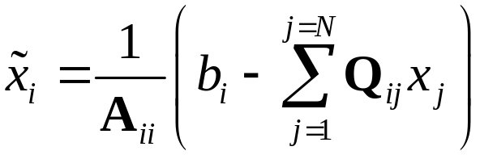


Pseudo-Code For Jacobi Method
1) build A, b
2) build modified A with diagonal zero → Q
3) set initial guess x=0
4) do {
a) compute:
b) compute error:
c) update x:
}while err>tol

Slide 28

Matlab
program

Slide 29

Running the program
I ran the script with the stopping tolerance (tol) set to 1e-8:
Note that the error is of the order of 1e-8 !!!
i.e. the Jacobi iterative method computes an approximate solution to the system of equations!.

Slide 30

The rules
We set up the Jacobi iteration but did not ask the question “when will the Jacobi iteration converge and how fast?”
Definition:
A matrix A is diagonally dominant if
Theorem:
If the matrix A is diagonally dominant then Ax=b has a unique solution x and the Jacobi iteration produces a sequence which converges to x for any initial guess
Informally:
The “more diagonally dominant ” a matrix is the faster it will converge… this holds some of the time.

