Slide 1
Fluid Mechanics
Introductory concepts

Slide 2
Introduction
Field of Fluid Mechanics can be divided into 3 branches:
Fluid Statics: mechanics of fluids at rest
Kinematics: deals with velocities and streamlines w/o considering forces or energy
Fluid Dynamics: deals with the relations between velocities and accelerations and forces exerted by or upon fluids in motion

Slide 3
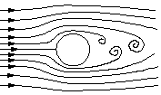
Streamlines
A streamline is a line that is tangential to the instantaneous velocity direction (velocity is a vector that has a direction and a magnitude)
Instantaneous streamlines in flow around a cylinder

Slide 4
Intro…con’t
Mechanics of fluids is extremely important in many areas of engineering and science. Examples are:
Biomechanics
  Blood flow through arteries
  Flow of cerebral fluid
Meteorology and Ocean Engineering
  Movements of air currents and water currents
Chemical Engineering
  Design of chemical processing equipment
  Aerodynamics

Slide 5
Intro…con’t
Mechanical Engineering
  Design of pumps, turbines, air-conditioning equipment, pollution-control equipment, etc.
Civil Engineering
  Transport of river sediments
  Pollution of air and water
  Design of piping systems
  Flood control systems

Slide 6
Dimensions and Units
Before going into details of fluid mechanics, we stress importance of units
In U.S, two primary sets of units are used:
  1. SI (Systeme International) units
  2. English units

Slide 7

Unit Table
Quantity | SI Unit | English Unit
Length (L) | Meter (m) | Foot (ft)
Mass (m) | Kilogram (kg) | Slug (slug) = lb*sec²/ft
Time (T) | Second (s) | Second (sec)
Temperature ( ) | Celcius (ºC) | Farenheit (ºF)
Force | Newton (N)=kg*m/s² | Pound (lb)

Slide 8
Dimensions and Units con’t
1 Newton – Force required to accelerate a 1 kg of mass to 1 m/s²
1 slug – is the mass that accelerates at 1 ft/s² when acted upon by a force of 1 lb
To remember units of a Newton use F=ma (Newton’s 2nd Law)
  [F] = [m][a]= kg*m/s² = N

Slide 9
More on Dimensions
To remember units of a slug also use F=ma => m = F / a
[m] = [F] / [a] = lb / (ft / sec²) = lb*sec² / ft
1 lb is the force of gravity acting on (or weight of ) a platinum standard whose mass is 0.45359243 kg

Slide 10
Weight and Newton’s Law of Gravitation
Weight
  Gravitational attraction force between two bodies
Newton’s Law of Gravitation
F = G m₁m₂/ r²
  G - universal constant of gravitation
  m₁, m₂ - mass of body 1 and body 2, respectively
  r - distance between centers of the two masses
  F - force of attraction

Slide 11
Weight
m₂ - mass of an object on earth’s surface
m₁ - mass of earth
r - distance between center of two masses
r₁ - radius of earth
r₂ - radius of mass on earth’s surface
r₂ << r_{1,} therefore r = r₁+r₂ ~ r₁
Thus, F = m₂ * (G * m₁ / r²)

Slide 12
Weight
Weight (W) of object (with mass m₂) on surface of earth (with mass m₁) is defined as
W = m₂g ; g =(Gm₁/r²) gravitational acceleration
g = 9.31 m/s² in SI units
g = 32.2 ft/sec² in English units
See back of front cover of textbook for conversion tables between SI and English units

Slide 13


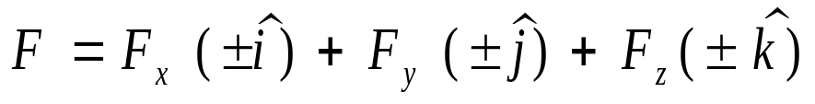
Properties of Fluids - Preliminaries
Consider a force, , acting on a 2D region of area A sitting on x-y plane
Cartesian components:
z
y
A
x

Slide 14



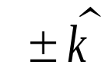
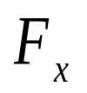



Cartesian components
- Unit vector in x-direction
- Unit vector in y-direction
- Unit vector in z-direction
- Magnitude of in x-direction (tangent to surface)
- Magnitude of in y-direction (tangent to surface)
- Magnitude of in z-direction (normal to surface)

Slide 15
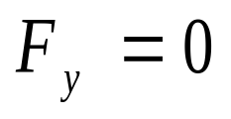
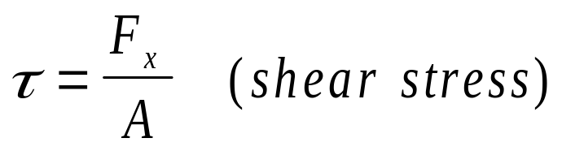
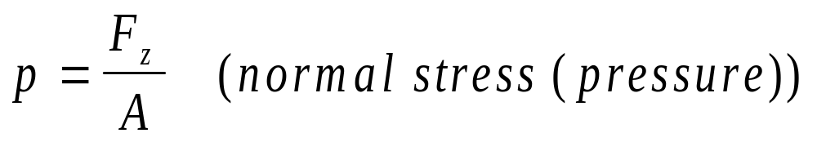
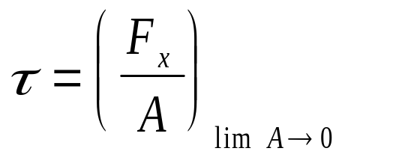
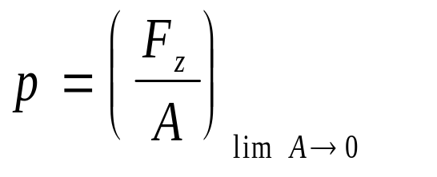
- For simplicity, let
Shear stress and pressure
Shear stress and pressure at a point

Slide 16
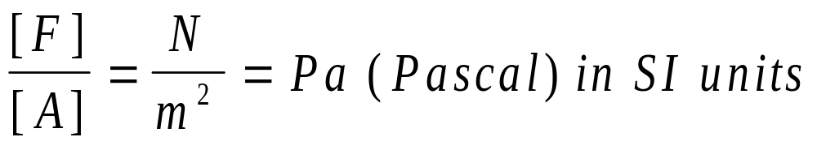
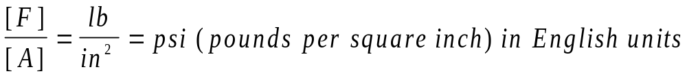
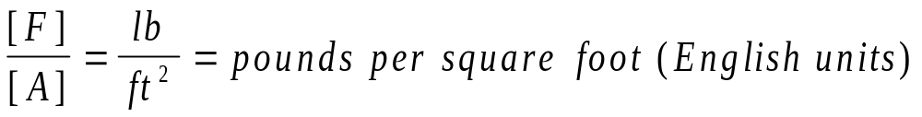
Units of stress (shear stress and pressure)

Slide 17
Properties of Fluids Con’t
Fluids are either liquids or gases
Liquid: A state of matter in which the molecules are relatively free to change their positions with respect to each other but restricted by cohesive forces so as to maintain a relatively fixed volume
Gas: a state of matter in which the molecules are practically unrestricted by cohesive forces. A gas has neither definite shape nor volume.

Slide 18
More on properties of fluids
Fluids considered in this course move under the action of a shear stress, no matter how small that shear stress may be (unlike solids)

Slide 19



Continuum view of Fluids
Convenient to assume fluids are continuously distributed throughout the region of interest. That is, the fluid is treated as a continuum
This continuum model allows us to not have to deal with molecular interactions directly. We will account for such interactions indirectly via viscosity
A good way to determine if the continuum model is acceptable is to compare a characteristic length of the flow region with the mean free path of molecules,
If , continuum model is valid

Slide 20
Mean free path ( ) – Average distance a molecule travels before it collides with another molecule.

Slide 21
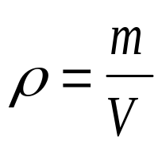
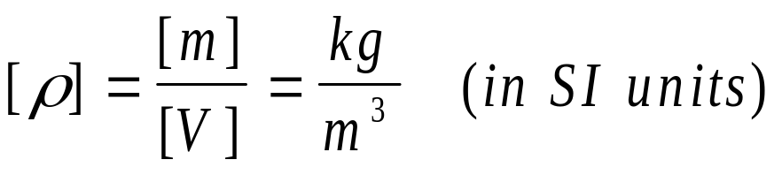

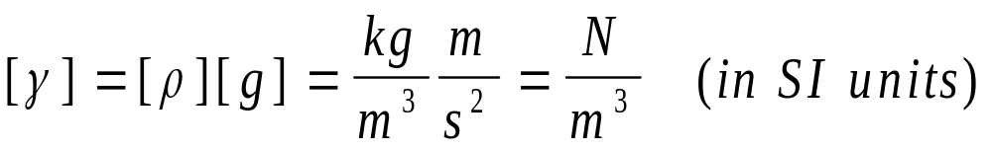
1.3.2 Density and specific weight
Density (mass per unit volume):
Units of density:
Specific weight (weight per unit volume):
Units of specific weight:

Slide 22
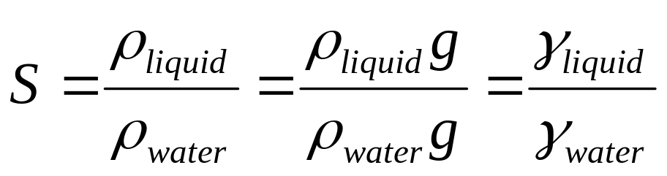
Specific Gravity of Liquid (S)
See appendix A of textbook for specific gravities of various liquids with respect to water at 60 ºF

Slide 23
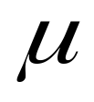
1.3.3 Viscosity ( )
Viscosity can be thought as the internal stickiness of a fluid
Representative of internal friction in fluids
Internal friction forces in flowing fluids result from cohesion and momentum interchange between molecules.
Viscosity of a fluid depends on temperature:
  In liquids, viscosity decreases with increasing temperature (i.e. cohesion decreases with increasing temperature)
  In gases, viscosity increases with increasing temperature (i.e. molecular interchange between layers increases with temperature setting up strong internal shear)

Slide 24
More on Viscosity
Viscosity is important, for example,
  in determining amount of fluids that can be transported in a pipeline during a specific period of time
  determining energy losses associated with transport of fluids in ducts, channels and pipes

Slide 25
No slip condition
Because of viscosity, at boundaries (walls) particles of fluid adhere to the walls, and so the fluid velocity is zero relative to the wall
Viscosity and associated shear stress may be explained via the following: flow between no-slip parallel plates.

Slide 26
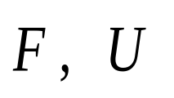




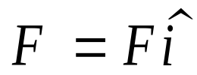
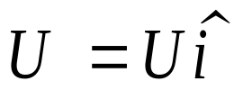



Flow between no-slip parallel plates
-each plate has area A
Moving plate
Fixed plate
Force induces velocity on top plate. At top plate flow velocity is
At bottom plate velocity is

Slide 27

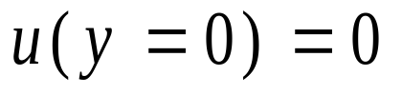
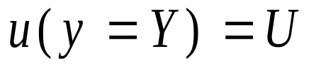
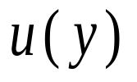
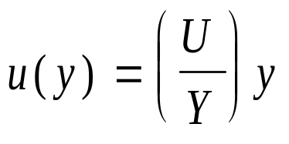
The velocity induced by moving top plate can be sketched as follows:
The velocity induced by top plate is expressed as follows:

Slide 28
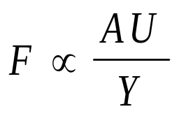
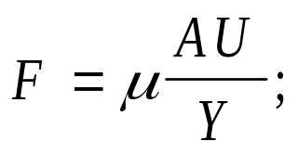

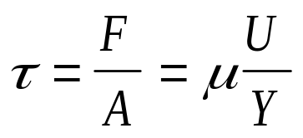

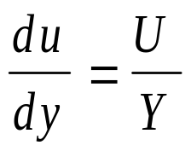
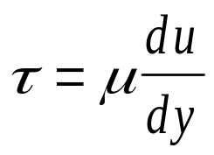
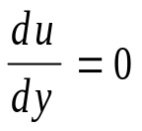
For a large class of fluids, empirically,
More specifically,
Shear stress induced by is
From previous slide, note that
Thus, shear stress is
In general we may use previous expression to find shear stress at a point
inside a moving fluid. Note that if fluid is at rest this stress is zero because

Slide 29
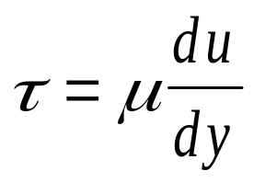
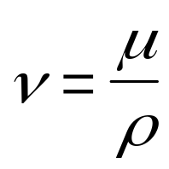



Newton’s equation of viscosity
Shear stress due to viscosity at a point:
- viscosity (coeff. of viscosity)
- kinematic
viscosity
fluid surface
e.g.: wind-driven flow in ocean
Fixed no-slip plate

Slide 30
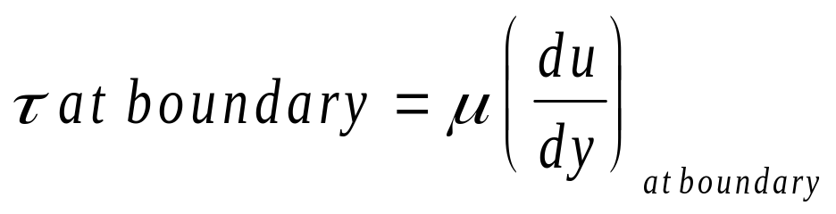

As engineers, Newton’s Law of Viscosity is very useful to us as we can use it to
evaluate the shear stress (and ultimately the shear force) exerted by a moving
fluid onto the fluid’s boundaries.
Note is direction normal to the boundary

Slide 31






Viscometer
Coefficient of viscosity can be measured empirically using a viscometer
Example: Flow between two concentric cylinders (viscometer) of length
- radial coordinate
Moving fluid
Fixed outer
cylinder
Rotating inner
cylinder

Slide 32
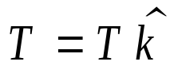





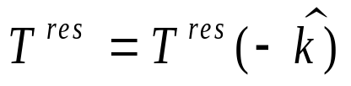
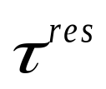





Inner cylinder is acted upon by a torque, , causing it to rotate about point at a constant angular velocity and
causing fluid to flow. Find an expression for
Because is constant, is balanced by a resistive torque exerted by the moving fluid onto inner cylinder
The resistive torque comes from the resistive stress exerted by the moving fluid onto the inner cylinder. This stress on the inner cylinder leads to an overall resistive force , which induces the resistive torque about point

Slide 33



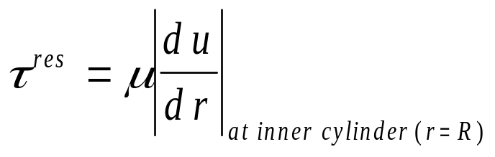


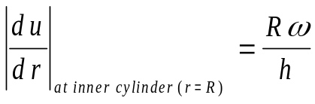



(Neglecting ends of cylinder)
How do we get ? This is the stress exerted by fluid onto inner cylinder, thus
If (gap between cylinders) is small, then

Slide 34
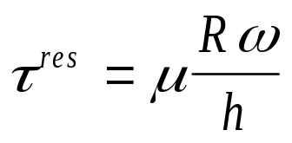

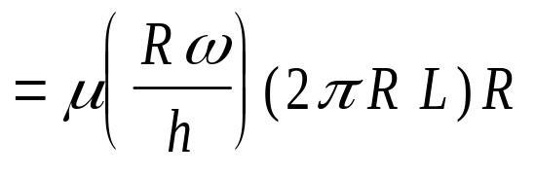
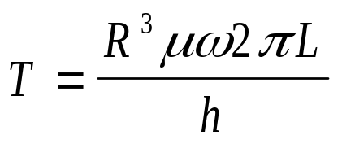


Thus,
Given previous result may be used to find of fluid, thus concentric cylinders may be used as a viscometer

Slide 35


Non-Newtonian and Newtonian fluids
Non-Newtonian fluid
Newtonian fluid (linear relationship)
Non-Newtonian fluid
(non-linear relationship)
In this course we will only deal with Newtonian fluids
Non-Newtonian fluids: blood, paints, toothpaste

Slide 36
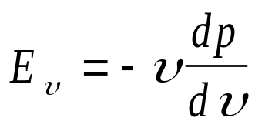
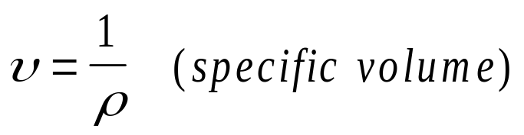

Compressibility
All fluids compress if pressure increases resulting in an
increase in density
Compressibility is the change in volume due to a
change in pressure
A good measure of compressibility is the bulk modulus
(It is inversely proportional to compressibility)

Slide 37
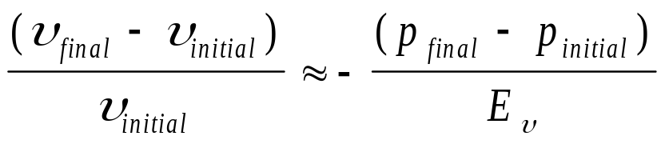


Compressibility
From previous expression we may write
For water at 15 psia and 68 degrees Farenheit,
From above expression, increasing pressure by 1000 psi will compress the water by only 1/320 (0.3%) of its original volume
Thus, water may be treated as incompressible (density is constant)
In reality, no fluid is incompressible, but this is a good approximation for
certain fluids

Slide 38
Vapor pressure of liquids
All liquids tend to evaporate when placed in a closed container
Vaporization will terminate when equilibrium is reached between
the liquid and gaseous states of the substance in the container
i.e. # of molecules escaping liquid surface = # of incoming molecules
Under this equilibrium we call the call vapor pressure the saturation
pressure
At any given temperature, if pressure on liquid surface falls below the
the saturation pressure, rapid evaporation occurs (i.e. boiling)
For a given temperature, the saturation pressure is the boiling pressure

Slide 39






Surface tension
Consider inserting a fine tube into a bucket of water:
- radius of tube
Meniscus
Surface tension vector (acts uniformly along contact perimeter between
liquid and tube)
Adhesion of water molecules to the tube dominates over cohesion between
water molecules giving rise to and causing fluid to rise within tube

Slide 40




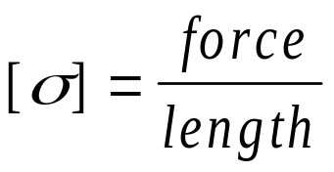
- unit vector in direction of
- surface tension (magnitude of )
Given conditions in previous slide, what is ?

Slide 41



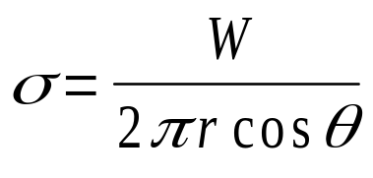

(weight vector of water)
Equilibrium in y-direction yields:
Thus
with

