Slide 1

Daraz E-Commerce Training
Getting Familiar with Daraz Policies

Slide 2
This lecture is about:
Learning Daraz policies
Understanding how to comply with the Daraz policies
Knowing what difference do these policies make
Setting up customer and seller accounts on Daraz

Slide 3
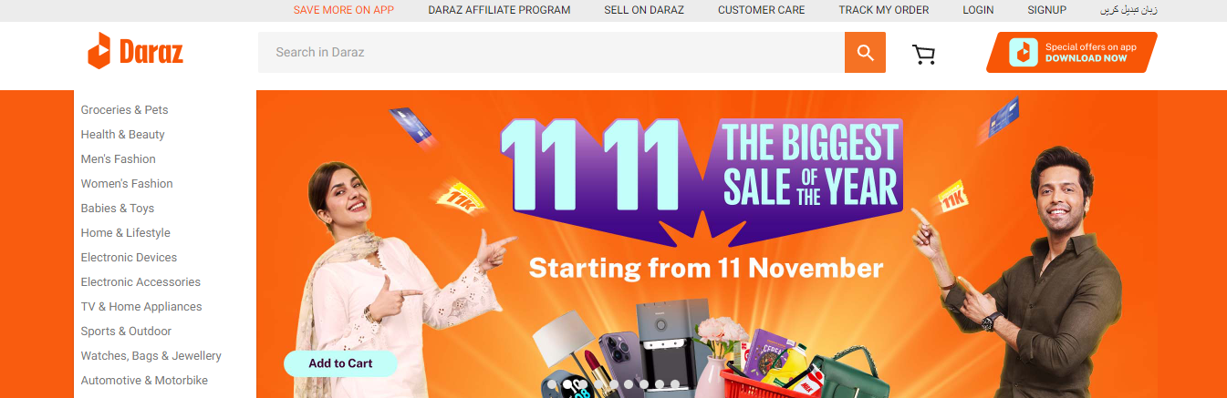
Creating Customer Account

Slide 4
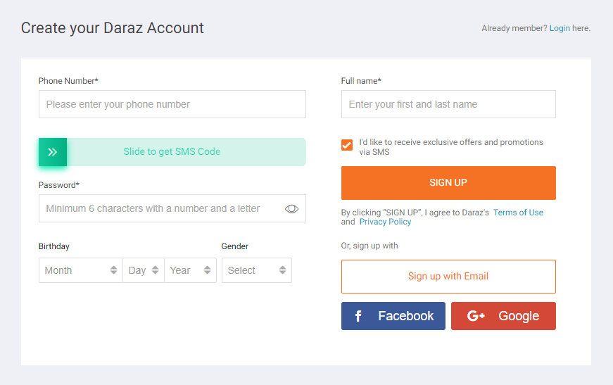

Slide 5
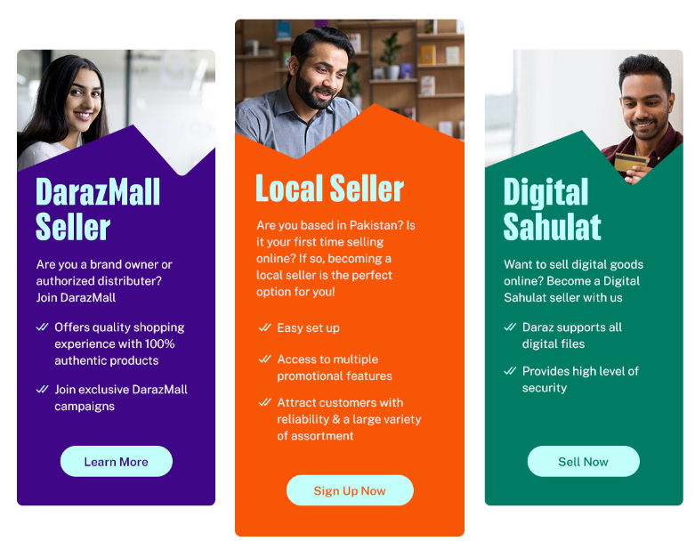
Seller Account Options

Slide 6
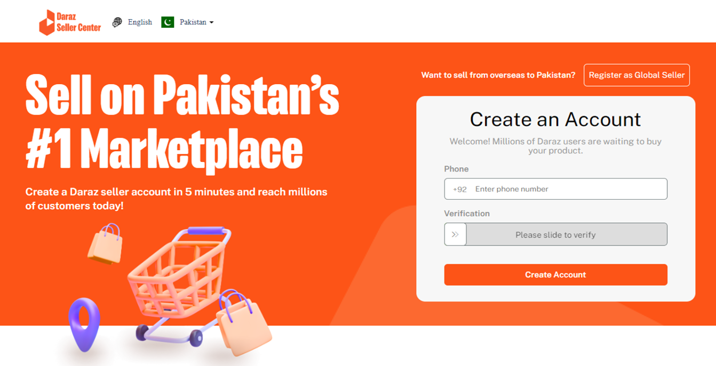
Daraz Seller Account
To become a Daraz Global Seller, register here
Go to https://sellercenter.daraz.pk/
Create an account to become a Daraz Local Seller

Slide 7
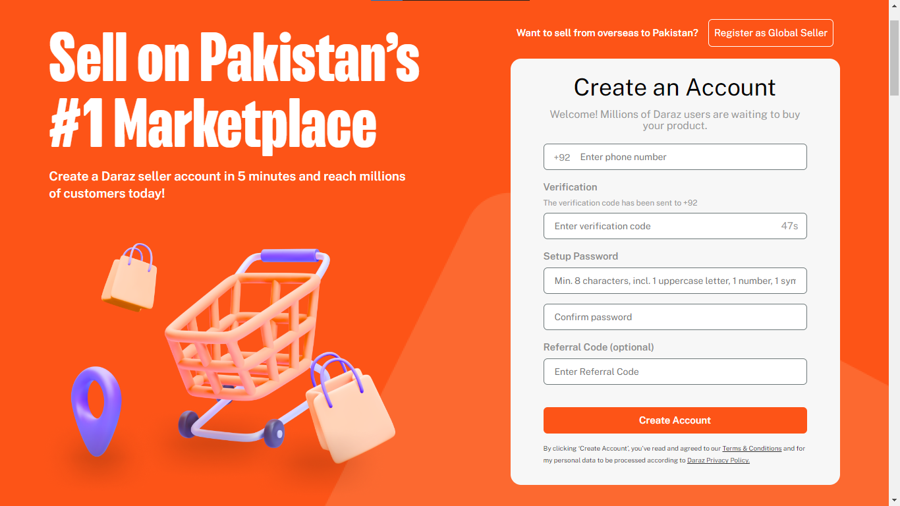

Slide 8



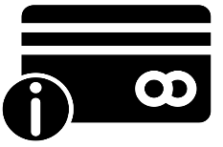
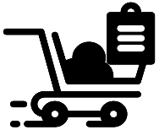
Simple Steps to Start Selling
Signup for Free. Create your account through our website or mobile app with just your phone number
Add Profile Information. Complete your profile by providing your email and store name so that we can identify you
Add Address Information. Provide all address details of your business
Add ID & Bank Information. Add in your ID & Business related details. Include necessary bank information for payments
List Products. Add products to your store through seller center. Start selling as soon as your products go live after going through quality control

Slide 9

“
“
Honesty is the best policy
– Proverb

