Slide 1

Daraz E-Commerce Training
A Preamble to E-Commerce and Daraz

Slide 2
This course will help you in:
Establishing a digital presence of your business
Thinking about different ways to market yourself online
Understanding how you can evaluate and improve your digital endeavors

Slide 3





Electronic Commerce
is the buying and selling of goods or services on the Internet.
Most digital businesses utilize an online platform like Daraz to engage with their customers.
Today, online world is very much a part of our daily lives
Online experience is constantly evolving
Recall the last time you ordered a good or service online

Slide 4
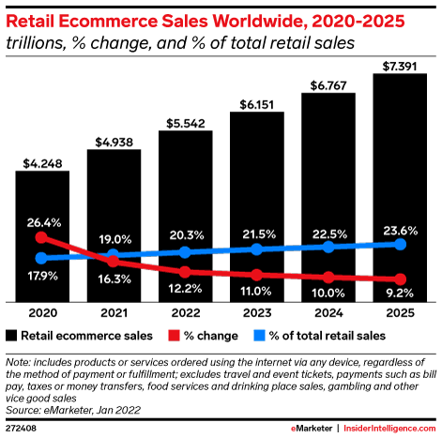
Global e-commerce sales
are expected to increase over the next years.
Post COVID-19, e-commerce sales increased by 26.4% in 2020
Global retail e-commerce sales in 2022: more than $5 trillion
E-commerce accounts for more than a 1/5 of total retail sales
By 2025, total e-commerce spending: $7 trillion

Slide 5

Pakistan’s e-commerce market
is projected to generate US$7.7 billion revenue in 2022
“
Pakistan is the 37th largest e-commerce market, with a revenue of $5.9 billion in 2021.
The Pakistan’s e-commerce market expanded by 45% in 2021, contributing to a global growth rate of 15%.
A bulging middle class and broadband subscriptions of over 100 million are stimulating the rapid development of the e-commerce market in Pakistan.
With a yearly growth rate of 7% between 2021 and 2025, Pakistan is even expected to outperform the global average of 6%.
“

Slide 6
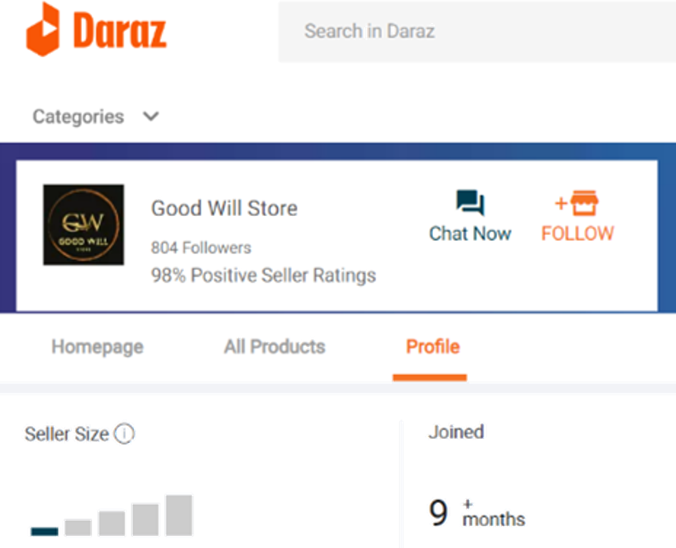
E-commerce firms can range
in size from small startups to enormous corporations.
Main four sizes of e-commerce firms
Startup. A small enterprise or medium enterprise up to 5 years old is considered as a startup.
Good Will Store is an example of an e-commerce startup on Daraz

Slide 7


Small business. Annual sales turnover up to PKR 150 million
Markhor, a handcrafted footwear company, is an example of a small business
Mid-market business. Annual sales turnover above PKR 150 Million to PKR 800 Million
TPS Pakistan, a leading payment solution provider, is an example of a medium-sized business

Slide 8



Large enterprise
Daraz is number one in e-commerce market of Pakistan
NETSOL Technologies, a large enterprise, is a global provider of IT solutions to the asset finance and leasing industry
Engro Corporation, a multinational company, has interests in a diverse range of businesses

Slide 9
Main models of e-commerce
are Business-to-Business (B2B) and Business-to-Consumer (B2C)
Let’s review each type of electronic commerce in a bit more detail.
B2B E-commerce
Transactions made between businesses, such as a manufacturer and a wholesaler or retailer
B2C E-commerce
Sales made between a business and a consumer
When you buy food from foodpanda, it’s a B2C e-commerce transaction.

Slide 10
Pakistan’s e-commerce leader
Daraz is enabling a new online shopping experience in South Asia (excluding India)
Daraz is a B2C marketplace for branded, original products
To fully understand Daraz, let’s take a look at its history
Founded in 2012, first e-commerce shopping portal in Pakistan
Took over kaymu.pk in 2016
Acquired by Chinese giant Alibaba in 2018
Daraz has 100,000 SMEs in Pakistan on its platform
Earned over PKR 5 billions revenue during last 11.11 Sale campaign

Slide 11

Daraz aims to beef up timely
“
We want to get to 300,000 active and educated SMEs selling on our platform within the next two years, and that will basically create a million jobs
“
– Bjarke Mikkelsen
Co-founder and CEO

Slide 12
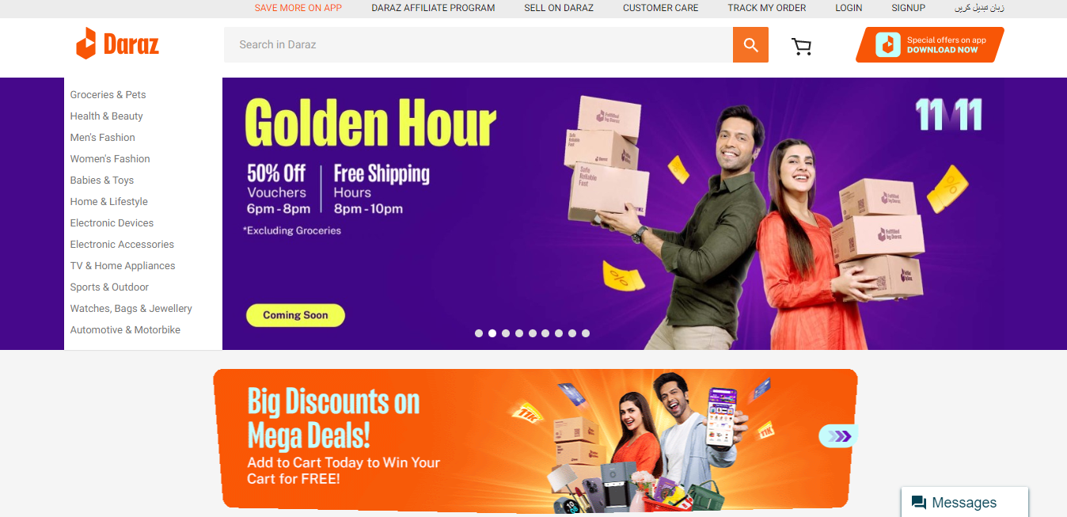
Daraz Desktop Website

Slide 13
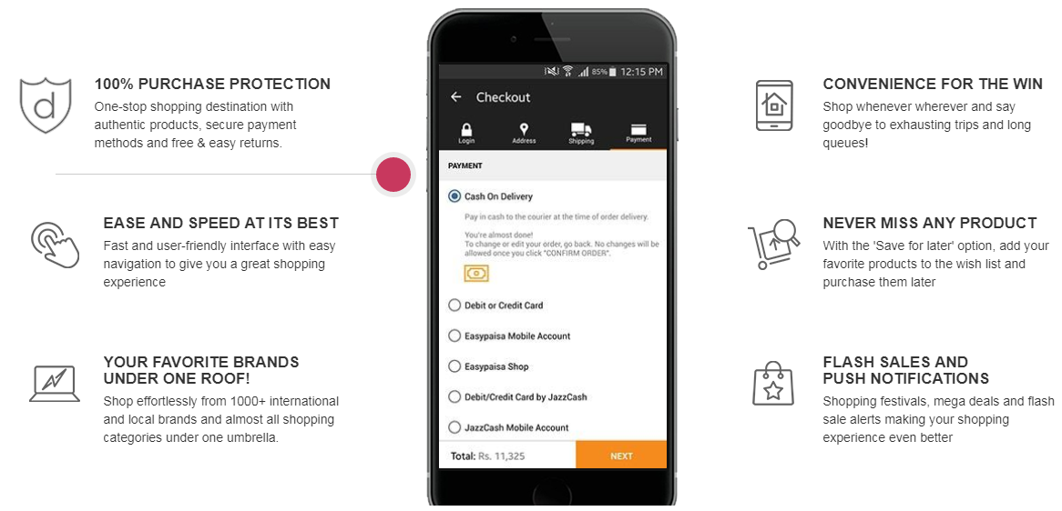
Daraz Mobile App

Slide 14
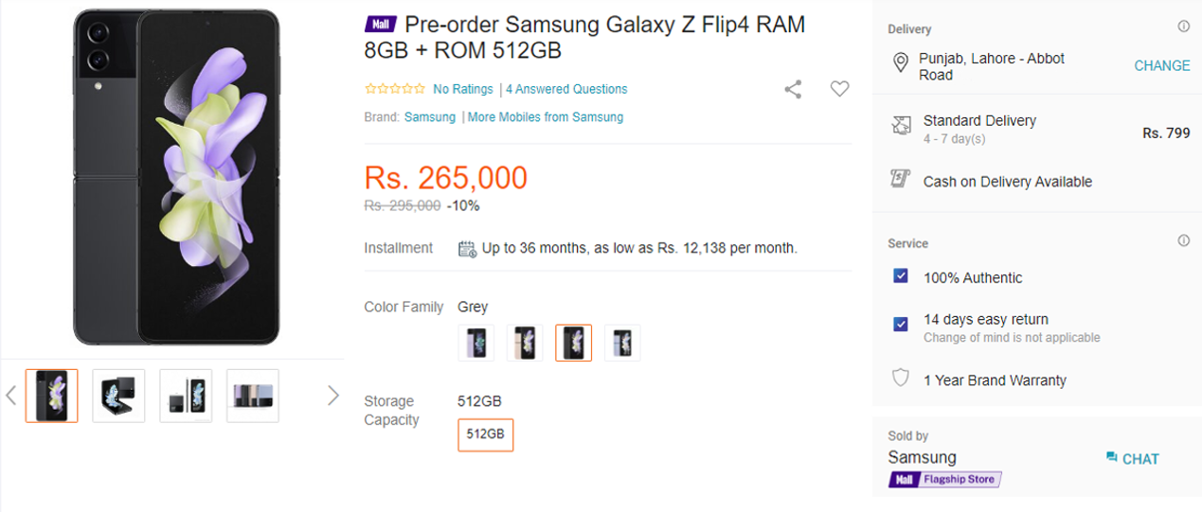
Product Webpage Detail
Product Title
Daraz title SEO, keywords
Product shipment
Charges about all the locations and understand about fulfilment methods
Images
Main, side images, infographic, lifestyle
Customer Services
Return time period, warranty
Offering or not
Brand Store
Store identity sold by

Slide 15
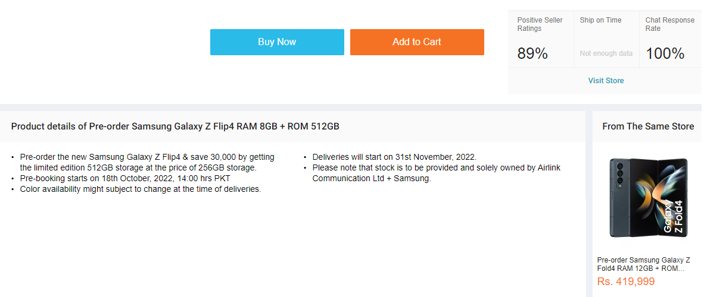
Seller Evolution
Seller Positive Ration, Shipping status, Customer Response
Product Description
Benefits, Specifications, Quality of product.

Slide 16
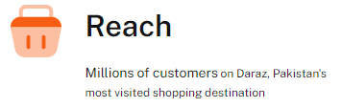
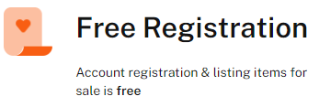
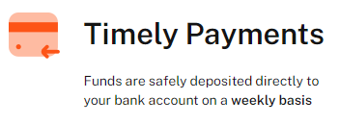
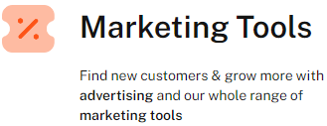
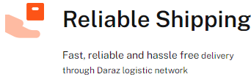
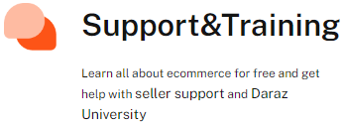
Why Sell on Daraz?

Slide 17
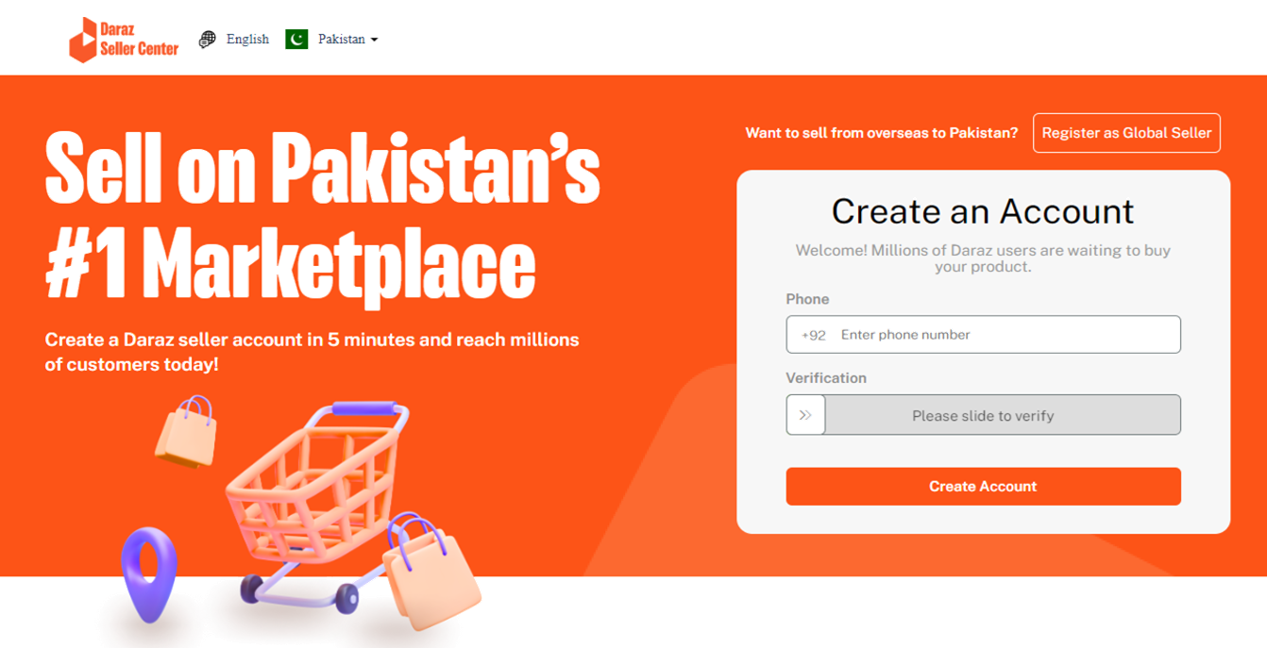
Daraz Seller Account
To become a Daraz Global Seller, register here
Go to https://sellercenter.daraz.pk/
Create an account to become a Daraz Local Seller

Slide 18
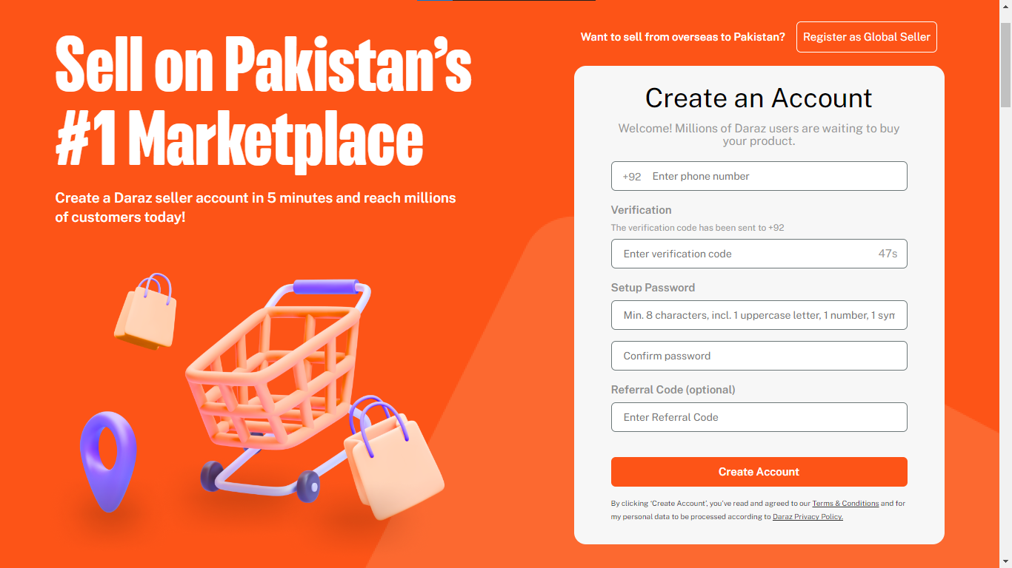

Slide 19




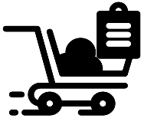
Simple Steps to Start Selling
Signup for Free. Create your account through our website or mobile app with just your phone number
Add Profile Information. Complete your profile by providing your email and store name so that we can identify you
Add Address Information. Provide all address details of your business
Add ID & Bank Information. Add in your ID & Business related details. Include necessary bank information for payments
List Products. Add products to your store through seller center. Start selling as soon as your products go live after going through quality control

Slide 20

“
Change is the law of life and those who look only to the past or present are to miss the future
“
– John F. Kennedy
Former President of the USA

