Slide 1
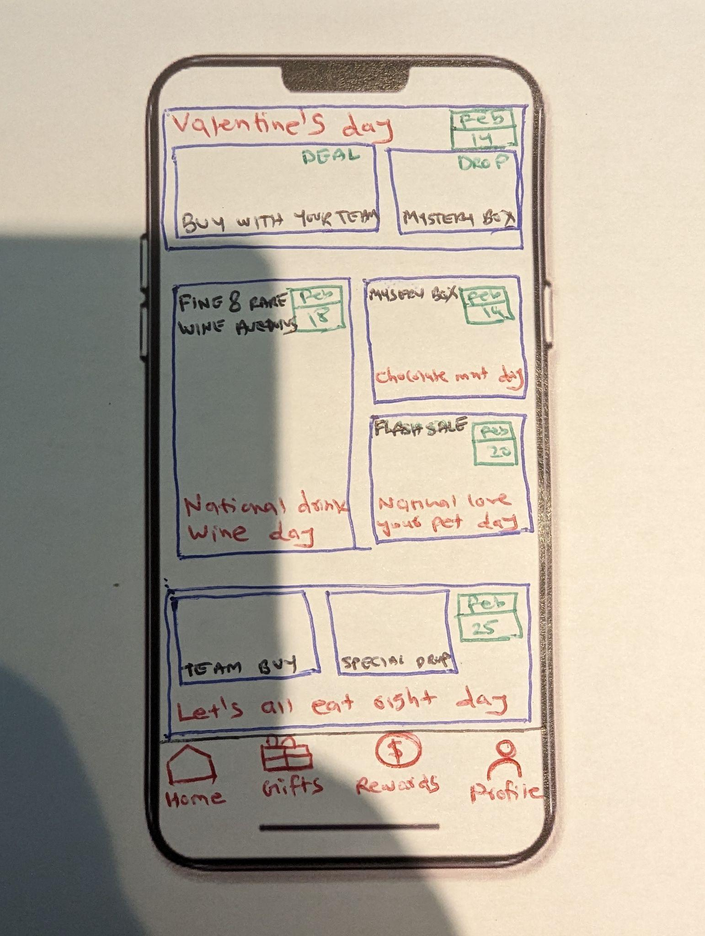
Make the “valentine’s day” section bigger than “let’s all eat right section”
- Replace “Buy with your team” with “Buy with a team”
- replace “Deal” with “Special discounts”
- Product / background image image should be from here and product name should be “Heart leaf plant”
- replace “Drop’ with “Mr. Beast exclusive”
- product / background image should be from here
- “Fine and rare wine Auction”
- “National drink wine day”
- Product / background image image should be from here and product name should be “The hedonist’s cellar”
- Mystery box
- Chocolate mint day
-- Product / background image image should be from here
- Flash sale: 50% off
- Love your pet day
- Product / background image should be from here and product name should be “Royal pet portrait”
- replace “Team buy” with “Buy with a team”, and add “Special discounts” badge similar to valentine’s day above
- Product / background image image should be here and product name should be “Superfood hamper”
- replace “Special drop” with “Exclusive drop”
- Product / background image image should be here and product name should be “Herb growing kit”
Home, Gifts, Rewards, Profile

Slide 2
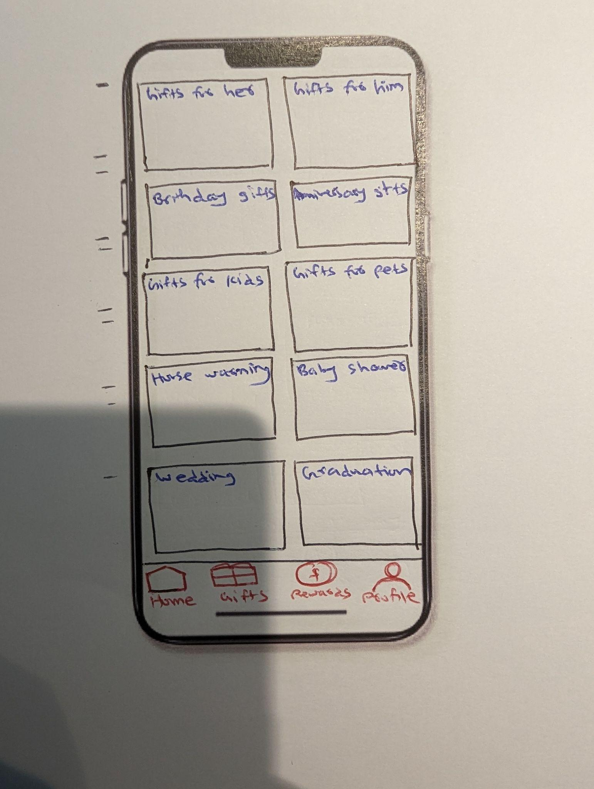
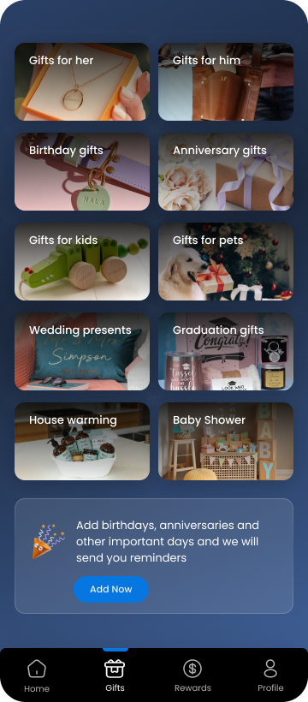
Gifts for her
Gifts for him
Birthday gifts
Anniversary gifts
Gifts for kids
Gifts for pets
Wedding presents
Graduation gifts
Make the design similar to this on etsy.com
The last section should be similar to the “Buy Etsy gift cards” … but replace “ Buy Etsy gift cards” with “Add “Birthdays, anniversaries and other important days and we will send you reminders”

Slide 3
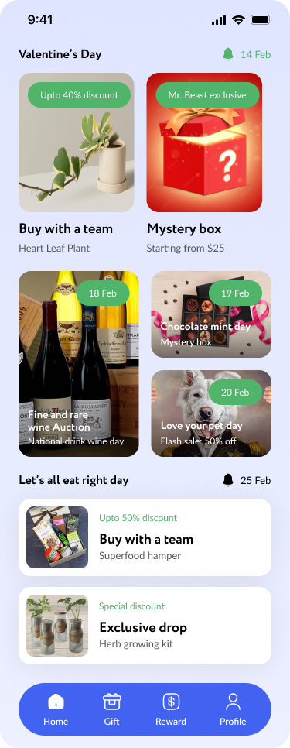
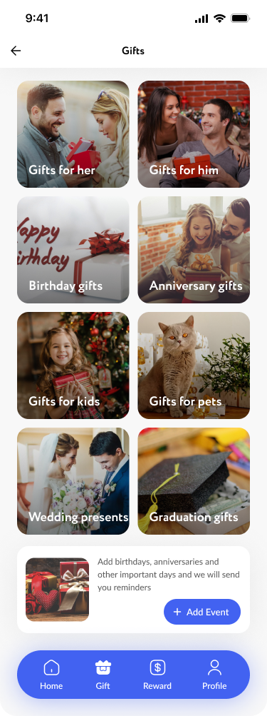

Slide 4
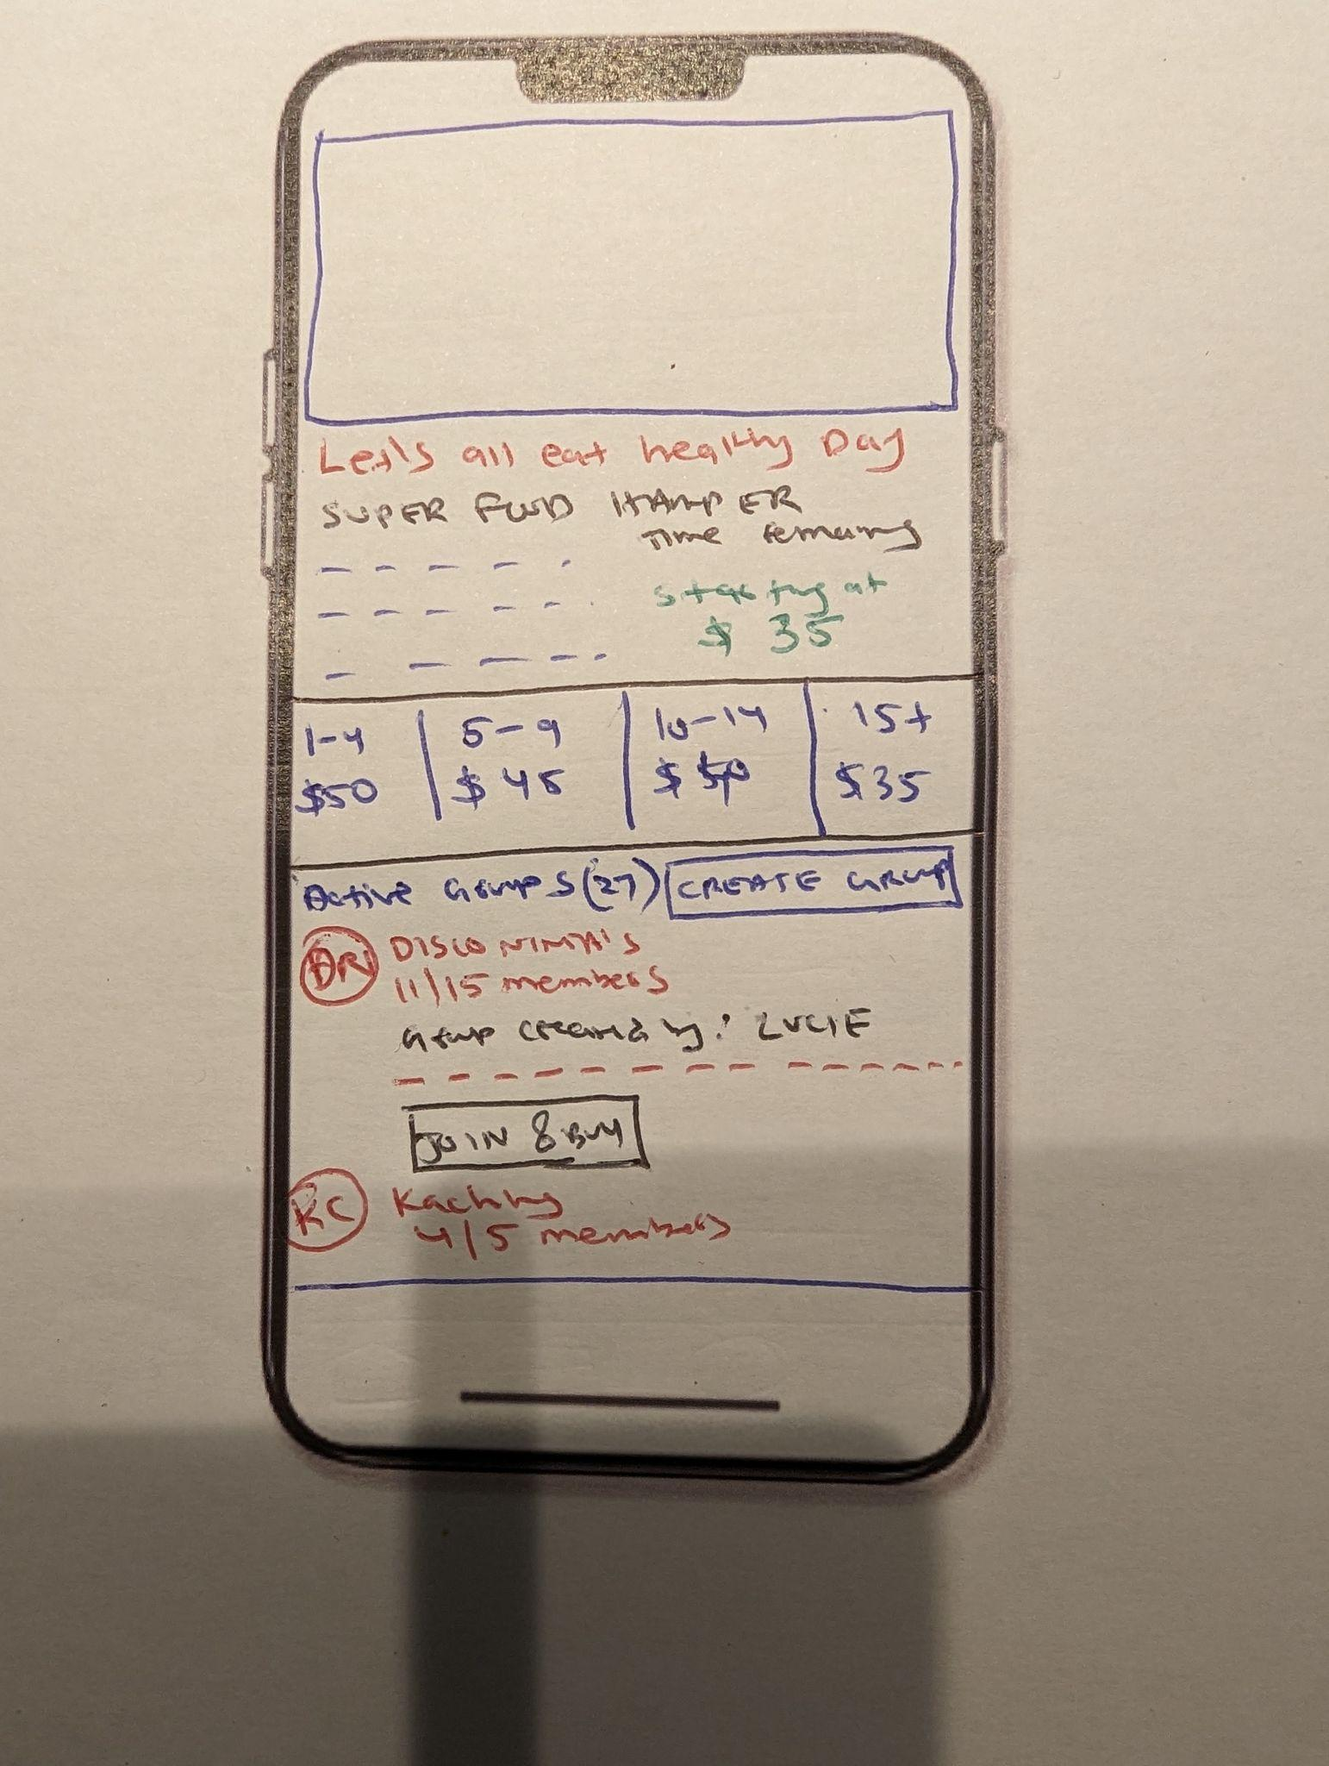
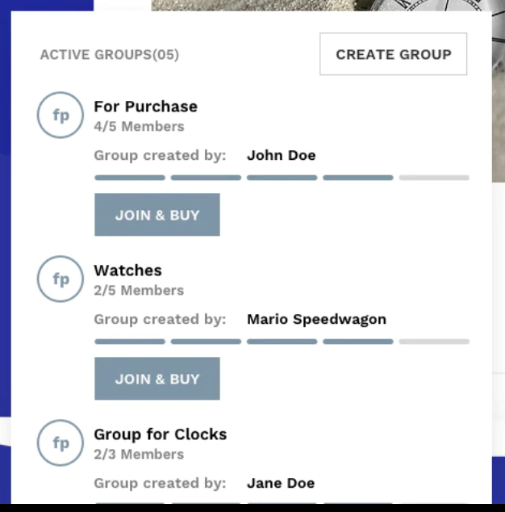
This is from the “Buy with a team” section on the Home screen. The background image should be the same as the Super food hamper
Text in this section should be as below:
You won't be disappointed by the contents of this Luxury Superfood Power Hamper! Our team has chosen the best high-quality superfoods from around the world to delight you or your loved one. Scrumptious raw organic chocolate delights, energising superfood powders and healthy premium oils are beautifully packed in a luxurious gift box and hand tied with a classic ribbon - perfect gift for the healthy foodie.
Active group and Create Group
Disco Ninja’s
11/15 members
Group created by: Lucie
Join and Buy
1-4 [$50]
5-9 [$45]
10-14 [$40]
15+ [$35]

Slide 5
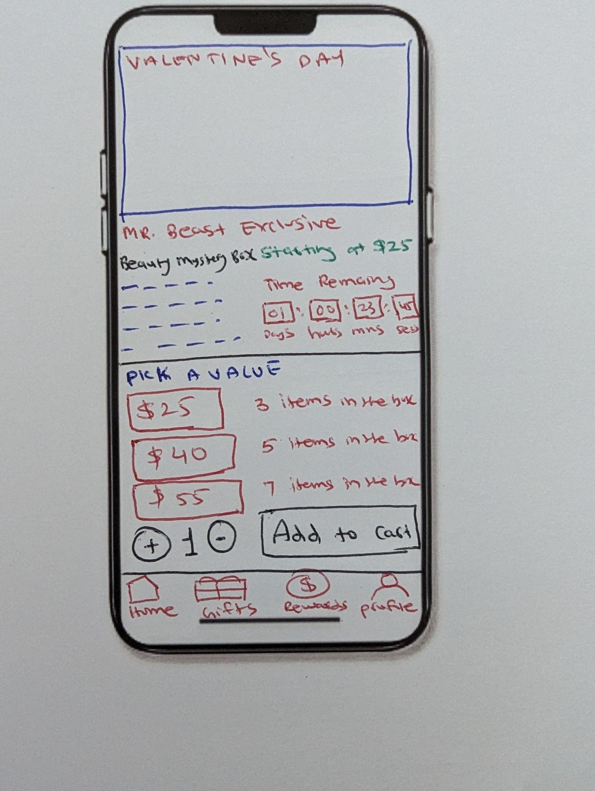
This is from the Valentine’s day mystery box from the home screen. Background image should be the same “mystery box” image as home screen
Mr. Beast Exclusive
Beauty Mystery Box starting at $25
Text in this section should be as below:
-Items handpicked to please & delight
-Unique, no 2 items in an order are the same
-Double The RRP value guarantee (at least twice what you spend)
-Brands include (not limited to) Rimmel, Max Factor, ACTY, Brow Gal, Sally Hensen, Loveshy
Pick a Value
3 items in the box
5 items in the box
7 items in the box

Slide 6
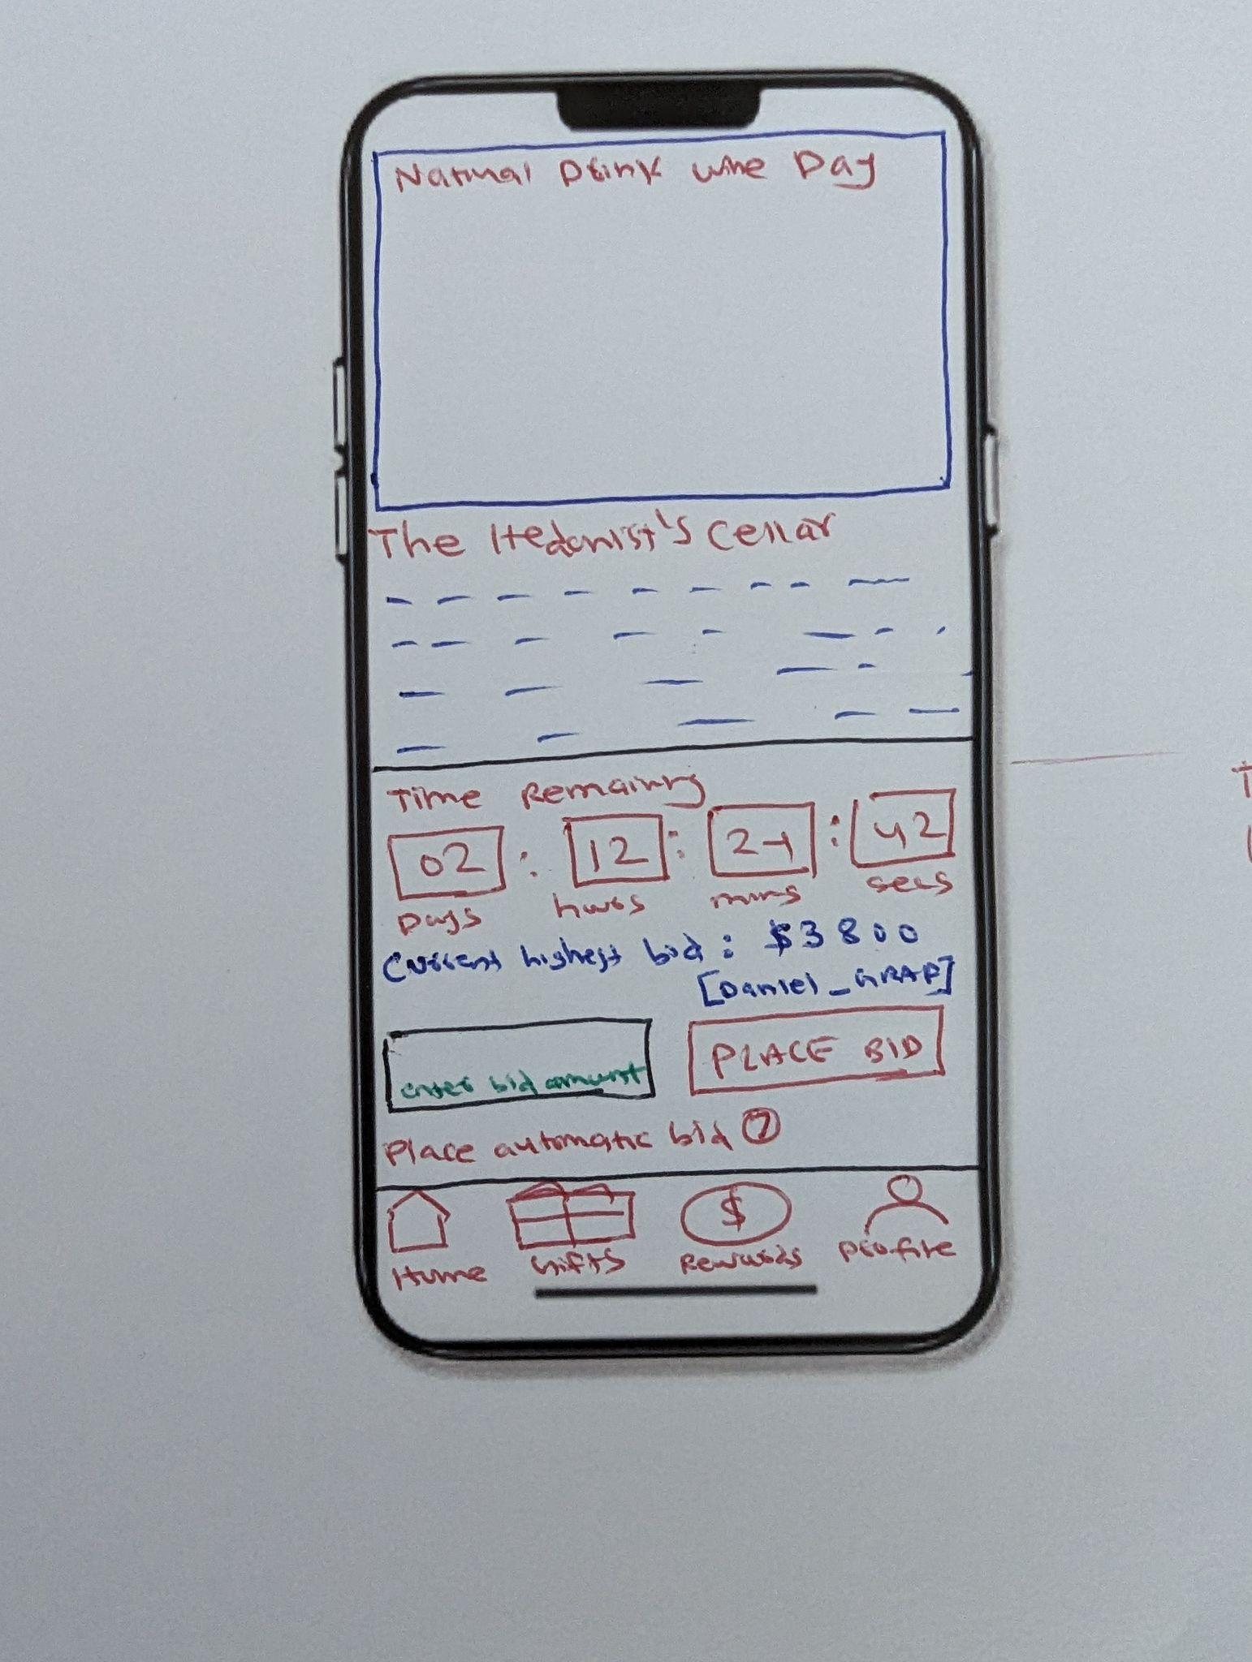
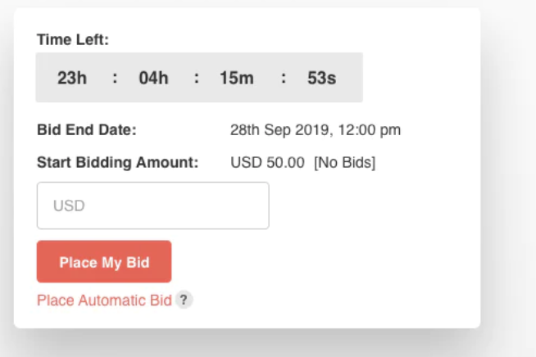
National drink wine day. The background image should be same at the Fine and rare wine auction from home screen
The hedonist’s cellar
The text in the section should be as below:
Comprised from only the very finest Domaines that Burgundy has to offer, this wonderful cellar supplies Grand Cru offerings from liquid luminaries such as Domaine de la Romanée-Conti, Domaine Leroy, Roumier, Rousseau, de Vogue, Leflaive, d'Auvenay, Coche-Dury, Comtes Lafon, Ramonet, Roulot, Bonneau du Martray Raveneau, a veritable embarrassment of riches for devotees of the Cote d'Or and Chablis.
Fine and rare wine auction

Slide 7
APPENDIX

Slide 8
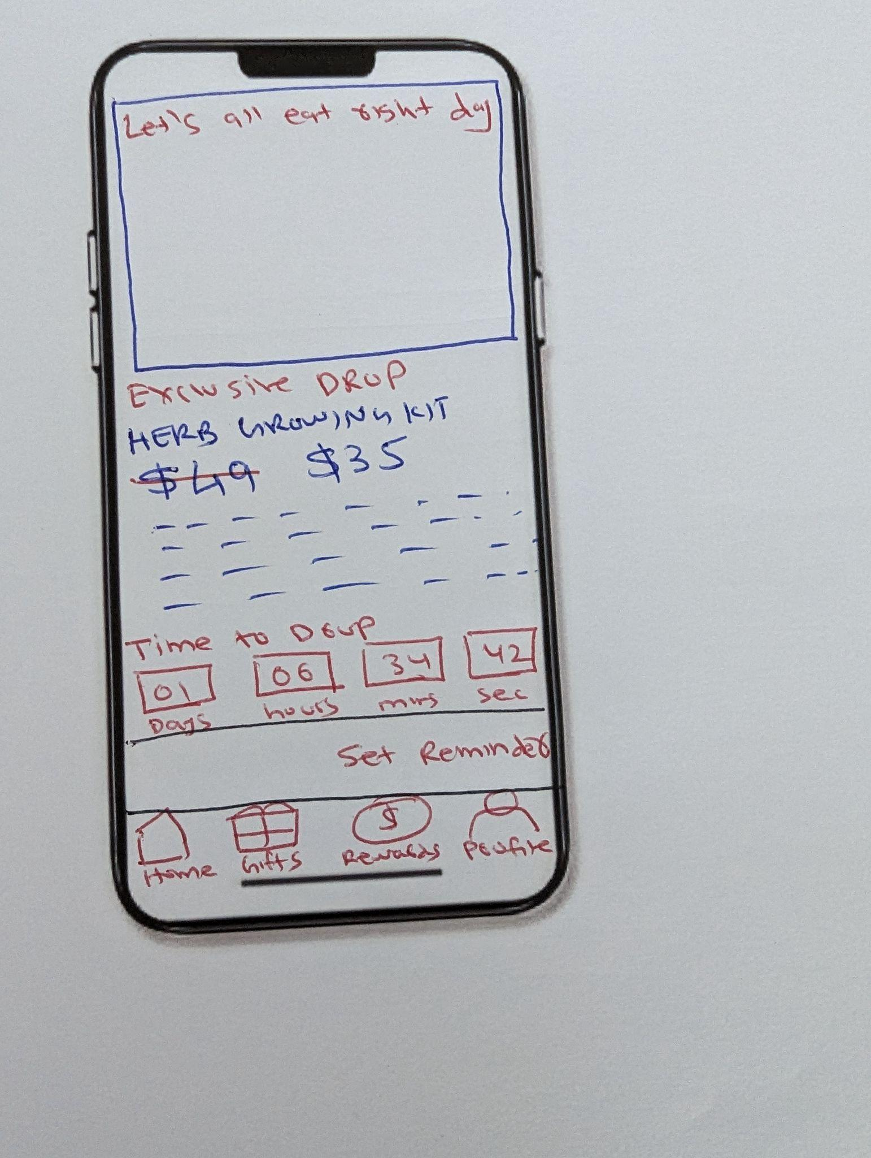
This is from the lets all eat right day - Exclusive drop section. Background image should be same
Text in this section should be:
Complete 34 piece kit: Everything you need to bring the joy of planting savory herbs into your or a loved one's life. 9 packets of premium seeds – Featuring 9 different herbs: Dill, Basil, Chives, Thyme, Parsley, Oregano, Cilantro, Sage, & Mustard.

Slide 9
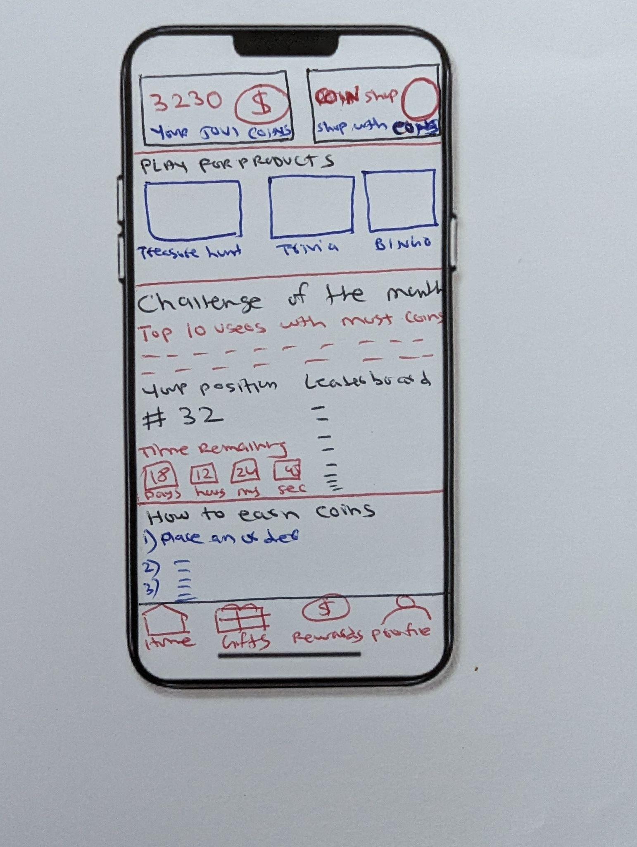
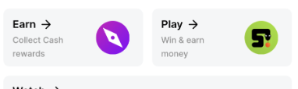
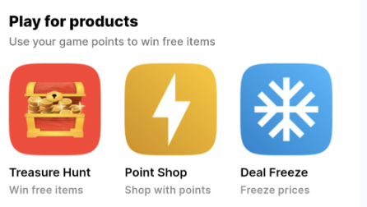
Something like this -
Your JOVI coins
Coin shop
Shop with coins
Something like this
Treasure hunt
Trivia
Bingo
Challenge of the month
Top 10 users with the most coins this month will get to meet Mr. Beast and have lunch with him
Your current position is #32
Leaderboard - list any top user_names
How to earn coins
Place an order - 100 coins per $1 spend
Follow on IG, Twitter, Threads - 100 coins each
Refer a friend - 200 coins
Start a group that materializes - 500 coins
Win coins by playing games

Slide 10
Create a mockup for web / desktop of the home screen

