Slide 1
Welcome

Slide 2


Slide 3
Team Members & Roles
Name | ID | Role
Asfar Hossain Sitab | 2022-3-60-275 | Frontend Developer
Parmita Hossain Simia | 2022-3-60-253 | Testing & Quality Assurance Engineer
Mushfida Ferdous Maisha | 2022-3-60-264 | Backend Developer
Ramiz Fariha Risha | 2022-3-60-274 | Database Manager

Slide 4
Project Overview
Quick Bite is a modern website for easy food ordering & delivery. ✅ Connects customers, restaurants & delivery people ✅ Simple, user-friendly platform ✅ Secure payments & real-time tracking ✅ Separate dashboards for restaurants, delivery agents & admins
Goal: Provide a smooth, fast, and reliable food delivery experience

Slide 5
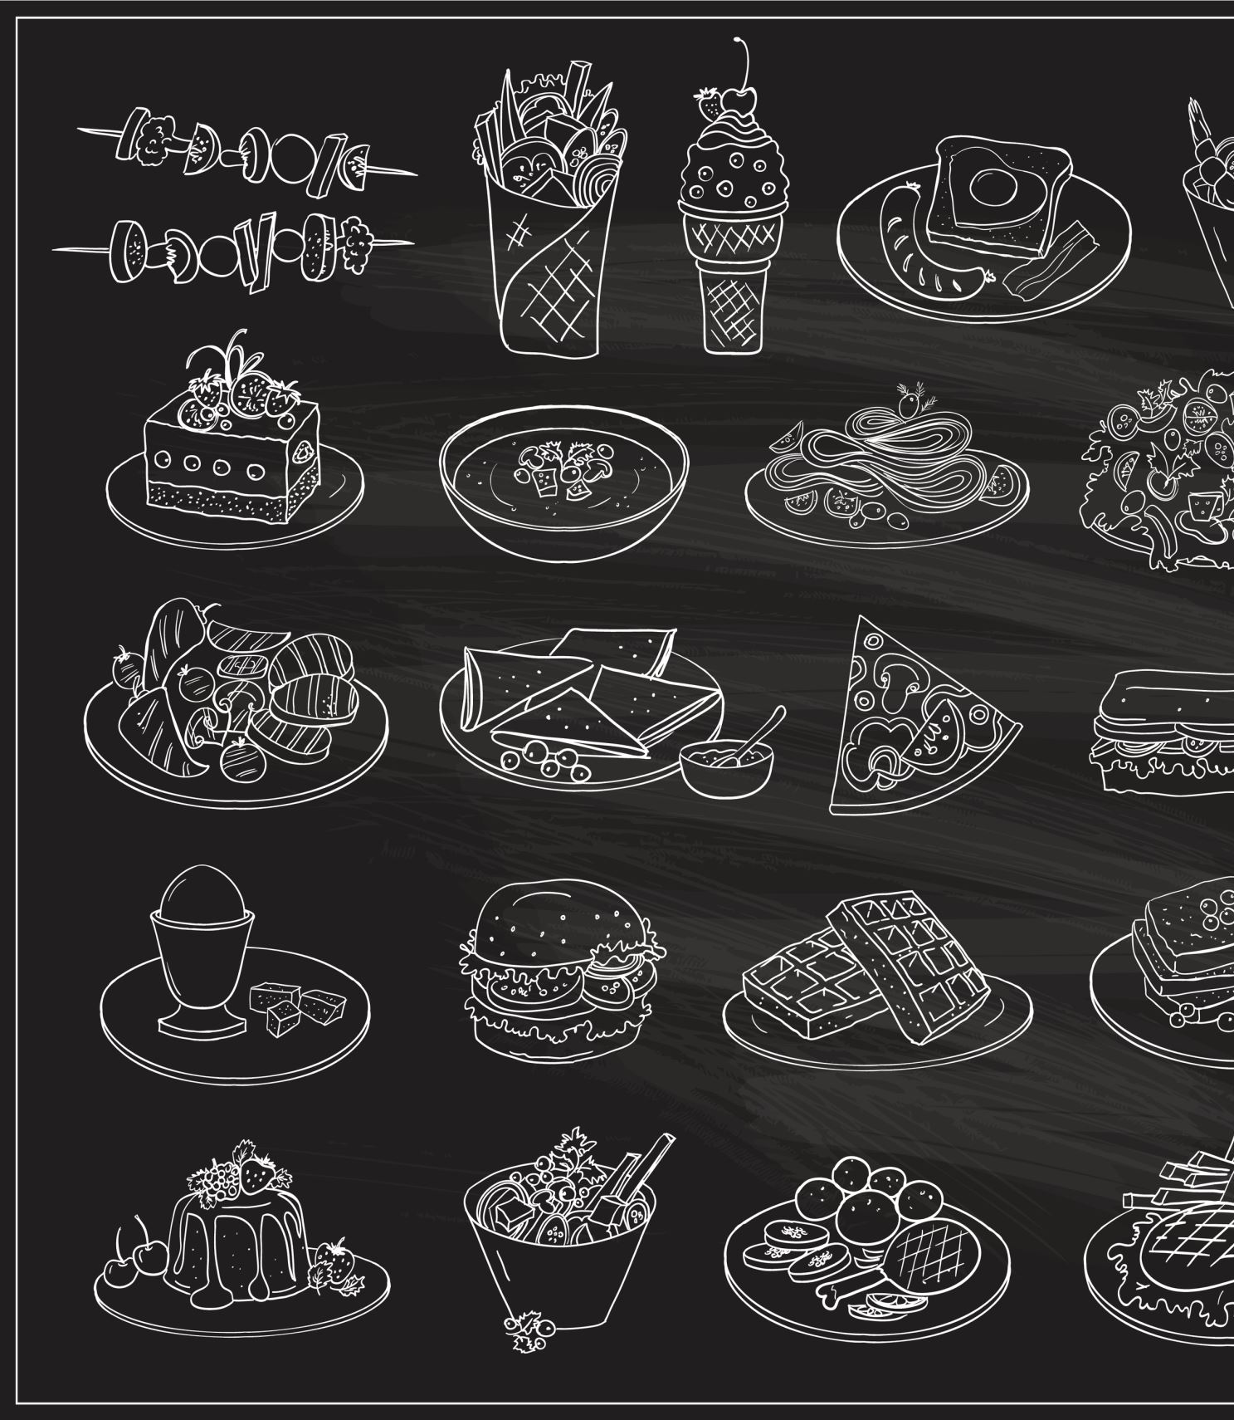
Project Objectives
Easy-to-use online food ordering website
Help restaurants manage menus, orders & sales
Real-time order tracking for delivery agents
Smooth performance under heavy load
Simple, helpful dashboards for restaurants & admins

Slide 6

Project Scope-For Customers
Registration & login
Find nearby restaurants (location/cuisine)
Menu viewing & search
Add to cart & place orders
Secure payments (bKash, Nagad)
Order history & ratings

Slide 7

Project Scope – Delivery Partner Module
Login & assignment overview
Update order status (Picked, Delivered)
Google Maps navigation integration

Slide 8
Project Scope – Restaurant Portal
Registration & login
Menu management (Add/Edit/Delete)
Real-time order management
Basic sales analytics & reporting

Slide 9
Project Scope – Administrative Panel
User & restaurant management
Conflict resolution
System usage analytics
Revenue monitoring

Slide 10

Proposed Methodology
Agile Software Development Methodology An iterative and flexible approach that focuses on continuous improvement and customer feedback.
✅ Development happens in small, manageable parts (called sprints) ✅ Requirements can evolve based on feedback ✅ Team collaboration is prioritized ✅ Continuous testing and integration

Slide 11




Tools & Technologies
Tools:
GitHub – Version Control
Docs/Word – Documentation
Gantt Chart – Timeline Tracking
Technologies:
Frontend: HTML, CSS, JavaScript
Backend: Node.js
Database: MongoDB

Slide 12

Deliverables
Fully functional website
Final project report
Project presentation
Code repository on GitHub

Slide 13
Tentative Timeline
Week | Activities
1 | Requirements gathering & analysis
2 | System Design (Architecture + UI)
3–4 | Frontend & Backend Development
5 | Database Integration & Payment Setup
6 | System Integration & Unit Testing
7 | Bug Fixing, Optimization & User Testing
8 | Final Deployment, Presentation & Report

Slide 14
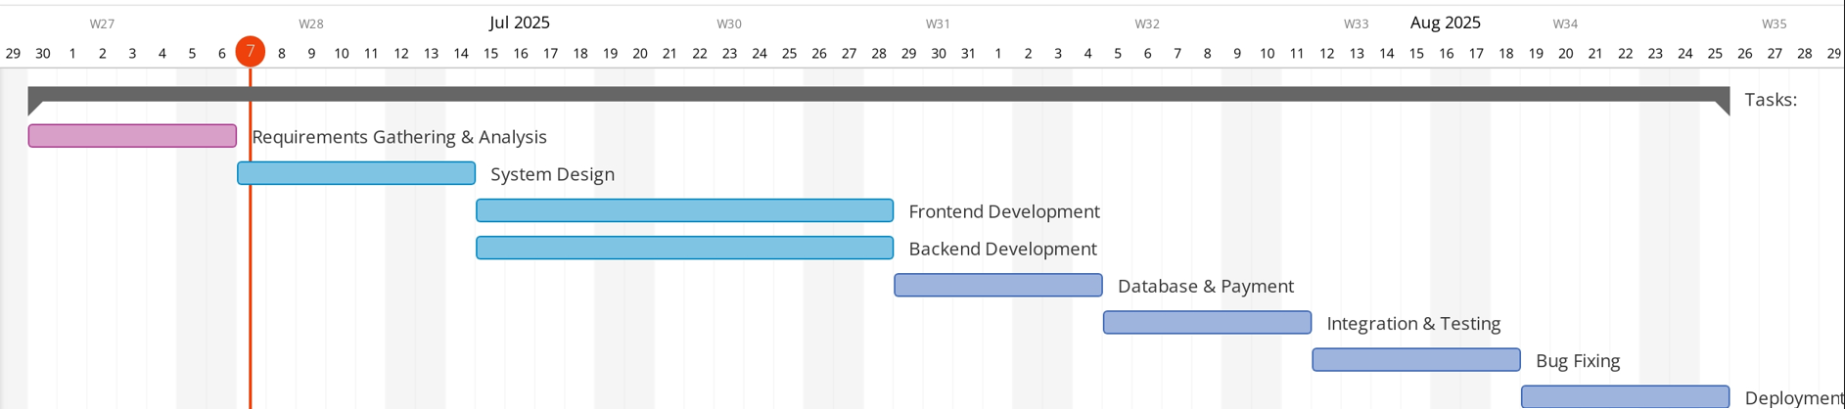
Gantt Chart
7/8/2025
14

Slide 15
Potential Risks & Solutions
Risk | Solution
Technical delays | Weekly goals & backup time
Team member unavailable | Proper documentation for easy handover
Integration issues | Start integration early, regular check-ins
Payment setup problems | Test payments early in sandbox environment
Mid-project feature changes | Stick to initial plan

Slide 16

Conclusion
In conclusion, Quick Bite is designed to provide a simple and convenient solution for online food ordering and delivery. The platform ensures a smooth user experience by offering secure payment options and real-time order tracking, making the entire process reliable and hassle-free. With its mobile-friendly and responsive design, users can easily access the service from any device. Beyond building a functional website, this project reflects our team's understanding and application of full-stack web development principles, including frontend, backend, database integration, and system design

Slide 17
Thank You

