Slide 1
EXPLAINABLE AI · DERMATOLOGY · HAM10000
Explainable Machine Learning
for Skin Cancer Detection
A multi-model deep learning pipeline — from convolutional and transformer
baselines to an attention-explainable graph neural network — for classifying
seven classes of pigmented skin lesions.
01

Slide 2
EXPLAINABLE AI · DERMATOLOGY · HAM10000
Submitted by (Group-2):
Jannatul Alam Shifa
2022-2-60-147
Md. Ahsiul Karim
2022-3-60-074
Md. Rahat Khan
2021-1-60-090
Fahim Hossain
2022-2-60-142
Submitted To:
Dr. Raihan Ul Islam
Associate Professor, Department of Computer Science and Engineering
East West University
01

Slide 3
INTRODUCTION
Skin cancer is among the most commonly diagnosed cancers worldwide, and prognosis depends heavily on early, accurate detection. Melanoma, its most aggressive form, is highly curable when caught early but life-threatening once it progresses — making reliable screening a clinical priority.
Dermatoscopic imaging combined with expert visual inspection remains the standard diagnostic approach, but manual assessment is time-consuming, requires specialized expertise, and is subject to inter-observer variability.
Deep learning models — CNNs and, more recently, vision transformers — can now match or exceed dermatologist-level accuracy on lesion classification. However, these models largely operate as "black boxes": they output a diagnosis with no rationale for why a lesion was classified as benign or malignant. In a clinical setting, a prediction that cannot be visually justified is difficult for a physician to trust, regardless of its accuracy.
This project addresses that gap by building and comparing a pipeline of models.

Slide 4
ROADMAP
What We'll Cover
01
02
03
Introduction
The Dataset
Pipeline
Why interpretability matters for AI-assisted skin cancer screening
HAM10000 — 10,015 dermatoscopic images across 7 diagnostic classes
Baseline CNNs → transformer ensembles → explainable GNN
04
05
06
Model Results
Explainability
Insights & Next Steps
Accuracy, macro-F1, and ROC-AUC across five architectures
Attention rollout — seeing what the model sees
Class-wise challenges and future directions
02

Slide 5
MOTIVATION
Why Explainability Matters
Skin cancer is among the most common cancers worldwide, and early, accurate diagnosis materially improves outcomes. Deep learning can match or exceed human performance on dermatoscopic image classification — but clinicians cannot act on a prediction they cannot interrogate.
7
diagnostic classes classified — from benign nevi to melanoma
A Black Box Problem
High-capacity CNNs and transformers deliver strong accuracy but offer no insight into which lesion features drove a decision.
10,015
Clinical Trust Gap
Dermatologists need visual evidence — not just a class label — before a model's output can support real diagnostic decisions.
dermatoscopic images in the HAM10000 benchmark dataset
Our Approach
Pair strong baseline classifiers with an attention-explainable architecture, so predictions come with a visual rationale.
5 models
benchmarked, from CNNs to an explainable graph neural network
03

Slide 6
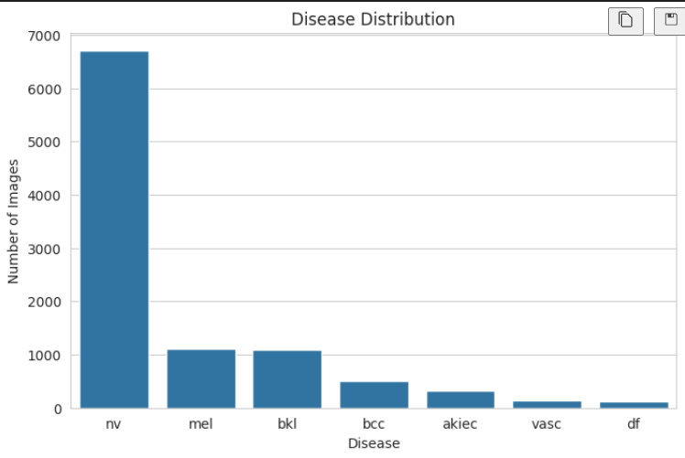
THE DATASET
HAM10000: Human-Against-Machine 10,000
A curated collection of multi-source dermatoscopic images covering seven pigmented lesion categories, widely used as a benchmark for automated skin lesion classification.
CLASS DISTRIBUTION
nv
Melanocytic nevi
6,705
mel
Melanoma
1,113
bkl
Benign keratosis
1,099
bcc
Basal cell carcinoma
514
akiec
Actinic keratoses
327
vasc
Vascular lesions
142
df
Dermatofibroma
115
Severe class imbalance: melanocytic nevi (nv) account for ~67% of all images — a central modeling challenge addressed throughout this project.
04

Slide 7
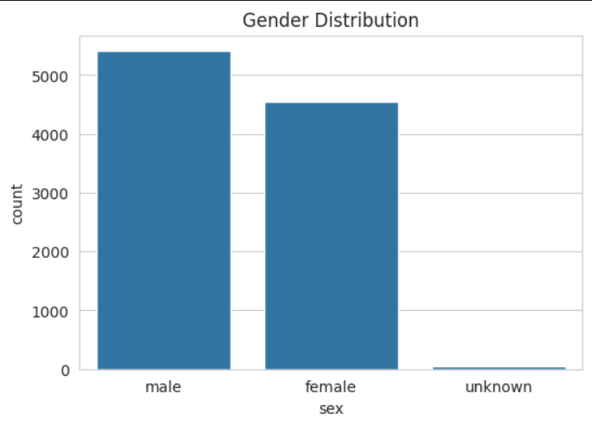
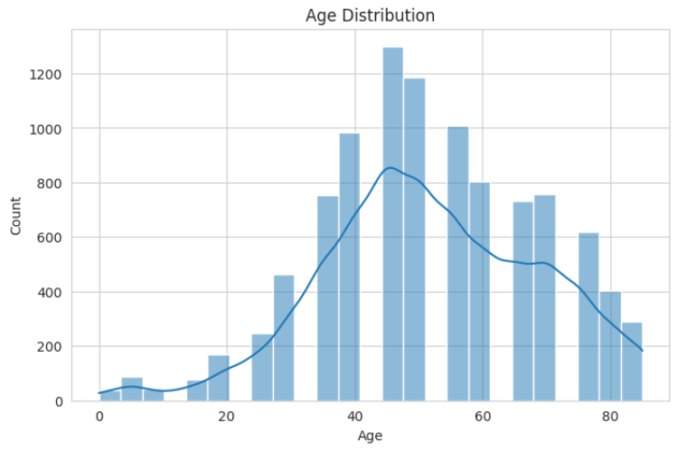
DATA PREPARATION
Patient-Aware Splitting & Demographics
Images were split at the lesion level — not the image level — so that no lesion's photos appear in more than one split, preventing data leakage across training, validation, and test sets.
GENDER DISTRIBUTION
TRAIN
VALIDATION
TEST
7,002
1,519
1,494
5,229 unique lesions
1,120 unique lesions
1,121 unique lesions
AGE DISTRIBUTION
No lesion overlap was found between any of the three splits.
Patients skew toward middle age (peak ~40–60 years), with a slightly higher share of male patients — both factors profiled during EDA to check for demographic bias.
05

Slide 8
METHODOLOGY
End-to-End Pipeline
1
2
3
4
5
Preprocess
→
CNN Baselines
→
Transformer
Ensembles
→
Explainable GNN
→
Explainability
HAM10000 images resized & normalized per backbone; lesion-level split
EfficientNet-B2 & ResNet50 fine-tuned as classification baselines
Swin-Tiny & ViT-B/16, each trained as 5-fold probability ensembles
GATv2 graph-attention pipeline built for interpretable predictions
Attention rollout visualizes the lesion regions driving each decision
Two strong black-box lines (CNN & transformer) establish the accuracy ceiling; the GNN branch trades a little peak accuracy for built-in, attention-based interpretability.
06

Slide 9
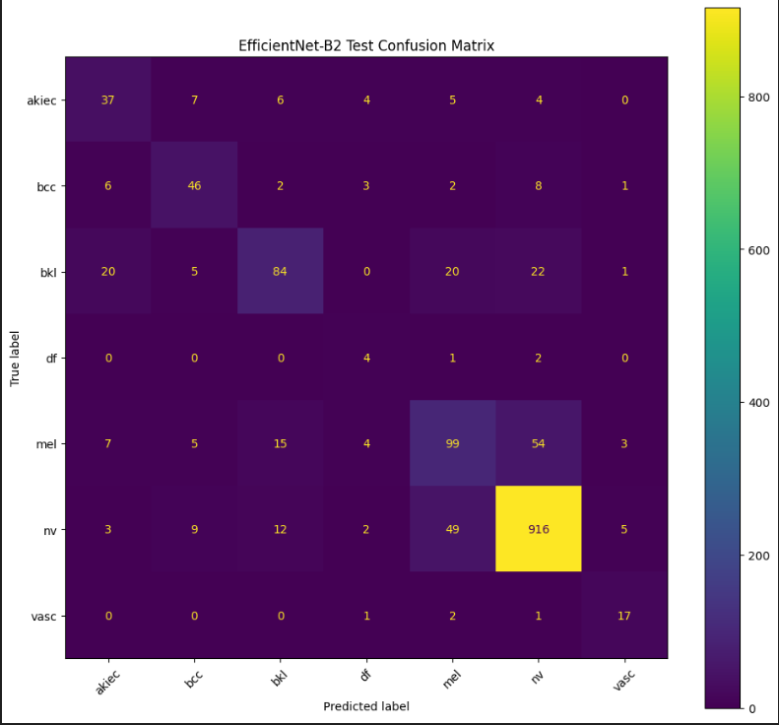
BASELINE MODELS
Convolutional Networks
EfficientNet-B2 and ResNet50 were fine-tuned end-to-end as strong conventional baselines before introducing transformer and graph-based architectures.
Metric
EfficientNet-B2
ResNet50
Test Accuracy
80.52%
78.51%
Macro Precision
59.56%
56.72%
Macro Recall
66.38%
69.18%
Macro F1
61.52%
58.87%
Weighted F1
80.50%
78.05%
EfficientNet-B2 edges out ResNet50 on accuracy and F1, but both baselines struggle on rare classes (df, akiec) — motivating the ensemble and GNN approaches ahead.
EfficientNet-B2 — Test Confusion Matrix
07

Slide 10
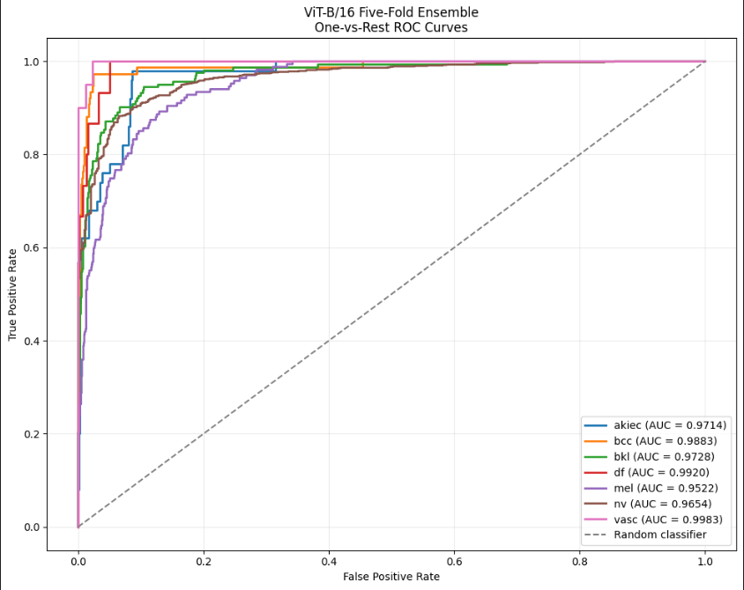
TRANSFORMER ENSEMBLES
Swin-Tiny & ViT-B/16
Both transformer backbones were trained as 5-fold cross-validation ensembles, then combined via probability averaging for the final test prediction — substantially lifting accuracy over the CNN baselines.
Swin-Tiny
ViT-B/16
5-fold probability ensemble
5-fold probability ensemble
Test Accuracy
85.46%
Test Accuracy
86.52%
Macro Precision
76.32%
Macro Precision
77.72%
Macro Recall
73.95%
Macro Recall
78.59%
Macro F1
72.89%
Macro F1
77.77%
Macro ROC-AUC
97.29%
Weighted F1
86.77%
ViT-B/16 Five-Fold Ensemble — One-vs-Rest ROC Curves
08

Slide 11
BENCHMARK RESULTS
Backbone Model Comparison
The transformer ensembles clearly outperform the CNN baselines. ViT-B/16 leads on every metric — but neither offers a built-in visual explanation of its decisions.
09

Slide 12
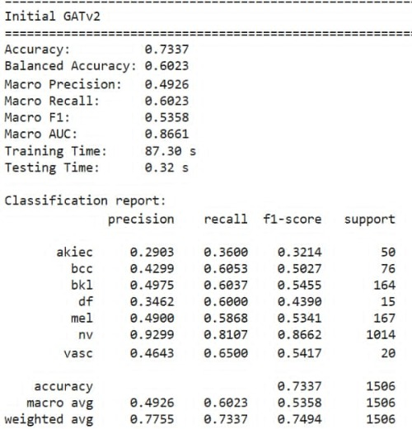
THE EXPLAINABLE MODEL
Graph Attention Network (GATv2)
Rather than treating an image as a flat grid, the GNN pipeline represents each lesion as a graph of interrelated regions and applies Graph Attention (GATv2) layers — so every prediction carries a natural, attention-based explanation of which regions mattered most.
Metric
Initial GATv2
Final GNN
Accuracy
73.37%
75.43%
Macro F1
53.58%
—
Macro AUC
86.61%
~88.1%
Training Time
87.30 s
—
Iterating on the graph construction and attention design improved both accuracy and macro AUC over the initial GATv2 baseline — while preserving interpretability.
Initial GATv2 — Test Results & Classification Report
10

Slide 13
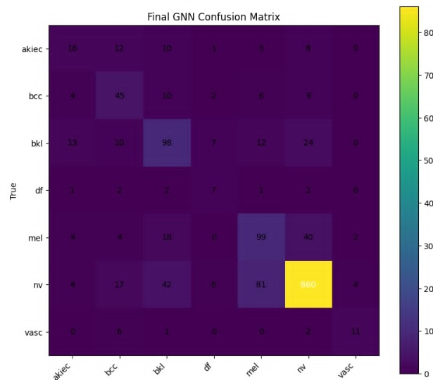
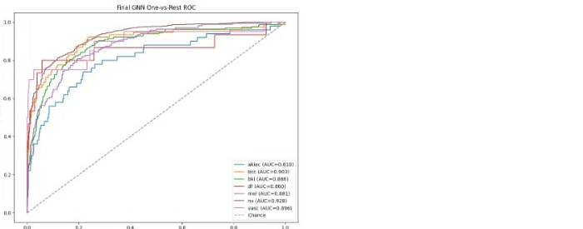
THE EXPLAINABLE MODEL
Final GNN — Test Performance
Final GNN — One-vs-Rest ROC Curves
PER-CLASS ROC-AUC
nv
bcc
vasc
mel
0.928
0.903
0.896
0.881
bkl
df
akiec
0.886
0.860
0.810
Final GNN — Test Confusion Matrix
11

Slide 14
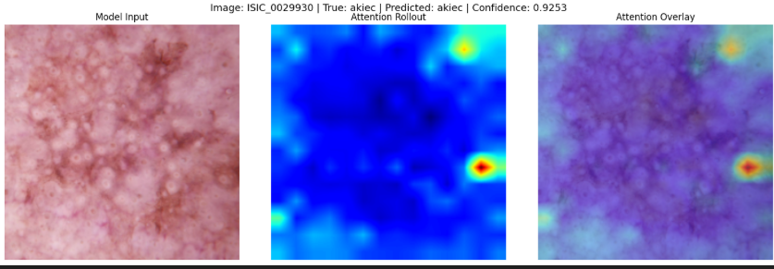
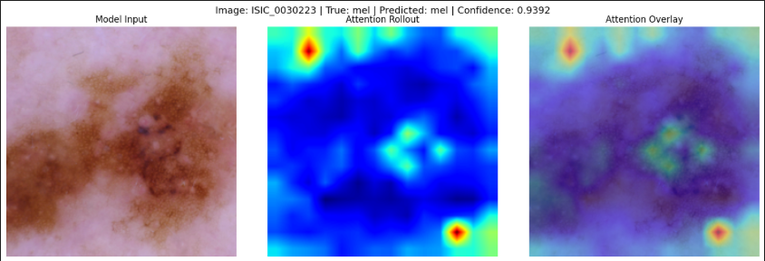
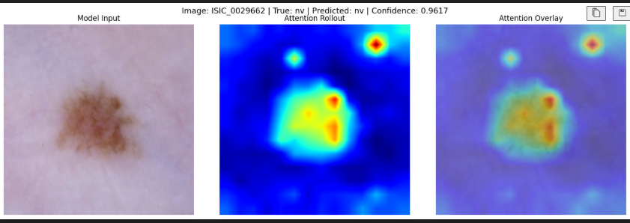
EXPLAINABILITY IN ACTION
Attention Rollout — Seeing What the Model Sees
For each prediction, attention rollout aggregates attention weights across layers into a single heatmap, revealing exactly which regions of the lesion the model relied on — overlaid here on three example diagnoses.
Model Input · Attention Rollout · Attention Overlay
12

Slide 15
KEY INSIGHTS & CONCLUSION
What We Learned
Class imbalance dominates errors
With nv at ~67% of images, minority classes like df and akiec remain the hardest to classify across every architecture.
Transformers lead on raw accuracy
5-fold ViT-B/16 and Swin-Tiny ensembles outperform CNN baselines by 6–8 points of accuracy and macro F1.
Explainability need not be free
The GATv2 graph pipeline trades a few points of accuracy for attention-based visual rationale behind every prediction.
Visual overlap drives confusion
bkl, akiec, and mel are visually similar pigmented lesions — the leading source of misclassification in every model's confusion matrix.
Next steps: address class imbalance with targeted augmentation/loss re-weighting, and extend attention-rollout explanations to the GNN's graph structure directly.
13

