Slide 1
Autonomous Control of Air-Launched Fixed-Wing Drone Swarm
Culminating Experience Project in the Pursuit of Mechanical Engineering Master’s Degree
Alex Springer, June 2021 - May 2024

Slide 2
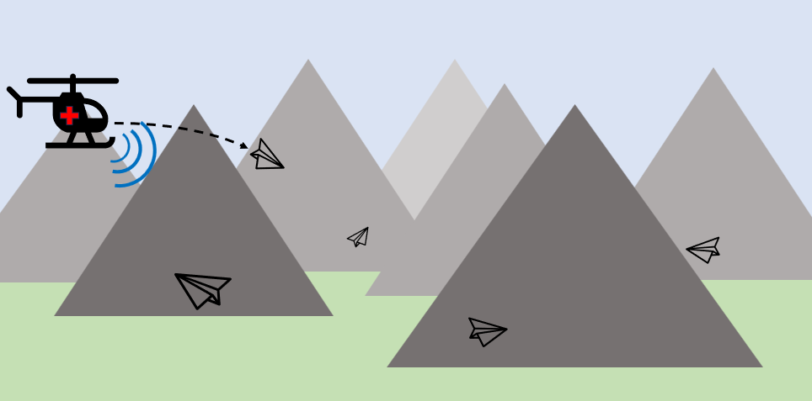
Project Definition and Overview
Air-Launched Drone Swarms
Independent Non-Linear Agent Control System
User-Specified Commands:
Fly-Over Waypoints
Drone trajectories
Agents Tracked by C2 Aircraft
Agents Autonomously Assigned to User Commands
Use-Case: Search and Rescue in Mountainous Terrain

Slide 3
Control System Hierarchy
Agent States Continuously Estimated
User Input of Fly-Over Waypoint (applications: search & rescue, surveillance, package drop)
Latitude, Longitude, Altitude, Groundspeed
Cost Estimated for Each Agent: Distance, Altitude, Heading, and Groundspeed all considered
Individual Agent Controller
Agent-Waypoint Assignment
Linear Hungarian Assignment Algorithm Used to Assign Agents and Minimize Overall Cost
Proportional Controller Converts Waypoint Assignments to Controller Inputs At Each Time Step
Non-Linear Navigation Controller to Command Airspeed, Heading, and Rate of Climb
Each Agent Tracked by Command & Control Aircraft
Agent Position, Velocity, and Acceleration Estimated by Random Finite-Set Based Filter
User Input

Slide 4
Fixed-Wing Aircraft Non-Linear Guidance System (FANGS)
Individual Agent Flight Controller

Slide 5
The Underlying Controller for Each UAS Agent
Based on Nonlinear Aircraft-Performance Simulation by Dr. John Schierman in his Modern Flight Dynamics textbook
Rigid fixed-wing aircraft operating in steady wind
Uses a default state estimator with ideal equations of motion
User can provide a state solution at any time step; any unprovided state variables are estimated using the default ideal estimator
Input: desired flight profile
Velocity, rate of climb, and heading

Slide 6
Simulation Setup
Drones initially modelled loosely from a C-130 fixed-wing aircraft
Long flight-time and/or range
Heavy payload (cameras, telemetry, first-aid package drop, etc.)
Modified for quicker/more responsive flight dynamics
Each drone launched from a C2 helicopter
Flight controller in operation 150 feet after launch
Assume wings deploy during first 150 feet
After 150 feet, assumed 50 kts airspeed with no ascent or descent
8 drones launched ~5 seconds apart

Slide 7
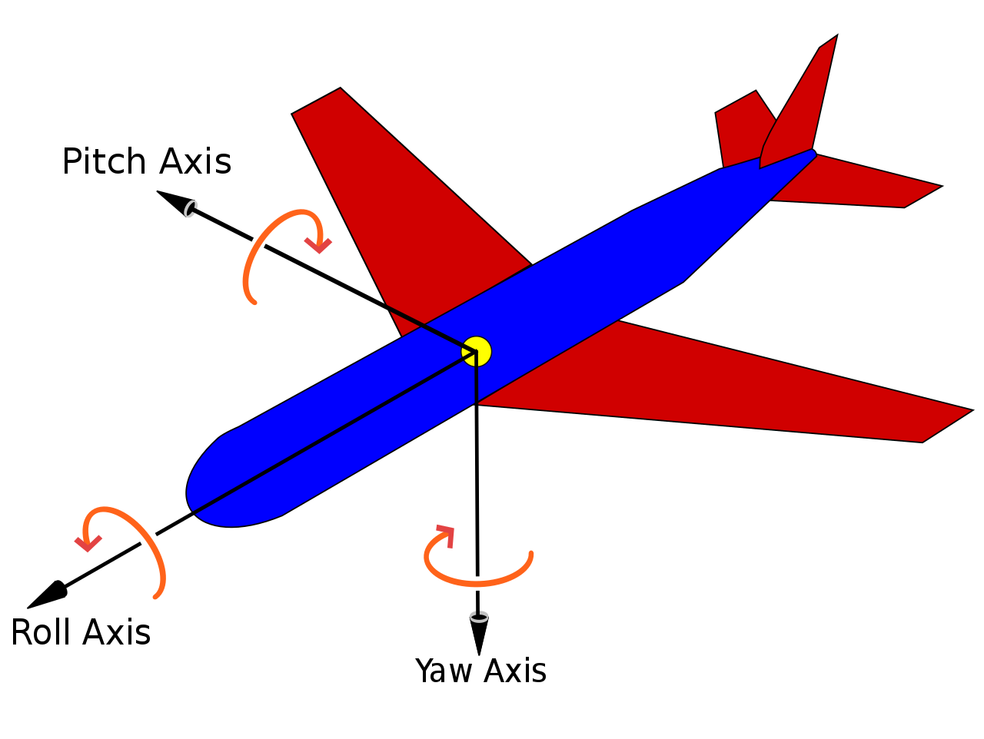

Ideal EOM: Governing Equations
Translational equations of motion for a vehicle with propulsive thrust aligned with the fuselage x-axis:
$$m{\dot{V}}_{V}=Tcos\left(α\right)\cos\left(β\right)−D−mgsin\left(γ\right)$$
$$mV_{V}\left({\dot{ψ}}_{W}\cos\left(φ_{W}\right)\cos\left(γ\right)−\dot{γ}\sin\left(φ_{W}\right)\right)=S+Tcos\left(α\right)\sin\left(β\right)+mgsin\left(φ_{W}\right)\cos\left(γ\right)$$
$$mV_{V}\left(\dot{γ}\cos\left(φ_{W}\right)+{\dot{ψ}}_{W}\sin\left(φ_{W}\right)\cos\left(γ\right)\right)=L+Tsin\left(α\right)−mgcos\left(φ_{W}\right)\cos\left(γ\right)$$
+Y
+X
+Z
Image from: By Yaw_Axis.svg: Auawisederivative work: Jrvz (talk) - Yaw_Axis.svg, CC BY-SA 3.0, https://commons.wikimedia.org/w/index.php?curid=9441238
Reference: Modern Flight Dynamics by Dr. John Schierman

Slide 8
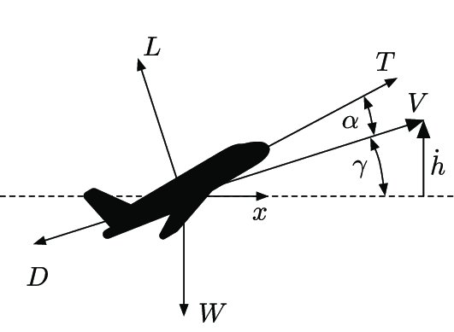
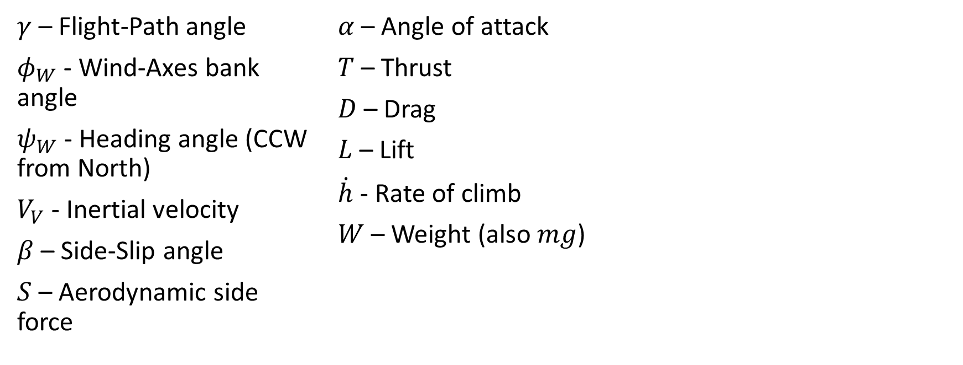
Ideal EOM: Definitions
$γ$ – Flight-Path angle
$φ_{W}$ - Wind-Axes bank angle
$ψ_{W}$ - Heading angle (CCW from North)
$V_{V}$ - Inertial velocity
$β$ – Side-Slip angle
$S$ – Aerodynamic side force
$α$ – Angle of attack
$T$ – Thrust
$D$ – Drag
$L$ – Lift
$\dot{h}$ - Rate of climb
$W$ – Weight (also $mg$)
Image from: Large-Scale Path-Dependent Optimization of Supersonic Aircraft (researchgate.net)

Slide 9
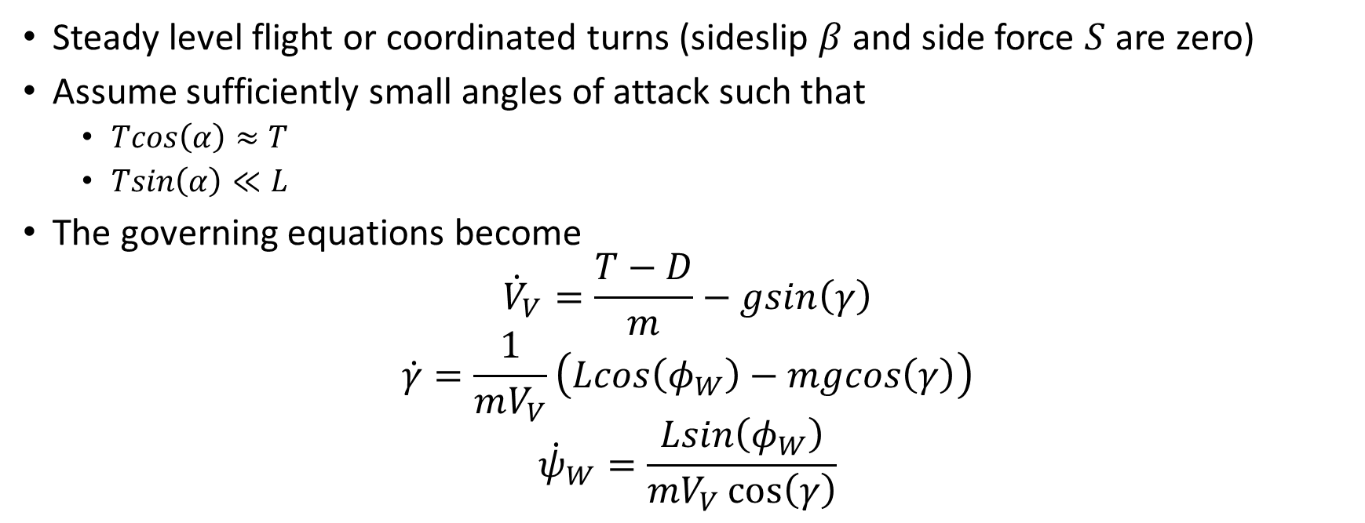
Ideal EOM: Simplifying Assumptions
Steady level flight or coordinated turns (sideslip $β$ and side force $S$ are zero)
Assume sufficiently small angles of attack such that
$Tcos\left(α\right)≈T$
$Tsin\left(α\right)≪L$
The governing equations become
$${\dot{V}}_{V}=\frac{T−D}{m}−gsin\left(γ\right)$$
$$\dot{γ}=\frac{1}{mV_{V}}\left(Lcos\left(φ_{W}\right)−mgcos\left(γ\right)\right)$$
$${\dot{ψ}}_{W}=\frac{Lsin\left(φ_{W}\right)}{mV_{V}\cos\left(γ\right)}$$
Reference: Modern Flight Dynamics by Dr. John Schierman

Slide 10
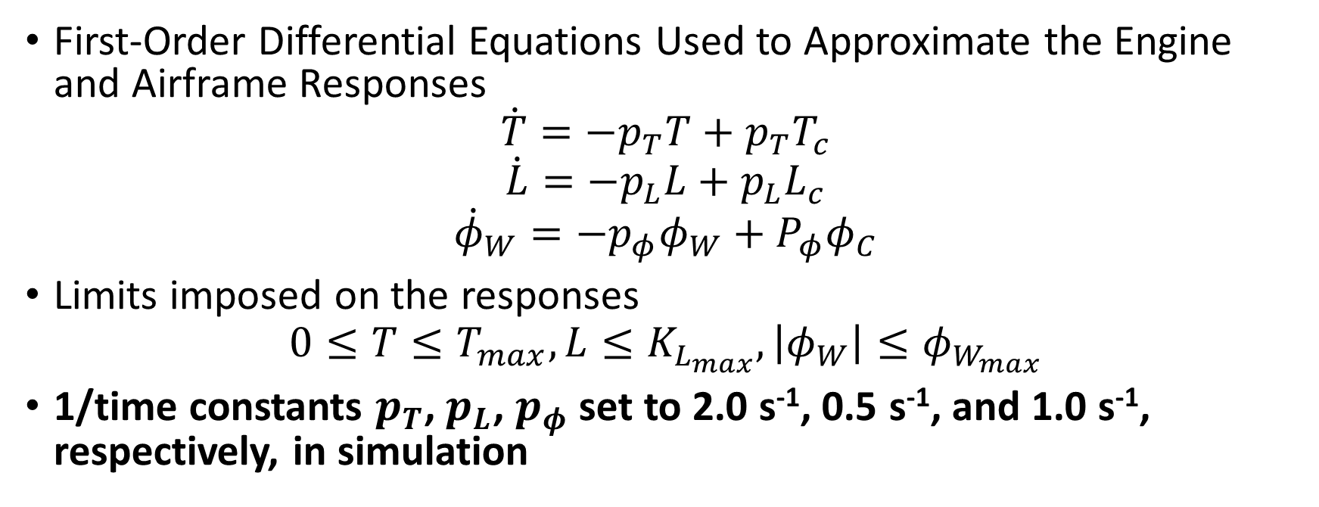
Ideal EOM: Engine and Airframe Responses
First-Order Differential Equations Used to Approximate the Engine and Airframe Responses
$$\dot{T}=−p_{T}T+p_{T}T_{c}$$
$$\dot{L}=−p_{L}L+p_{L}L_{c}$$
$${\dot{φ}}_{W}=−p_{φ}φ_{W}+P_{φ}φ_{C}$$
Limits imposed on the responses
$$0≤T≤T_{max}, L≤K_{L_{max}}, \left|φ_{W}\right|≤φ_{W_{max}}$$
1/time constants $p_{T}$, $p_{L}$, $p_{φ}$ set to 2.0 s⁻¹, 0.5 s⁻¹, and 1.0 s⁻¹, respectively, in simulation
Reference: Modern Flight Dynamics by Dr. John Schierman

Slide 11
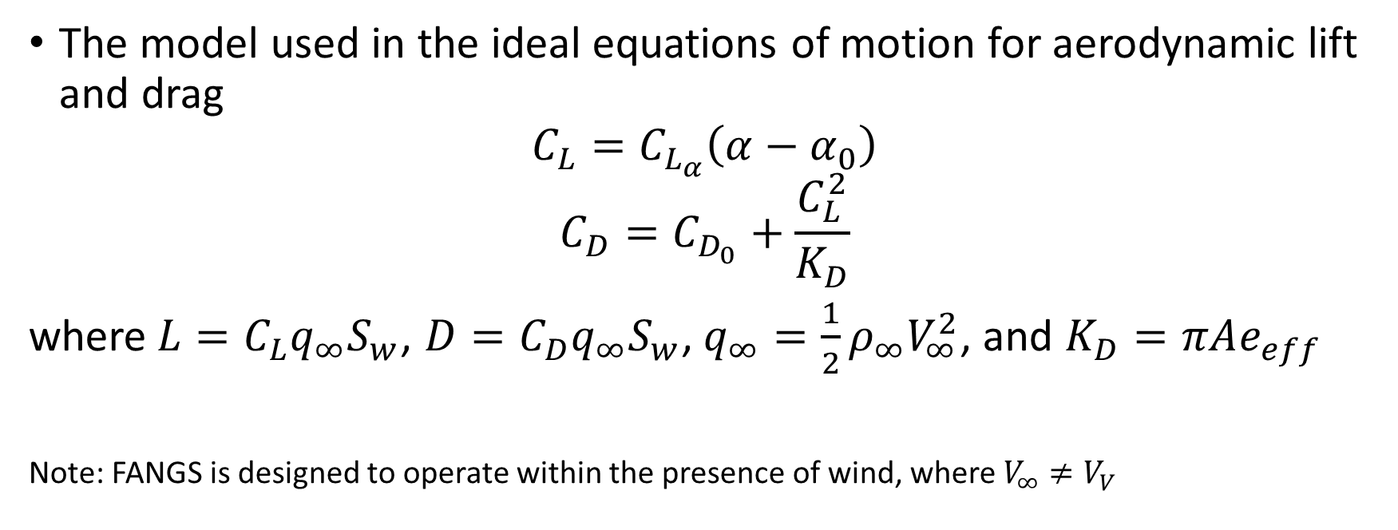
Ideal EOM: Aerodynamic Responses
The model used in the ideal equations of motion for aerodynamic lift and drag
$$C_{L}=C_{L_{α}}\left(α−α_{0}\right)$$
$$C_{D}=C_{D_{0}}+\frac{C_{L}^{2}}{K_{D}}$$
where$L=C_{L}q_{∞}S_{w}$, $D=C_{D}q_{∞}S_{w}$, $q_{∞}=\frac{1}{2}ρ_{∞}V_{∞}^{2}$, and $K_{D}=πAe_{eff}$
Note: FANGS is designed to operate within the presence of wind, where $V_{∞}≠V_{V}$
Reference: Modern Flight Dynamics by Dr. John Schierman

Slide 12
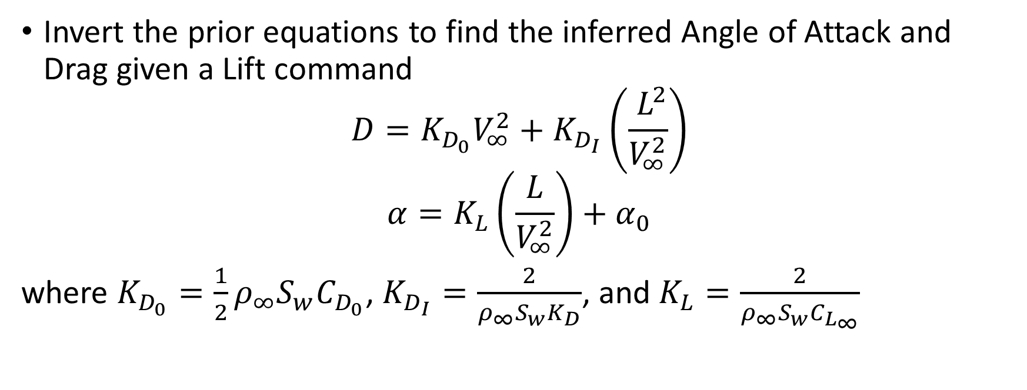
Ideal EOM: Angle of Attack and Drag
Invert the prior equations to find the inferred Angle of Attack and Drag given a Lift command
$$D=K_{D_{0}}V_{∞}^{2}+K_{D_{I}}\left(\frac{{ L}^{2}}{V_{∞}^{2}}\right)$$
$$α=K_{L}\left(\frac{L}{V_{∞}^{2}}\right)+α_{0}$$
where $K_{D_{0}}=\frac{1}{2}ρ_{∞}S_{w}C_{D_{0}}$, $K_{D_{I}}=\frac{2}{ρ_{∞}S_{w}K_{D}}$, and $K_{L}=\frac{2}{ρ_{∞}S_{w}C_{L_{∞}}}$
Reference: Modern Flight Dynamics by Dr. John Schierman

Slide 13
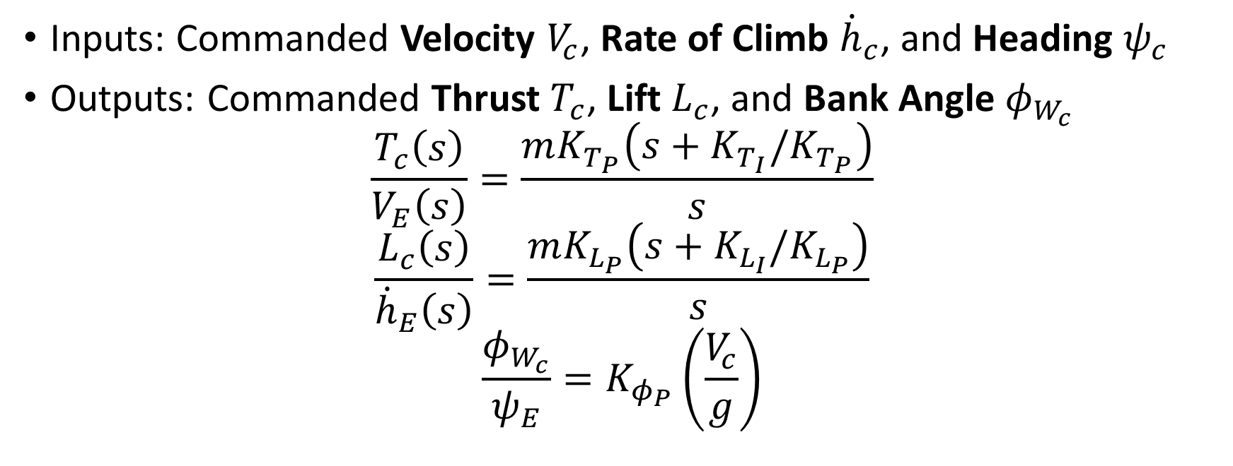
Guidance Laws – Transfer Functions
Inputs: Commanded Velocity $V_{c}$, Rate of Climb ${\dot{h}}_{c}$, and Heading $ψ_{c}$
Outputs: Commanded Thrust $T_{c}$, Lift $L_{c}$, and Bank Angle $φ_{W_{c}}$
$$\frac{T_{c}\left(s\right)}{V_{E}\left(s\right)}=\frac{mK_{T_{P}}\left(s+K_{T_{I}}/K_{T_{P}}\right)}{s}$$
$$\frac{L_{c}\left(s\right)}{{\dot{h}}_{E}\left(s\right)}=\frac{mK_{L_{P}}\left(s+K_{L_{I}}/K_{L_{P}}\right)}{s}$$
$$\frac{φ_{W_{c}}}{ψ_{E}}=K_{φ_{P}}\left(\frac{V_{c}}{g}\right)$$
Reference: Modern Flight Dynamics by Dr. John Schierman

Slide 14
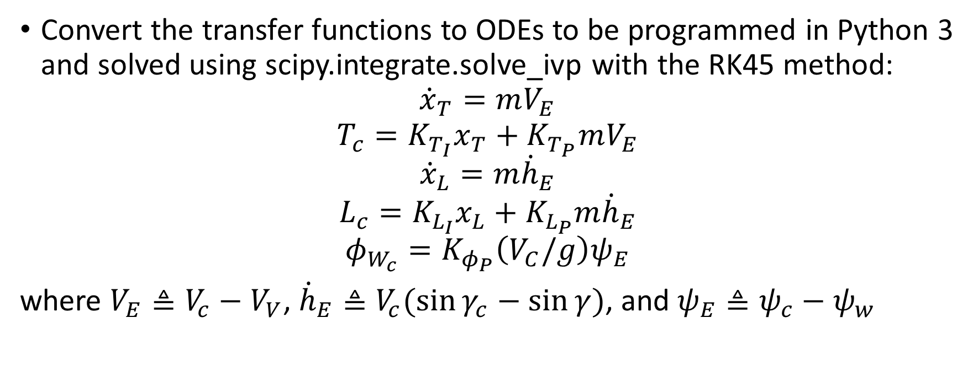
Guidance Laws - ODEs
Convert the transfer functions to ODEs to be programmed in Python 3 and solved using scipy.integrate.solve_ivp with the RK45 method:
$${\dot{x}}_{T}=mV_{E}$$
$$T_{c}=K_{T_{I}}x_{T}+K_{T_{P}}mV_{E}$$
$${\dot{x}}_{L}=m{\dot{h}}_{E}$$
$$L_{c}=K_{L_{I}}x_{L}+K_{L_{P}}m{\dot{h}}_{E}$$
$$φ_{W_{c}}=K_{φ_{P}}\left(V_{C}/g\right)ψ_{E}$$
where $V_{E}≜V_{c}−V_{V}$, ${\dot{h}}_{E}≜V_{c}(\sin{γ_{c}}−\sin{γ})$, and $ψ_{E}≜ψ_{c}−ψ_{w}$
Reference: Modern Flight Dynamics by Dr. John Schierman

Slide 15
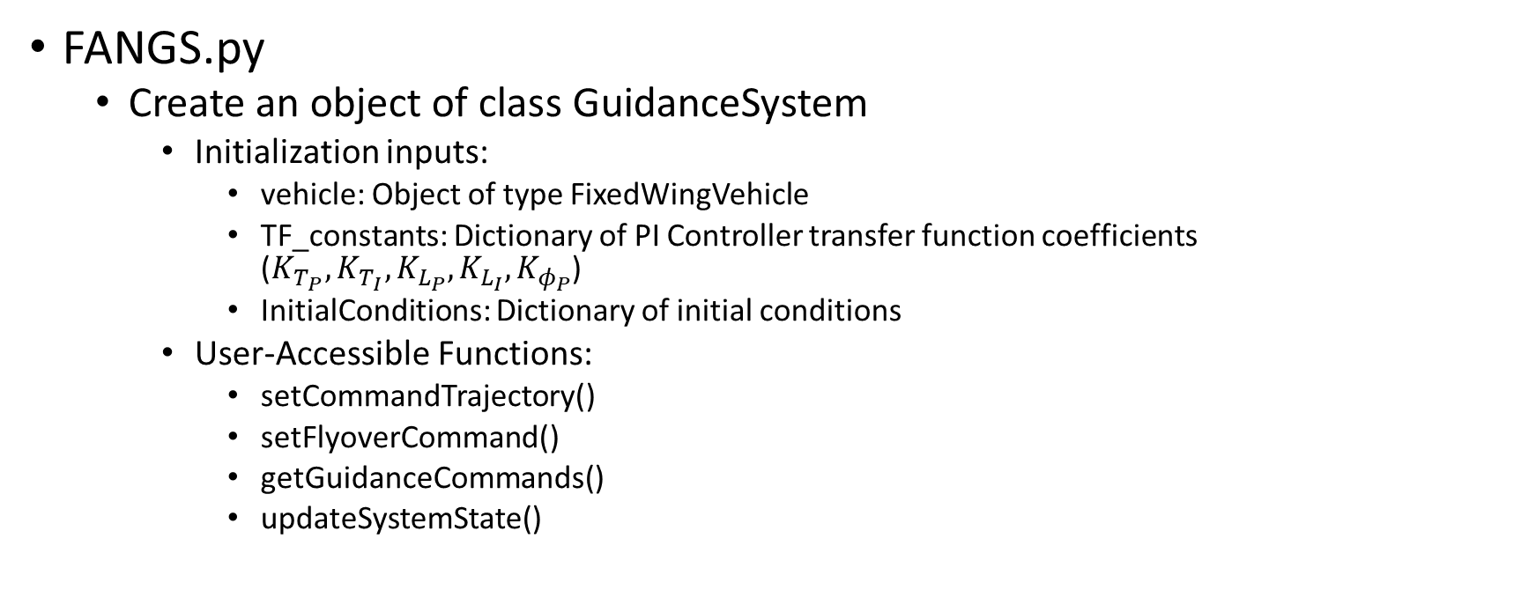
Implementation (Python 3)
FANGS.py
Create an object of class GuidanceSystem
Initialization inputs:
vehicle: Object of type FixedWingVehicle
TF_constants: Dictionary of PI Controller transfer function coefficients ($K_{T_{P}}, K_{T_{I}},K_{L_{P}}, K_{L_{I}}, K_{φ_{P}}$)
InitialConditions: Dictionary of initial conditions
User-Accessible Functions:
setCommandTrajectory()
setFlyoverCommand()
getGuidanceCommands()
updateSystemState()

Slide 16
Implementation (Python 3), continued
After initialization, the drone is commanded to fly at initial conditions.
The user may give any drone a command of either:
Trajectory
The user will supply a desired airspeed, heading, and rate of climb.
Flyover
The user will supply a desired waypoint, altitude, and groundspeed.
Alternatively, the user may give the swarm a list of Flyover commands
See ATAMS section for more.

Slide 17
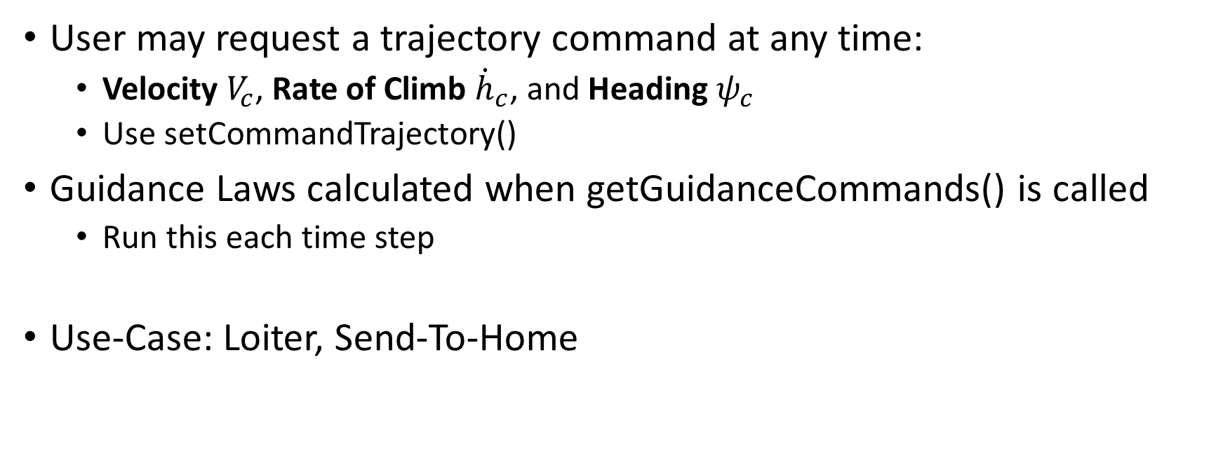
User Commands: Trajectory
User may request a trajectory command at any time:
Velocity $V_{c}$, Rate of Climb ${\dot{h}}_{c}$, and Heading $ψ_{c}$
Use setCommandTrajectory()
Guidance Laws calculated when getGuidanceCommands() is called
Run this each time step
Use-Case: Loiter, Send-To-Home

Slide 18
User Commands: Flyover
The user may request a flyover command at any time:
Groundspeed (feet/sec), Altitude (ft, MSL), Waypoint (latitude, longitude)
Use setCommandFlyover()
An internal flag will note that a flyover has been requested
At each timestep, when getGuidanceCommands() is run, FANGS will internally convert flyover commands to trajectory commands for the aircraft guidance logic
Proportional Controller: see next slide

Slide 19
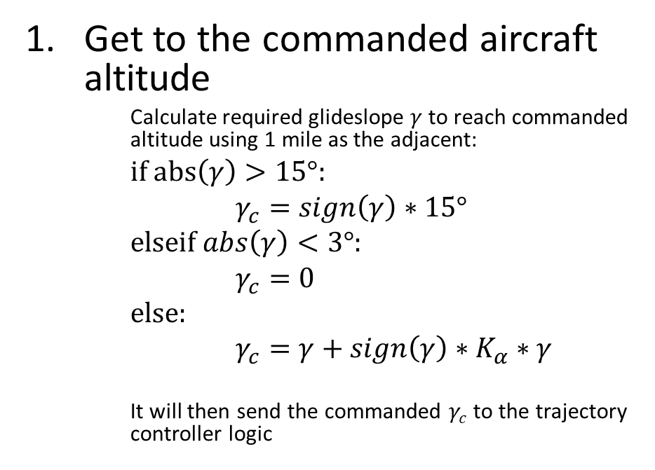
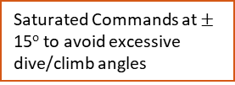
User Commands: Flyover, continued
Get to the commanded aircraft altitude
Calculate required glideslope $γ$ to reach commanded altitude using 1 mile as the adjacent:
if $abs\left(γ\right)>15°$:
$γ_{c}=sign\left(γ\right)∗15°$
elseif $abs\left(γ\right)<3°$:
$γ_{c}=0$
else:
$γ_{c}=γ+sign\left(γ\right)∗K_{α}∗γ$
It will then send the commanded $γ_{c}$ to the trajectory controller logic
Dead-Band for Glideslope Commands to Reduce Overshoot
Saturated Commands at $±$ 15º to avoid excessive dive/climb angles

Slide 20
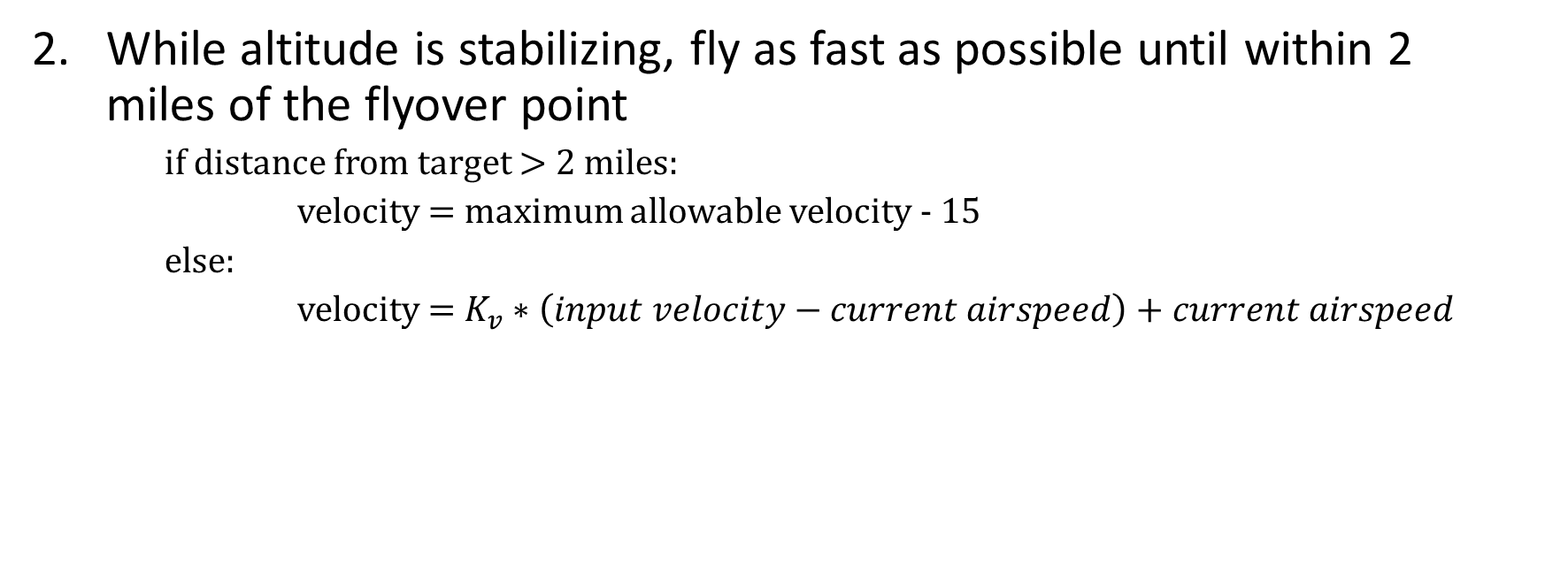
User Commands: Flyover, continued
While altitude is stabilizing, fly as fast as possible until within 2 miles of the flyover point
if distance from target $>$ 2 miles:
velocity = maximum allowable velocity - 15
else:
velocity = $K_{v}∗\left(input velocity−current airspeed\right)+current airspeed$

Slide 21
User Commands: Flyover, continued
While changing velocity and altitude, continually adjust heading to intercept flyover point
heading = bearing between(current latitude/longitude, target latitude/longitude)
If the aircraft is within 300 feet of the target, “let go” of the flyover waypoint and switch to a trajectory controller holding the current flight path for intercept.
Aircraft will maintain this flight path until the user specifies a new trajectory or flyover command

Slide 22
Example Simulation – Single Agent
Initial Conditions
Airspeed = 50 knots
Altitude = 7000 feet above mean sea level
Ascent = 0 degrees
Heading = 0 degrees (North)
(Latitude, Longitude) = (36.2434, -112.2822) degrees
Weight = 80 pounds
Wind = 15 knots east

Slide 23

Example Simulation – Single Agent
Drone Parameters
Max speed = 75 knots
Min speed = 25 knots
$p_{T}, p_{L}, p_{φ}$ = (2.0, 0.5, 1.0)
Max thrust = 45 pounds
Max $K_{L}$ = 0.26
Max bank angle = 45 degrees
$C_{D_{0}}$ = 0.05
$C_{L_{α}}$ = 0.5 radians
$α_{0}$ = -0.1 degrees
Wing area = 8 square feet
Aspect ratio = 12
Wing efficiency factor = 0.8

Slide 24

Example Simulation – Single Agent
Controller Transfer Function Gains
$K_{T_{P}}=0.15$
$K_{T_{i}}=0.05$
$K_{L_{P}}=0.3$
$K_{L_{i}}=0.03$
$K_{φ_{P}}=0.03$
$K_{α}=0.05$
$K_{v}=0.05$

Slide 25
Example Simulation – Inputs
Initial conditions: 50 knots, level flight, North heading (0º)
15 knot wind out of the west
After 120 seconds, command trajectory: 95 knots, 6-degree ascent, West heading (270º)
After 600 seconds, command flyover: 50 knots, 11000 feet MSL, (36.530367, -112.057600)
After 1800 seconds, command flyover: 50 knots, 7700 feet MSL, (36.449291, -112.399009)
Simulate 45 total minutes of flight time

Slide 26
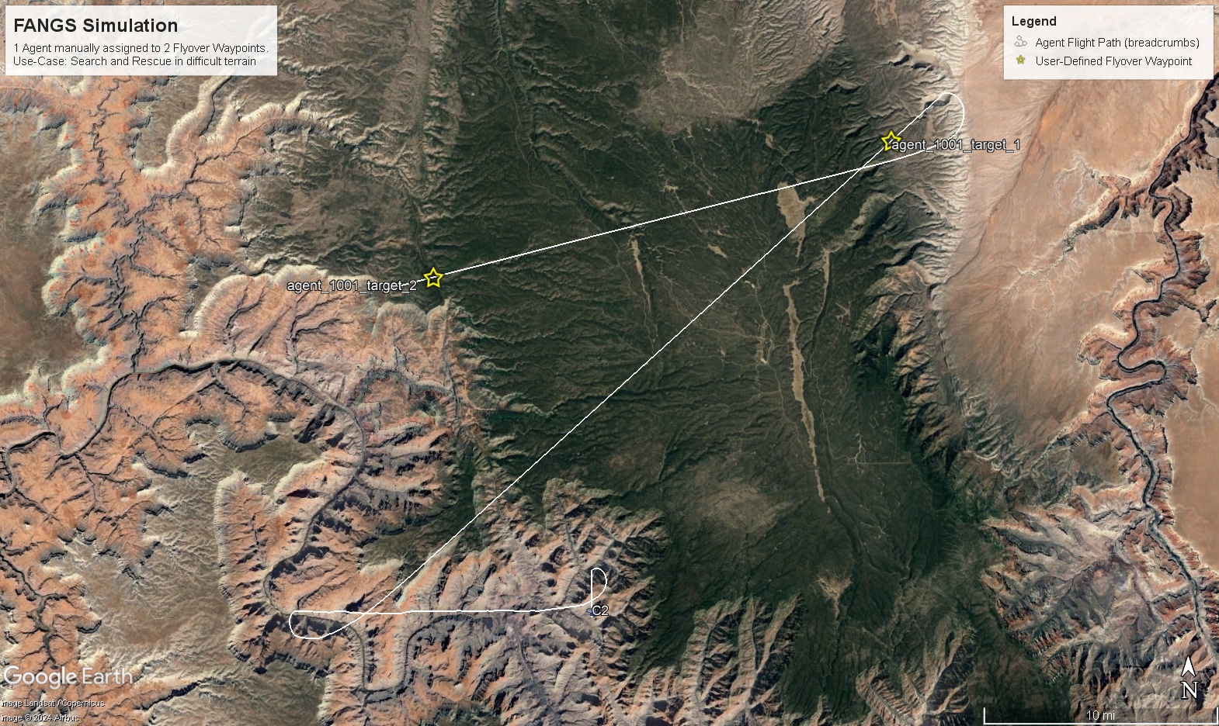
Results
4. Agent Assigned Target 2 (“Flyover Command”)
3. Agent Assigned Target 1 (“Flyover Command”)
1. Agent launched at C2 location with North-Bound Heading
2. Agent Assigned West-Bound Heading with Climb (“Trajectory Command”)

Slide 27
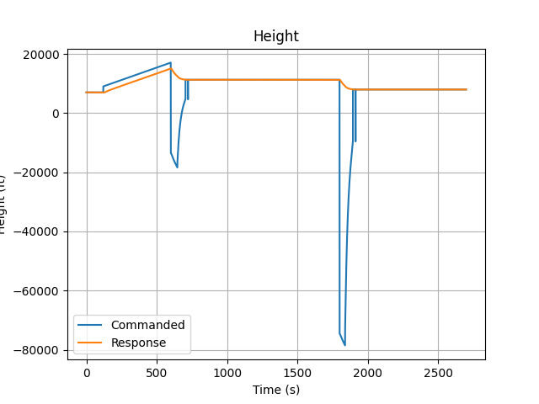
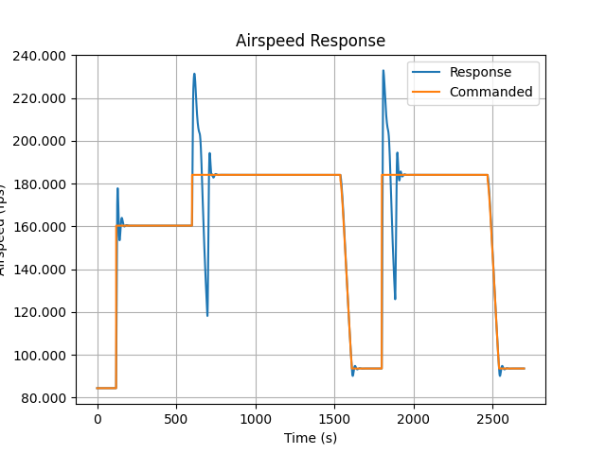
Example Simulation Results, Altitude and Airspeed
Dives commanded to match flyover altitudes. Extreme dives are intermittently commanded within FANGS to force strong aircraft dive response.
Airspeed response overshoot before settling due to proportional control

Slide 28
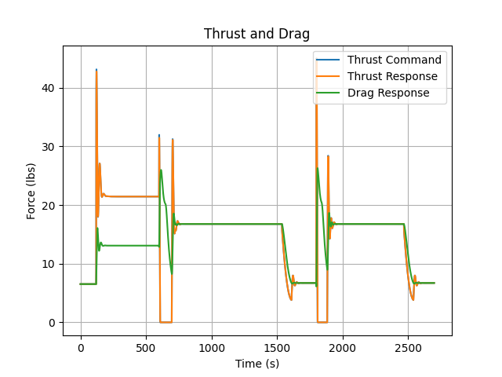
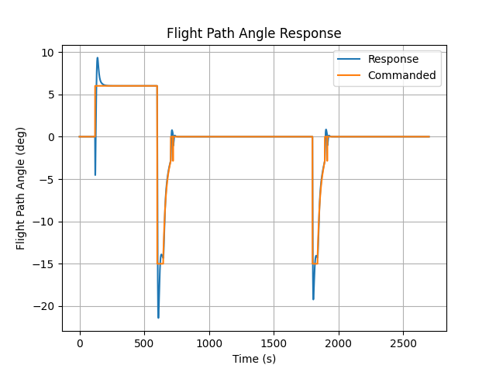
Example Simulation Results, Thrust, Drag, and Flight Path Angle

Slide 29
Agent Tracking and Assignment Management System (ATAMS)
Agent-Waypoint Assignment

Slide 30
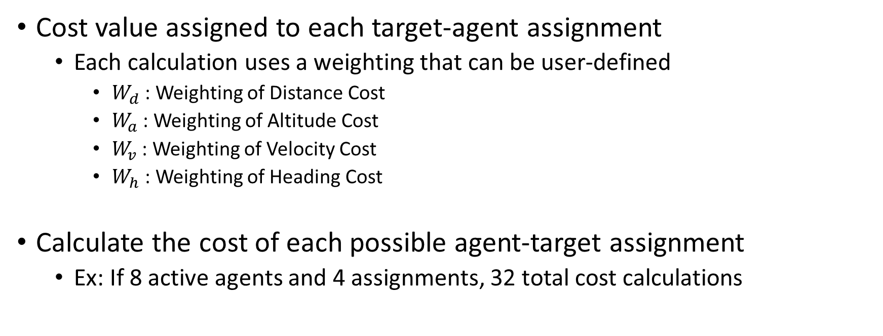
Target Assignments – Cost
Cost value assigned to each target-agent assignment
Each calculation uses a weighting that can be user-defined
$W_{d}$ : Weighting of Distance Cost
$W_{a}$ : Weighting of Altitude Cost
$W_{v}$ : Weighting of Velocity Cost
$W_{h}$ : Weighting of Heading Cost
Calculate the cost of each possible agent-target assignment
Ex: If 8 active agents and 4 assignments, 32 total cost calculations

Slide 31
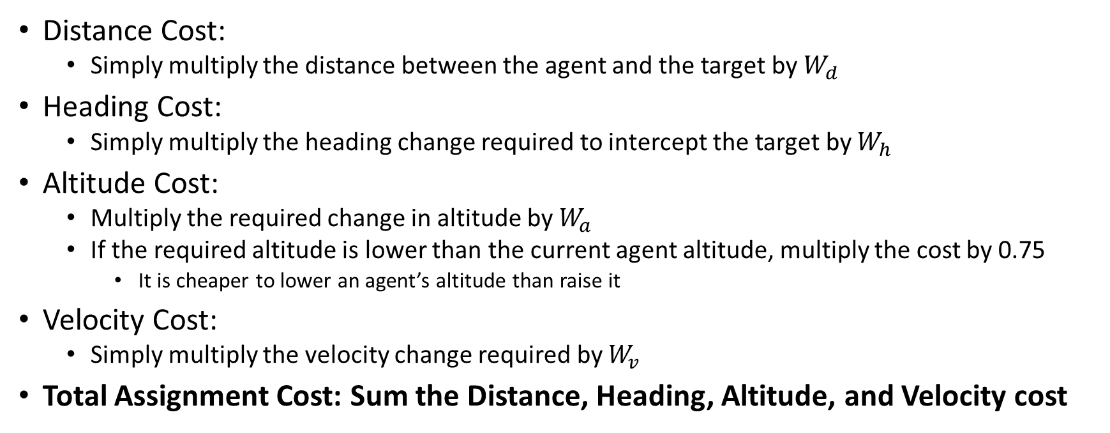
Target Assignments – Cost, Continued
Distance Cost:
Simply multiply the distance between the agent and the target by $W_{d}$
Heading Cost:
Simply multiply the heading change required to intercept the target by $W_{h}$
Altitude Cost:
Multiply the required change in altitude by $W_{a}$
If the required altitude is lower than the current agent altitude, multiply the cost by 0.75
It is cheaper to lower an agent’s altitude than raise it
Velocity Cost:
Simply multiply the velocity change required by $W_{v}$
Total Assignment Cost: Sum the Distance, Heading, Altitude, and Velocity cost

Slide 32
Target Assignments – Cost Matrix
Cost Matrix calculated using Hungarian Algorithm
Use Python 3 scipy package scipy.optimize.linear_sum_assignment
Returns cost matrix of n targets to m agents
Targets assigned by Cost Matrix

Slide 33
Target Assignments - Example
Eight active airborne agents
Each defined using parameters in Single Agent example (slides 21-26)
Launched from C2 helicopter ~5 seconds apart
Each given unique random trajectory 30 seconds after initialization
All agents given a 10 degree rate of climb
Define 8 target flyovers
Command flyovers to swarm 120 seconds after 1st drone initialization
Target flyovers defined on next slide

Slide 34
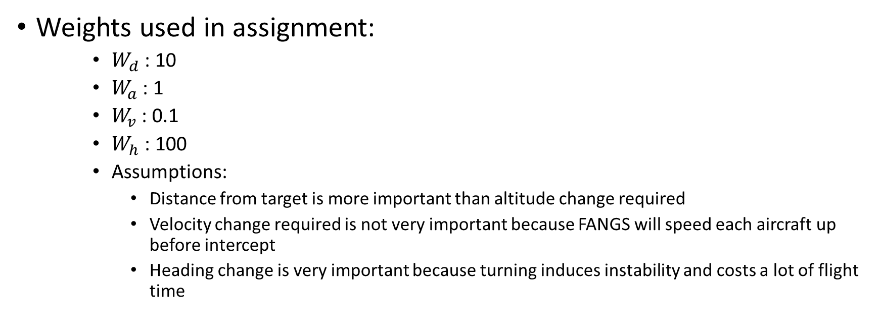
Target Assignments – Example, Continued
Weights used in assignment:
$W_{d}$ : 10
$W_{a}$ : 1
$W_{v}$ : 0.1
$W_{h}$ : 100
Assumptions:
Distance from target is more important than altitude change required
Velocity change required is not very important because FANGS will speed each aircraft up before intercept
Heading change is very important because turning induces instability and costs a lot of flight time

Slide 35
Target Assignments – Example, Continued
8 Flyover Assignments
Target | Latitude (Deg, North) | Longitude (Deg, West) | Altitude (MSL) | Groundspeed (knots)
1 | 36.530367 | 112.057600 | 11000 | 50
2 | 36.179491 | 111.951595 | 12000 | 50
3 | 36.276756 | 112.687766 | 9600 | 50
4 | 36.542782 | 112.124202 | 12000 | 50
5 | 36.089355 | 112.409598 | 10000 | 50
6 | 36.218540 | 111.969167 | 12600 | 50
7 | 36.449291 | 112.399009 | 7700 | 50
8 | 36.580698 | 111.866192 | 9000 | 50

Slide 36
Target Assignments – Example, Continued
Agent States at 120 seconds (time of cost estimate)
Agent | Latitude (Deg, North) | Longitude (Deg, West) | Altitude (MSL) | Groundspeed (knots) | Heading (Deg) | Flight Path Angle (Deg)
1 | 36.23111 | -112.27017 | 8525.751 | 80.058 | 182.888 | 10.00212
2 | 36.25135 | -112.24750 | 9046.887 | 106.007 | 99.566 | 10.00093
3 | 36.23797 | -112.29225 | 8535.040 | 96.050 | 268.649 | 10.01889
4 | 36.26619 | -112.28151 | 8425.689 | 80.023 | 1.920 | 9.999995
5 | 36.23514 | -112.27546 | 8424.269 | 102.037 | 208.198 | 10.02664
6 | 36.25800 | -112.26417 | 8195.515 | 94.866 | 82.316 | 10.00612
7 | 36.23767 | -112.28039 | 8077.037 | 84.689 | 225.048 | 10.03656
8 | 36.23940 | -112.28349 | 8047.320 | 90.942 | 245.432 | 10.07828

Slide 37
Target Assignments – Example, Continued
Agent-Target Cost Matrix with Optimal Assignments
Total assignment cost = 20784.93
 | AGENT 1 | AGENT 2 | AGENT 3 | AGENT 4 | AGENT 5 | AGENT 6 | AGENT 7 | AGENT 8
TARGET 1 | 2980.23 | 3798.31 | 1475.21 | 3988.04 | 1661.90 | 4399.78 | 1051.47 | 1049.03
TARGET 2 | 2298.85 | 3139.92 | 1106.01 | 3309.01 | 1307.57 | 3714.36 | 1401.93 | 447.31
TARGET 3 | 2923.33 | 3951.30 | 1302.78 | 3897.66 | 1685.80 | 4551.22 | 905.93 | 1038.87
TARGET 4 | 2852.11 | 3953.20 | 1558.17 | 3824.42 | 1980.81 | 4524.15 | 738.10 | 969.83
TARGET 5 | 3124.64 | 3947.58 | 1529.54 | 4108.66 | 1717.72 | 4548.34 | 929.64 | 1194.79
TARGET 6 | 3114.98 | 4031.45 | 1936.90 | 4123.21 | 2178.88 | 4601.87 | 719.90 | 1185.37
TARGET 7 | 3450.58 | 4324.94 | 1842.07 | 4425.55 | 2065.54 | 4925.22 | 636.43 | 1565.91
TARGET 8 | 3446.11 | 4392.38 | 1834.55 | 4420.77 | 2133.14 | 4992.35 | 578.07 | 1561.64

Slide 38
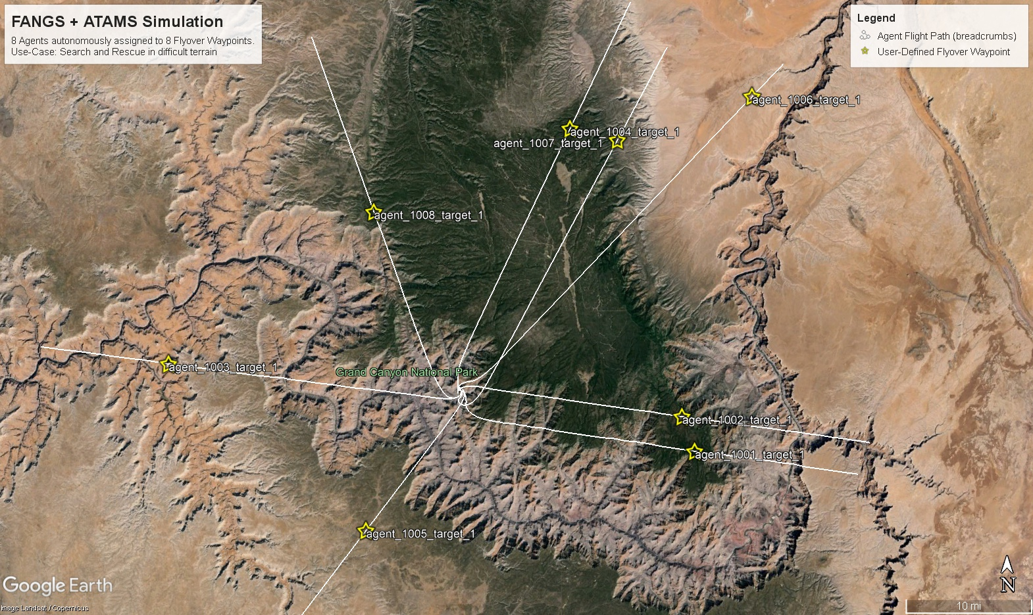
Results
Future Development:
Post-Flyby Behavior?
Loiter
Return to C2
??

Slide 39
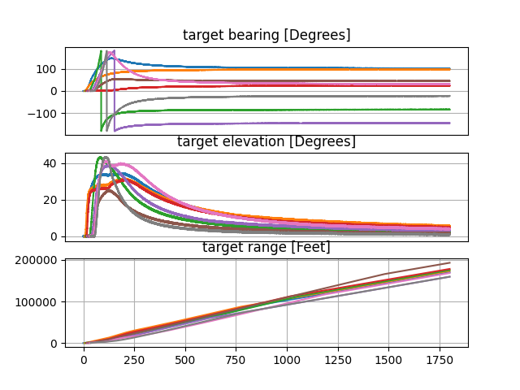
Future Development - Agent Tracking
Each agent tracked by the C2
Assumption: onboard radar, infrared, or other sensor system
Raw track data output by FANGS
Target bearing, elevation, and range relative to C2
Simulated sensor noise
Gaussian noise
Future iterations may simulate false tracks, track drop-outs, non-Gaussian noise, and range-dependent noise

Slide 40
Future Development - Agent Tracking, Continued
Future Development: Implement random finite-set based tracking algorithms from University of Alabama LAGER Python package CARBS.
Add air-to-air targets and track these targets
Intercept air-to-air targets with drones commanded by FANGS

