Slide 1
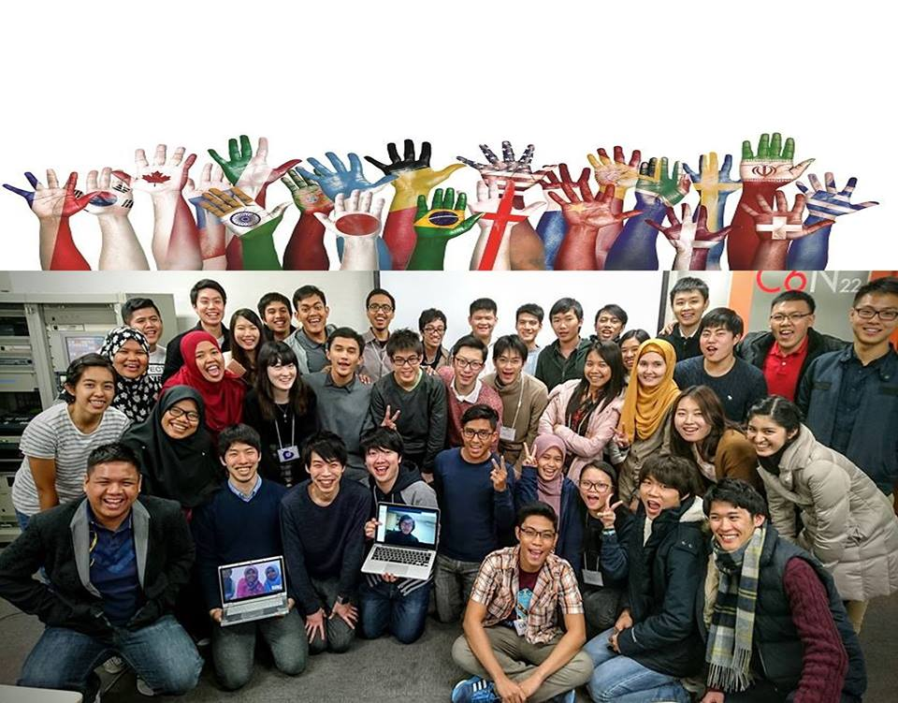
PEOPLE, CULTURE AND COUNTRY

Slide 2

What is culture?
“Culture” refers to a group or community which shares common experiences that shape the way its members understand the world.

Slide 3
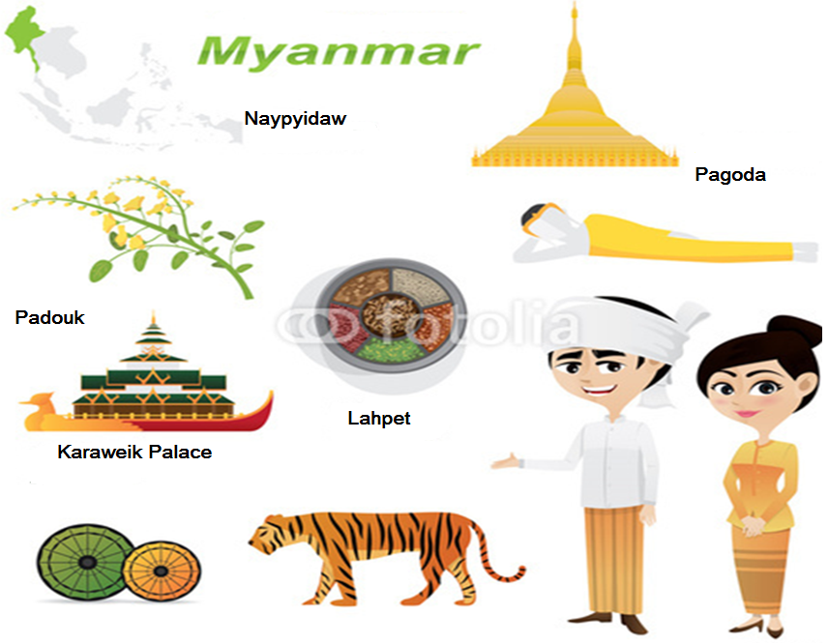
Notes:
Myanmar is known as the Golden Land.
Naypyidaw is the capital city of Myanmar
Padouk is the national flower of Myanmar
Lahpet (green tea leaf) is one of the traditional food
Pagoda and the Karaweik Palace are the landmark of Myanmar

Slide 4
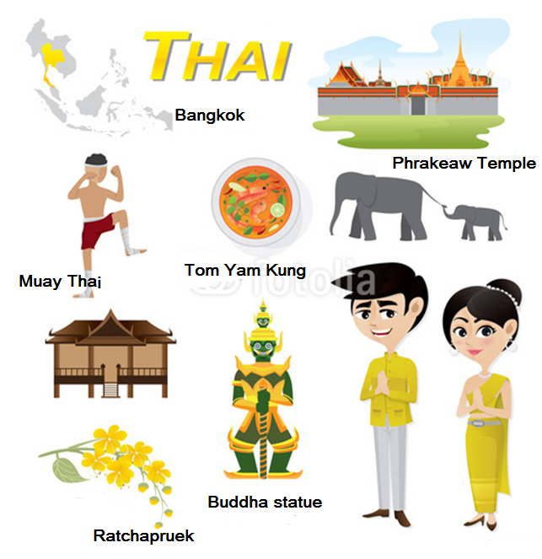
Notes:
Thailand is known as the Land of Smiles
Capital city of Thailand is Bangkok
Ratchapruek is the national flower.
Tom Yam Kung is the famous food in Thailand.
Buddha statue and Phrakeaw Temple are the famous landmark.

Slide 5
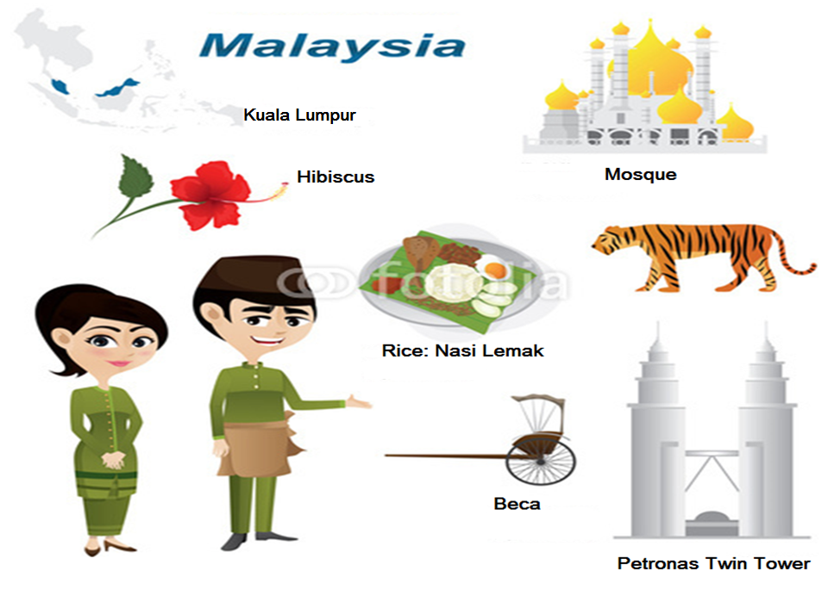
Notes:
Malaysia is also known as the “Food paradise of South East Asia”.
The capital city of Malaysia is Kuala Lumpur.
Rice is the main food.
Hibiscus is the national flower.
Beca is one the historical transportation.
Petronas twin tower is the famous landmark of Malaysia.

Slide 6
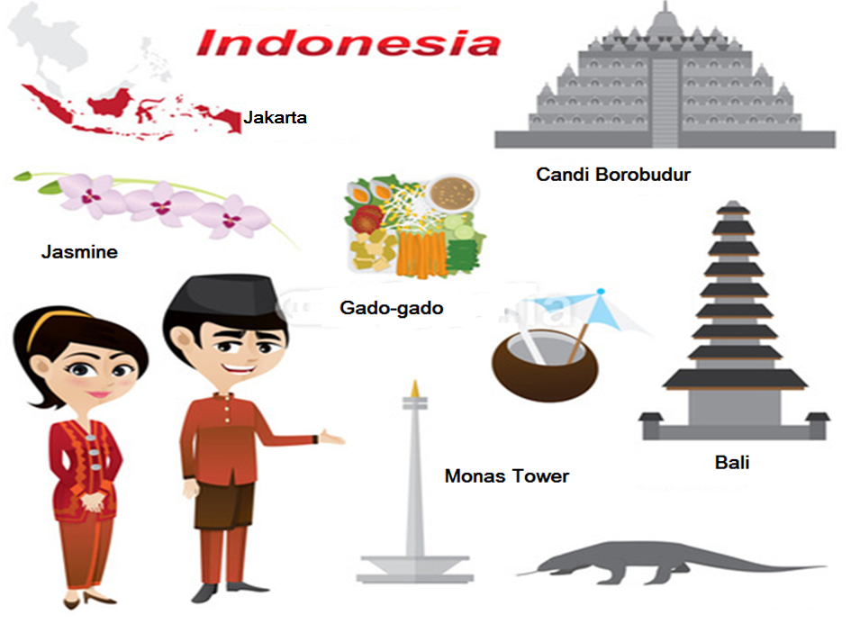
Notes:
Indonesia is known as the Emerald of the Equator.
Capital city of Indonesia is Jakarta.
The national flower is Jasmine.
One of the famous food is gado-gado.
Monas tower and Candi Borobudur are the famous landmark in Indonesia.
Bali is the tourist attraction spot in Indonesia.

Slide 7
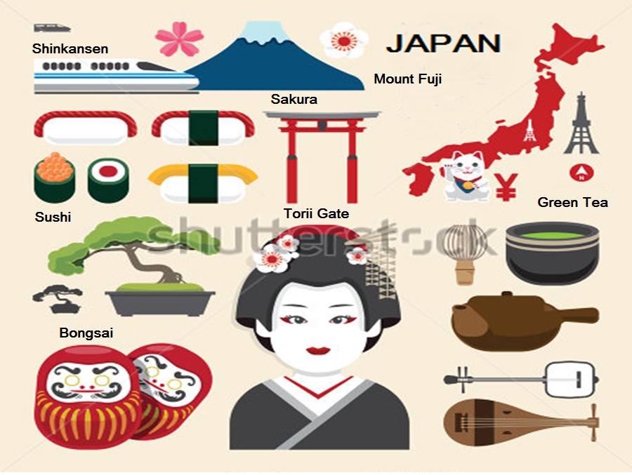
Daruma
Notes:
Japan is known as the Land of the Rising Sun.
The capital city of Japan is Tokyo.
Sakura is the country's iconic flower of Japan.
People eat Sushi and green tea in Japan.
Mount Fuji and Torii Gate are the famous landmark of Japan.
The iconic transportation in Japan is the Shinkansen.

Slide 8

Cultures provide us with the blueprint for how to most effectively function within society.
It defines not only our own behaviour, but how we interpret the behaviour of others

Slide 9

What is the capital city of Myanmar?
What is national flower of Indonesia?
What is the Japanese traditional doll?
What is the famous sport in Thailand?
What is the famous landmark of Malaysia?

Slide 10

https://www.fotolia.com

