Slide 1
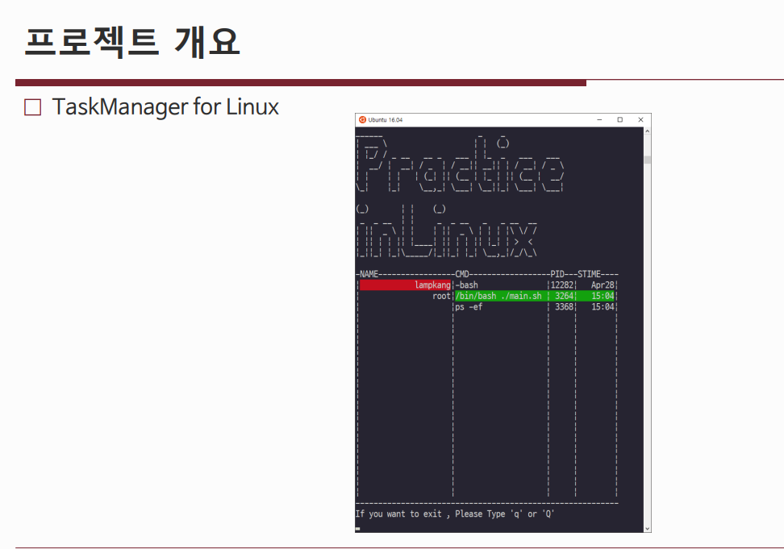

Slide 2
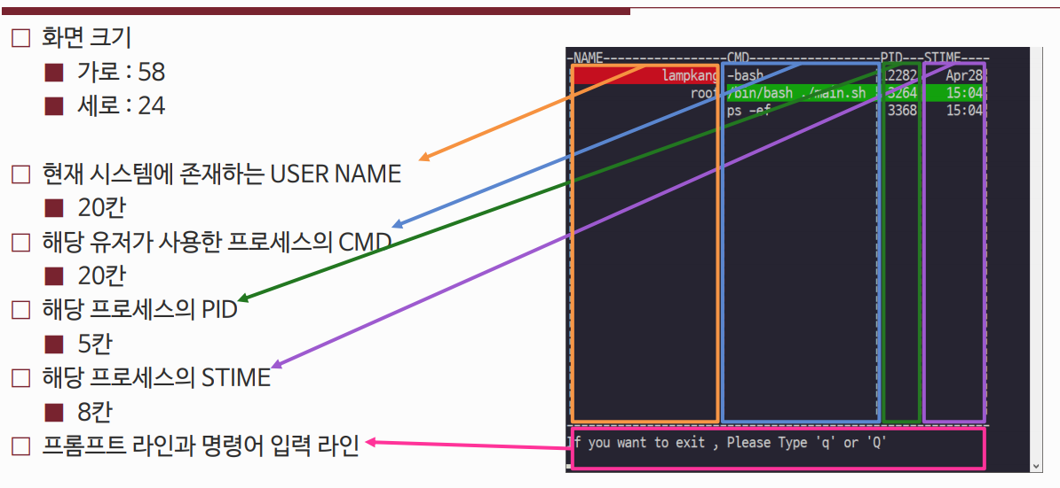
Screen Size
horizontal
vertical
USERNAME that exists in current system
20spaces
Process CMD that user used
20spaces
PID of that process
→ 7spaces
STIME of that process
8 Spaces
Prompt line and command input line

Slide 3
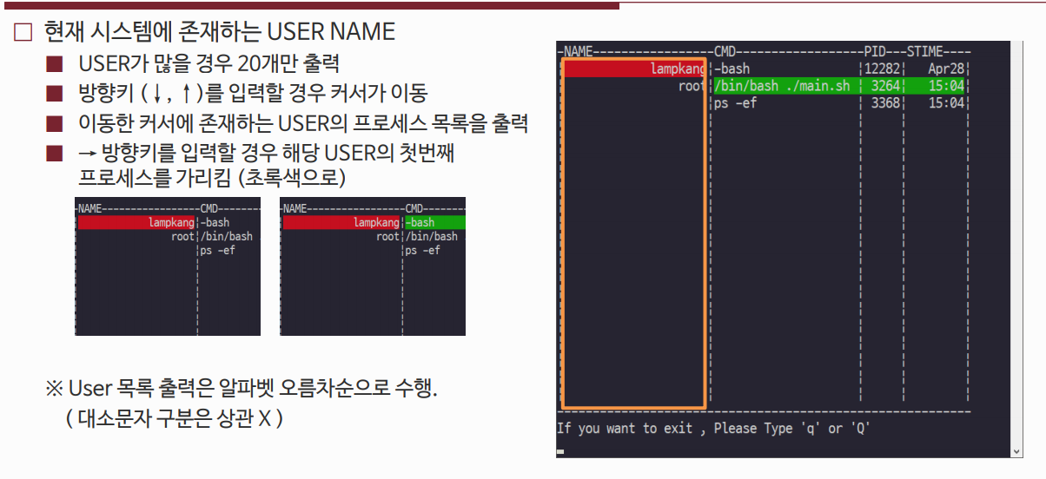
USER NAME that exists in current system
Print only just 20 users if there is more
Use Up and Down keys to move the cersor
Print list of USER’s process of that cersor
If press “right Key” point out User’s first process in green color
Printed User list should be in alphabetical order

Slide 4
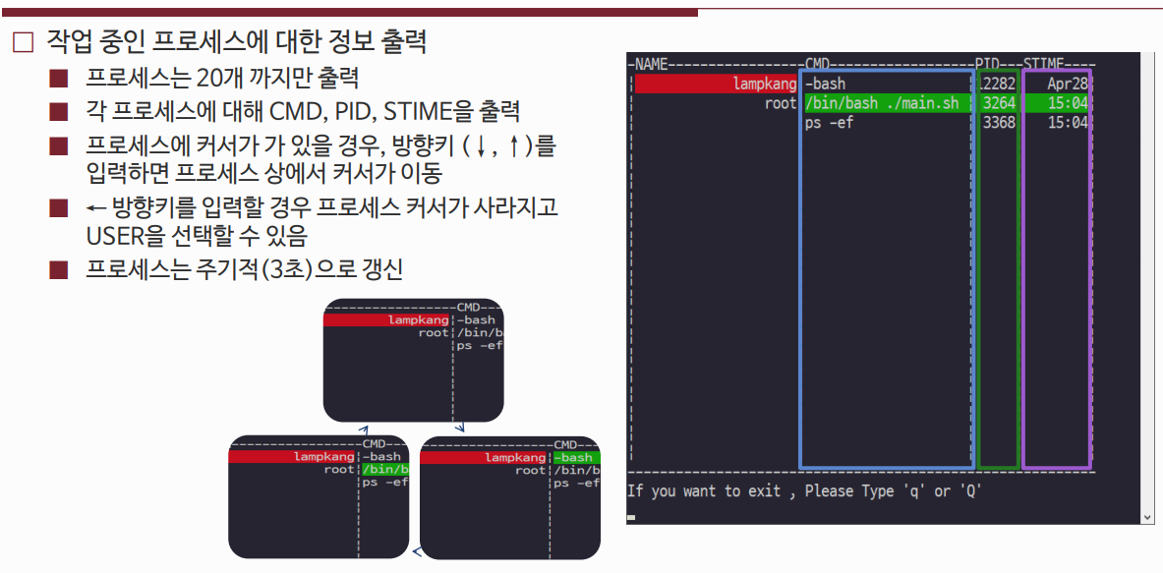
Printing information of working process
Print less than 20 process
Print the CMD,PID,STIME of each process
Use up and down keys to move the cursor
Pressing “Left key” = cursor disappear from the process and should be able to select USER
Process should be updated every 3 seconds

Slide 5
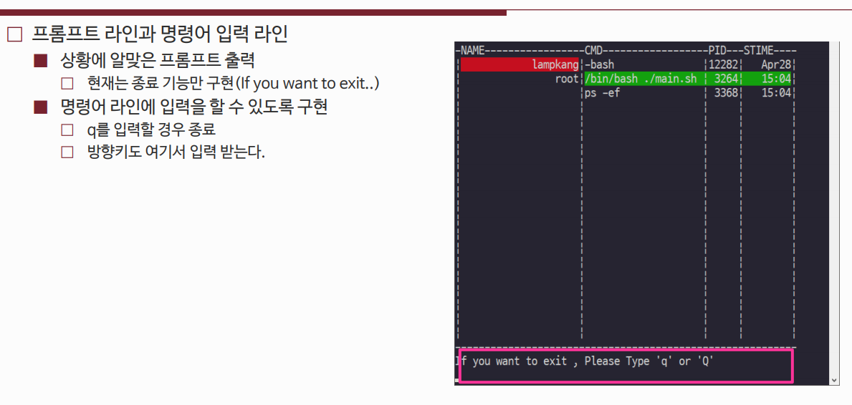
Prompt line and command line
Print appropriate prompt
For now just exit function
Able to input on the command line
Press q to exit
Direction keys are also input here

Slide 6
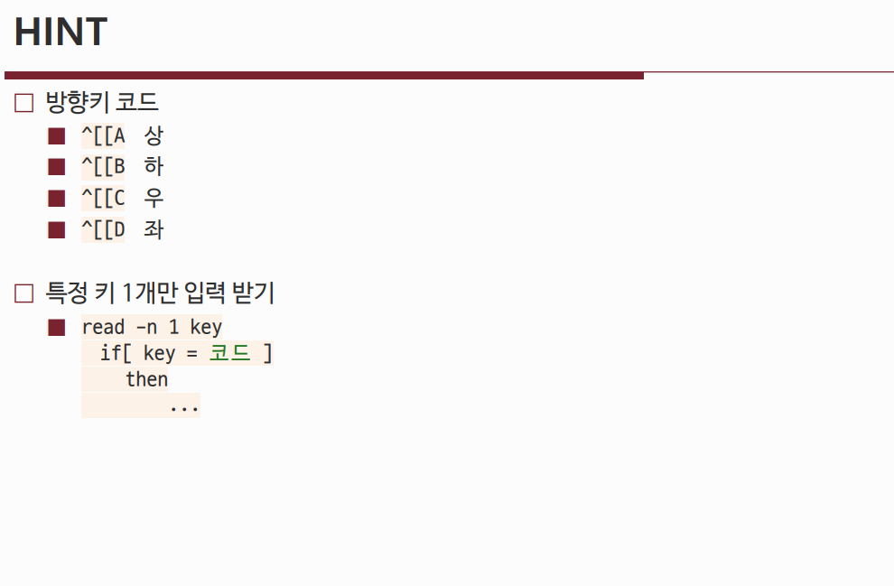
Arrow keys
Top
Down
Right
Left
Receive input of Certain Key
코드

