Slide 1
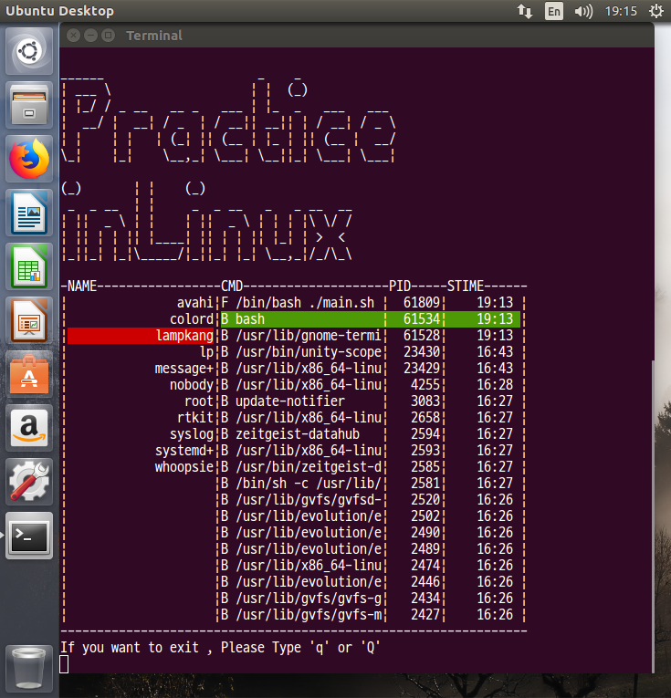
TaskManager for Linux Ver.2

Slide 2
Changes
Screen Size
Horizonatal : 58 -> 64
Vertical : 24(same)
USER NAME that exists in current system
20 (same)
Process CMD that user used
20 -> 22
PID of the process
5 -> 7
STIME of the process
8 -> 9
Prompt lime and command lime (No change)

Slide 3
Added functions
1 . Print list order in reverse order based on PID
When displaying the process of the selected user, sort in descending order based on PID
2. Print whether CMD is being used on background
If the process is running in the background, put a B in front of CMD
If running in foreground, put F

Slide 4
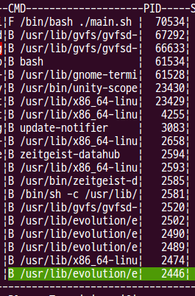
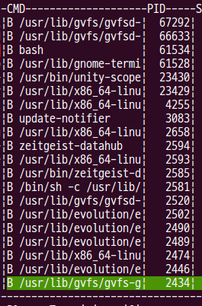
Added functions
3. Implement scrolling if process is more than 20
If more than 20 process are running, print 20 first. (0 ~ 19)
If there is cursor in the last column and if the down arrow is pressed, print the process (1~20) in state where cursor does not change
If lesser than 20 process act same as previous code(ver.1)

Slide 5
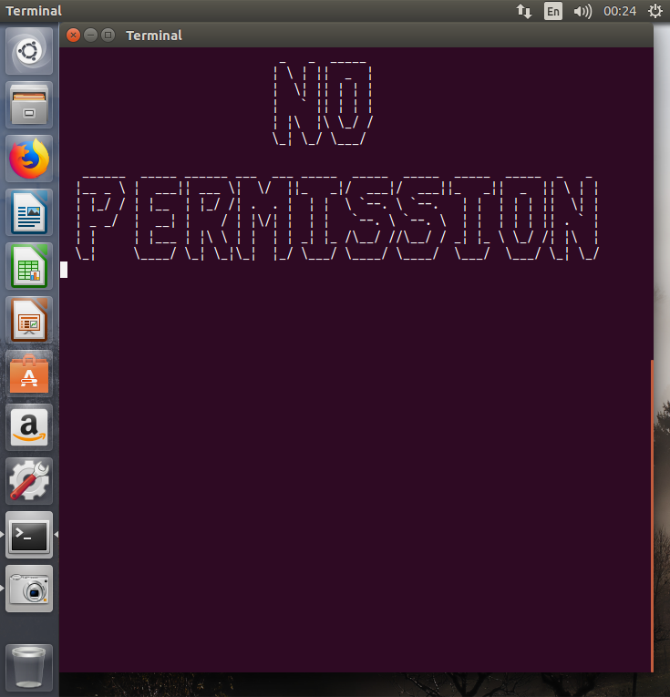
Added functions
4. If the cursor is on the process, press enter to end the process
As shown in the pic on the right, if you press enter on PID 61534, the bash process is terminated by force
If you force terminate any process, there will be a problem so only terminate the process of the account currently logged
A warning message should be displayed when an attempt is made to forcibly terminate an unauthorized process

