Slide 2
Comparison of Machine Learning Classifiers for Land Use Land Cover Change Detection and its Relationship with Land Surface Temperature
By
Ahtsham Mustafa Awan – MS 2021
Institute of Geographical Information Systems (IGIS)
School of Civil and Environmental Engineering (SCEE)
National University of Sciences and Technology (NUST)

Slide 3
Contents
Introduction​
  Background​
  Literature Review​
  Research Gap
  Objectives​
Materials and Methods ​
  Study Area ​
  Data to be used ​
  Flow Diagram​
Results
  LULC, LST, Spectral Indices, Terrain Analysis, Online Survey, Correlation
Conclusions
References​
Thesis Final Defense: Dec, 2023

Slide 4
Research Paper Submitted to the ‘Journal of Applied Remote Sensing’ for a potential Publication

Slide 5
Graphical Abstract
Performance of RF, SVM, GTB, and CART
Spectral Indices and Terrain Analysis
LST, UHI, UTFVI, UDI
Socio-economic Survey
Correlation Analyses
Thesis Final Defense: Dec, 2023

Slide 6
Background
Land use and land cover concepts are pivotal in environmental studies, urban planning, and land management, providing fundamental insights into ecosystems, urban development, and resource utilization.
Monitoring Land Use Land Cover (LULC) alterations, including urban expansion, and deforestation, is imperative due to their far-reaching impacts on the natural environment, including disruptions to habitats, alterations in hydrological processes, effects on biodiversity, and contributions to urban heat islands.
Thesis Final Defense: Dec, 2023

Slide 7
Background
These transformations underscore the critical importance of timely identification and tracking of landscape dynamics, serving as a foundational element for informed decision-making, sustainable land governance, and the preservation of environmental integrity.
Rapid urbanization in Asia and Pakistan has caused significant land use and land cover changes and alterations in Land Surface Temperature (LST).
Thesis Final Defense: Dec, 2023

Slide 8
Background
The rise in land surface temperature (LST) in Pakistan can be attributed to the combined effects of climate change and rapid urbanization, including the expansion of built-up.
These factors have led to the urban heat island effect, resulting in higher LST, which has adverse effects on the environment and public health.
Thesis Synopsis Defense; 29 March, 2023

Slide 9
Background
Factors like rural-urban migration, industrialization, economic development, and population growth contribute to these changes.
Urbanization has increased from 17% in the 1950s to 49% in 2018 in Asia and from 17% in 1951 to 36% in 2017 in Pakistan.
These shifts in LULC contribute to the urban heat island effect, negatively impacting the environment, public health, and socio-economic development.
Azad Kashmir (AJK) is no exception, making it crucial to analyze the impacts of landscape dynamics on LST, and socio-economic development in the region.
Thesis Final Defense: Dec, 2023

Slide 10
Literature Review
A study by Roy et al. (2022) explores how spectral indices derived from Landsat imagery of Sylhet Sadar Upazila (2000–2018) relate to land surface temperature (LST). It finds LST changes between -6°C and +4°C, with the northeast, featuring higher vegetation and forests, experiencing the most significant temperature variations. Notably, NDVI and NDBI show correlations with LST ranging from -0.52 to +0.57.
Basher et al. (2022) conducted a study to assess LULC classification performance in Charlottetown, Canada, comparing ArcGIS Pro and Google Earth Engine with various satellite datasets. SVM classifiers consistently achieve the highest accuracy, with SVM in ArcGIS Pro reaching 94% accuracy with Planet data, and SVM in Google Earth Engine achieving 92% accuracy with Sentinel 2 data. The study also identifies significant forest-to-bare land and urbanization changes, aiding in the selection of remote sensing classifiers and satellite imagery for accurate LULC mapping.
Thesis Final Defense: Dec, 2023

Slide 11
Literature Review
Mathew et al. (2019) predicted land surface temperatures (LSTs) for the assessment of the urban heat island (UHI) effect in the area surrounding Chandigarh city. Remote sensing data from MODIS and ASTER GDEM were used, and a support vector regression (SVR) model was developed using LST values from the previous three years, along with enhanced vegetation index (EVI), road density (RD), and elevation as input parameters to predict LST. The results showed that the SVR model was a significant tool to predict LST for the assessment of the heat island effect, with higher efficacy compared to the artificial neural networks (ANN) model.
Hui et al. (2020). utilized remote sensing techniques to estimate Land Surface Temperature (LST) in district Malakand, Pakistan using LANDSAT-8 data. The study highlighted the potential of GIS tools and offers accurate information that can guide land use planning, ecological restoration, and sustainable development in the district.
Thesis Final Defense: Dec, 2023

Slide 12
Literature Review
Mustafa et al., (2020) compared four soft computing models for predicting land surface temperature (LST) changes in Beijing using statistical analysis, with the ANFIS model showing the highest performance. The study emphasized the impact of climate change and urban development on LST and highlights the importance of considering topographic changes and previously recorded temperature changes in LST prediction models.
Shahfahad et al. (2022) conducted a research to analyze land use/land cover changes and their impact on land surface temperature in Khanewal district, Pakistan, using remote-sensing techniques. The study found that the built-up area increased from 1.75% in 1980 to 5.27% in 2020, while the vegetation area decreased by 4.12% during the same period. As a result of these changes, the land surface temperature increased by 0.50°C from 1980 to 2020.
Thesis Final Defense: Dec, 2023

Slide 13
Literature Review
Mehmood et al. (2022) investigated the changes in surface Urban Heat Island Intensity (SUHII) in six major cities in Punjab, Pakistan from 2006 to 2020 using MODIS land surface temperature data. Results indicate an increase in SUHII for both daytime and night-time in all seasons and annually, with the greatest increase occurring during the spring season. The ARIMA model forecast predicts a continued rise in SUHII until 2030.
Nasir et al. (2022) examined the relationship between urban land-use dynamics and land surface temperature in Kohat City, Pakistan using satellite imagery from 1998 to 2018. Results showed that built-up areas increased, and land surface temperature rose, especially in densely populated areas, highlighting the importance of monitoring and managing urban land-use to mitigate the negative impacts on the environment and human health.
Thesis Final Defense: Dec, 2023

Slide 14
Research Gap
Previous research lacks a comprehensive comparison of machine learning techniques for analysing Land Use Land Cover Changes, and assessing their efficiency is crucial for robust and accurate results.
Insufficient emphasis on socioeconomic impacts and an underexplored consideration of the correlation with topographic factors indicates a need for a more comprehensive understanding.
Thesis Final Defense: Dec, 2023

Slide 15
Objectives
Comparison of performance of four ML classifiers (Random Forest, Support Vector Machine, Gradient Tree Boost, and Classification and Regression Trees) for LULC Classification.
Modelling relationship between LULC Change, LST, Socio-economic Indicators, and Topographic Variables.
Thesis Final Defense: Dec, 2023

Slide 16
Study Area – Muzaffarabad AJK
Capital of Azad Jammu and Kashmir
Tehsil Muzaffarabad has a total area of 729.677 Square Km, and population of 498230 according to 2017 census.
Located between 34.37°N and 73.47°E at an 737 m (2,418 ft) m above mean sea level.
Mean annual temperature between 3°C to 16°C in winters and 23°C to 37°C in summers.
Average yearly precipitation of 1511 mm and a relative humidity of around 73%.
Figure: Study Area Map Muzaffarabad Azad Jammu and Kashmir
Thesis Final Defense: Dec, 2023

Slide 17
Data Used
No​ | Data​ | Specification​ | Source​ | Cloud Cover | Date of Acquisition
01 | Study Area Shapefile | GeoRef PDF | P&D AJK | N/A | 22-08-2023
02 | Landsat 5 TM | SR_B1-B5, B7, B6 | USGS – GEE Catalog​ | 2% | 12-06-2002
03​ | Landsat 8 OLI | ​SR_B2 – B7, B6, B10,11 | USGS – GEE Catalog | 3.4% | 19-06-2013
04 | Sentinel 2A MSI | B2, B3, B4, B8 | COAH – GEE Catalog | 0.386% | 24-06-2022
05 | SRTM DEM | 30m (Terrain Analysis) | GEE Catalogue (USGS) | N/A | 22-11-2023
06 | Online Survey | Socio-Economic Indicators | Google Forms Responses | N/A | N/A
Thesis Final Defense: Dec, 2023

Slide 18
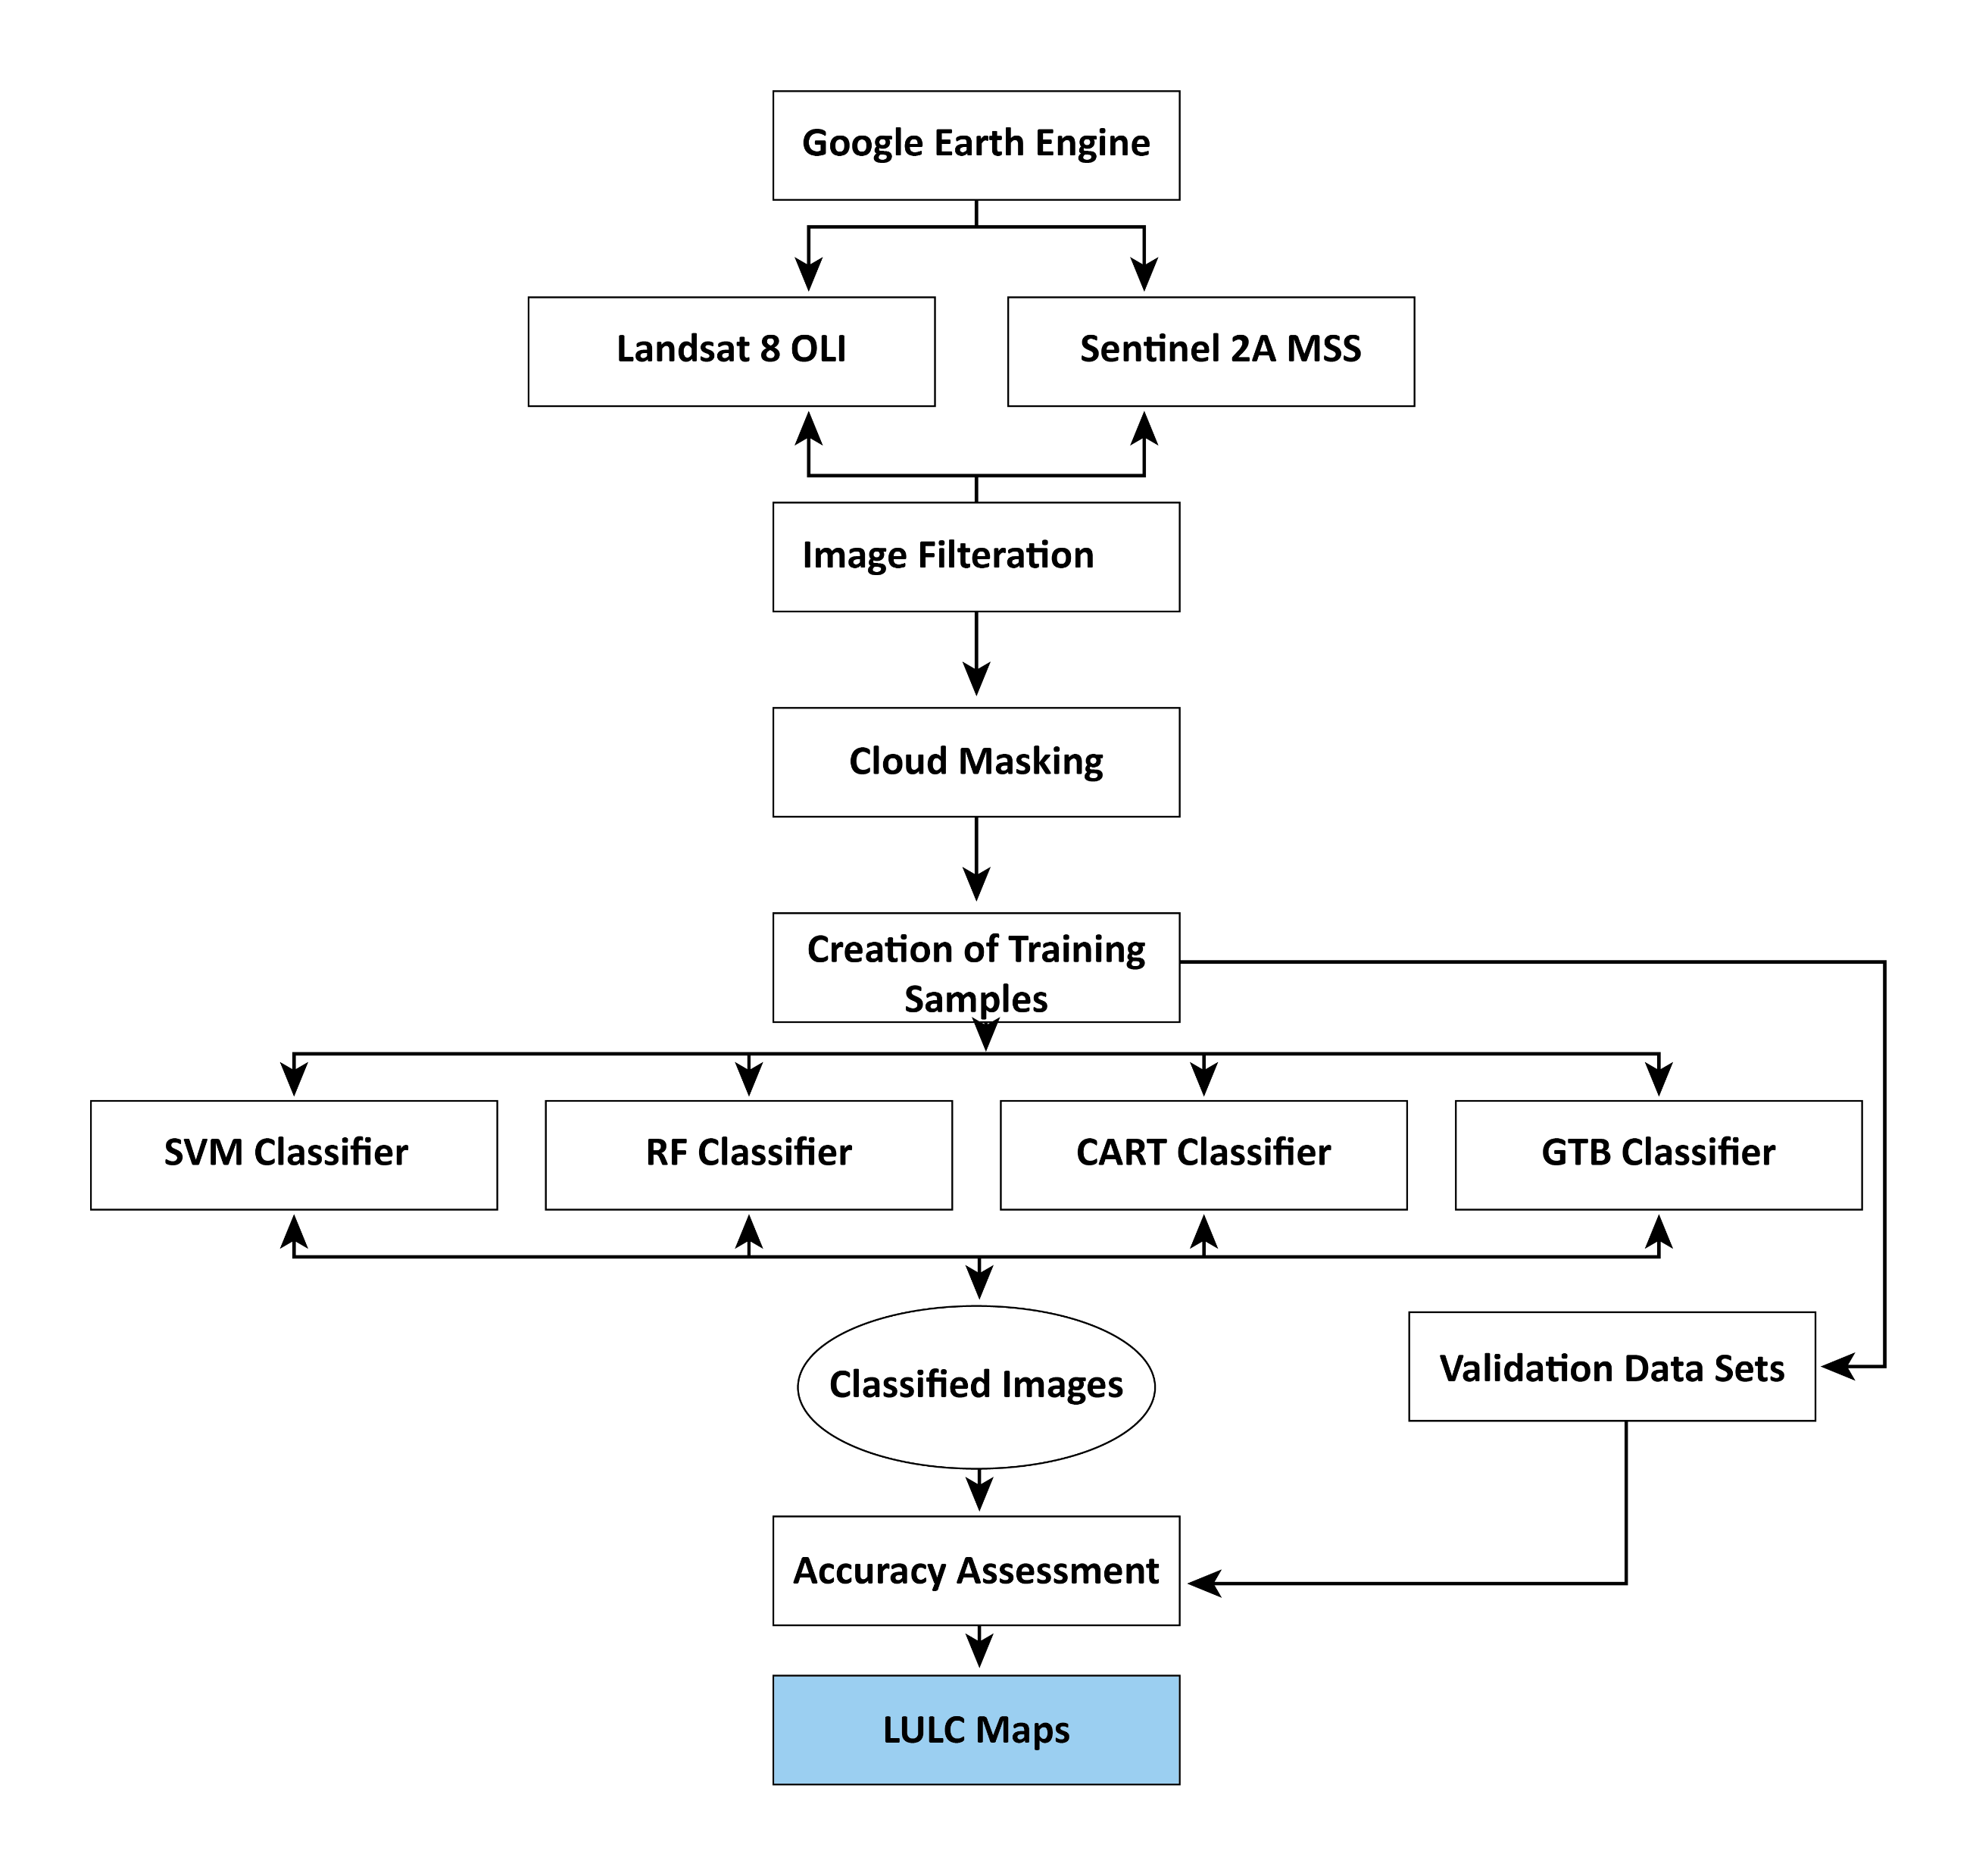
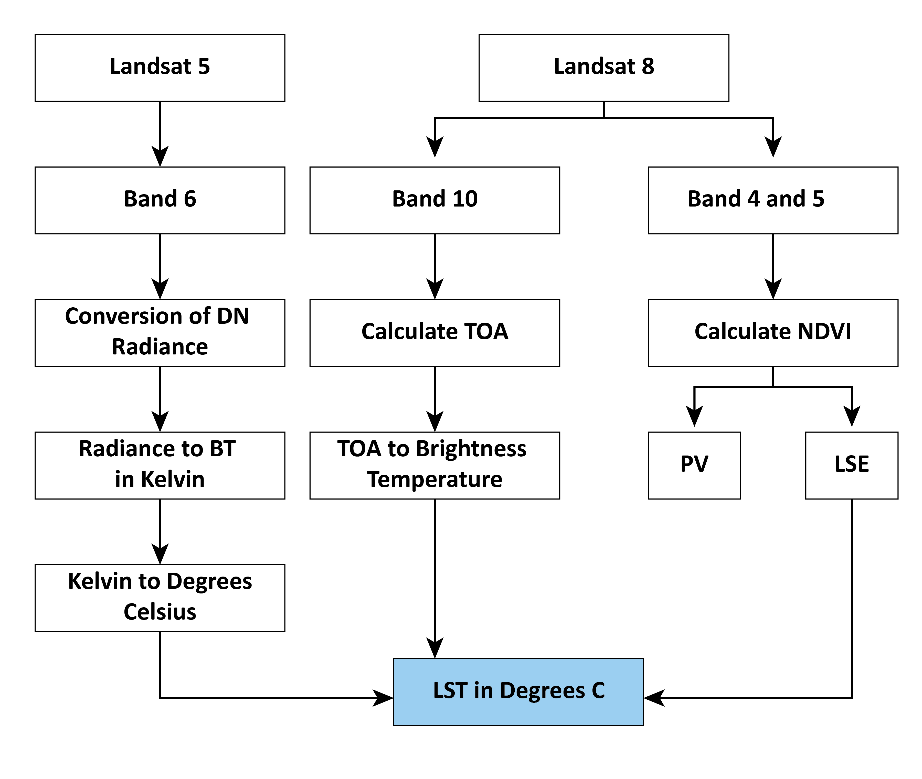
Methodology Flow Chart Diagram
SRTM DEM
NDVI
Elevation
NDBI
Slope
NWI
Aspect
UDI
Correlation with LST
Online Survey
Thesis Final Defense: Dec, 2023

Slide 19

Google Earth Engine
Cloud based
Catalogue – 90 PB of ARD
Cloud-Based Processing
Data Visualization
Code Editor
Applications
Google Earth Engine: https://developers.google.com/earth-engine
Thesis Final Defense: Dec, 2023

Slide 20
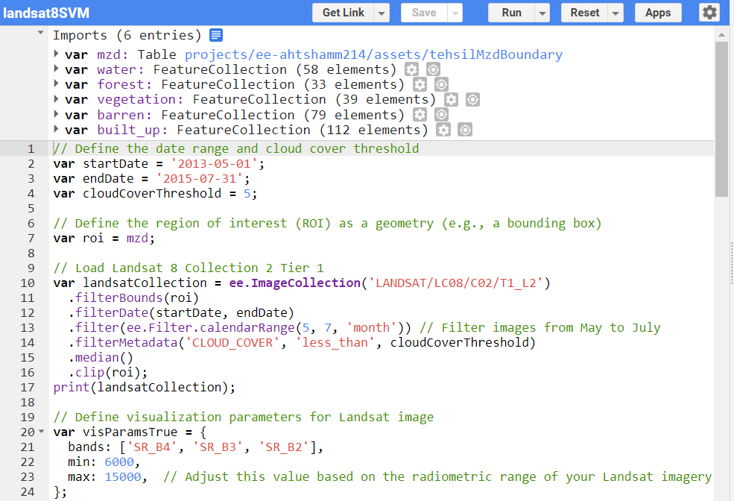
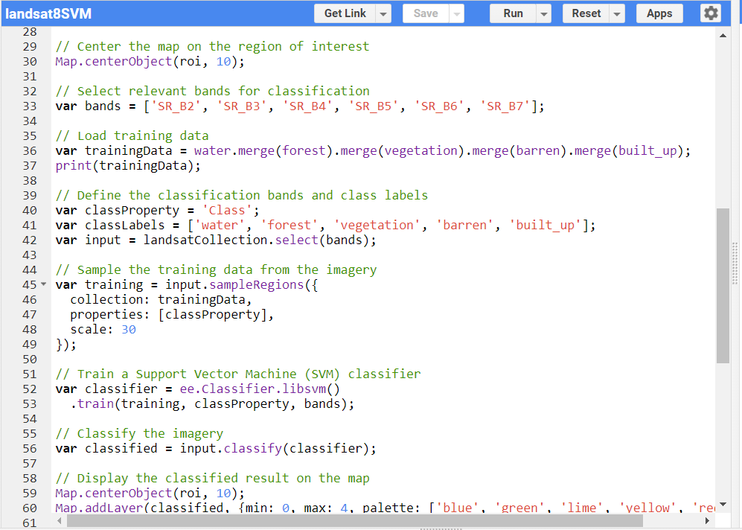
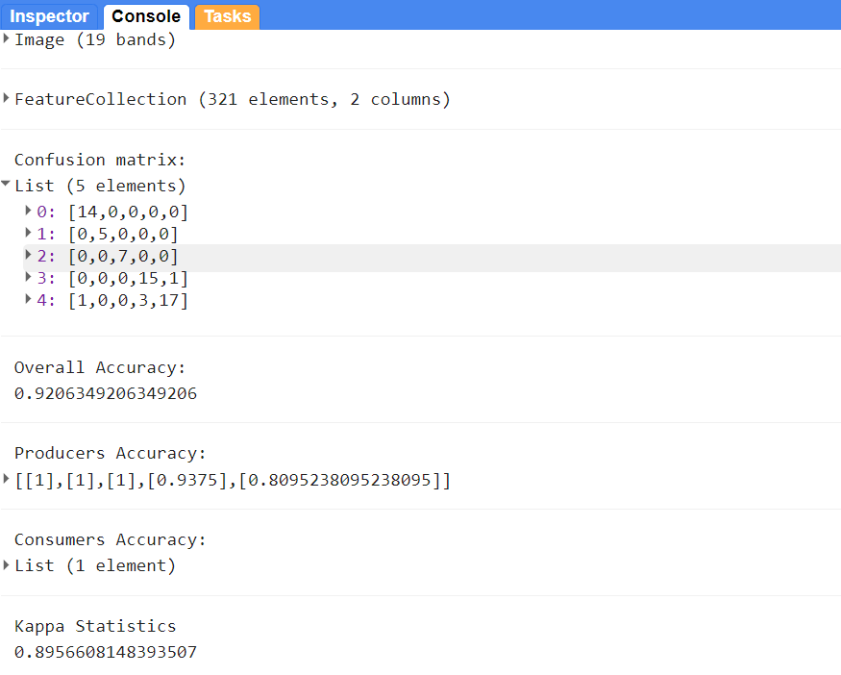
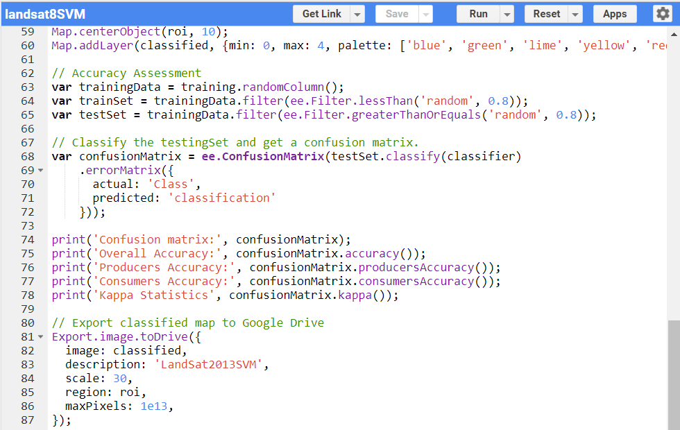
ML Models Workflow in Google Earth Engine
Loading, Filtering
Spatial Class Segregation
Train Test Split
Model Selection
Model Training
Prediction
Model Evaluation
Final LULC Maps
Thesis Final Defense: Dec, 2023

Slide 21
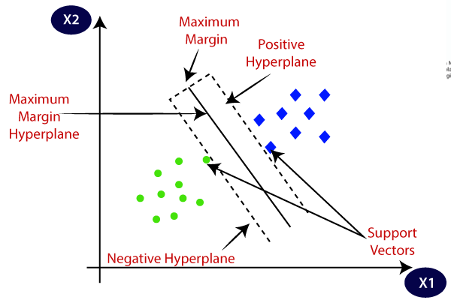
Support Vector Machine
SVM is a supervised machine learning algorithm that identifies a hyperplane to separate data into distinct classes, accommodating both linear and non-linear data using various kernels, with performance optimization through support vectors and hyperparameter tuning.
Source: https://www.javatpoint.com/machine-learning-support-vector-machine-algorithm
Thesis Final Defense: Dec, 2023

Slide 22
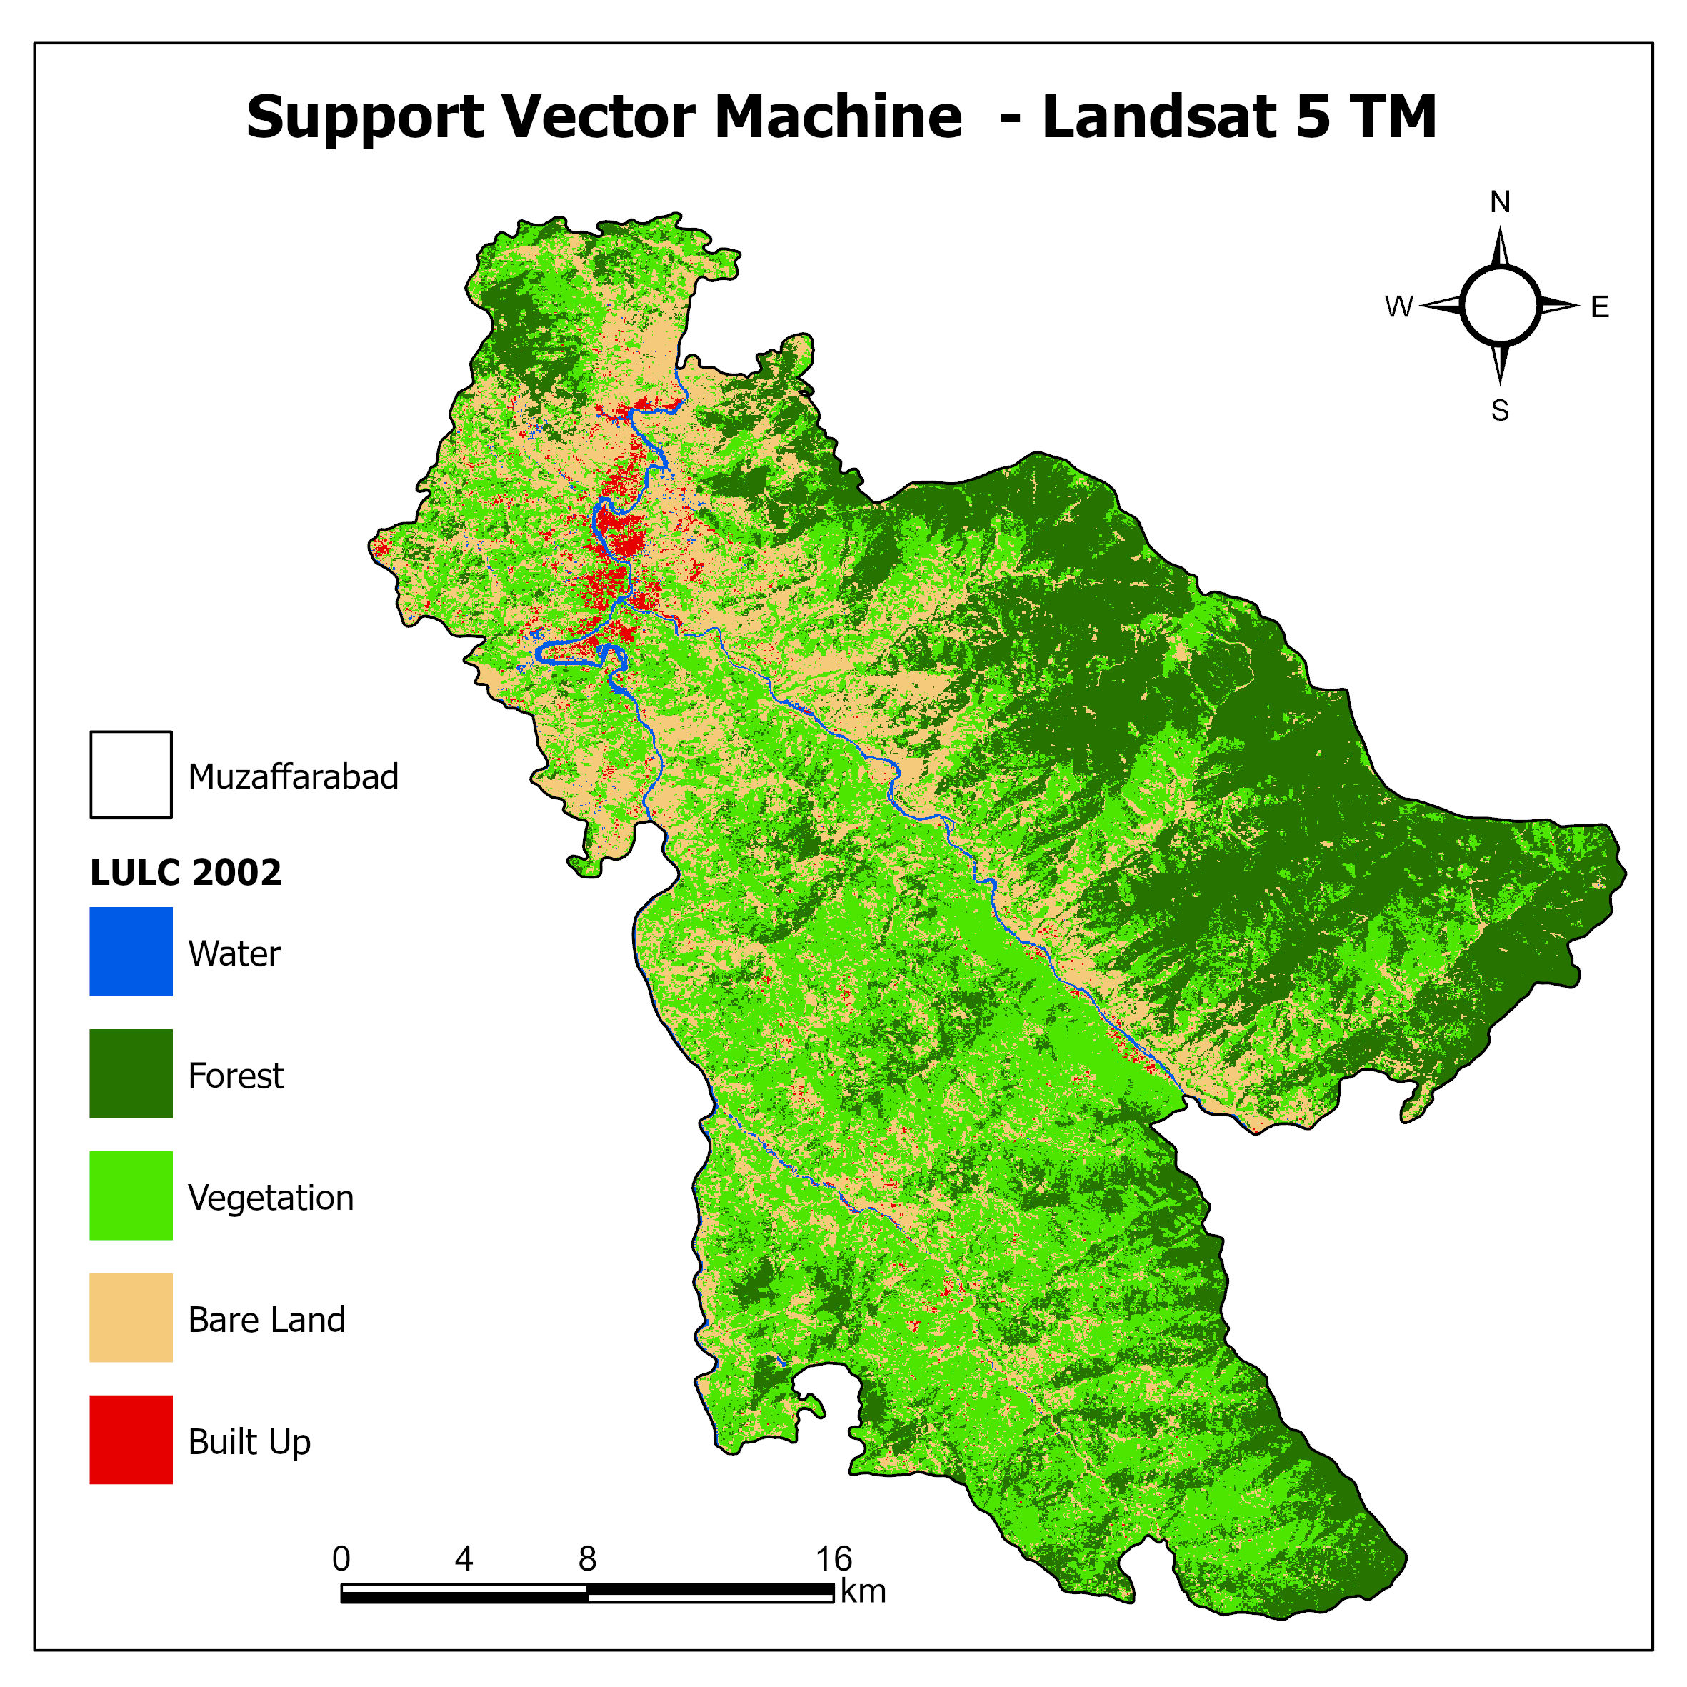
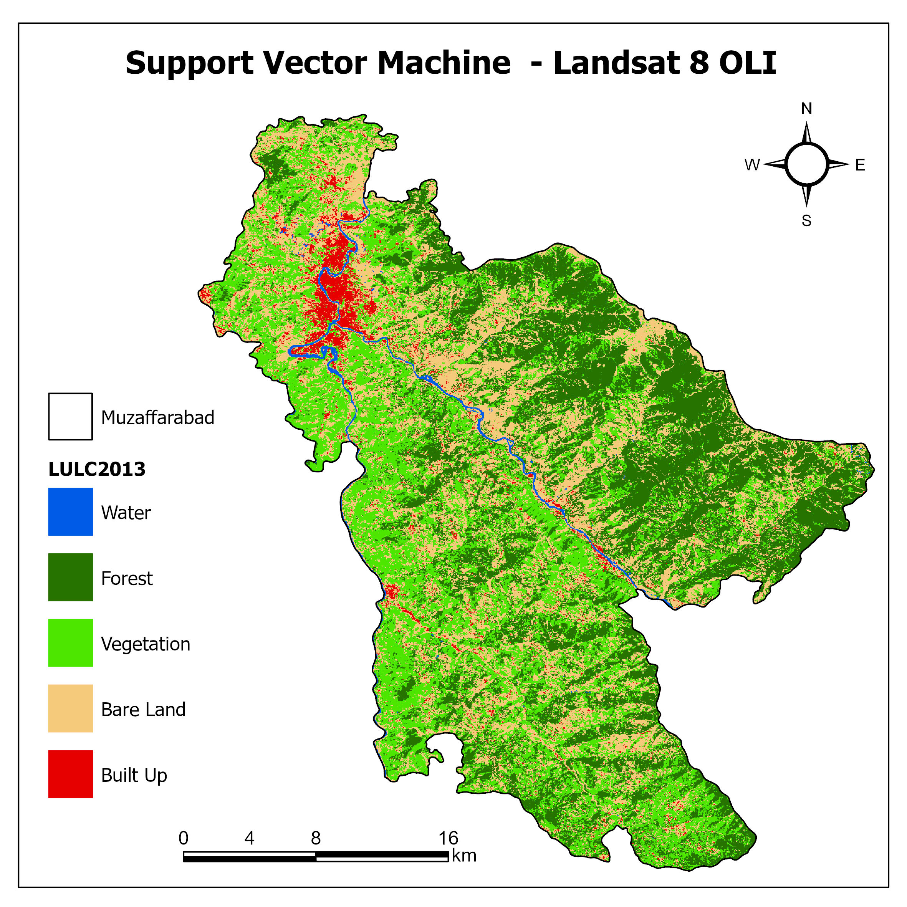
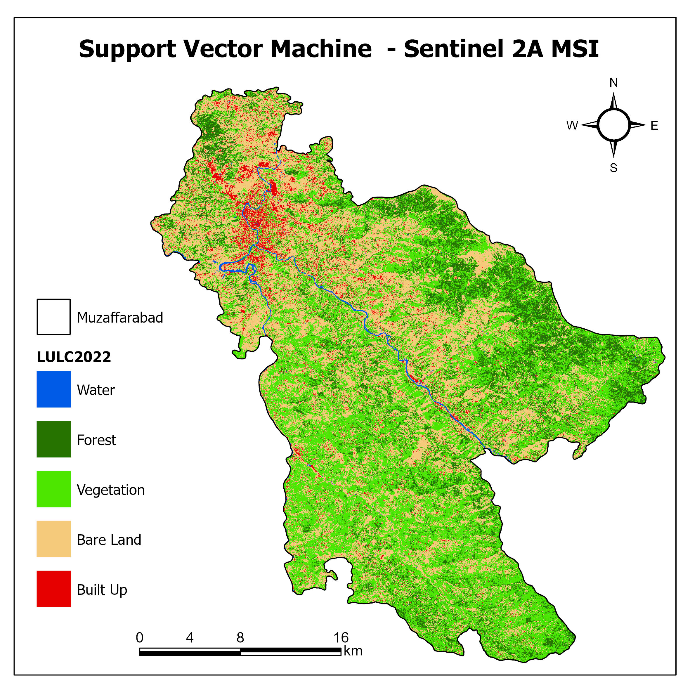
Support Vector Machine
Figure: LULC Classified Images using Support Vector Machine (2002, 2013, 2022)
GEE Code Repository: https://code.earthengine.google.com/?accept_repo=users/ahtshamm214/lulc
Thesis Final Defense: Dec, 2023

Slide 23
Change Detection – Support Vector Machine
LULC | 2002 |  | 2013 |  | 2022
 | Area (Ha) | % | Area (Ha) | % | Area (ha) | %
Water | 631.0872 | 1% | 798.3279 | 1% | 768.51131 | 1%
Forest | 11627.39 | 32% | 23540.07 | 33% | 23621.57246 | 16%
Vegetation | 30069.33 | 42% | 23877.01 | 33% | 30722.60421 | 42%
Bare Land | 26336.06 | 23% | 21186.05 | 30% | 17042.74075 | 37%
Built Up | 3059.419 | 1% | 2401.253 | 3% | 825.587214 | 4%
Total | 71723.2862 | 100% | 71802.7109 | 100% | 72981.01594 | 100%
Thesis Final Defense: Dec, 2023

Slide 24
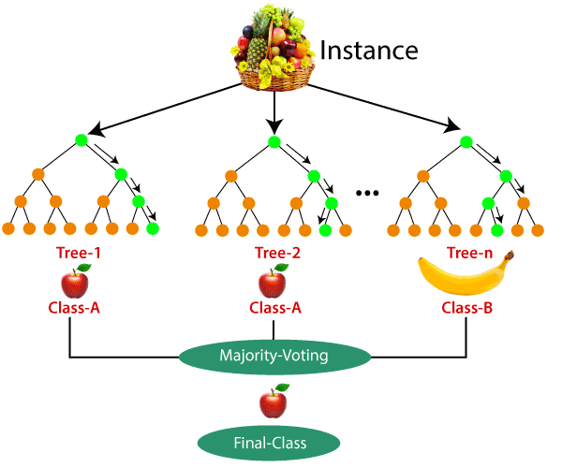
Random Forest Classifier
Random Forest Assumptions:
Actual Data for accurate predictions
Predictions from each tree in the Random Forest should have minimal correlations to improve overall accuracy.
Source: https://www.javatpoint.com/supervised-machine-learning
Thesis Final Defense: Dec, 2023

Slide 25
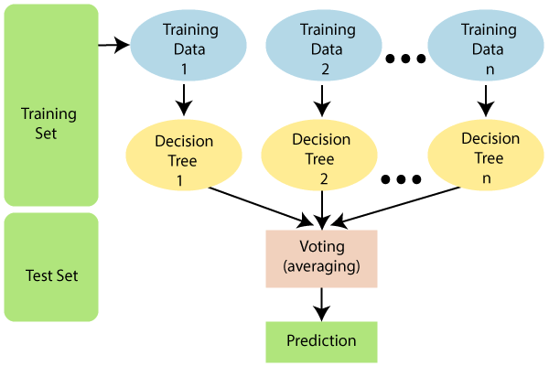
Random Forest Classifier
Advantages of Using Random Forest:
Faster Training Time
Higher accuracy and efficiency for lager datasets
Robust even if missing data values
Source: https://www.javatpoint.com/supervised-machine-learning
Thesis Final Defense: Dec, 2023

Slide 26
Random Forest Classifier
How Random Forest Works:
Selection of Random Data
Build decision trees
Desired Number of Trees
Repeat steps 1 and 2.
Majority Votes for final Prediction
Source: https://www.javatpoint.com/supervised-machine-learning
Thesis Final Defense: Dec, 2023

Slide 27
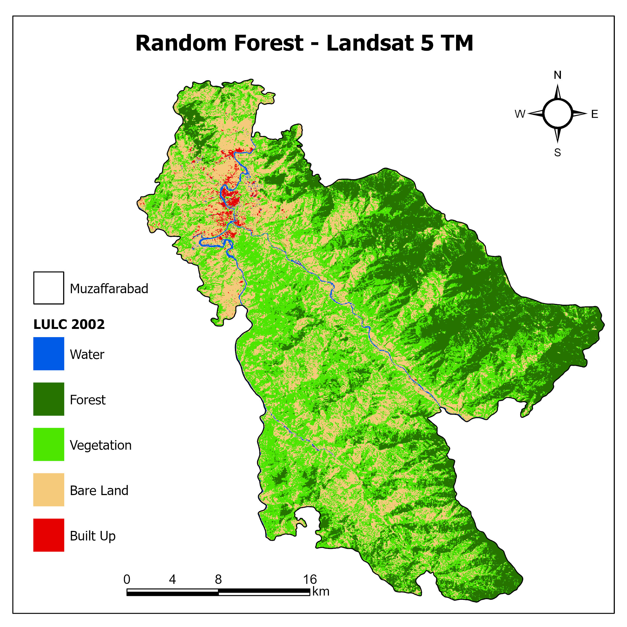
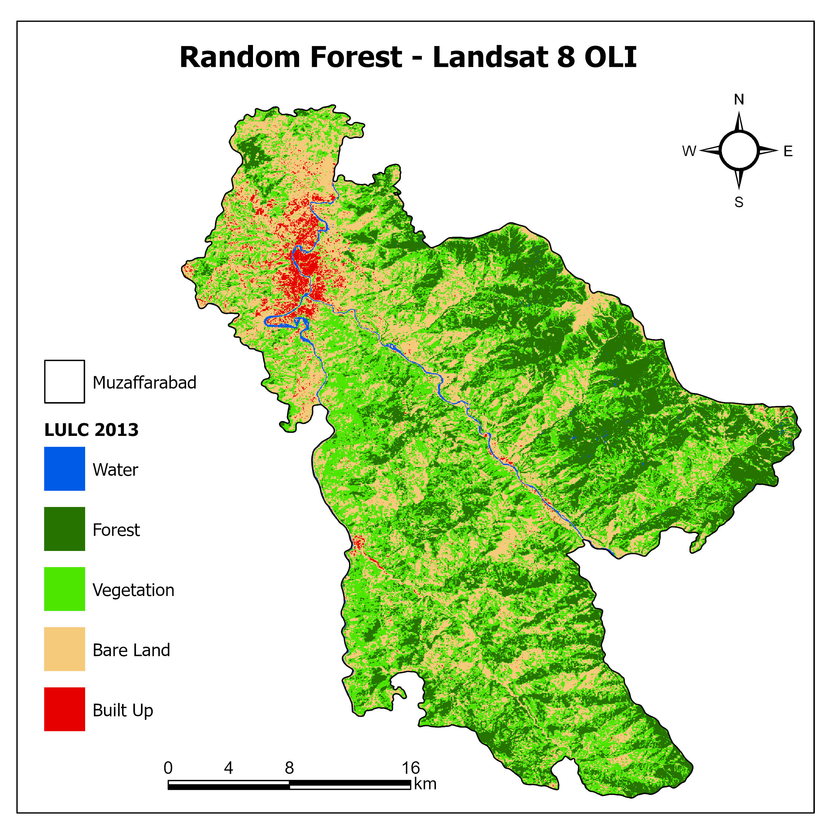
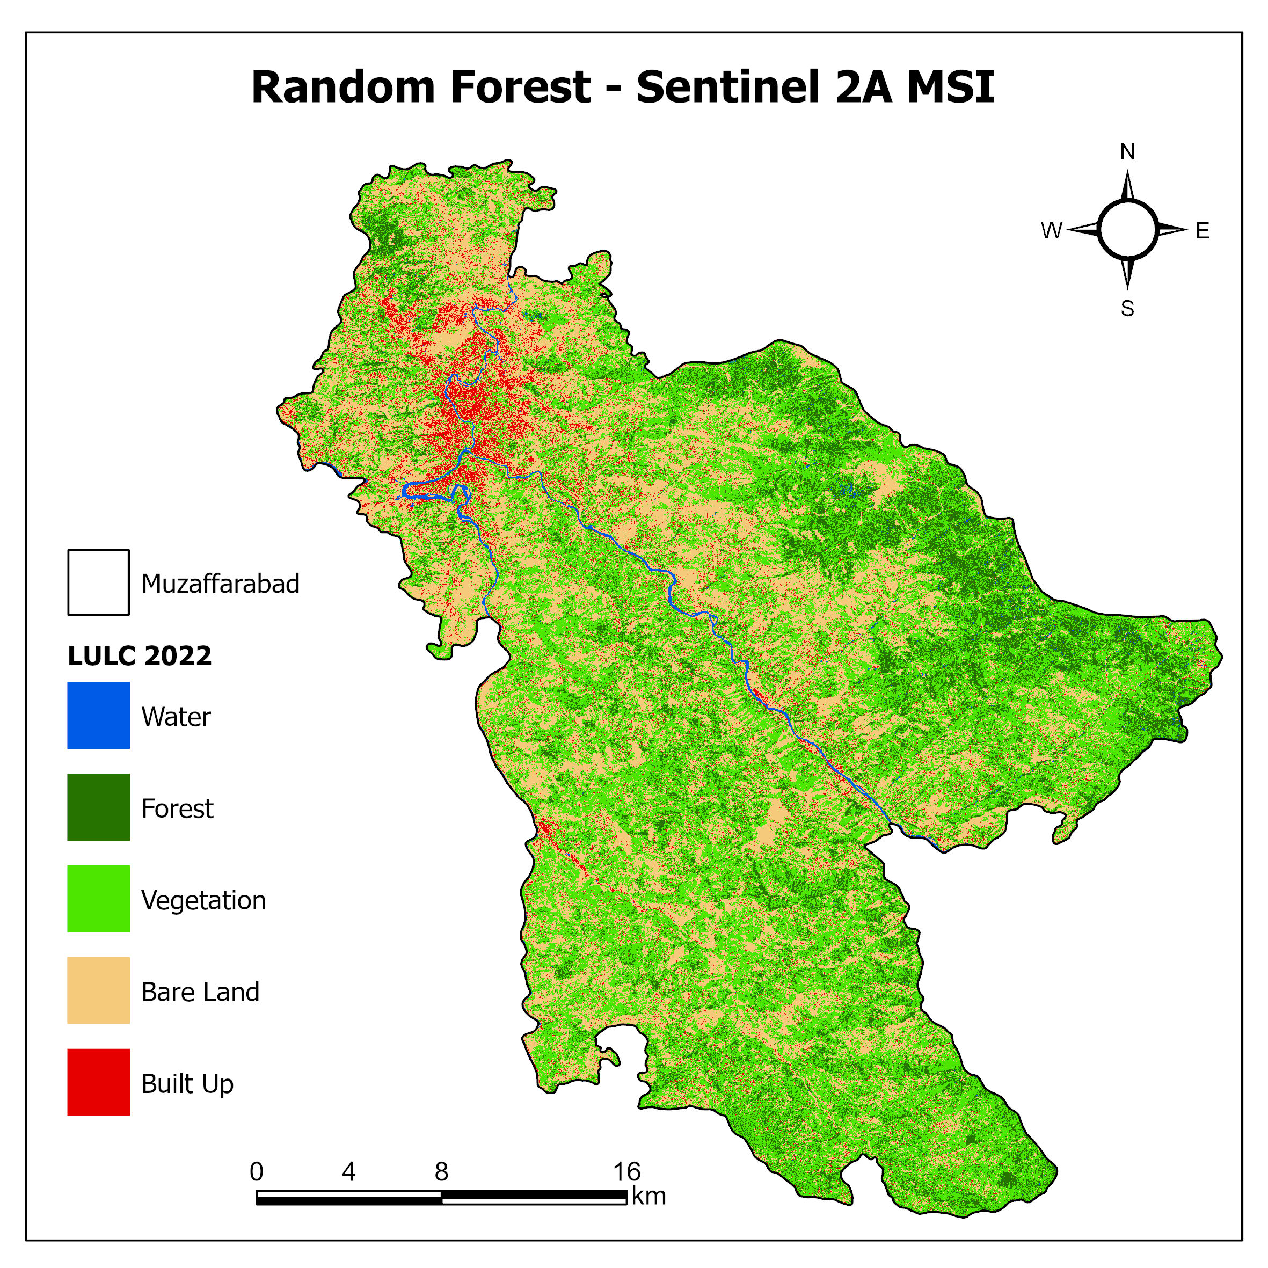
Random Forest
Figure: LULC Classified Images using Random Forest (2002, 2013, 2022)
GEE Code Repository: https://code.earthengine.google.com/?accept_repo=users/ahtshamm214/lulc
Thesis Final Defense: Dec, 2023

Slide 28
Change Detection - Random Forest
LULC | 2002 |  | 2013 |  | 2022
 | Area (Ha) | % | Area (Ha) | % | Area (ha) | %
Water | 687.666 | 1% | 583.1271 | 1% | 684.3123 | 1%
Forest | 19965.8 | 28% | 19756.34 | 28% | 10114.397 | 14%
Vegetation | 30956.7 | 43% | 27607.74 | 38% | 32652.639 | 45%
Bare Land | 19622.6 | 27% | 22292.75 | 31% | 24461.765 | 34%
Built Up | 570.005 | 1% | 1562.757 | 2% | 3810.1752 | 5%
Total | 71802.7 | 100% | 71802.71 | 100% | 71802.709 | 100%
Thesis Final Defense: Dec, 2023

Slide 29
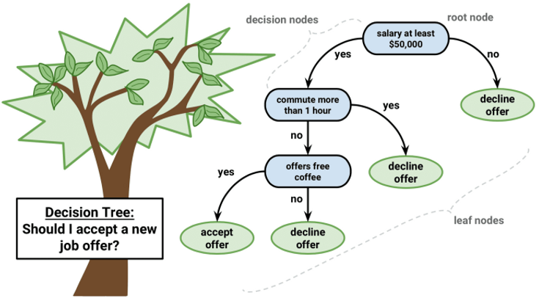
Classification and Regression Trees (CART)
CART (Classification and Regression Trees) is a versatile algorithm that constructs interpretable decision trees for classification and regression tasks, but it may overfit on complex data.
Source: https://www.datainsightonline.com/post/decision-tree-cart-algorithm
Thesis Final Defense: Dec, 2023

Slide 30
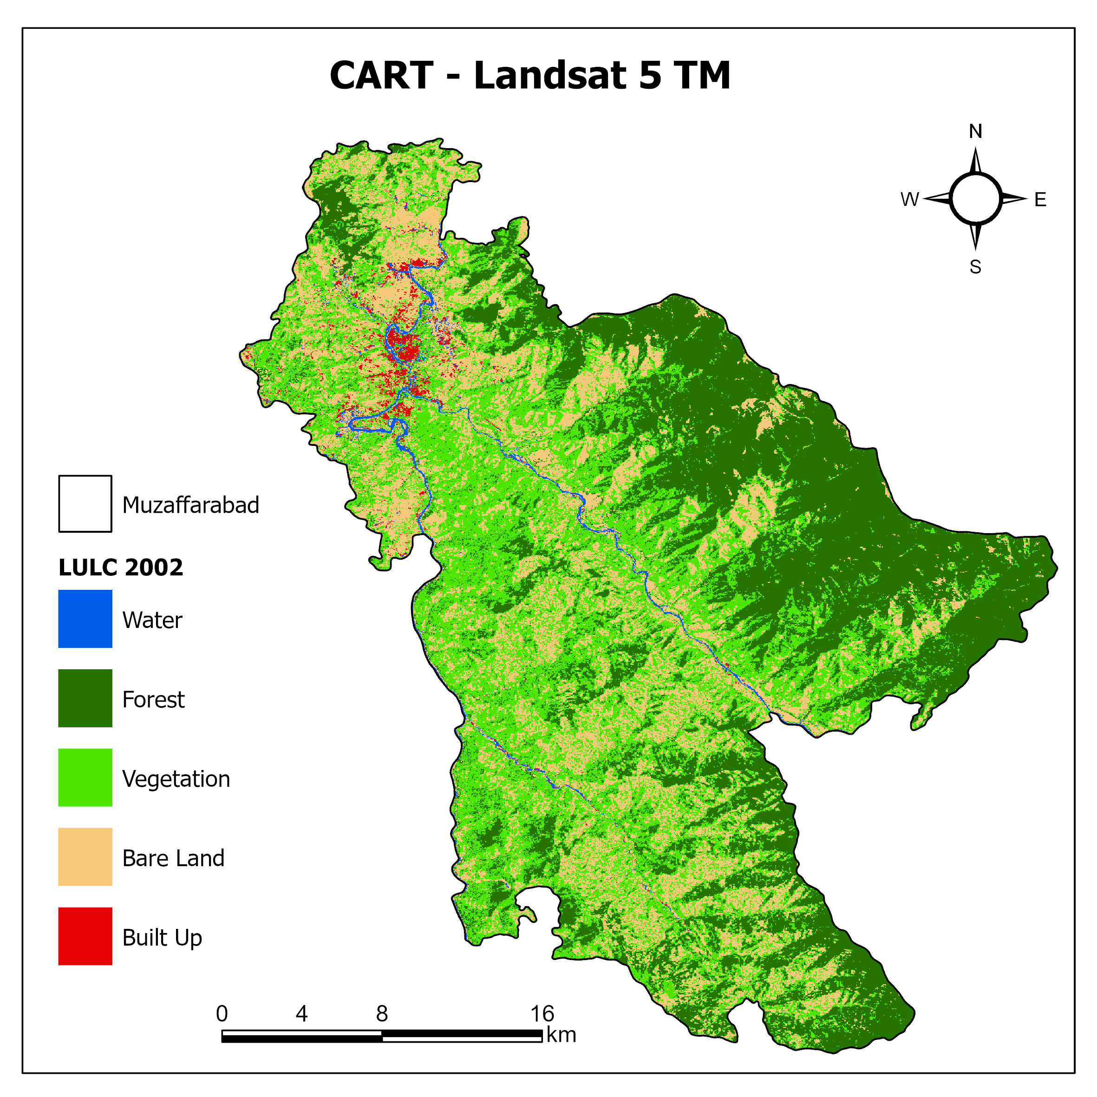
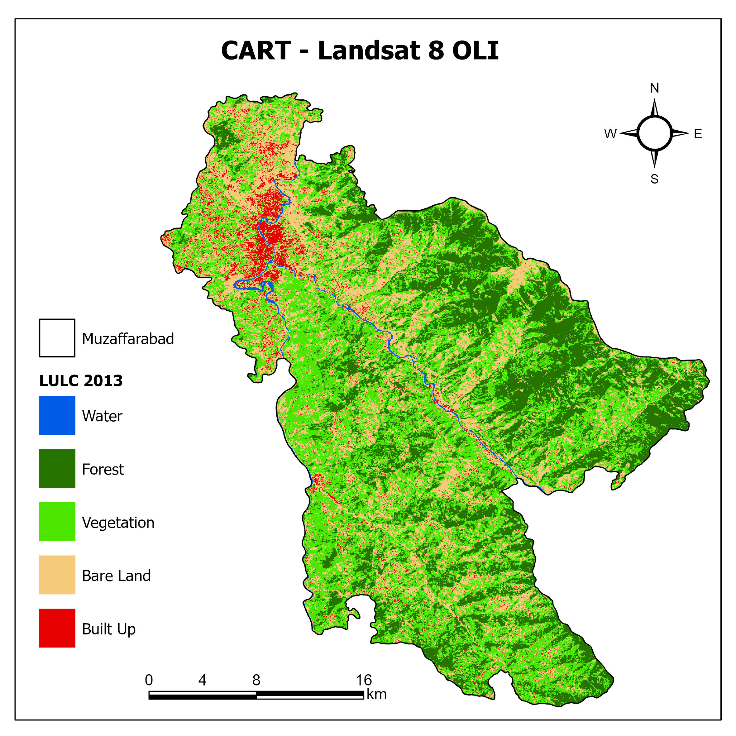

Classification And Regression Tree
Figure: LULC Classified Images using CART (2002, 2013, 2022)
GEE Code Repository: https://code.earthengine.google.com/?accept_repo=users/ahtshamm214/lulc
Thesis Final Defense: Dec, 2023

Slide 31
Change Detection - Classification And Regression Tree
LULC | 2002 |  | 2013 |  | 2022
 | Area (Ha) | % | Area (Ha) | % | Area (Ha) | %
Water | 850.306 | 1% | 590.49 | 1% | 671.239 | 1%
Forest | 24917.2 | 35% | 19733.5 | 27% | 11511.5 | 16%
Vegetation | 27354.6 | 38% | 30714.4 | 43% | 30570.6 | 43%
Bare Land | 17949.8 | 25% | 17991.3 | 25% | 24337 | 34%
Built Up | 730.75 | 1% | 2773.04 | 4% | 4633.04 | 6%
Total | 71802.7 | 100% | 71802.7 | 100% | 71723.3 | 100%
Thesis Final Defense: Dec, 2023

Slide 32
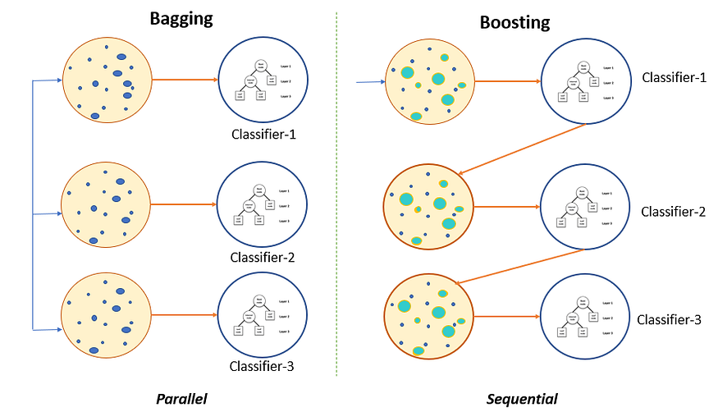
Gradient Tree Boost Classifier
Ensemble learning method that combines the predictions of multiple decision trees to create a more accurate and robust predictive model.
Bagging – Majority Voting
Boosting – Weak Start and then improvement on each iteration
Loss function
Source: https://medium.com/swlh/gradient-boosting-trees-for-classification-a-beginners-guide-596b594a14ea
Thesis Final Defense: Dec, 2023

Slide 33
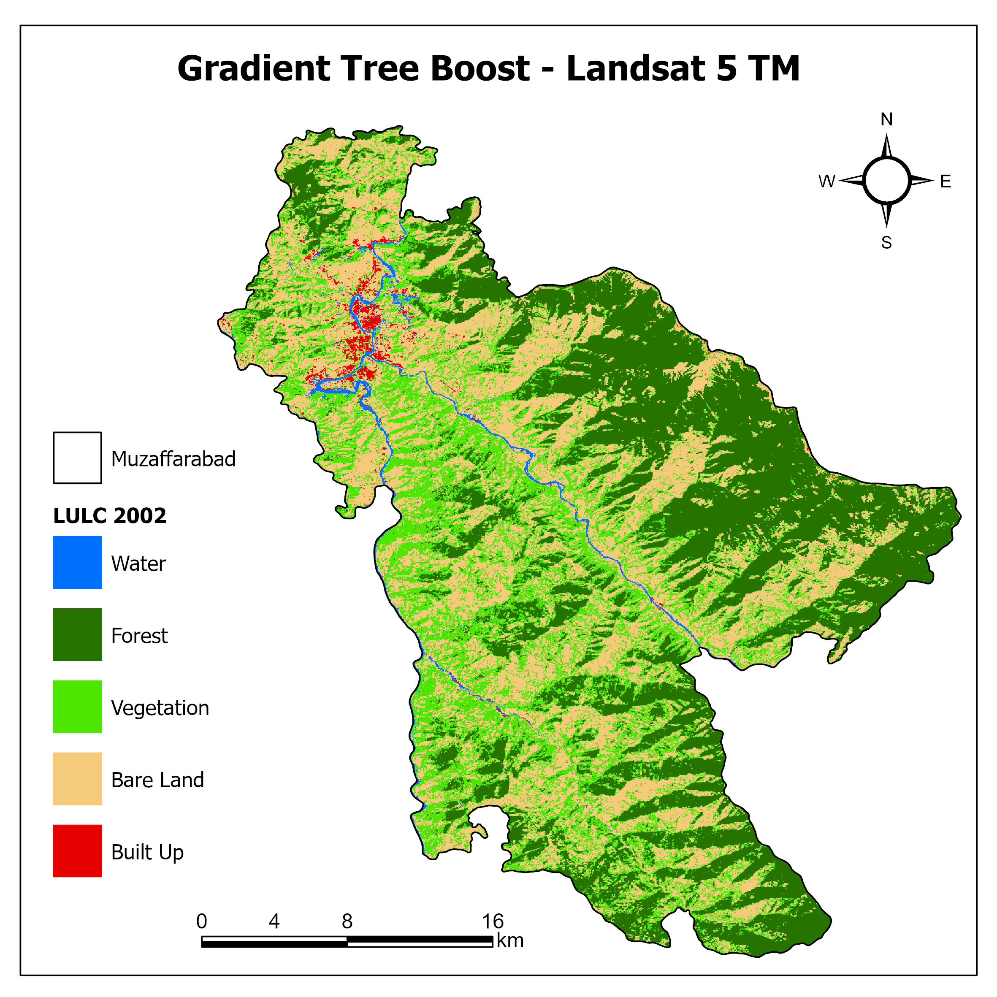


Gradient Tree Boost
Figure: LULC Classified Images using Gradient Tree Boost (2002, 2013, 2022)
GEE Code Repository: https://code.earthengine.google.com/?accept_repo=users/ahtshamm214/lulc
Thesis Final Defense: Dec, 2023

Slide 34
Change Detection - Gradient Tree Boost
LULC | 2002 |  | 2013 |  | 2022
 | Area (Ha) | % | Area (Ha) | % | Area (ha) | %
Water | 946.6794 | 1% | 524.2239 | 1% | 665.8119 | 1%
Forest | 24965.55 | 35% | 19735.78 | 27% | 10240.13 | 14%
Vegetation | 19572.48 | 27% | 32532.57 | 45% | 30199.34 | 42%
Bare Land | 25673.85 | 36% | 17437.32 | 24% | 27829.32 | 39%
Built Up | 644.1444 | 1% | 1572.818 | 2% | 2788.684 | 4%
Total | 71802.71 | 100% | 71802.71 | 100% | 71723.29 | 100%
Thesis Final Defense: Dec, 2023

Slide 35
Accuracy Assessment
Year​ | Data​ | Landsat 5 TM/8 OLI | Source​ | Sentinel 2A MSI | Date of Acquisition
2002 | SVM RF CART GTB | Accuracy % Kappa Coefficient |  | Accuracy % Kappa Coefficient
2002 | SVM RF CART GTB | 84 82 81 76 | 0.79 0.76 0.75 0.72
2013 | SVM RF CART GTB | 83 81 79 78 | 0.78 0.75 0.74 0.74
2022 | SVM RF CART GTB |  |  | 83 85 84 76 | 0.78 0.75 0.79 0.72
Table showing Accuracy & Kappa Coefficient of Four Machine Learning Classifiers
Thesis Final Defense: Dec, 2023

Slide 36
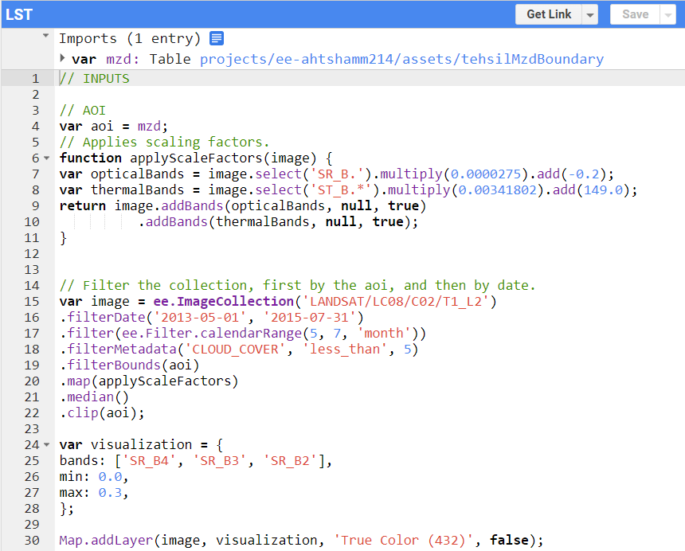
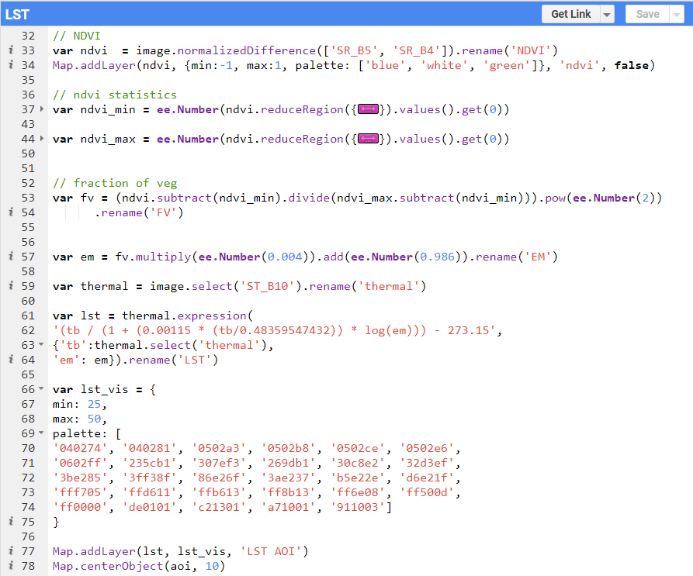
Land Surface Temperature Calculation
a. Image filtering, scaling and visualization
b. Land surface temperature calculation
Thesis Final Defense: Dec, 2023

Slide 37
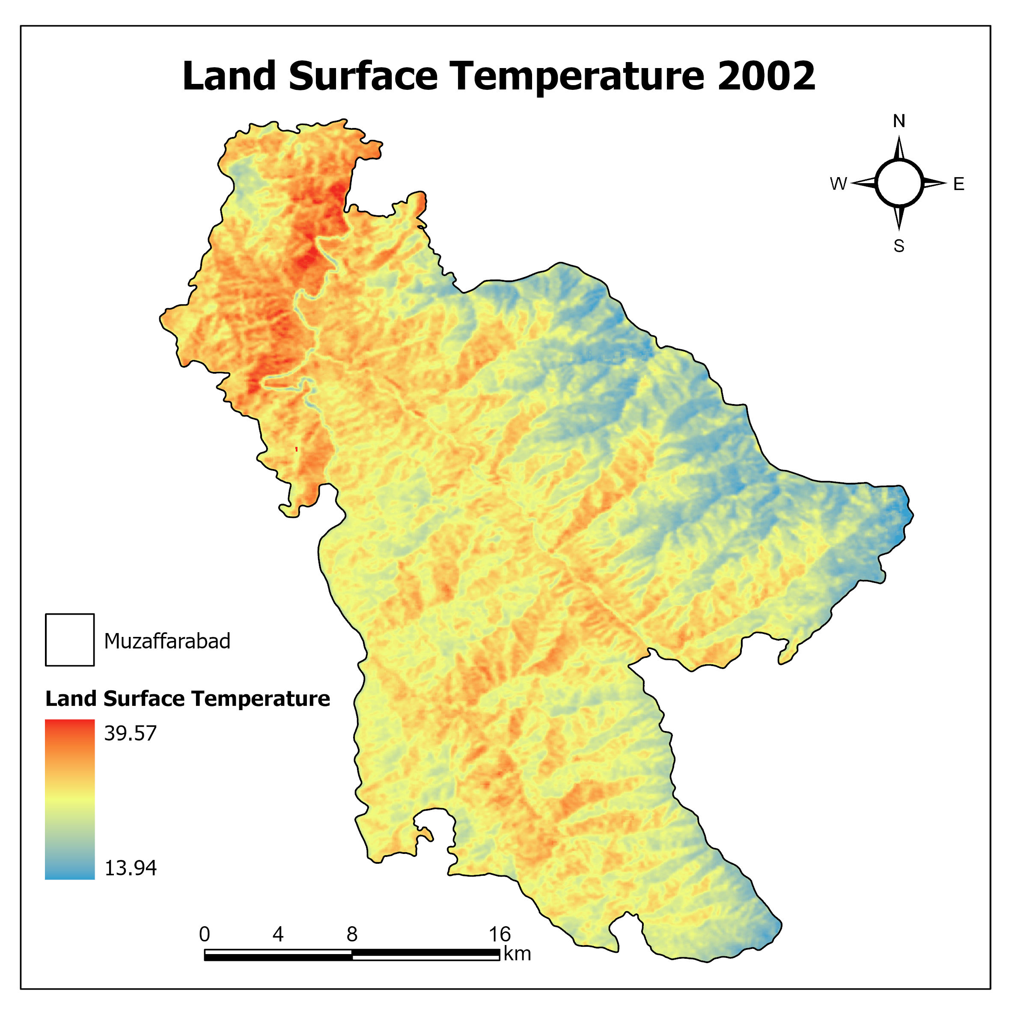
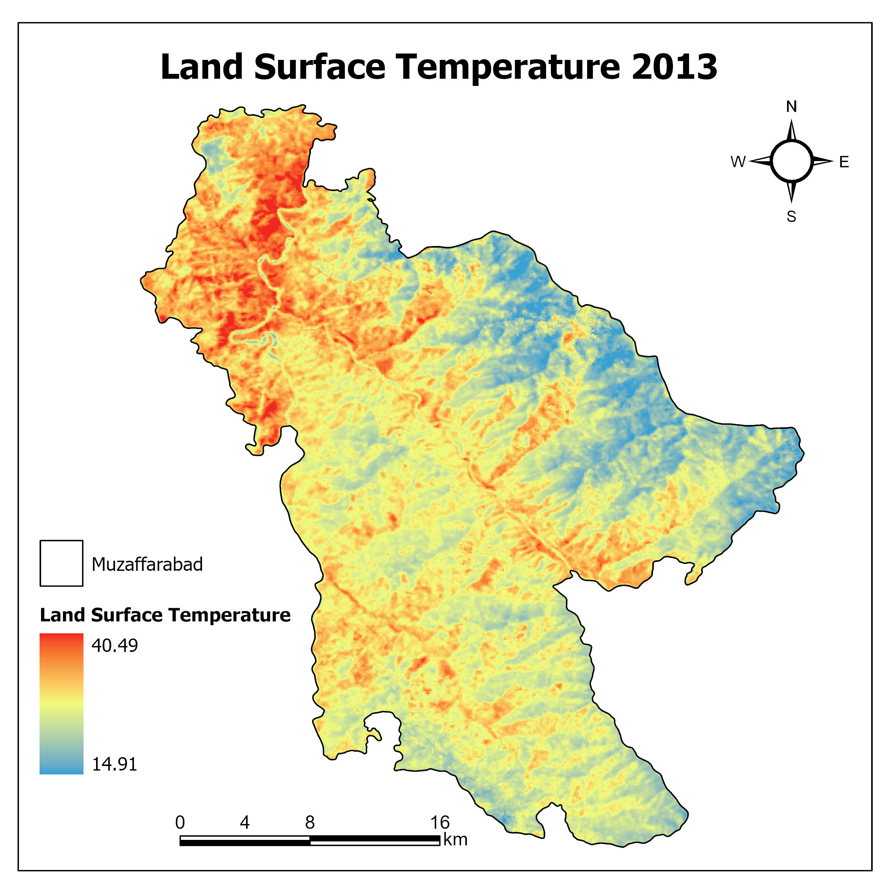
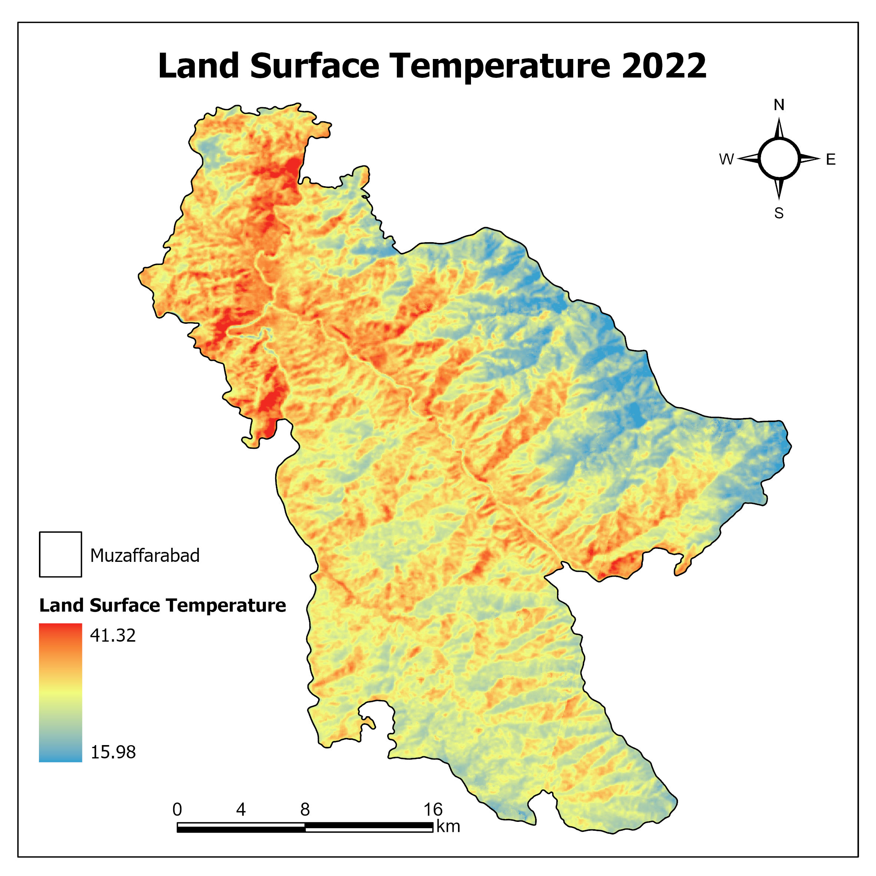
Land Surface Temperature – 2002, 2013, 2022
GEE Code Repository: https://code.earthengine.google.com/59665e53d76529fb4b89234f76b1d2d7
Thesis Final Defense: Dec, 2023

Slide 38
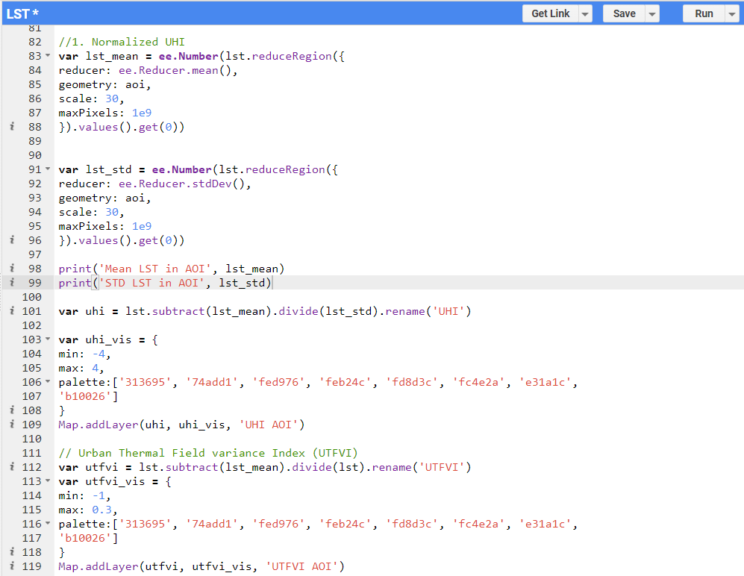
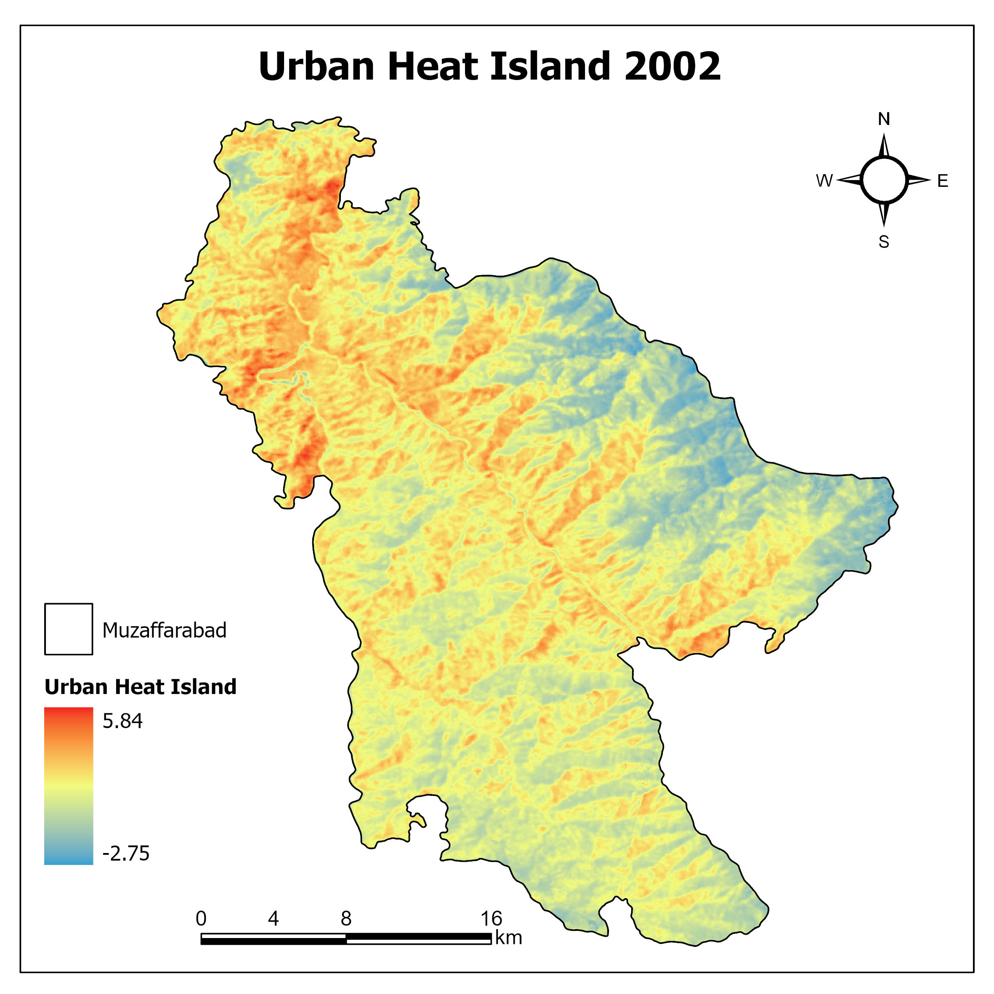
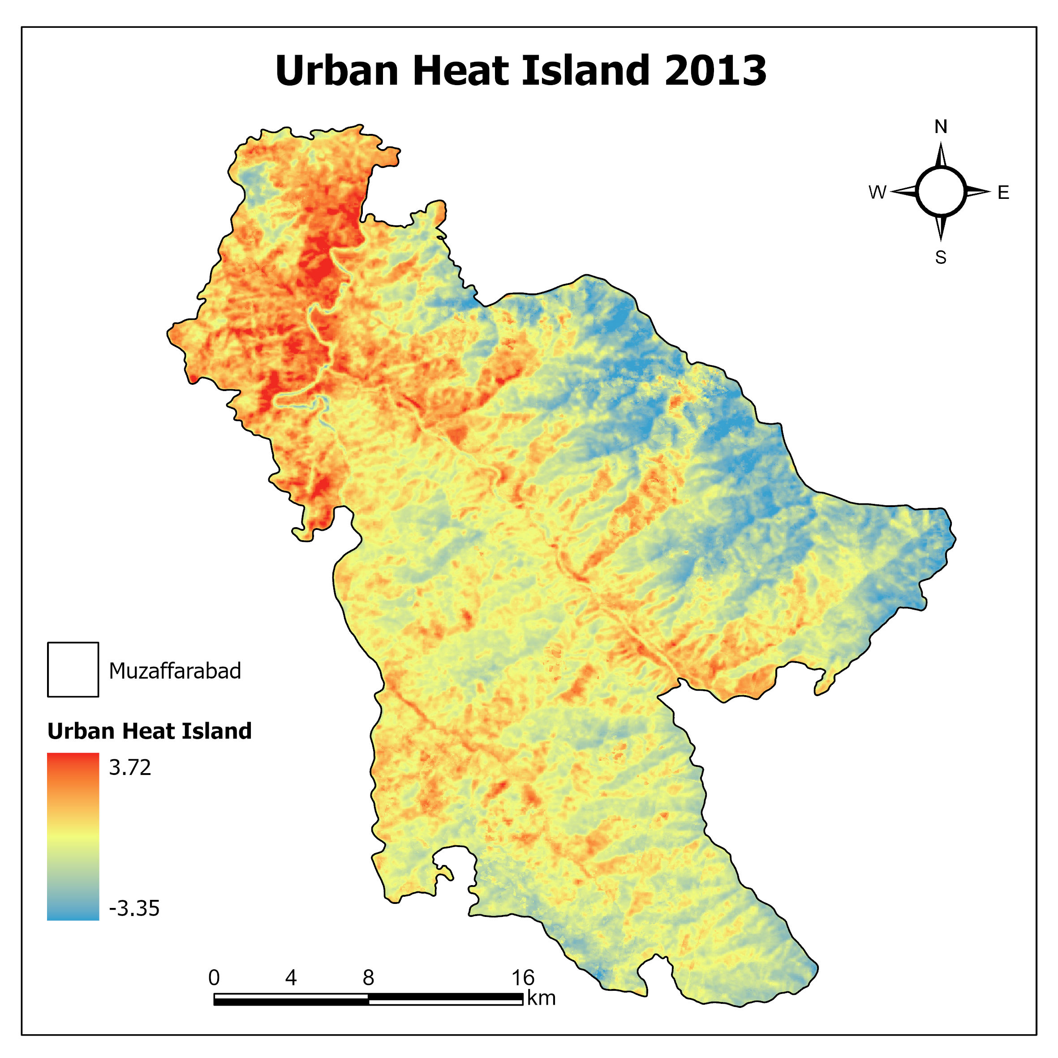
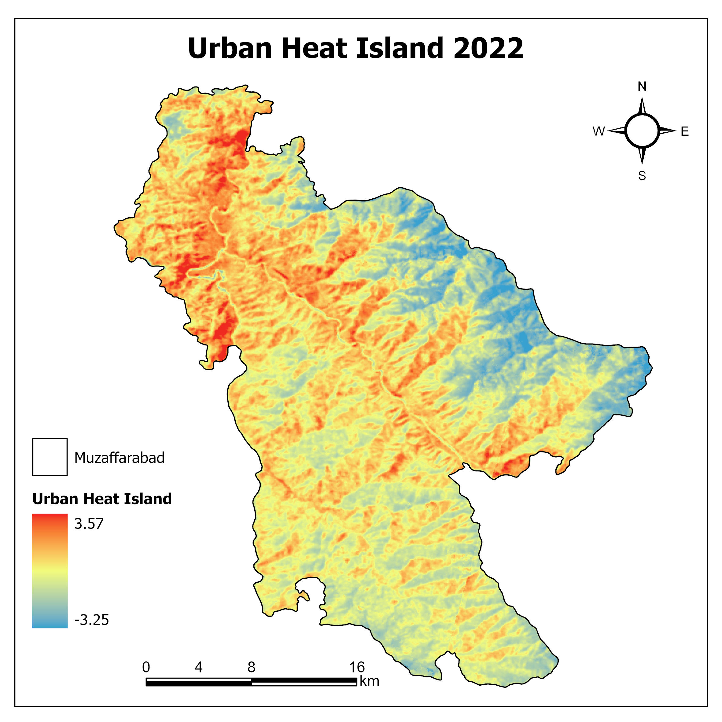
Urban Heat Island
c. Urban Heat Island and Urban Thermal Field Variance Index Extraction from LST
Thesis Final Defense: Dec, 2023

Slide 39
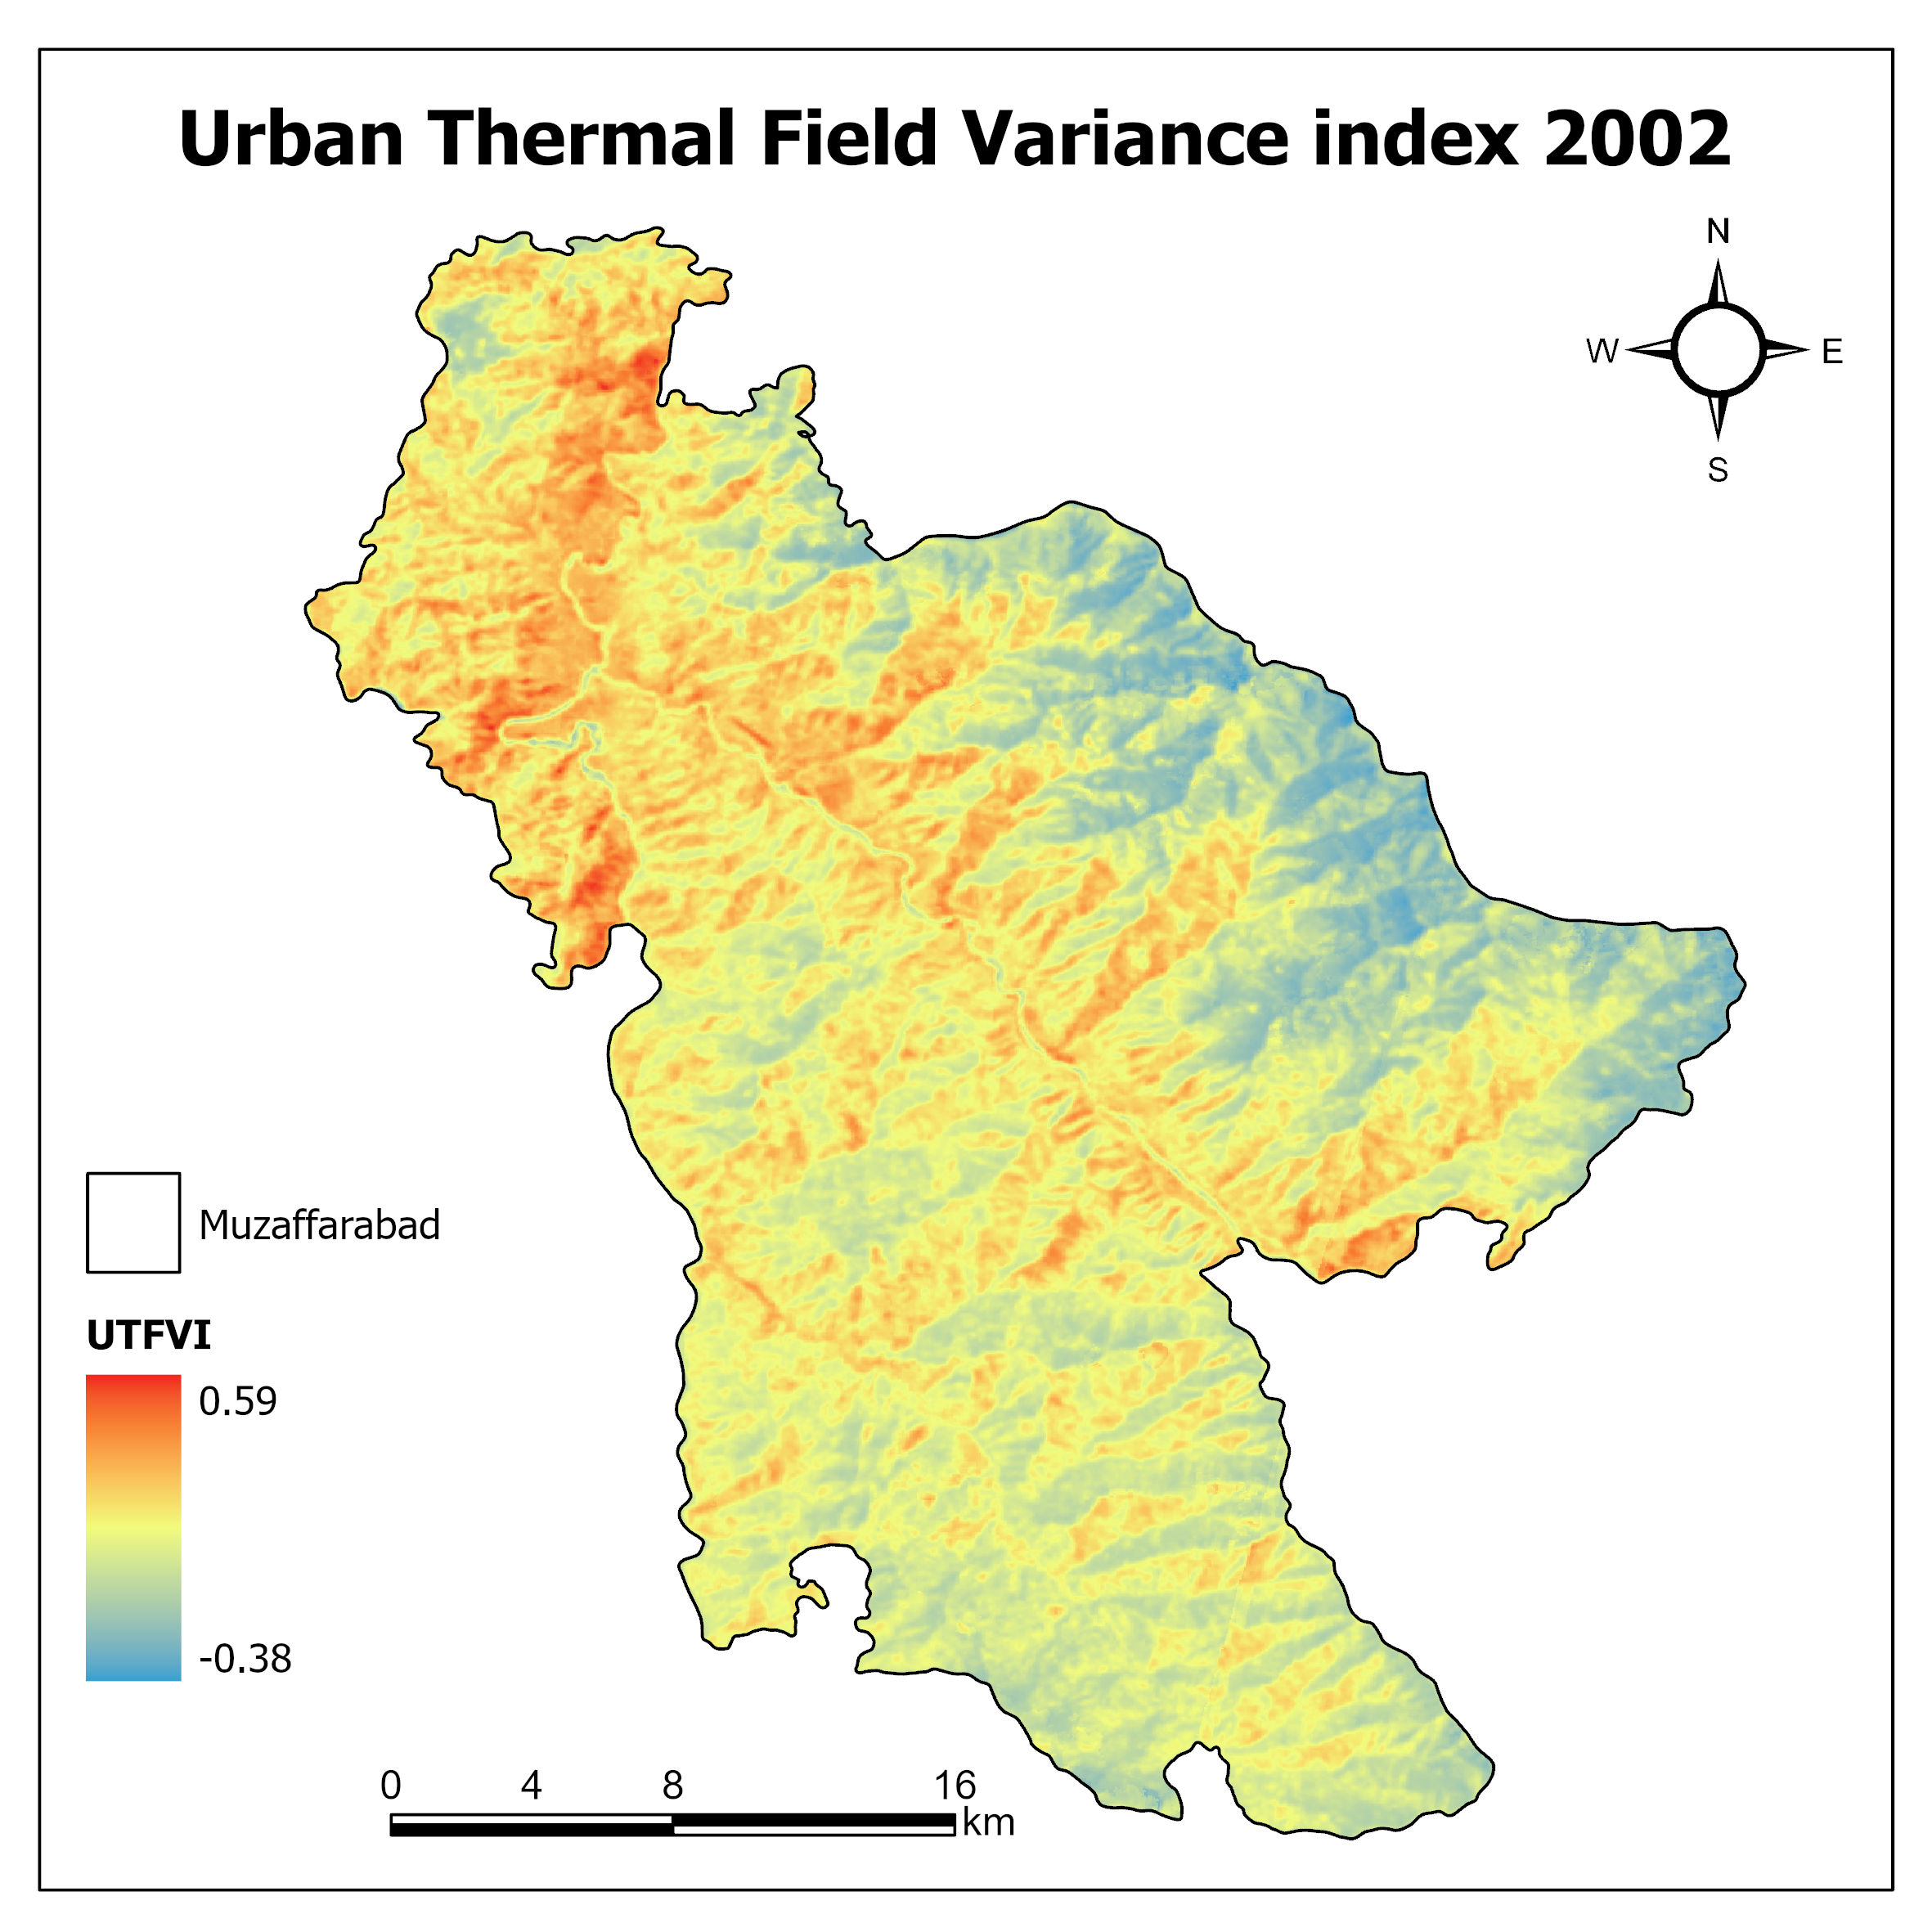
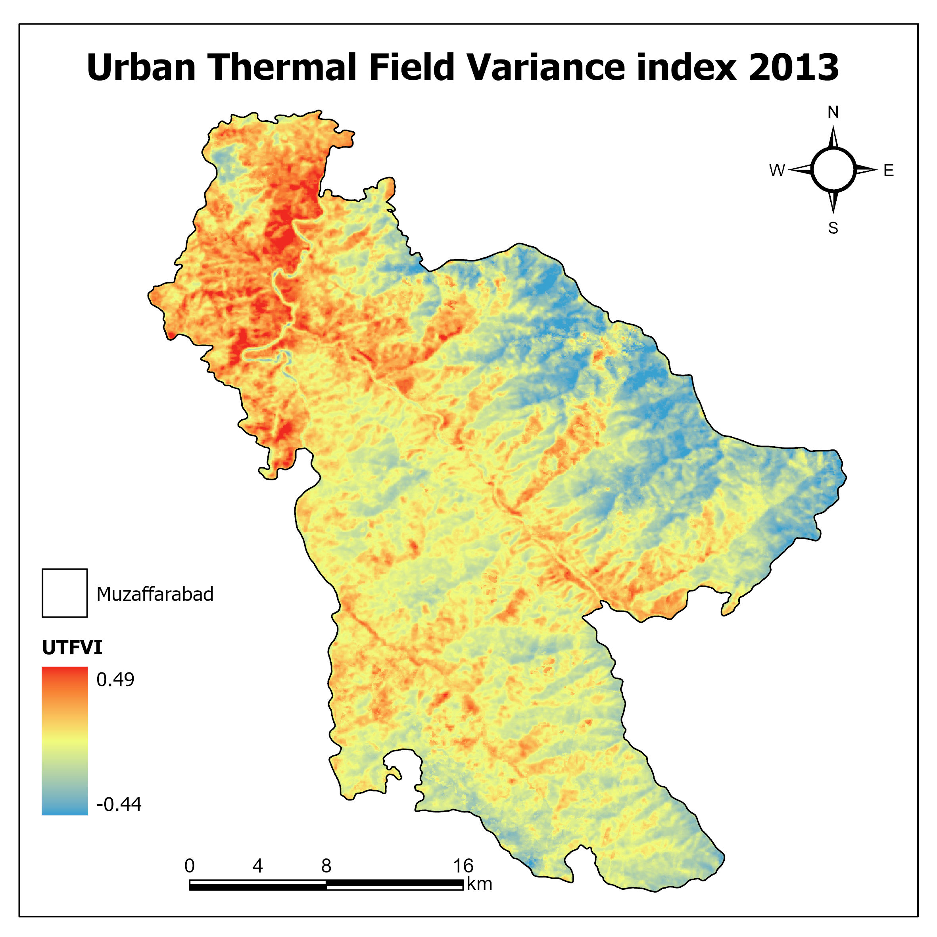
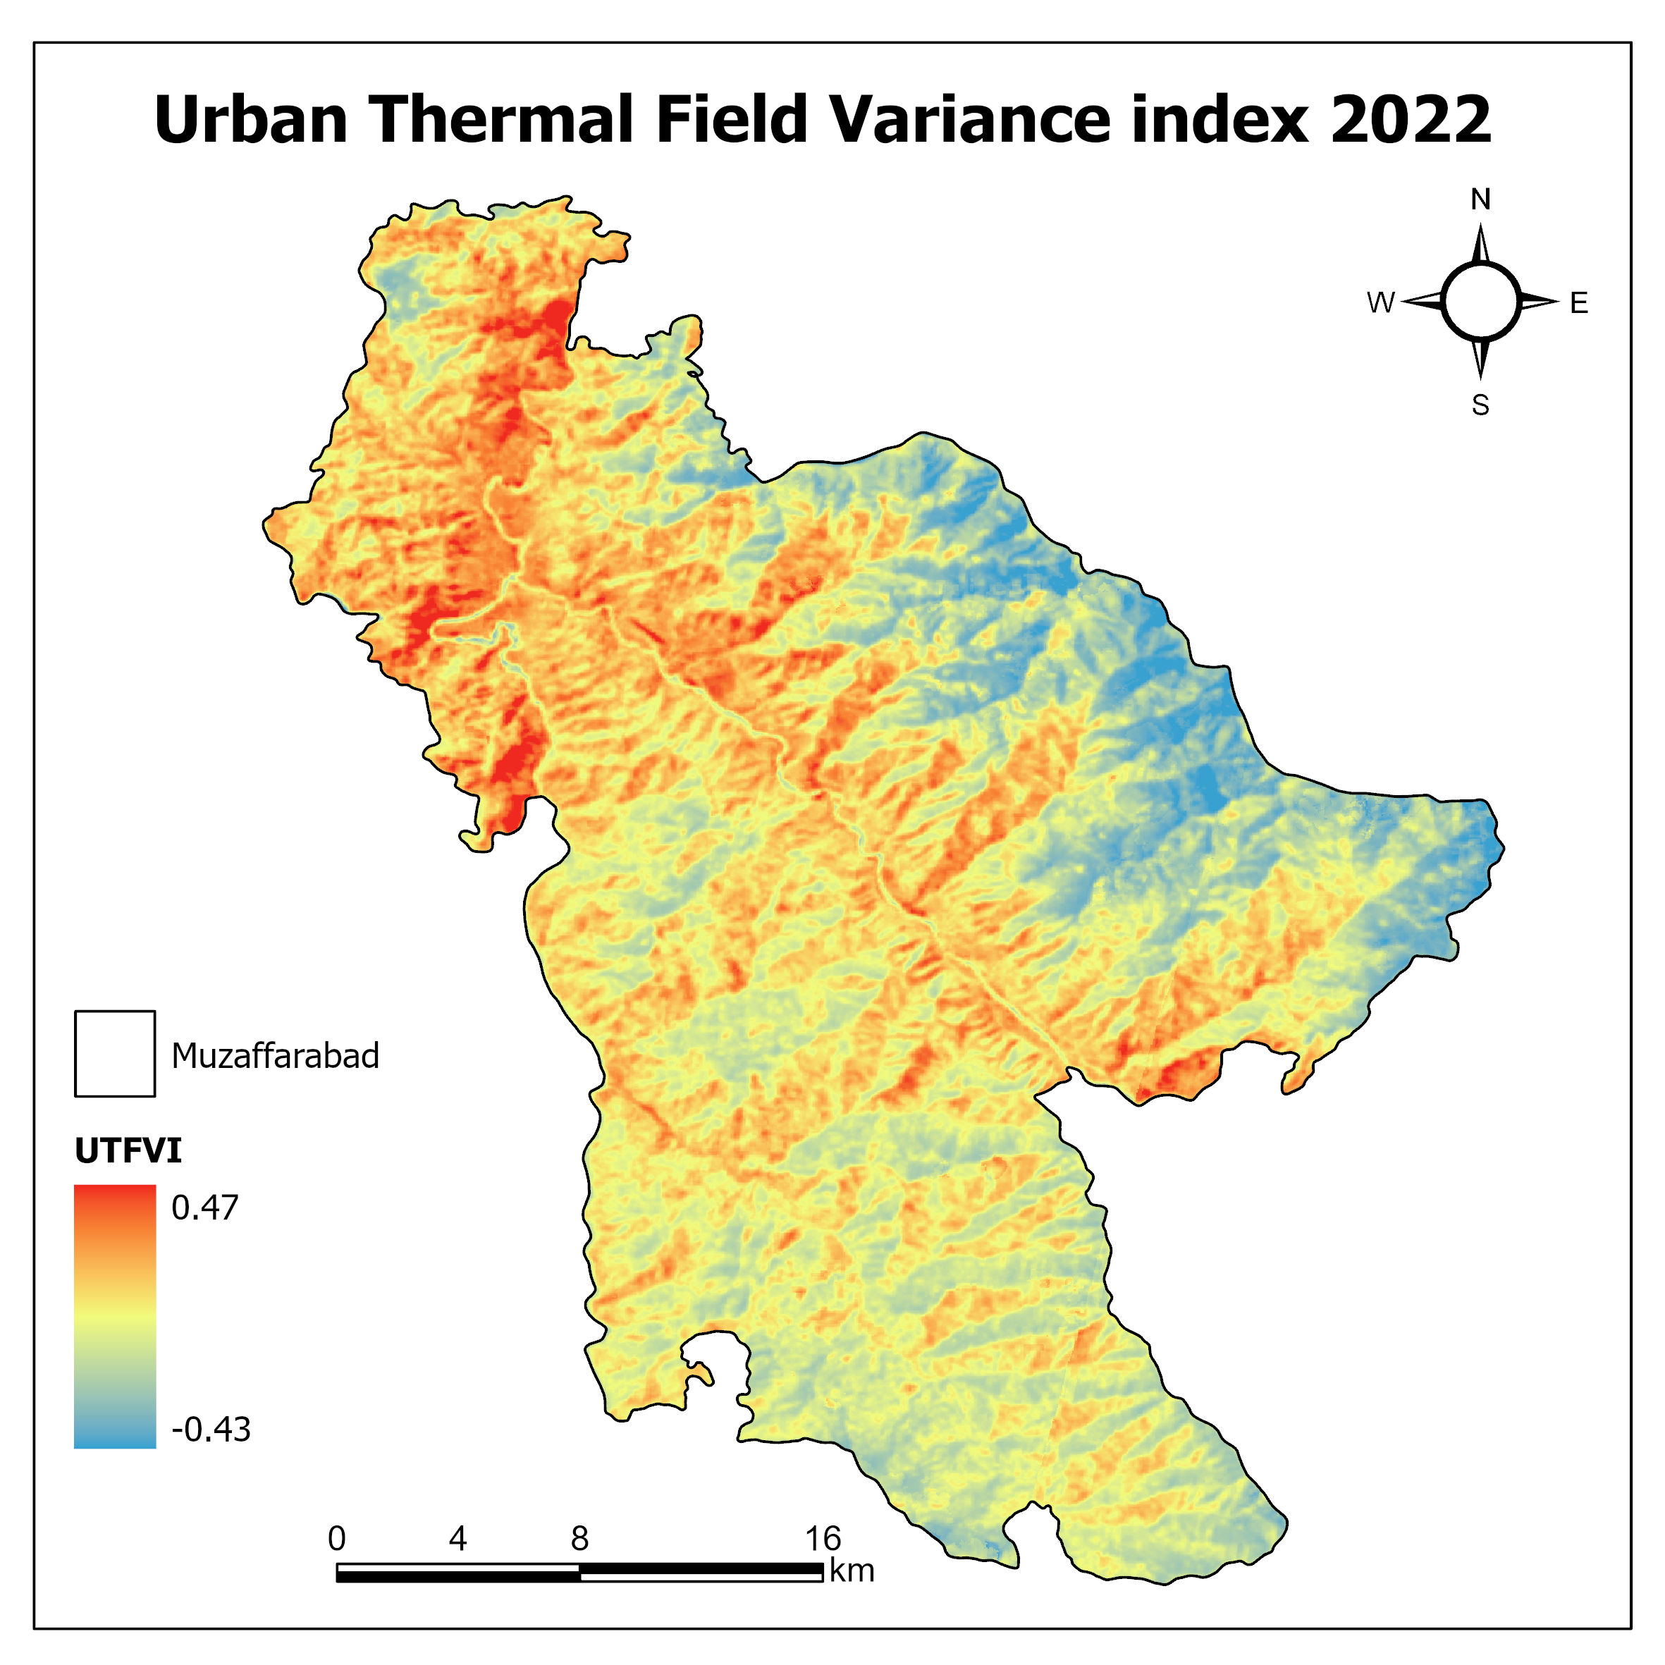
Urban Thermal Field Variance Index
GEE Code Repository: https://code.earthengine.google.com/59665e53d76529fb4b89234f76b1d2d7
Thesis Final Defense: Dec, 2023

Slide 40
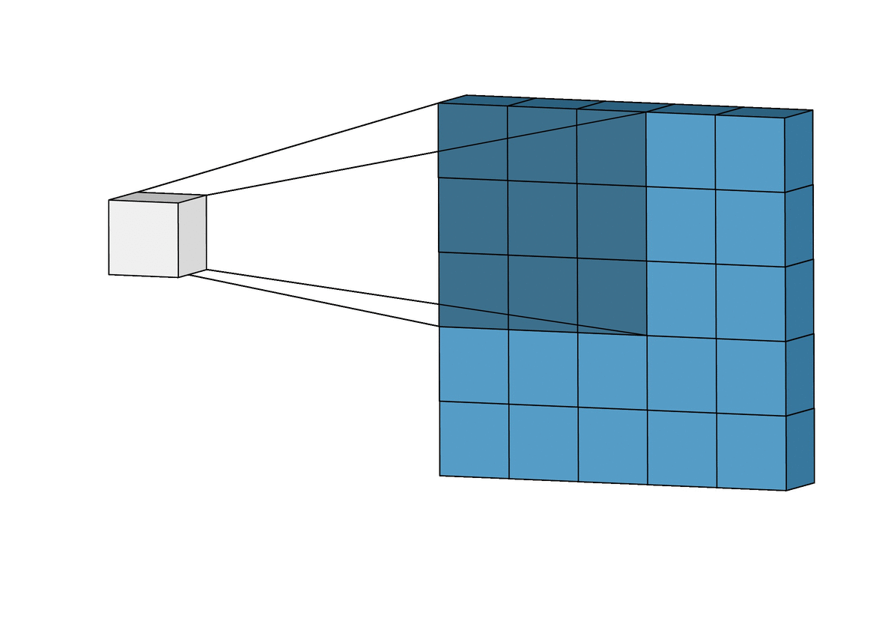
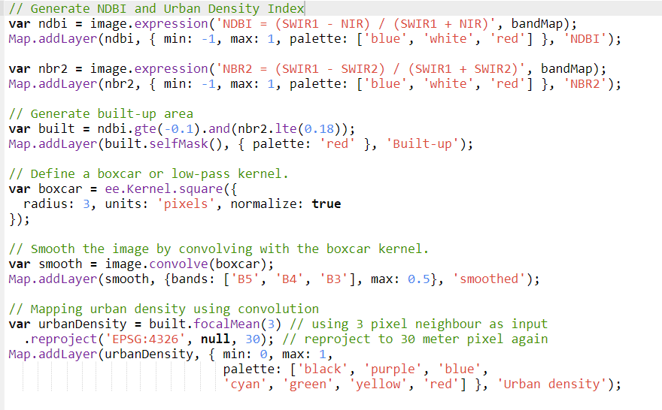
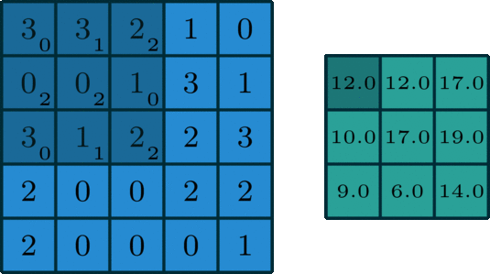
Convolution in Google Earth Engine
Source: https://towardsdatascience.com/intuitively-understanding-convolutions-for-deep-learning-1f6f42faee1
Thesis Final Defense: Dec, 2023

Slide 41
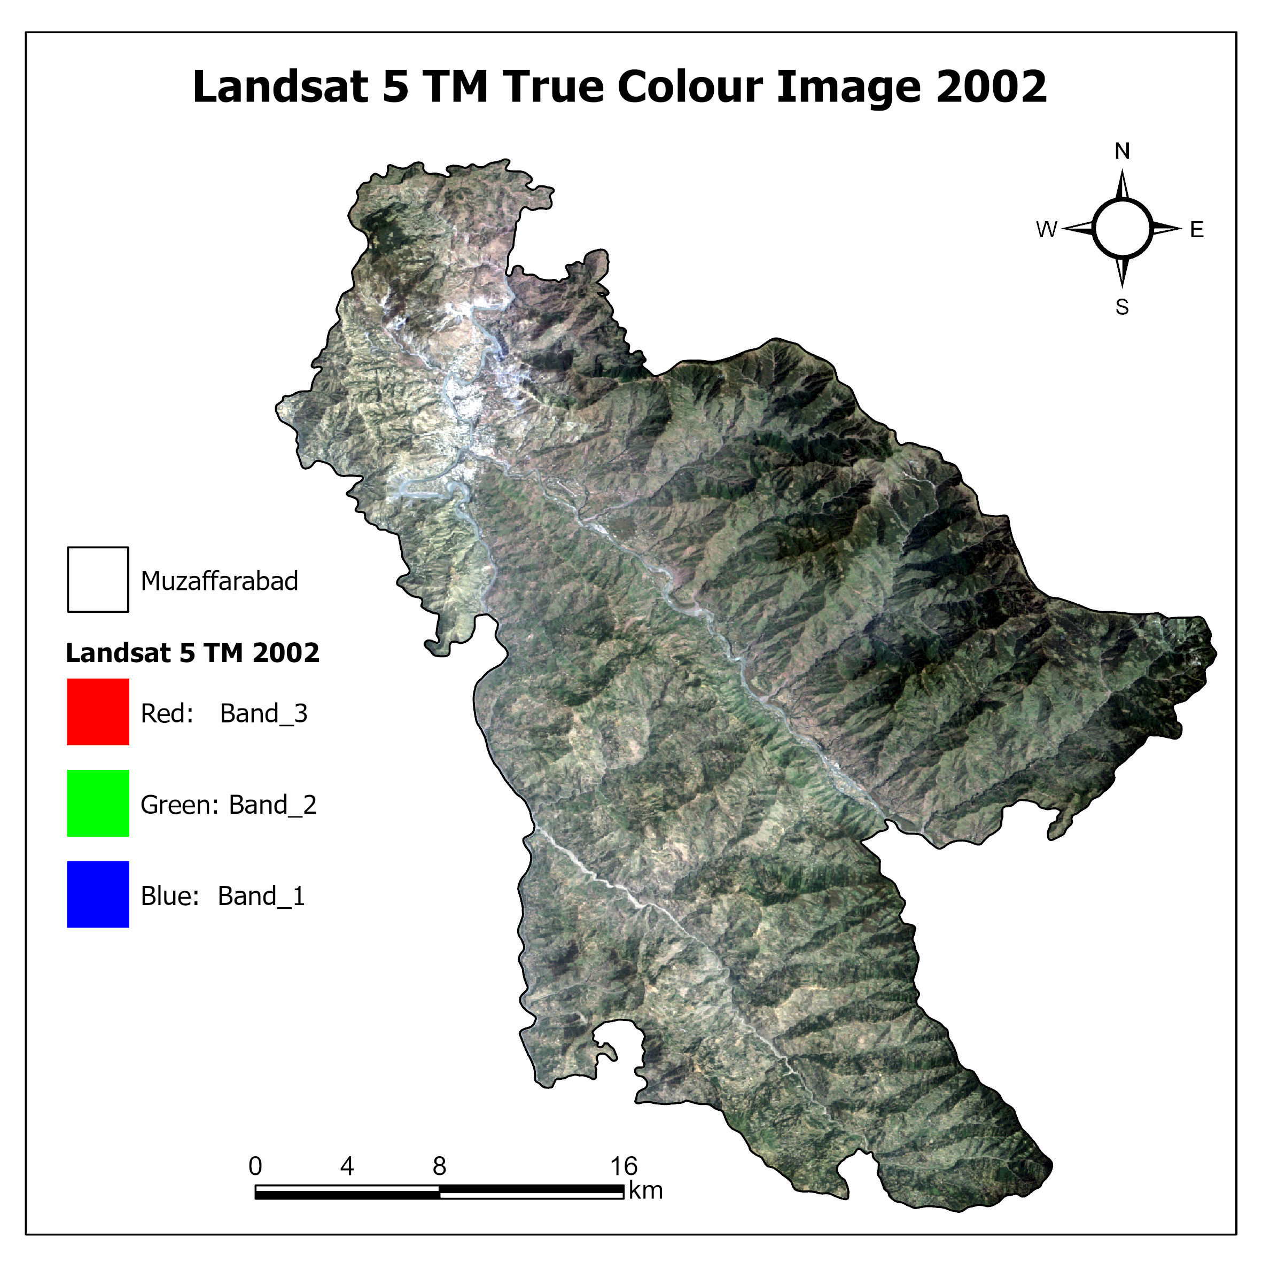
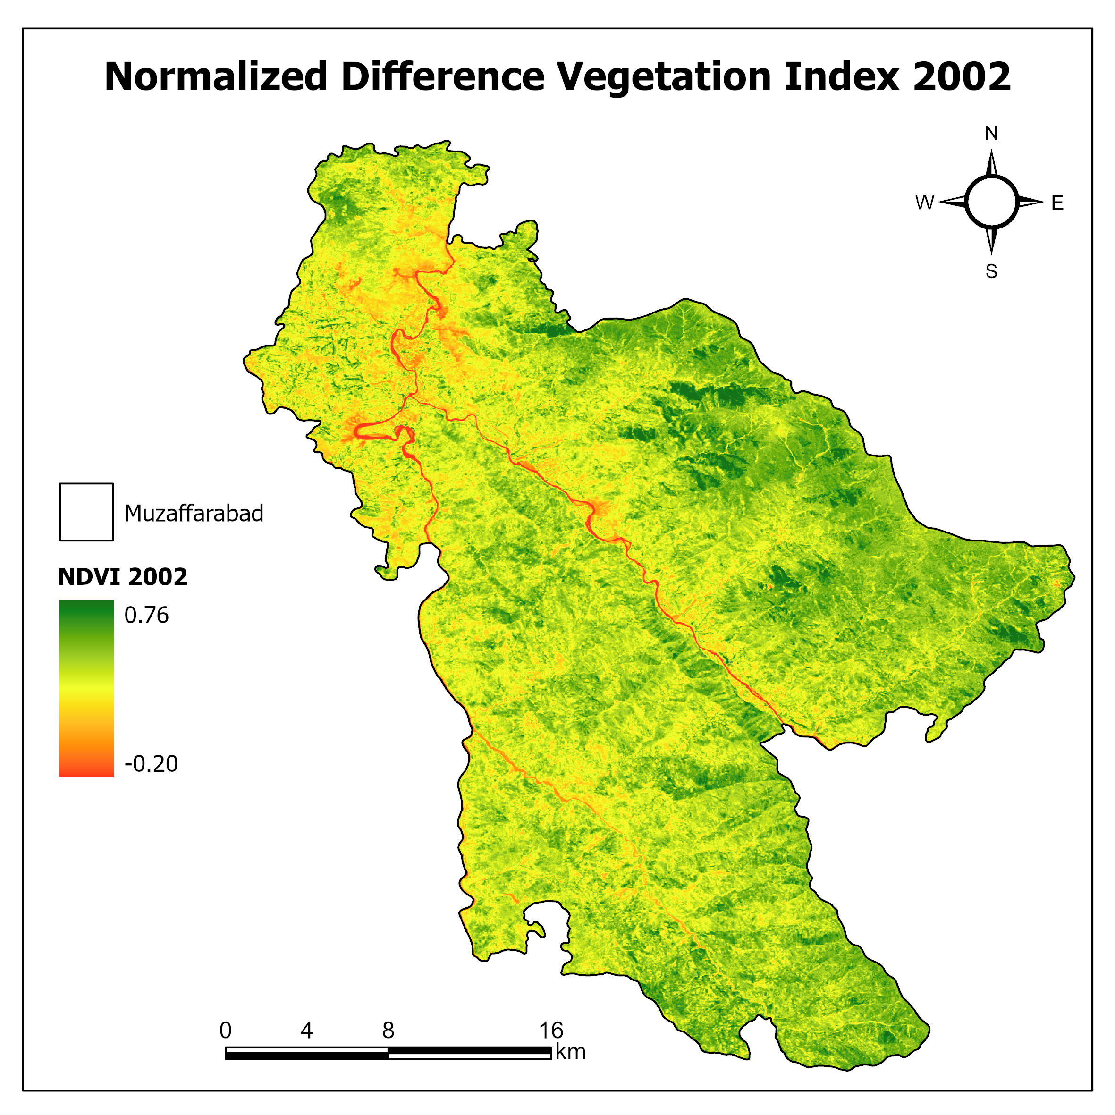
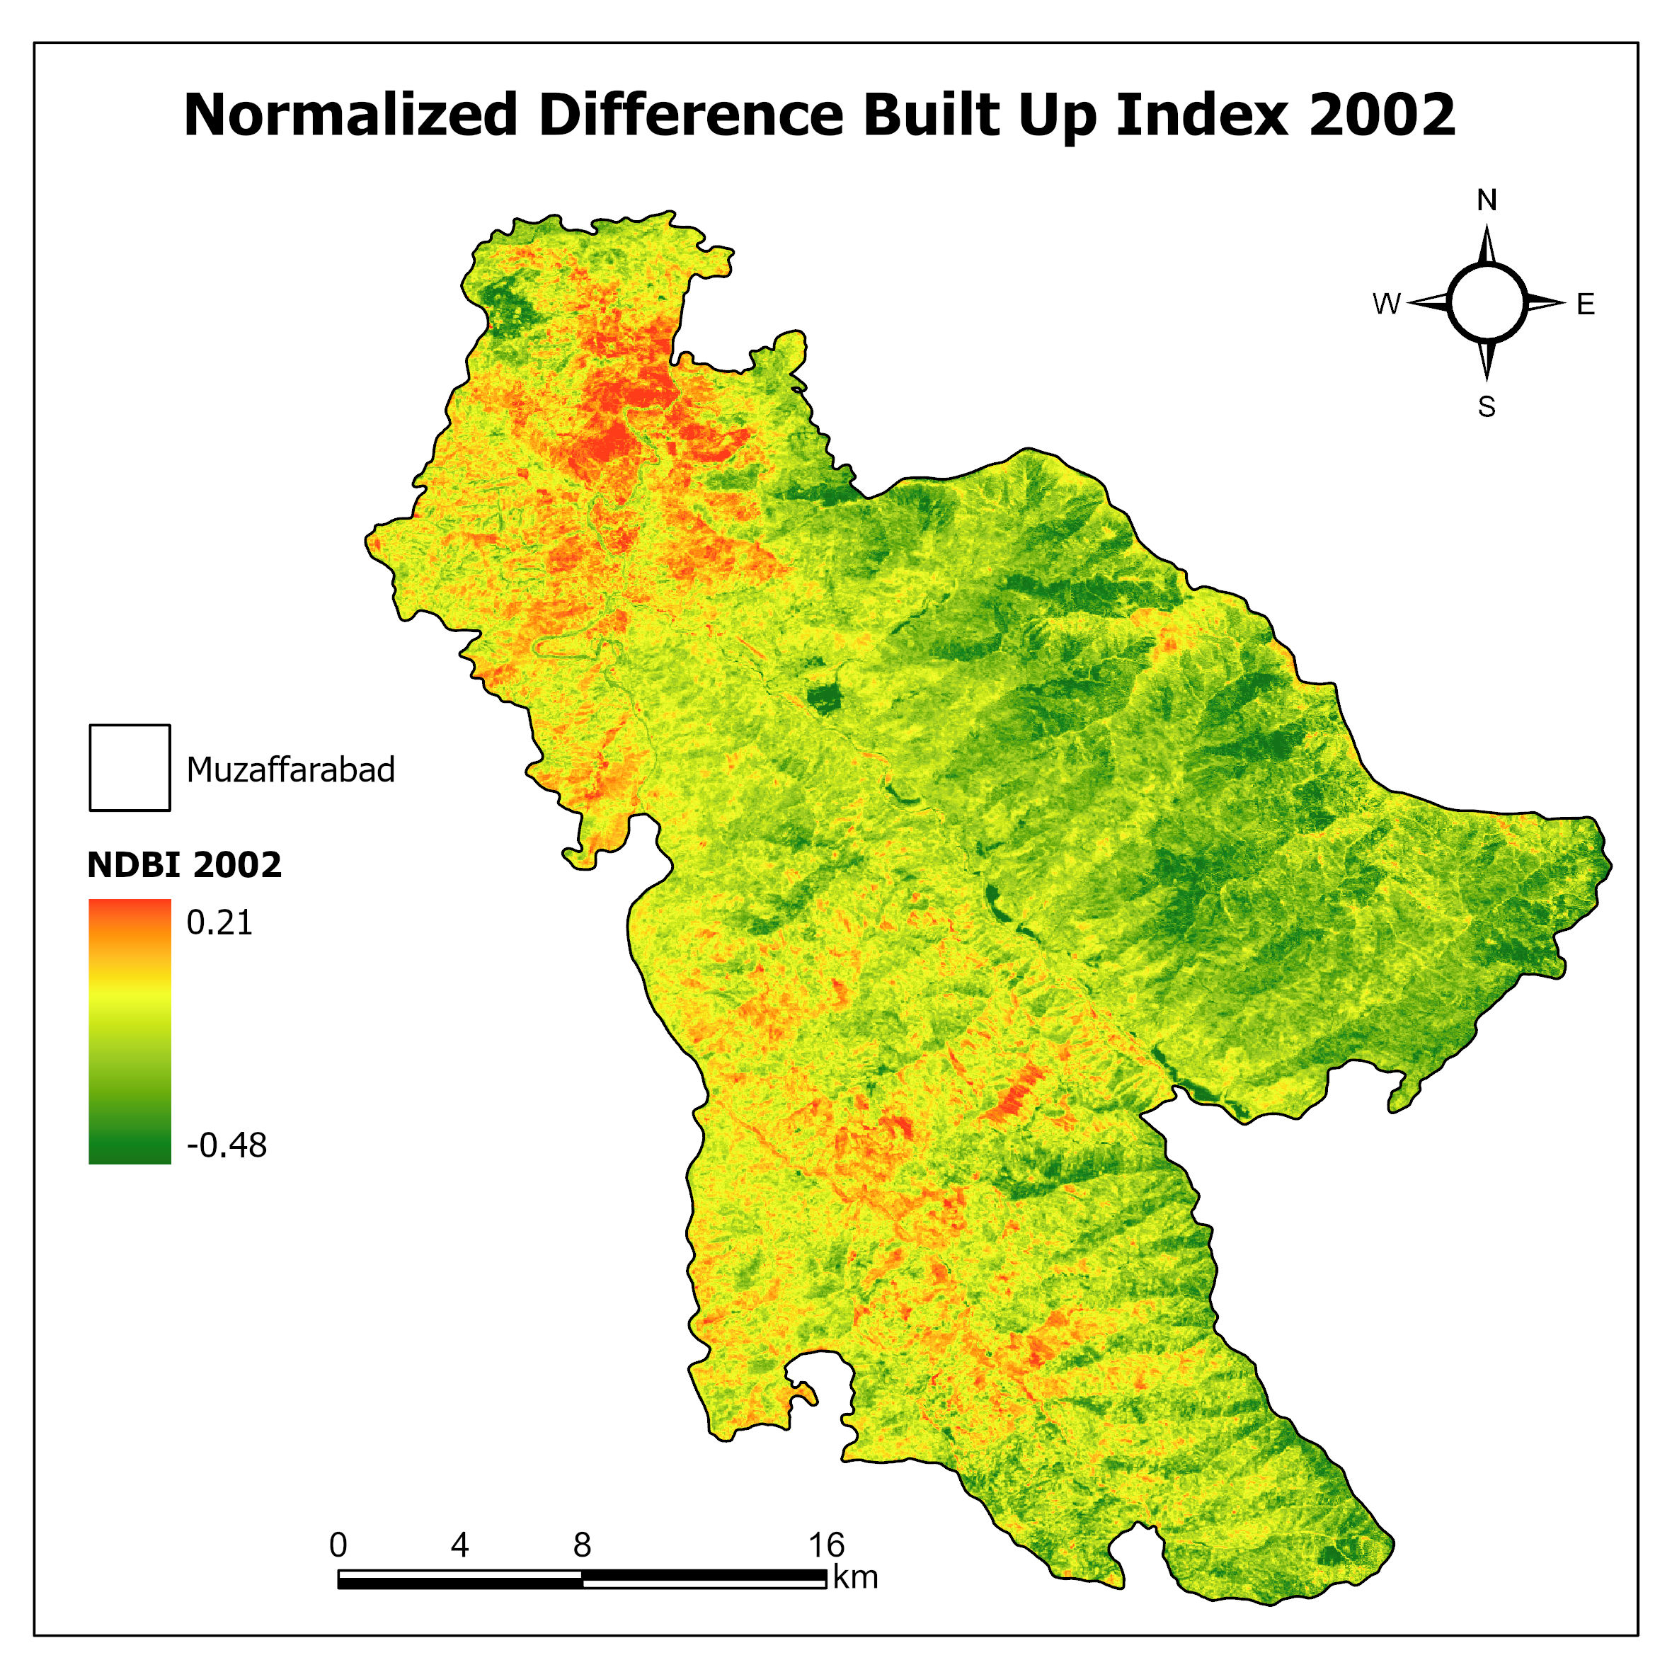
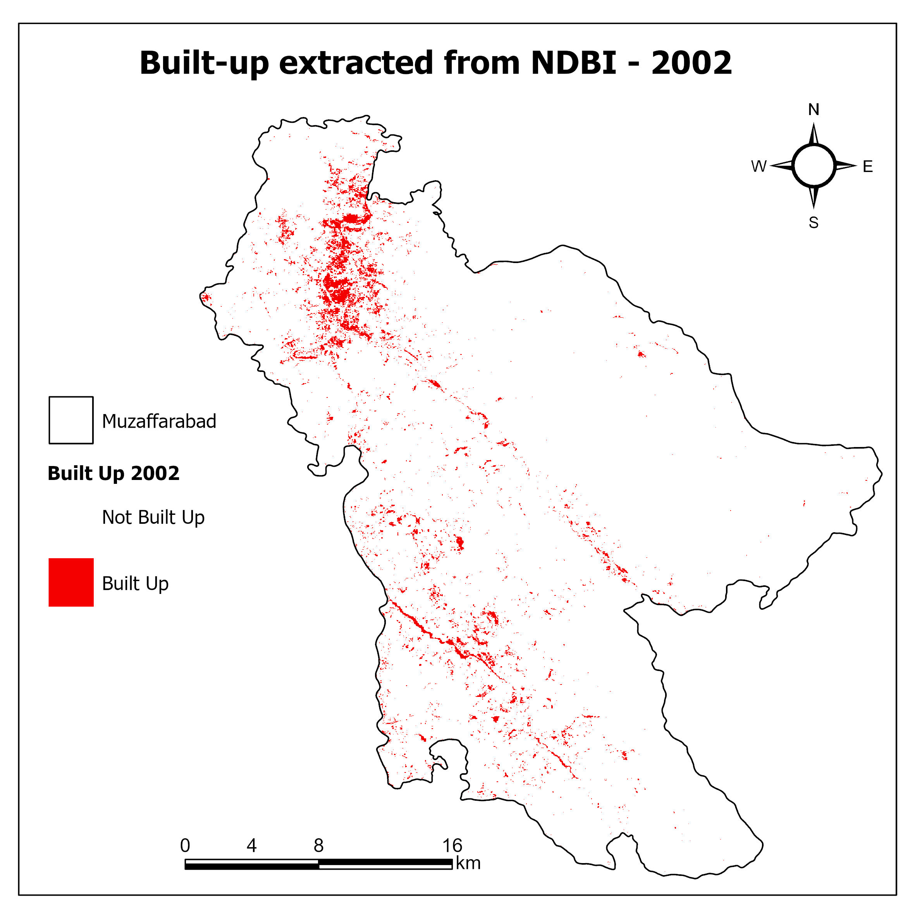
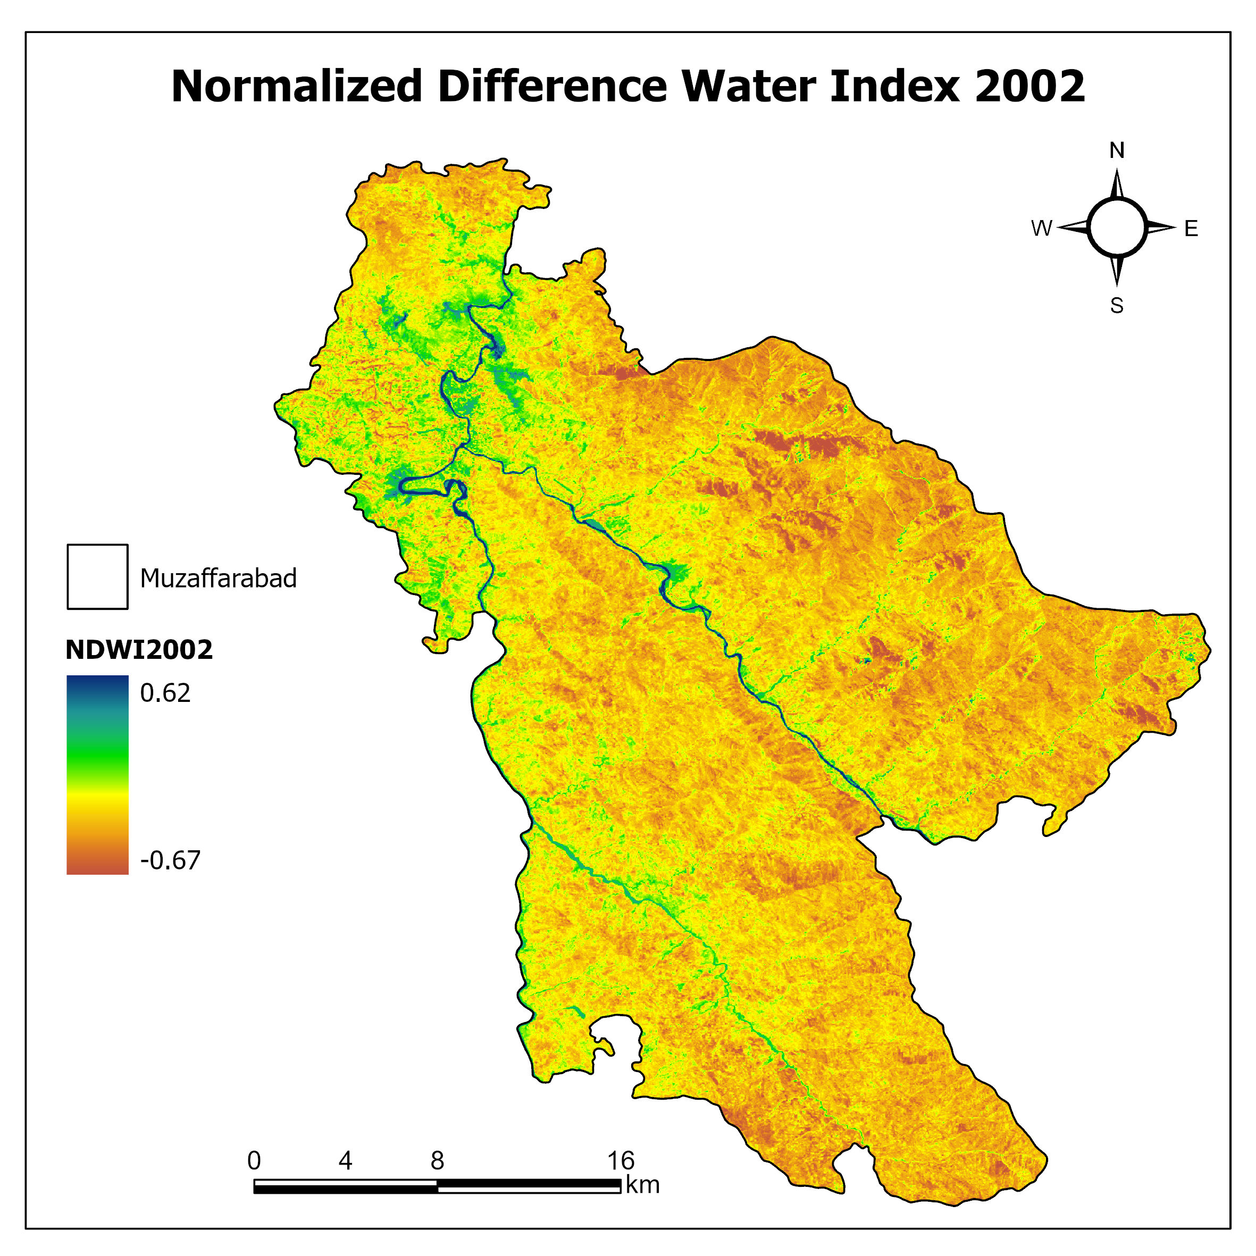
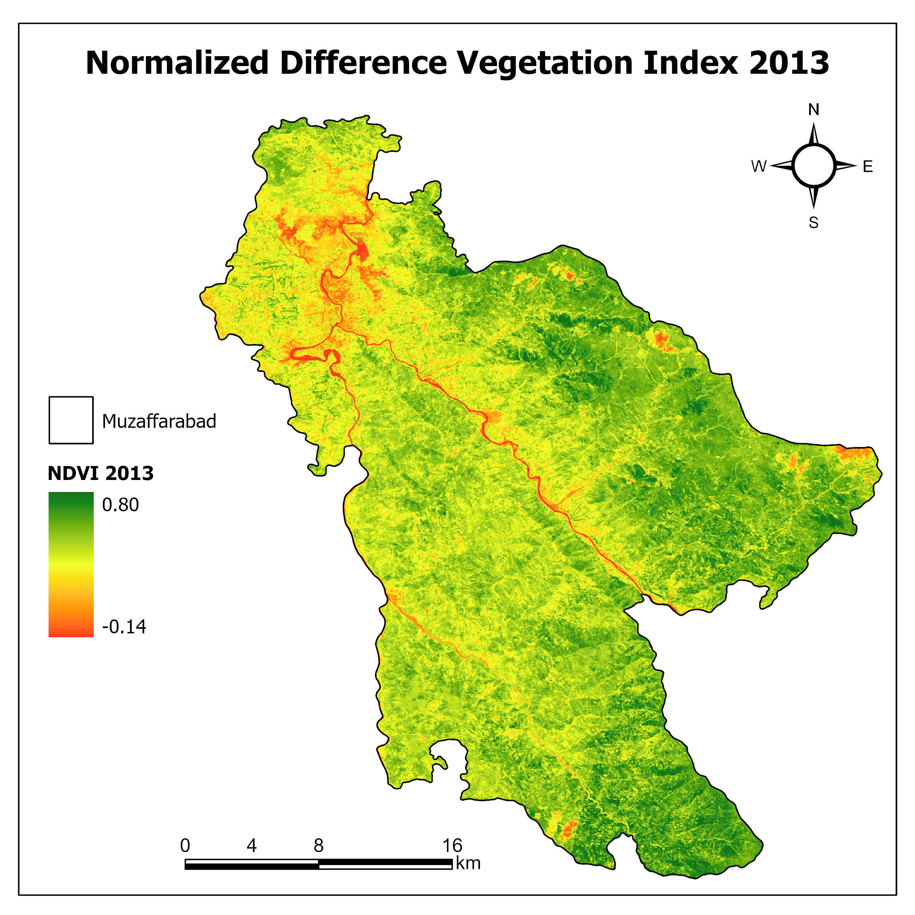
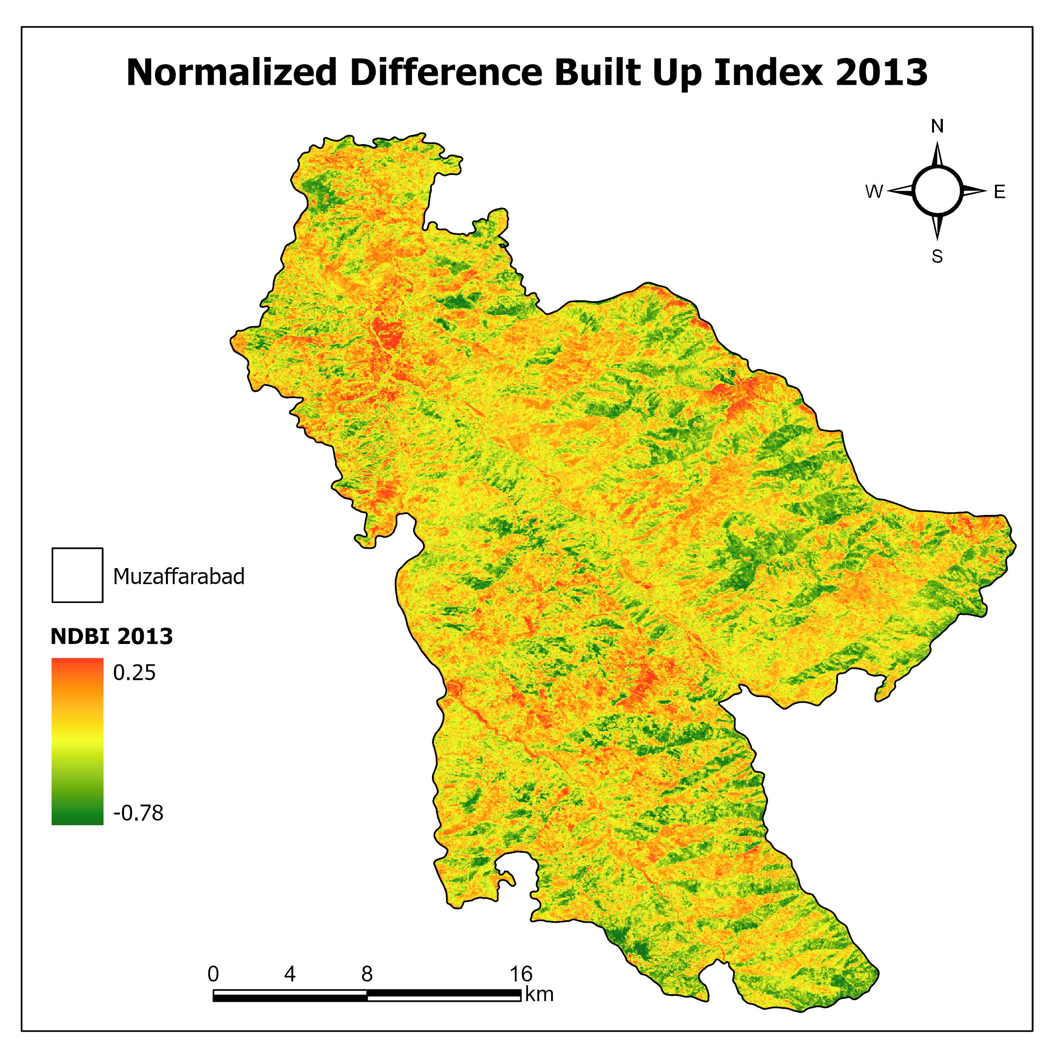
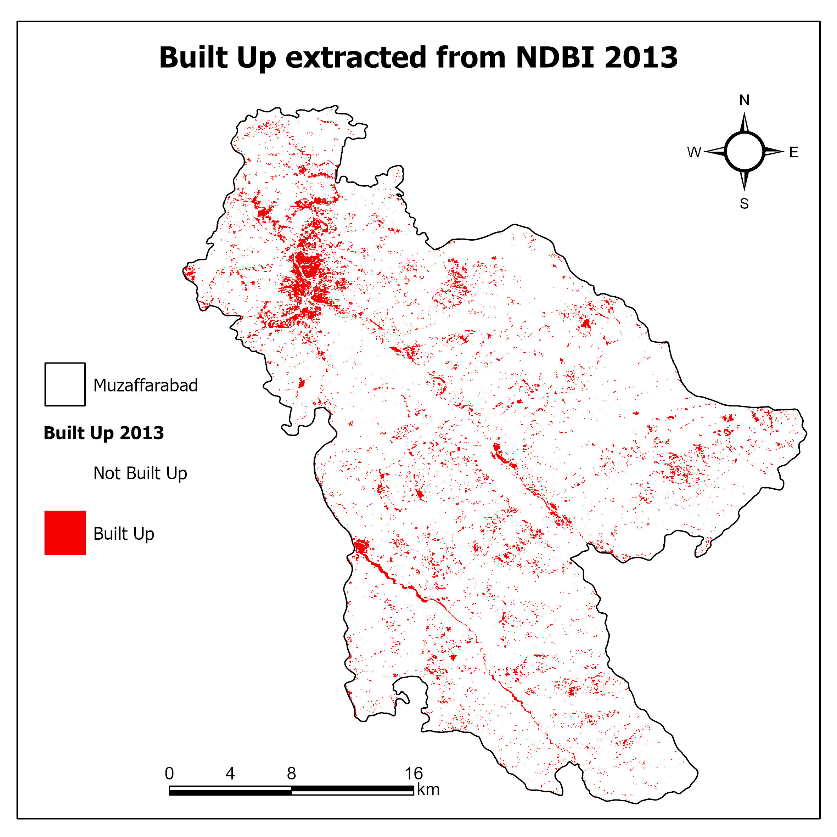
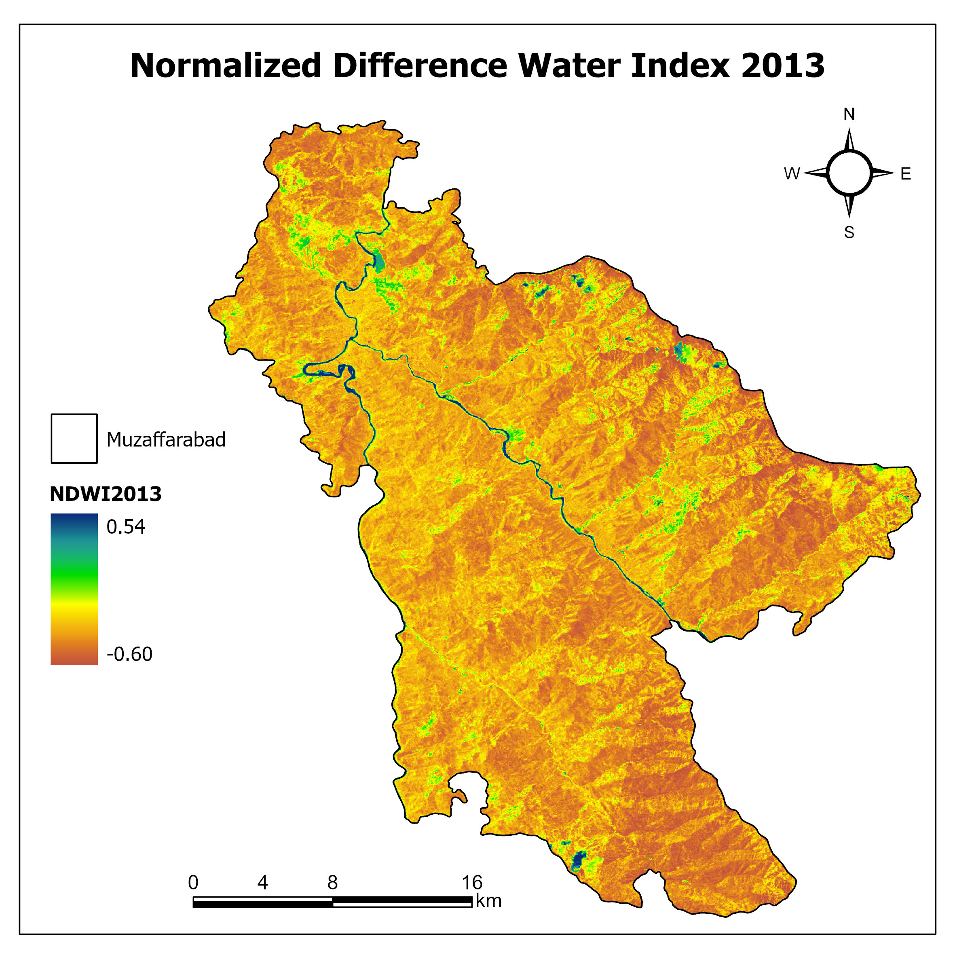
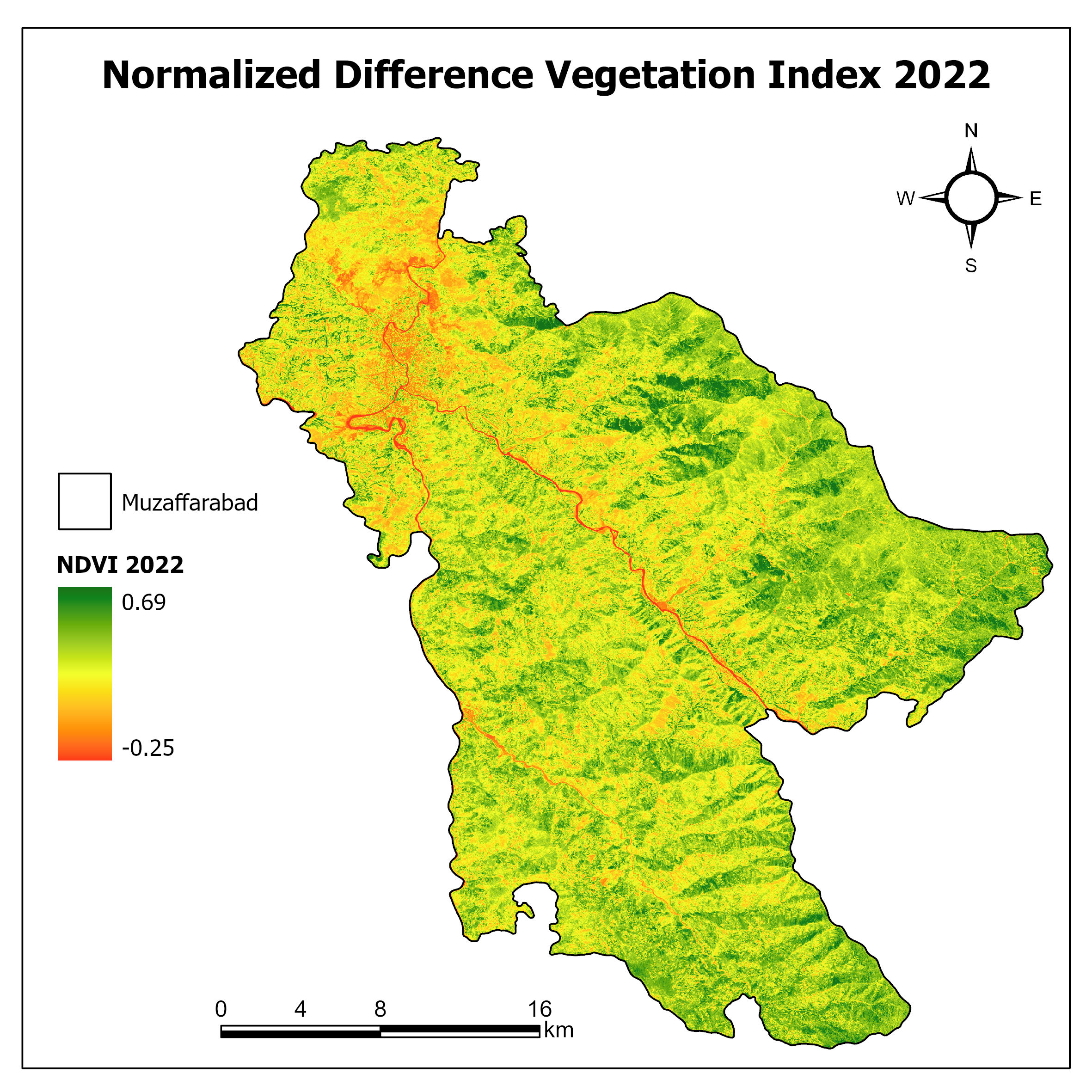
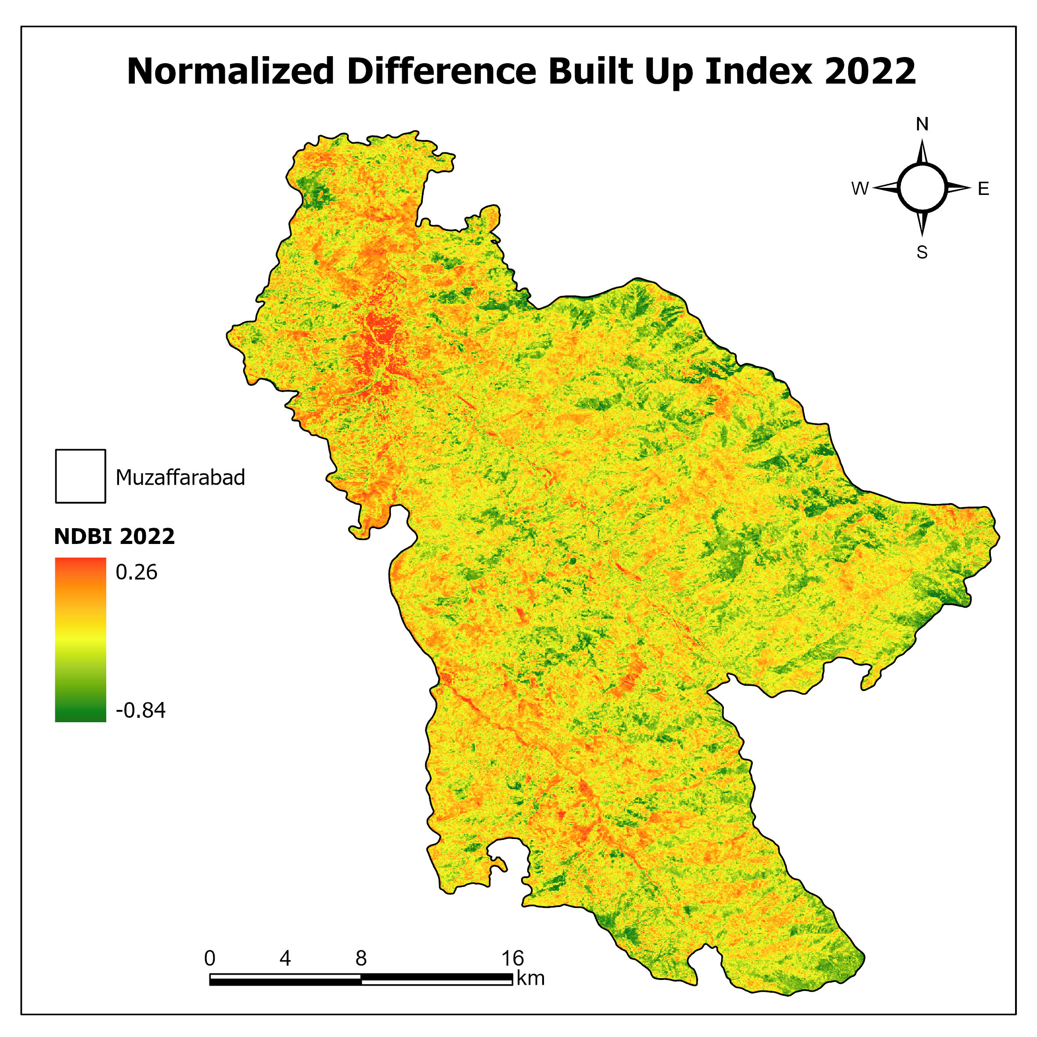
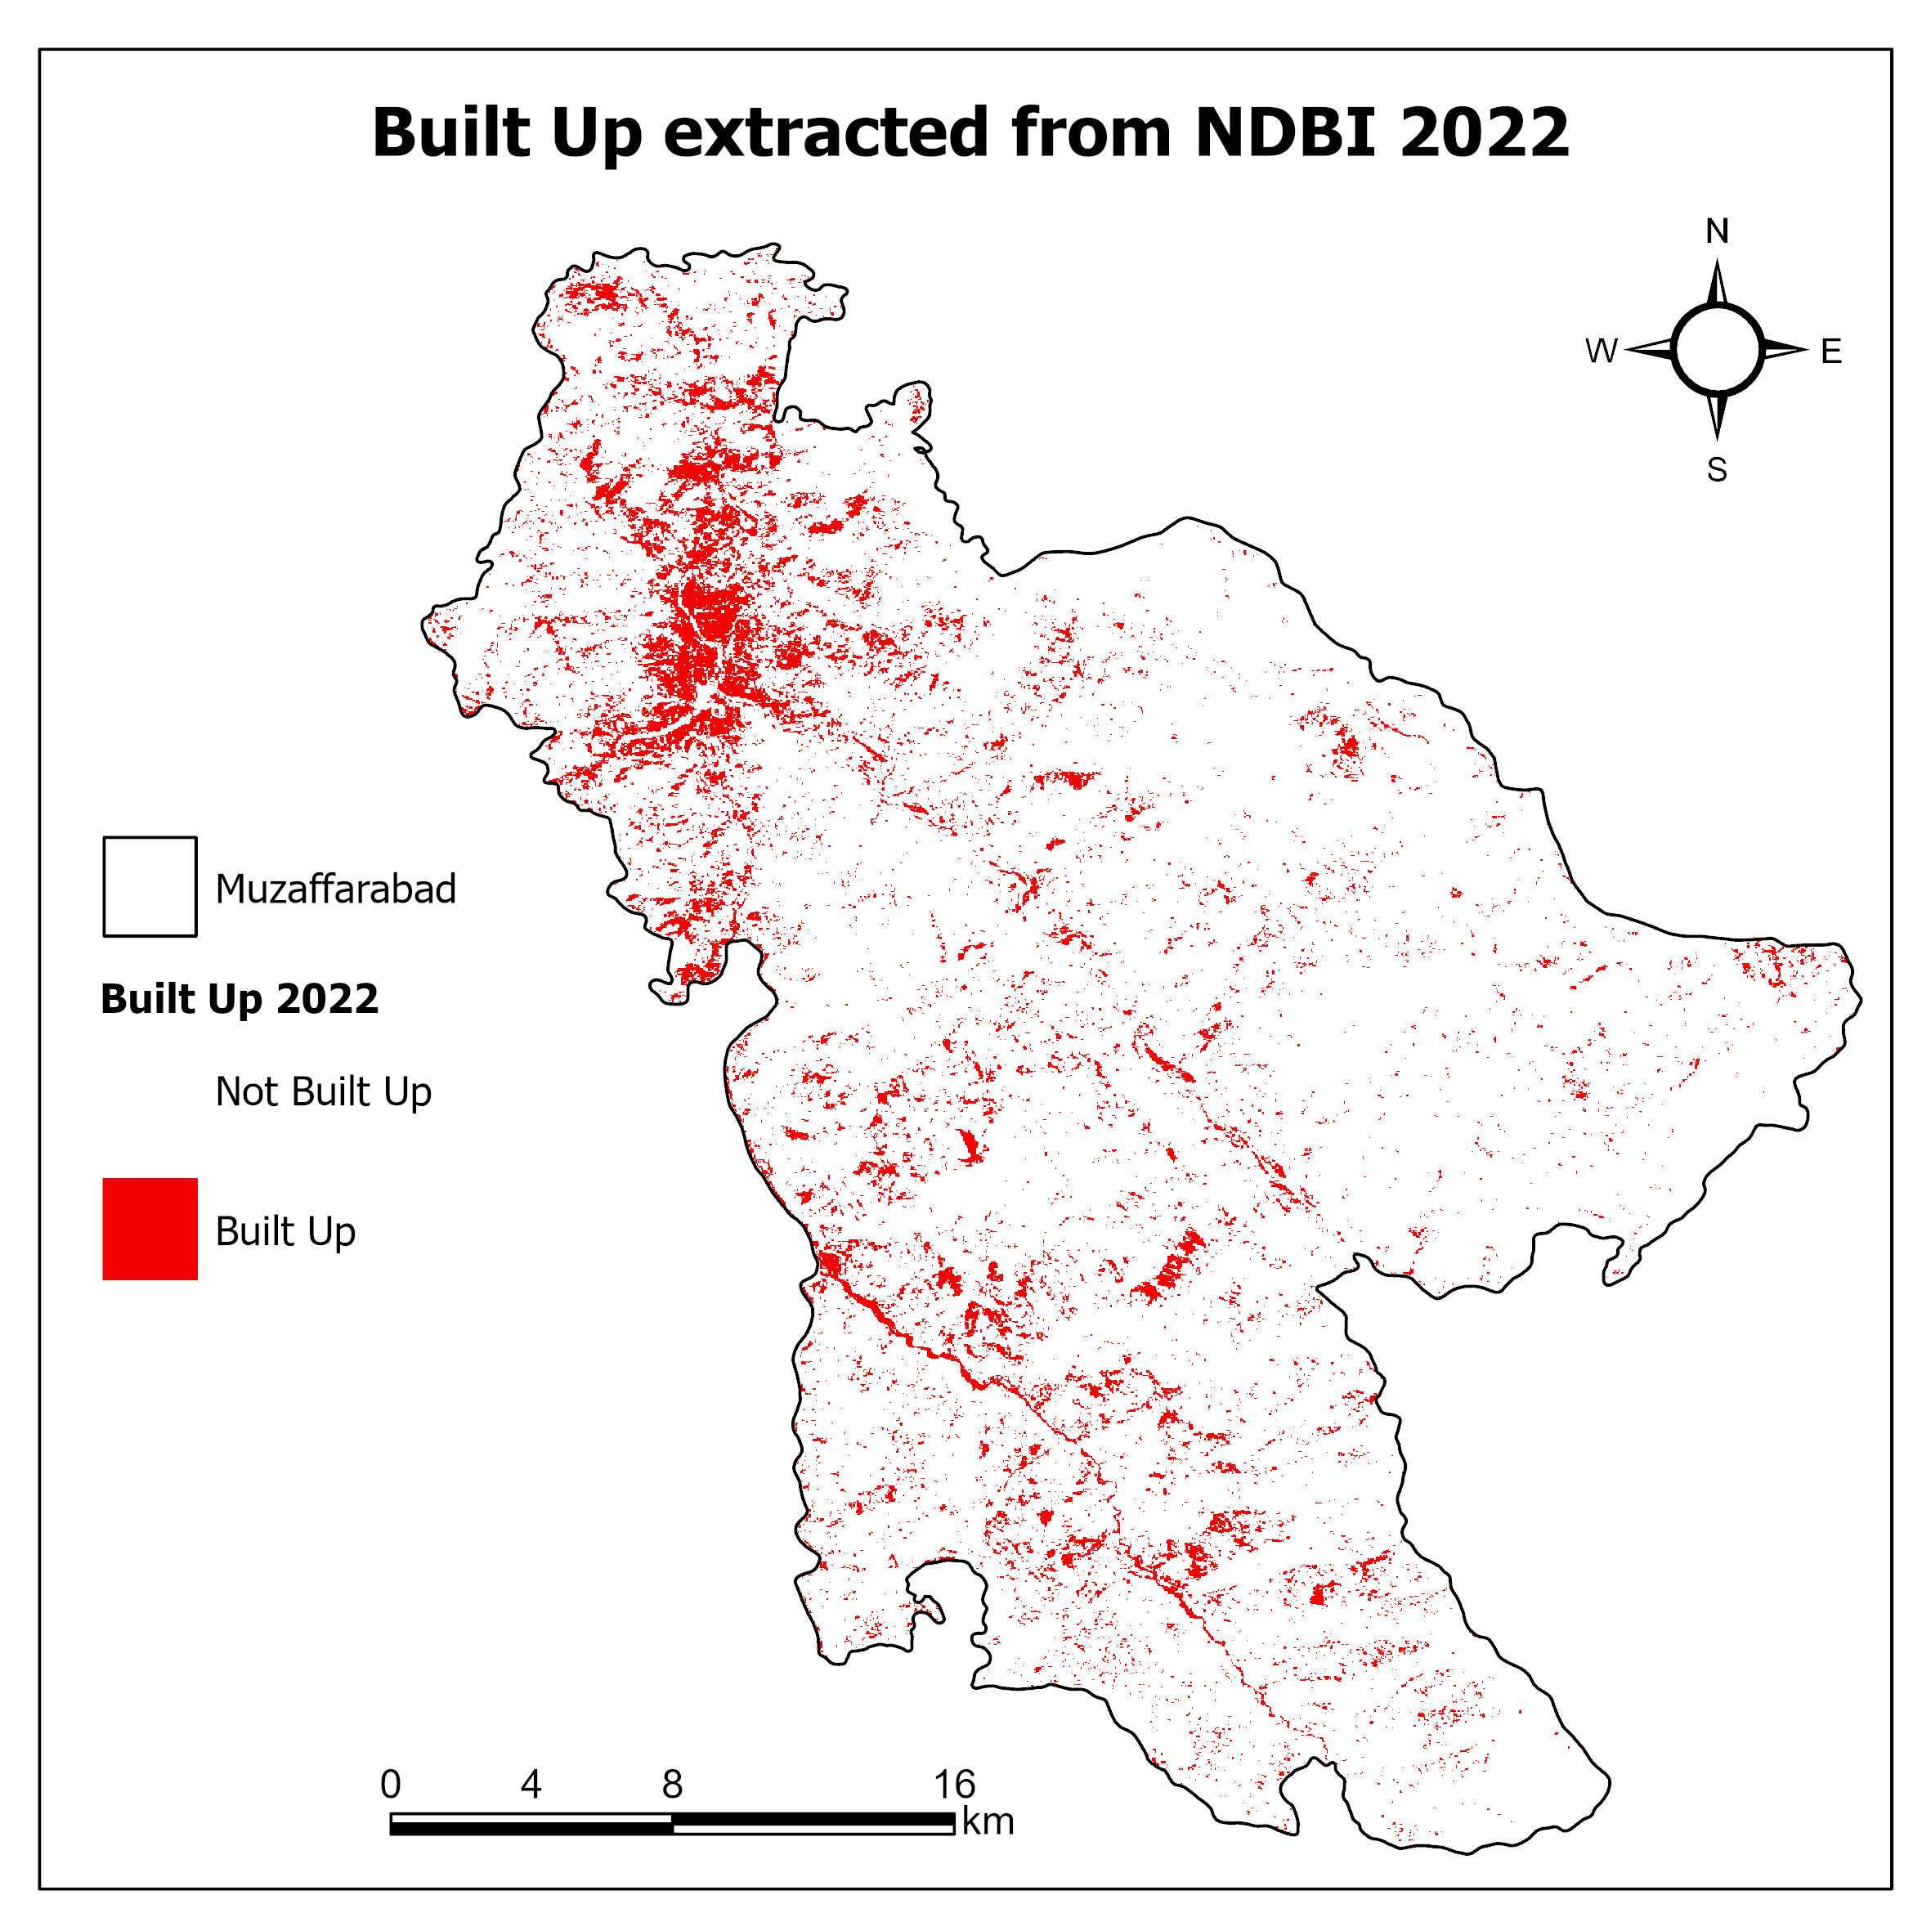
Spectral Indices – NDVI, NDBI, BUA, UDI, NDWI
Thesis Final Defense: Dec, 2023

Slide 42
Topographic Variables
Elevation range from 563 – 3434m, Slope from 0 – 86.3 degrees
Thesis Final Defense: Dec, 2023

Slide 43
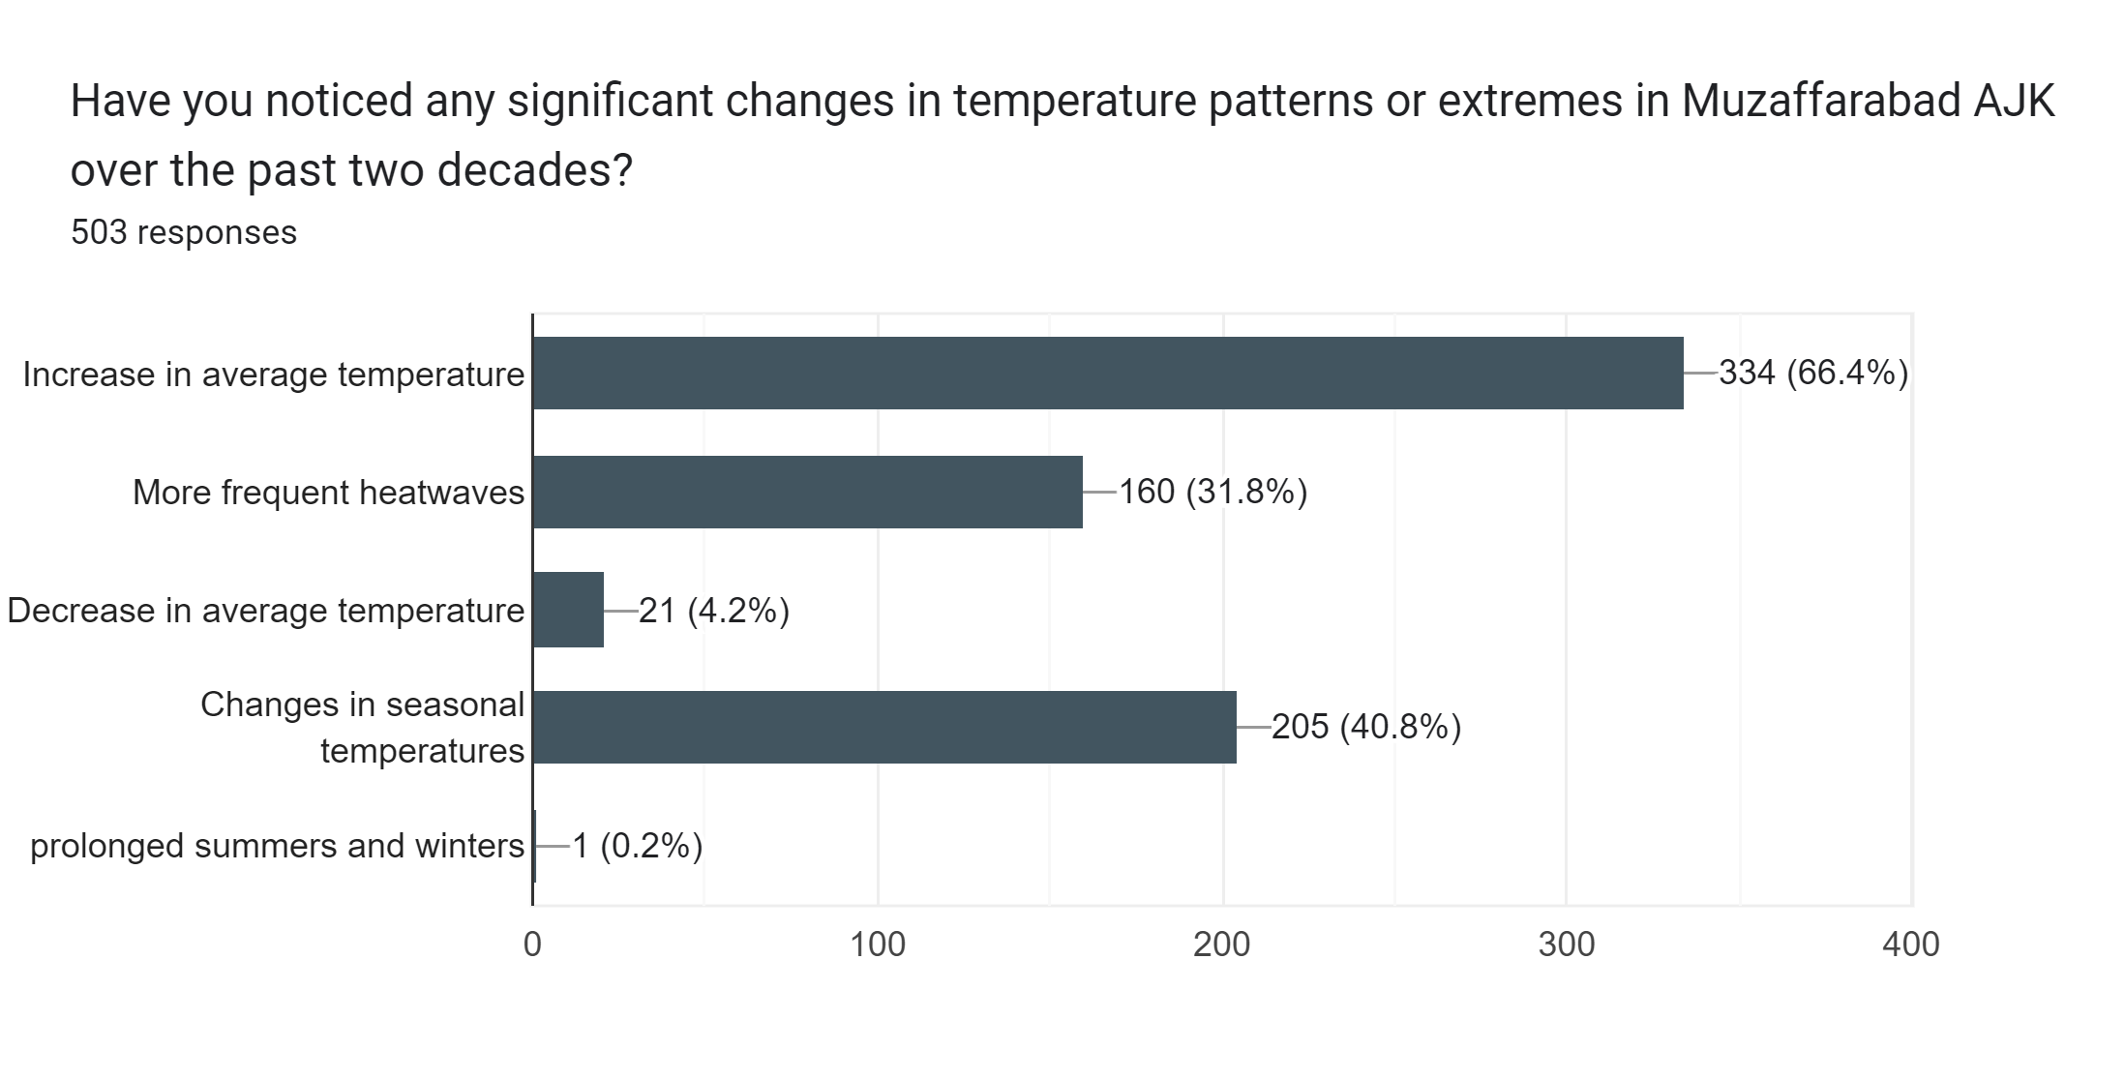
Online Survey
Thesis Final Defense: Dec, 2023

Slide 44
Online Survey
Thesis Final Defense: Dec, 2023

Slide 45
Online Survey
Thesis Final Defense: Dec, 2023

Slide 46
Correlation Analysis – LST, NDVI and NDBI
Thesis Final Defense: Dec, 2023

Slide 47

Correlation Analysis & Multiple Linear Regression
Regression Statistics (LST & Indices)
Multiple R | 0.750
R Square | 0.703
Adjusted R Square | 0.702
Standard Error | 3.057
Observations | 1139
-
Regression Statistics (MLR LST & Terrain)
Multiple R | 0.772
R Square | 0.603
Adjusted R Square | 0.602
Standard Error | 2.552
Observations | 1148
Thesis Final Defense: Dec, 2023

Slide 48
Conclusions
Support Vector Machines are effective for handling non-linear relationships in data. SVM produced results with 83-84% accuracy and a Kappa coefficient of 0.76-0.79. Random Forest also yielded accurate results with up to 84% accuracy.
The CART and GTB algorithms underperformed in water and shadow delineation attributed to the topography of the study area.
Overall Bare Land (5 – 10%) and Built-Up Increased (by 1 to 6%) while forest and vegetation (15 – 20%) and water (0.5 – 1%) decreased between 2002-2022.
Thesis Final Defense: Dec, 2023

Slide 49
Conclusions
Temperature has risen by almost 1.8 degrees in Muzaffarabad AJK
Overall change in Pakistan is 2.3C. More Frequent Urban Heat Island and Heatwaves
Built-up and barren land are the primary contributors to LST change and UHI
Cloud Computing Platforms, AI, ML, and DL (CNN) Models are more efficient than traditional models
Slope aspect and elevations are inversely related to LST
LST showed a positive relationship with NDBI, and Hillshade while a negative correlation with NDVI, elevation, slope, and aspect.
Thesis Final Defense: Dec, 2023

Slide 50
Recommendations
  Based on the findings of the study we recommend:
  Panned infrastructure development avoiding congested construction and leaving space for tree cover and vegetation around impervious spaces. Planting deciduous trees can help both in summer and winter.
  Socio-economic surveys to be carried out by decision-makers.
Thesis Final Defense: Dec, 2023

Slide 51
Recommendations
  Creating eco-roofs or rooftop gardens as recommended by EPA to reduce UHI.
  Integrating high-resolution spatial data along with Drones, LiDAR, and BIM using ML/DL techniques, and image fusion to help decision-makers with more spatially informed policymaking.
Thesis Final Defense: Dec, 2023

Slide 52
Software and Tools
S/N | Software & Tools | Purpose
1 | Google Earth Engine | LULC Classification, LST Calculation, Topographic Variables Extraction.
2 | ArcGIS Pro | Reclassification, Change Detection, Final Maps
3 | Microsoft Excel | Correlation Analysis
4 | Google Online Forms | Socio-economic Survey
Thesis Final Defense: Dec, 2023

Slide 53
Acknowledgment
Supervisor
Prof. Dr. Javed Iqbal (HoD IGIS NUST)
GEC Members
Prof. Dr. Ejaz Hussain (Associate Dean IGIS NUST)
Asst Prof. Dr. Muhammad Ali Inam (HoD IESE NUST)
Thesis Final Defense: Dec, 2023

Slide 54
Timeline
Ser | Activity | To be completed by
01 | Synopsis Defense | March 2023
02 | First Progress Report | Sep 2023
03 | Second Progress Report | Sep 2023
04 | Preliminary Defense | Dec 2023
05 | Final Defense | May 2023
Thesis Final Defense: Dec, 2023

Slide 55
References
Basheer, S., Wang, X., Farooque, A. A., Nawaz, R. A., Liu, K., Adekanmbi, T., & Liu, S. (Year). Comparison of Land Use Land Cover Classifiers Using Different Satellite Imagery and Machine Learning Techniques.
Roy, B., & Bari, E. (2022). Examining the relationship between land surface temperature and landscape features using spectral indices with Google Earth Engine.
Thesis Final Defense: Dec, 2023

Slide 56
References
Aneesh Mathew, Sreenu Sreekumar, Sumit Khandelwal, Rajesh Kumar, Prediction of land surface temperatures for surface urban heat island assessment over Chandigarh city using support vector regression model, Solar Energy, Volume 186, 2019, Page 404-415, ISSN 0038-092X,
Yasir, M., Hui, S., Rahman, S. U., Ilyas, M., Zafar, A., & Mehmood, A. (2020). Estimation of land surface temperature using LANDSAT-8 data-A case study of district Malakand, Khyber Pakhtunkhwa, Pakistan. J Liberal Arts Humanities, 1, 140-148.
Mustafa, E. K., Co, Y., Liu, G., Kaloop, M. R., Beshr, A. A., Zarzoura, F., & Sadek, M. (2020). Study for Predicting Land Surface Temperature (LST) Using Landsat Data: A Comparison of Four Algorithms. Advances in Civil Engineering, 2020, 7363546. https://doi.org/10.1155/2020/7363546
Thesis Final Defense: Dec, 2023

Slide 57
References
Aneesh Mathew, Sreenu Sreekumar, Sumit Khandelwal, Rajesh Kumar, Prediction of land surface temperatures for surface urban heat island assessment over Chandigarh city using support vector regression model, Solar Energy, Volume 186, 2019, Page 404-415, ISSN 0038-092X,
Yasir, M., Hui, S., Rahman, S. U., Ilyas, M., Zafar, A., & Mehmood, A. (2020). Estimation of land surface temperature using LANDSAT-8 data-A case study of district Malakand, Khyber Pakhtunkhwa, Pakistan. J Liberal Arts Humanities, 1, 140-148.
Mustafa, E. K., Co, Y., Liu, G., Kaloop, M. R., Beshr, A. A., Zarzoura, F., & Sadek, M. (2020). Study for Predicting Land Surface Temperature (LST) Using Landsat Data: A Comparison of Four Algorithms. Advances in Civil Engineering, 2020, 7363546. https://doi.org/10.1155/2020/7363546
Thesis Final Defense: Dec, 2023

Slide 58

THANK YOU

