Slide 1

G2M Case Study
Virtual Internship
Alyssa Hubiak
21-Sept-2022

Slide 2
Background- G2M Cab Data case study
The purpose of this analysis is to provide insight to XYZ, a private firm in US. Due to remarkable growth in the cab industry in last few years and multiple key players in the market, it is planning for an investment in Cab industry and as per their Go-to-Market(G2M) strategy they want to understand the market before taking final decision.
Objective: provide actionable insights to advise XYZ firm on which company to invest in
This analysis will be split into four parts:
1. Initialization and Loading Data
2. Data Cleaning and Preparation
3. Exploratory Data Analysis
3. Final Recommendations

Slide 3
Data Exploration
23 features – (8 derived)
Data spans from 01/2016 to 12/2018
359,392 observations
Assumptions
There are likely outliers in price, but since we do not have details on this, we will not treat them as such
Profit will be calculated using Cost of Trip and Price Charged
Users feature will be assumed to be the total number of cab users per city, including but not limited to Yellow and Pink Cab
Cab_Data.csv + Customer_ID.csv + Transaction_ID.csv + City.csv + US_Holiday_Dates.csv
cab_df

Slide 4

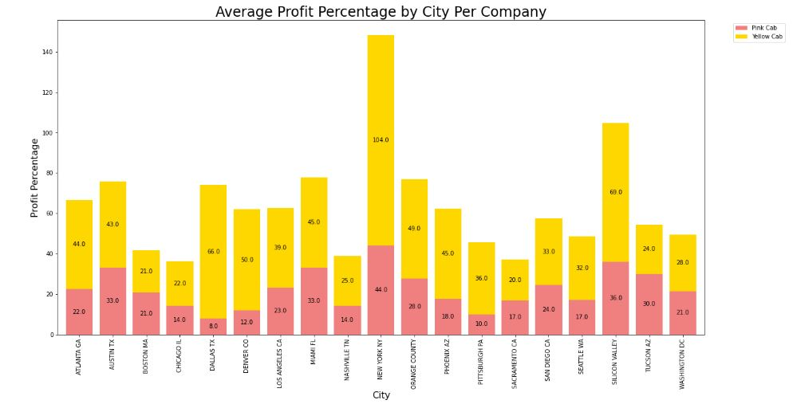
Profit Analysis

Slide 5
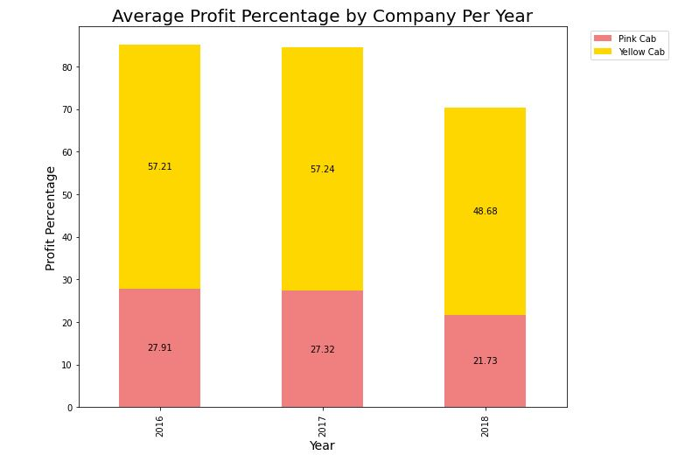
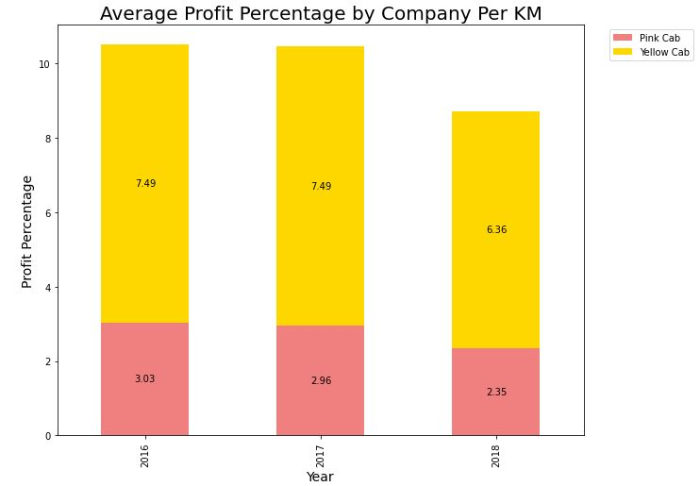
Profit Analysis (p2)

Slide 6
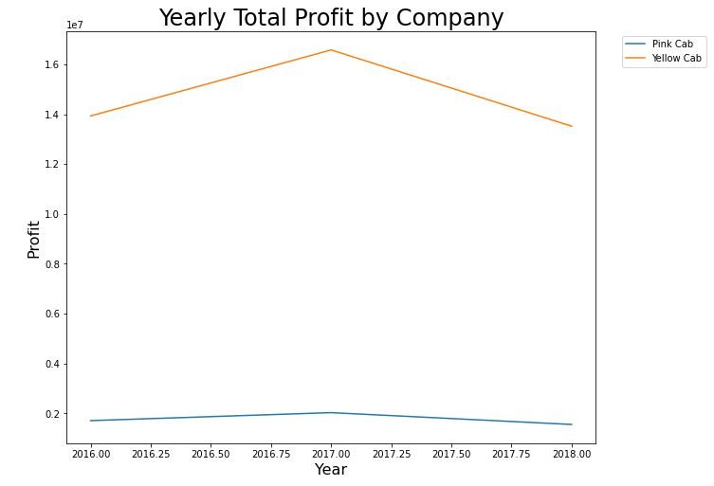
Yearly Profit Analysis

Slide 7
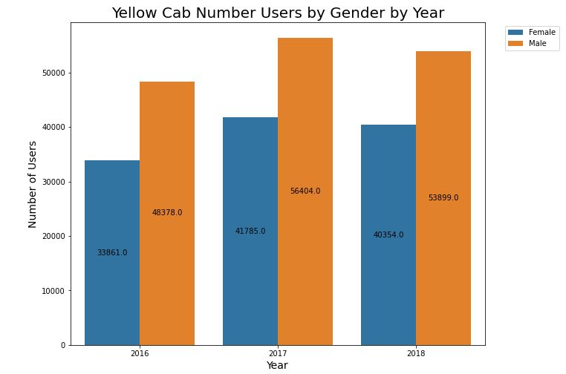
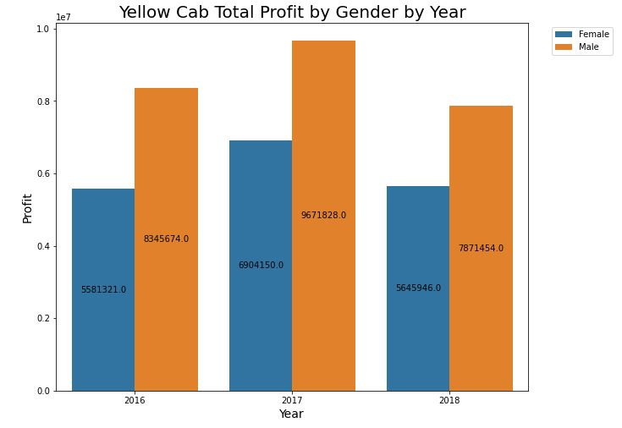
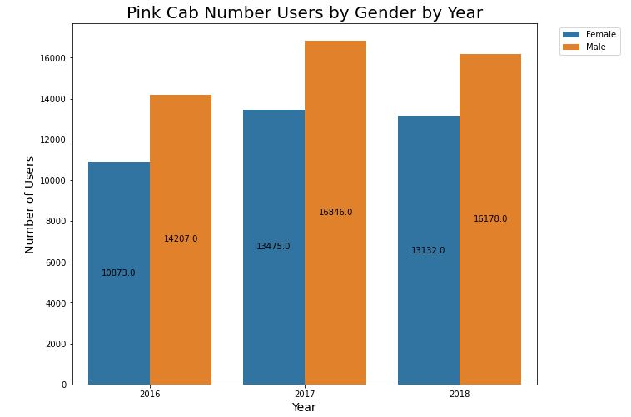
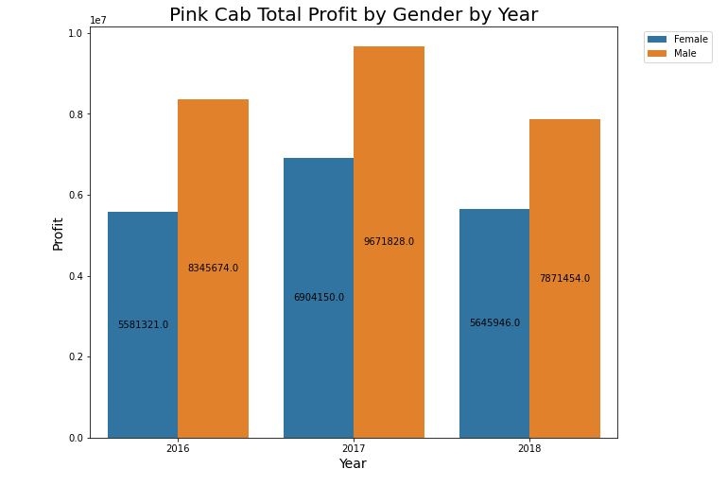
Profit and Customer Analysis by Gender

Slide 8
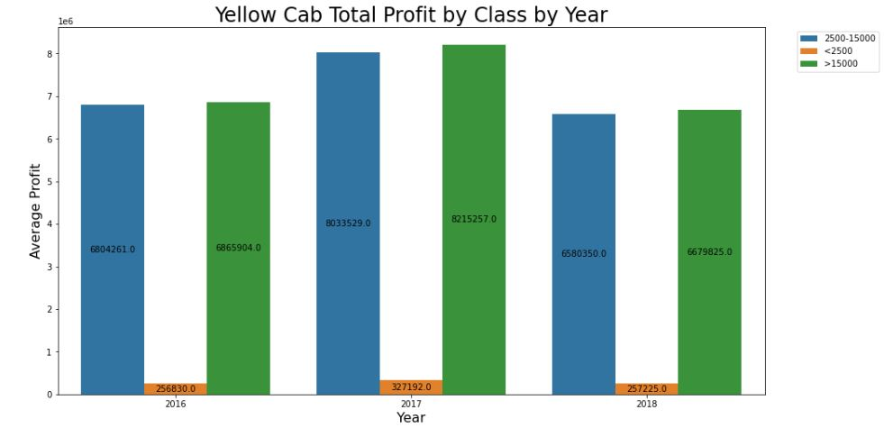
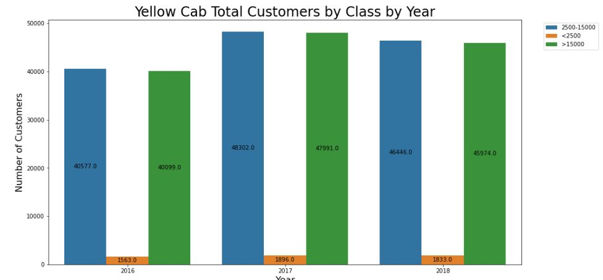
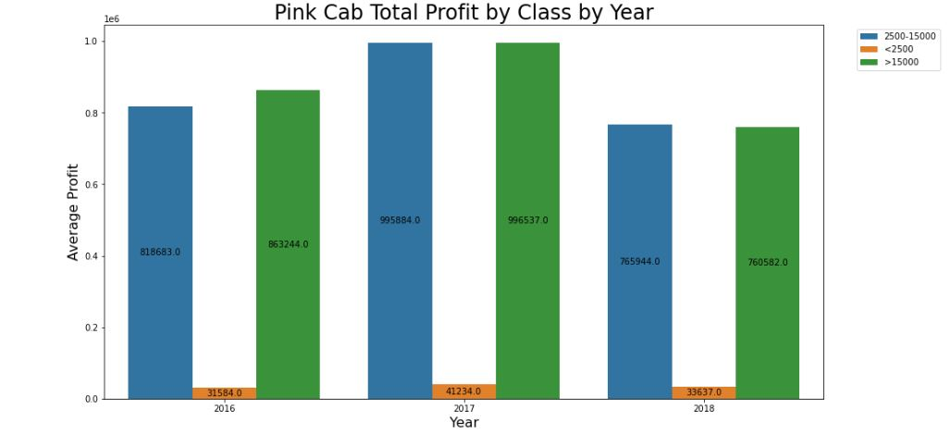
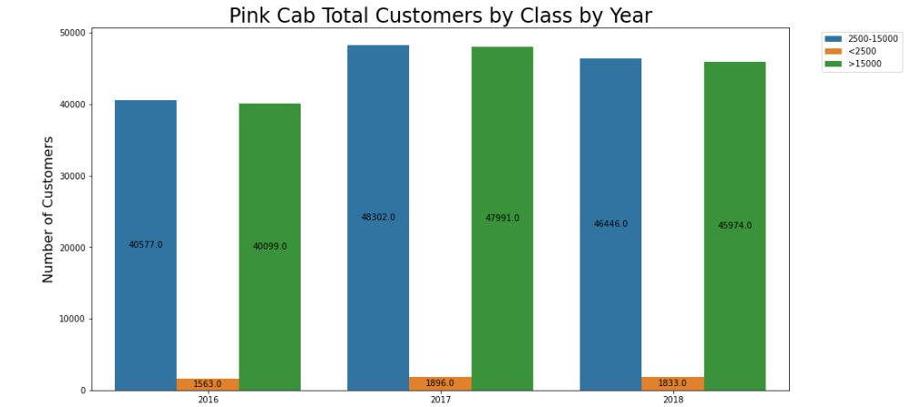
Customer Analysis by Income Class

Slide 9
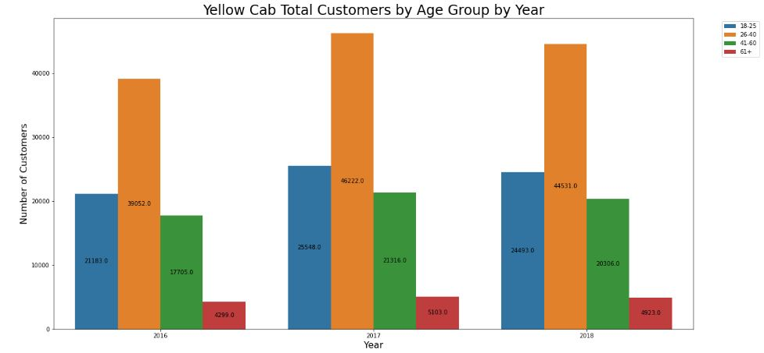
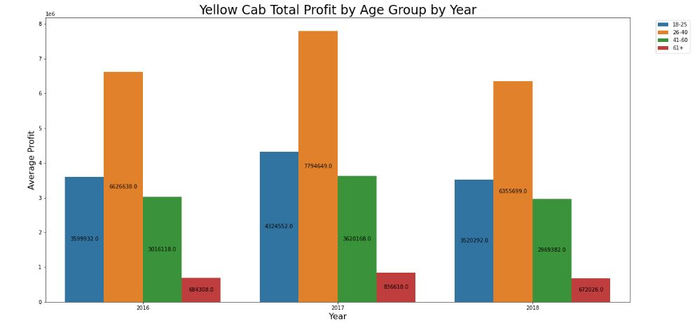
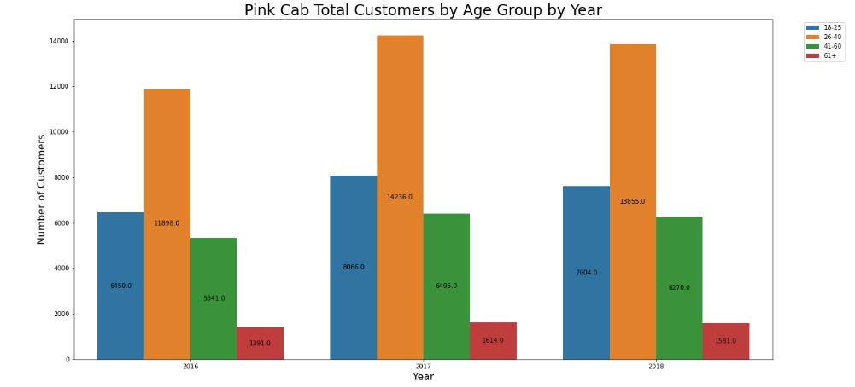
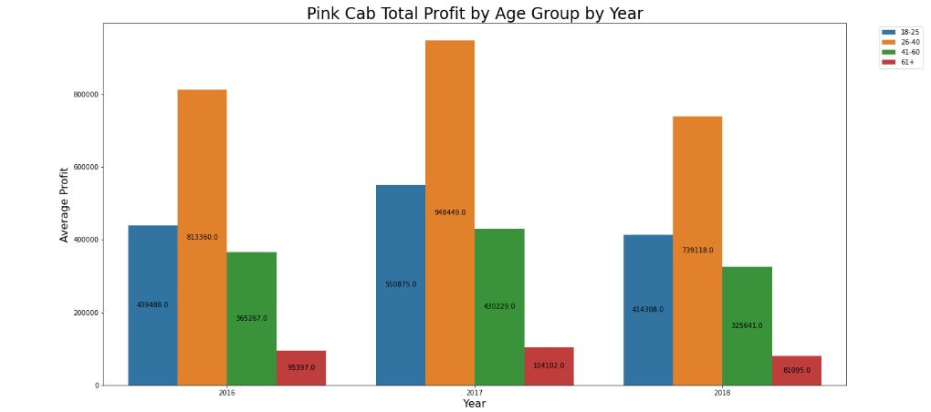
Customer and Profit Analysis by Age Group

Slide 10
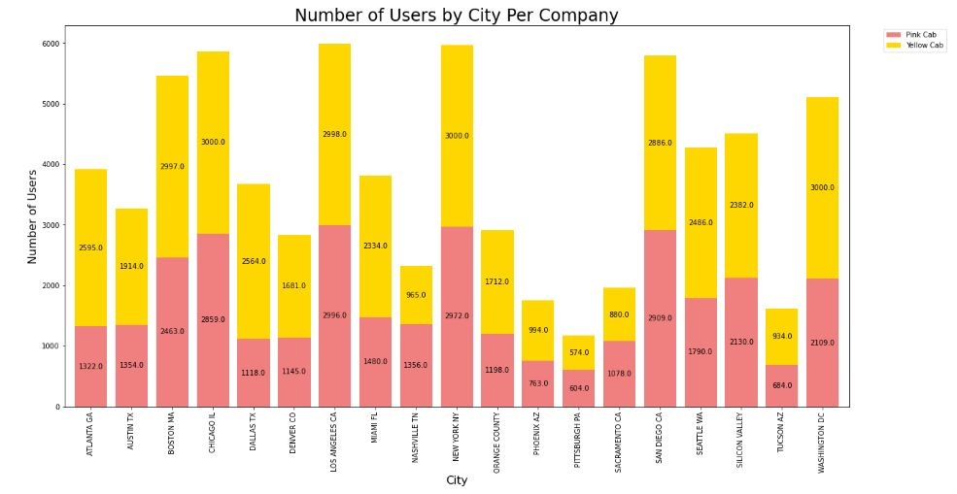
Cab Users Covered by Each Company

Slide 11
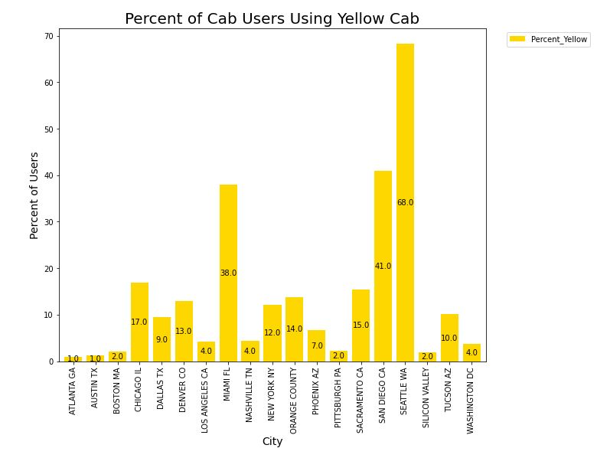
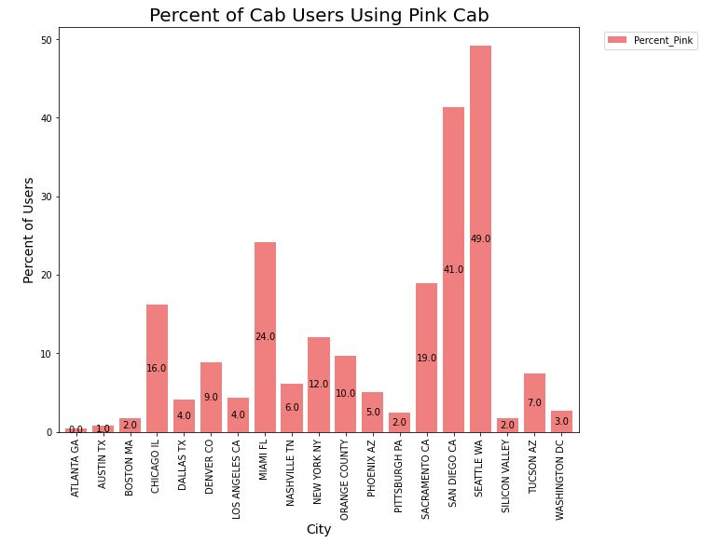
Percentage of Cab Users by Each Company

Slide 12
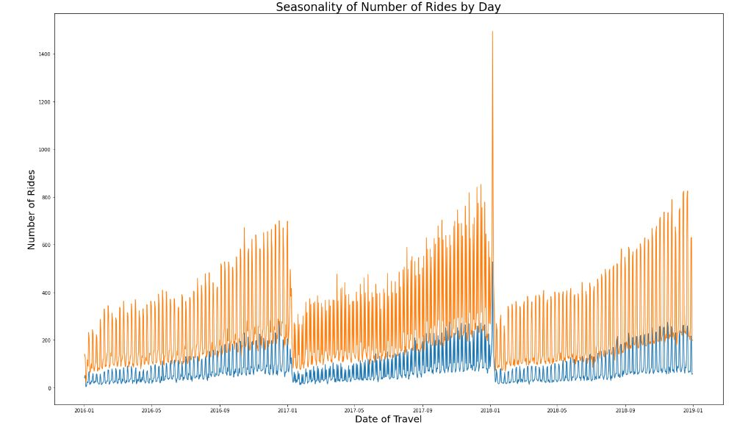
Yearly Seasonality of Number of Rides
There is a yearly repetition, with the most rides occurring towards the holidays at the end of the year and the least number directly after the new year. This cycle repeats every year, steadily increasing until the drop.

Slide 13
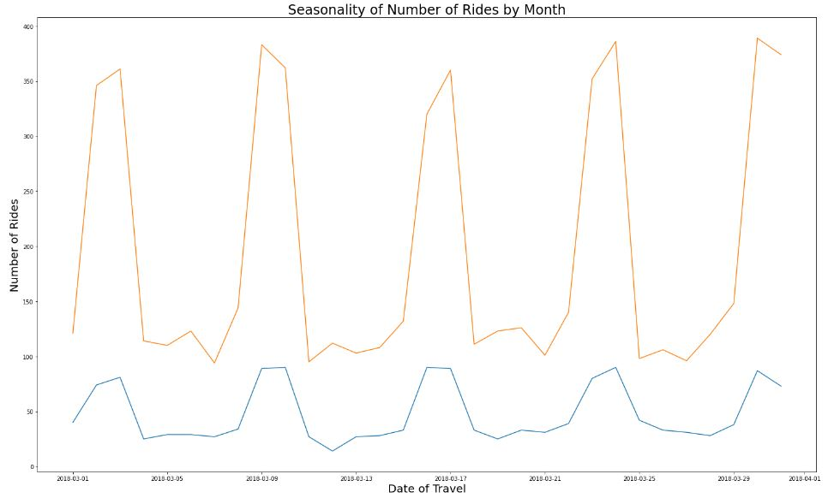
Monthly Seasonality of Number of Rides
There is a spike on the third of every month, and then it drops off by the fifth. This cycle repeats weekly for the whole month.

Slide 14
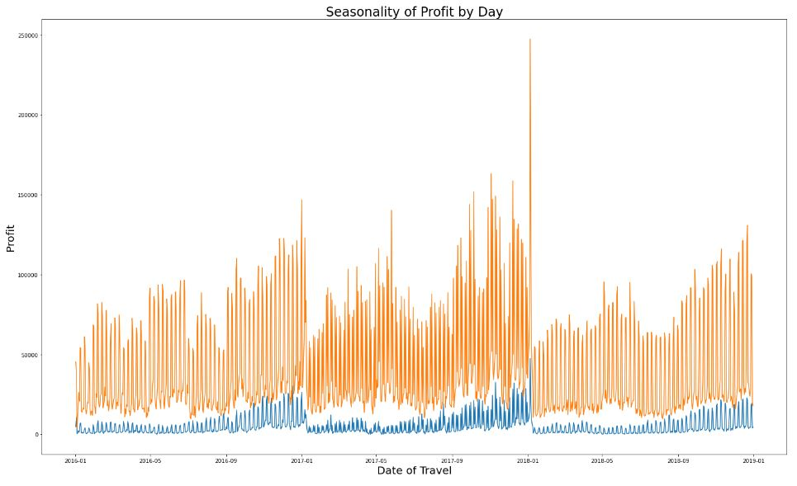
Yearly Profit Seasonality
There is a similar increase in profit seasonally, with the largest amount towards the end of the year. However, the increase is much slighter and appears more stable towards the beginning of the year.

Slide 15
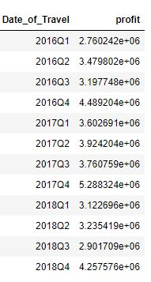
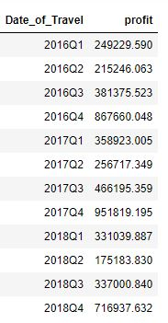
Quarterly Profit Tables
Yellow Cab
Pink Cab

Slide 16
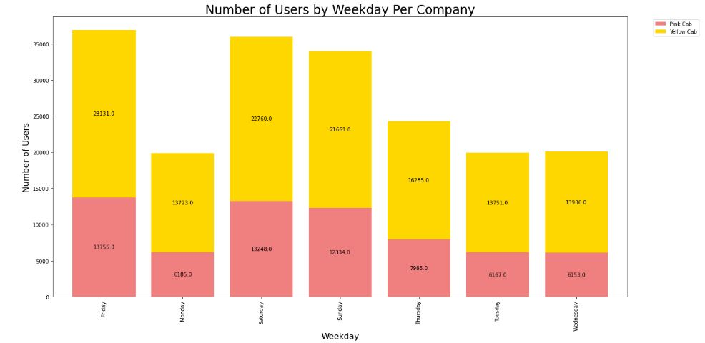
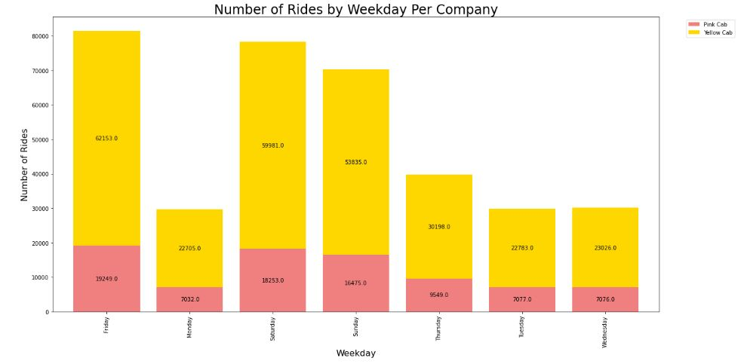
Weekday Analysis by Company

Slide 17
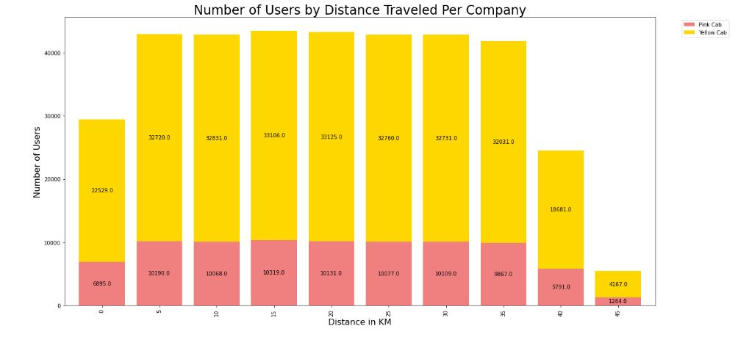
Users by Distance Traveled Analysis

Slide 18
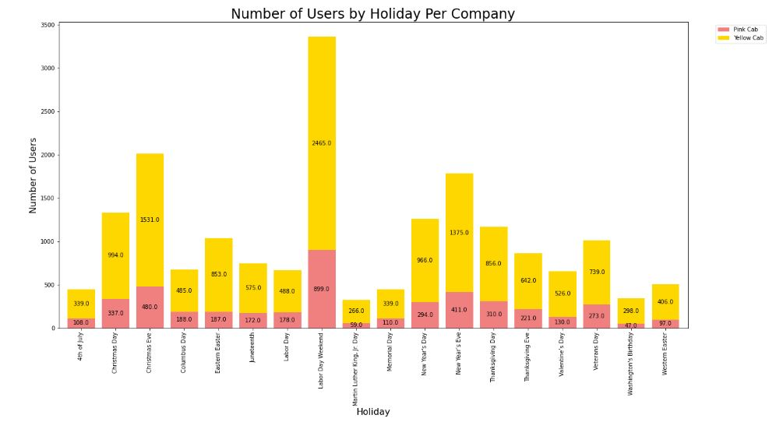
Users by Holiday Analysis

Slide 19
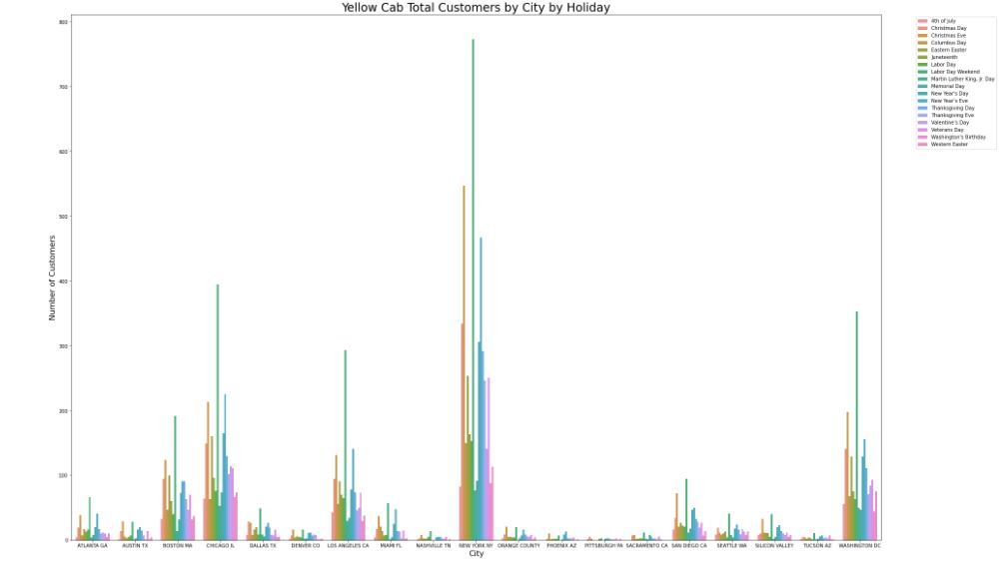
Yellow Cab Users by City on Holidays

Slide 20
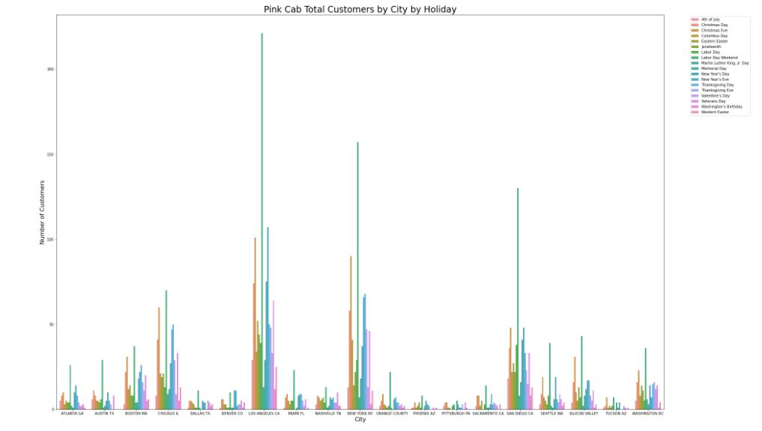
Pink Cab Users by City on Holidays

Slide 21
Conclusion and Recommendations
It is our recommendation based on this analysis that Yellow Cab is a better company for investment than that of Pink Cab for the following reasons:
Yellow Cab has more customer reach in the majority of cities evaluated, and while Pink Cab does have more in a few, the difference is vast in the number of customers across all points.
Yellow Cab also reaches more clients across all age groups than that of Pink Cab.
In addition, Yellow Cab makes over twice the profit per KM than that of Pink Cab.
While both companies appear to be experiencing loss, and it is projected to drop some in future years for both companies, Pink Cab has significantly lower profit margins, and thus any drop is more likely to affect them.
Based on all of these points, it is our recommendation that XYZ invests in Yellow Cab.

Slide 22

Thank You

