Slide 1
Sprint Execution and Review
CIDM4390

Slide 2
Daily Scrum
Three meetings per week
1 with me
2 with team (daily scrums)
15 minutes
What have I worked on (PROOF in CODE)
What I will be working on
Issues I’m having
Transparency, Inspection, Adaptation
Code is committed to repo
Code is in a feature branch
Code is reviewed during discussion
Record these.

Slide 3
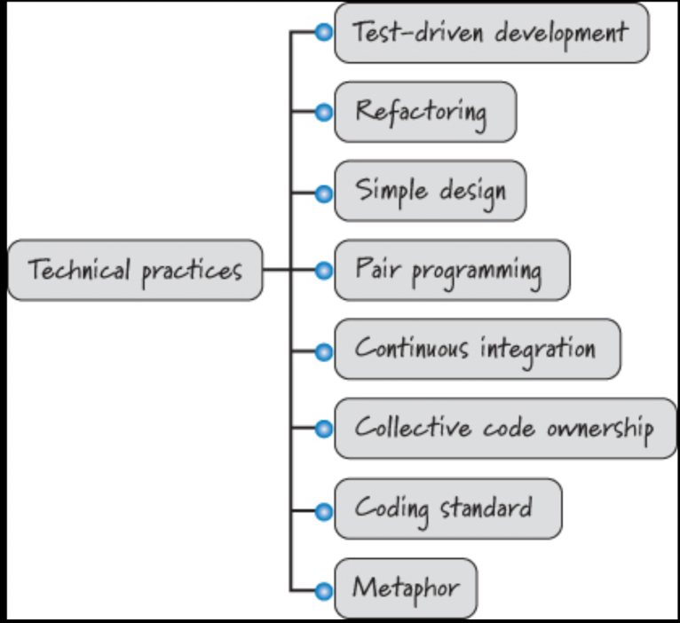
Tasks == Doing Technical Work

Slide 4
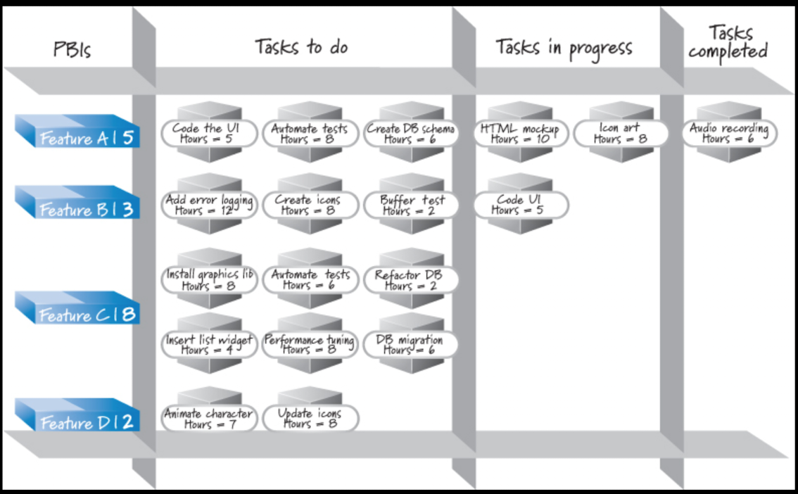
Task Board

Slide 5
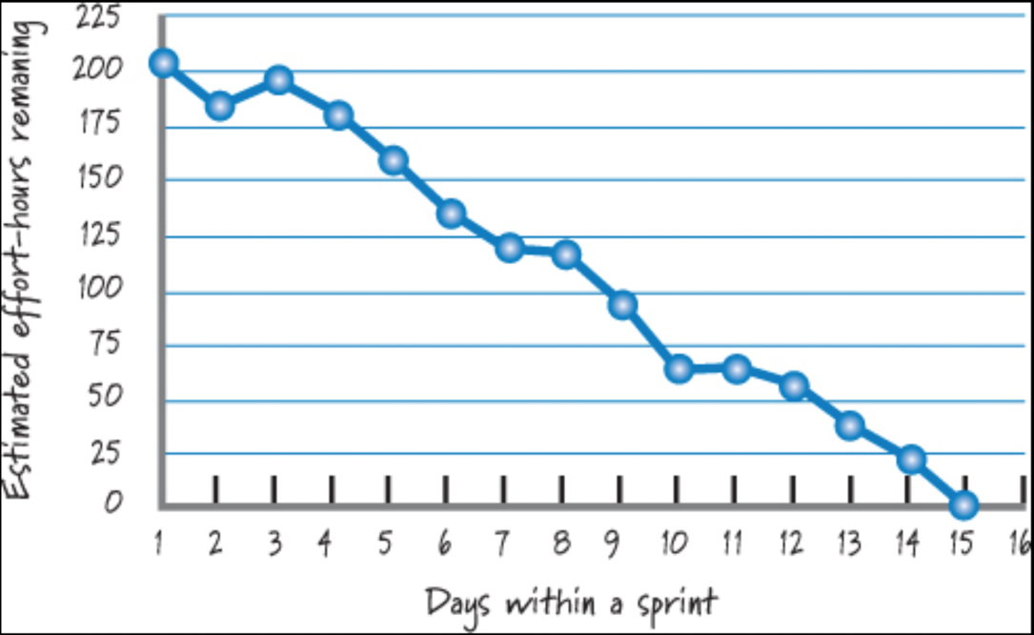
Sprint Burndown

Slide 6
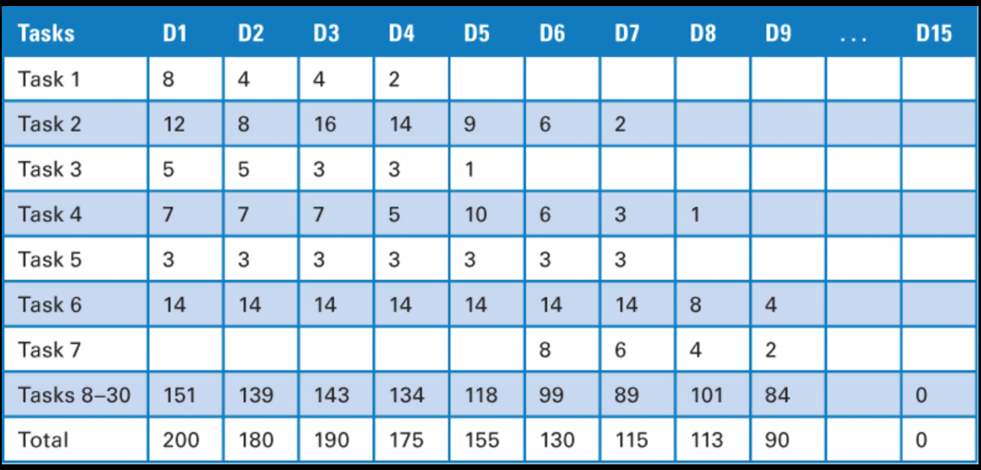
Task Effort Tracking

Slide 7
Elect/Select a Scrum Master
Runs sprint planning
Runs daily scrums
Liaise with Product Owners (I am included here)
Runs Sprint Review
Runs Sprint Retrospective
Has some offset in allocation in exchange for these duties

Slide 8
Sprint Review

Slide 9
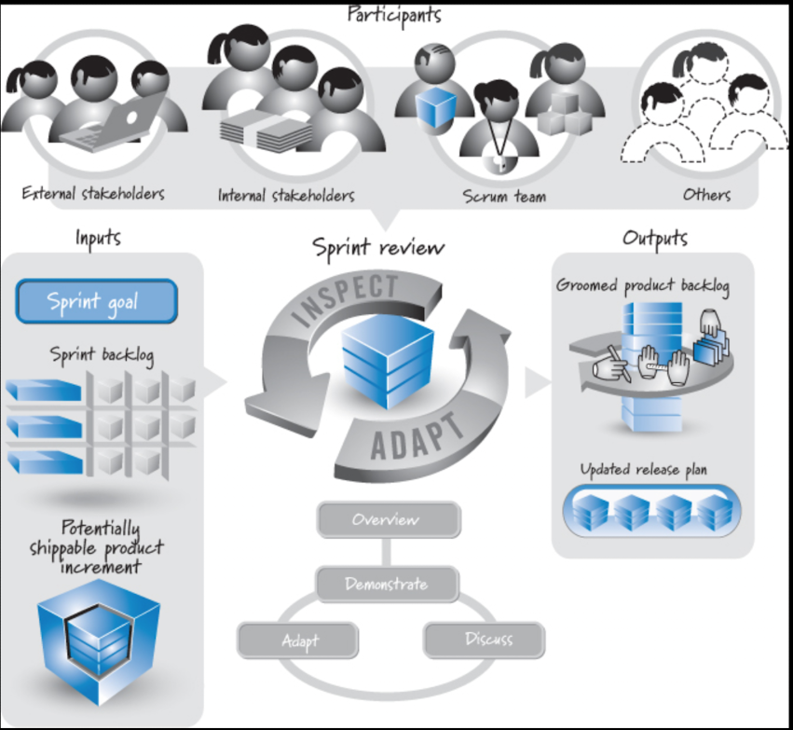
Sprint Review Activity

Slide 10
Steps
Overview – Review Sprint Goal and Definition of Done
“The sprint goal was….”
Demonstrate – Potentially shippable code
READ a user story – “Title and haiku”
DEMONSTRATE fulfilled acceptance criteria
Technical/team backlog vs. customer value
Tested and meets acceptance criteria
Discuss – What does this product increment mean for the big picture?
Validate – “Was the sprint goal met and are you ‘done?’”
Adapt – Outcomes should influence next sprint planning

