Slide 1




Predictive Maintenance
Final Report
Alfred D. Hull

Slide 2
Table of Contents
Phase I. Business Understanding
Project Flow - Business
Project Flow - Details
Phase II. Data Understanding
Phase III. Data Preparation
Phase IV. Modeling
Phase V. Evaluation
Phase VI. Deployment Iteration I

Slide 3

Phase I.
Business Understanding

Slide 4
Project Flow
Problem
Solution
High Cost
Machine Failure
Downtime
Engage
Proactive Maintenance
Business
Sensor Readings
Pinpoint Sensor Status
Data

Slide 5
Project Flow - Details
Problem
Solution
When machines fail the associative costs bringing them back online are sunk.
Maintenance hours could be utilized more efficiently.
Mitigate system downtime by monitoring target sensors.
Focus attention on proactively maintaining sensors with high odds of failure
Business
Many sensor readings are highly correlated.
Understand the correlation between sensors and reduce features.
Adjust input parameters to reduce variance inflation.
Data

Slide 6
Phase II.
Data Understanding

Slide 7
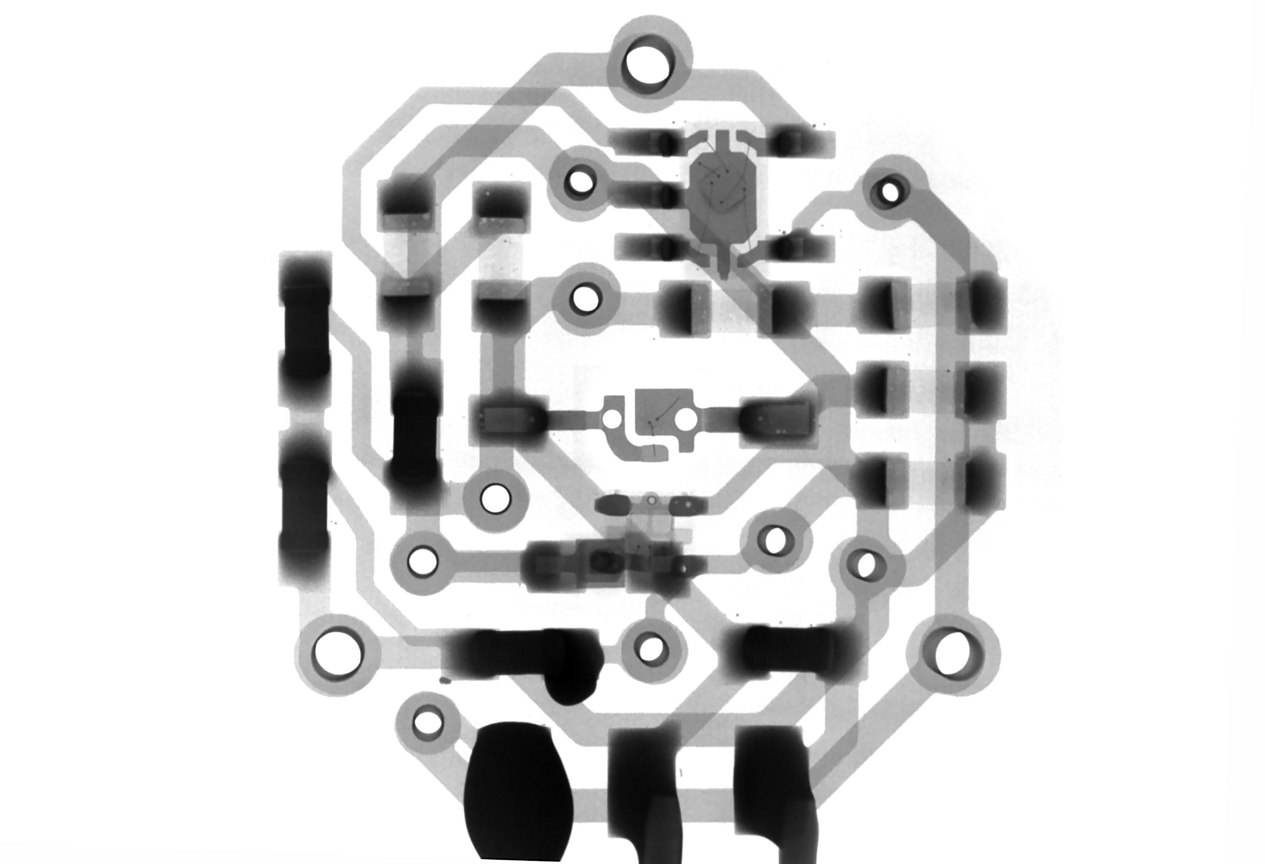
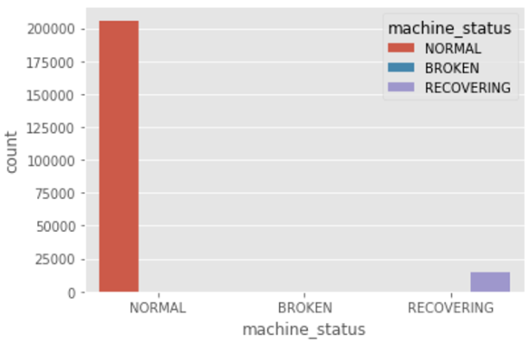
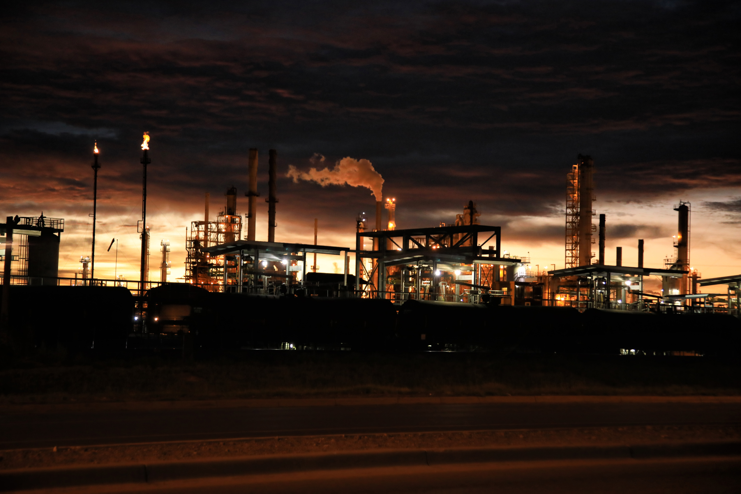
Sensors
Readings
Monitoring
Sensor Readings
Sensor Readings
Auto Surveillance
The manufacturing plant collects telemetry readings from sensors every hour on the hour on every machine. The readings include: Failure, Recovering, and Normal.
Clearly, there is a class bias, meaning a condition observed when the proportion of events is much smaller than proportion of non-events. So we must sample the observations in nearly equal proportions to get a more efficient model.
Time series uncovered that timing of the month does not appear to be a factor with sensor failures. In April they appear in the mid-month, March the mid to late month, June only once, July beginning and end of the month, and August none.

Slide 8
Phase III.
Data Preparation

Slide 9
Correlation
Sensor Parameters
Binary Classification
As one variable increases or decreases, how do the other variables respond, if at all?
Data
Cleansing

Slide 10
Phase IV.
Modeling

Slide 11
Machine Learning
Logistic Regression
The scientific study of algorithms and statistical models to effectively perform a specific task, relying on patterns and inference, as opposed to explicit instructions.
Random Forest

Slide 12
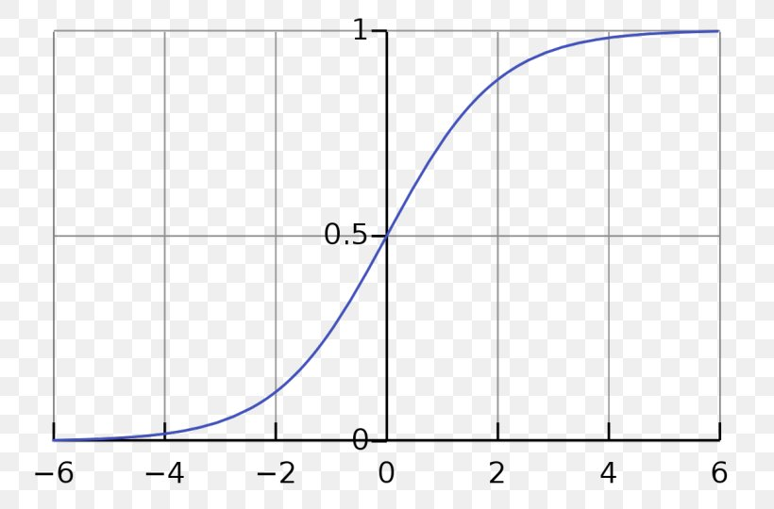
Logistic Regression
A statistical model that in its basic form uses a logistic function to model a binary dependent variable, although many more complex extensions exist..
Out of 49 sensors collecting readings 5 were able to predict system failure at about 79% of the time. This in itself highlights a cost savings with respect to monitoring.

Slide 13
Phase V.
Evaluation

Slide 14
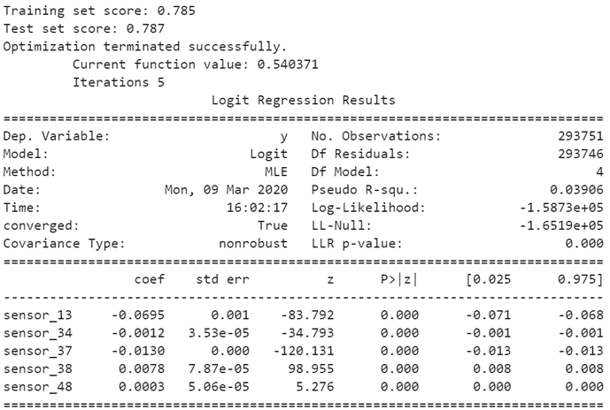
Machine Learning Results
A function was created to initialize, train and test a Logistic Regression model. Here is an overview of the coefficients of the model, how well those coefficients fit, the overall fit quality, and several other statistical measures.
Notes:
Linear Regression - MPM
t2_sat_area(microns2) = 2.514793e-04
int_s_avg_5(counts/ms) = 1.243470e-04
Random Forest - MPM
Tree = 3
t2_sat_num(-) = 0.64
int_s_p(counts/ms) = 0.33

Slide 15
Phase VI.
Deployment Iteration I.

Slide 16
Conclusion
System Surveillance
Data Collection
Results
Set monitoring activities to collect and house data.
Sensor Data captured during normal operations.
The best way to prevent costly downtime during system failure is to deploy iterative surveillance of sensor data to constantly predict when sensors have tripped thresholds set for failure. The best way to control this is by catching the system before it fails to engage in proactive maintenance when required.
Sensor Readings
Machine Learning
Iterative monitoring database
Logistic Regression model used to predict sensor failure.

Slide 17
Looking Forward
Increase Number
Of Features
Data Capture
Proactive Monitoring
51 initial features were included while only 5 were used to build predictive modeling. | Currently the system captures data and does not house it. | Currently the organization spends countless hours repairing a machine after system failure and even more hours monitoring the systems during recovery.
It may be beneficial to select other features for instance machine run time to conduct deeper time series analysis to analyze meantime between system fail. | It may be beneficial to invest in a database so that the firm can house sensor readings over the life of a machine to analyze its health and any other hidden drivers of failure. | It is critical that management deploy the machine learning model produced in this analysis to catch future failures. Additionally, it is important that this model be tuned over time with more training data as it is collected to refine the output.
Current
Future

