Slide 1


The Effect of State Humidity Covid-19 Cases
Alfred Hull, adh8mb;
Farhan Kanani, fk3ak;
Dara Maguire, dkm2bd;
Francisco Estrada, fge8tj
Niraja Bohidar, nb4dg

Slide 2
Table of Contents
Phase I. Business Understanding: “Introduction”
Phase II. Data Understanding: “The Data”
Phase III. Data Preparation: “Beyond the Original Specification:”
Phase IV. Modeling & Analysis: “Results”
Phase V. Evaluation: “Testing”
Phase VI. Deployment: “Conclusion”

Slide 3

Phase I.
Business Understanding

Slide 4
Phase I.
Business Understanding
Background
Severe Acute Respiratory Syndrome Coronavirus 2 (SARS-CoV-2), also known as COVID-19, has manifested into a pandemic that has spread to 188 countries and territories with more than 17.5 million cases as of August 2020. In the United States alone there have 4.68 million confirmed cases and rising.
Though the complete means of the method of transmission is still unclear, several scientists postulate that transmission of COVID-19 occurs primarily in droplets through the air. In order to combat this, health officials have recommended that people wear masks and face shields, and maintain social distancing of at least 6 feet. However, many researchers believe that in order to truly help prevent transmission, we need to protect the air.
One aspect of air quality that seems to have been overlooked is humidity. Infection control specialist Stephanie Taylor identified that midrange humidity levels have been able to help prevent the transmission of airborne pathogens. When air is too dry, large air droplets dry out to become smaller droplets. In moister air, airborne viruses like COVID-19, don't seem to be as virulent, though the mechanism is not fully understood. Though creating a more humid environment isn't a complete solution to prevent transmission, it seems to be another step in creating a safer environment.

Slide 5
Phase I.
Business Understanding
Who might care:
Healthcare professionals, businesses, household owners, and the general public. It would be in their best interests to consider implementing these precautions in order to deter the spread of COVID-19.
Set-Objective:
The objective is to corroborate the evidence that humidity may have a role in reducing transmission by looking at the humidity in each state and the number of cases in those states.
Should our data corroborate these findings, it will be further justification for businesses to maintain a midrange (40%-60%) humitity level in their establishments.
Cost and benefits:
Though businesses may invest more in quality humidifiers to maintain this level of humidity, it may be a necessity in order create a safer environment for people.
Constraints, Limitations, and Assumptions (CLAs):
Should we find a trend between humidity and number of COVID cases, it is important to remember that this is evidence of correlation, not causation.

Slide 6
Phase II.
Data Understanding

Slide 7
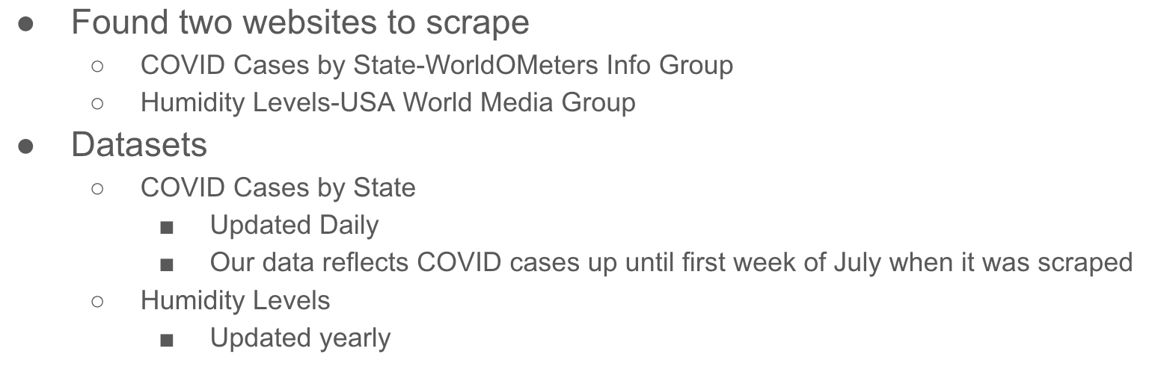
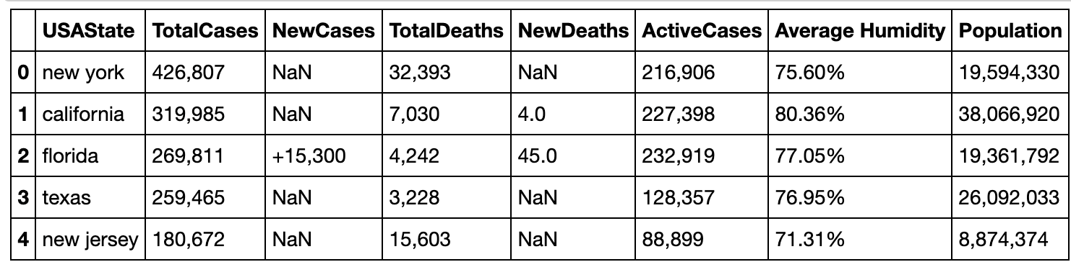
Phase II.
Data Understanding

Slide 8
Phase III.
Data Preparation

Slide 9
Phase III.
Data Preparation
covid19_states_cases.csv
Data Transformation
Covid19_states_humidtyandcases.csv
covid19_states_humidity.csv

Slide 10
Phase IV.
Modeling & Analysis

Slide 11
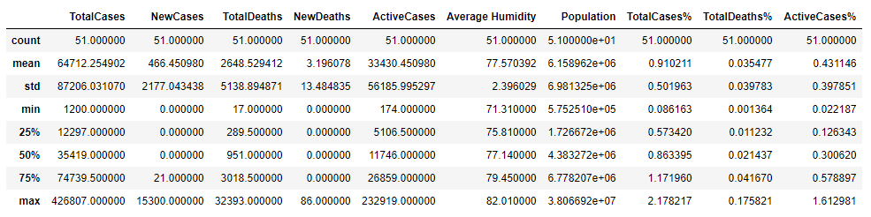
Phase IV.
Modeling & Analysis
Step 1: Data processing + manipulation
Remove special characters
Add relevant columns
Notes:
With the cleaned data set, we then moved onto processing and analyzing our results. There were a couple steps in this process. First, we wrote a couple of functions that we used to manipulate and process the data. We removed extra characters (such as commas, plus signs, % signs) from the data so that we could do numerical operations. We also added additional columns – a few that scaled key metrics such as total deaths, total cases, and active cases by state population so that we could compare more fairly across states. We also added another column that labelled our states into humidity buckets based on the quartile that they fell in.

Slide 12
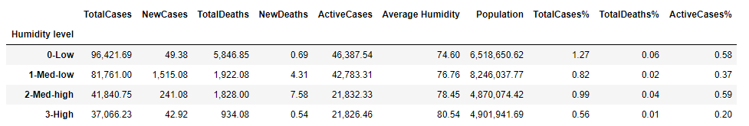
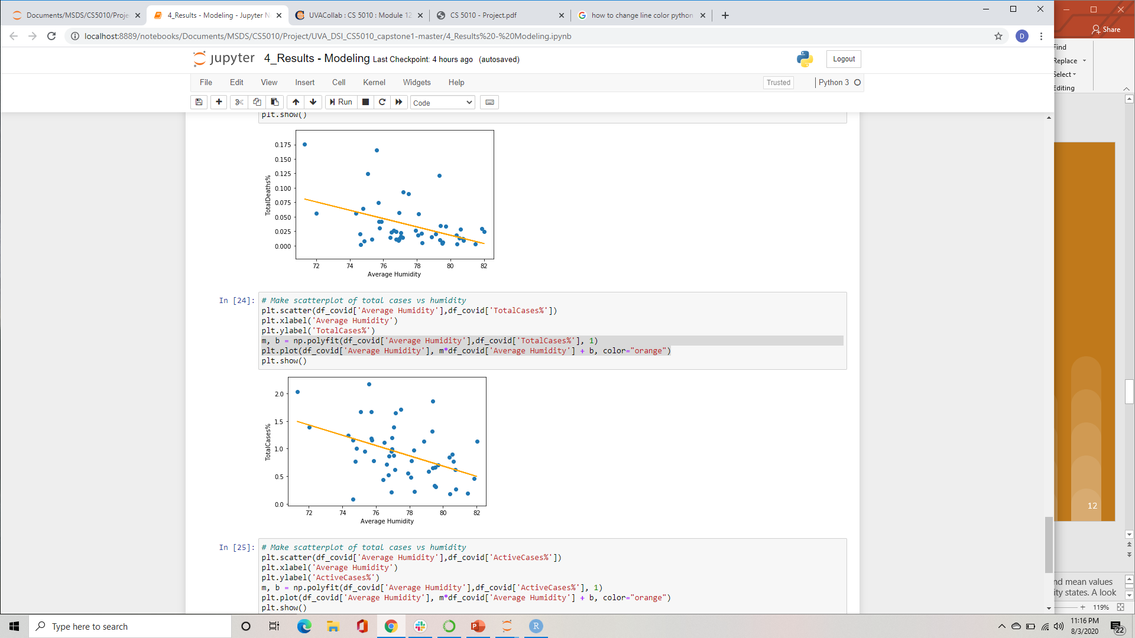
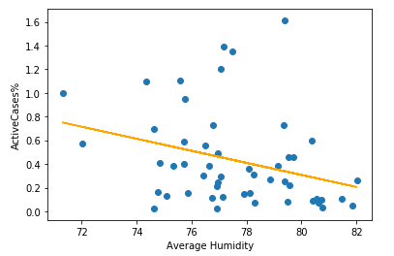
Phase IV.
Modeling & Analysis
Step 2: Analysis of data
Notes:
With these additions, we then used panda’s group and aggregate functions to analyze our data. We grouped by humidity levels and looked at both the median and mean values across the various metrics available to us. Of particular interest to us was how the cases and deaths varied among high humidity states vs medium and low humidity states. A look at the mean grouped data indicated lower cases and death rates within the high humidity grouping. The medians of the grouped data showed similar results.
The next and final step for our analysis was to display our results graphically. We graphed the three most relevant measures – Total Deaths, Total Cases, and Active Cases – all as a percentage of the population. We note that each of them showed results consistent to our hypothesis. States with higher average humidity had lower deaths, total cases, and active cases.

Slide 13
Phase V.
Evaluation & Validation

Slide 14
Phase V.
Evaluation & Validation
Unit testing
......Testing: test_cleanNumeric_comma
Starting DataFrame is:
ID num
0 a 15,000
1 b 2500
2 c 36,000
3 d 180
New DataFrame is:
ID num
0 a 15000.0
1 b 2500.0
2 c 36000.0
3 d 180.0
Expected DataFrame is:
ID num
0 a 15000.0
1 b 2500.0
2 c 36000.0
3 d 180.0
......Testing: test_cleanNumeric_float
Starting DataFrame is:
ID num
0 a 15000
1 b 2500
2 c 36000
3 d 180
Cleaned DataFrame is:
ID num
0 a 15000.0
1 b 2500.0
2 c 36000.0
3 d 180.0
Expected DataFrame is:
ID num
0 a 15000.0
1 b 2500.0
2 c 36000.0
3 d 180.0
......Testing: test_divideDf
Starting DataFrame is:
ID num1 num2
0 a 15000 10000
1 b 2500 1000
2 c 3600 100
3 d 180 -100
Divided DataFrame is:
ID num1 num2 num1%
0 a 15000 10000 150.0
1 b 2500 1000 250.0
2 c 3600 100 3600.0
3 d 180 -100 -180.0
Expected DataFrame is:
ID num1 num2 num1%
0 a 15000 10000 150.0
1 b 2500 1000 250.0
2 c 3600 100 3600.0
3 d 180 -100 -180.0
----------------------------------------------------------------------
Ran 6 tests in 0.198s
OK
Notes:
As we performed our analysis, there were a couple functions that we wrote to help us. We performed unit testing as we coded each of these.
The first function was the one which cleaned the symbols from the data and transformed it into type float. We wrote unit tests that checked that each symbol was removed correctly, as well as a test to check that the type transformation was successful.
The second function was used to divide 2 columns of our dataframe and add the results as a new column in our dataframe. We wrote unit tests to check that the results were divided correctly and that the new column was named correctly.
Failures of our unit tests helped point to errors in our code as we went, and in the end all of our unit tests passed.

Slide 15
Phase VI.
Deployment & Conclusion

Slide 16
Phase V.
Deployment & Conclusion
Conducted web scraping, module testing, data pre-processing, and data cleaning
Created a .csv file of the data and ingested back in to program for processing
Saved the data into data frame data structures
Queried data and captured results
Generated tables and plots
Conclusions of analysis

Slide 17


