Slide 1

Artificial intelligence for modelling infectious disease epidemics
Kraemer et al. 2025
ACCDMi journal club #1
May 12, 2026

Slide 2
Box 1. Glossary (of machine learning/modelling terms)
Foundation model - refers to very large deep learning models that are pre-trained on vast, general-purpose, datasets—for example, LLMs.
Box 2. Important epidemiological concepts

Slide 3
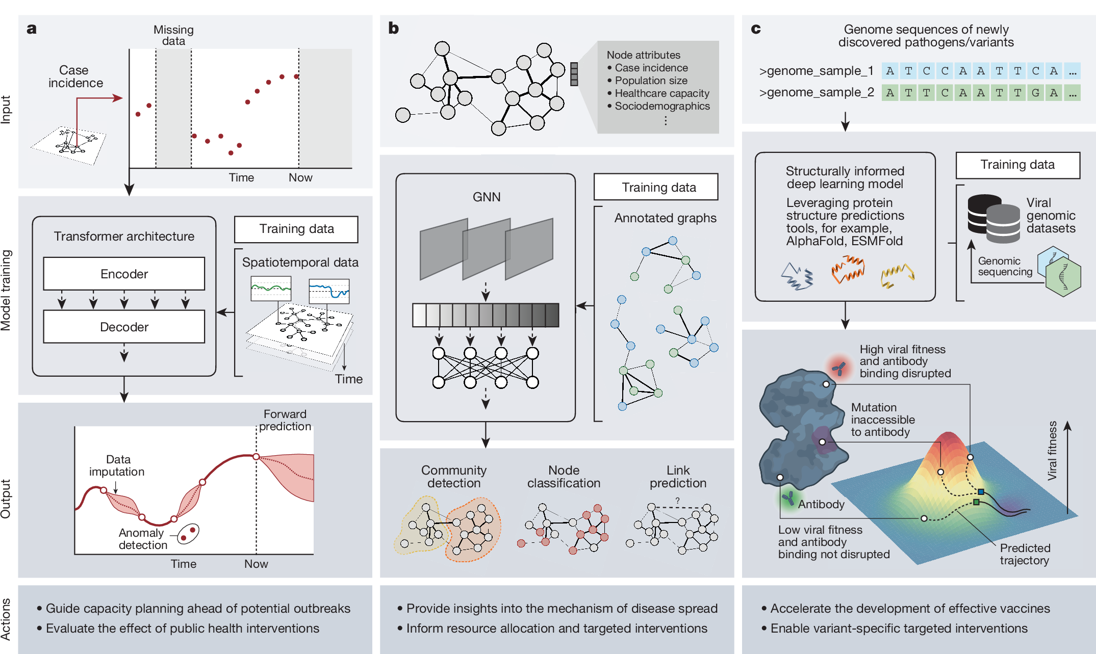
Notes:
a, Time-series analysis using foundation models. Pre-training large-scale foundation models with transformer architecture using observations (empirical and/or simulated) from time-series epidemic data enables zero-shot applications (Box 1) for forward prediction, data imputation and anomaly detection. The output from these models can be used to evaluate the effect of public interventions and guide capacity planning for future outbreaks. b, Modelling infectious disease spread using GNNs. Pathogen dissemination can be represented by annotated graphs, in which the nodes correspond to locations or individuals and the edges represent potential transmission pathways (such as human or vector interactions); each node is associated with a set of features (for example, case incidence and population size) that are either indicators or drivers of spread. GNNs have the ability to learn complex patterns from such data, enabling node classification (predicting disease prevalence), community detection (identifying infection clusters) and link prediction (revealing cryptic transmission pathways). These insights can provide a detailed understanding of the underlying mechanism of disease spread and inform resource allocation and targeted interventions. c, Predicting immune-escape mutations using biologically informed deep learning models. By taking advantage of recent advances in protein structure prediction (such as AlphaFold and ESMFold), these models could enable the early detection of pathogens or variants that are likely to develop mutations conferring resistance to existing vaccines or therapeutics through antibody-binding disruption. Such predictions can inform the design of next-generation vaccines and guide the prioritization of containment strategies targeted at emerging lineages.

Slide 4
AI to answer epidemiological questions
Bayesian data augmentation can be used to improve parameter inference given missing data (Fig 1A)
Inferences can be accelerated by approximating the original model with a generative model surrogate or by using variation inference
AI-accelerated methods have the potential to reduce model run times, so more complexity can be included in the model

Slide 5
AI to answer epidemiological questions
Prediction and forecasting
Now-casting attempts to address systematic biases and enable robust estimation of the contemporary epidemic situation given noisy an incomplete data.
Foundation models for large deep neural networks are powerful ways to understand surveillance data.

Slide 6
Modelling mechanisms of disease spread
Traditionally achieved with compartment models
AI approaches can facilitate inference on agent-based models that lack analytical components by leveraging variational Bayesian inference.
Foundation time series models can be used to constrain function space by restricting the set of functions a priori and embedding these constrains within a mechanistic/semi-mechanistic model

Slide 7
Modelling mechanisms of disease spread
Alternative models (to ODEs) include PDEs, branching processes or self-exciting branching processes.
Graphs neural networks (GNN) can expand agent-based models to capture spatio-temporal dynamics and can expand agent-based models by allowing differentiability of all model components

Slide 8
Immunological and genomic interactions (Fig 1C)
Applied to genomic data AI models can be used to classify lineages, infer when and how a pathogen emergence, predict pathogen traits such as transmissibility, escapability and spread, predict the likelihood of spillover.
Predict vaccines

Slide 9
AI-aided integration of key data
Data science and representative sampling
Data scarcity and geographic biases are major obstacles to global epidemiology research
Can accerbate racial biases and lead to non-optimal public health policy decisions.
Big Data Paradox: it is not only the volume of data, but the quality of it (sample design, representativness) that is needed
Active learning and Bayesian optimization can be used to inform the design of active surveillance strategies (selecting new locations based on current locations)

Slide 10
Integrating novel data sources
New technology, i.e. contact-tracing apps and smart phone-derived mobility data have a lot of potential
Reinforcement learning systems have been used to support testing decisions at airports

Slide 11
AI-driven disease modelling for policy
Public health decision making
Modellers face the challenge of developing increasingly complex models to address a wide range of questions, for which characterizing a clear objective or task can sometimes be difficult (Figure 3).
Markov Decision Processes and reinforcement learning are promising theoretical frameworks in which data, models and expert feedback can enable timely decision-making (Fig 3).

Slide 12
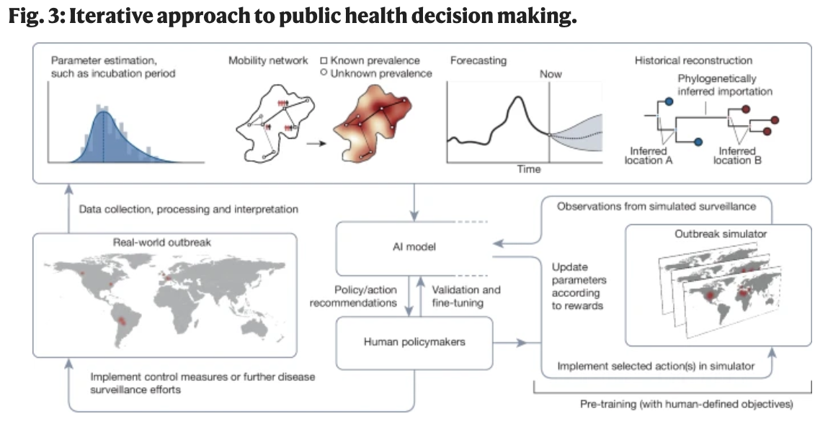
Notes:
Conjectured use of AI to optimize the design and implementation of effective control measures during a hypothetical multicountry disease outbreak. Data collected from disease surveillance are processed and analysed by an AI agent, potentially integrating other AI models for parameter estimation, nowcasting and forecasting of epidemic trajectories, as well as reconstructing historical transmission events based on current observations (top row). Before deployment of the AI model, it is trained using an outbreak simulator that simulates the spread of infectious diseases and the effects of different control measures; the model learns from these simulations by updating its model parameters according to the outcomes of the simulations and corresponding rewards (bottom right). Insights from the empirical data are used by the trained model to inform and recommend the most effective control measures, with validation and feedback from human policymakers and stakeholders to fine-tune alignment between model objectives and societally beneficial criteria. This is followed by the execution of public health actions (for example, whether to implement recommended or alternative control measures, or deploy further disease surveillance efforts) made ultimately by human policymakers (bottom left). The map shapefile was obtained from the Africa Data Hub under a Creative Commons licence CC BY 4.0.

Slide 13
AI-driven disease modelling for policy
Public health decision making
Close collaboration between decision makers, civil society, and the scientific community is necessary to appropriately define clear objectives and rewards in re-inforcement learning.
It is an open question when the data or the models will be limiting
Evolution and behavioral responses have yet to be incorporated in a systematic way in epidemic models

Slide 14
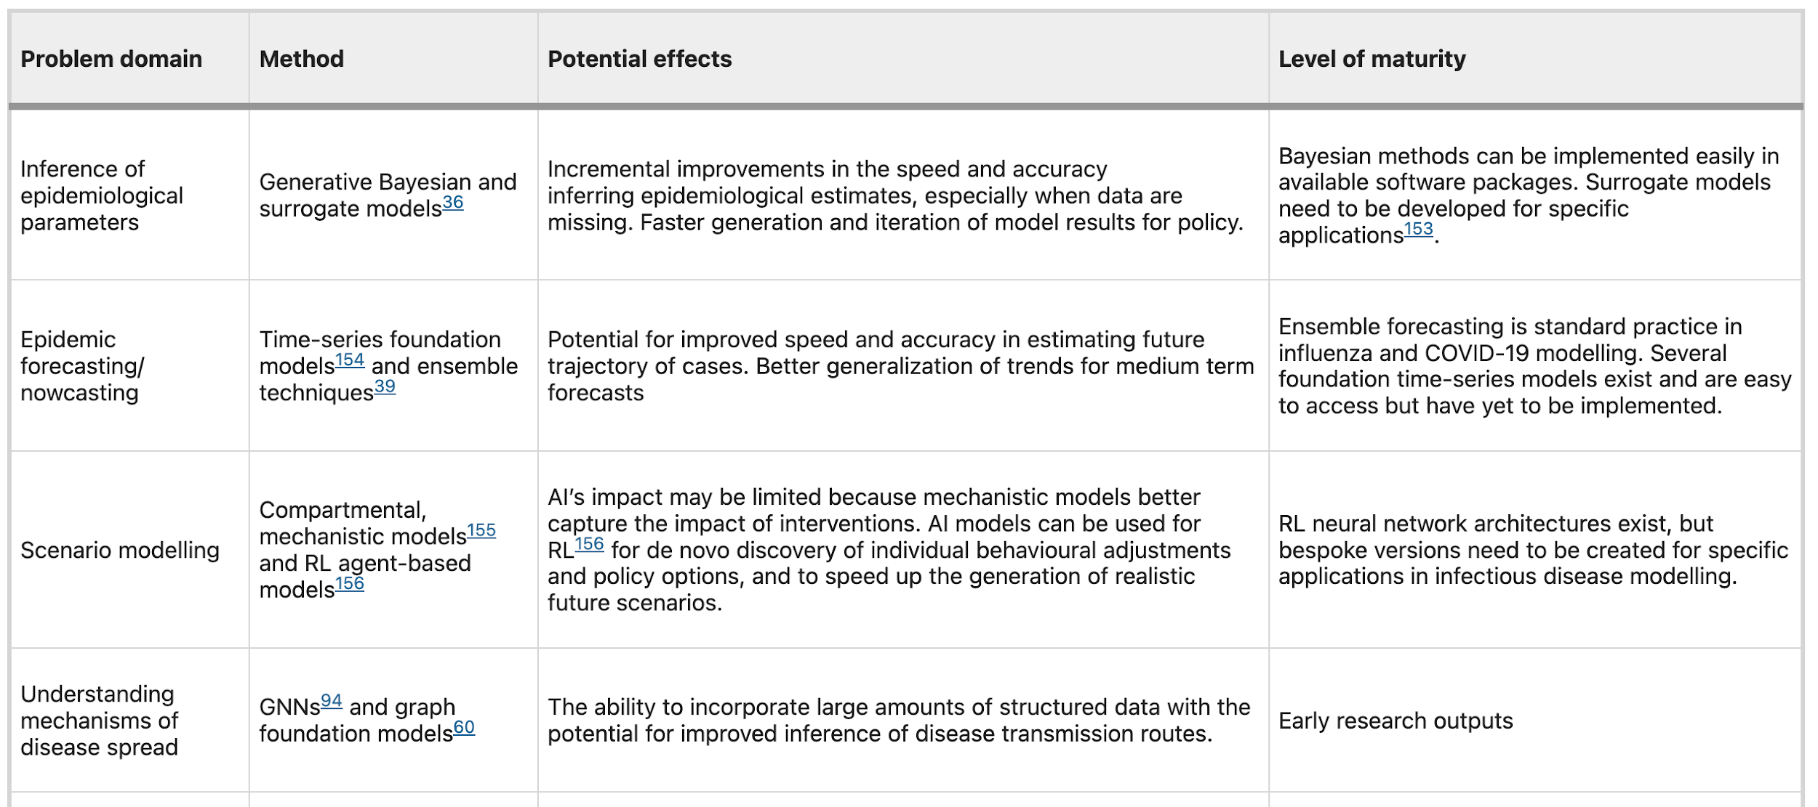
Table 1 New AI approaches to answering key questions in infectious disease epidemiology, their potential effects and the level of maturity in the scientific and public health community

Slide 15
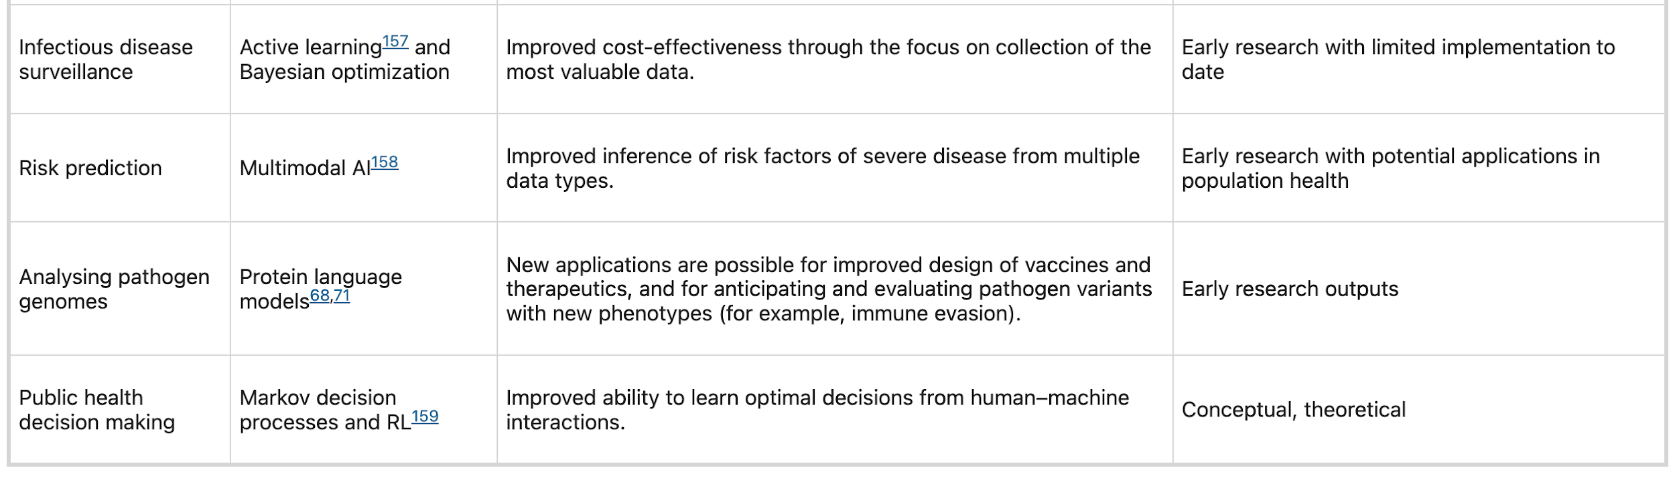

Slide 16
Ethics in the development of AI tools
What is owed to communities in return for surveillance/public health measures
Are AI tools being shared equitably for use by PH officials
Making AI tools accessible to all that need it will require capacity building
AI could potentially be used to minimize the impact of interventions on disadvantaged communities
Who should get vaccines first?
Models must be explainable, fair, and accountable

Slide 17
Public health communication
The WHO highlighted the importance of fighting misinformation during the COVID-19 pandemic
There are risks due to exclusion of groups from training data
Research shows AI chatbots are not a trusted means for disseminating PH advice
LLMs can produce false information called ‘AI hallucinations’

Slide 18
Open data and explainability
Harmonization of data from across the world is a major challenge
LLMs can support systematic reviews
FAIR principles: findability, accessibility, interoperability and reusability
A barrier to open data is that some data, i.e., mobility have commercial value
Quantitative measures for explainable AI have been developed
Causal inference methods in statistics are promising for developing comprehensive standards for explainability

Slide 19
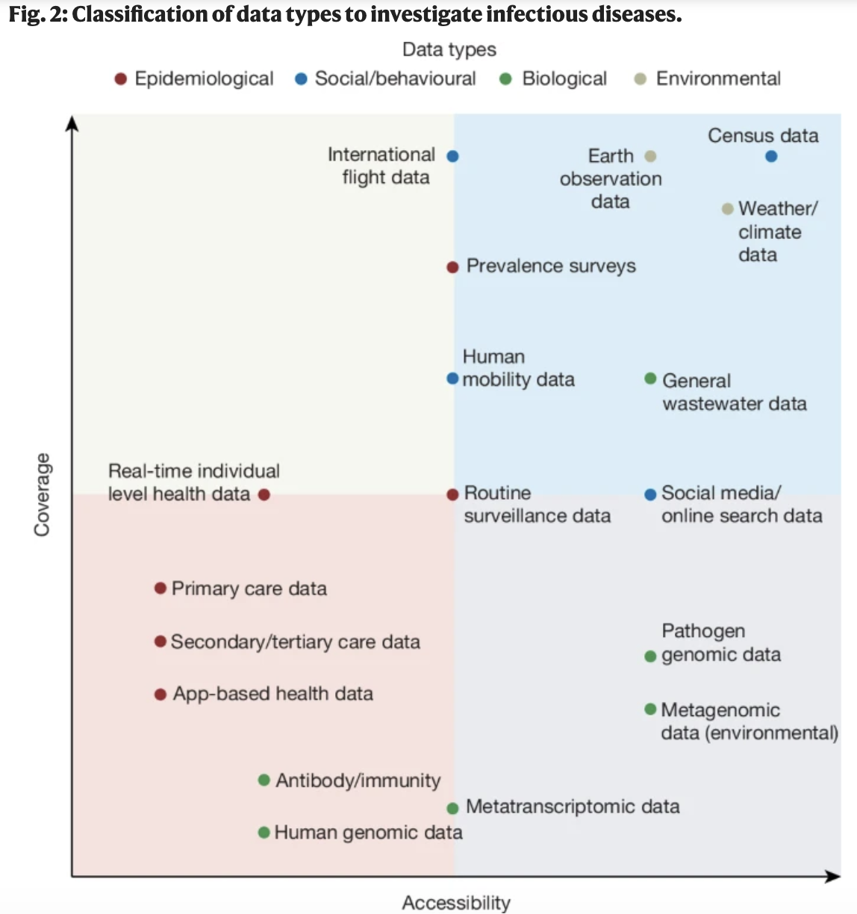
Notes:
Data used to inform epidemiological modelling are placed in terms of their accessibility to the research community and their population-level coverage. Data are classified based on their data types, including epidemiological (red), environmental (brown), social–behavioural (blue) and biological (green)

Slide 20
Limitations of AI in ID modelling
Current AI models struggle with explainability
Models for general tasks do not support epidemiological modelling
AI models are trained by large companies at huge costs

Slide 21
Recommendations for AI in ID epidemiology
“When viewed through a broad lens, AI can be seen as a continuation of the rich legacy of mathematics, statistics and computer science in the field of infectious disease epidemiology”
Likely breakthroughs include pretraining large and foundation models, zero-shot and few-shot learning approaches that require few data
Requires embedding of fundamental biological knowledge

Slide 22
Recommendations for AI in ID epidemiology
The benefits of AI for public health is critical dependent of availability, accessibility, representativeness of data and a firm ethical framework.
Data accessibility is an issue
Justifiable barriers for entry, and research into robustness, training and evaluation of population AI models

Slide 23
Recommendations for AI in ID epidemiology
Are the advances of AI models worth the environmental costs?
Decisions depend on factors beyond data fit and marginal gains in fit may not be worth the environmental costs
To improve success in policy requires collaborations between research, policy and society

Slide 24
My conclusions for our group
Maintaining methodological sophistication is necessary for our group to support accessibility and equitability for PH in Atlantic Canada
Modelling education supports communities that may not understand that lack of access to AI tools is an equity issue due to lack of education on the value of modelling
The responsibility of this group is also to develop technical proficiency in using AI tools, i.e. rather than leveraging them to complete systematic reviews

Slide 25
My conclusions for our group
Informing surveillance may be particularly valuable for our group due to limited resources and to support vast regions with isolated populations, i.e., Newfoundland and Labrador and the territories.

Slide 26
Others conclusions for our group
Edit these in to start the discussion!

