Slide 1

Simulation as a supervisor: mechanistic pretraining for scientific discovery
Dudley et al. 2026 Arxiv
ACCDMi journal club #2
May 19, 2026

Slide 2
SGNN
Dudley et al. introduce Simulation-Grounded Neural Networks (SGNNs) as a general framework for training neural networks on ensembles of mechanistic simulation

Slide 3
Related, but different, frameworks
Physics-Informed Neural Networks (PINNs) incorporate governing equations into the loss function, constraining optimization to satisfy known physical laws
Universal Differential Equations (UDEs) incorporate domain knowledge into the model architecture by using neural networks to represent unknown terms within a larger system of differential equations
These methods perform well when equations are known and all relevant variables are observable, but can introduce bias or cause the learning process to fail when mechanistic models are incomplete or structurally misspecified

Slide 4
Simulation of training data/structural uncertainty
Another approach is to incorporate mechanistic knowledge into the training data itself by using simulations to generate synthetic datasets for neural network training.
In physics, simulation-trained networks often serve as fast surrogates for computationally expensive models
In epidemiology and social science, they can address data scarcity issues by generating synthetic training data.
Many of these efforts rely on a single, fixed simulator, which can be effective in domains like physics where governing equations are well-understood, but is less effective in fields where the data-generating process is fundamentally uncertain

Slide 5
SGNN
By pretraining on synthetic corpora spanning diverse model structures, parameter regimes, and realistic observational artifacts, the model internalizes the global geometry of physically plausible dynamics.
This allows the neural network to inherit scientific structure from the underlying models without being explicitly constrained by a single, potentially misspecified governing model.

Slide 6
SGNN
This shift from statistical to mechanistic supervision ensures that the model internalizes the causal structure and constraints of the physical world.
Consequently, SGNNs yield models that are not only performant but also mechanistically interpretable and inherently aligned with scientific theory.

Slide 7
SGNN
This approach directly addresses a core limitation of machine learning in science: the inability to infer unobservable quantities.
Scientific parameters like the basic reproduction number in an infectious disease outbreak or ecological carrying capacity cannot be measured directly.
Traditional methods estimate them by fitting mechanistic models to observed trajectories, a process sensitive to noise, delays, and structural mismatch.
Simulation-based inference addresses this by using simulation-grounded training to learn posterior distributions over parameters, providing a principled approach to Bayesian parameter inference.

Slide 8
SGNN
SGNNs also enable back-to-simulation attribution, a form of mechanistic interpretability.
After training, the model retrieves training simulations that it considers most similar to real-world inputs, revealing which mechanistic regimes the model associates with observed data

Slide 9
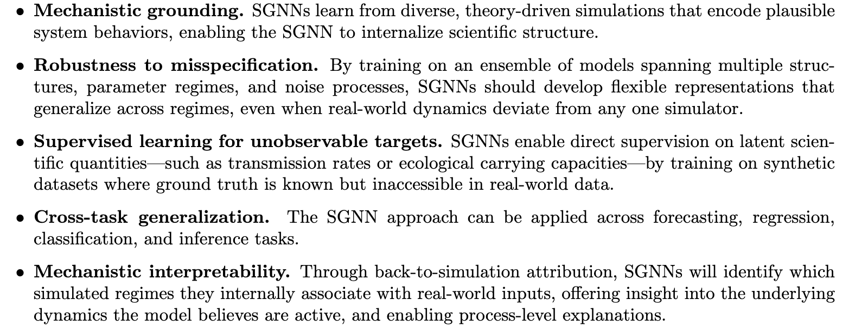
SGNN: Key capabilities

Slide 10
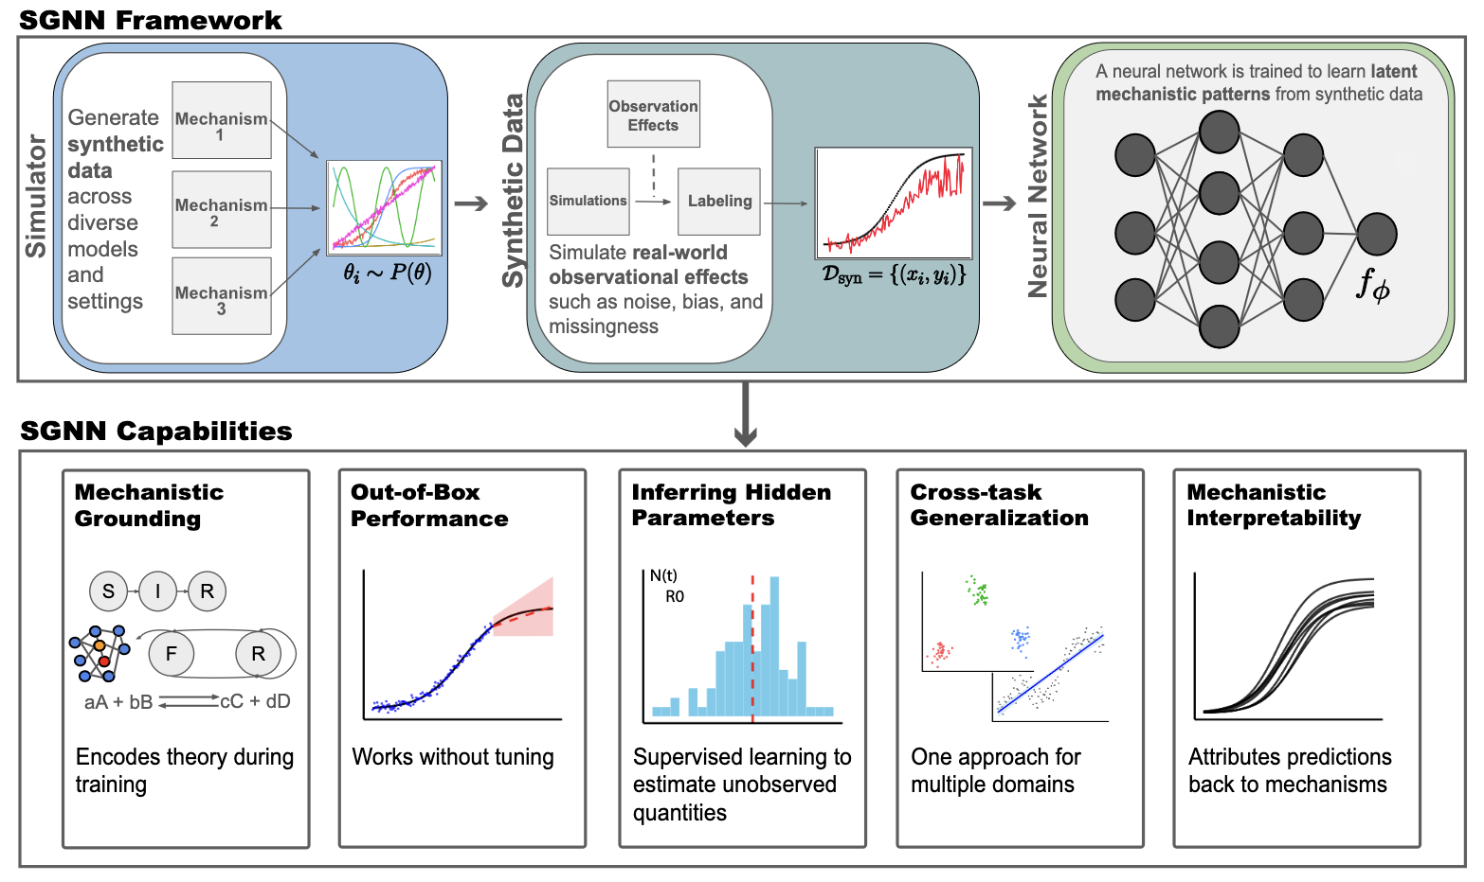

Slide 11
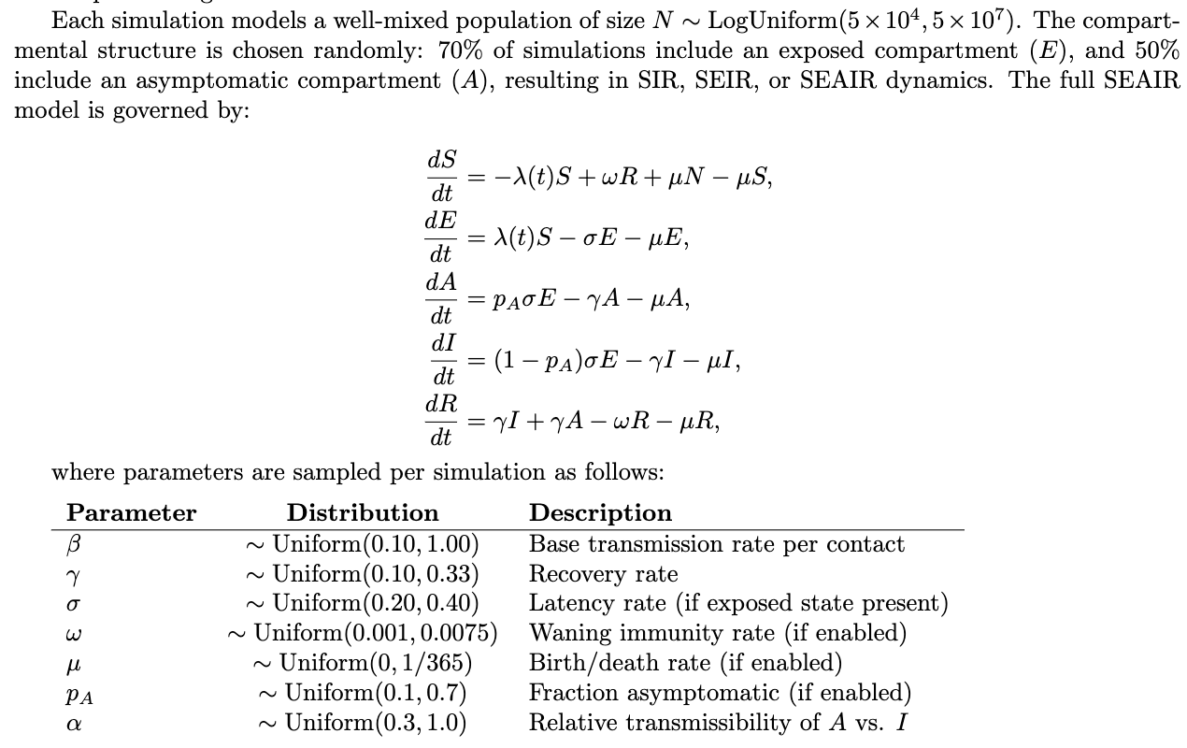

Slide 12
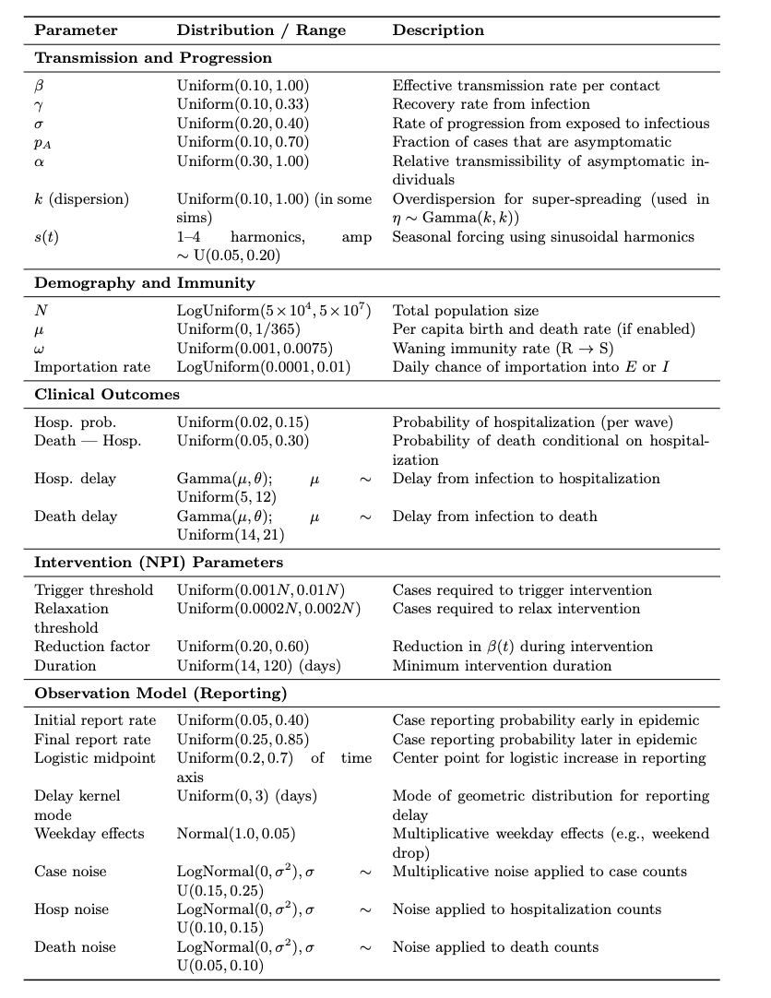

Slide 13
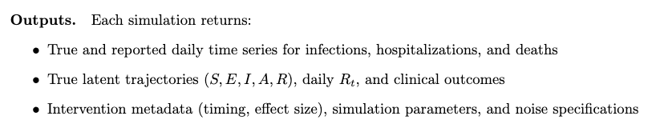
SGNN outputs for epidemic model

Slide 14
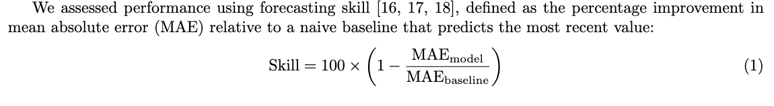
Model performance

Slide 15
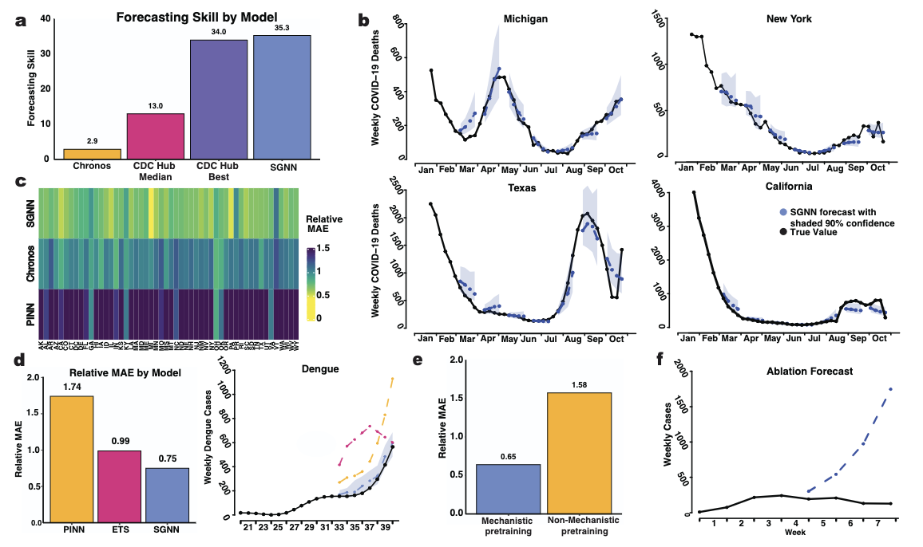
Notes:
Figure 2: SGNNs outperform state-of-the-art baselines in real-world disease forecasting and
reveal the importance of mechanistic grounding. (A) SGNNs achieve 35.3% forecasting skill on early
COVID-19 mortality, almost tripling the CDC Forecast Hub median and exceeding its best model—despite
using no real COVID-19 data. (B) SGNNs produce accurate forecasts with calibrated uncertainty across
diverse real-world locations, including Michigan, New York, Texas, and California (four states chosen to
represent US regions: West Coast, East Coast, South, and Midwest). (C) Across all U.S. states, SGNNs
consistently achieve lower error (lighter) than Chronos and PINNs, showing robust generalization from syn-
thetic pretraining. (D) On dengue, a domain with fundamentally different transmission dynamics, SGNNs
outperform both PINNs and statistical models in a fully zero-shot setting—demonstrating robustness to
mechanistic misspecification. (E) Replacing mechanistic simulations with neural simulators causes perfor-
mance collapse, highlighting the necessity of mechanistic fidelity. (F) Restricting pretraining to simple SEIR
models leads to overconfident exponential forecasts, confirming that mechanistic diversity and surveillance
realism are essential for robust downstream performance.

Slide 16
Ablation study and importance of mechanistic grounding
An ablation study aims to determine the contribution of a component to an AI system by removing the component, and then analyzing the resultant performance of the system.
https://en.wikipedia.org/wiki/Ablation_(artificial_intelligence)
To assess the importance of mechanistic grounding in SGNN training, Dudley et al. performed two ablation studies that isolate the contributions of both model realism and mechanistic diversity

Slide 17
Conclusion from ablation studies
These findings underscore a strength of SGNNs: by training on a broad ensemble of mechanistic simulations spanning multiple model structures and parameter regimes, SGNNs learn flexible, scientifically grounded representations that can generalize when structural elements differ from those seen in training.
This result suggests that SGNNs may not merely memorize surface patterns, but instead internalize scientific principles that extend across mechanistic boundaries. SGNNs may be learning abstract representations that capture core features of disease spread—such as delays, feedback, and depletion—that hold across different mechanistic forms.

Slide 18
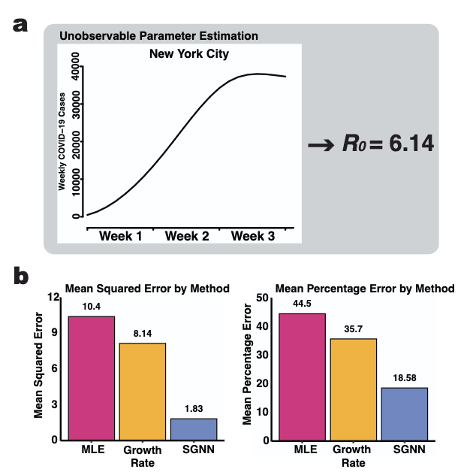
Estimating unobservable targets
(A) SGNNs infer a high reproduction number
(R0 = 6.14) for New York City from early COVID-19 case data (Feb–Mar 2020, shown in the plot), aligning
with estimates from more complete datasets.
(B) SGNNs achieve substantially lower mean squared
error (left) and mean percentage error (right) in R0 estimation compared to maximum likelihood estimation
(MLE) and exponential growth-based methods. Ground truth is known in this case since we are testing on
simulated data.

Slide 19
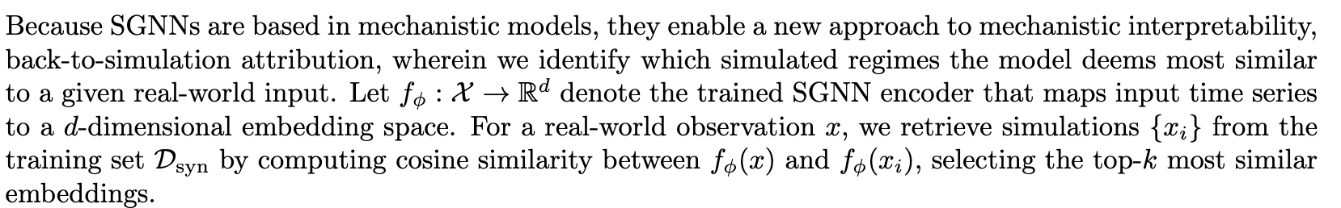
Back-to-simulation attribution

Slide 20
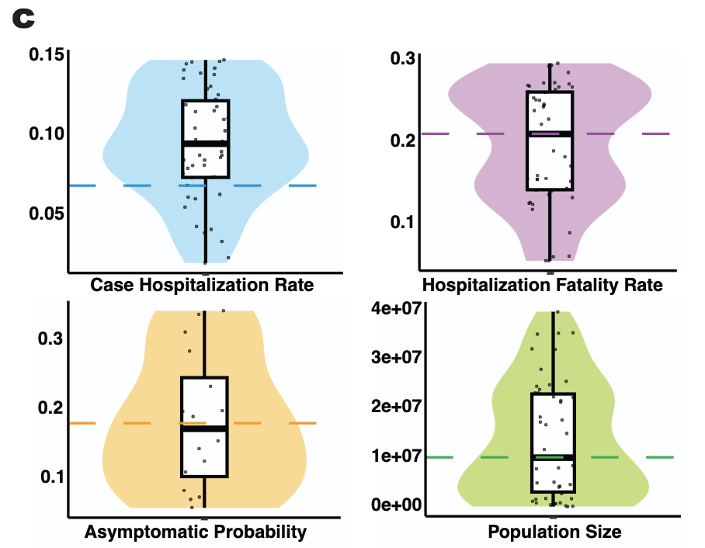
Back-to-simulation attribution
Back-to-simulation attribution retrieves the 50 most similar synthetic outbreaks to a
real-world input and visualizes the distribution of their underlying mechanistic parameters.
For Michigan COVID-19 mortality, the retrieved simulations align closely with true estimates for hospitalization rate, population size, asymptomatic transmission rate, and hospitalization fatality rate (dashed lines) , confirming
that the SGNN’s internal representations encode meaningful mechanistic structure.

Slide 21
Limitations
Performance depends fundamentally on simulation quality: if key mechanisms are absent from the training simulators, performance can be substantially degraded.
Even with realistic noise models and observational artifacts, Dudley et al. anticipate that systematic differences between synthetic and real data will hurt performance.
Results show promising zero-shot transfer (e.g., human-to-human models predicting vector-borne disease), Dudley et al. cannot predict a priori which cross-domain generalizations will succeed

Slide 22
Limitations
Generating comprehensive simulation corpora can be computationally expensive, particularly for high-fidelity mechanistic models - may be prohibitive for extremely expensive simulator.
Back-to-simulation attribution reveals what the model believes is happening mechanistically, but that can be wrong.
Retrieved simulations reflect learned associations that, while often informative, can be incorrect and depend heavily on the simulation prior.

Slide 23
My thoughts for our group
This sounds very promising and an obvious test of our capability to implement SGNN methods is to apply this same methodology to Canadian COVID-19 data (in the same way Dudley et al. considers US COVID-19 data).

Slide 24
My thoughts for our group
I found the demonstration of the back-to-simulation approach to demonstrate explainability lacking. This was shown for parameter values (i.e. population size, asymptomatic probability), but I am more interested in the structure of the training models that are most similar to the SGNN.
The ablation studies showed that mechanism is a necessary component of high performance. This tells us what doesn’t work, but is vague in terms of understanding what does work.
What was the structure of the top 50 training models and what does this tell us about the mechanistic features (i.e., reporting gaps, consideration of asymptomatic individuals) that are critical?

Slide 25
Next steps
1. Clone repository: https://github.com/carsondudley1/SGNNs
2. Install python and work through training module
3. Apply to Canadian COVID-19 data: https://open.canada.ca/data/en/dataset/261c32ab-4cfd-4f81-9dea-7b64065690dc/resource/39434379-45a1-43d5-aea7-a7a50113c291
(if you do this – and you are welcome to - please collaborate with Binod who is doing this for his MSc capstone project)

Slide 26
Your thoughts for our group
Add your thoughts here

