Slide 1
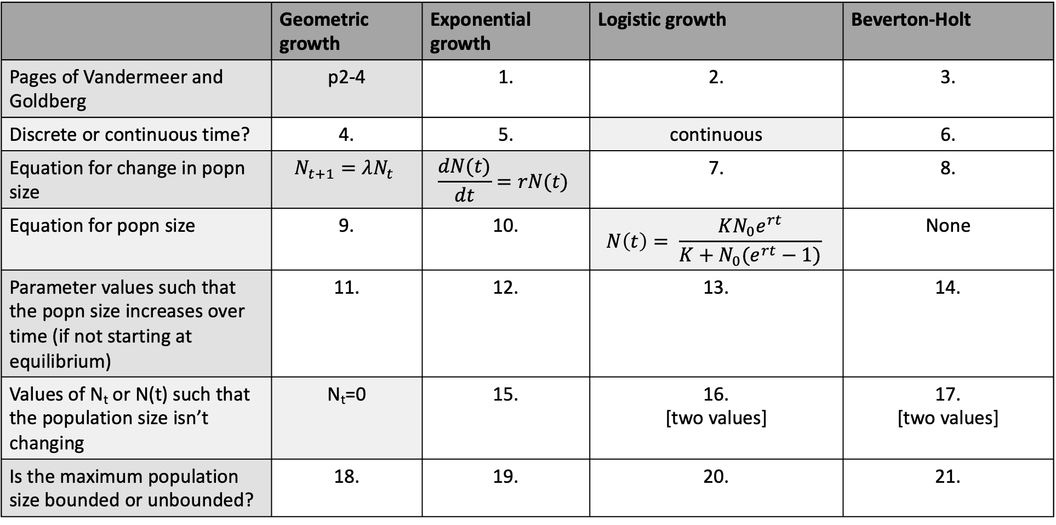
 | Geometric growth | Exponential growth | Logistic growth | Beverton-Holt
Pages of Vandermeer and Goldberg | p2-4 | 1. | 2. | 3.
Discrete or continuous time? | 4. | 5. | continuous | 6.
Equation for change in popn size | $$N_{t+1}=λN_{t}$$ | $$\frac{dN(t)}{dt}=rN(t)$$ | 7. | 8.
Equation for popn size | 9. | 10. | $$N\left(t\right)= \frac{KN_{0}e^{rt}}{K+N_{0}(e^{rt}−1)}$$ | None
Parameter values such that the popn size increases over time (if not starting at equilibrium) | 11. | 12. | 13. | 14.
Values of N_{t} or N(t) such that the population size isn’t changing | N_{t}=0 | 15. | 16. [two values] | 17. [two values]
Is the maximum population size bounded or unbounded? | 18. | 19. | 20. | 21.

